Slide 1
Synthesis of Incomplete and Qualified Data using the GCE Data Toolbox
Wade Sheldon
Georgia Coastal Ecosystems LTER
University of Georgia

Slide 2
GCE Data Toolbox Background
Developed MATLAB storage standard (GCE Data Structure)
  Any tabular data
  QC/QA information for every attribute (rules, flags)
  Attribute metadata
  General dataset metadata
Developed MATLAB software library to support standard
  API to abstract low-level operations
  Analytical function library for high-level operations
  Multiple user interfaces (CLI, GUI, HTML/CGI)
Used to acquire, process, Q/C all GCE raw data
Integrated with GCE-IS for data management, distribution
Prototype technology for metadata-based data synthesis, workflow tools (ClimDB, USGS, NCDC, NOAA data mining)

Slide 3
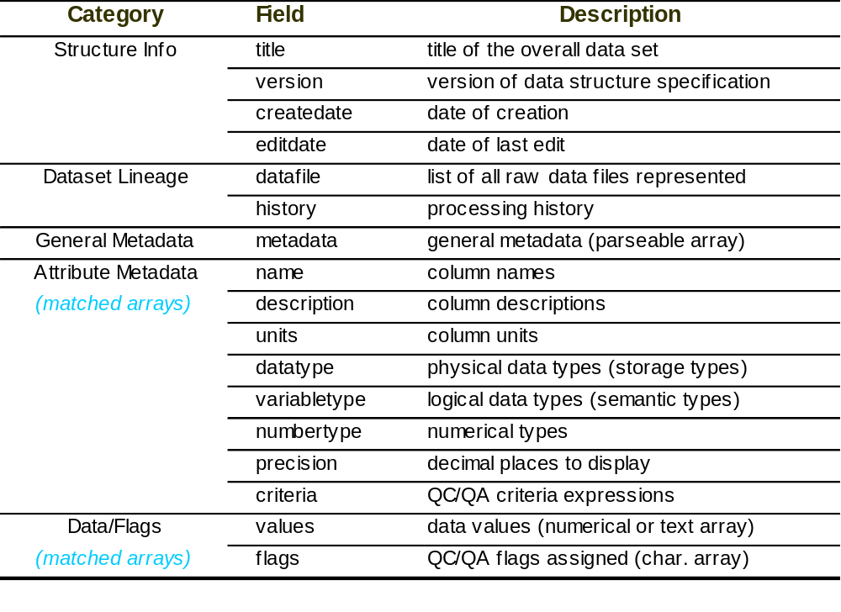
GCE Data Structure Specification v1.1 (2001)

Slide 4
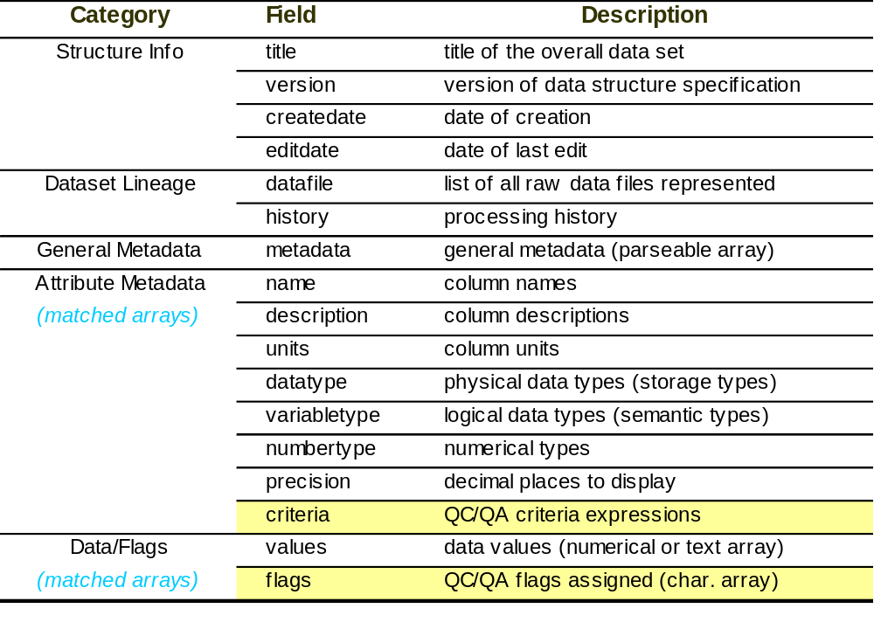
GCE Data Structure Specification v1.1 (2001)

Slide 5
QC/QA Framework
Define unlimited rules for each attribute (templates & user-defined)
  Simple syntax: [expression]=[flag code] (e.g. x<0=‘I’;x>100=‘Q’; ...)
    Mathematical/statistical equations (e.g. x>mean(x)+2.*std(x)=‘Q’; ...)
    Reference other attributes (e.g. x>col_Total_Mass=‘Q’; ...)
    Call custom Q/C functions (e.g. flag_percentchange(x,50,50,3,2)=‘Q’; ...)
  Combine expressions to perform any type of QC/QA operation
  Rules can reference external data via functions (files, database, web services)
Flags managed automatically via Toolbox functions
  Recalculated after data changes
  Sync’d with corresponding data array after any operation
  Attribute name changes synchronized to Q/C rules
Flags can be set/cleared manually (locks auto flags)
  Edited with mouse on data plots, keyboard in data grid view
  Flag attributes in data table merged with automatic/manual flags

Slide 6
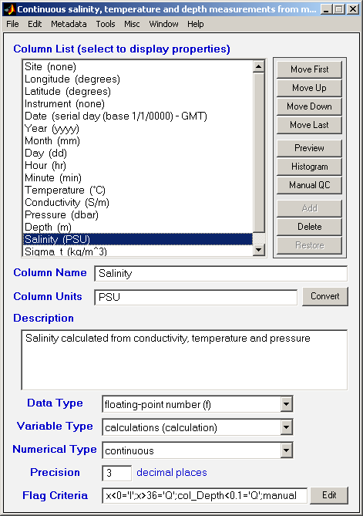
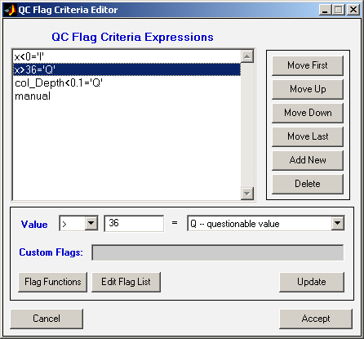
QC/QA Criteria (Rules)

Slide 7
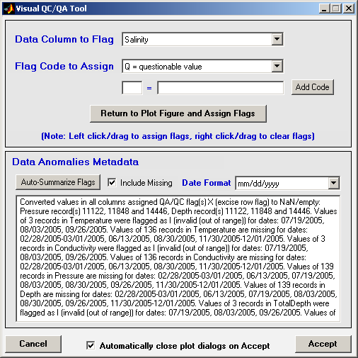
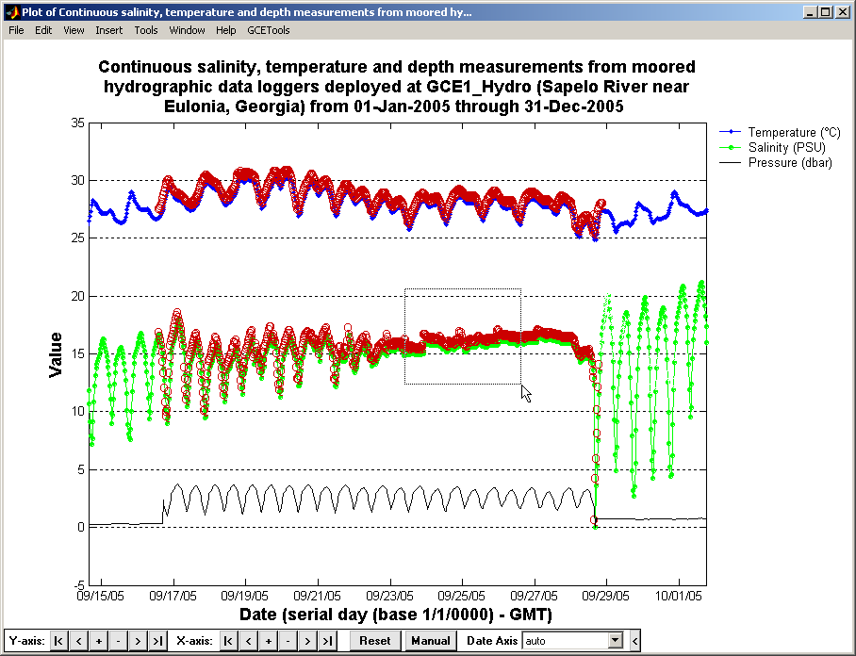
Manual QC/QA Flagging

Slide 8
Use of Q/C Flag Information
Flags displayed in data grid view, on plots
Variety of flag operations supported
  Propagation of flags to dependent columns (many:many)
  Selective data removal based on flags
  Flag arrays instantiated as coded attributes (used for export)
  Analytical tools can include/exclude flagged values on the fly
Generate data quality metadata
  Editable text summaries created on demand
    flagged/missing values summarized by parameter, date range
  Flag operations logged to processing history
    Value nulling, row deletion
    Flag recalculation, propagation
  Flag rules listed in description when flag arrays instantiated as coded attr.

Slide 9
Synthesis of Flagged, Missing Data
Data mining and harvesting tools (e.g. USGS, ClimDB)
  Provider-specified flags/qualifiers retained, converted to flag arrays
  Rule-based flags can be defined in templates, meshed with provider-specified flags automatically on acquisition
  Missing value codes, flag codes ‘normalized’ by import filters
    Unsupported flags stripped (e.g. ‘G’ flags for good values)
    Placeholder definitions added in metadata for unexpected flags
  Full suite of flag operations available for mined/harvested data
Data sub-setting, filtering tools
  Flags, rules maintained with corresponding data
  Flags recalculated after record deletions, filtering

Slide 10
Synthesis of Flagged, Missing Data
Statistical re-sampling, aggregation tools
  Options to retain/remove flagged values
  Counts of missing & flagged values added as attributes in
  derived data sets (e.g. Missing_Salinity, Flagged_Salinity,...)
  Options to automatically flag aggregates containing >N missing, flagged values (i.e. automatic Q/C rule generation)
  Automatic documentation of flagging/missing values

Slide 11
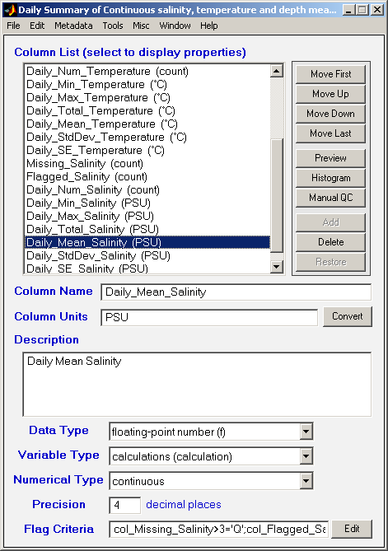
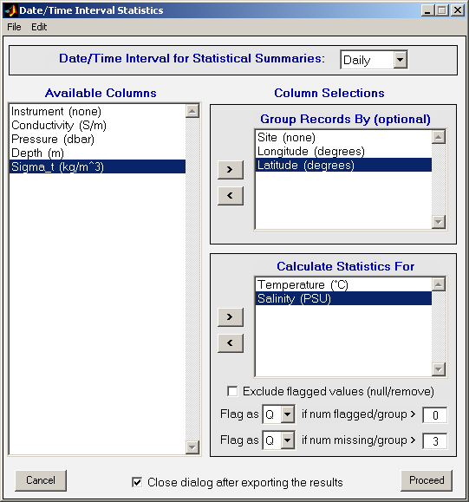
Synthesis of Flagged, Missing Data

Slide 12
Synthesis of Flagged, Missing Data

Slide 13
Synthesis of Flagged, Missing Data
Statistical re-sampling, aggregation tools
  Options to retain/remove flagged values
  Counts of missing & flagged values added as attributes in
  derived data sets (e.g. Missing_Salinity, Flagged_Salinity,...)
  Options to automatically flag aggregates containing >N missing, flagged values (i.e. automatic Q/C rule generation)
  Automatic documentation of flagging/missing values
Data integration tools
  Join operations retain flags, rules for data in result set
  Merge (union) operations ‘lock’ flags to prevent rule conflicts
  Metadata from multiple data sets meshed on integration
    Q/C flag definitions reconciled
    Data anomalies metadata retained for all primary data

Slide 14
Unresolved Challenges
GCE Toolbox issues:
  Full lineage of all primary data not captured in integrated data
  Flag semantics not implemented (i.e. all flags equally weighted)
  Not providing qualifiers for missing values
EML-specific issues:
  Instantiated flags doc’d as independent coded attribute in table
    Can’t relate flag attributes to corresponding data attributes
    No attribute metadata types for qualifiers, annotations
  “Soft” or algorithmic Q/C rules can’t be described in EML
    Can only define absolute bounds of numerical attributes
    Constraint module can be used, but implies “hard” restrictions
  No pre-defined anomalies field – using ../dataTable/additionalInfo
  Not clear how to report processing history – using ../dataTable/method

