Slide 1
Survey of Current Practices for Reporting Missing, Qualified Data
Wade Sheldon
GCE-LTER

Slide 2
Missing Data
Missing observations are ubiquitous in environmental data sets
Primary data
  Failures in measurement (equipment, data logging, communications)
  Failures in data management (data entry, data loss, corruption)
Processed data
  QC/QA operations (data removal)
Important to distinguish nature of missing values (Little & Rubin, 1984):
  MCAR = missing completely at random (independent of data)
  MAR = missing at random (independent of missing parameter, but may depend on other observed components and be predictable)
  Non-ignorable (pattern non-random, cannot be predicted; mechanism related to missing values themselves like off-scale readings)

Slide 3
Common Reporting Practices
Structured binary storage systems
  RDBMS – ANSI NULL
  MATLAB, R (C, Java, …) – NaN (IEEE 754)
XML text
  Omitted elements
  Empty elements
  Text codes (unless numeric-typed in schema)
Other text storage formats, spreadsheets
  Anything and everything
  Commonly seen examples:
    Omitted records (e.g. long data gaps)
    Omitted fields (i.e. delimiter-delimiter, empty cell)
    Text codes: nd, n/a, M, NaN, period
    Out-of-range numeric values: -9999

Slide 4
Ramifications of Missing Value Encodings
Non-standard codes need to be filtered, replaced before loading ASCII data into structured storage
  Requires source-specific processing
  Adds overhead, points of failure
Omitted records can disrupt parsers (e.g. space-delimited text files)
Out-of-range numeric values can lead to major analytical errors if not recognized by data users and automated workflow tools

Slide 5
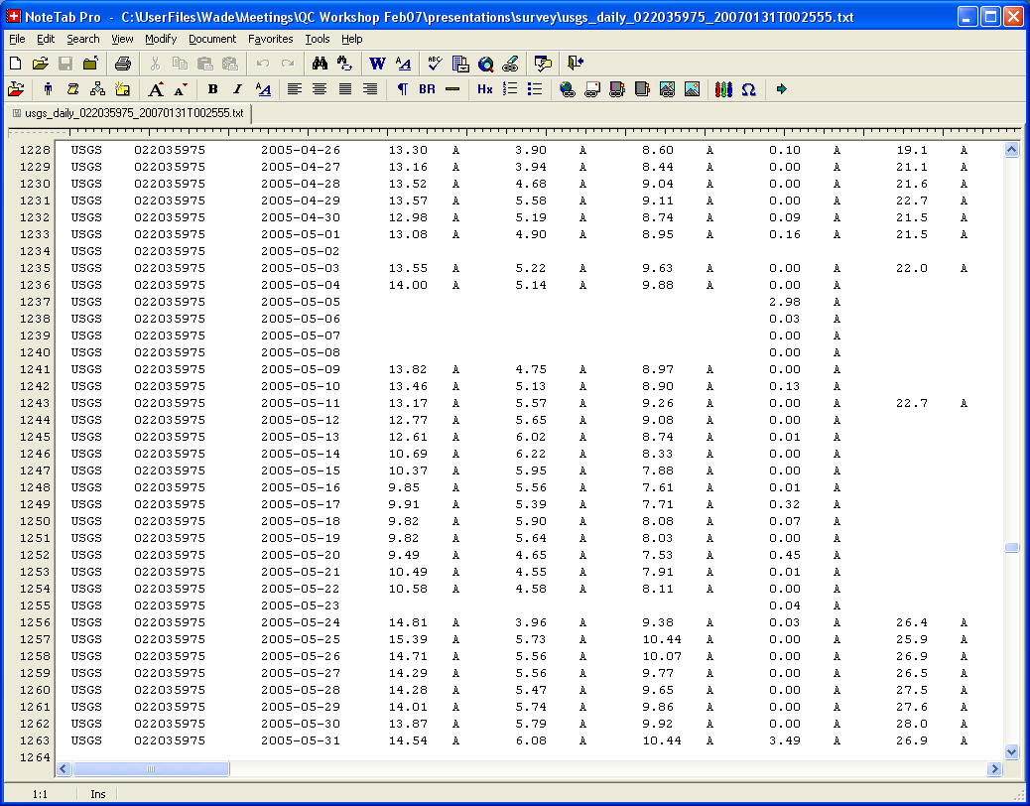
Example – USGS

Slide 6
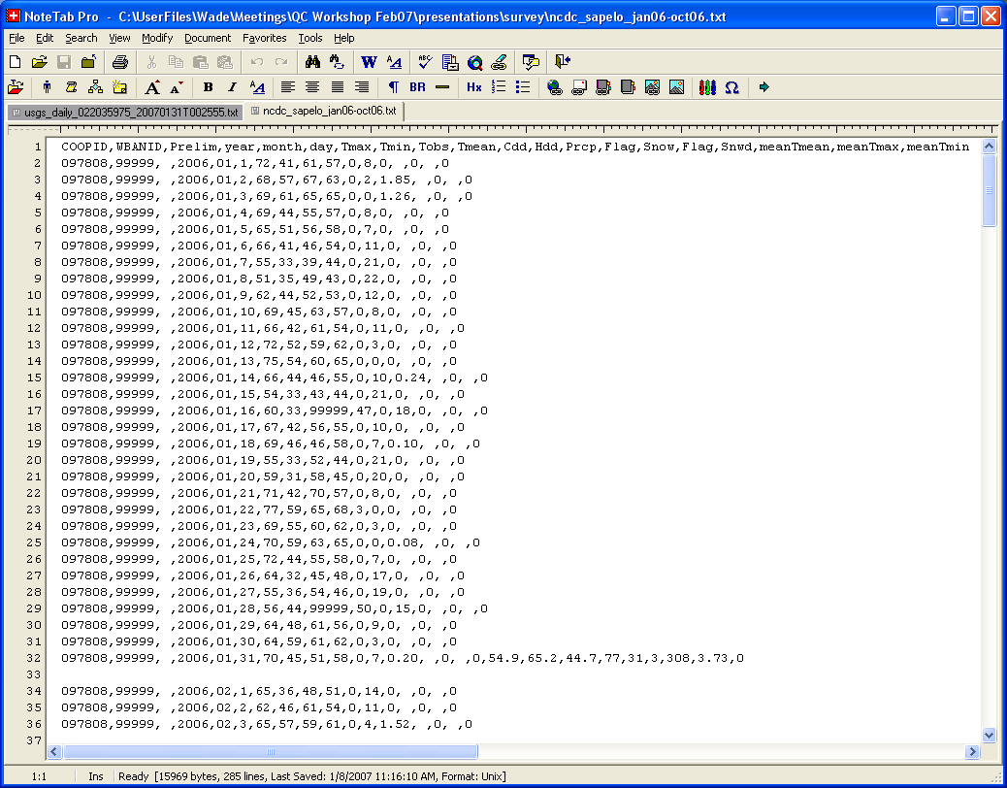
Example – NOAA NCDC/NWS

Slide 7
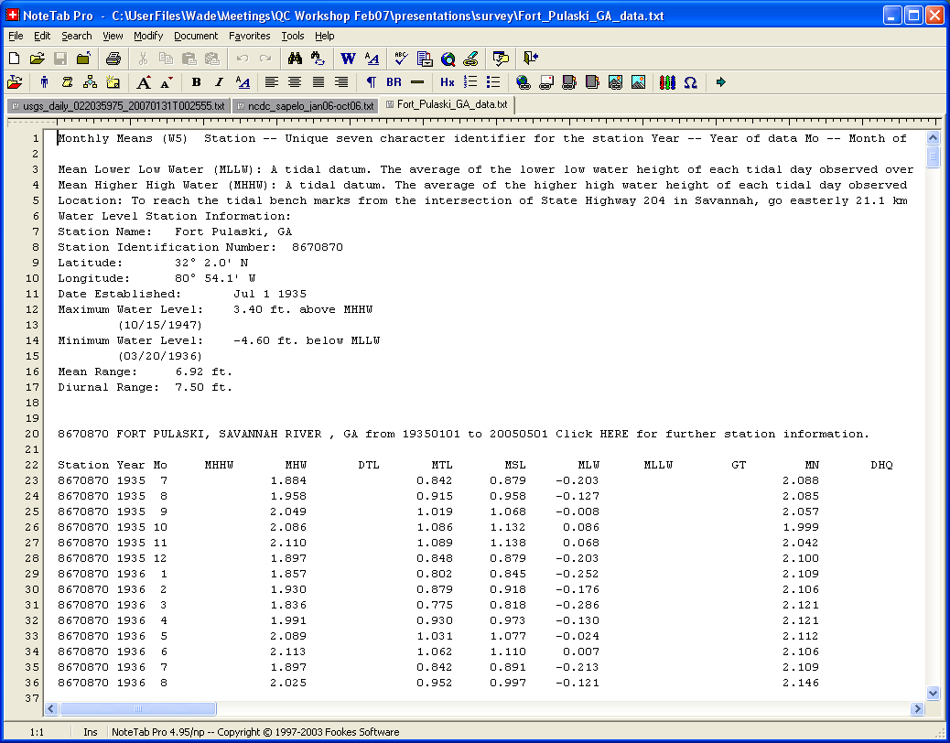
Example – NOAA NOS

Slide 8
Flags/Qualifiers
Field annotations often present in data sets (record-level metadata)
Often used to indicate anomalies identified during QC/QA (questionable/ suspect, invalid, estimated)
Also used to convey data use information (accumulating amount, accepted/provisional, good value)
Representations highly variable
  Flag attribute adjacent to observation attribute in table
  Text/special characters appended to value (e.g. *)
  Embedded flags in place of observation value (ice, rat, eqp, ***)
  Variation in formatting (braces/brackets around values)
Code definitions often hard to find for federal data

Slide 9
Ramifications of Flags/Qualifers
Flag formats other than dedicated attributes often break data parsers (particularly embedded flags)
Conventional analysis software (e.g. spreadsheets, graphics apps) ignorant of flags, provide few uses for information
Non-obvious, undefined flags of dubious value (1,*)

Slide 10
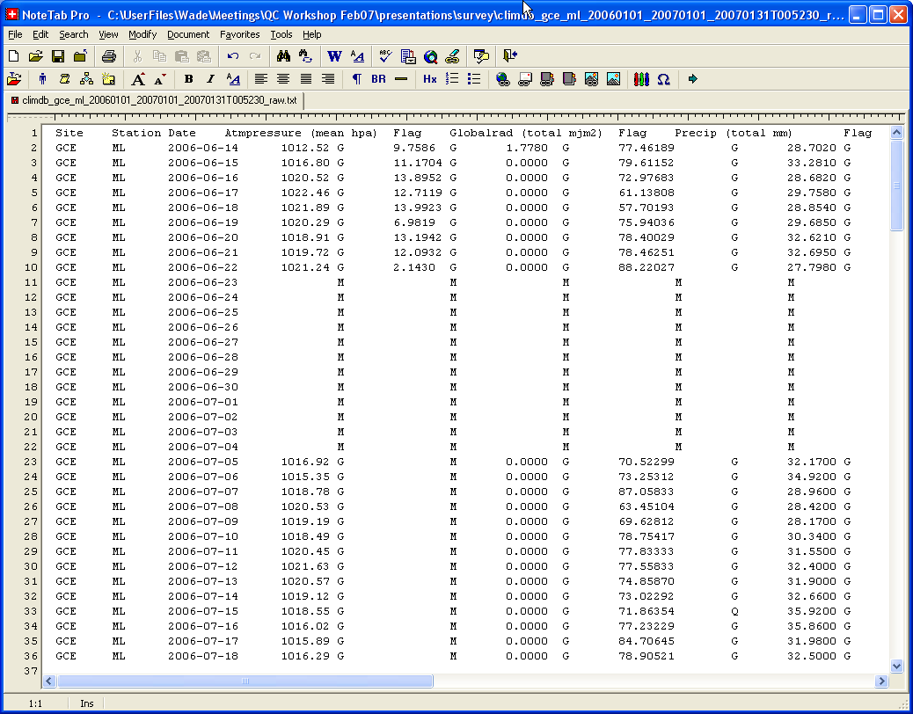
Example – ClimDB

Slide 11
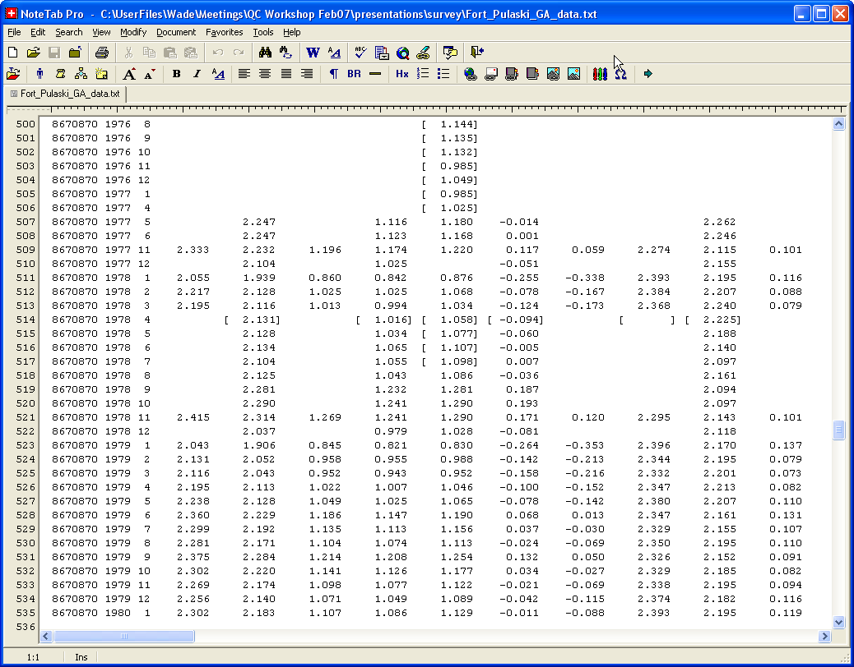
Example – NOAA NOS

Slide 12
Metadata Practices
USGS, NOAA
  Rely on published protocols for documenting QC/QA practices and qualifier code defs – can be very hard to find
  Metadata distributed with files sparse
LTER/EML
  Missing value codes defined at the attribute level (requires full implementation of dataTable, physical, attribute)
  Various places to document QC/QA and data anomalies (e.g. add Q/C methods trees at various levels in doc like dataset, dataTable, attribute, …)
  EBP document doesn’t provide specific guidelines, and no mention of how to describe data anomalies (dataTable/additionalInfo, additionalMetadata, ?)
General
  Reporting of QC/QA methodology and data anomalies varies tremendously in both structure and depth

