Slide 1
GEONIS

Slide 2
From the IM Proposals
Developing “PASTA” ready spatial data for the Network Information System (NIS)
1. Attend a workshop to create best practices for converting FGDC-type metadata into PASTA ready EML , discuss strategies for optimizing the process through development of scripts and/or models that can be shared by all LTER sites. This group will continue discussions with the LNO on integrating spatial data into the NIS and making enhancements to SiteDB.

Slide 3
continued
2. Convert site FGDC- style metadata to EML with specific URL links to the spatial data, following the best practices developed at the workshop. (followup) Share progress, share conversion tools, publish into the NIS
3. LTERMapS pilot sites will prepare their site spatial data for inclusion into the geospatial data portal (and other sites as well).

Slide 4
Outcomes
Best Practices document for spatial data management
Completed spatial data packages ready for inclusion into the NIS
Inclusion of pilot site data into the geospatial data portal.
Tools for automating 2 and 3

Slide 5
Insert copy of agenda

Slide 6
Defining the GEONIS
Spatial component of the NIS
Stand alone geospatial data sets.
Geographic coverage/reference of study data.
Need EML so that our data is discovered in the NIS.
PASTA currently can not read formats other than flat files
We can’t wait for PASTA, so we will develop a process that by-passes PASTA, but will be able to be connected when PASTA is ready.

Slide 7
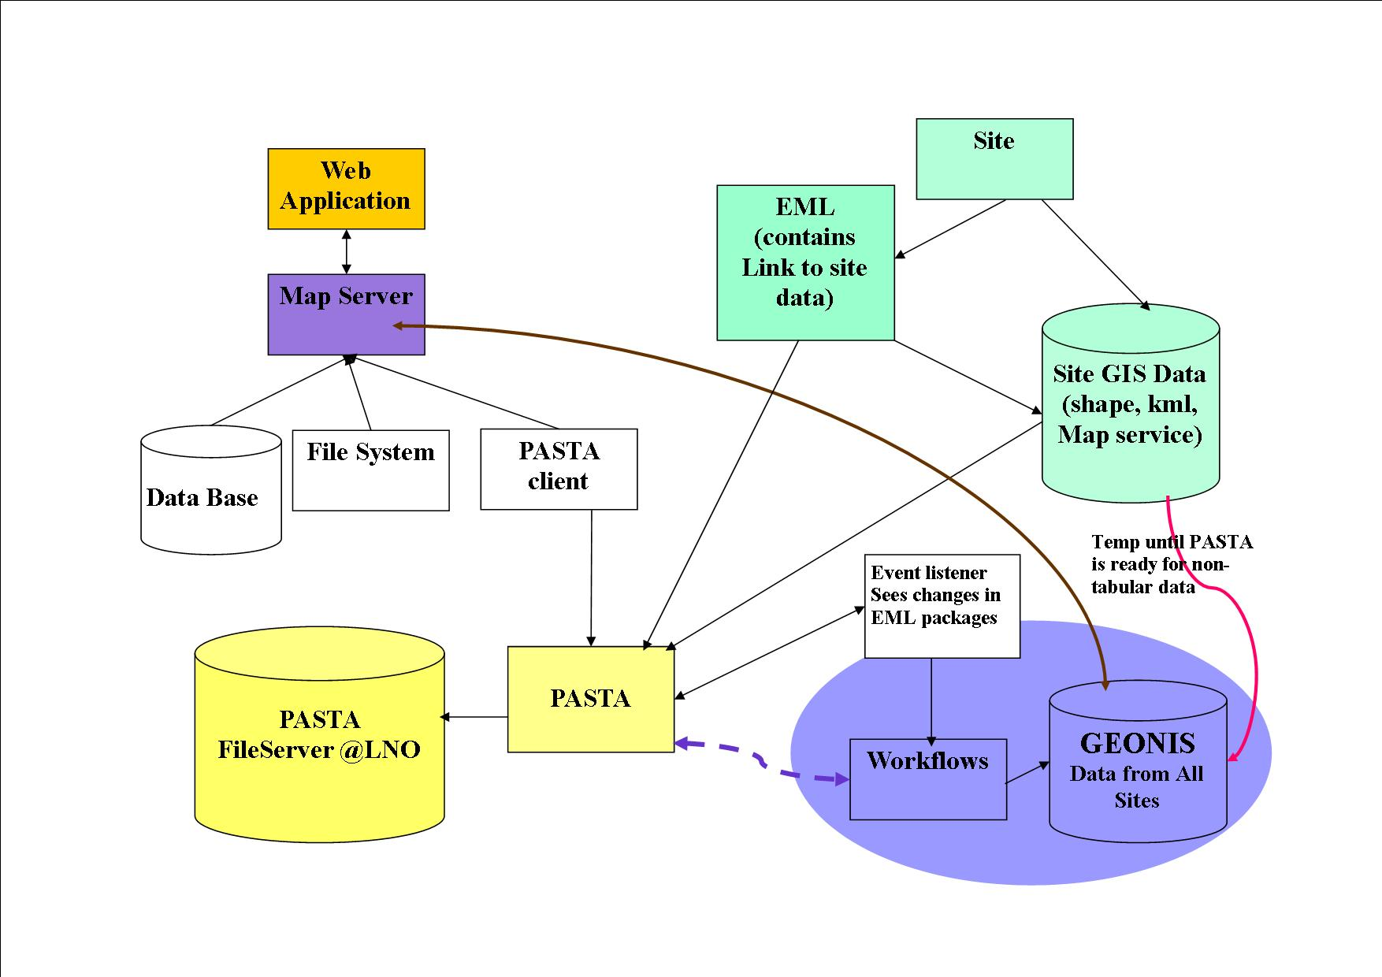

Slide 8
GEONIS
Bring in files from sites to repository.
Move to database
POSTGRIS with SDE on Linux server running ArcGIS Server (located at LNO)
Plans for data in a single projection at this time.
DEMS, watersheds, NHD data,
Study site locations in SiteDB
Create diagram of the GEONIS module

Slide 9
Get Ready for Meeting with Mark
Questions from group on PASTA/GEONIS?
come up with a list of questions for Mark..
Issues/ different data types?/ implementation issues
Obstacles to preparing their data?
Future issues? Integration with web services..

Slide 10
Get from Mark
Update on PASTA progress.
Review plan (changes, if any)

Slide 11
Other issues
Coordination with new web design and spatial searches.
Pilot sites discuss what other resources we might need (other $ in IM supplement and if we need to ask Bob for any resources)

Slide 12
IMC Meeting Followup
Need to set up groups for birds of a feather
Follow up with Ned
Talk about ASM
Talk about DataBits

