Slide 1
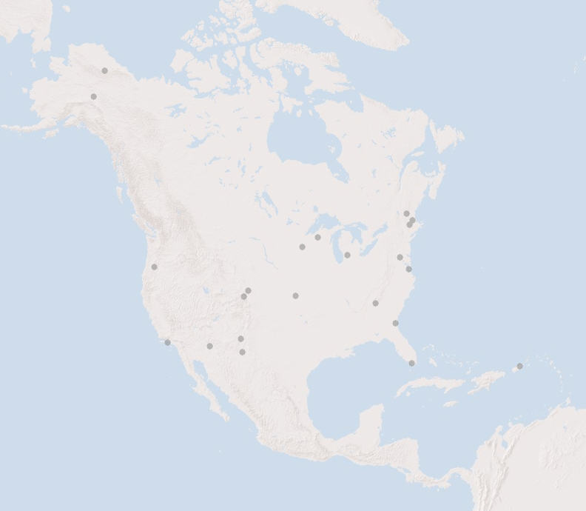
GIS Working Group Report to IM Exec
April 7th, 2009

Slide 2
GIS Working Group
LTER Spatial Data Standards/Best Practices
Internet Mapping: LTERMaps
ASM Workshops
  General and during IM meeting

Slide 3
LTER Spatial Data Standards/Best Practices
Several requests for information on spatial data metadata (standard, format, integrating with EML, etc)
Formats for distribution on web?
How to document spatial data that is not in ESRI format? What tools are available, what are the other sites doing?
Asked for someone in the GIS working group to take this one on and start a white paper.

Slide 4
Internet Mapping: LTERMaps
Core group of TheresaValentine, Jamie Hollingsworth, John Carpenter, Adam Skibbe, and Jonathan Walsh.
Met 3 time via VTC
Notes available in IM portal under projects.
John Carpenter and Theresa are working on data.
Jamie and Adam are working on the front end
Jonathan is providing input/feedback

Slide 5
3 Tiered Approach
LTER Overview Site
Trends Site
LTER Detailed Site
Currently working on 1 and 2.

Slide 6

Overview Site
We have a name for the application and a logo
Current set-up:
  Map Service is set up on Andrews, with linkage to data on Georgia Coastal and ESRI in Redlands, CA.
  Application is running from Bonanza in Alaska

Slide 7
Overview Site
Data: Limited functionality
  Site locations from WshedDB, updated (points)
  Site boundaries (John is gathering them from sites, not complete)
  We have not included Antartic sites (need to do a globe for this, and will try to do in version 2.0)
  Aerial Imagery coming from ESRI in California.

Slide 8
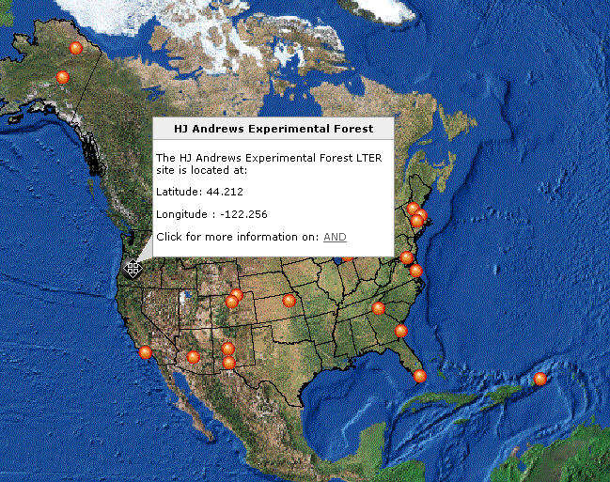
Click on site and get pop-up with info and link to site.

Slide 9
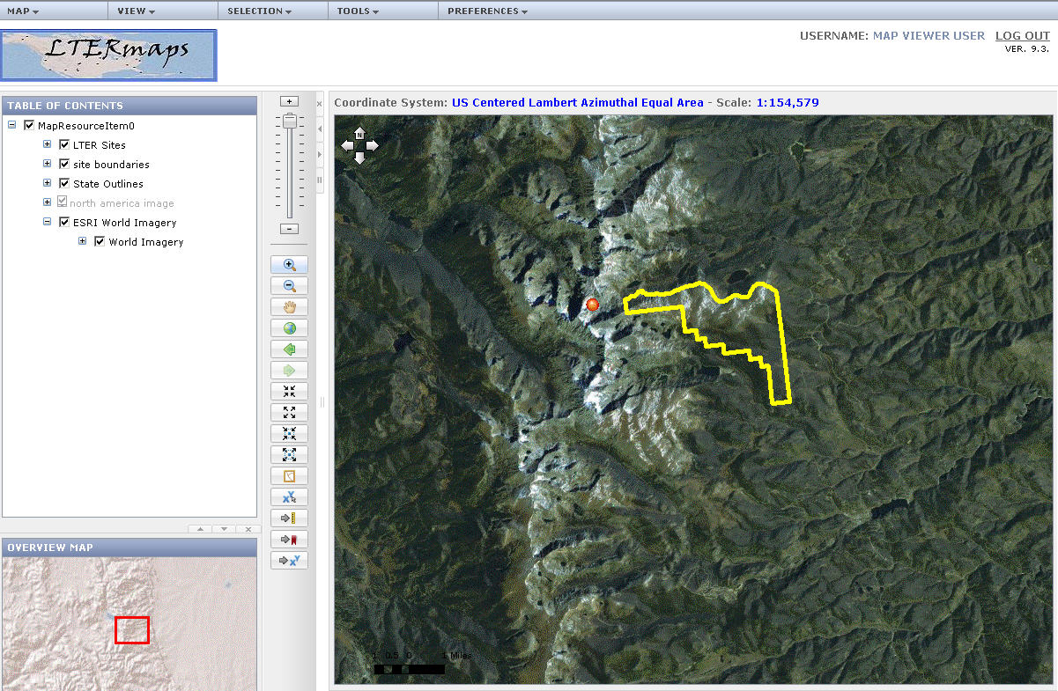
Zoom into site and get aerial photography with site boundary

Slide 10
Trends Site
Functionality: Spatial View of Trends Data
Data: All of the Social-Economic data from Coweeta website has been downloaded and joined with a GIS layer of US and Puerto Rico counties.
Status: Data is available on a map service from Andrews, Theresa working on a web interface to the data. Right now we have snapshots of total population at the following time frames: 1790, 1850, 1900, 1950, and 1990

Slide 11
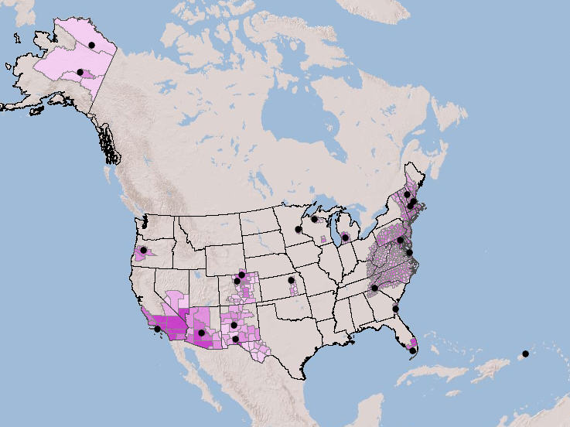
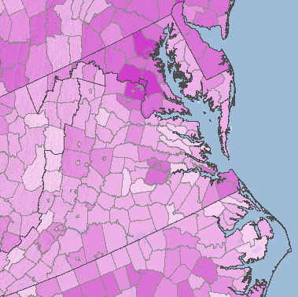

Trends Population Data
(1990 View)

Slide 12
LTER Detailed Site - Options
  Direct link from a site internet mapping service to the central application (uses the same wrapper/application around a site’s service).
  LTER site deploys the LTER application from their local server.
  LTER site develops an arcmap mxd file and ships file and data to the central service and the site is deployed.
  Committee/volunteer takes data from site and develops an Arcmap mxd file for the site with associated data and it’s deployed at the central server.

Slide 13
Next Steps
Increasing functionality of 1, working on performance, zoom to sites, customizing, looking at style sheets.
Connecting to SiteDB data so we can enhance what shows up in pop-up. (would like to do direct connect)
Would like to add someone from LNO to our team so we can coordinate, make sure that the infrastructure is in place to transfer when we’re ready.
Continue working on Trends data. Coordinate with Trends folks.
Goal is to rollout at ASM. (at least 1 and 2)
Determine what resources we’ll need to make 3 happen.

Slide 14
ASM Workshops
GIS Working group thinking about
  1. Using Demographic Data to monitor societal changes around LTER sites.
  (work with Social Scientists on this one)
  2. Visualization tools for communicating scientific information to non-scientists (cool tools)
  3. Detecting changes in land use and land cover around LTER sites.

Slide 15
ASM IM Meeting
Request workshop time to work on geospatial standards.
Server group would like to present more detailed information to interested folks on LTERmaps.

