Slide 1
07 Jul 2010 - GWG
Governance Working Group - First Steps
2008 Create Governance Working Group (Kaplan, Baker, Melendez)
Investigate History of IMC decision making
Conduct IM Chair Interviews
Begin HistoryDB and Communication with other working groups
Carry out analysis of materials
2009 Present figure and preliminary results at IMC annual meeting
- Identified need to formalize some of the decision making,
roles of committee members, partnerships, and help
legitimize and prioritize working groups
Present poster on HistoryDB
Present figure on community and organization of LTER IM
Investigate Terms of Reference to meet our needs
2010 Present to IMExec
Present to NISAC (March)
Present to IMC in TeleConf (July)
IMC Charge: 2 Issues and Terms of Reference

Slide 2
July 2010 Next Steps: Documenting governance to support work in communication, integration and synthesis
Supplemental figures to help set the stage:
- GWG Timeline
  LTER Community figure (IMC 2009) – about membership
  LTER Organization figure (operational plan 2010) – about authority
    Standing committees: IMC, NISAC
    IMC/IMExec reports to LTER EB
  LTER Organization Sci-IM Standing Committees and WGs figure (IMC 2010) – and lines of communication

Slide 3
LTER Community Diagram V5
NSF
S
2010 March (IMC 09)
Where are decisions made? Kinds of decisions?
Strategic vs tactical vs practical/internal
Decision making
LNO
NIS
team
advisory
communication
Informatics community
NISAC
S
?1
SES
community
community affiliations
IMC
IMExec
SC
EB
WG
WG
Standing Committees
-IMC
-NISAC

Slide 4
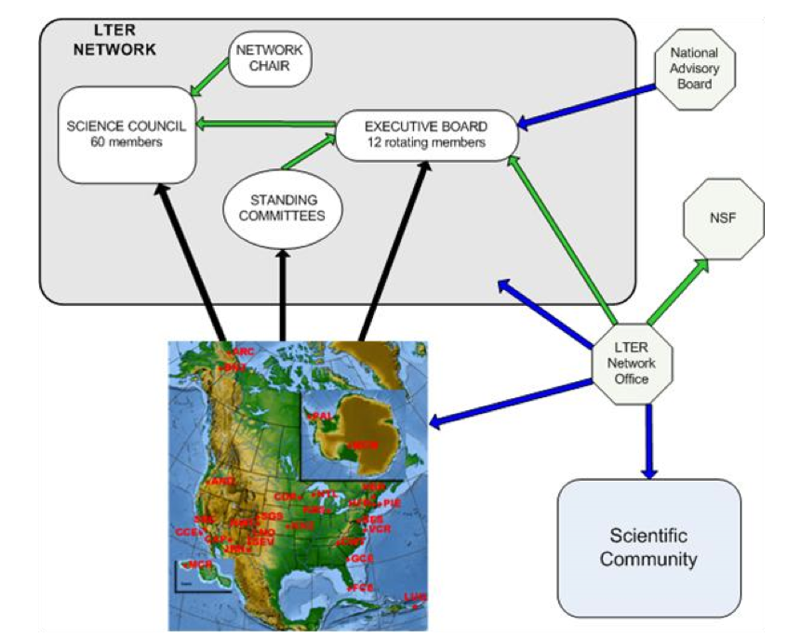
Figure 1. Organizational chart for the LTER network:
green lines denote reporting lines,
blue lines denote services provided, and
black lines (from member sites) denote membership pools
LTER Operational Plan 2010

Slide 5

LTER CI Organization: Black lines denote communication in support of reporting, proposing, and/or decision making regarding development of LTER cyberinfrastructure; membership is addressed in the LTER organizational chart and LTER By-laws V3.
2010 JuneV3
LTER Network Infrastructure
NAB
Chair
EB
WG
SC
Note – IM exec authority to make decisions and formalize communication with NISAC?
NSF
NISAC
Chair
IMC
IMExec
LNO
WG
Sites
Notes:
Decisions that drive activities that develop or grow the LTER Information Environment:
Kinds of decisions?
Strategic vs tactical vs practical/internal
Activities associated with the LTER Information Ecosystem and affected by LTER organizational entities:
0Constitutes
1Reports
2Sends directives,
requests
3Elects
4Appoints
5Inquires
6Informs (content
and expectations)
7Design, Dev (structure
and function)
8coordination and integration
Plan
9 prototype
10 targeted implementation
11 enactment
8Implement
What about Community Affiliations: NCEAS, NEON, EcoInformatics

