Slide 1
Documenting governance to support work in communication, integration and synthesis
Moving toward formalization of governance:
investigation of our history shows not everything should be formalized but it’s time to consider the range of governance options
- formal, semi-formal, informal, and traditional -
What’s in place now? The LTER By-Laws
Version 3 (things do change over time)
What do we need? Additional documentation
- to define our Standing Committees and WGs
- to outline roles, procedures, and membership
- to support decision-making processes
How do we do it? Terms of Reference
5 issues and related tasks identified by GWG
07 Jul 2010 - GWG

Slide 2
ISSUE #1: IMExec Role
Existing LTER By-Laws (V3 – 2008)
Article IV, Section 1.
Science Council
Powers: The scientific direction and vision of the LTER Network is established by the Science Council. The Science Council reserves ultimate authority for decisions affecting the Network, and may address any issue that arises from the Executive Board, the Network Office, or the participating LTER sites. … As needed, the Science Council shall appoint subcommittees to help carry out its responsibilities.
Article V
Executive Board Note: Here is an example of power granted to a steering committee (#1)
Article V, Section 1. Powers: Full power in the management of the affairs of the LTER Network is vested in the Science Council. To this end and without limitation of the foregoing or of its powers expressly conferred by these Bylaws, the Executive Board shall have power to authorize such action on behalf of the LTER Network; make such rules or regulations for its management; create, evaluate, and dissolve such additional offices or special committee; and select, employ or remove such of its officers or agents as it shall deem best. The Executive Board shall have the power to fill vacancies in, and change the membership of, such duly constituted committees. The Executive Board shall have the responsibility for developing and updating the LTER Strategic Plan for the Network and for developing and recommending Bylaws changes. If a site objects to a decision of the executive board, it can seek redress of the issue with the Executive Board, and with the support of at least 5 sites, with the Science Council. With the exception of the Chair, the Executive Board receives no compensation other than reasonable expenses.
Article V, Section 2. Composition: The Executive Board shall be composed of the elected Chair of the Science Council serving as Chair of the Executive Board; nine Members selected by individual Sites on a rotating basis; an Information Manager; the Executive Director of the Office, and, as needed, a Chair-Elect. All members of the Executive Board shall act in behalf of and are accountable to the membership of the LTER Network. Members will serve as liaisons to LTER Network committees and perform other functions as delegated by the Chair.
Article VII
Other Committees
Article VII, Section 1. General: Other committees, consisting of Network-wide Standing, Targeted Standing, or Ad Hoc, may be created by resolution adopted by the Executive Board. Each committee shall have only the lawful powers specifically delegated to it through the charge to the committee approved by the Executive Board. The Executive Board shall evaluate all committees on an annual basis. Any committee may be dissolved by a vote of the Executive Board. Committees may have representation at Executive Board meetings at the discretion of the Executive Board. Committee Chairs shall report on their work at least annually to the Executive Board and at such other times.

Slide 3
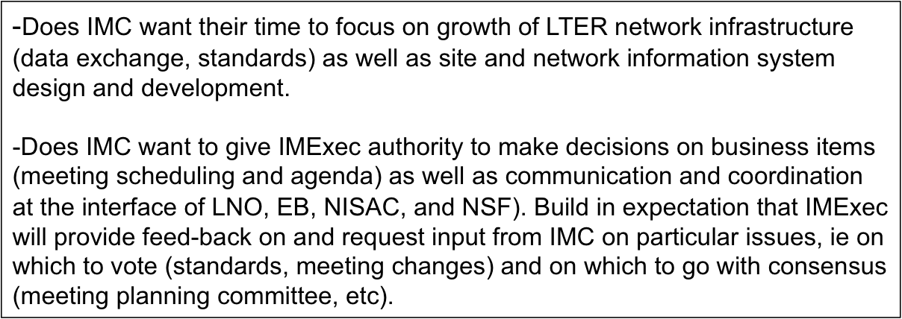
ISSUE #1: IMExec Role
(IMExec from orange to blue, from communication to authority for decision making as seen in the supplemental figures)
Terms of Reference are like by-laws
-are self-generated rules/code of conduct about how we operate;
-use of ‘terms of reference’ vs by-laws seems related to scale
-a way to build identity and advocate for your group in the
information ecosystem;
-can still have a working group without the terms of reference
Define roles within the Terms of Reference.

Slide 4
ISSUE #2: IM rep to EB
Existing LTER By-Laws V3 - 2008
V, 2.4 Information Management Representative
The LTER Information Management (IM) Committee shall select one member from among them to serve as the Information Management Representative to the Executive Board. The IM Committee shall determine the method by which the Representative is selected. The Information Management Representative is a non-voting member of the Executive Board and shall serve a single three (3) year term. In addition to the responsibilities shared by all Executive Board members, the Information Management Representative shall serve as the liaison between the Executive Board and the Information Management Committee providing insight on informatics, technology implementation, and human-technology infrastructure issues as well as on design and implementation of federated information system activities. In the event that an Information Management Representative is removed or not able to fulfill his or her term, the IM Committee will choose a replacement to complete the term.
Note: this relates to issue (#2) of the need to decide how we identify IM representative to EB, which is currently done informally.

Slide 5
ISSUE #3: NISAC Terms of Reference
issue: membership and co-chair
Existing LTER By-Laws V3 - 2008
Article VII, Section 2. Network-Wide Standing Committees: (Ex: IMC)
One or more Network-wide standing committees may be formed by the Executive Board for each major scientific, educational, or research program identified by the LTER Network. Members shall include one Representative from each Site. Network-wide Standing Committees, once formed, shall elect their own Chairs. The Chairs of each Network-wide Standing Committee are non-voting members of the Science Council.
VII, Section 3. Targeted Standing Committees (Ex: NISAC)
One or more Targeted Standing Committees may be formed by the Executive Board. A Targeted Standing Committee shall be formed to address specific, long-term scientific or administrative issues that require particular kinds or combinations of expertise. Targeted Standing Committees do not require representation from all sites to meet their charge. Targeted Standing Committees, once formed, shall elect their own Chairs. An individual from any of the LTER Sites may be a member of a Targeted Standing Committee. The Chairs of each Targeted Standing Committee are non-voting members of the Science Council.
Note: relates to issue (#3) of number of IM reps and length of term for NISAC membership ; co-chair arrangements

Slide 6
ISSUE #3: NISAC Terms of Reference
issue: membership
From the draft EB minutes that Will forwarded this month:
NISAC recommends changing the composition and terms of committee
members to include:
  6 domain scientists with a 3 year commitment and a possible 4th year for those who agree to serve as co-chair;
  4 information managers each with a 2 year term and a possible additional 2 years for those willing to serve as co-chair; and
  3 members from the LNO with permanent appointments (Executive director, CIO, and NIS developer).
Questions re IM membership
  - longer terms?
  - more members?
  term limits?

Slide 7
ISSUES #4 & #5: Proposed
Terms of Reference
for LTER Standing Committees and Working Groups
Related names: by-laws, statement of operation, articles of assembly, rules of order
Terms of Reference – What are they?
-the regulation of a group’s own actions, by the group itself; in the absence of law to the contrary, the power to make by-laws resides in the constituent body of members or stockholders’
-consist of rules written by the body itself (often referred to as bylaws), but also usually supplemented by a published parliamentary authority adopted by the body.
-typically, national, state, and other full-scale legislative assemblies have extensive internally written rules of order, whereas non-legislative bodies write and adopt a limited set of specific rules as the need arises.
Online Examples
http://www.ausaid.gov.au/ausguide/pdf/ausguideline6.1.pdf
http://tipdeck.com/how-to-write-terms-of-reference

Slide 8
Proposed: Terms of Reference Template
Name: LTER (IMC) XYZ Committee/Working Group (NAME Abbrev)
Approved by _____ on _______
1. Background
The committee/working group was established by ____. It is a _________committee/working group
Prioritization of IMC activities are both active and reactive, influenced by network infrastructure, scientific project support, working group plans, and funding opportunities
Purpose
The committee/working group goal is
2. Activities
-Meeting
-Agenda
-Reporting
-Tasks and Activities
3. Organization
-Membership (from LTER By-Laws)
-Roles
role, terms, decision-making, relations and communicatio
-Subgroups
  e.g. Working groups may be created (by boards, councils, and standing committees)
  e.g. Subgroups my be created (by working groups)
-Actions (types)
  -formal (votes will be taken; example: EML as an LTER community standard)
  -semi-formal (concensus; example: where meeting is to be held)
  -informal agreement (iterative discussions; example: meeting agenda)
  -tacit (tradition; example: having a meeting mixer; IMExec winter meeting)
4. Budget and Expenses
5. Modifications
  These rules of order may be amended by
  e.g. majority vote of members at a meeting, by two-thirds vote of the voting members at an annual meeting.
  Are to be approved by EB?

Slide 9
Issues and Tasks for IMC 2010
1. Issue: Define IMExec role and responsibilities (communication to decision making)
-Task: Describe IMExec role in Terms of Reference (ToR) for IMC
2. Issue: Discuss selection of EB representative from IMC to EB
-Task: Define selection process (can be informal, semi-formal, formal) and record in ToR
3. Issue: Determine number of reps and length of term for NISAC membership
-Task: Describe membership in ToR for NISAC (formal)
4. Issue: Which WGs need Terms of Reference and Why?
-Task: Identify which WGs want Terms of Reference and construct them
(can be short or long description)
5. Issue: Define relations with other committees (Possible activity for Fri, Sept 24th):
-Task: Consider communication with NISAC and more formalized activity review process with NISAC and describe in ToR
-Task: Consider partnership with SC; describe in ToR?

