Slide 1
Geospatial Metadata in GCE EML
Wade Sheldon
Georgia Coastal Ecosystems LTER

Slide 2
Geospatial Data Management at GCE
Store study site polygon and point data as vector features in ArcSDE 9.3 Geodatabases
  “Core” study sites defined in GCE-I by PIs (marsh sites, transects)
  “Ancillary” study sites created to bound researcher-defined locations
  Point locations for fixed monitoring equipment, CTD profiling stations, permanent plots, investigator-defined sites, ...
Sync vector coordinates for polygons, points to metadata database tables (GCE_Metabase - SQL Server)
Associate datasets with “Sites” (=polygons) and “Locations” (=points) in metadata database
Use info in ArcSDE for GIS projects, SQL Server for web display and metadata generation

Slide 3
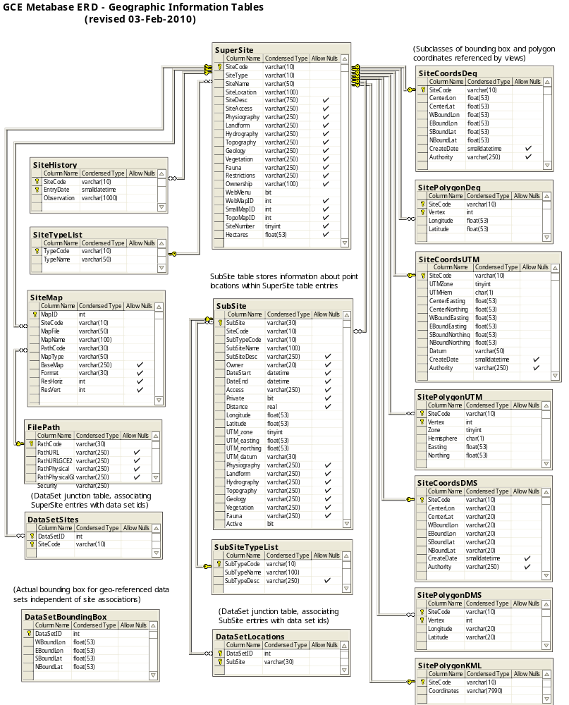
GCE_Metabase
Geospatial Schema

Slide 4
KML Web Services
Generate KML dynamically from GCE_Metabase tables
  SQL views to format coordinates, labels, balloon HTML text
    Polygons from tables of vertices preformatted/clipped to <=400 pts
    Points from location coordinate tables
  SQLXML 3 “query templates” used to generate KML from views
    MS server-side technology based on XML features in SQL Server
    Combines static XML with embedded SQL queries that return XML
  Implemented as web service using IIS virtual directories
Multiple KML web services
  sites.kml – KML for list of polygons
    http://gce-lter.marsci.uga.edu/gce_metabase/xml/sites.kml?SiteCode=GCE1,GCE2,GCE3
  locations.kml – KML for locations (all sites or list of sites)
    http://gce-lter.marsci.uga.edu/gce_metabase/xml/locations.kml
  site_locations.kml – KML for sites plus associated locations
    http://gce-lter.marsci.uga.edu/gce_metabase/xml/sites_locations.kml?SiteCode=GCE-AL
  dataset_geography.kml – KML for sites/locations referenced in dataset
    http://gce-lter.marsci.uga.edu/gce_metabase/xml/dataset_geography.kml?Accession=PLT-GCET-0608

Slide 5
Geospatial Metadata in GCE EML
Overall dataset coverage
  Generate overall bounding box from all referenced sites/locations
  (eml/dataset/coverage/geographicCoverage/...)
Methods/Sampling coverage
  Generate bounding boxes for each referenced site (polygon)
  (eml/dataset/methods/sampling/studyExtent/coverage/geographicCoverage/...)
KML coverage
  Generate KML entity (“otherEntity”) description for every dataset, reference in /methods/sampling/spatialSamplingUnits
  URL for “dataset_geography.kml” web service in otherEntity/physical
Any studies with GPS data also include latitude, longitude and location name as data set attributes
Not currently including point locations in EML coverage tags

Slide 6
Dataset Level
<coverage>
<geographicCoverage>
<geographicDescription>Overall bounding box describing the geographic region
within the Georgia Coastal Ecosystems LTER study domain represented in data set
PLT-GCET-0608, based on geographic coordinates present in the data table
</geographicDescription>
<boundingCoordinates>
<westBoundingCoordinate>-81.478000</westBoundingCoordinate>
<eastBoundingCoordinate>-81.226170</eastBoundingCoordinate>
<northBoundingCoordinate>31.647330</northBoundingCoordinate>
<southBoundingCoordinate>31.051330</southBoundingCoordinate>
</boundingCoordinates>
</geographicCoverage>
...

Slide 7
Sampling Level
<coverage>
<geographicCoverage>
<geographicDescription>GCE Study Site GCE1 -- Eulonia, Georgia, USA. Transitional salt marsh/upland forest site at
the upper reach of the Sapelo River near Eulonia, Georgia. The main marsh area is to the north of the channel where the
upland is controlled by DNR. Several small creeks lie within the study area. Residential development is increasing on the
upland areas south of the channel. A hydrographic sonde is deployed within this site attached to a private dock to the south
of the main channel near the HW-17 bridge.</geographicDescription>
<boundingCoordinates>
<westBoundingCoordinate>-81.428481</westBoundingCoordinate>
<eastBoundingCoordinate>-81.410732</eastBoundingCoordinate>
<northBoundingCoordinate>31.546750</northBoundingCoordinate>
<southBoundingCoordinate>31.533963</southBoundingCoordinate>
</boundingCoordinates>
</geographicCoverage>
<geographicCoverage>
<geographicDescription>GCE Study Site GCE3 -- North Sapelo, Sapelo Island, Georgia, USA. High salinity marsh/Sapelo
Sound site. Few or no small creeks, but one large creek is easily accessed. Further upstream upland drainage is affected by
culvert at Reynolds' duck pond. Upland is heavily forested. Hydrographic sonde is deployed adjacent to this site attached to
a channel marker (under U.S. Coast Guard permit). A huge mud flat is present at the northern tip of Sapelo
Island.</geographicDescription>
<boundingCoordinates>
<westBoundingCoordinate>-81.233249</westBoundingCoordinate>
<eastBoundingCoordinate>-81.195661</eastBoundingCoordinate>
<northBoundingCoordinate>31.546868</northBoundingCoordinate>
<southBoundingCoordinate>31.515188</southBoundingCoordinate>
</boundingCoordinates>
</geographicCoverage>
...

Slide 8
KML Entity
<methods>
<sampling>
<spatialSamplingUnits>
<referencedEntityId>PLT-GCET-0608.kml</referencedEntityId>
</spatialSamplingUnits>
...
<otherEntity id="PLT-GCET-0608.kml">
<entityName>PLT-GCET-0608.kml</entityName>
<entityDescription>Google Earth Keyhole Markup Language file describing the geographic locations sampled in
data set knb-lter-gce.290.12</entityDescription>
<physical>
<objectName>PLT-GCET-0608.kml</objectName>
<dataFormat>
<externallyDefinedFormat>
<formatName>application/vnd.google-earth.kml+xml</formatName>
</externallyDefinedFormat>
</dataFormat>
<distribution>
<online>
<url function="download">http://gce-lter.marsci.uga.edu/gce_metabase/xml/dataset_geography.kml?Accession=PLT-GCET-0608</url>
</online>
...
</otherEntity>

Slide 9
GCE Examples
Thesis data with GPS coordinates
  summary: http://gce-lter.marsci.uga.edu/public/app/dataset_details.asp?accession=PLT-GCET-0608
  eml: http://gce-lter.marsci.uga.edu/public/app/send_eml.asp?accession=PLT-GCET-0608&metacat=yes
Plant monitoring dataset with only geographic metadata
  summary: http://gce-lter.marsci.uga.edu/public/app/dataset_details.asp?accession=PLT-GCEM-0812a
  eml: http://gce-lter.marsci.uga.edu/public/app/send_eml.asp?accession=PLT-GCEM-0812a&metacat=yes

