Slide 1
Root Group Figures
Jessica Moore
3-11-20

Slide 2
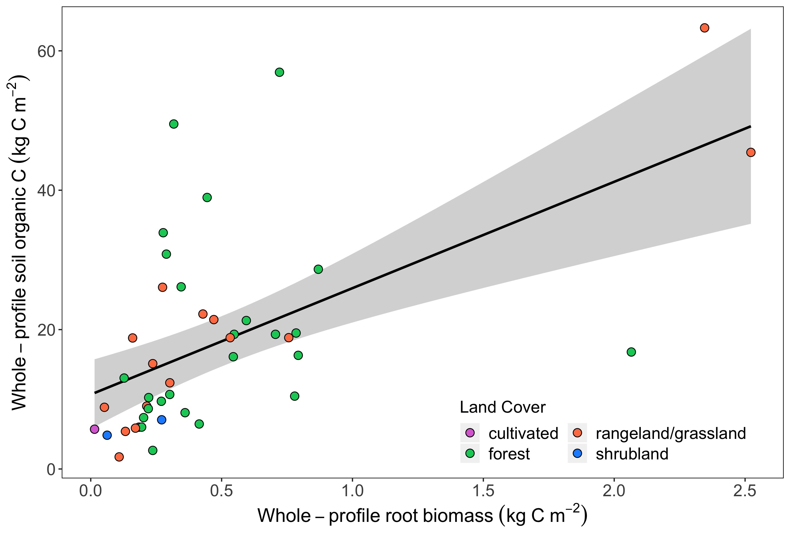
Fig 1a. Total SOC stock is related to root biomass, land cover, MAT, and clay

Slide 3
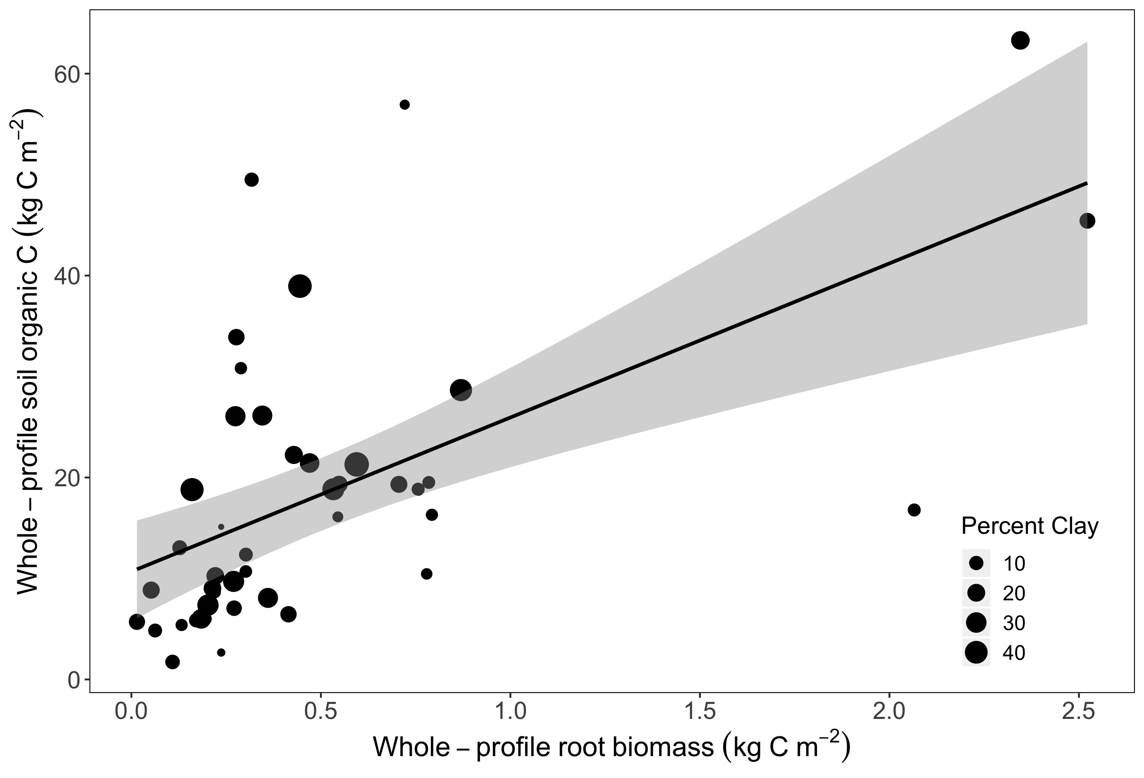
Fig 1b. Total SOC stock is related to root biomass, land cover, MAT, and clay

Slide 4
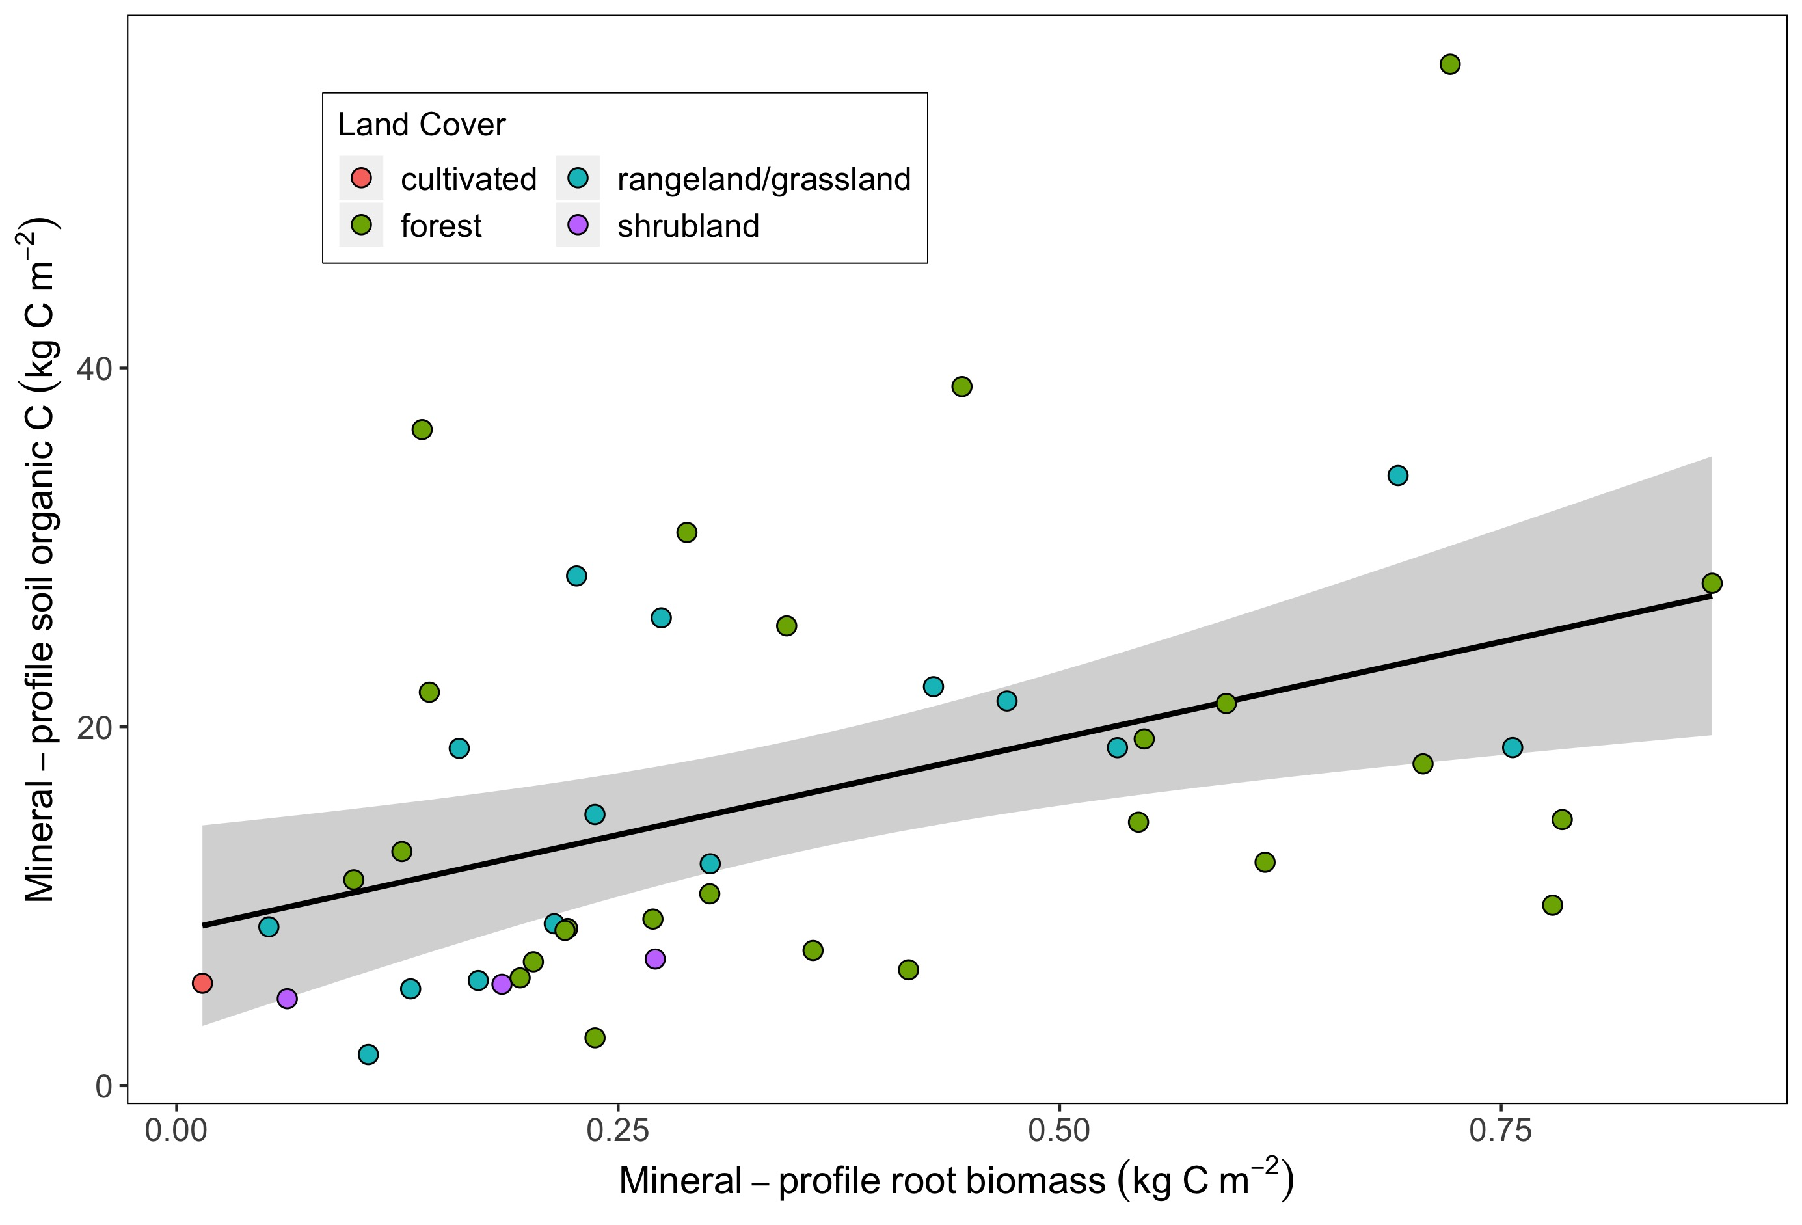
Supp Fig1a. Mineral horizon SOC stock is related to root biomass, land cover, MAT, and clay

Slide 5
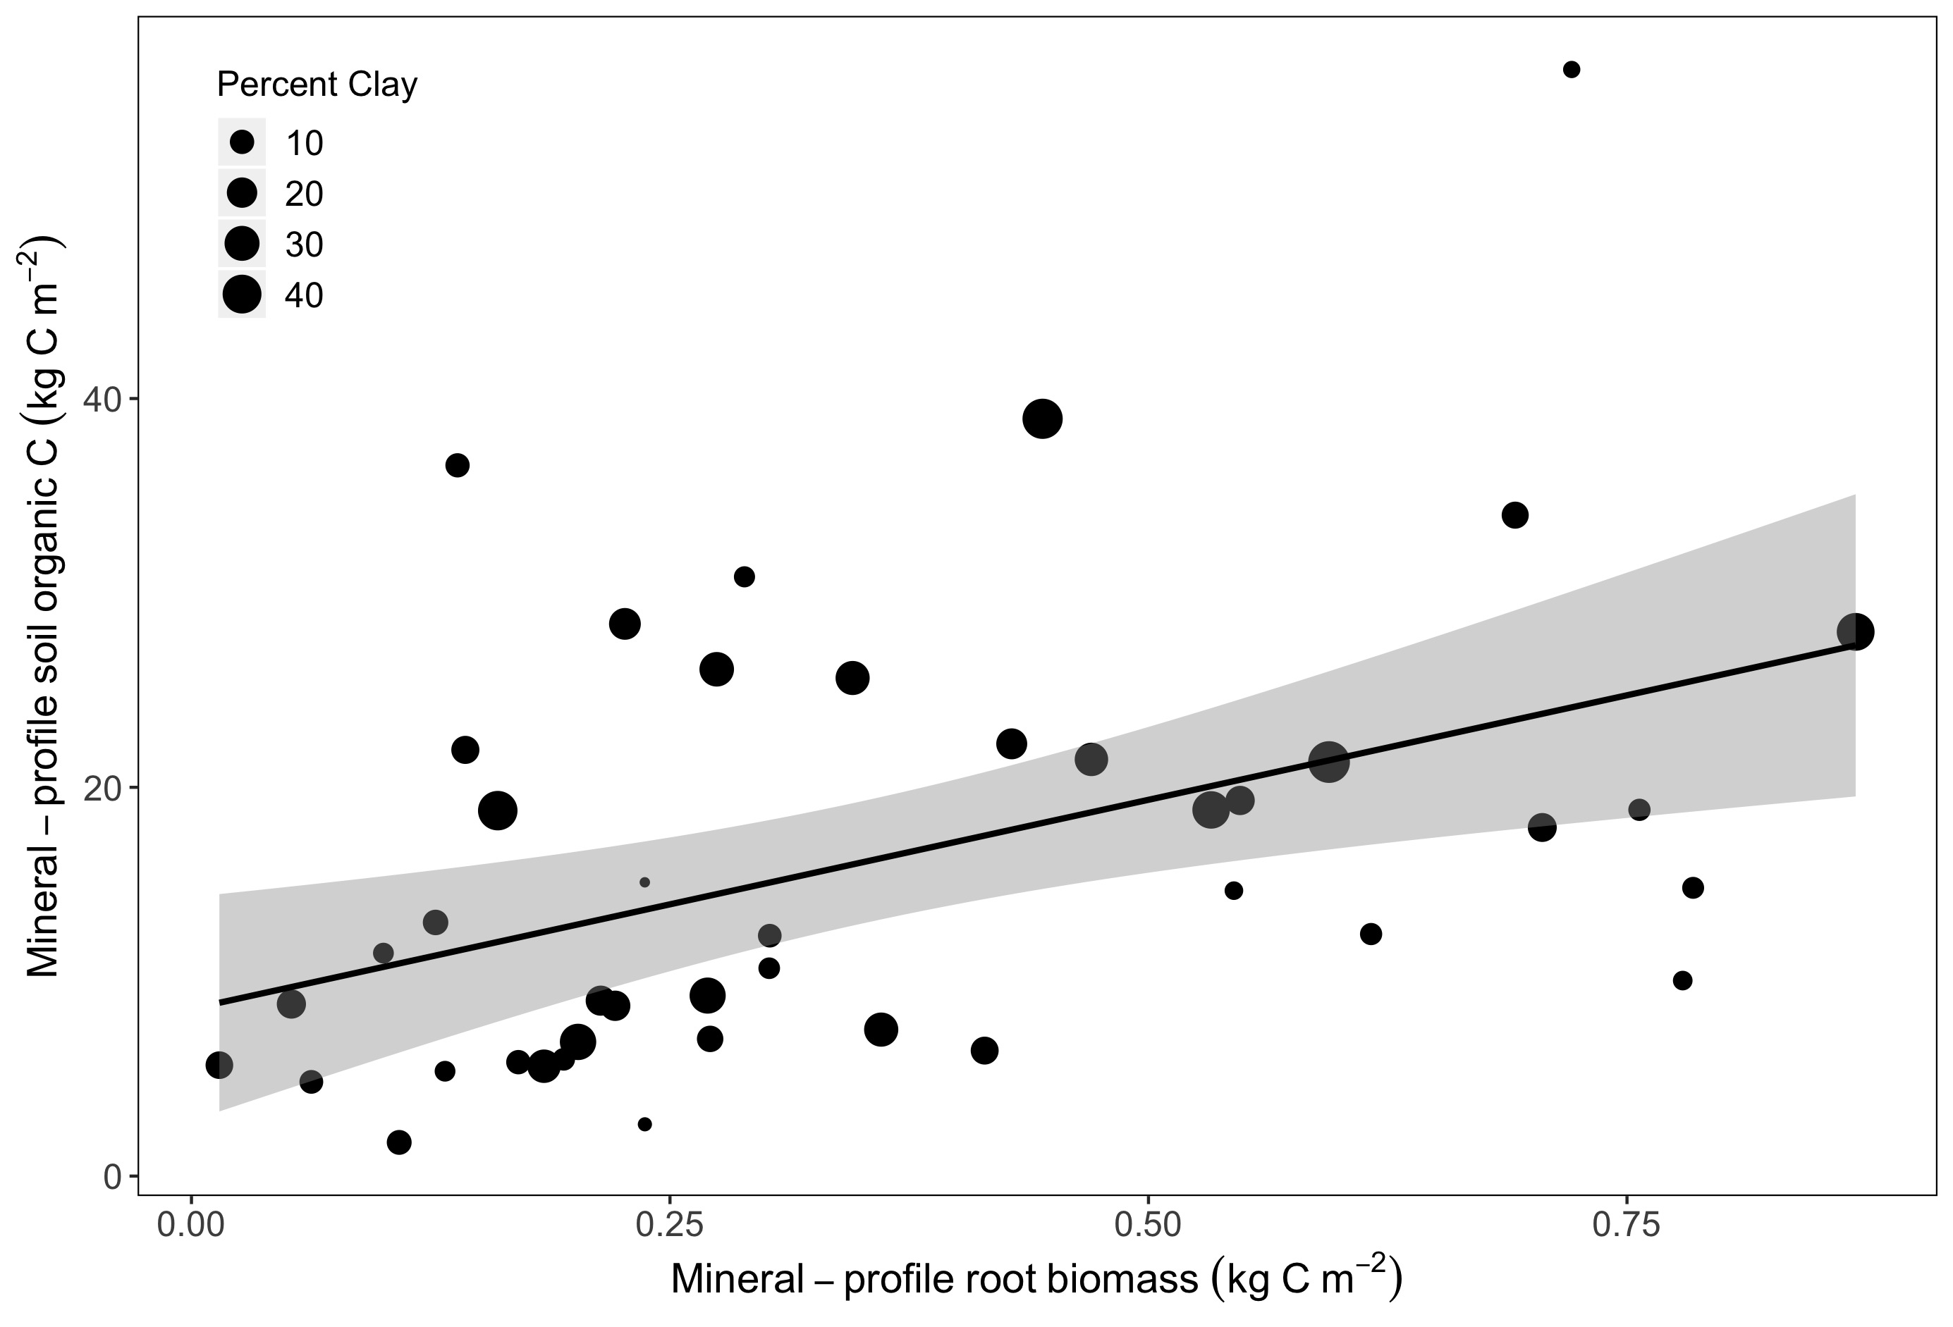
Supp Fig1b. Mineral horizon SOC stock is related to root biomass, land cover, MAT, and clay

Slide 6
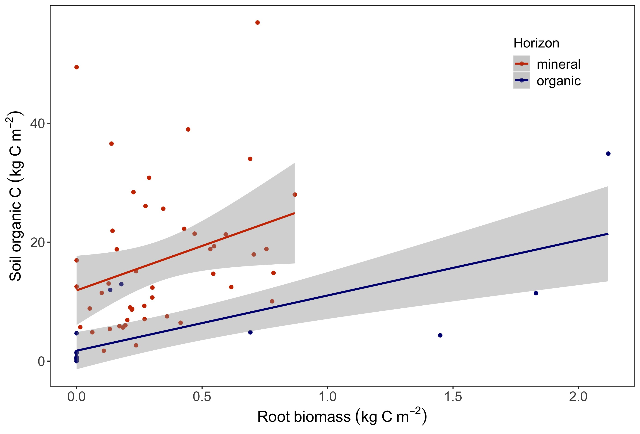
Fig 2. The relationship between root biomass and SOC varies between organic and mineral horizons

Slide 7
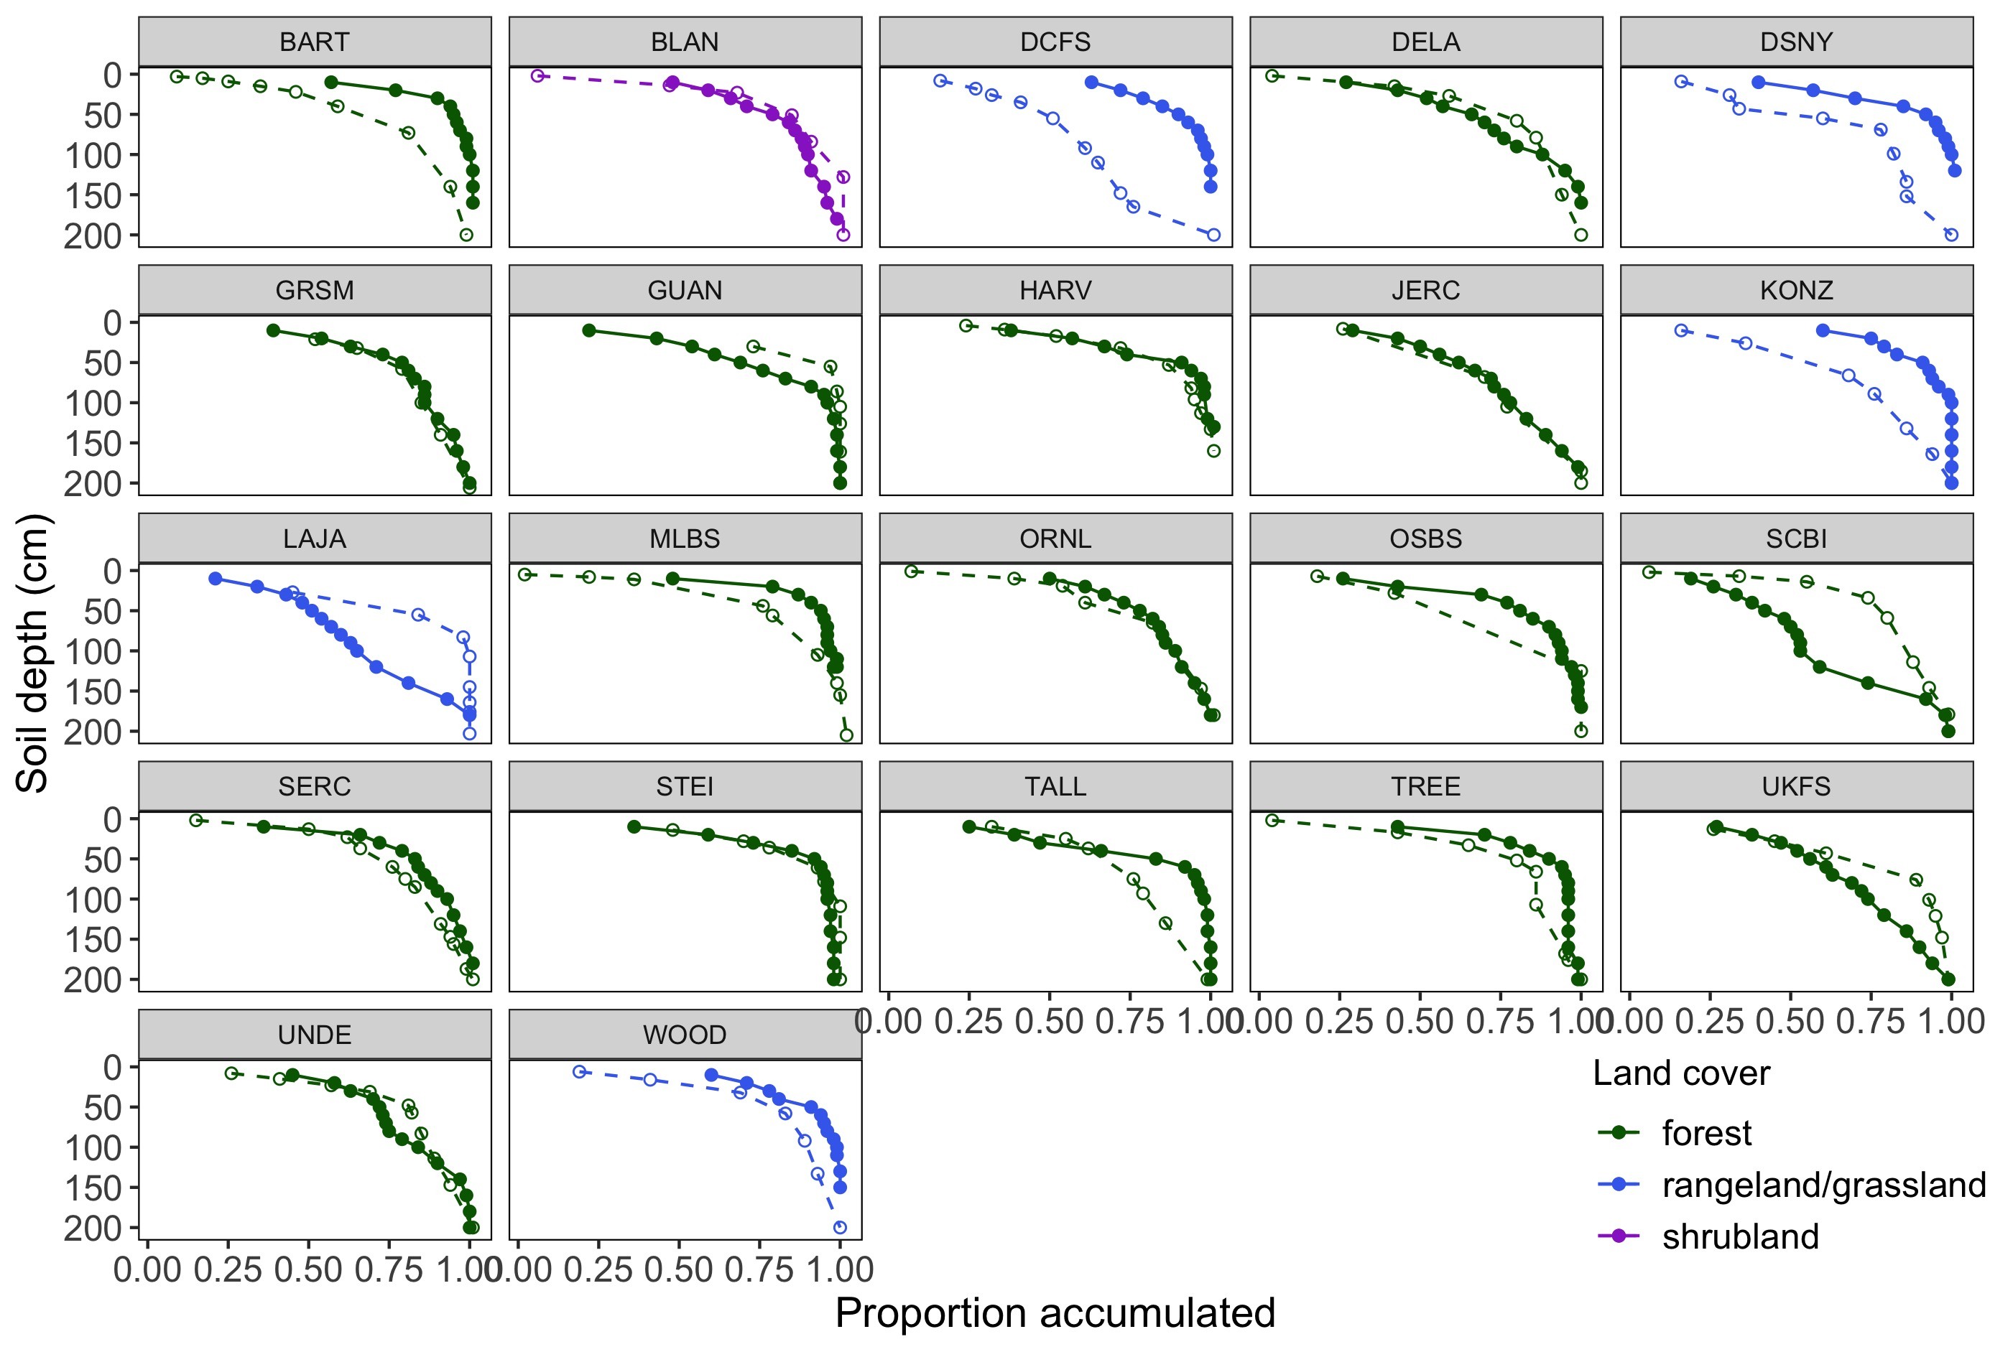
Fig 2. The relationship between root biomass and SOC varies between organic and mineral horizons

Slide 8
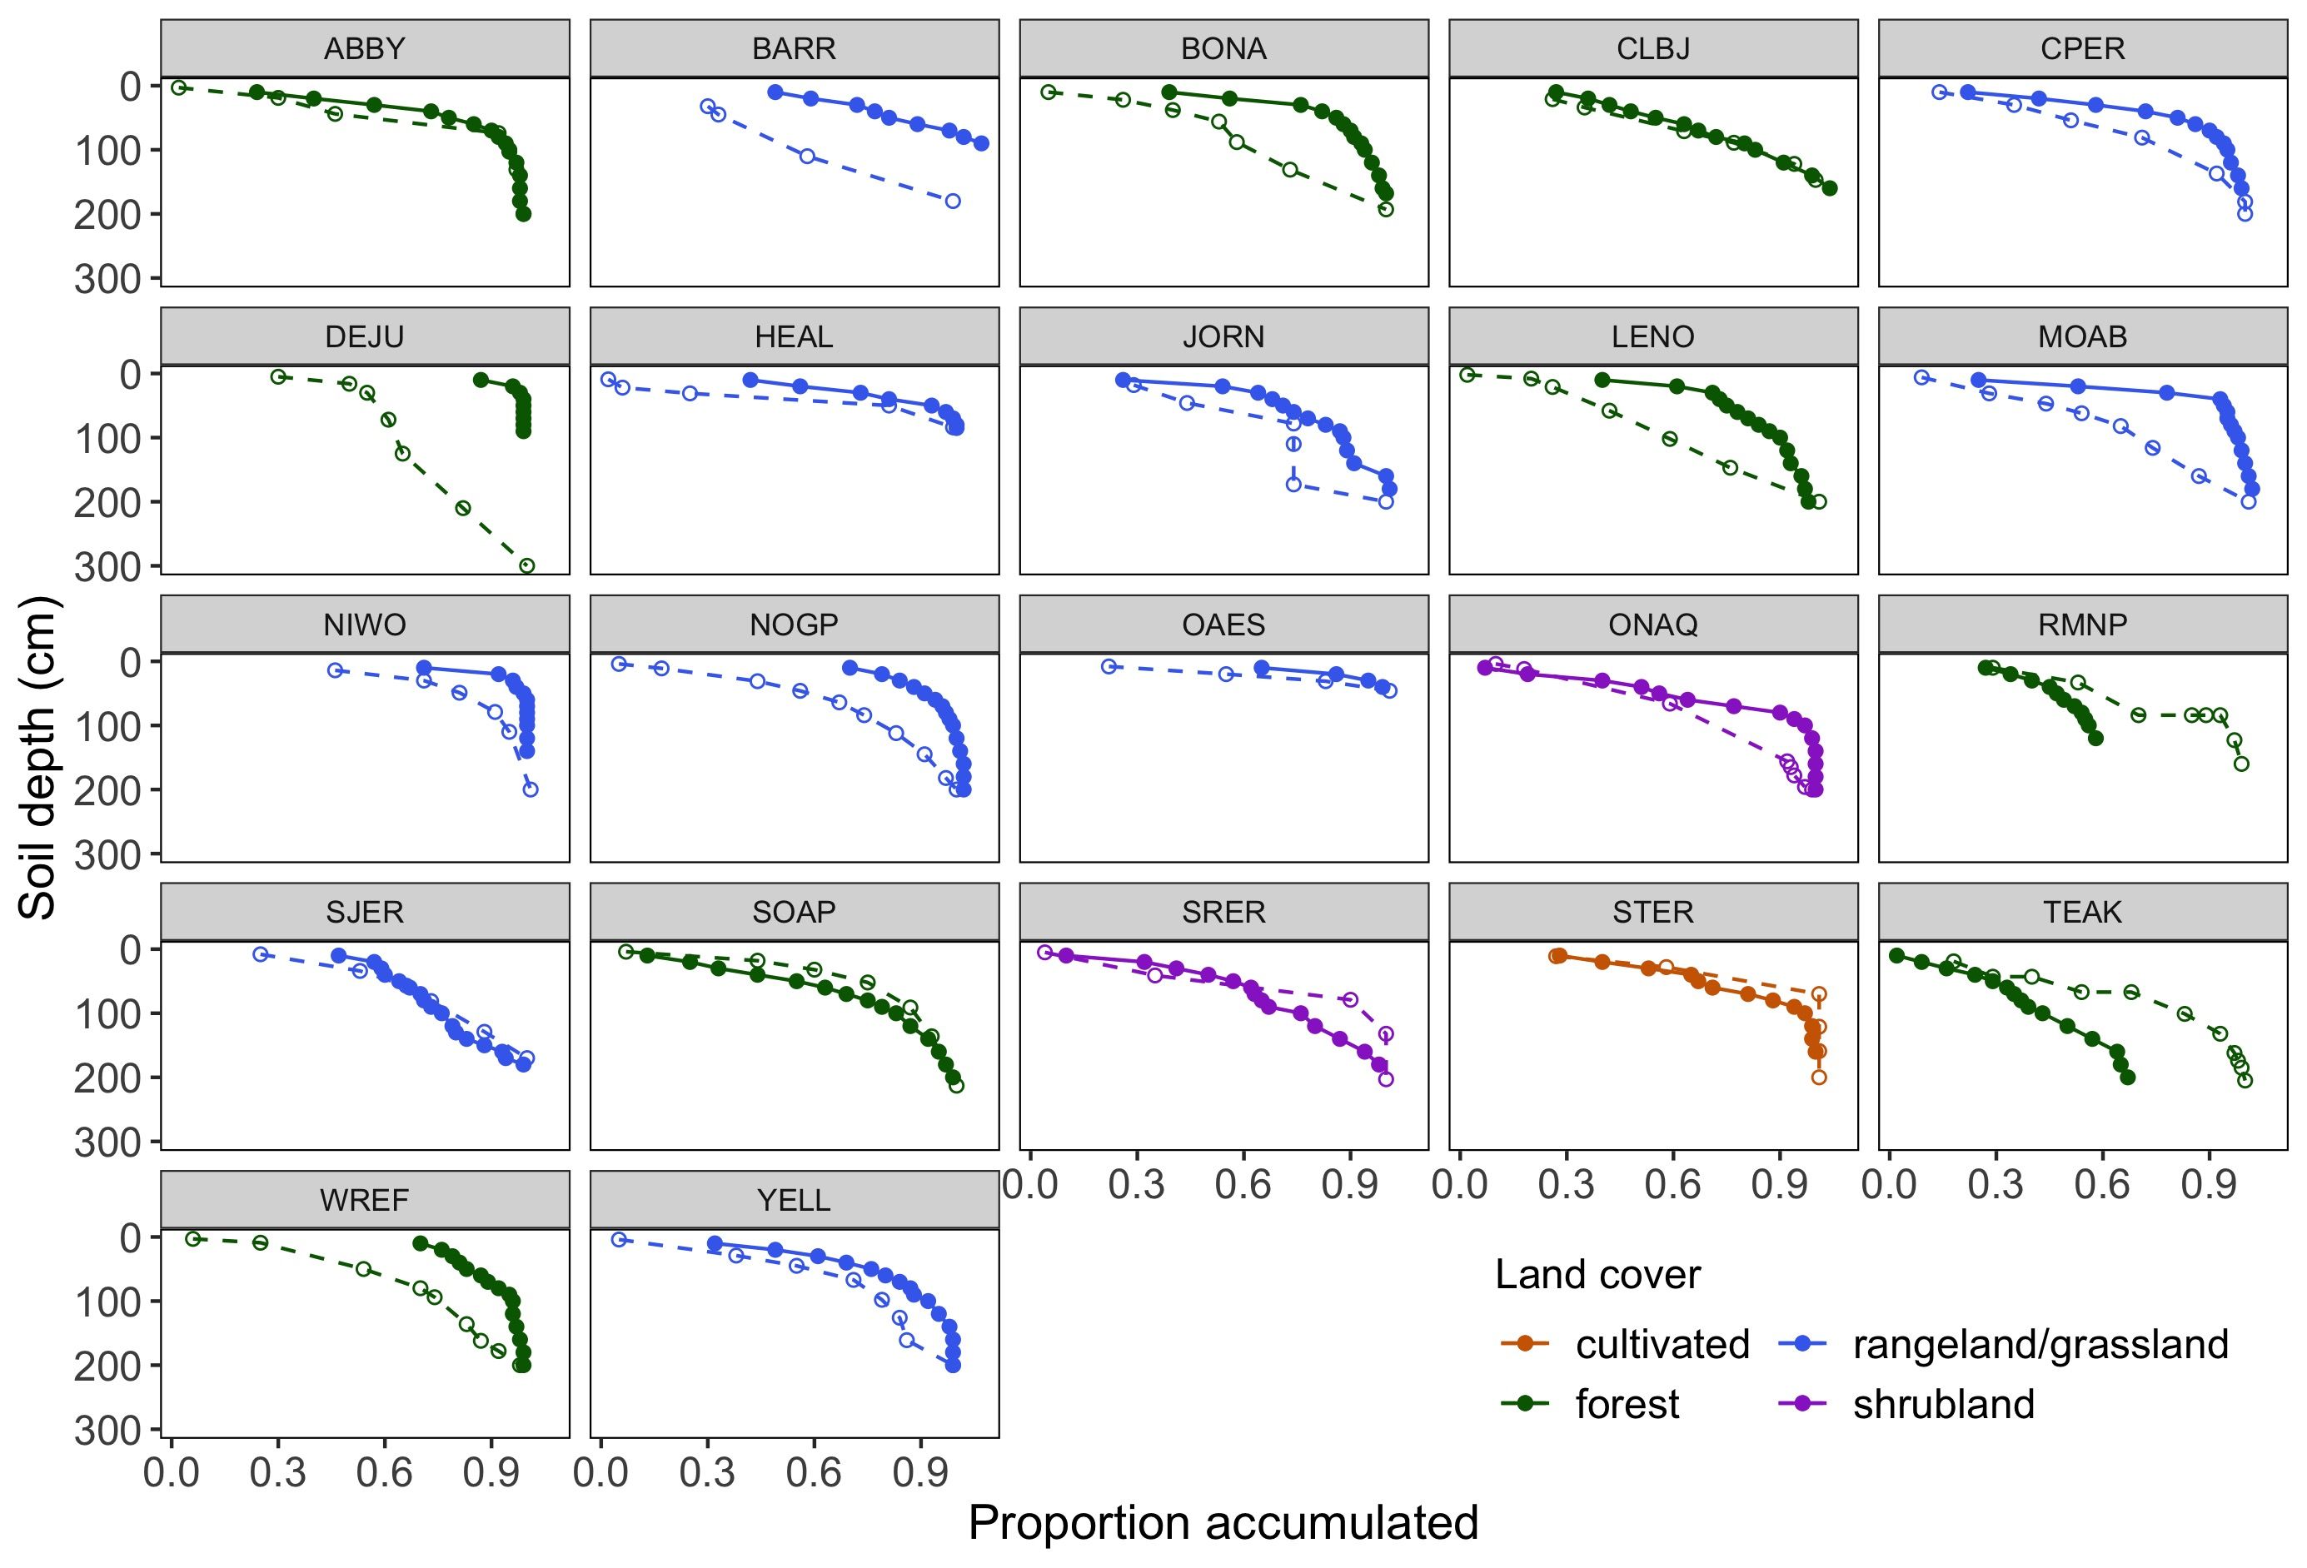

Slide 9
Fig 2. The relationship between root biomass and SOC varies between organic and mineral horizons

Slide 10
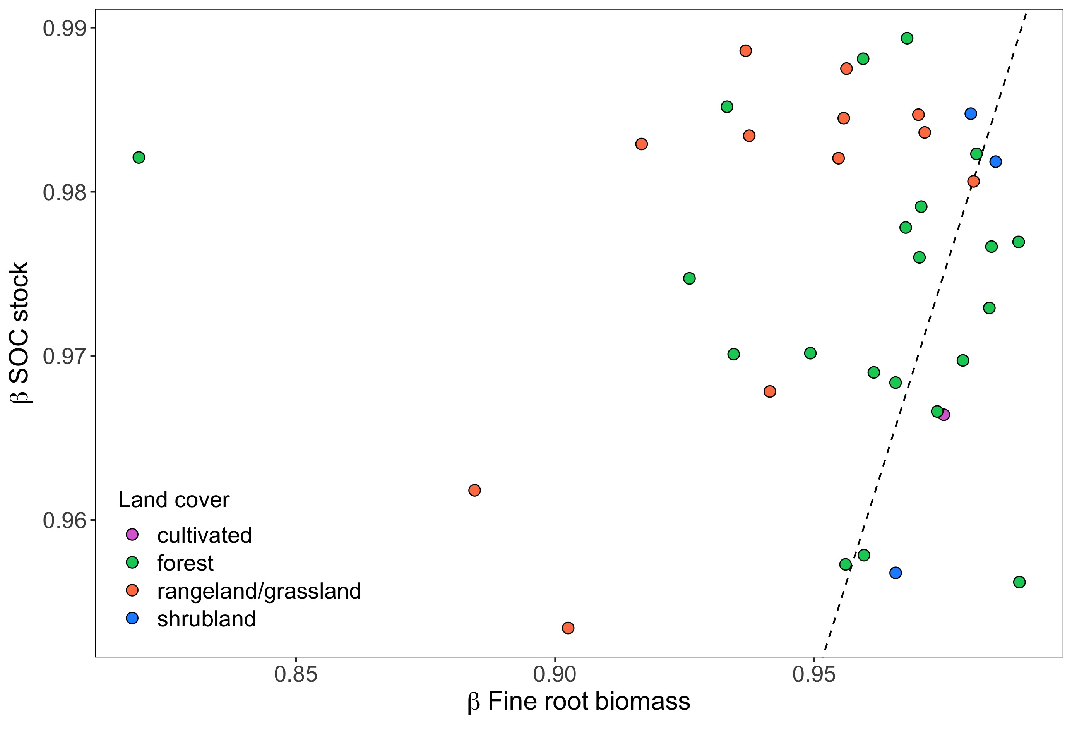
Fig 3a. Beta coefficients for roots and SOC through depth profiles (O+M) depend on land cover
Post-hoc Tests
R/g vs shrub: P = 0.04
R/g vs forest: P = 0.09
Shrub vs forest: P > 0.1

Slide 11
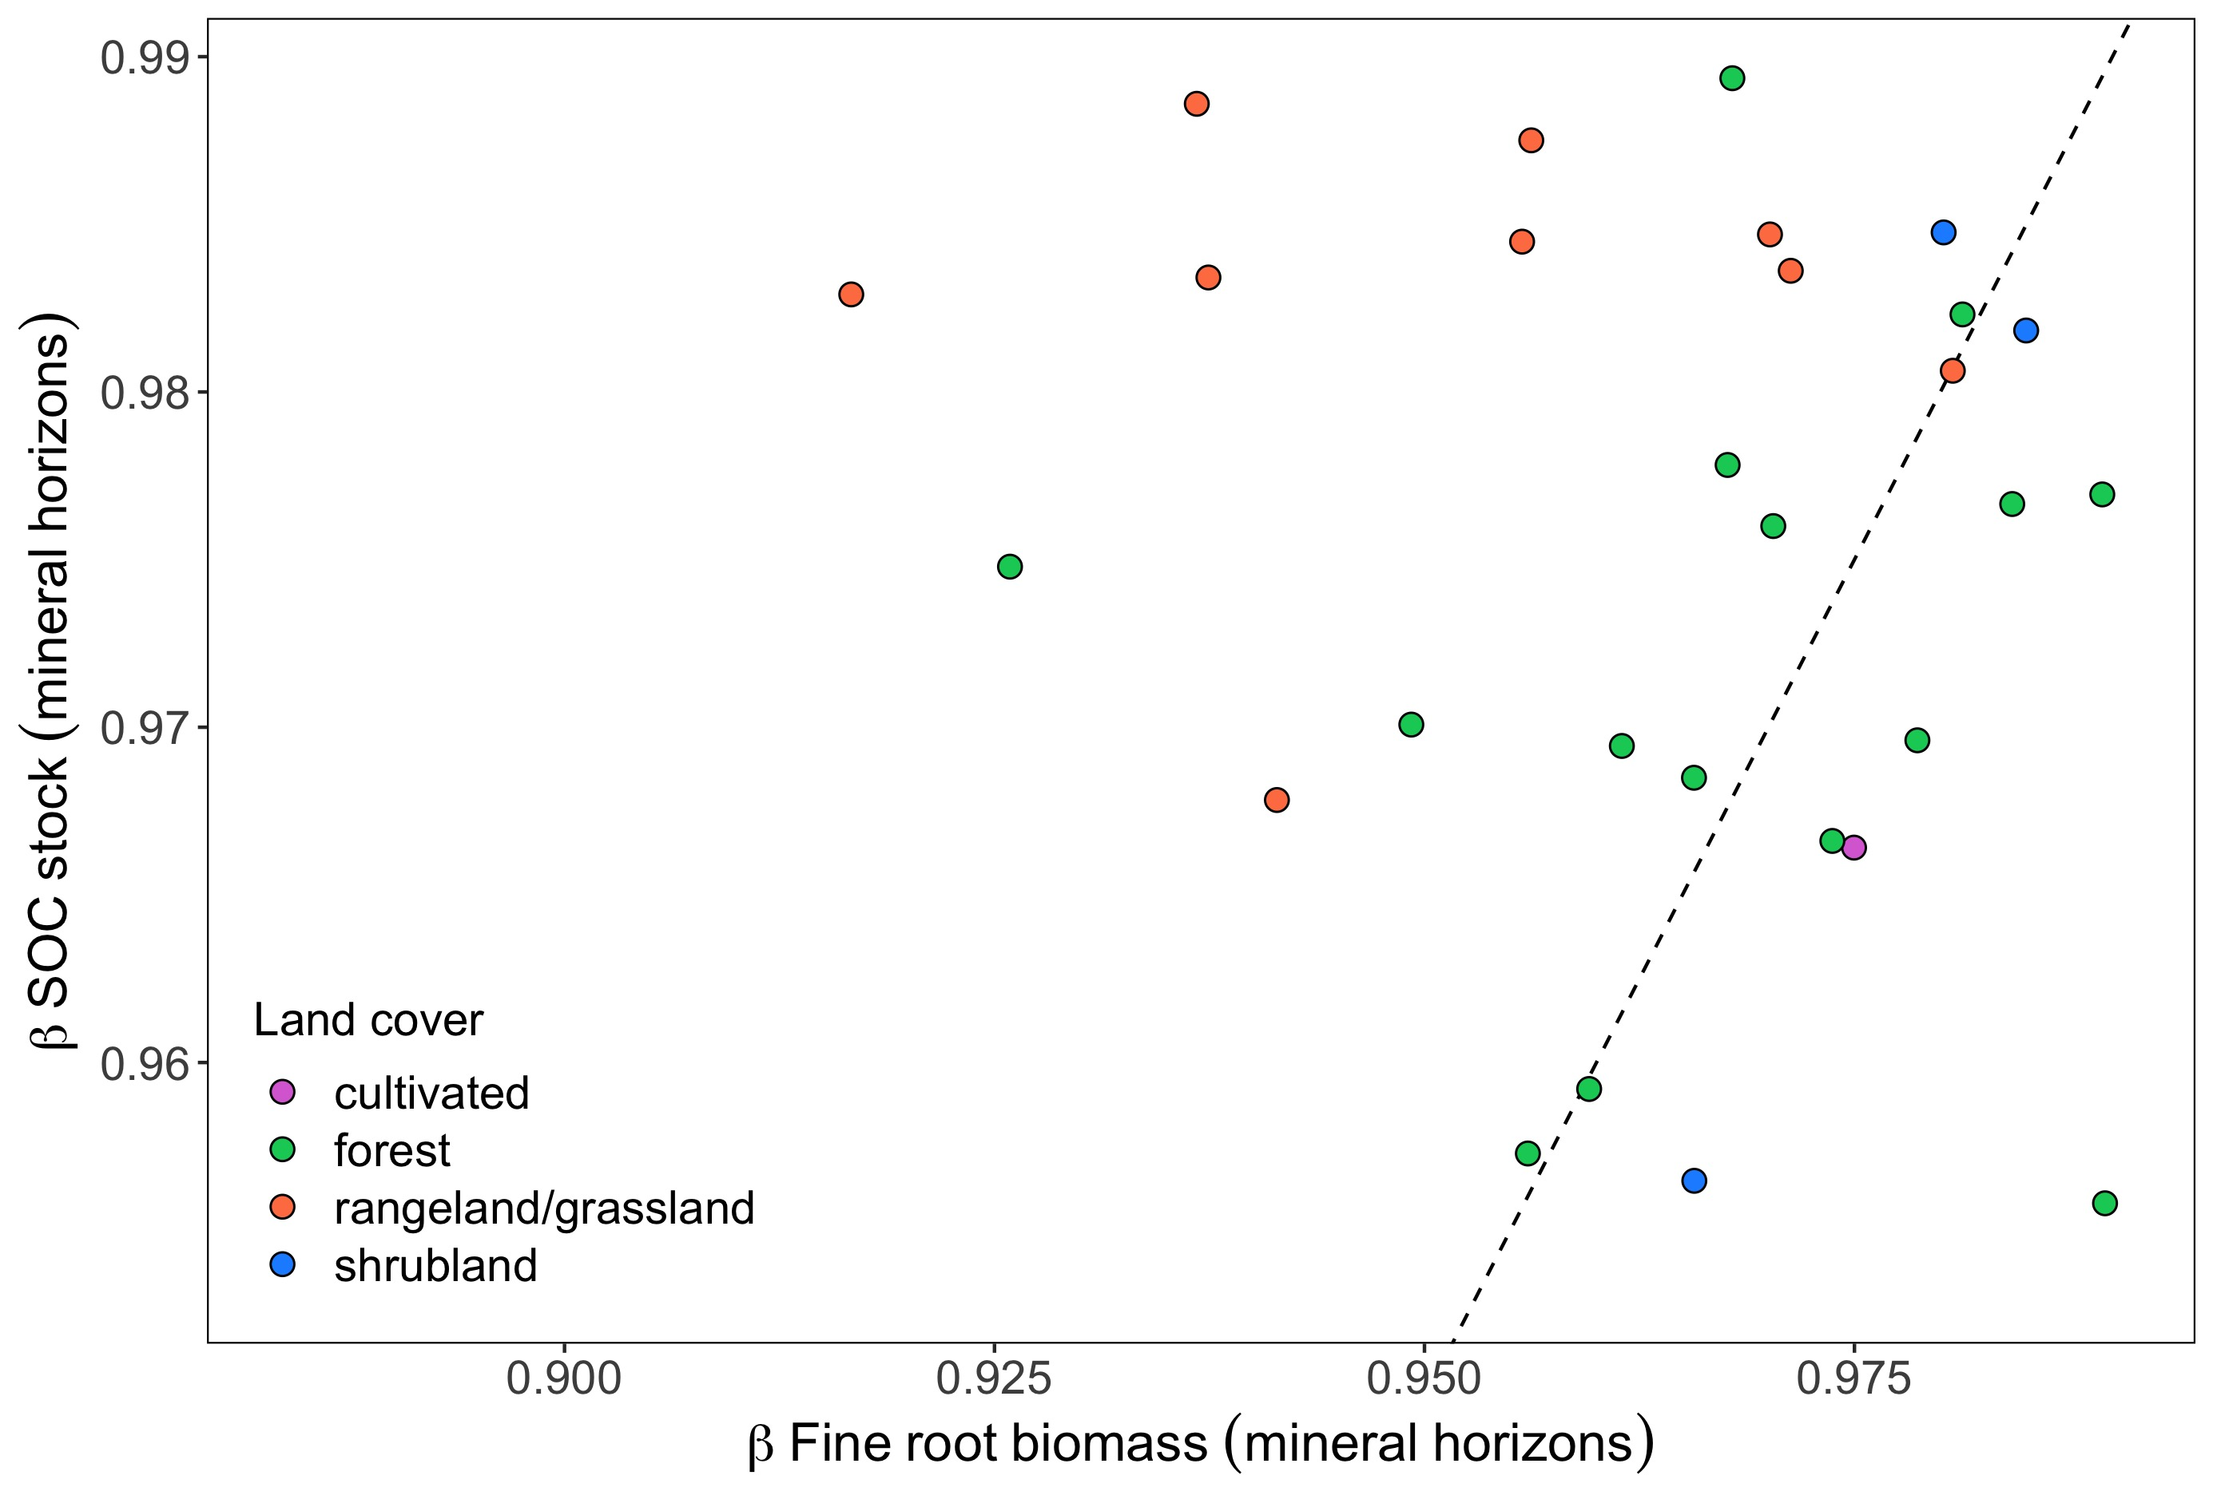
Fig 3b. Beta coefficients for roots and SOC through depth profiles depend on land cover, clay, and (marginally) on MAP
Mineral horizons
Post-hoc Tests
R/g vs shrub: P = 0.03
R/g vs forest: P = 0.03
Shrub vs forest: P > 0.1

