Slide 1
Root Group Figures
Jessica Moore
3-11-20

Slide 2
Is SOC a function of root biomass? What factors govern this relationship?
Is whole-profile SOC a function of root biomass?
Does the function vary among landcover types, horizon, climate, or edaphic properties?
Does SOC and root biomass accumulate through the soil profile similarly (i.e., beta coefficients are similar)?
Does the beta correlation vary among landcover types, horizon, climate, or edaphic properties?

Slide 3
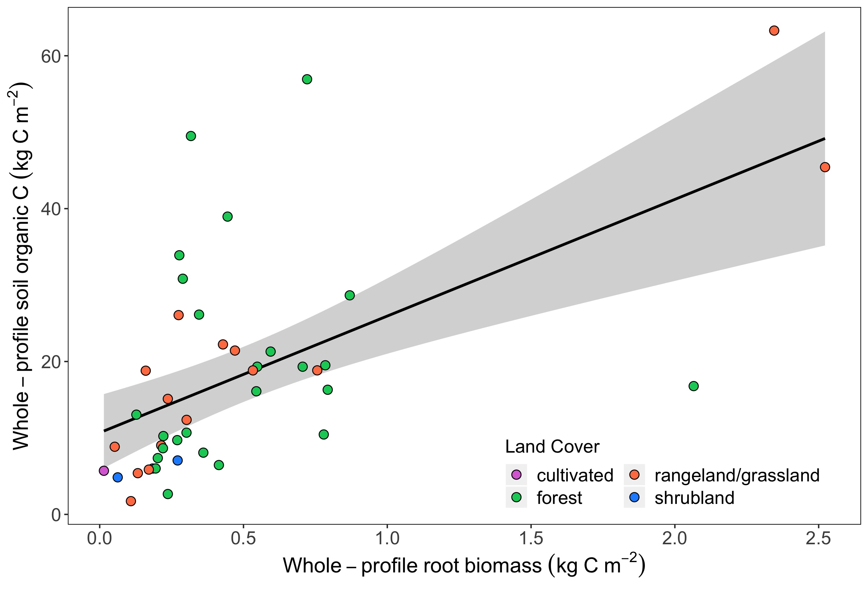
Fig 1a. Total SOC stock is related to root biomass, land cover, MAT, and clay
P < 0.001
X² = 34.46
R² = 0.39
Notes:
Far right points are BARR and HEAL; both included in the O horizon data sets

Slide 4
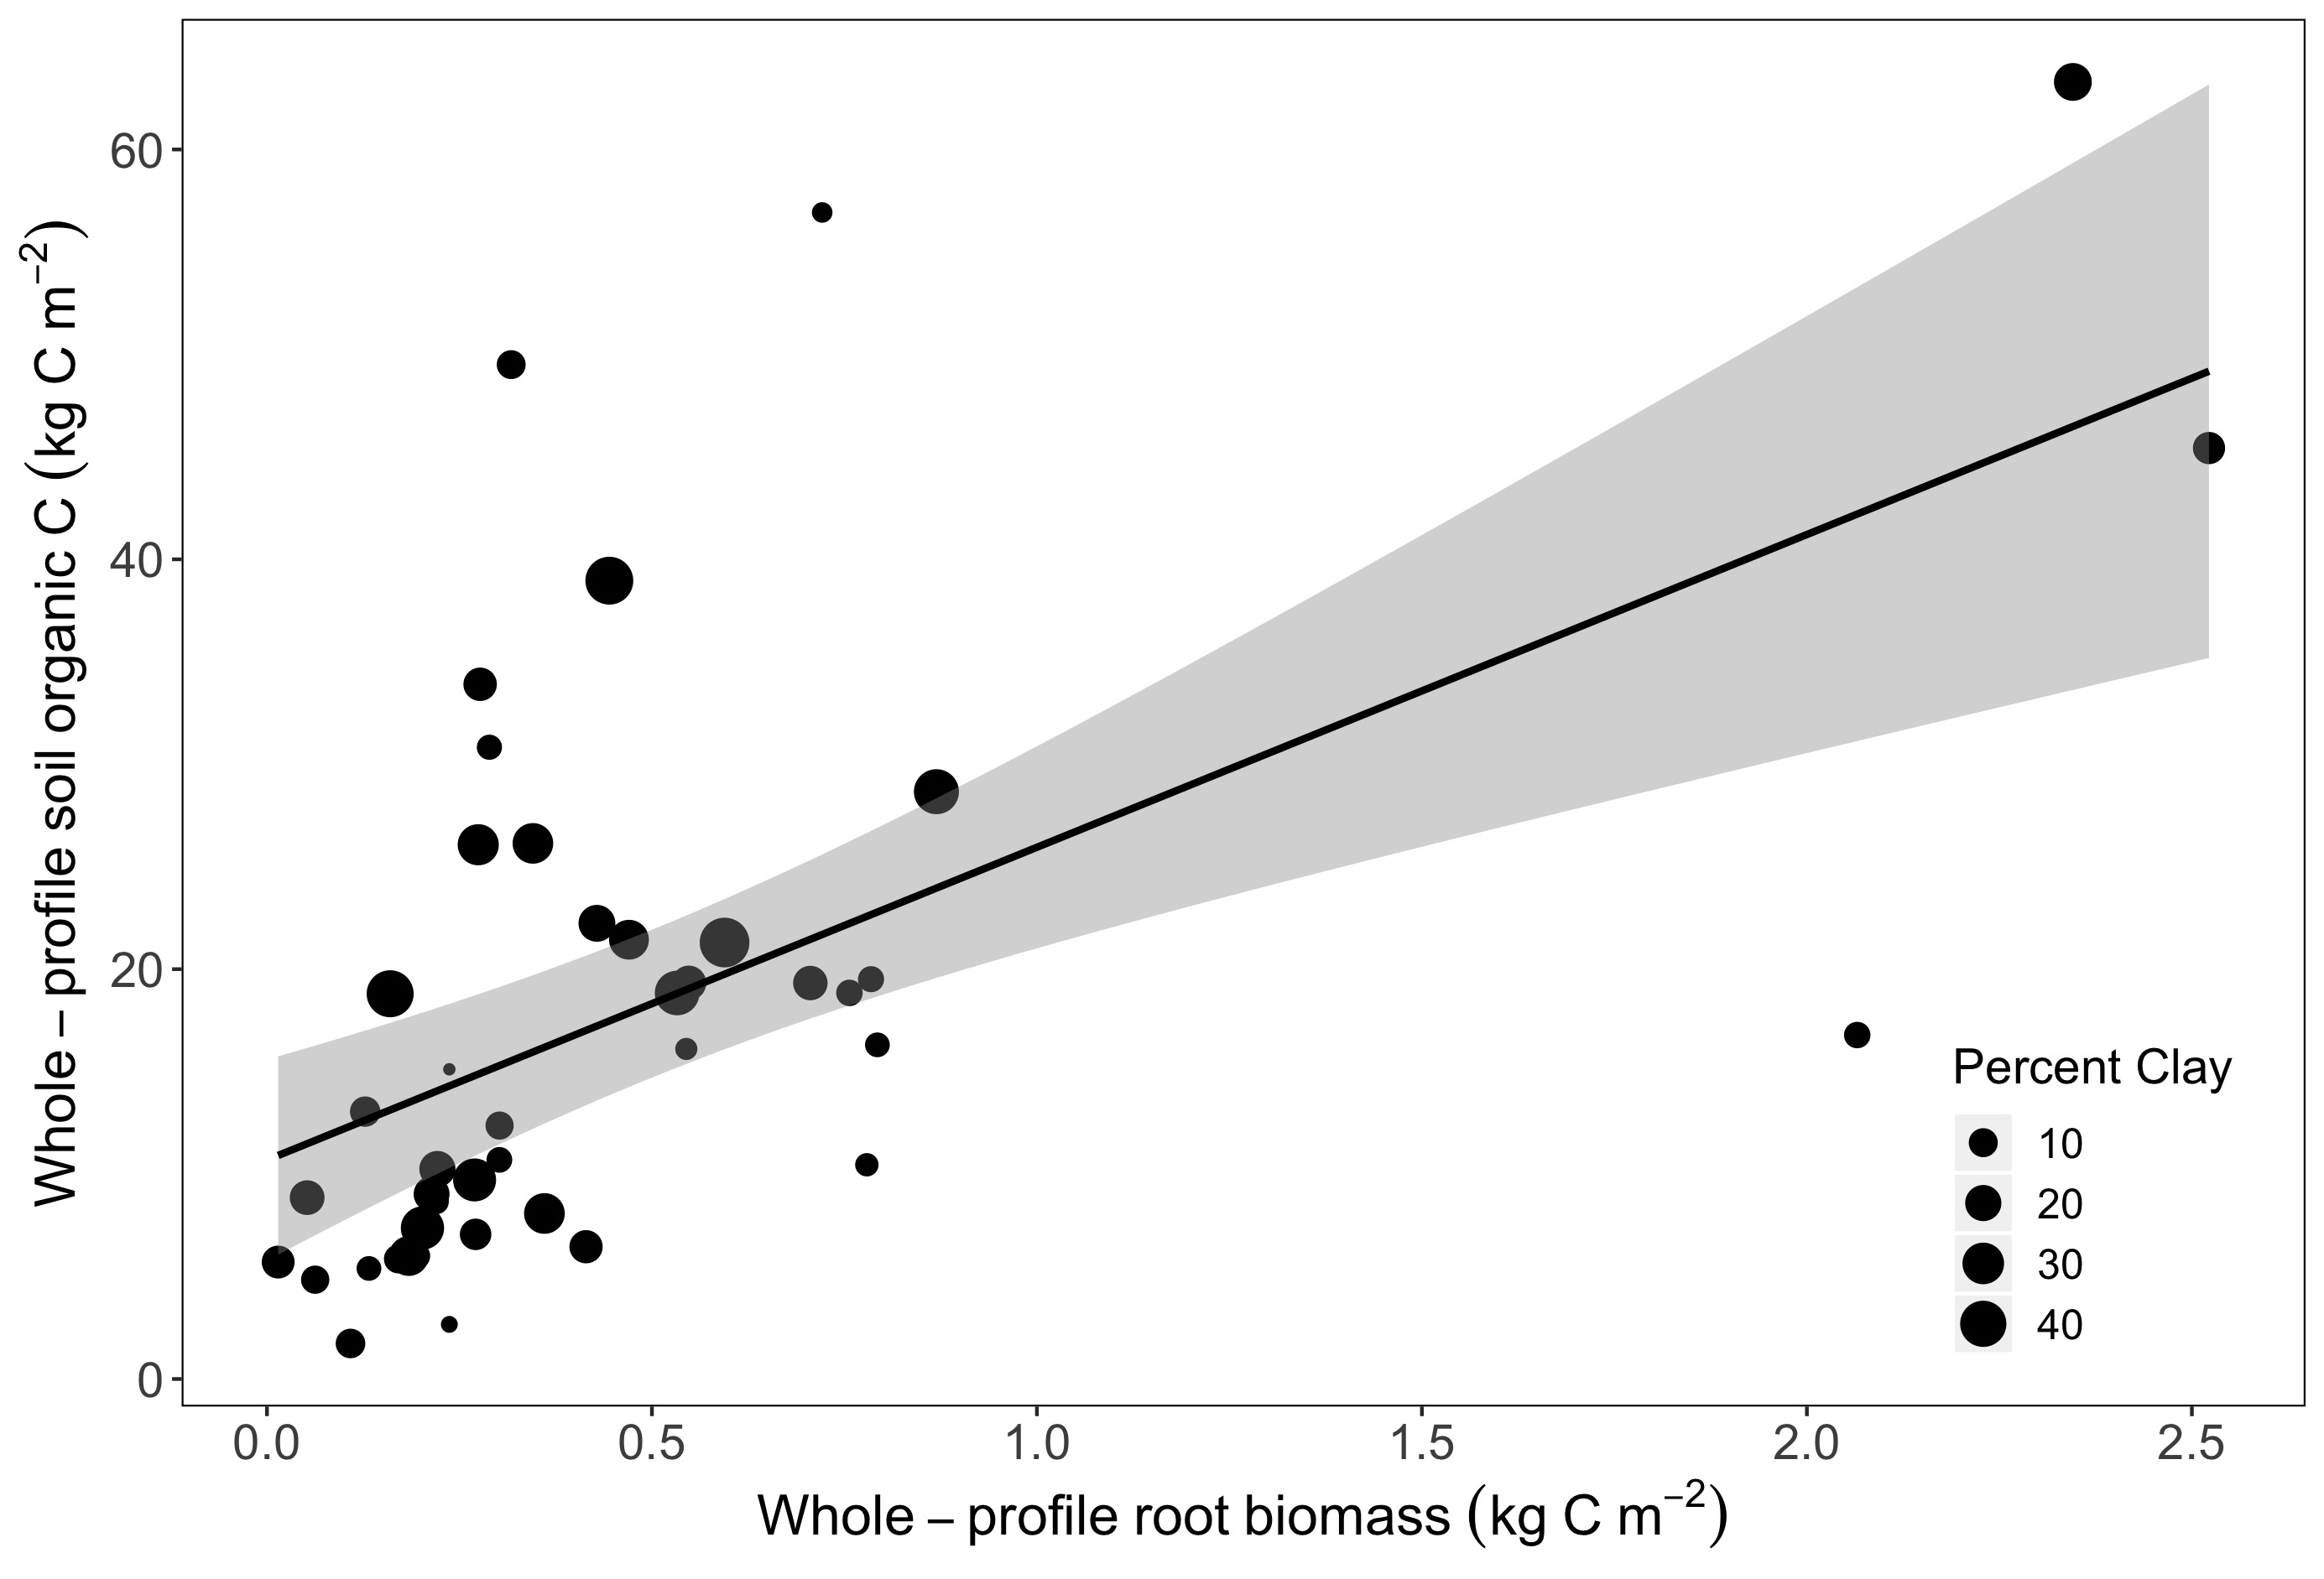
Fig 1b. Total SOC stock is related to root biomass, land cover, MAT, and clay
P < 0.001
X² = 34.46
R² = 0.39

Slide 5
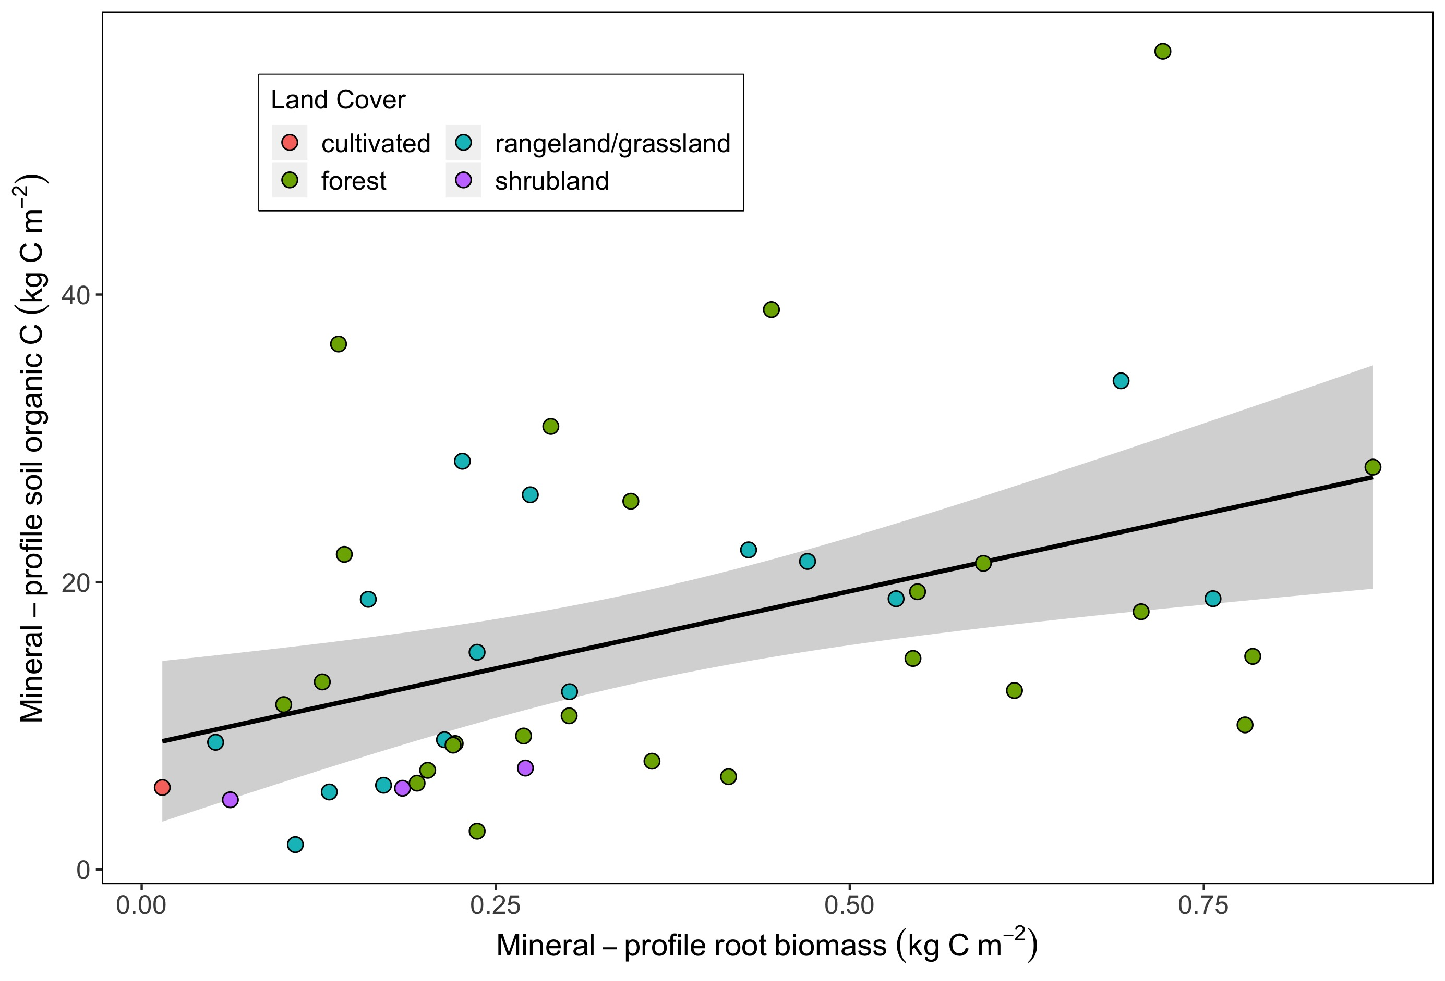
Supp Fig1a. Mineral horizon SOC stock is related to root biomass, land cover, MAT, and clay
P = 0.003
X2 = 19.44
R² = 0.30

Slide 6
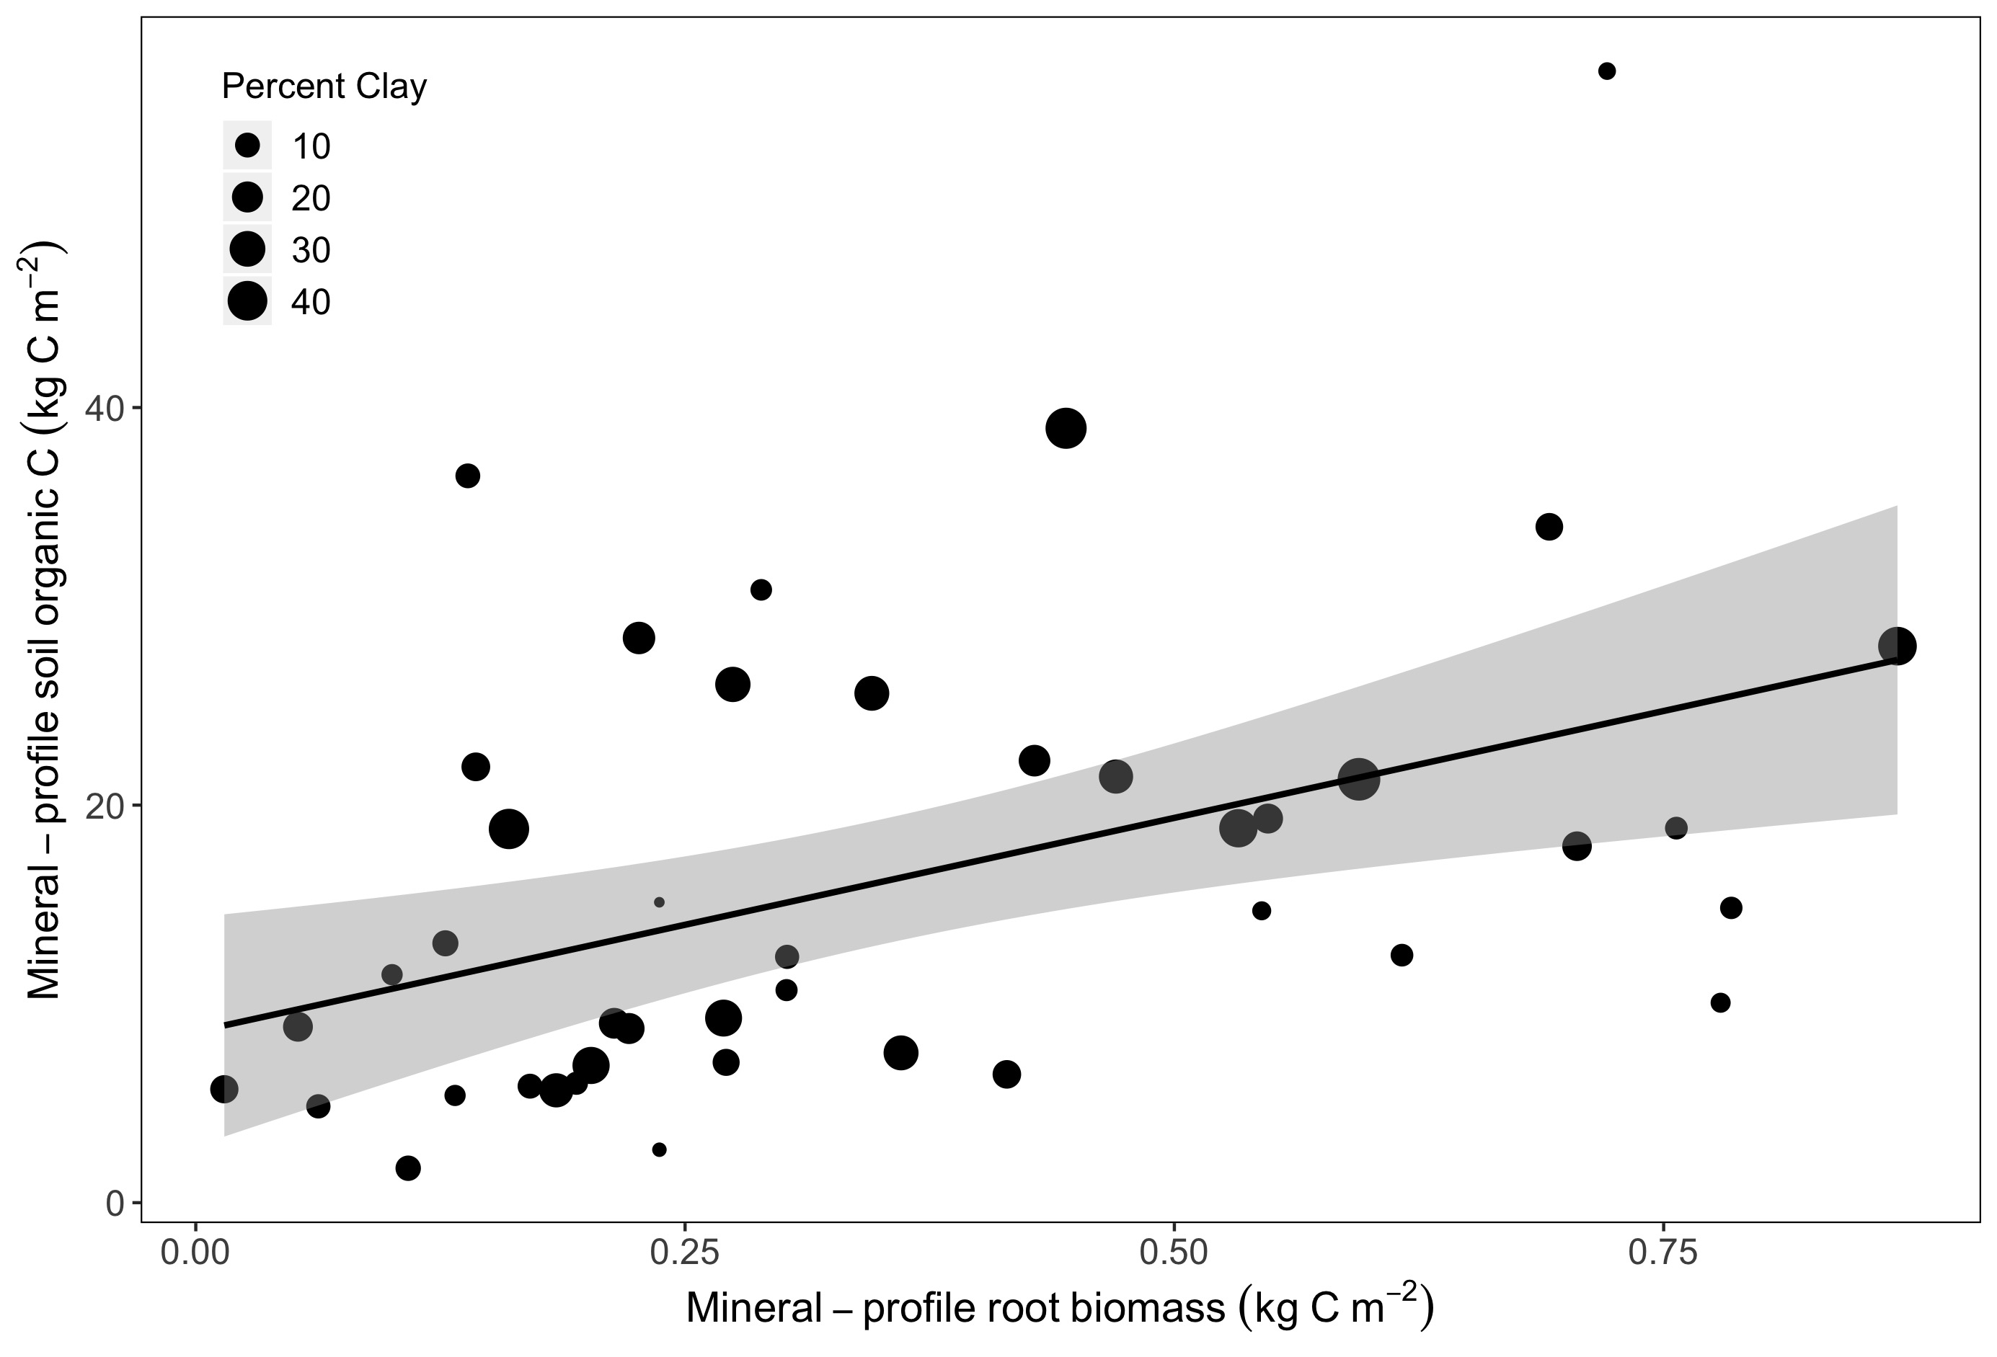
Supp Fig1b. Mineral horizon SOC stock is related to root biomass, land cover, MAT, and clay
P = 0.003
X2 = 19.44
R² = 0.30

Slide 7
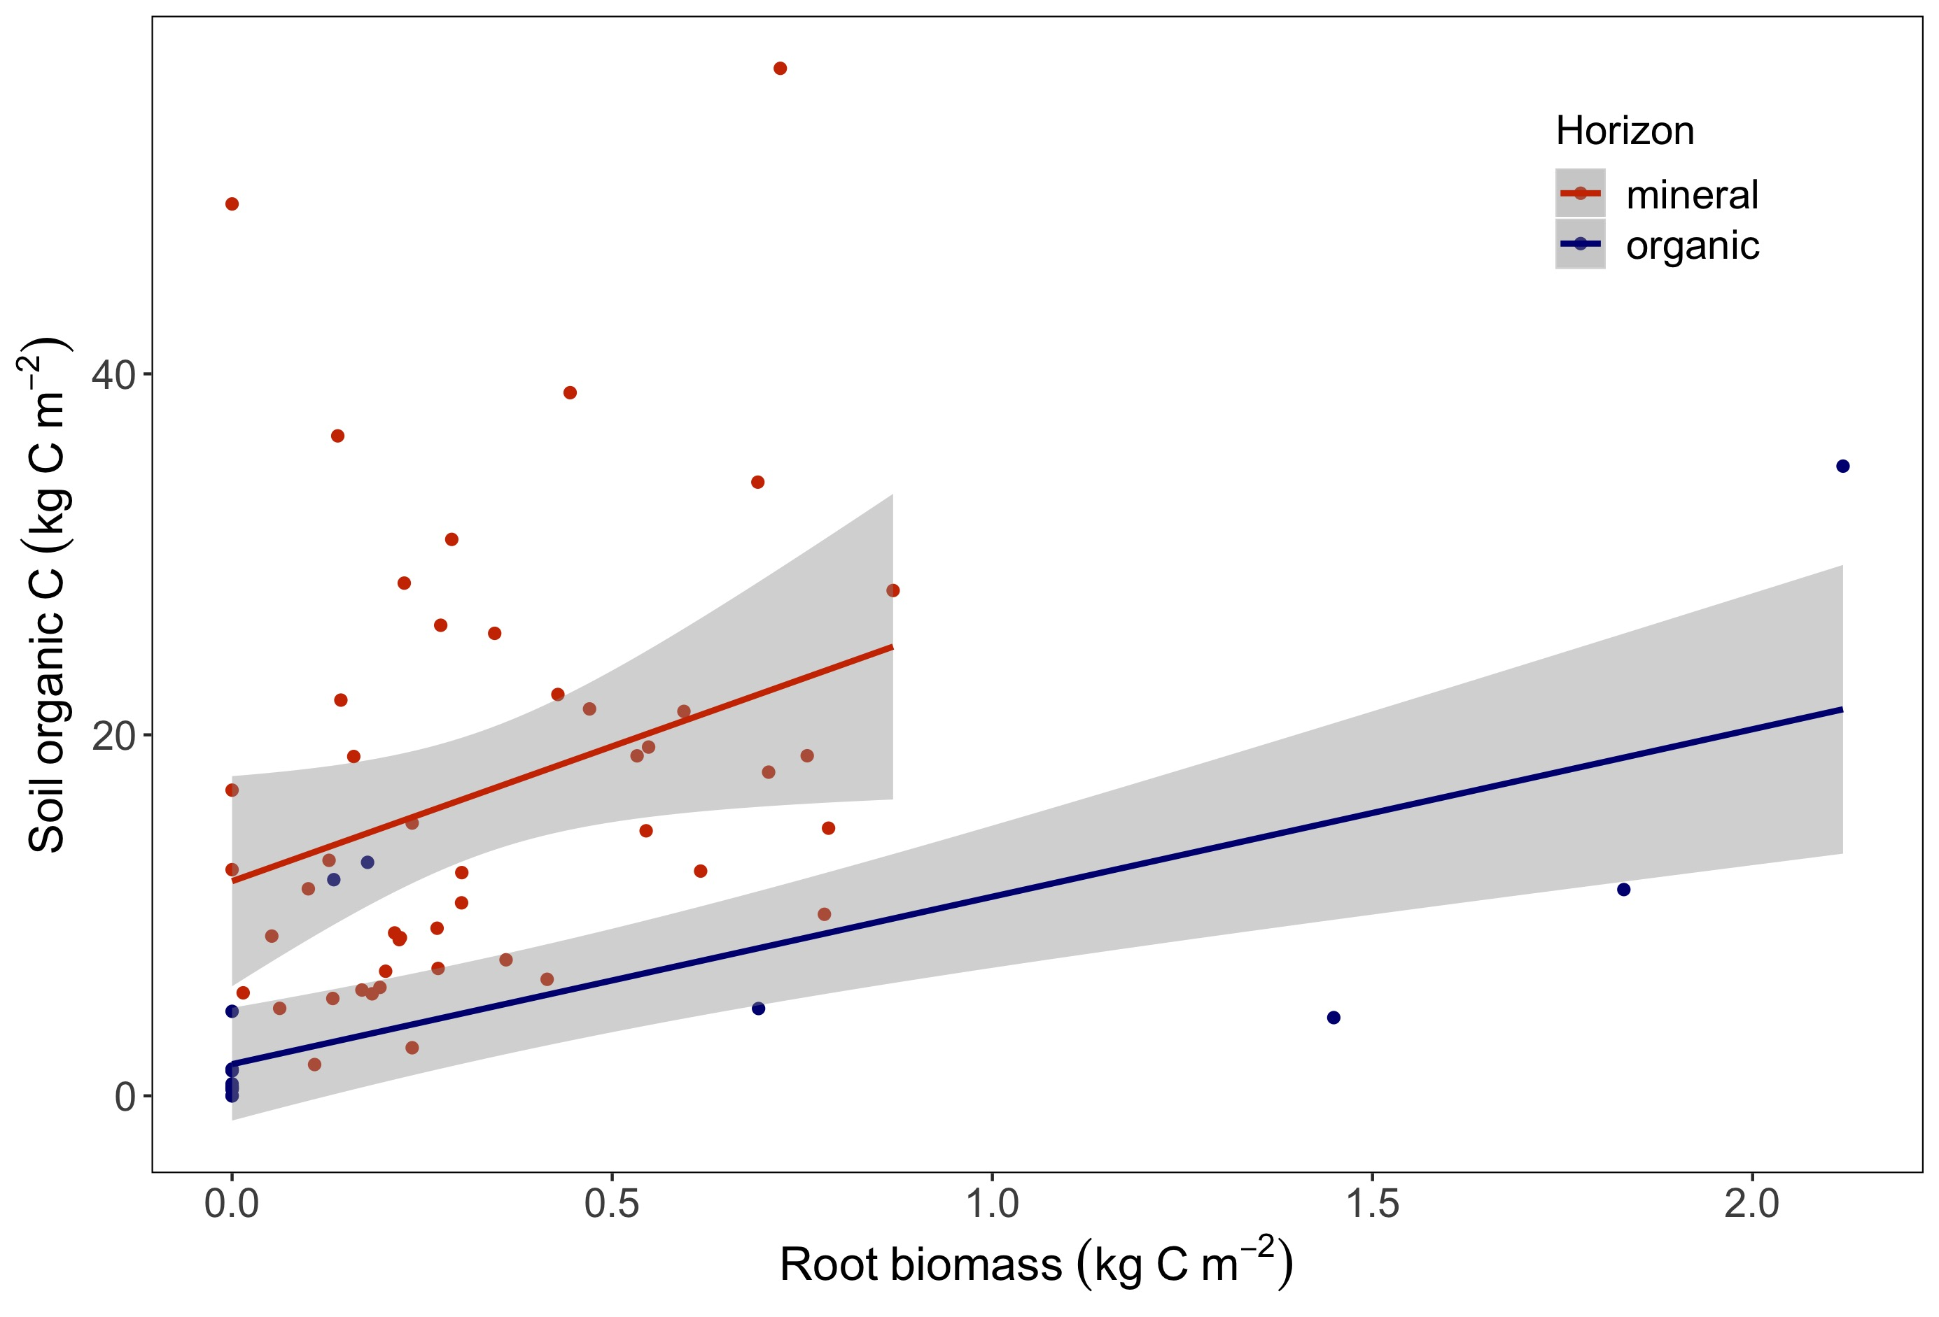
Fig 2. The relationship between root biomass and SOC varies between organic and mineral horizons
P = 0.001
t = 3.85

Slide 8
Is SOC a function of root biomass? What factors govern this relationship?
Is whole-profile SOC a function of root biomass?
Does the function vary among landcover types, horizon, climate, or edaphic properties?
Does SOC and root biomass accumulate through the soil profile similarly (i.e., beta coefficients are similar)?
Does the beta correlation vary among landcover types, horizon, climate, or edaphic properties?

Slide 9
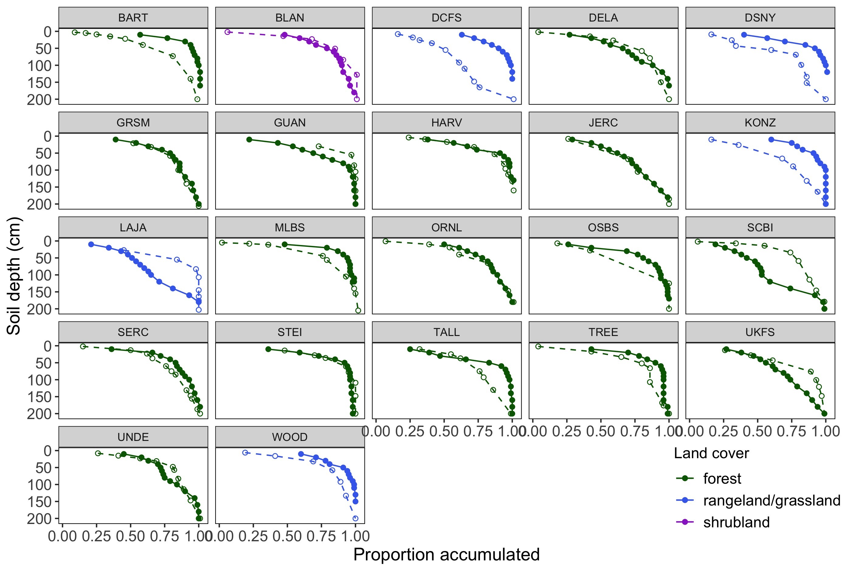
Fig 2. The relationship between root biomass and SOC varies between organic and mineral horizons
Solid = roots
Open = SOC

Slide 10
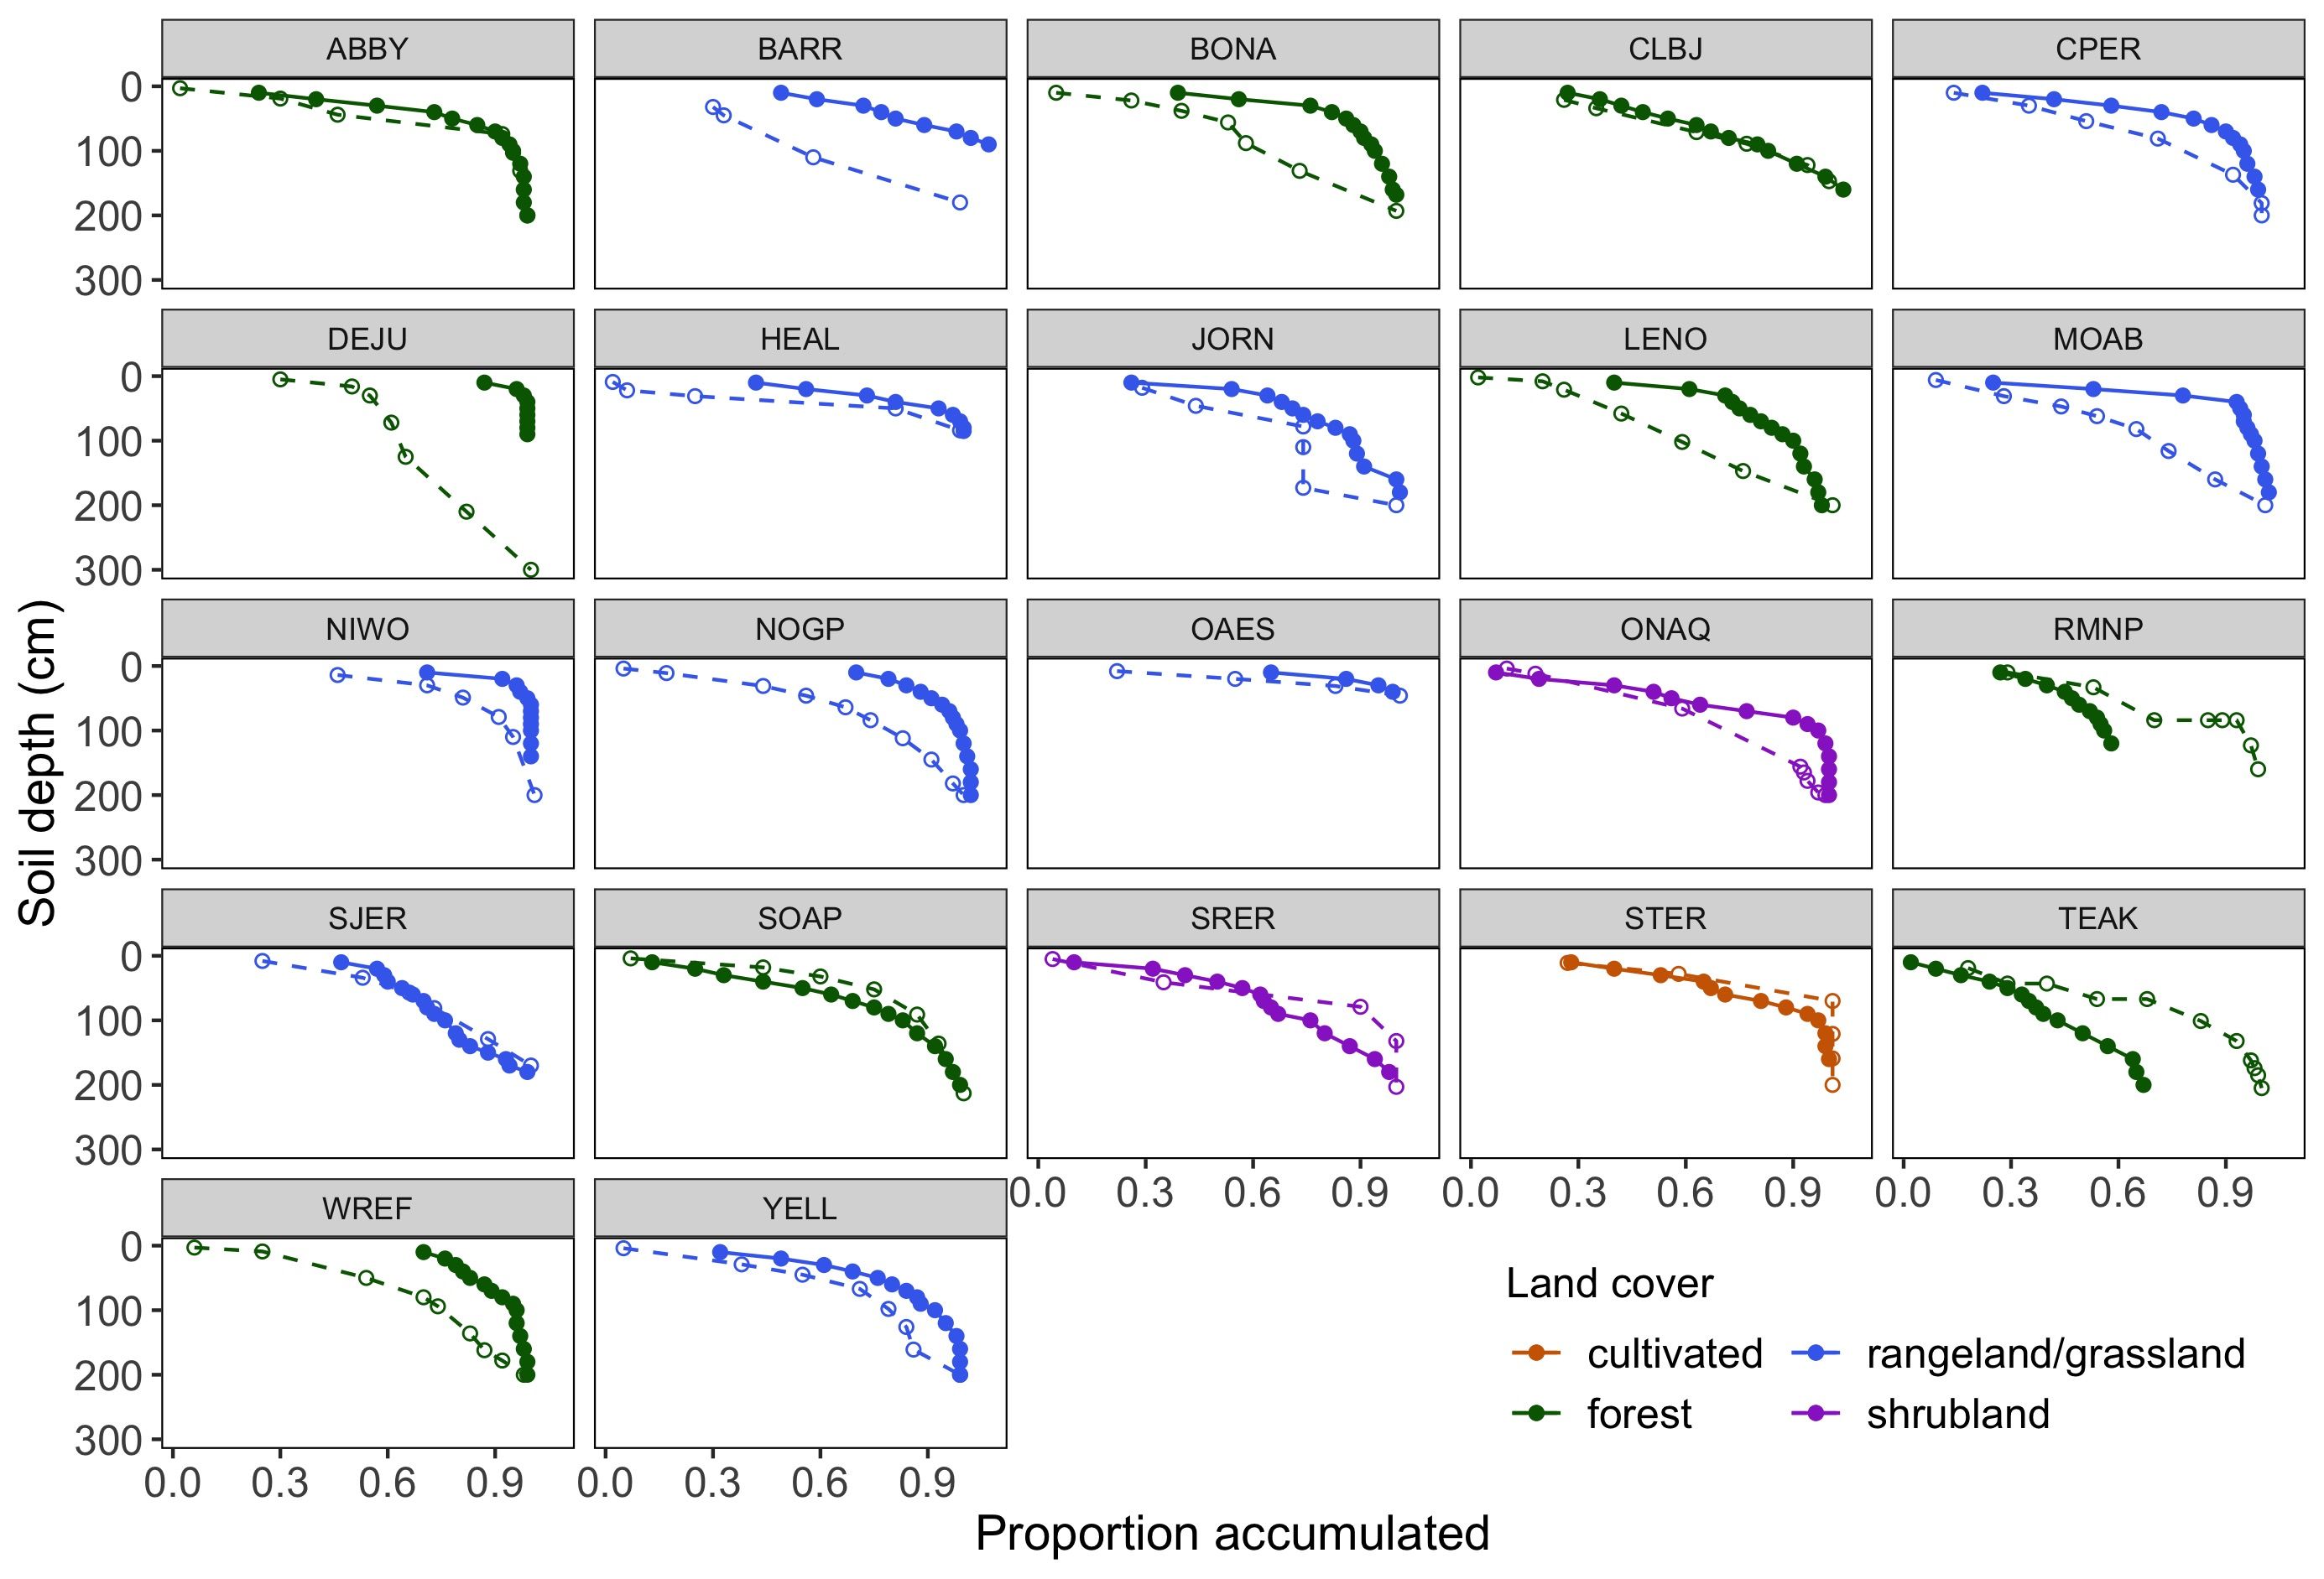
Solid = roots
Open = SOC

Slide 11
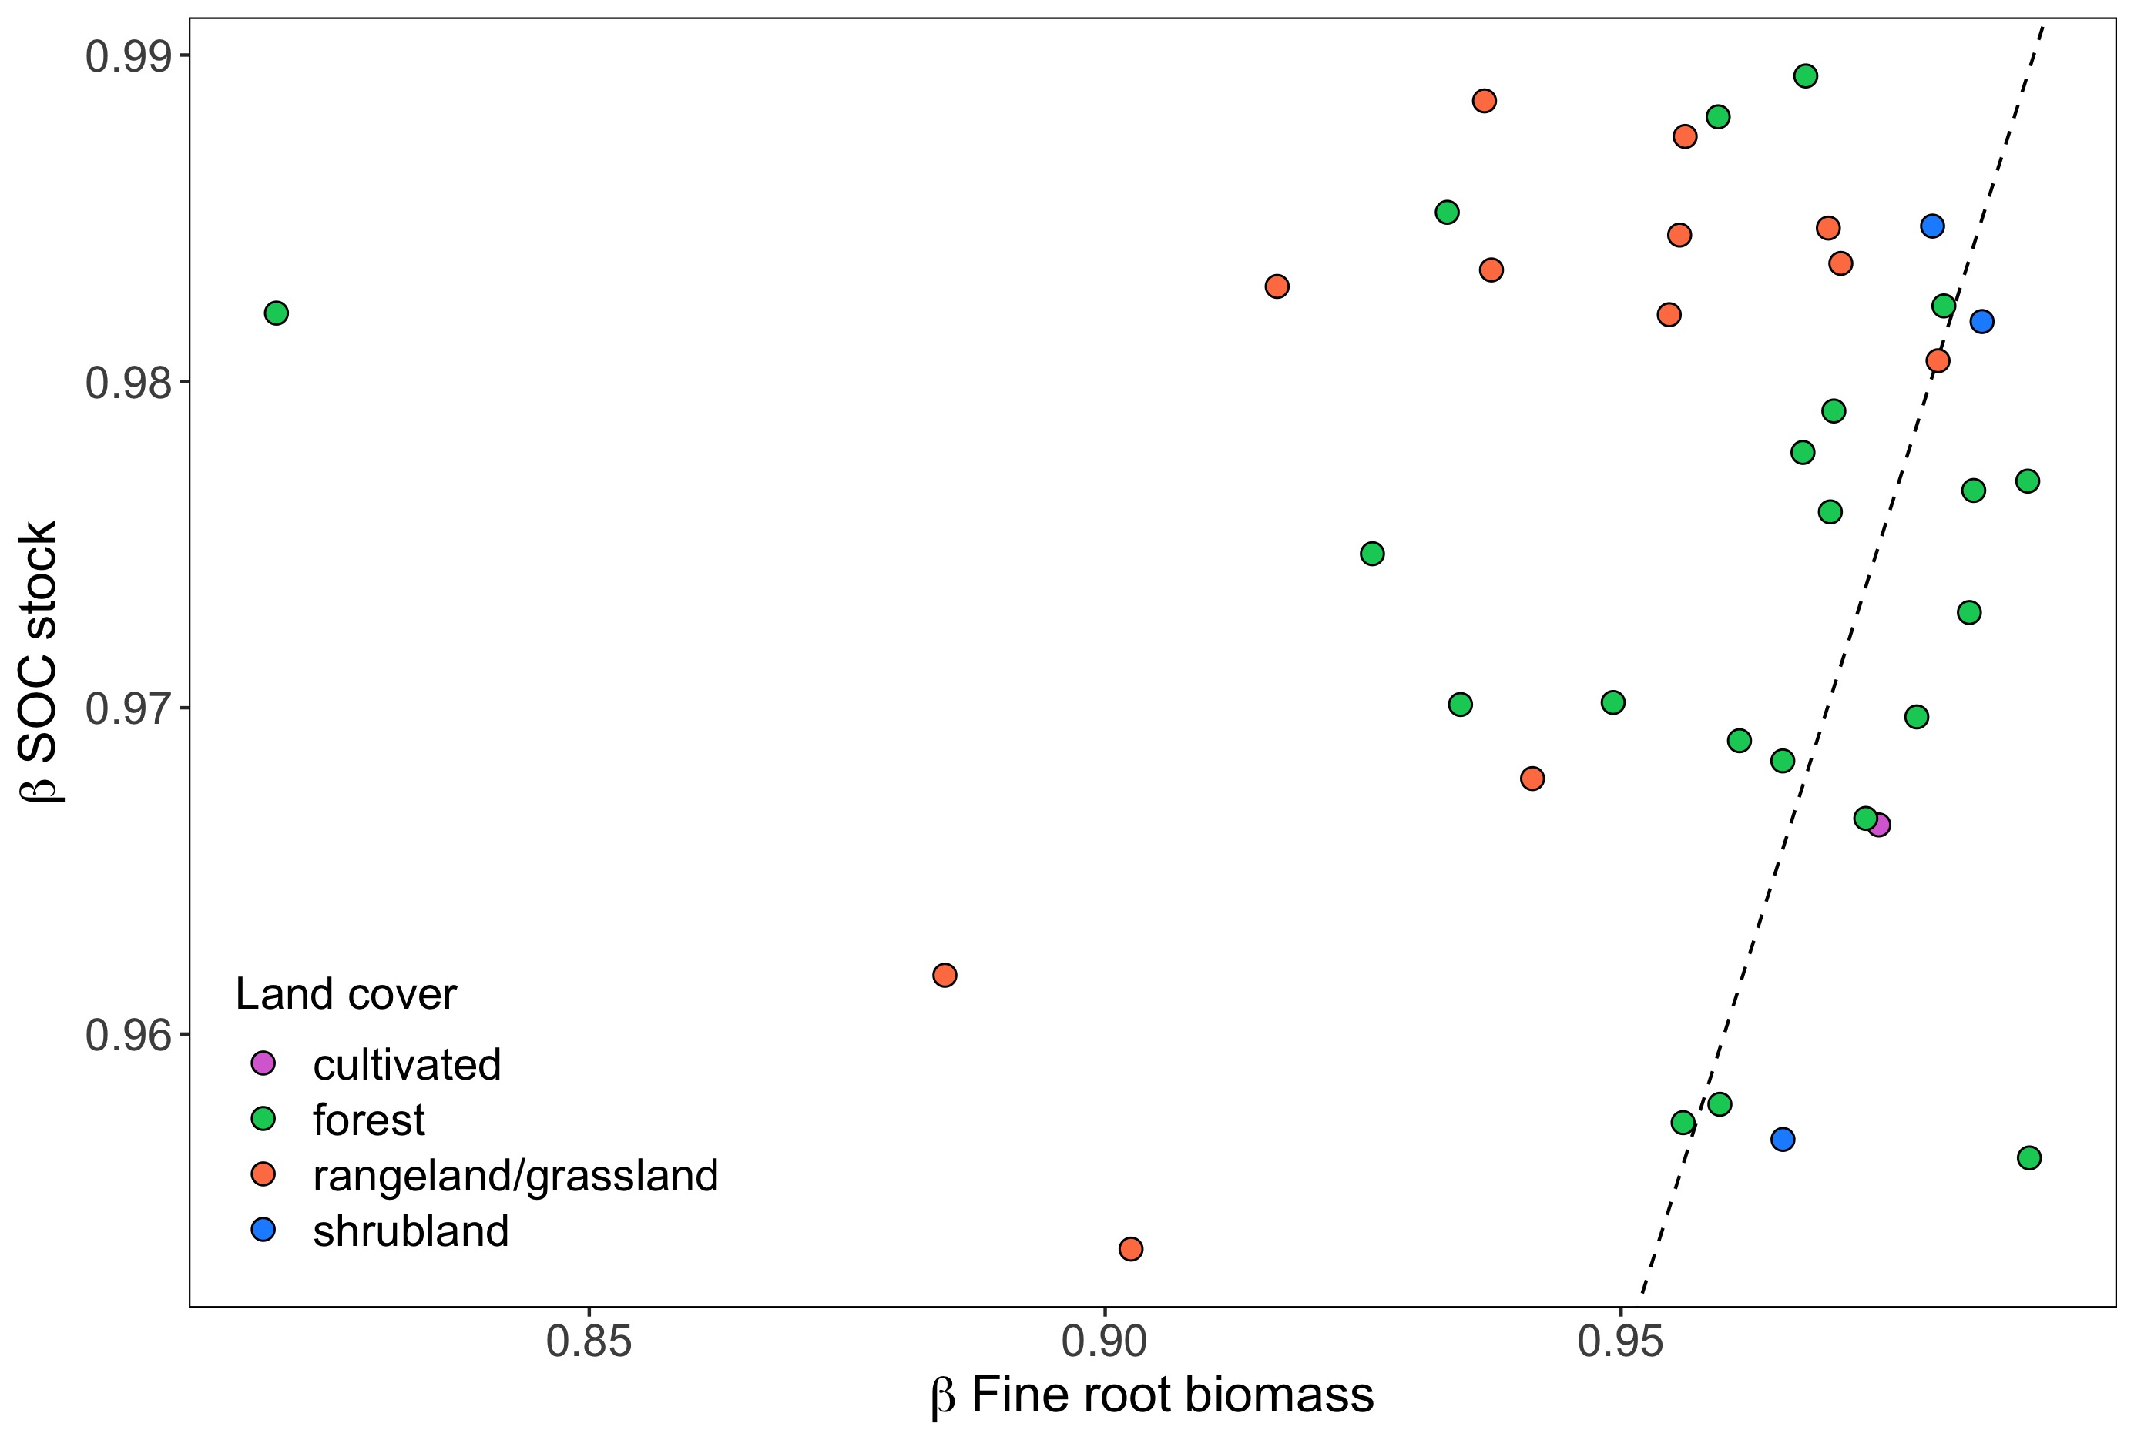
Fig 3a. Beta coefficients for roots and SOC through depth profiles (O+M) depend on land cover
Post-hoc Tests
R/g vs shrub: P = 0.04
R/g vs forest: P = 0.09
Shrub vs forest: P > 0.1

Slide 12
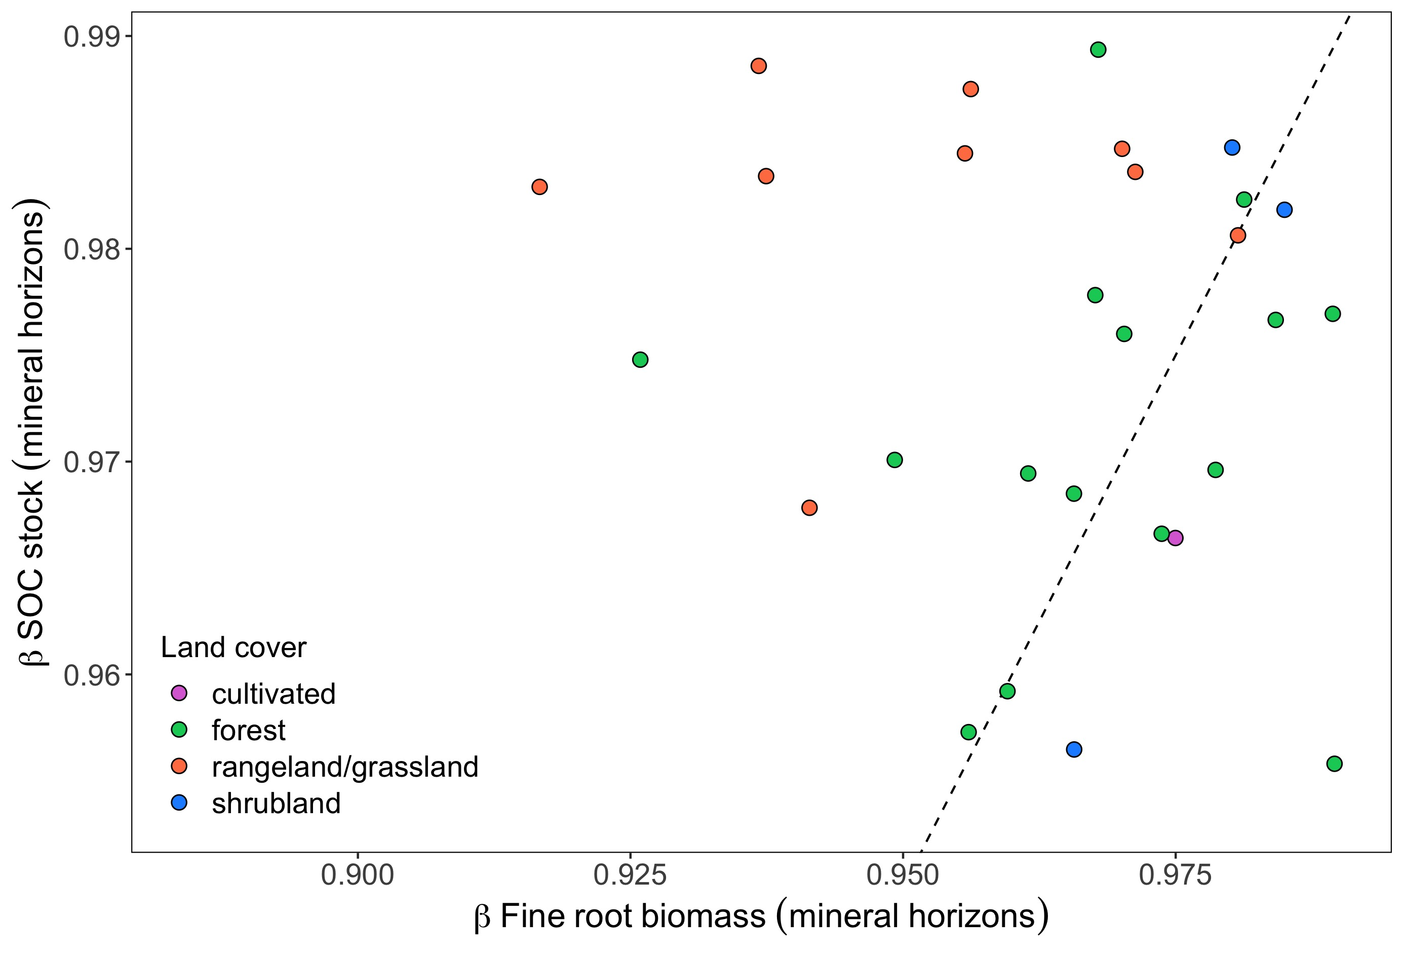
Fig 3b. Beta coefficients for roots and SOC through depth profiles (mineral only) depend on land cover, clay, and (marginally) on MAP
Mineral horizons
Post-hoc Tests
R/g vs shrub: P = 0.03
R/g vs forest: P = 0.03
Shrub vs forest: P > 0.1

