Slide 1
‘Megapit’ roots and soil – 1 pit per site, to 2 m or bedrock
Soil Chem – by genetic horizon. Many variables measured including total C, N, P, cations, metals, texture, BD
Roots – 10 cm depth increments for first 100 cm, then 20 cm depth increments thereafter. 2 size categories (< 2 mm, > 2 mm), live and dead, chem on both live and dead
Notes:
To use these together, would need to do some conversions, since top and bottom depths don’t match exactly. Could plot decay with depth (soc, root biomass), then extract value for any given layer or bottom depth. Or, some other method…
Should be one pit for all 47 NEON terrestrial sites. Would have NLCD category, climate (MAT/MAP), can estimate site-level fine litter inputs, and lots of edaphic data from the megapits themselves.

Slide 2
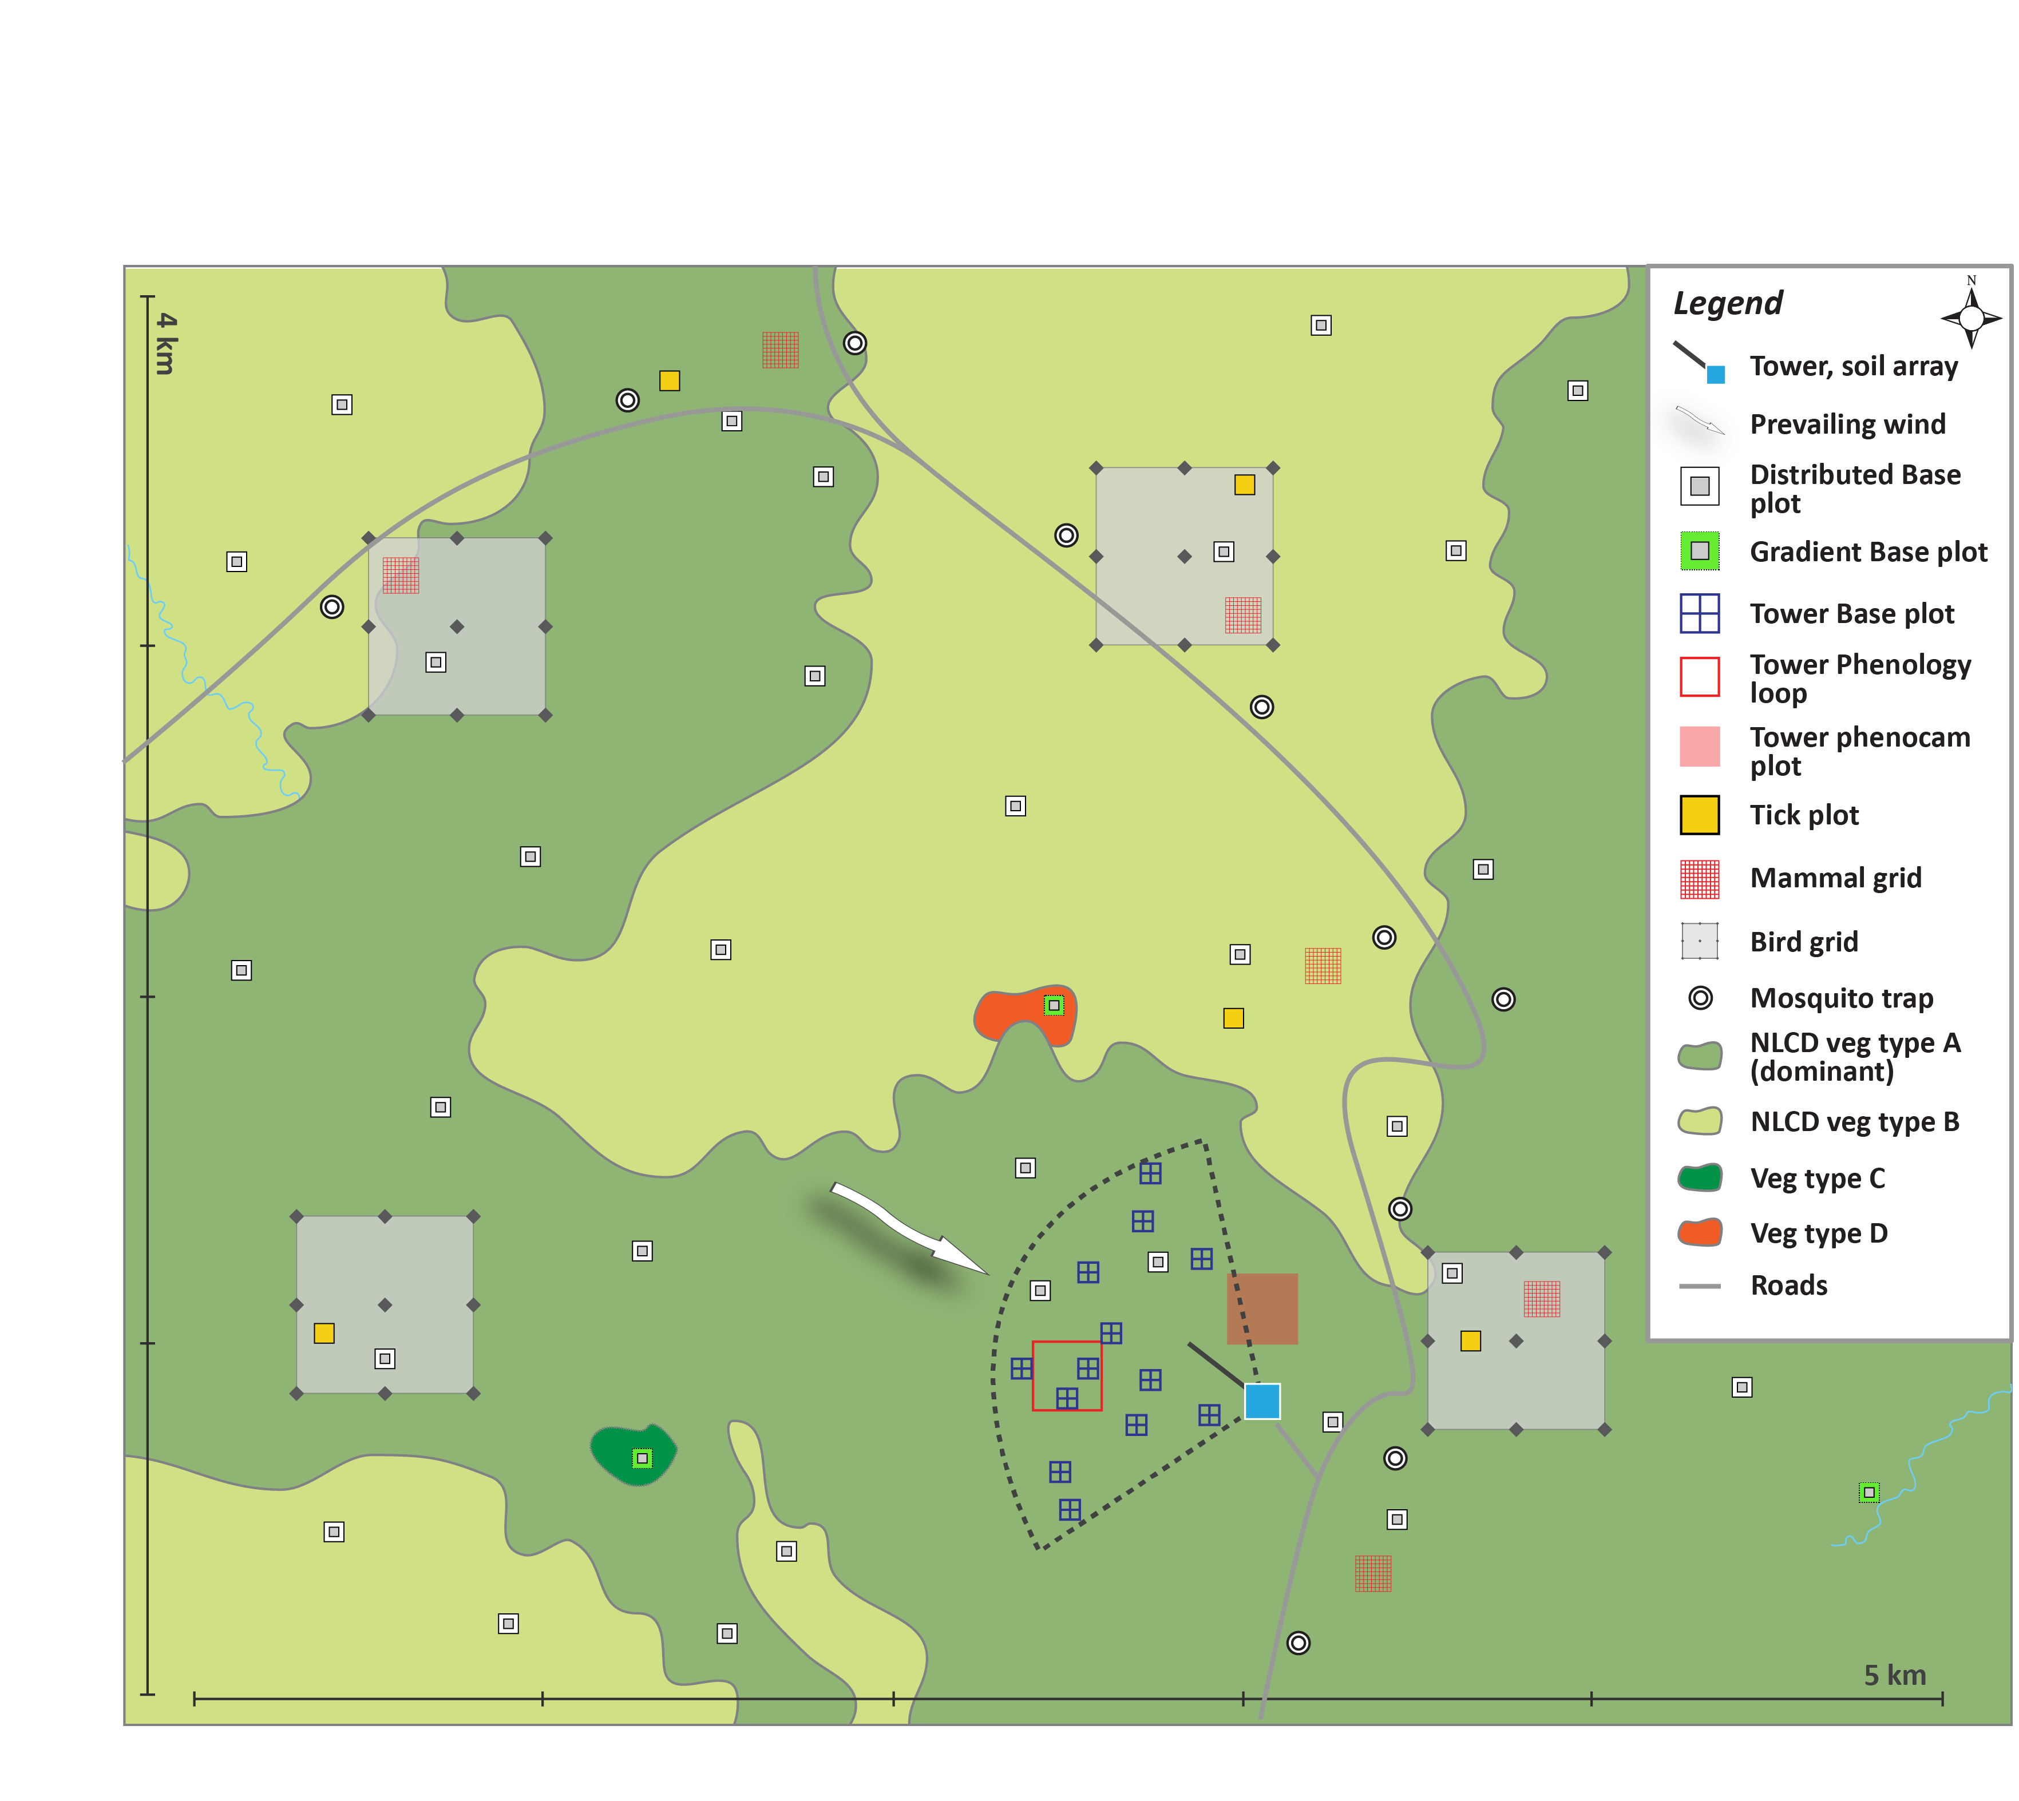
‘Periodic’ roots and soil
Periodic root sampling only happens in Tower plots
20-30 plots per site
2 cores per grid cell (north and south), 0-30 cm
4 size categories, live/dead, C&N = live only
Could pull in aboveground herbaceous biomass from same cell (not yet included)
Periodic soil sampling is more dispersed
6 Distributed plots, 4 Tower plots
3 samples per plot (3 of 4 quadrats), 0-30cm, separated by Organic and Mineral horizons
C, N, d13C, d15N, net N min
Initial soil co-located with Periodic soil at plot level
Pits to 1 m by genetic horizon
Chem (C, N, P, minerals, metals), texture, BD
40m
40m
Notes:
If we pull all of this together, we have a pretty rich dataset. As shown in the cartoon beneath the text, the Tower plots will have many of the desired measurements co-located at the plot scale. Shall we take within-plot means and then join on plotID? We’d end up with 3-4 plots per site with root data and soil data.
It’s possible to use only the Initial Soil and Periodic Root datasets, ignoring Periodic Soil. The latter has a lot of associated microbial data, but if that isn’t of interest here then it might be simpler to exclude. Same as with megapits, we’ll have to decide how to match up the bottom depths, since Initial Soil was sampled by genetic horizon but roots to a fixed depth. As well, do we want to combine any of the root size classes or keep everything separate?

