Slide 1
Diversity-stability relationships
Junna

Slide 2
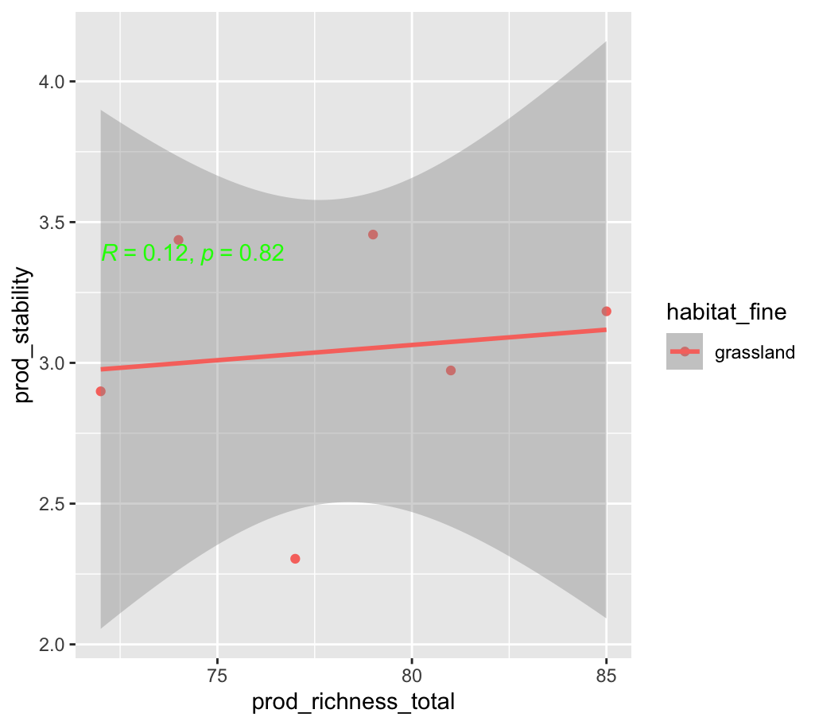
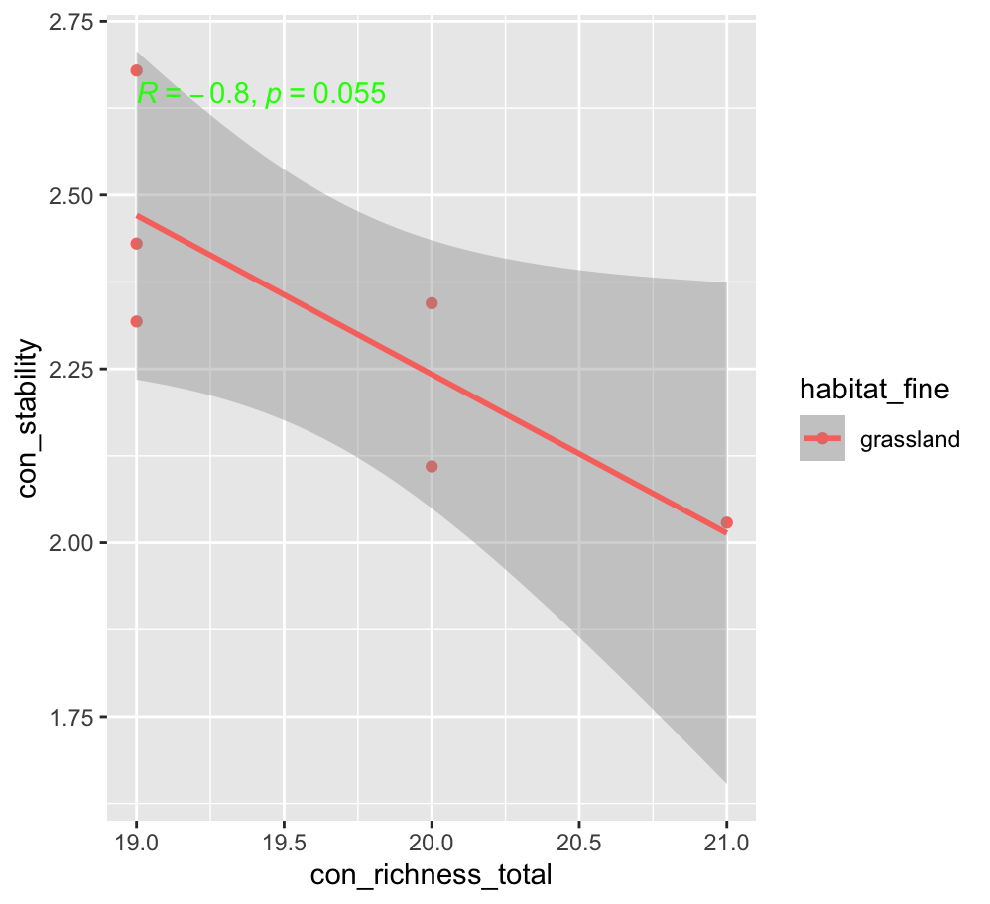
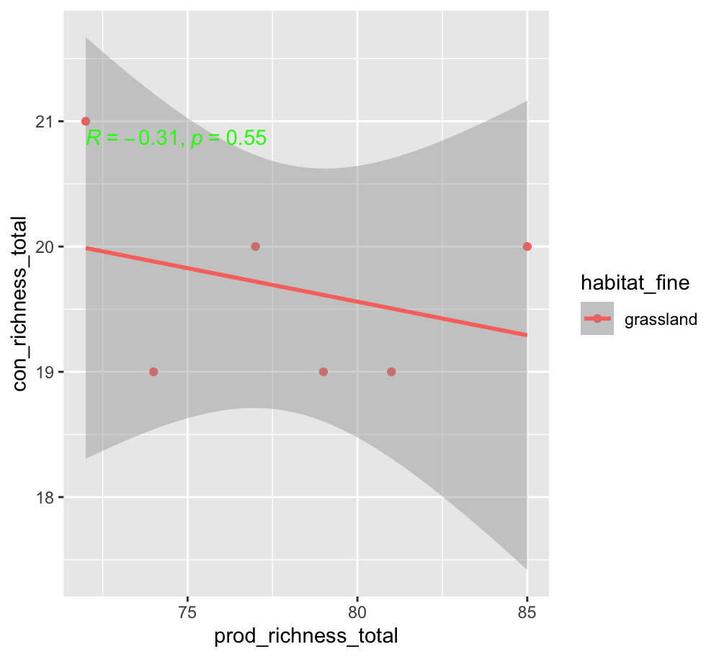
KBS

Slide 3
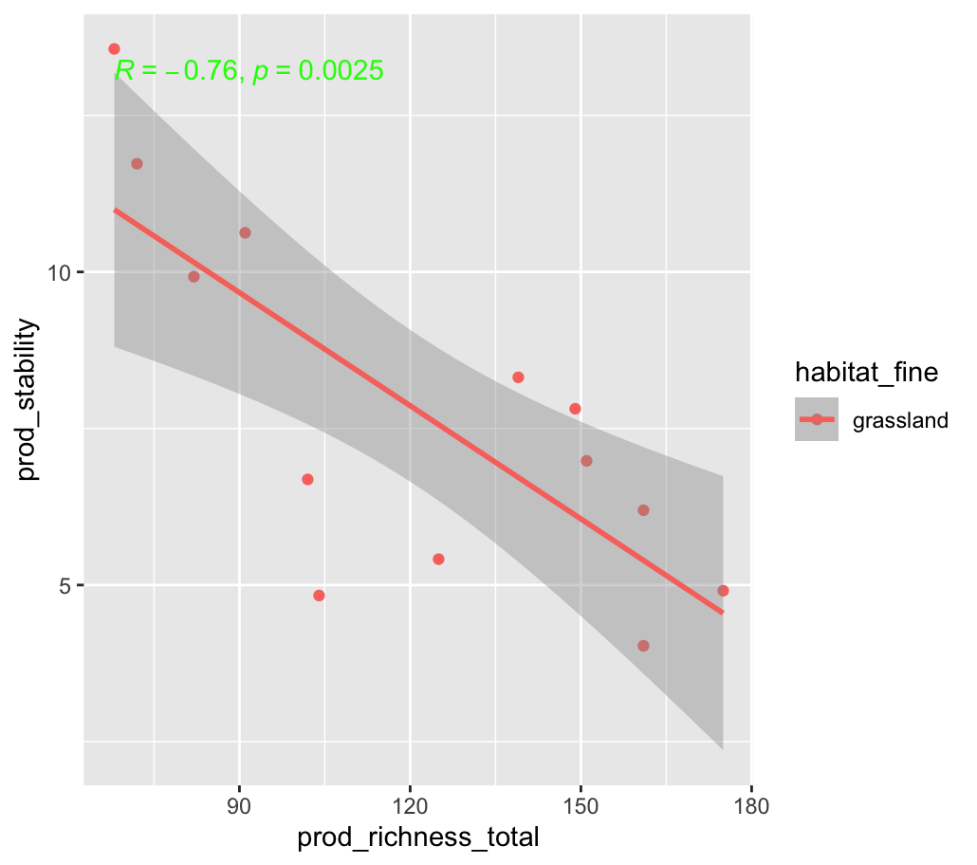
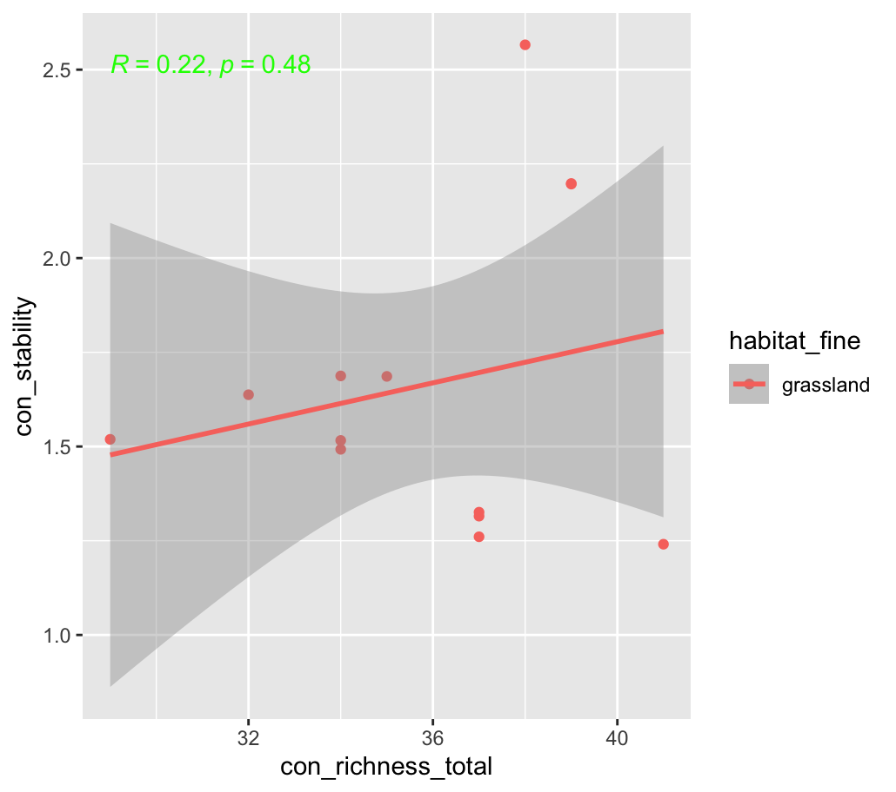
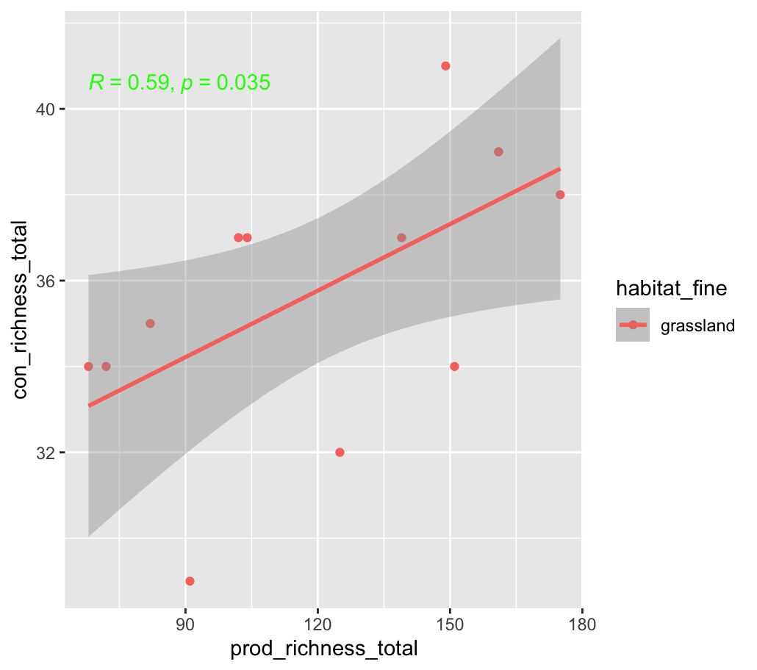
KNZ

Slide 4
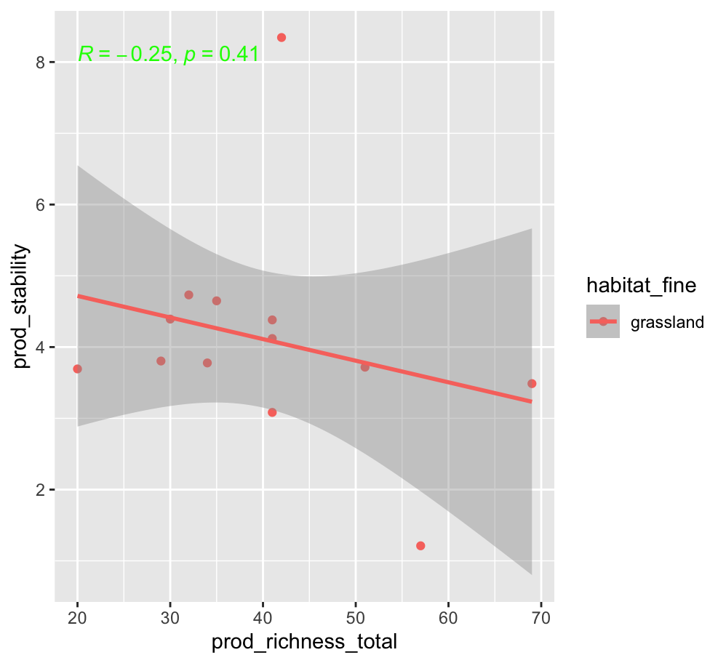
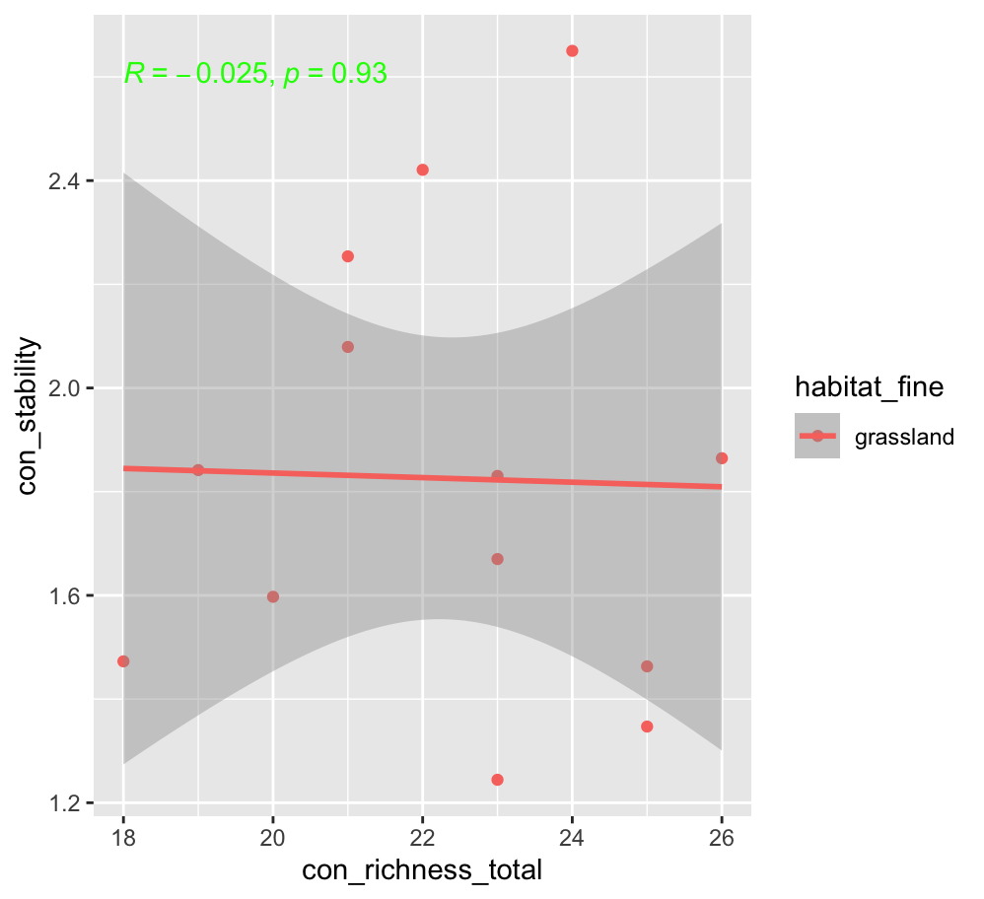
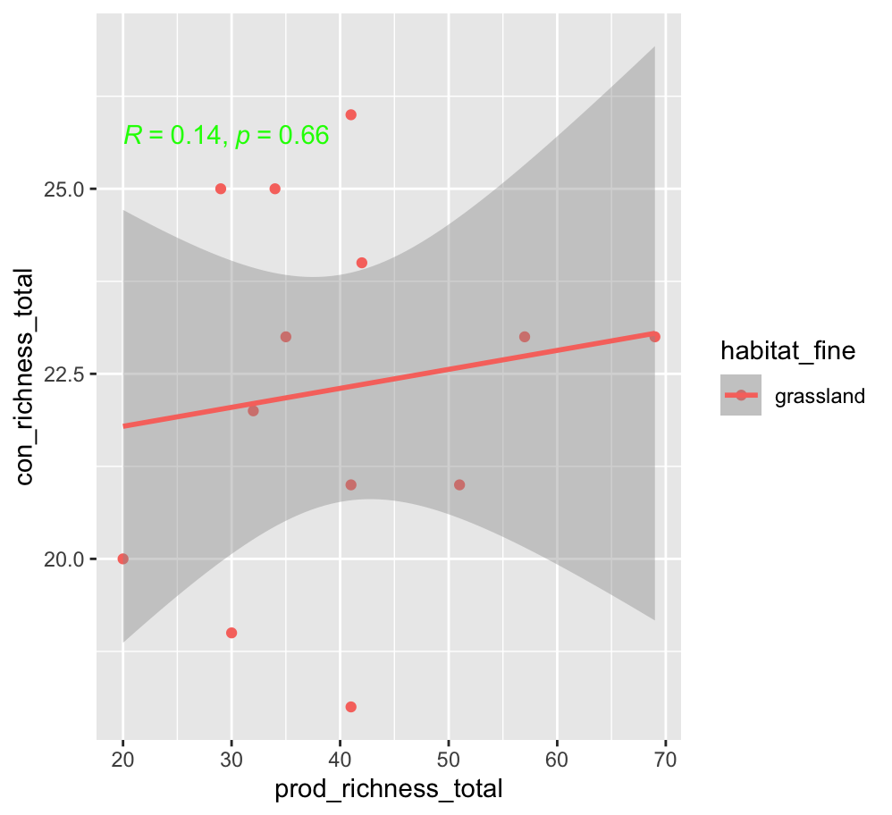
CDR_oldField

Slide 5
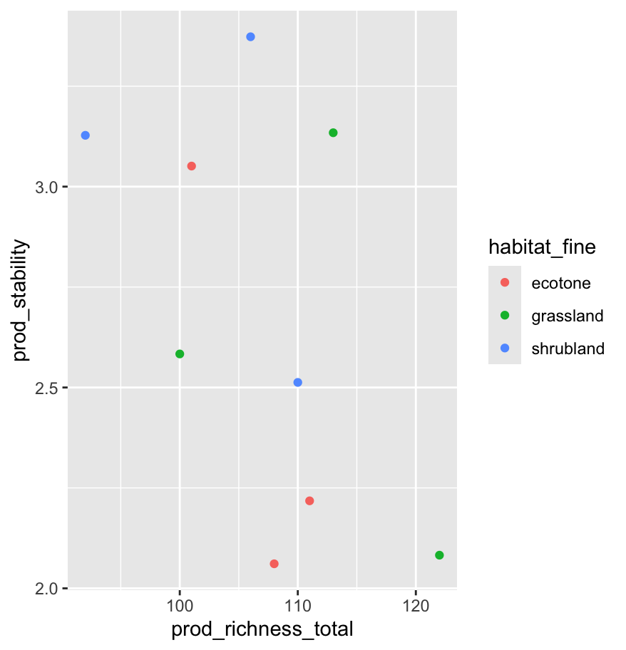
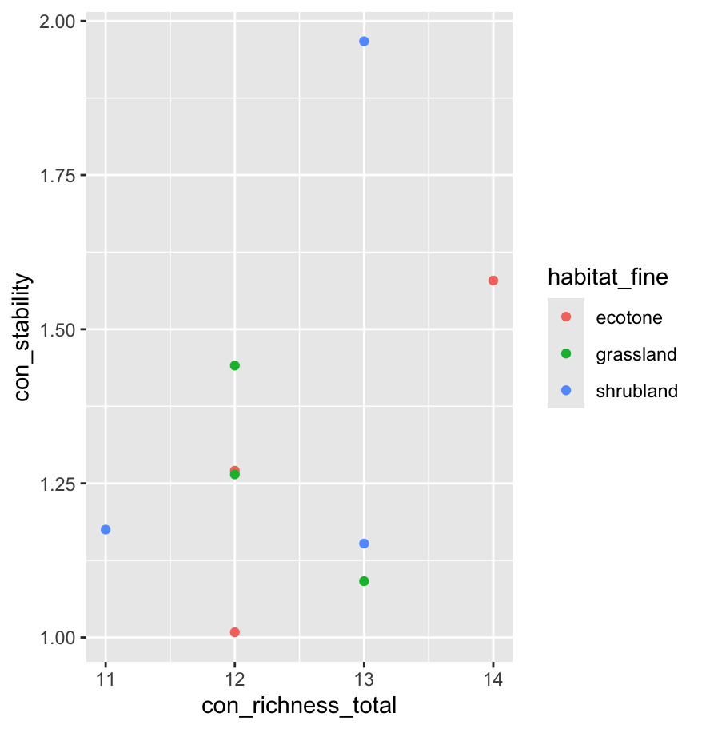
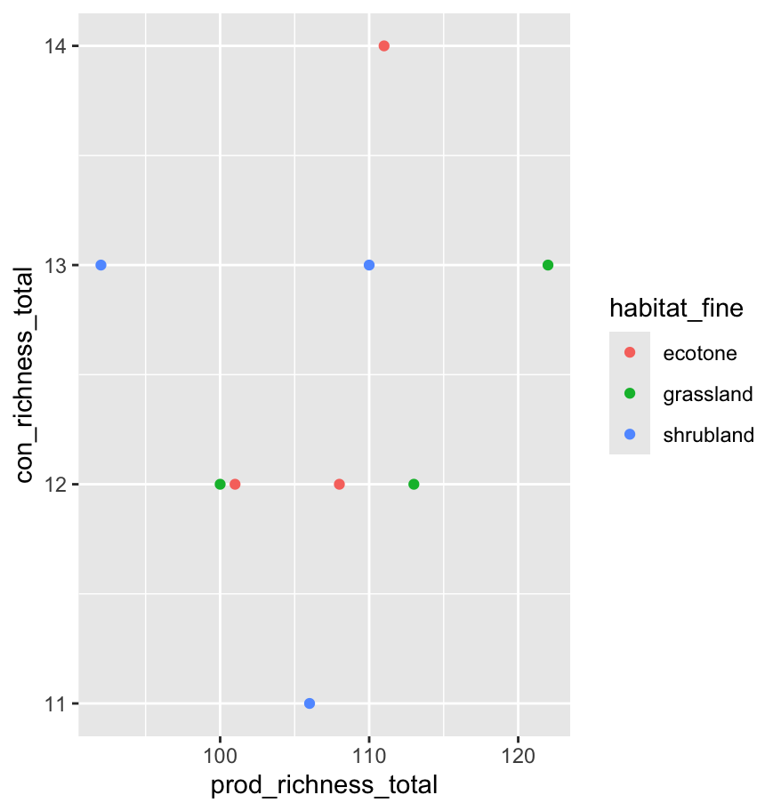


JNR
No relationship

Slide 6
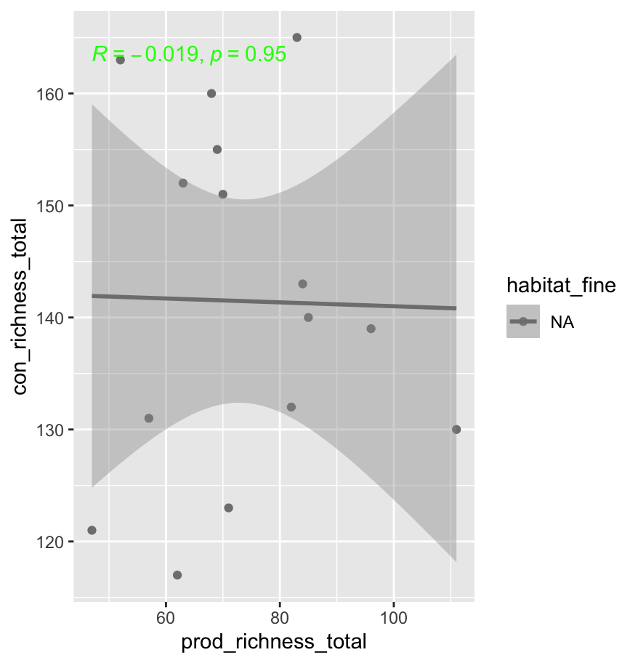
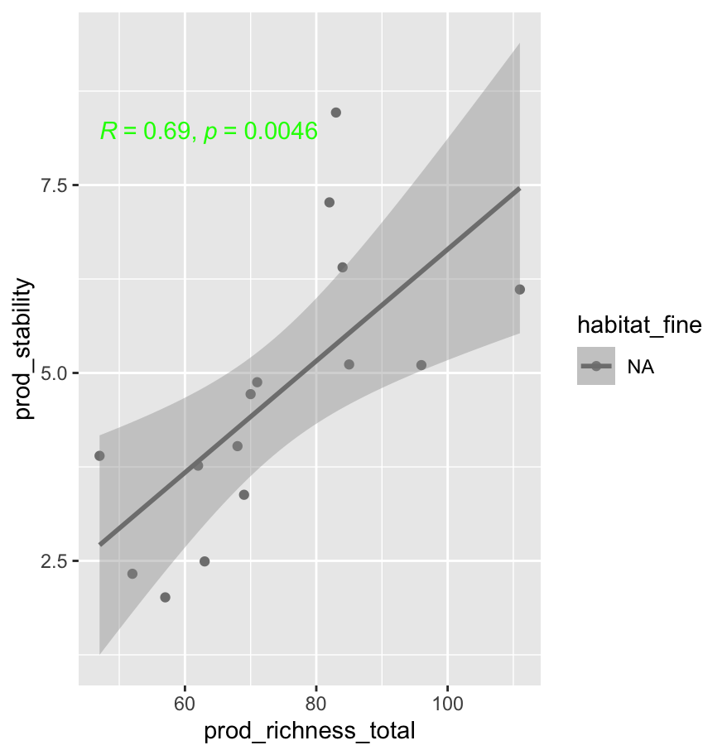
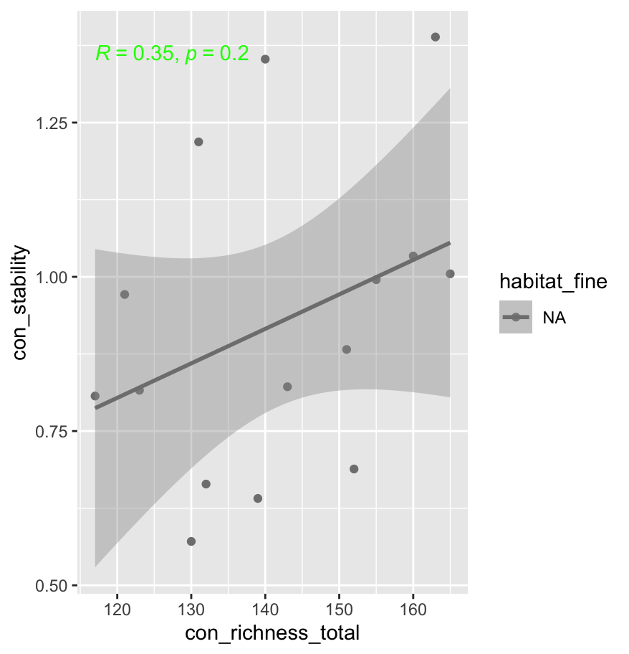
bex_he (habitat fine is empty)

Slide 7
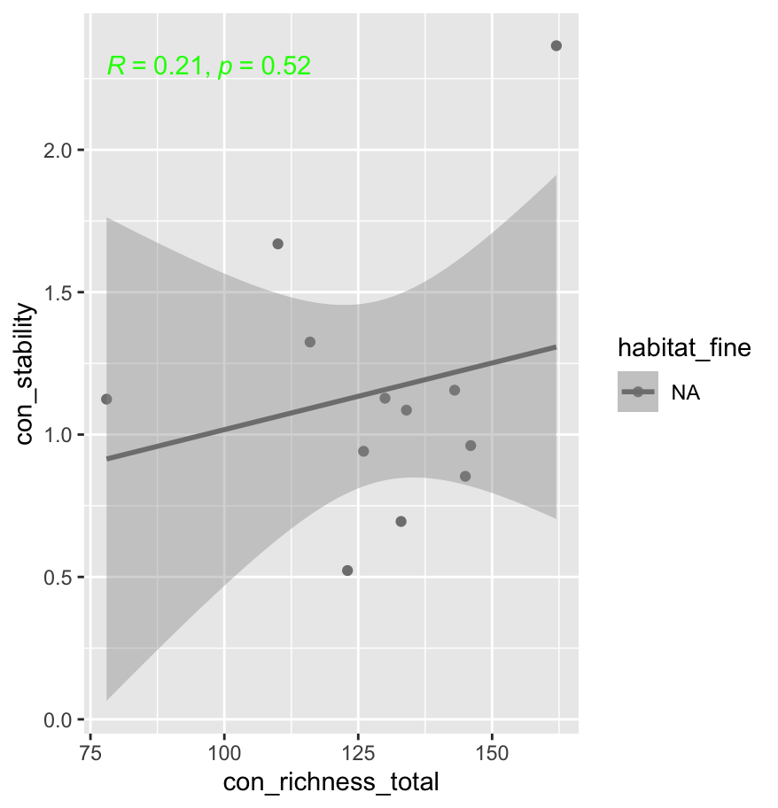
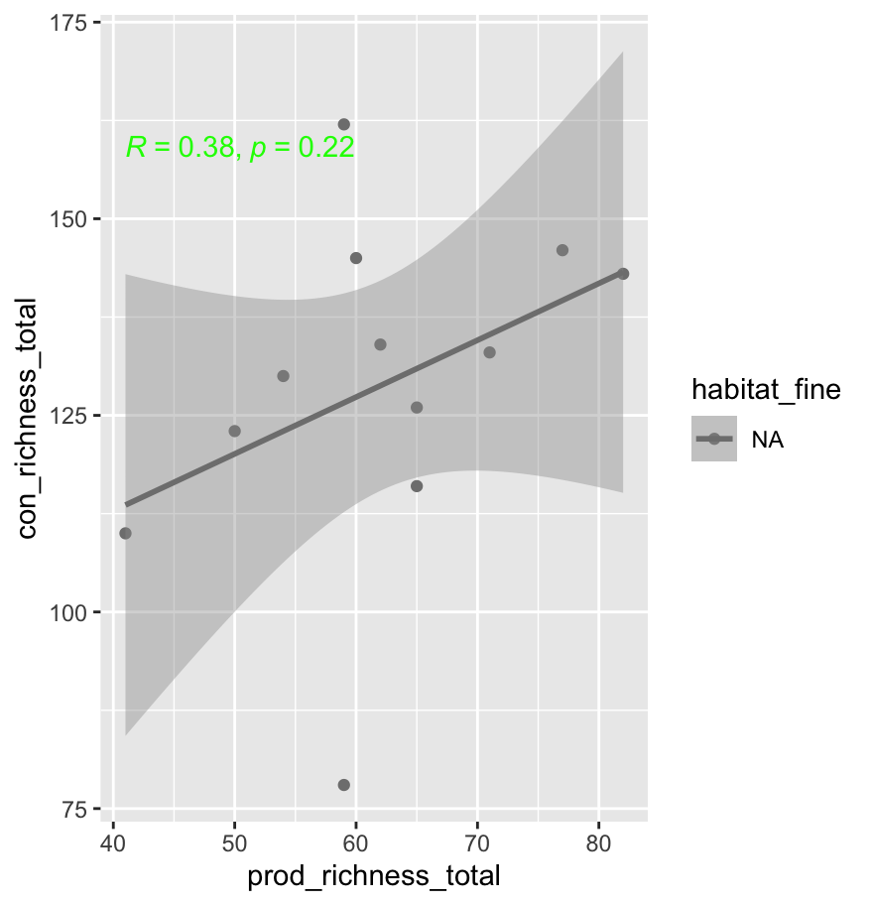
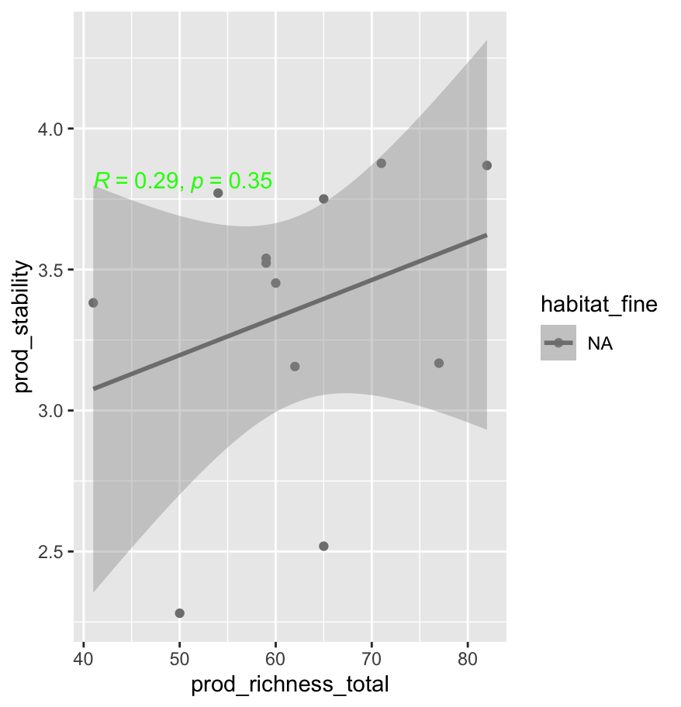
bex_ae

Slide 8
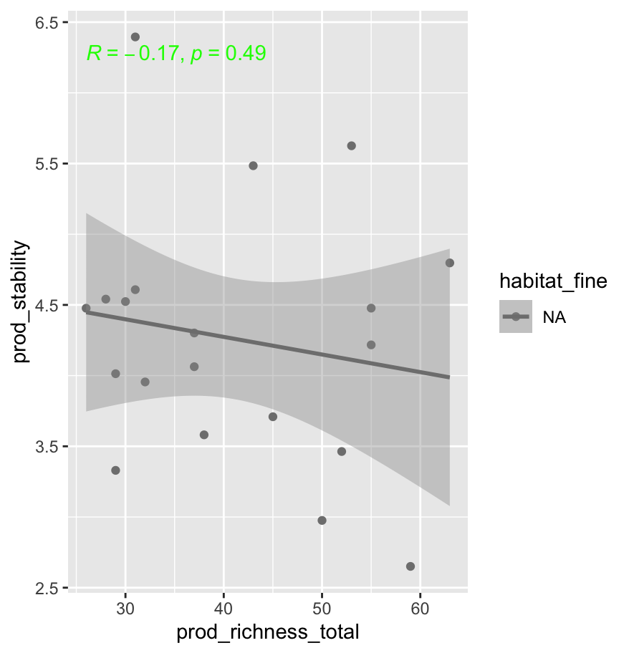
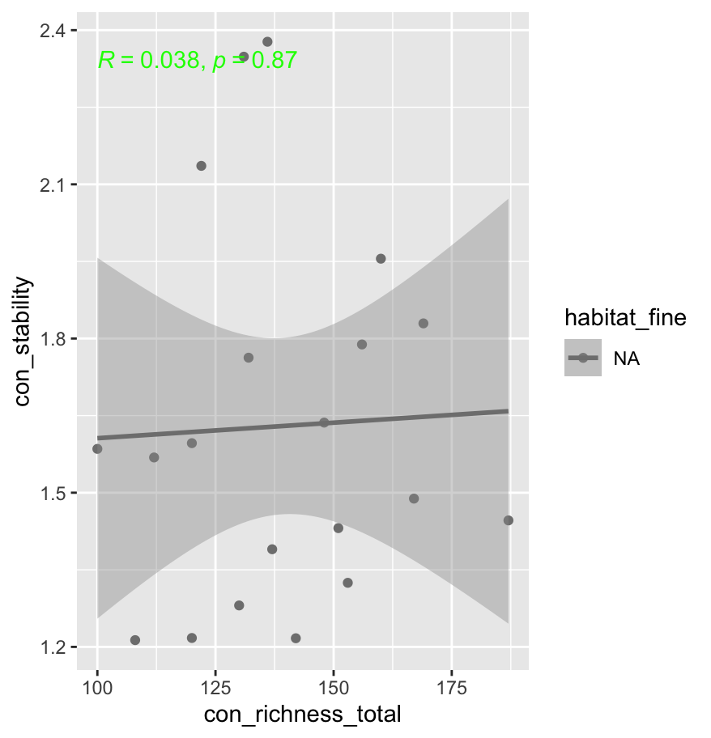
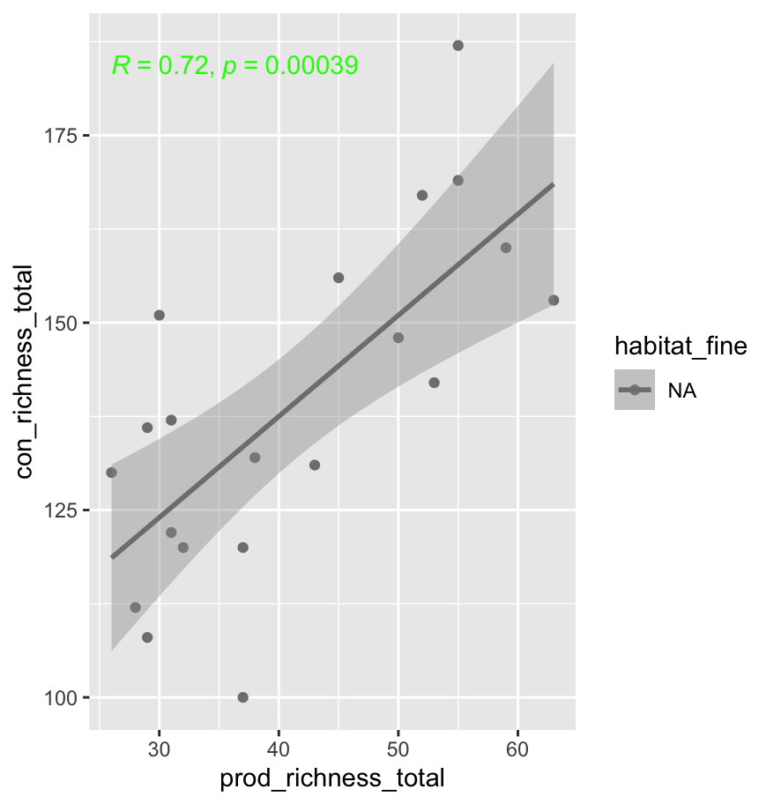
bex_se

Slide 9
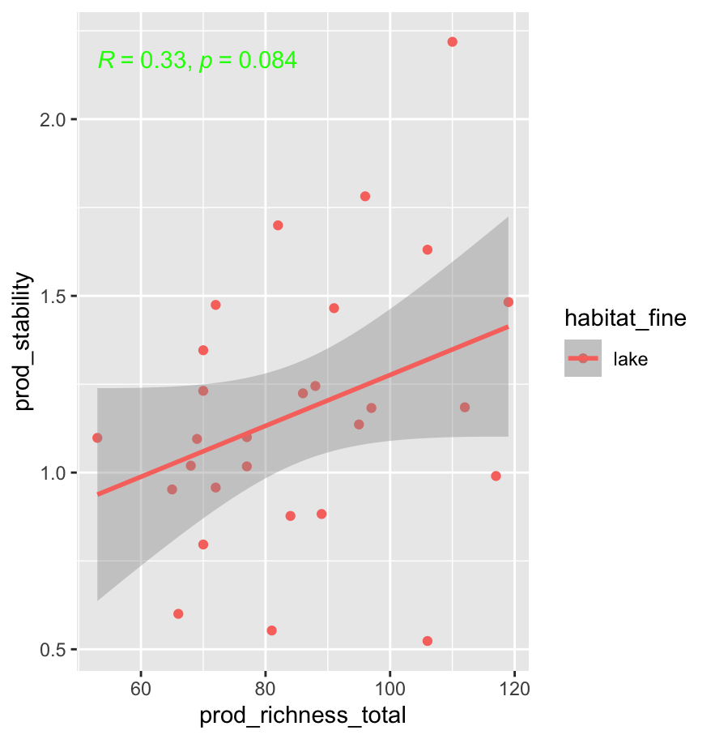
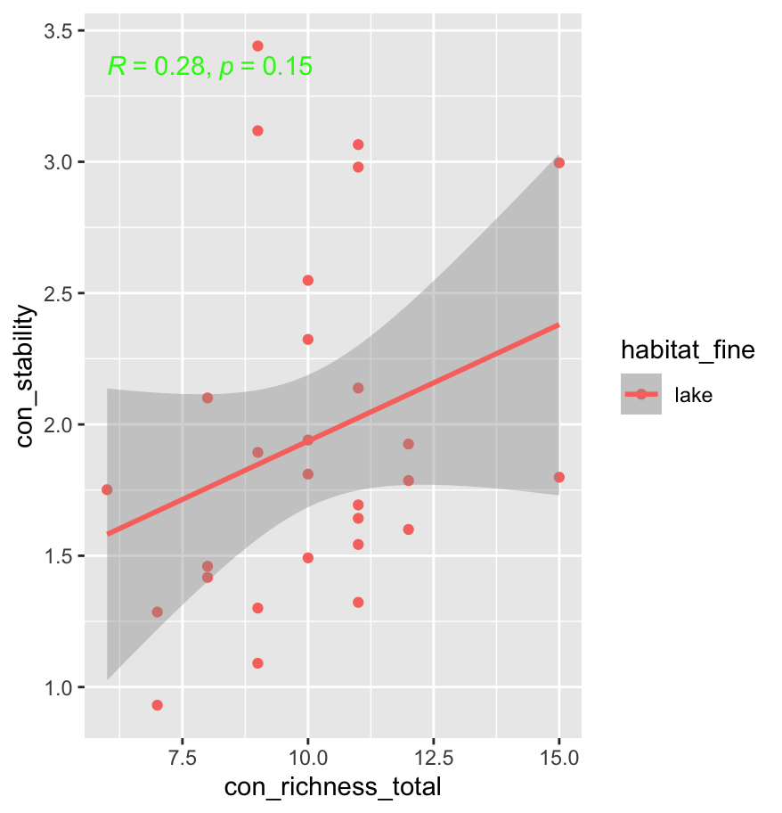
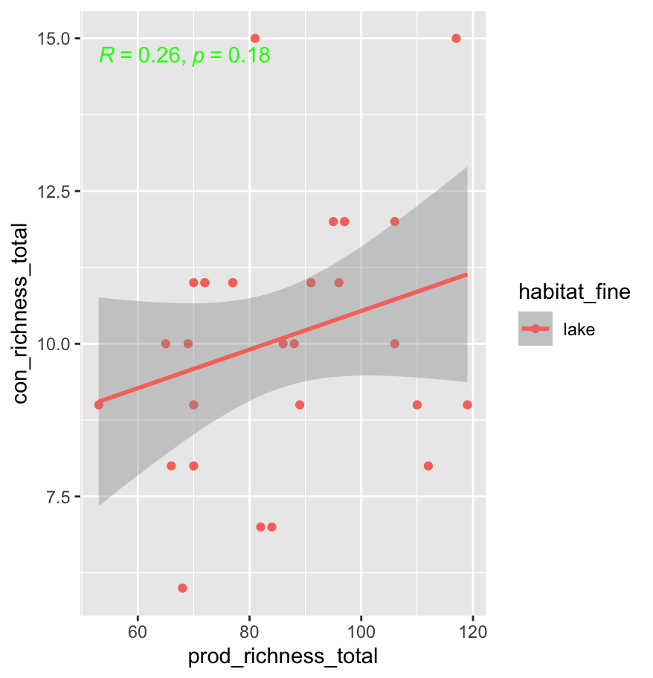
ADK----use total richness have worse results we cannot use this!

Slide 10
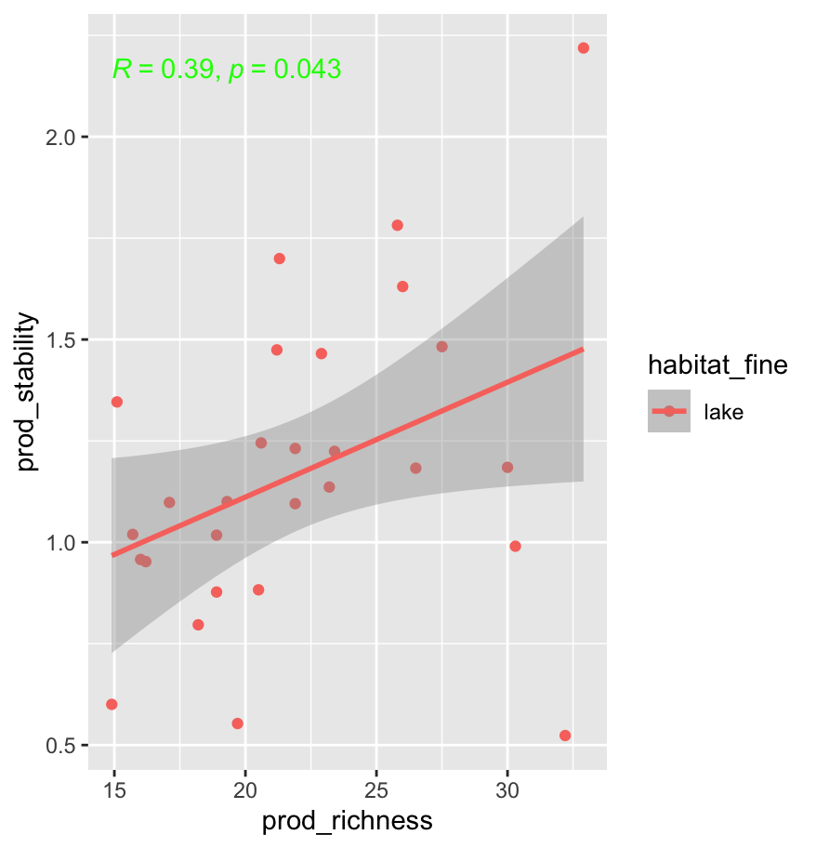
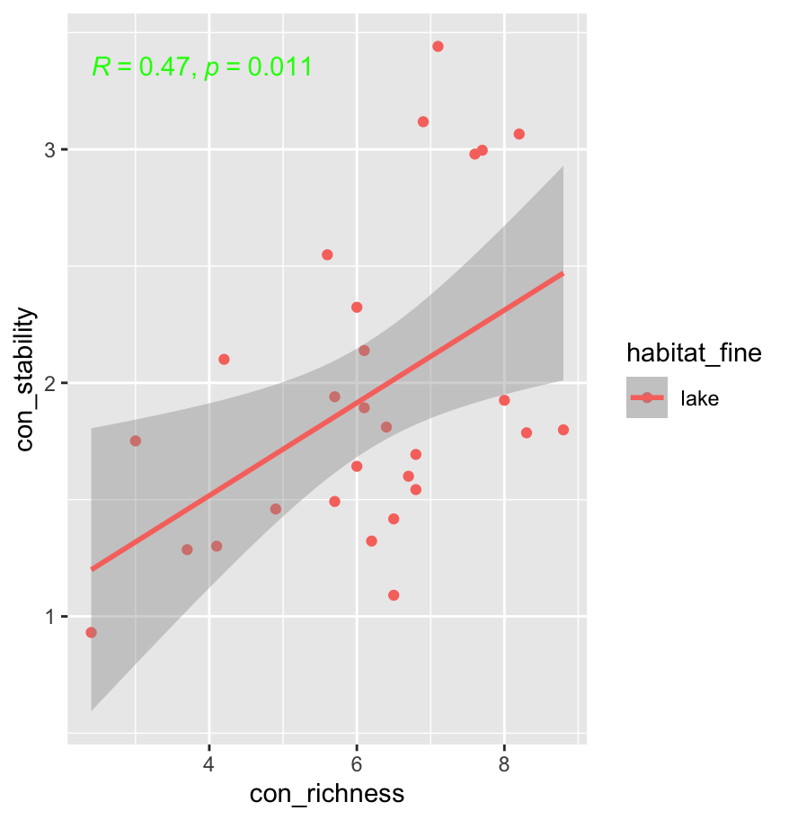
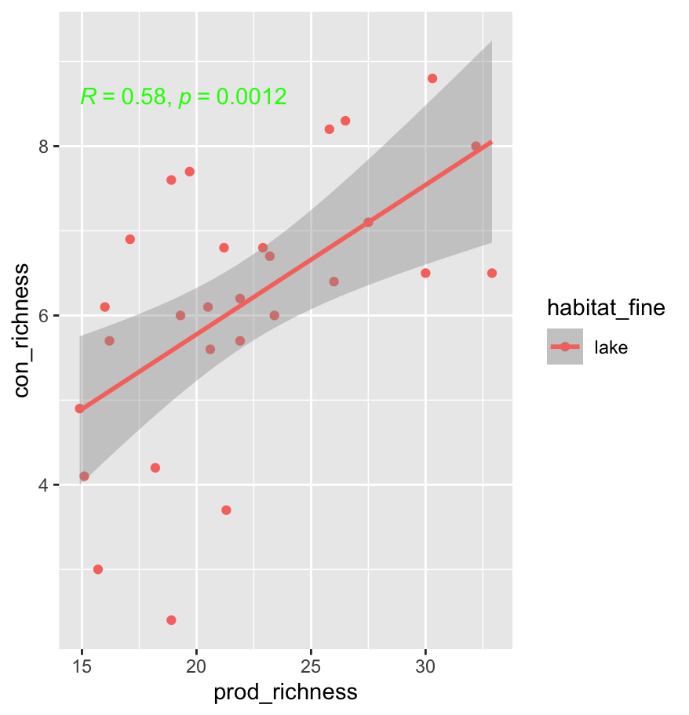
ADK--use plot-annual-average richness have better results
Notes:
The lake data is very unique, they could be very different year after year!

Slide 11
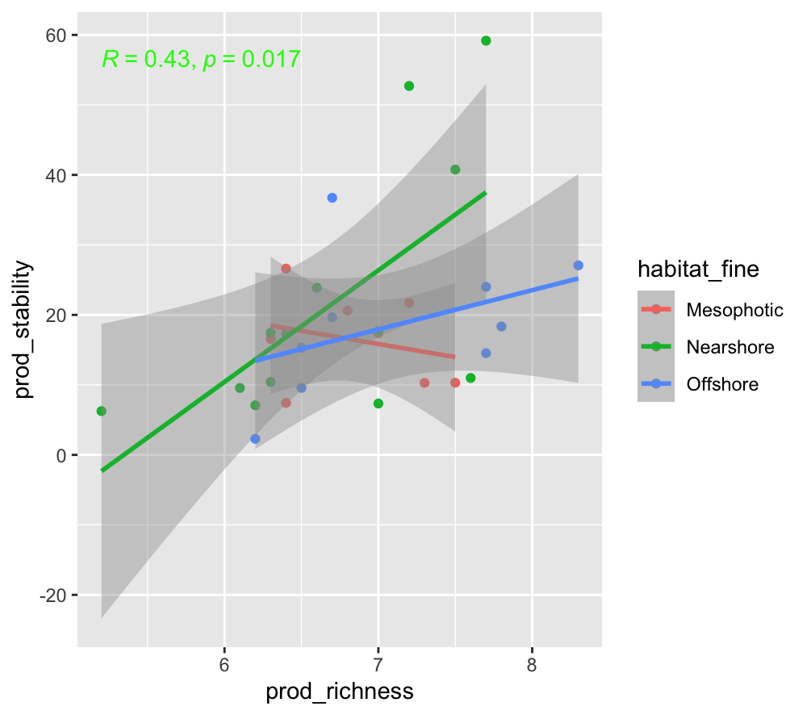
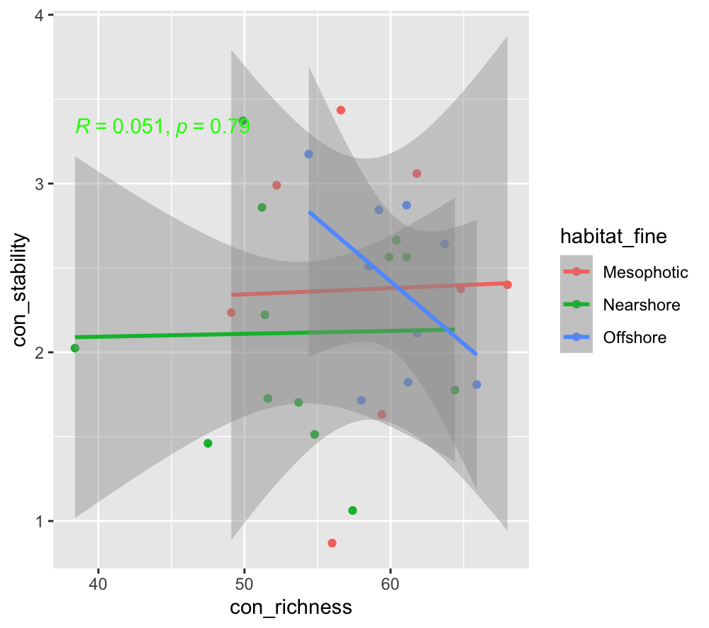
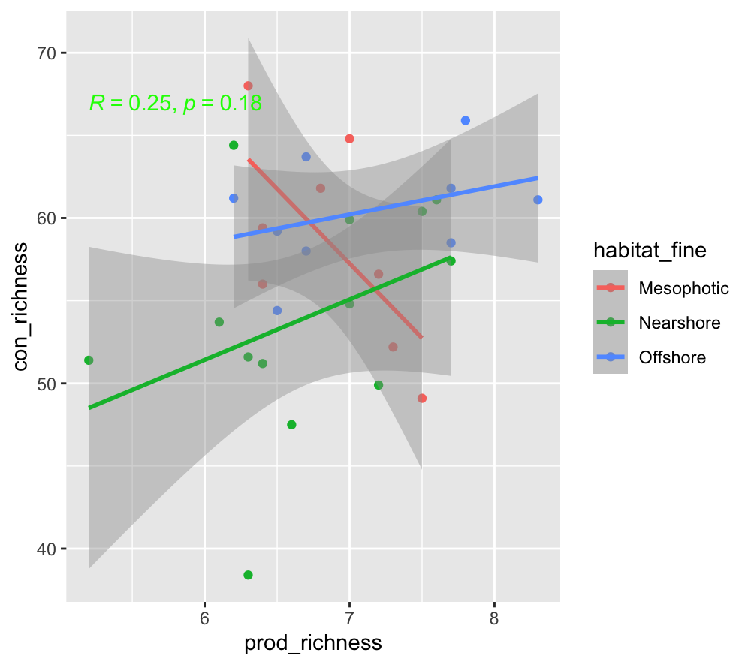
USVI

Slide 12
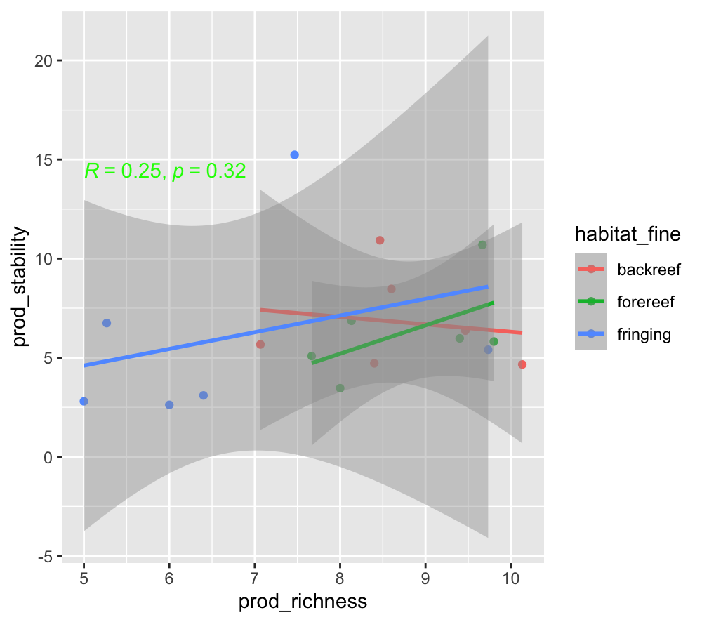
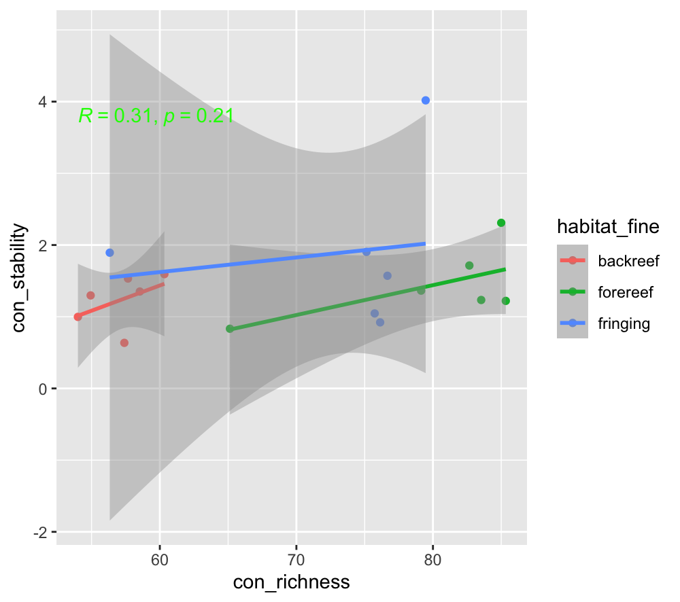
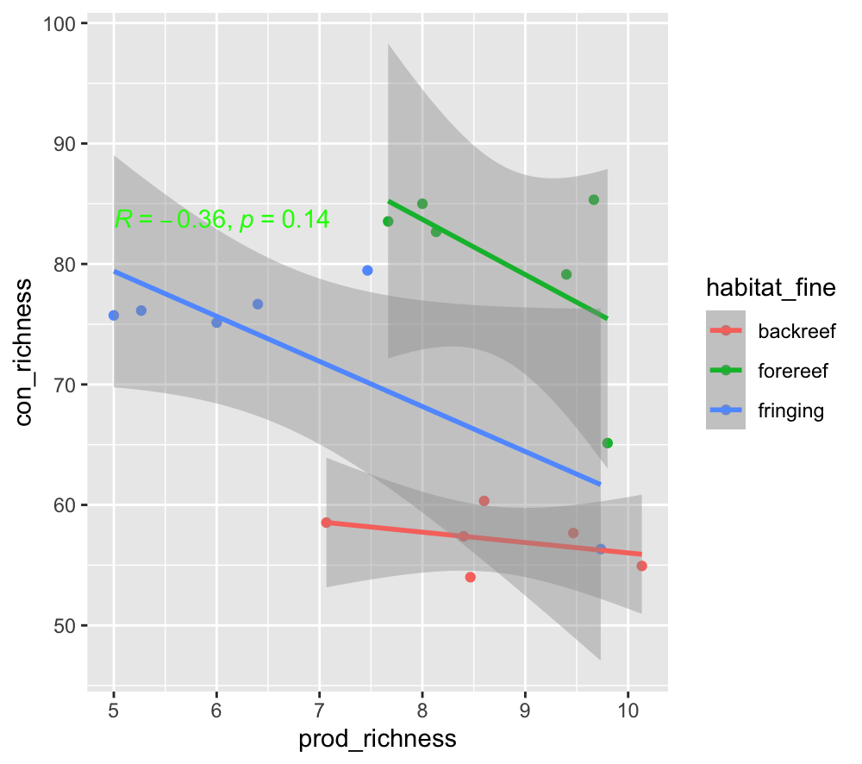
MCR-fish

Slide 13
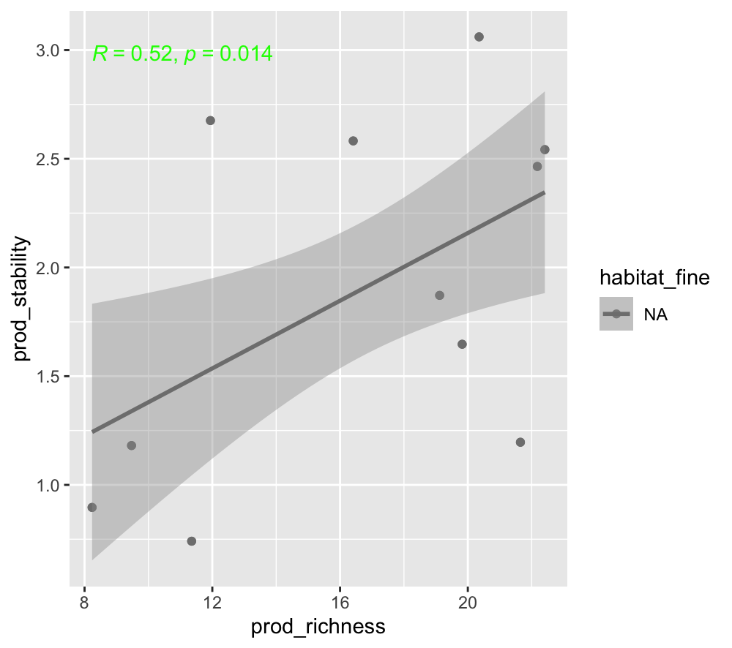
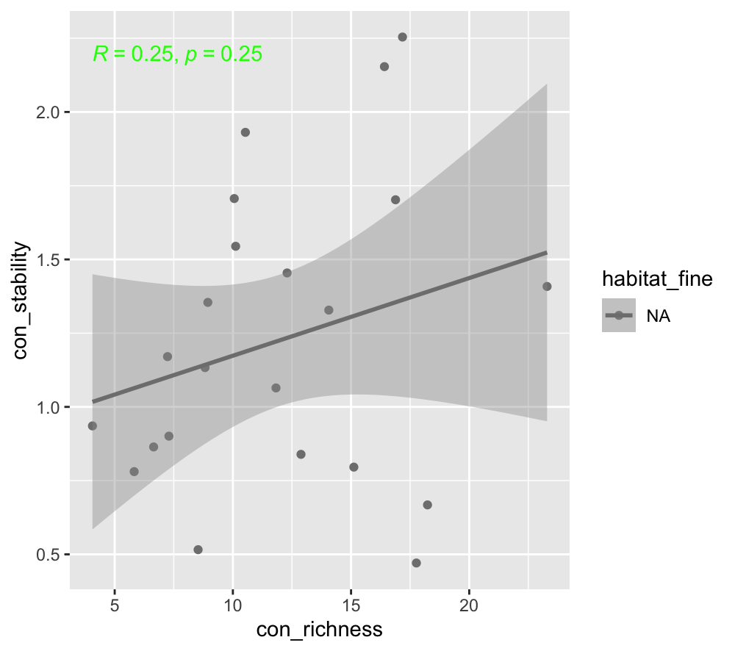
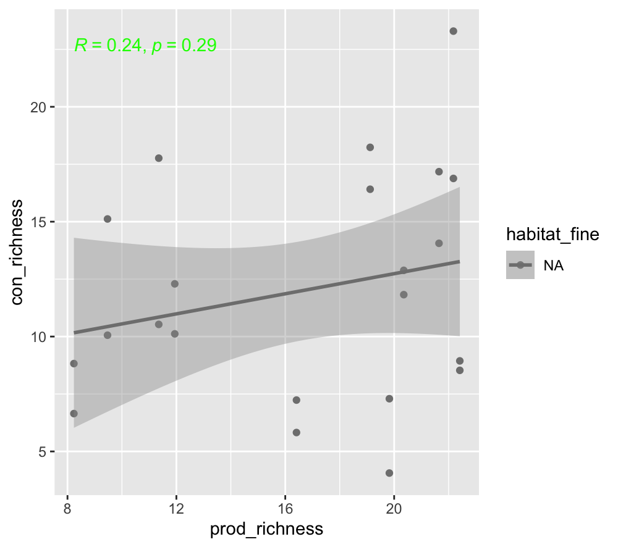
SBC
Notes:
USE total richness can get the opposite results.

Slide 14
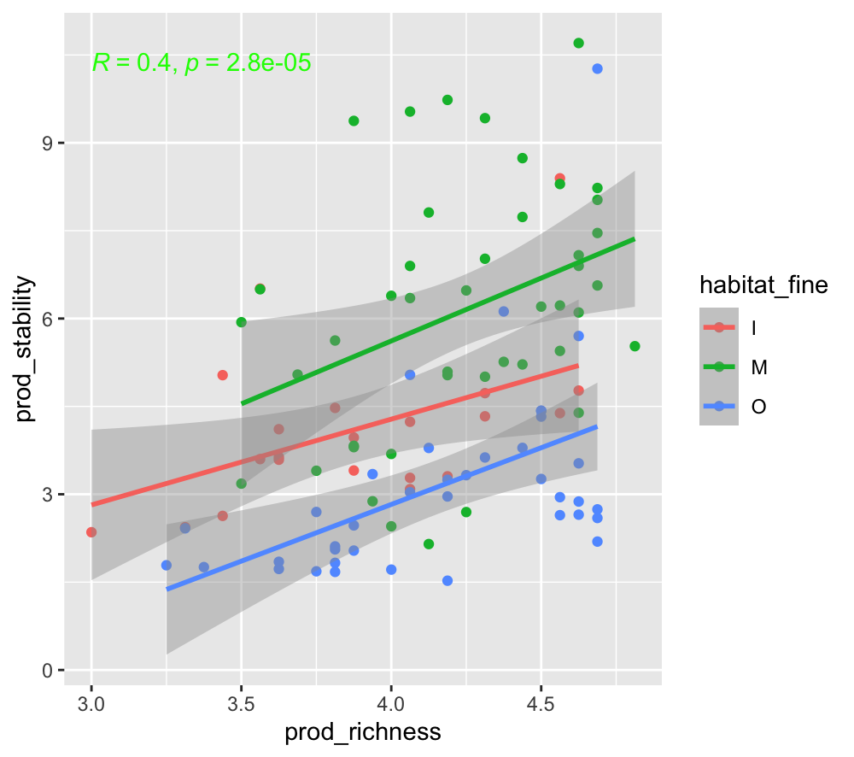
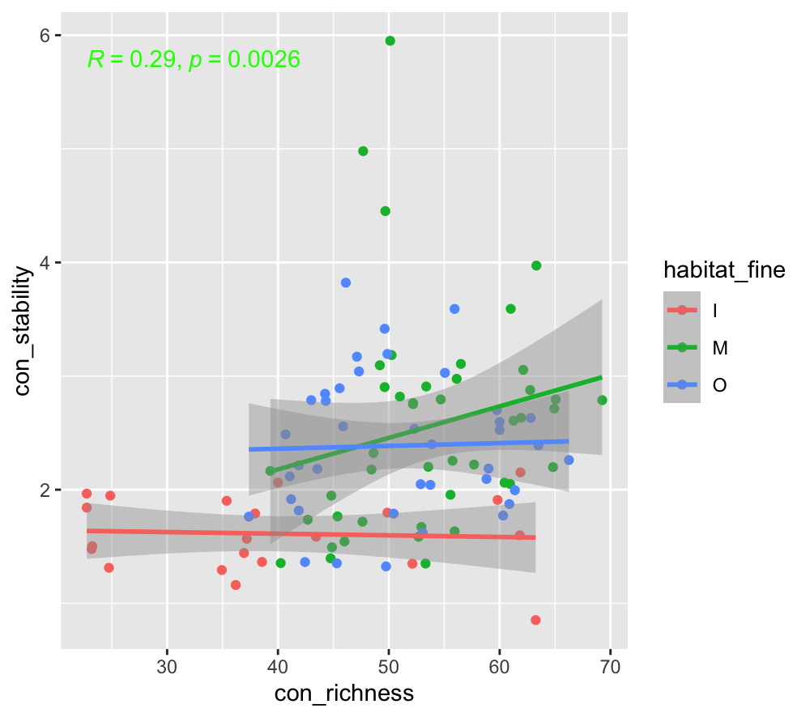
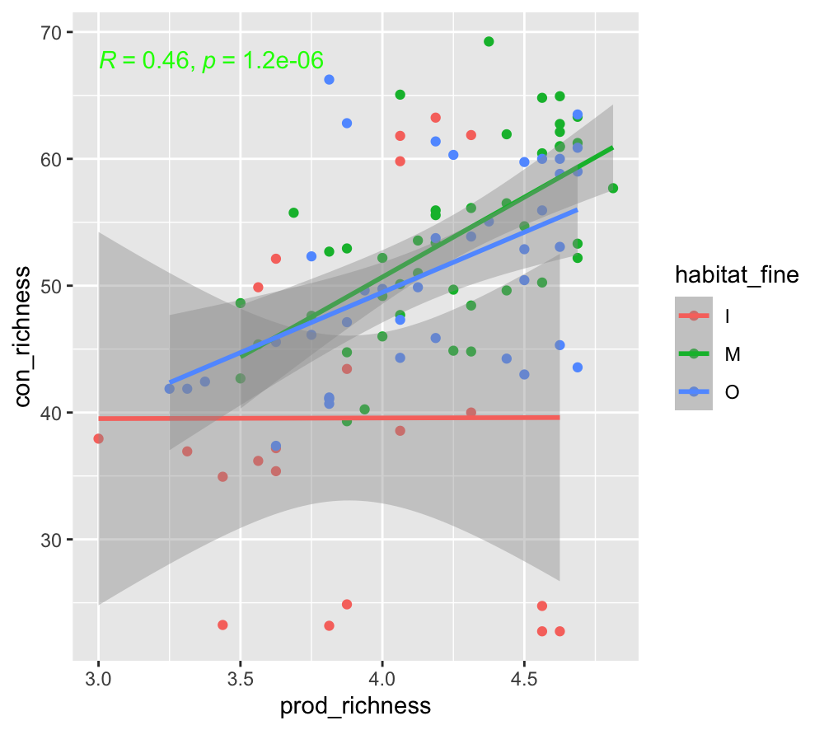
AIMS

Slide 15
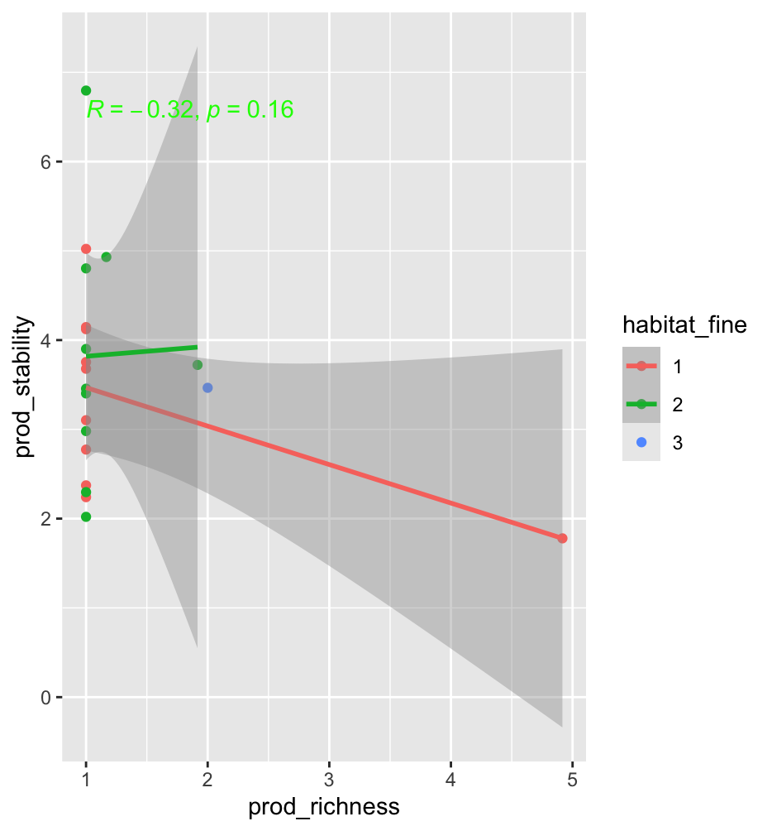
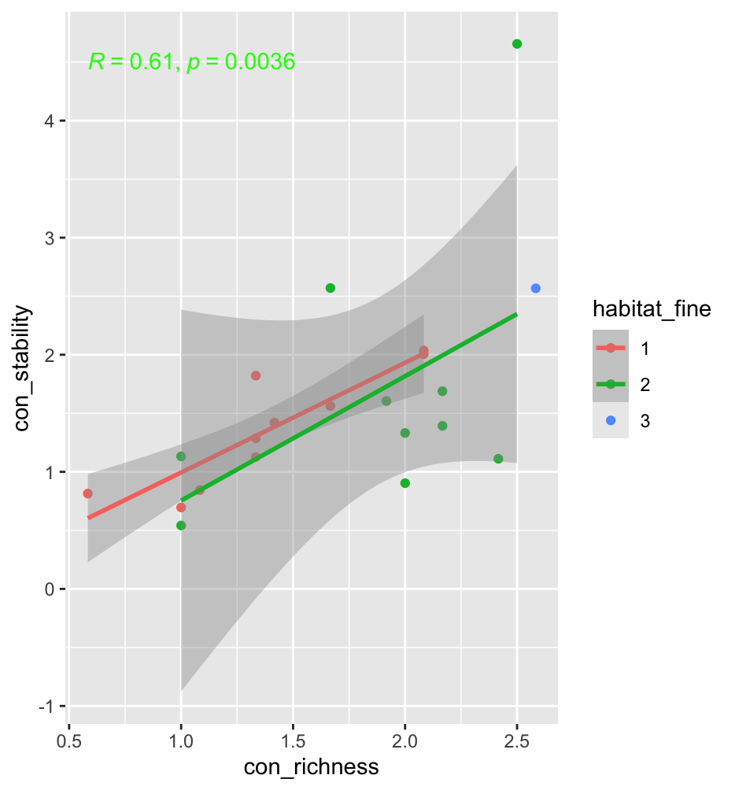
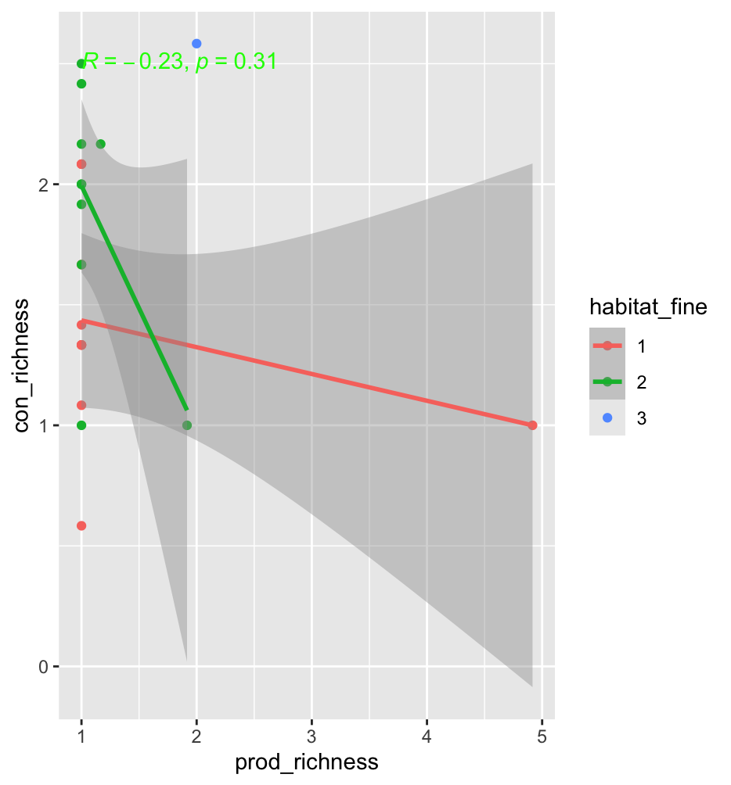
GCE data

Slide 16
Something wrong with Madison lake producer stability.

Slide 17
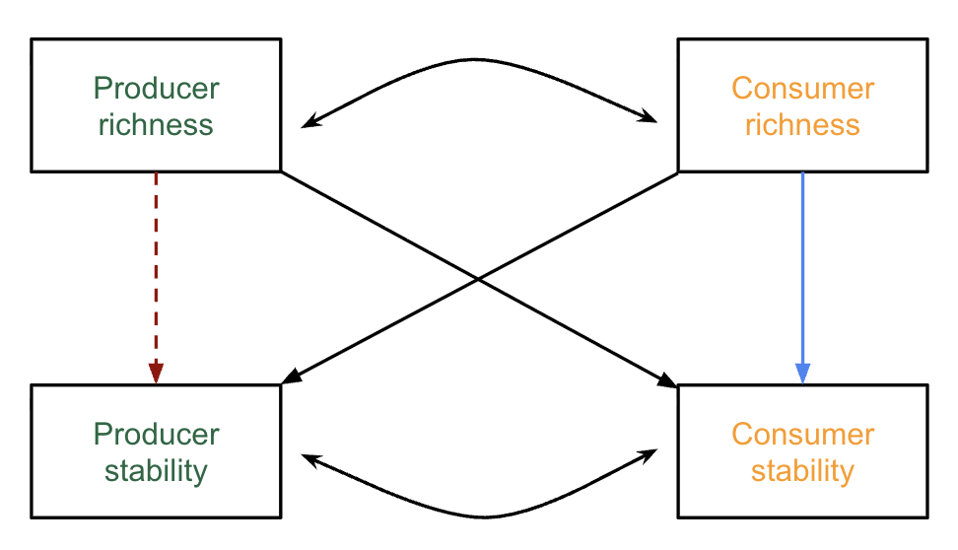

Do we need both bottom-up and top-down controls?
Producer richness is correlated with consumer richness for both aquatic and terrestrial ecosystems.
Producer stability is NOT correlated with consumer stability for both aquatic and terrestrial ecosystems.

Slide 18
Assume only bottom up?
Terrestrial:
Use causal inferences:
?
Producer
richness
Consumer richness
Producer
stability
Consumer stability

Slide 19
Spatial method—consumers by all the data
Aquatic:
Terrestrial:
0.450
0.183
Producer
richness
Consumer richness
Producer
richness
Consumer richness
0.567 (*)
0.049
-0.091
1.828(*)
0.182
-0.717(*)
-0.302
0.426(.)
Producer
stability
Consumer stability
Producer
stability
Consumer stability
Notes:
This is counter-intuitive, because I thought top-down effect is strong in aquatic ecosystems, but it turns out such effect is stronger in terrestrial ecosystems.

Slide 20
Spatial method—herbivores
Aquatic:
Terrestrial:
0.450
0.183
Producer
richness
Herbivore richness
Producer
richness
Herbivore richness
0.553 (*)
0.098
0.032
0.958(*)
0.200
-0.629(*)
-0.293
0.384(*)
Producer
stability
Herbivore stability
Producer
stability
Herbivore stability

Slide 21
What are inconsistent with my expectation?
The two results are surprisingly similar.
Cross-trophic effects are stronger in terrestrial ecosystems than in aquatic ecosystems. This is unbelievable.
When using herbivores cross-trophic relationships remain the same.

Slide 22
Temporal method —consumers by all data
I would expect that these relationships would be weaker than the spatial method.

Slide 23
discussion
Do we need get some statistics for herbivore data, so that to show why we got the similar results?
I remember that one terrestrial site has no herbivore data??

Slide 24
Hypothesis: if we use herbivore, we should see stronger cross-trophic relationships.

Slide 25
Spatial and temporal models

Slide 26
What are the hypothesis of across-trophic relationships?

Slide 27
Some sites have two sets of consumers.
SBC: use fish
MCR:

Slide 28
We need to specify priors for brms models to ensure using non-informative priors.

