Slide 1
LTER Controlled Vocabulary Virtual WaterCooler - July, 2011

Slide 2
Controlled Vocabulary ActIVITIES
Workshops: March & May 2011 and lots of VTCs! Details at: http://im.lternet.edu/projects/controlled_vocabulary/meeting_notes
Workshop Participants: John Porter, Margaret O’Brien, Kristin Vanderbilt, Don Henshaw, Corrina Gries, Eda Melendez, Todd Crowl, Julia Jones, & Rodger Ruess
Produced:
Terms of Reference (submitted to IMEXEC)
Draft “Keywording Best Practices”
Draft Use Cases for keywording and searching

Slide 3
VTC - Objectives
Get feedback on general direction of working group activities
Prioritize “Next Steps” on connecting the controlled vocabulary to LTER systems
“Scientists seeking data should be able to efficiently and reliably locate LTER datasets through searching, and browsing …“

Slide 4
The Challenge
Eclectic use of terms to used for discovering LTER data makes it difficult to perform reliable or efficient searches
Often several terms for one concept
One site uses CO2 another Carbon Dioxide, another Carbon-dioxide
Carbon to Nitrogen Ratio, C:N, C:N Ratio, Carbon-to-nitrogen Ratio
No way to relate broader terms with narrower terms
Searching on “Landscape Change” doesn’t find data sets related to “desertification” even though desertification is a kind of landscape change

Slide 5
Goals for Development of Keyword List
Identify a list of preferred terms that would be used by sites in creating metadata documents
Focus on LTER-wide searches
Want to facilitate cross-site synthesis
People searching LTER Metacat rather than individual sites are interested in relevant data from multiple sites
Want to hit the “sweet spot” for the number of terms
Too many terms make keywording documents difficult, and results in searches with too few datasets
Too few terms make it hard to locate usably small numbers of datasets

Slide 6
Steps Taken
Assembled list of words already in LTER Metadata (EML documents)
Selected using criteria:
Keywords shared with GCMD and NBII, or
Keywords used at more than one LTER site
Reviewed by Information Managers
Removals and additions were suggested
Edited based on voting

Slide 7
Structuring the Controlled vocabulary
Goal: Improve Searching & Browsing
Reliability (of all the suitable target documents, what percentage did you find)
Efficiency (of the documents your search returned, what percentage were suitable)
A list alone is not sufficient to support browsing and sophisticated searching of data – more structure is needed

Slide 8
Structures
List | Synonym Ring | Taxonomy | Thesaurus | Ontology
=
=
=
=
Multiple taxonomys are a Polytaxonomy
Complexity

Slide 9
Activities
The VOCAB Working Group has created a draft set of 10 taxonomys containing 627 preferred terms
Includes additional “broader” terms needed for grouping
Additionally there are 144 synonyms (non-preferred terms)
Some terms originally in the list have been removed because the were perceived to be too ambiguous or context-sensitive to be useful for the purposes of searching or browsing
E.g., “Aboveground”
Some “related” terms have also been identified

Slide 10
How List and Polytaxonomy Will be used
Permit use of a browse interface
Make searches more sophisticated
search includes synonyms plus narrower terms and/or related terms
Develop tools to help in adding keywords to LTER metadata documents
Duane Costa HIVE tool
Web form Autocomplete
Keyword Browser

Slide 11
Tools
Adopted “TemaTres” Thesaurus Database
http://vocab.lternet.edu
Provides web-service-based access
Instances can be set up for individual sites to meet specific site needs
e.g., http://vocab.lternet.edu/vocab/luq
See: http://databits.lternet.edu/spring-2011/managing-controlled-vocabularies-tematres
Margaret O’Brien and John Porter customized it to perform Metacat Searches for testing purposes

Slide 12
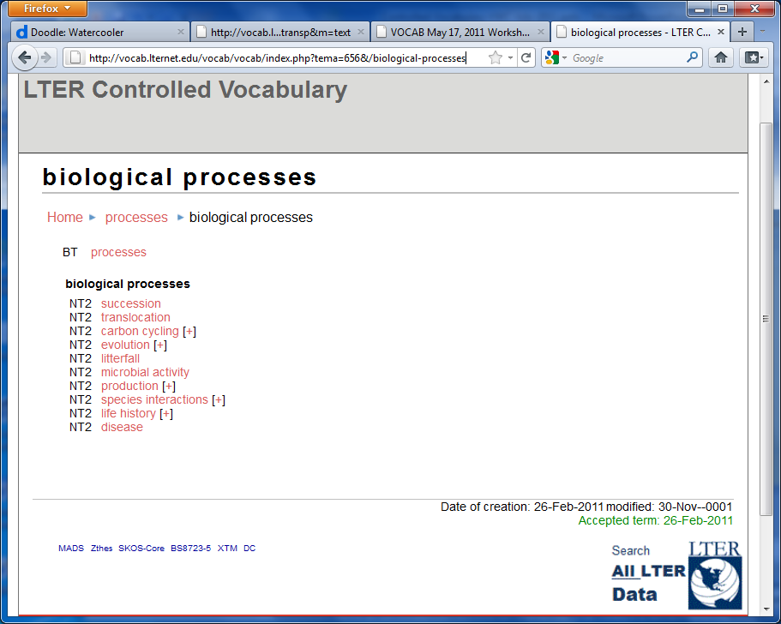
Search button allows searching the LTER Metacat for the term

Slide 13
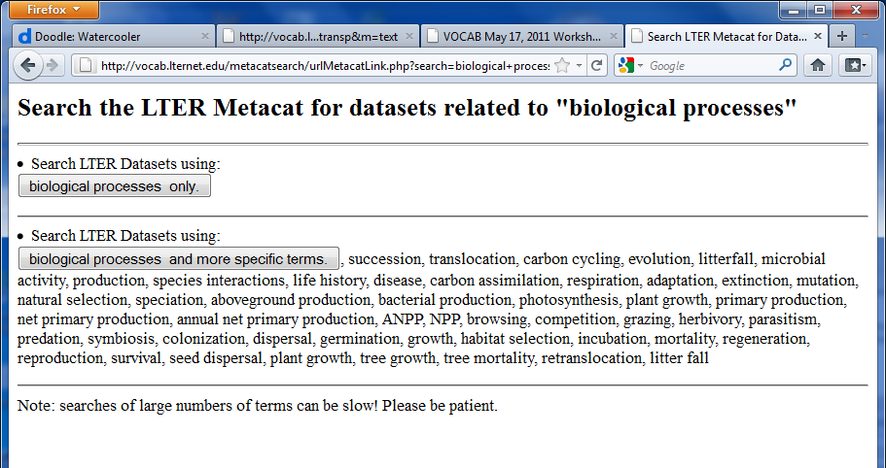
The “test” interface lets you select which terms will be used in the search

Slide 14
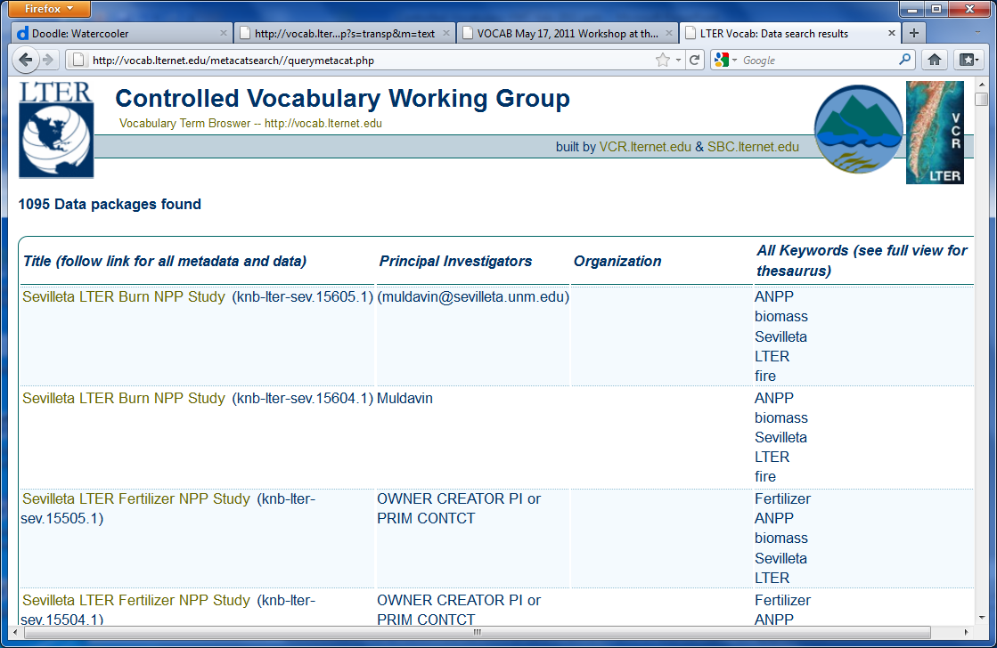

Slide 15
Other “Tematres” tools
Thesaurus Web Publisher - Viewer
http://vocab.lternet.edu/thesauruswebpublisher
Visual Vocabulary – Graphical Viewer
http://vocab.lternet.edu/visualvocabulary/lter
Tematres View – Viewer
http://vocab.lternet.edu/TematresView/view_thesaurus.php
Keyword Distiller (tries to find suitable keywords based on input text block)
http://vocab.lternet.edu/keywordDistiller

Slide 16
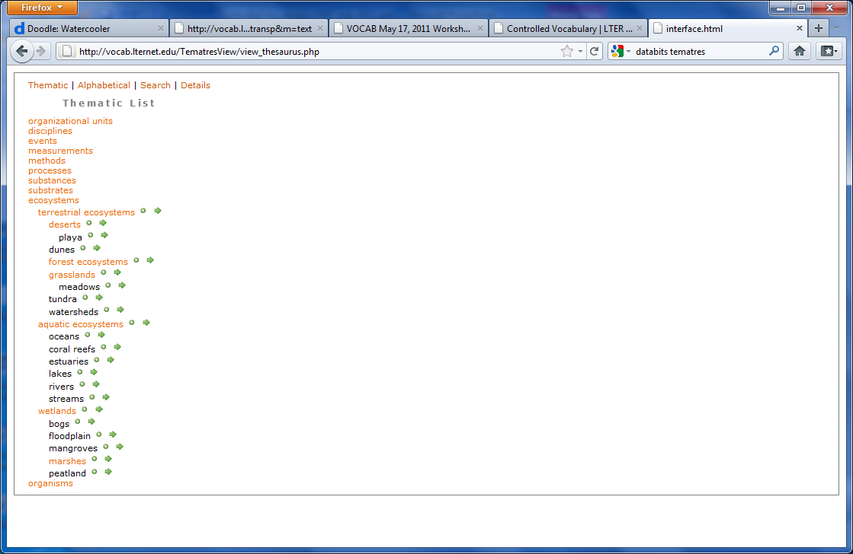
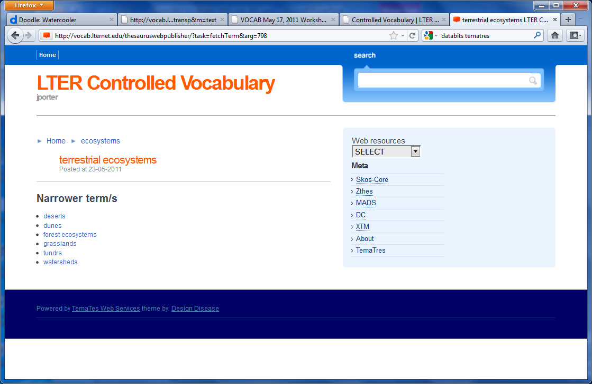
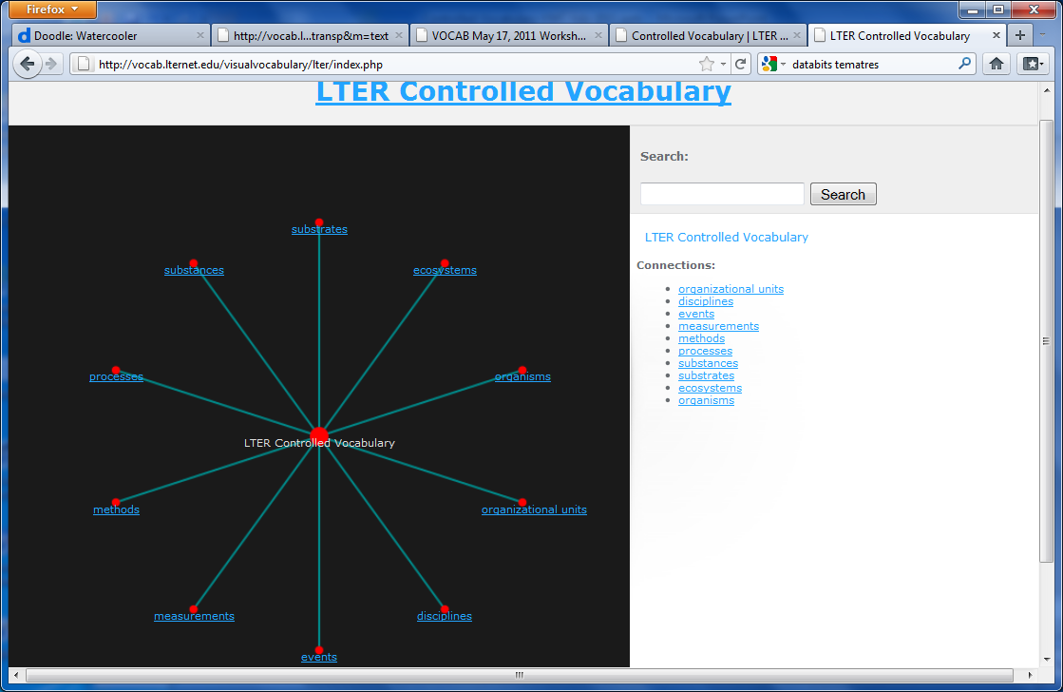
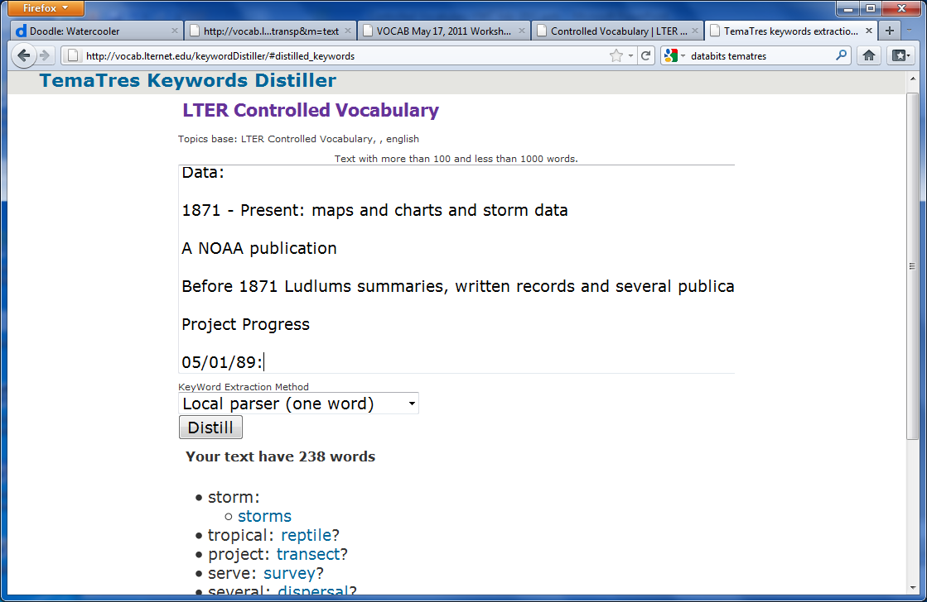
Other TemaTres-related Tools

Slide 17
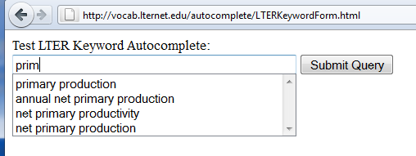
TOOLS: Autocomplete Keywords
Adapted existing PHP/JavaScript-based autocomplete tool to serve LTER Keywords into existing web forms
http://vocab.lternet.edu/autocomplete/LTERKeywordForm.html
Relatively simple installation
Copy JavaScript code from example into your web form
Add the included PHP program to your server
Options allow use of local or site dictionaries, if desired.
Download Files at:
http://vocab.lternet.edu/autocomplete/LTERKeywordAutocomplete1.1.zip

Slide 18
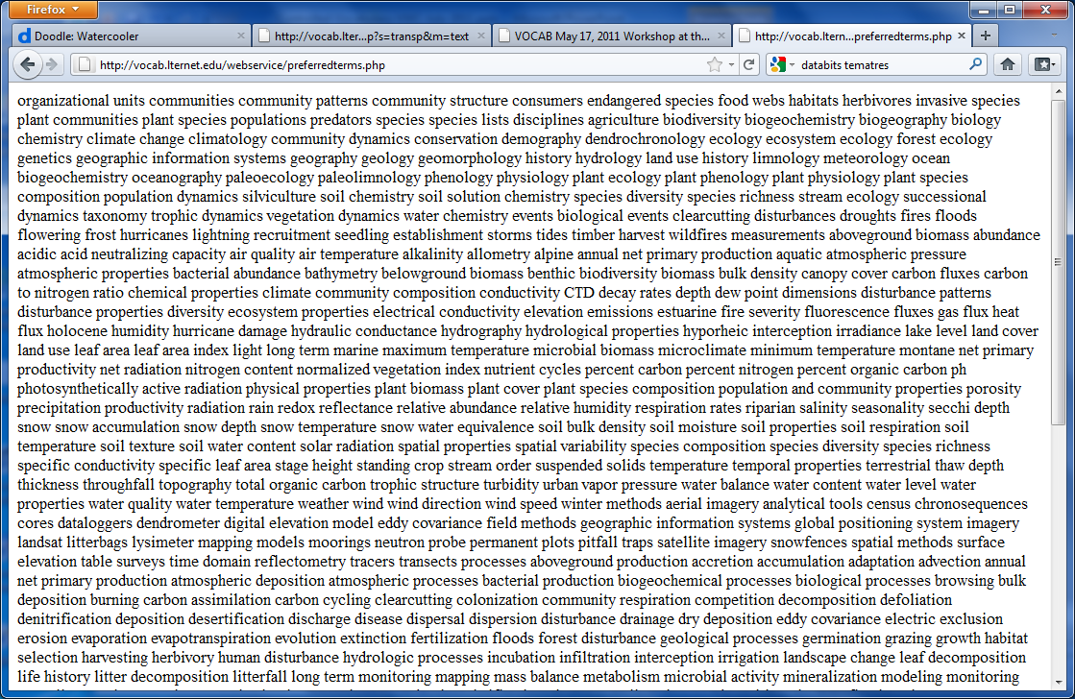
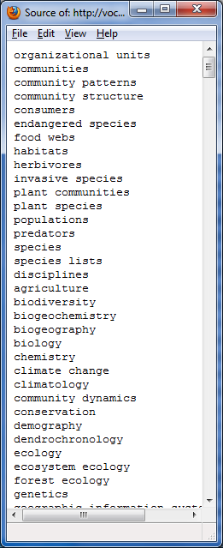
Tools: New WeB Services
Get list of preferred terms only
Used with keywording tool
http://vocab.lternet.edu/webservice/preferredterms.php
Purpose: Get current list of LTER Preferred Keywords for use with Autocomplete and other tools

Slide 19
Tool: Keyword expander web service
Provides lists of linked terms for a target search
Synonyms
Narrower
Related
Narrower + Related
Narrower + Related and the narrower terms of related terms
Provides results in a variety of formats (list, XML, csv)
Purpose: to provide LTER an expanded list of search terms for other systems (e.g., LNO Data Catalog)
http://vocab.lternet.edu/webservice/keywordlist.php

Slide 20
Next Steps – List & Taxonomy
There is still some minor cleaning up to be done (terms marked for possible deletion)
The “Best Practices” document contains instructions on how to propose additions to the controlled vocabulary

Slide 21
NEXT STEPS - Priorities for LNO ????
LNO has agreed to provide 1 week of Duane Costa’s time to help link the LTER Controlled Vocabulary to the LNO web site
We need to provide Duane with a prioritized list of tasks
And enter them into the tracking system
https://trac.lternet.edu/trac/NIS/report

Slide 22
Next Steps
Task: Replace existing Metacat Hierarchy with Controlled vocabulary
Limited to 2 levels displayed on the web page
Task: Enhance Basic Search Box
Replace existing autocomplete list with LTER preferred keywords
Automatically add synonyms and narrower (possibly narrower+related) terms to searches as OR’s
Task: Upgrade Advanced Search
use checkboxes to select automatic addition of narrower, or related or both or all

Slide 23
Next Steps - Keywording
Semi-automated keywording
Adapt Duane’s HIVE tool to ingest EML documents and return a modified EML document, or EML snippet
Select Keywords via Browse Interface
Browse through hierarchy and select keywords with checkboxes
Returns list or EML snippet
Implement Keyword Autocomplete on web forms at LTER sites

Slide 24
PRIORITIES?
Below are some of the suggested activities. Which should have the highest priority for implementation?
Searching | Keywording | Other
LNO Browse * | HTML Form Autocomplete * | Site vocabularies (if needed)
LNO Simple Search * – -- make work with non-preferred inputs | LNO/HIVE Semi-automated keywording - ******, return list as well | Improvement of keyword lists associated with datasets
LNO Advanced Search | Browse interface for keywording - * | Definitions for every term*
 |  | EML evaluator – how many preferred keywords, synonyms, and taxonomys are represented *
* - priorities not in list order

Slide 25
Discussion
Core Areas Keywords
EML keyword modifications
Improve tagging – type attributes for keyword attributes
Interest in how terms are organized or displayed
Site search clients also needed

Slide 26
THANKS!
Members of the Controlled Vocabulary Working Group have all made major contributions to the work of the group.
Henshaw, Donald; Jones, Julia; Laundre, James; Ruess, Roger;
Downing, Jason; Costa, Duane; Servilla, Mark; San Gil, Inigo; Brunt, James; Melendez-Colom, Eda; Crowl, Todd; Gries, Corinna; O'Brien, Margaret; Vanderbilt, Kristin; and Porter, John

