Slide 1
Controlled Vocabulary Working Group
Virtual Water Cooler Session April 6-7, 2009
Moderator: John Porter
http://webmeeting.dimdim.com/portal/JoinForm.action?confKey=jhp7e

Slide 2
Goals for this VTC
Brief review of activities
Get feedback on “LTER Data Keywords” draft list
Discuss process for managing keyword list
Next steps? – Taxonomys, Tools etc.
What should we do at the ASM meeting?

Slide 3
Disjointed keywords
make it hard to locate similar datasets
Carbon Dataset 1
Carbon
Dataset
2
Carbon
Dataset
3

Slide 4
Overlapping keywords
make it easier to locate similar datasets
Carbon Dataset 1
Carbon
Dataset
3
Carbon
Dataset
2
Note that the purpose of keywords and a controlled vocabulary is not to provide the best possible description of a particular dataset, but to provide a mechanism for appropriate groupings of datasets

Slide 5
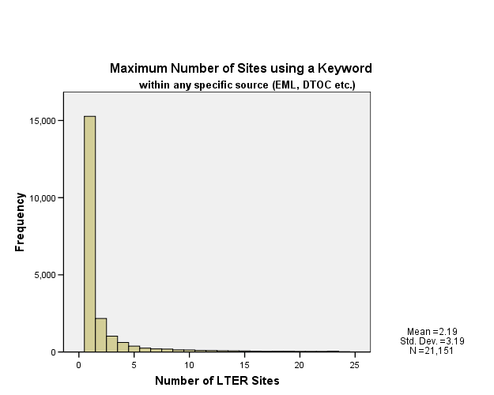
The Problem
Inconsistent, disjunct and sparse keywords negatively impact data discovery
72.2% of all keywords are used at only a single LTER site
90% of all keywords are used at 4 or fewer LTER sites

Slide 6
Goals for the Controlled Vocabulary Group
Aid the discovery of data by researchers
  Consistent, broadly applied keywords
  Develop “browseable” structures (taxonomys, thesauri, ontologies)
Aid in the creation of high-quality metadata
Make it easier for LTER data to interoperate with other data systems

Slide 7
Past Activities
Research
  A variety of studies regarding which words are used where
Improvement of existing systems
  Metacat drop down list now features the most common existing keywords
Discussion of possible tools to:
  Aid in Keywording
  Aid in searching

Slide 8
Draft List
Creation of a draft list of ~650 words for an LTER-wide controlled vocabulary
  Words must be used at two or more sites, OR
  Words must be used at one or more sites and also be found in either NBII, GCMD, the KNB/Metacat browse list or recent metacat searches
  Excluded were species names and names of geographic locations which probably belong in separate lists

Slide 9
Draft List
Words on the candidate list were edited to create “Preferred forms” that comply with NISO-Z39.19-2005
  Nouns are plural if you would count them, singular if they are an amount
  Removal of hyphenated words when possible
  Creation of a “synonym ring” linking extant forms with preferred forms (~150 terms)

Slide 10
A Logical Next Step
The draft list needs to be formalized in a database that includes (NISO Z39.19 sections 11.1.4 & ):
  term
  source(s) consulted for terms and entry terms.
  scope note
  USED FOR references – to indicate which synonyms, near synonyms, and other expressions are covered by the term.
  nondisplayable variations, e.g., common spelling errors
  broader terms
  narrower terms
  related terms
  locally established relationships
  category or classification number
  history note, including minimally the date added, as well as the record of changes, if any
Some elements support development of hierarchical taxonomys and thesauri

Slide 11
Issues
Who should make decisions regarding the content of the list (11.3 in NISO Z39.19)?
How should site-specific terms be handled?
  Include in list, but use Scope or Category elements to distinguish
What steps are needed to create a hierarchical polytaxonomy or thesaurus?

Slide 12
Discussion Topics
Get feedback on the draft list
How (who) should manage the keyword list?
Next steps? – Taxonomys, Tools etc.
What should we do at the ASM meeting to move the process forward?

Slide 13
Day 1 – Discussion Points
Generally pleased with the list. Issues:
  Site-specific words
  Human dimensions largely absent
  Locations
  Homographs
Next Steps:
  Give sites a chance to propose addition, deletion or substitution of terms in the list, and/or additions to the synonym ring
  Vote on changes

Slide 14
Day 1 – Discussion Points
What to do at ASM meeting?
  Session presenting different approaches
    Lists through ontologies
  Session: New Tools for Locating Data
    Spec out tools for keywording and searching
  Session “How to find and use data”

