Slide 1
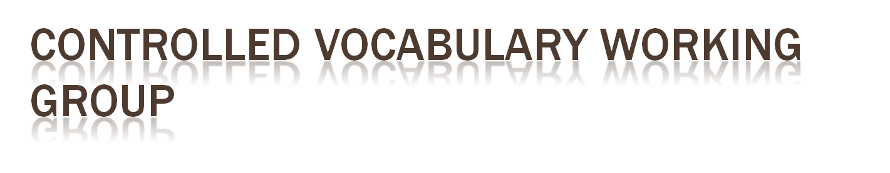
LTER IM Meeting 2008 – Benson, Boose, Bohm, Gries, Gu, Kaplan, Koskela, Laney, Porter, Remillard, Sheldon and others

Slide 2
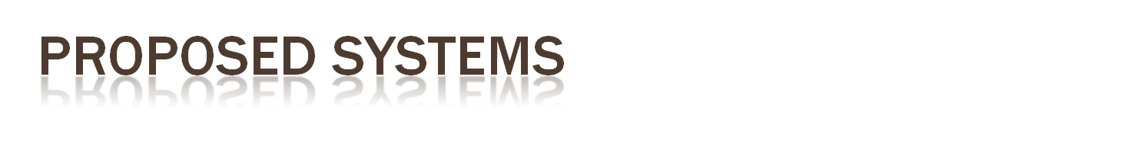
Response to requests in VTC Aug. 2008

Slide 3

Duane Costa

Slide 4

Goal: Enhance search results for end-user by extending the list of matching search terms to include broader/narrower/related terms
How: Query a thesaurus via web service and use the extended set of terms to expand the search; two possible approaches (see next slide)
Potential problem: Could overwhelm user with too many search results
  Extended search mode could be made optional for user, toggled on/off with a checkbox
  Or, user could be offered a list of additional terms to select from, where only the selected terms would be included in the extended search

Slide 5

Approach #1: Extend list of user-entered terms by dynamically querying a thesaurus via web service at search time
  Web service is used at time of search, adding overhead to search time
  Too many search terms could severely degrade performance of Metacat search
  Only terms entered by user are queried via web service (this is an advantage over Approach #2, where all terms in an EML document must be queried via web service)
Approach #2: (1) Evaluate terms in each EML document; (2) For each term, query thesaurus via web service to get additional terms; (3) Store additional terms for each document somewhere external to the document (e.g. database table)
  Web services are used during “off-hours” and results are cached locally in a table
  Need to decide which terms in EML document should be queried via web services; potentially many
  Need a good indexing scheme to efficiently retrieve all matching terms for an EML document
  Whenever an EML document is updated, the cached set of extended terms must be updated

Slide 6
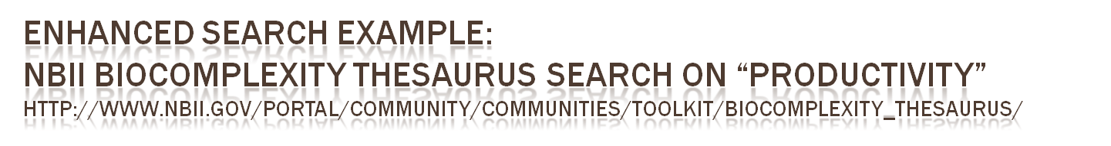
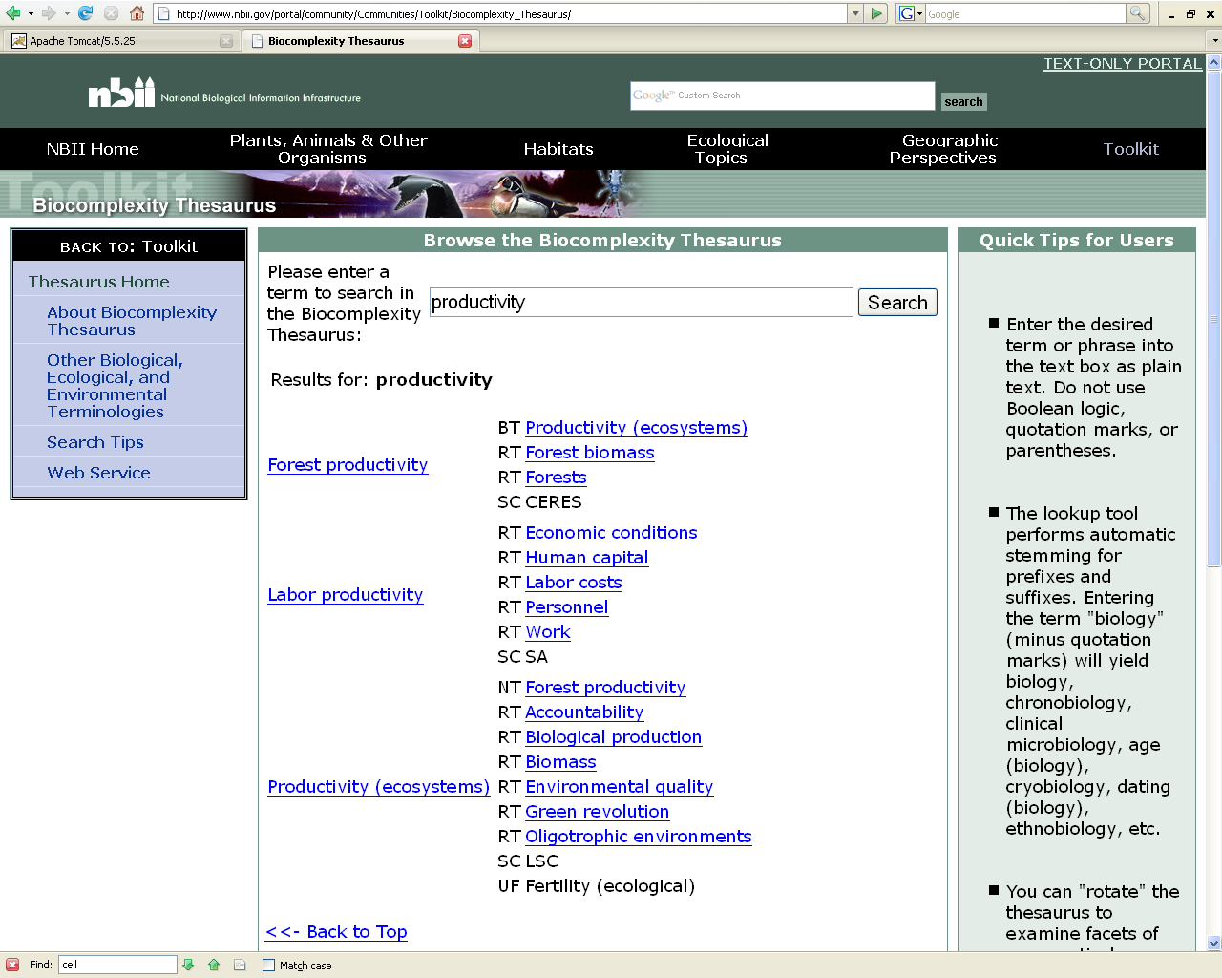

Slide 7

John Porter

Slide 8

GOALS
HOW
Interfaces
  Web interface – returns string that can be cut-and-pasted into documents
  Web service – accepts XML queries (tentative suggestions) and returns XML results
Technology
  Compare words in documentation with existing list(s) to get initial suggestions
  Expand the words that do match to include more general and more specific terms
  Table of synonyms
To make it easier for metadata creators to use existing/accepted terms rather than making up new ones
To analyze metadata content to suggest suitable terms

Slide 9

1. Document to Scan for words
http://metacat.org/myEML
2. Select the Word(s) that might make good Keywords
Suggest your own word:
Salmon
OR
Fish,
Bird,
Forest,
Carbon
3. Select Related Terms that also would make good keywords
Anadromous species
Commercial fishing
Marine fishes
4. XML result to paste into document:
<term>fish </term>
<term>Commercial fishing</term>

Slide 10


Slide 11

Create Preferred Word list
  With tools that display list quickly
  Process for adding new terms
  Ordered list so present only the most important ones first
    Both NET and Site relevance “permafrost”
An tools that use that list “google term list style”

Slide 12
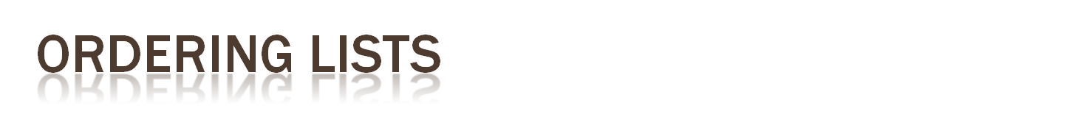
List sources
  EML Keywords
  EML attributes names and labels
  Single words from Abstracts and titles and publications
Criteria for Ordering
  How often does the term appear in metacat searches?
  Number of sites using term
  Number datasets that use the term (weight by total number of site datasets)
  Is it in GCMD list?
  Is it in NBII thesaurus and if so how many related terms?

Slide 13

Periodically develop hierarchy of 500 highest rated terms
  Periodially generate synonomy that includes preferred version
    Best Practices on keywords

Slide 14

Tools to automatically generate ranked list from sources
AJAX-based web page widget/insert that uses list
Group charged with creation of hierarchy /synonomy etc.
  Get funding to do this
  Scientists
  Need way to code hierarchy in EML?

