Slide 1
Controlled Vocabulary Working Group
LTER IMC Meeting Sept. 2010

Slide 2
Past Activities
Created list of about ~650 terms based on widely-used LTER EML Keywords
Autocomplete search aid added to Metacat
In early 2010 the LTER Executive Board gave permission for the IMC to manage a controlled vocabulary list for LTER sites

Slide 3
Recent Activities
Duane Costa – work with HIVE* project
Transformed list and synonym ring into SKOS format
Created HIVE-RS (REST-based web services)
scheme resources
concept resources
search & tagger resources
Developed prototype tool that uses HIVE services to suggest appropriate LTER and NBII keywords for EML documents
*HIVE = Helping Interdisciplinary Vocabulary Engineering

Slide 4
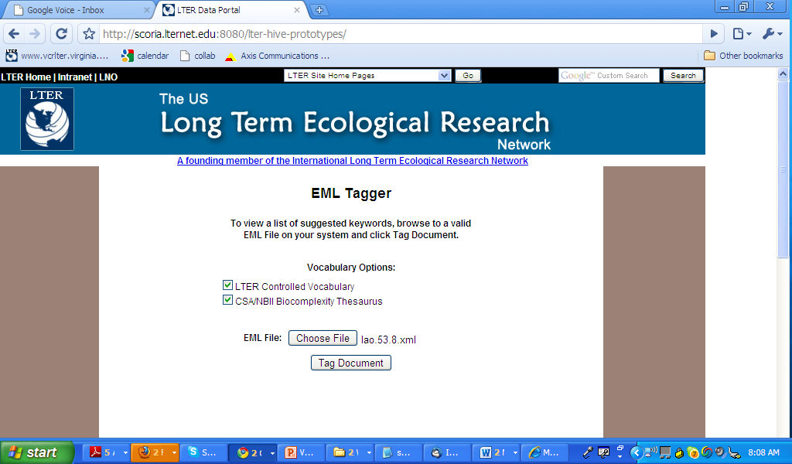

Slide 5
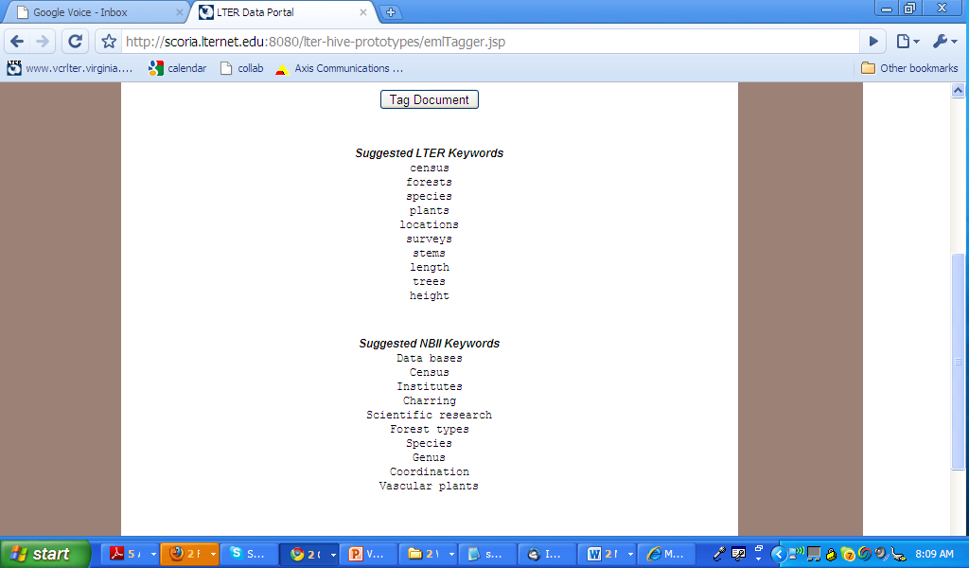

Slide 6
Needed Activities – Vocabulary
Draft “Vocabulary Management Plan”
Who will oversee updates, when, how vetted
Develop/adopt database structure and tools for managing the list, synonym ring and hierarchical relations
Develop a polytaxonomy for placing terms into a hierarchical framework
Will result in new terms added to the list
Who should do this? How?

Slide 7
Using the Vocabulary
How can the HIVE keywording tool be enhanced to enable its use by LTER sites?
Use EML as input
How should suggested terms be incorporated back into site systems?
How can the vocabulary be incorporated into searching and browsing?

Slide 8
Discussion
Polytaxonomy is priority
Kristin has her own taxonomy browser for subset of words
Using Drupal
Working with ontologies
Entities (terms in keyword list)
Has some parent child stuff
Needs to populate
Need relational database to host content
Mapping to EML
Do we include only lowest level

Slide 9
Next Steps
Vocab organization and governance, procedures for modifying
Jim, Jason, Eda, Emery
Polytaxonomy creation
Margaret, Don, Phil Tarrant, Dan, Sue
Tools for ingestion & searching
Kristin
Duane
(Jason possibly)
(Eda possibly)

Slide 10
Action items (main meeting)
ToR
Work group
List management (include scientists )
Suggested in EB response
Begin generating polytaxonomy
Tools for ingestion and search
Schedule VTCs
Consider joining Discovery/API tiger team

