Slide 1

CHORD PROTOCOL
Distributed Systems
course
A.Y. 2018/2019

Slide 2
TABLE OF CONTENTS
1 - Protocol
2 - Application layer
3 - Critical parts
4 - Code structure
5 - Team composition

Slide 3
1 – PROTOCOL
The network supports 2^N – 1 nodes, with N hard coded
The finger table contains N nodes.
Implemented functionalities:
- lookup
- crash detection through UDP
- successors list
- dimension N
- resources replication
- replication factor 1
Notes:
We guarantee the recovery of the resources only if one node at a time crashes. Actually even if several nodes crash and they are not adjacent.

Slide 4
2 – APPLICATION LAYER
Resources management:
- resources creation
- resources publication
Network interaction:
- create the network
- join the network
- lookup
- leave the network
Information printing:
- resources
- node information

Slide 5
3 – CRITICAL PARTS
Resources management
- Finger table consistency after changes in the network topology
- Resources recovery after the crash of a node
Crash detection
- TCP Ack vs UDP ping
Network
- Socket management
- Port exhaustion
Synchronization
- Concurrent data structures
- Different locks to enable parallelism

Slide 6
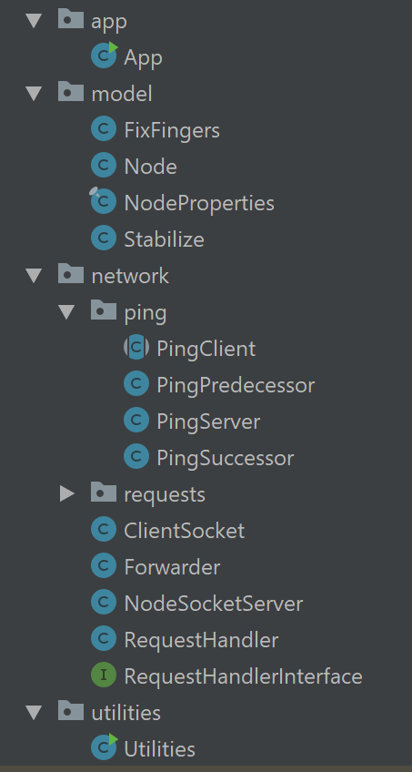
4 – CODE STRUCTURE
App
- Demo application
Model
- Library functions
Network
- Ping
- UDP implementation to detect crashes
- Requests
- Visitor pattern
Utilities
- SHA1

Slide 7
5 – TEAM COMPOSITION
Romeo Paolo 10542300
Staccone Francesco 10504541
Terracciano Luca 10493487

