Slide 1
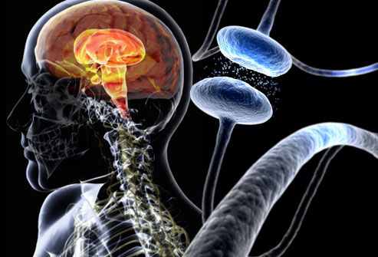

Diagnostic of early Parkinson’s disease
Using automatic classification and prediction models
Notes:
Diagnostic précoce de la maladie de Parkinson
Par classification automatique et modèle de prédiction

Slide 2
Overview
Topic & Data
Feature Analysis
Classifiers
Explanation
Design
Validation
Classifiers comparison

Slide 3
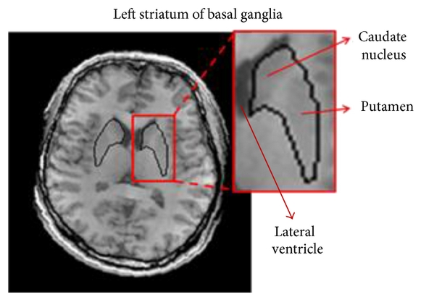
Topic & Data
Neurodegenerative disease
Bio marker's progression analysis
4 features for 736 patient (71.33% of PD)
SBR : Striatal
Binding Ratio
Notes:
Mort des cellules qui produisent la dopamine. Plus le marqueur augmente (ou diminue) plus on a de chance d’avoir la maladie.

Slide 4
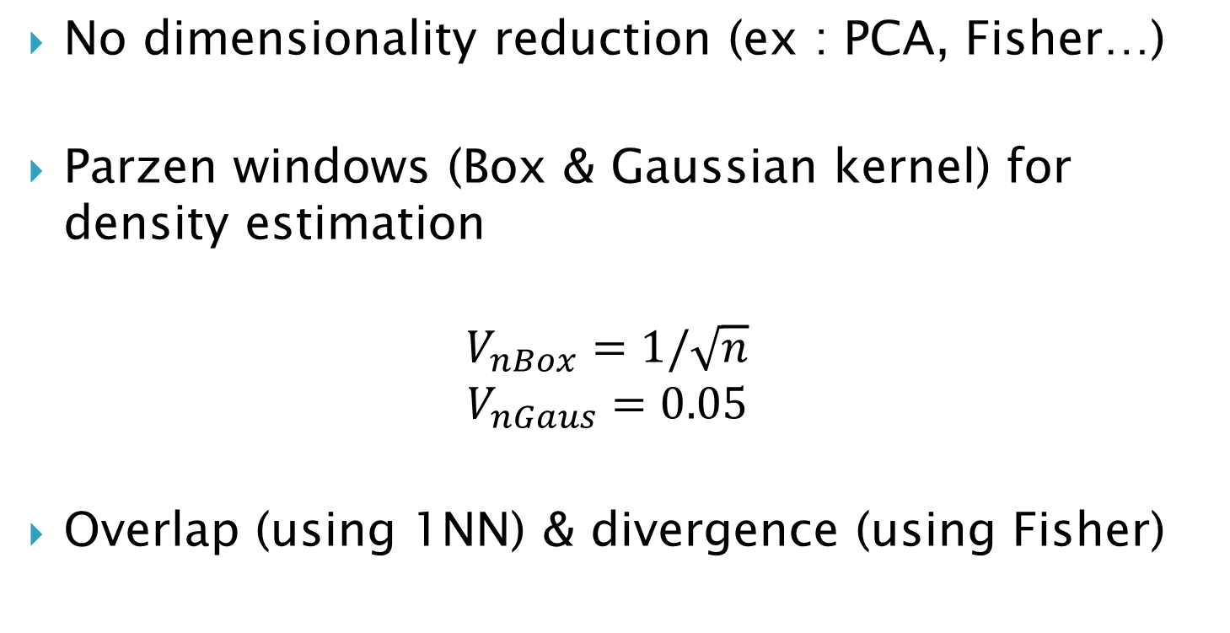
Feature Analysis
No dimensionality reduction (ex : PCA, Fisher…)
Parzen windows (Box & Gaussian kernel) for density estimation
$$V_{nBox}=1/\sqrt{n}$$
$$V_{nGaus}=0.05$$
Overlap (using 1NN) & divergence (using Fisher)
Notes:
Ce qui est intéressant c’est que l’article date de 2013, j’ai plus de données à ma disposition

Slide 5
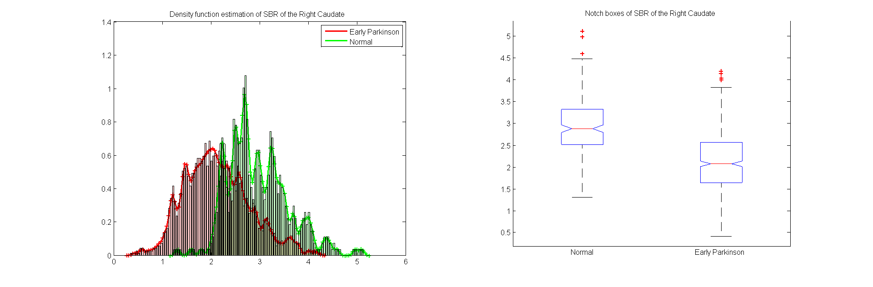
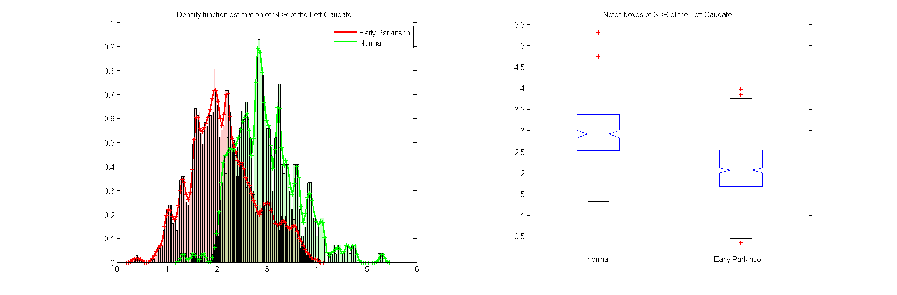
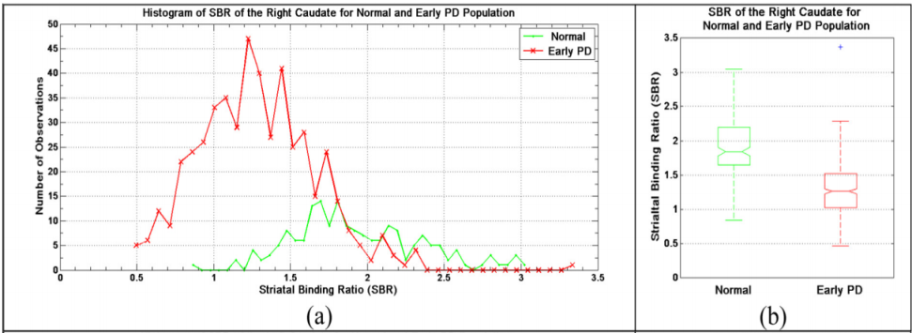
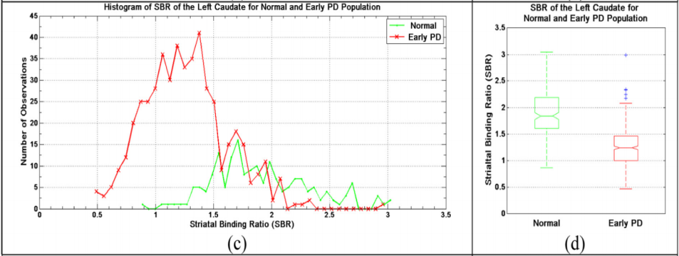
Feature analysis
SBR of Caudate
D = 0.8157 ; O = 27.5815% D = 0.8447 ; O = 28.6685%

Slide 6
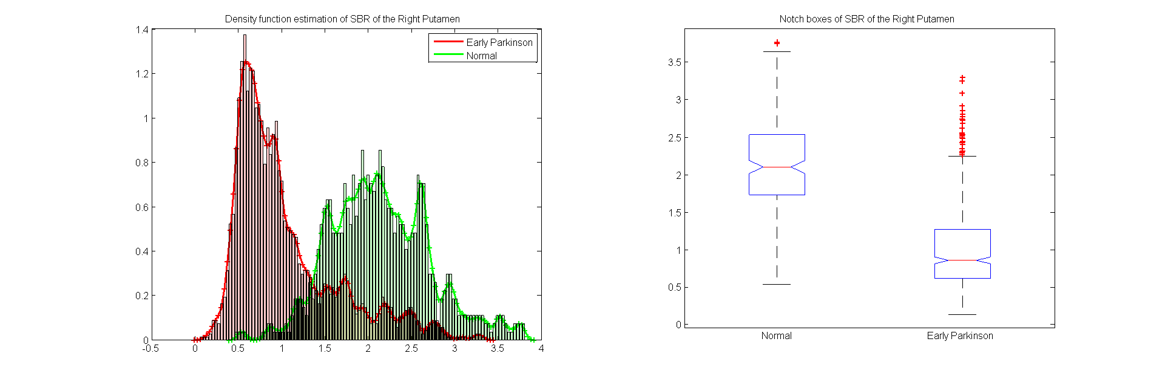
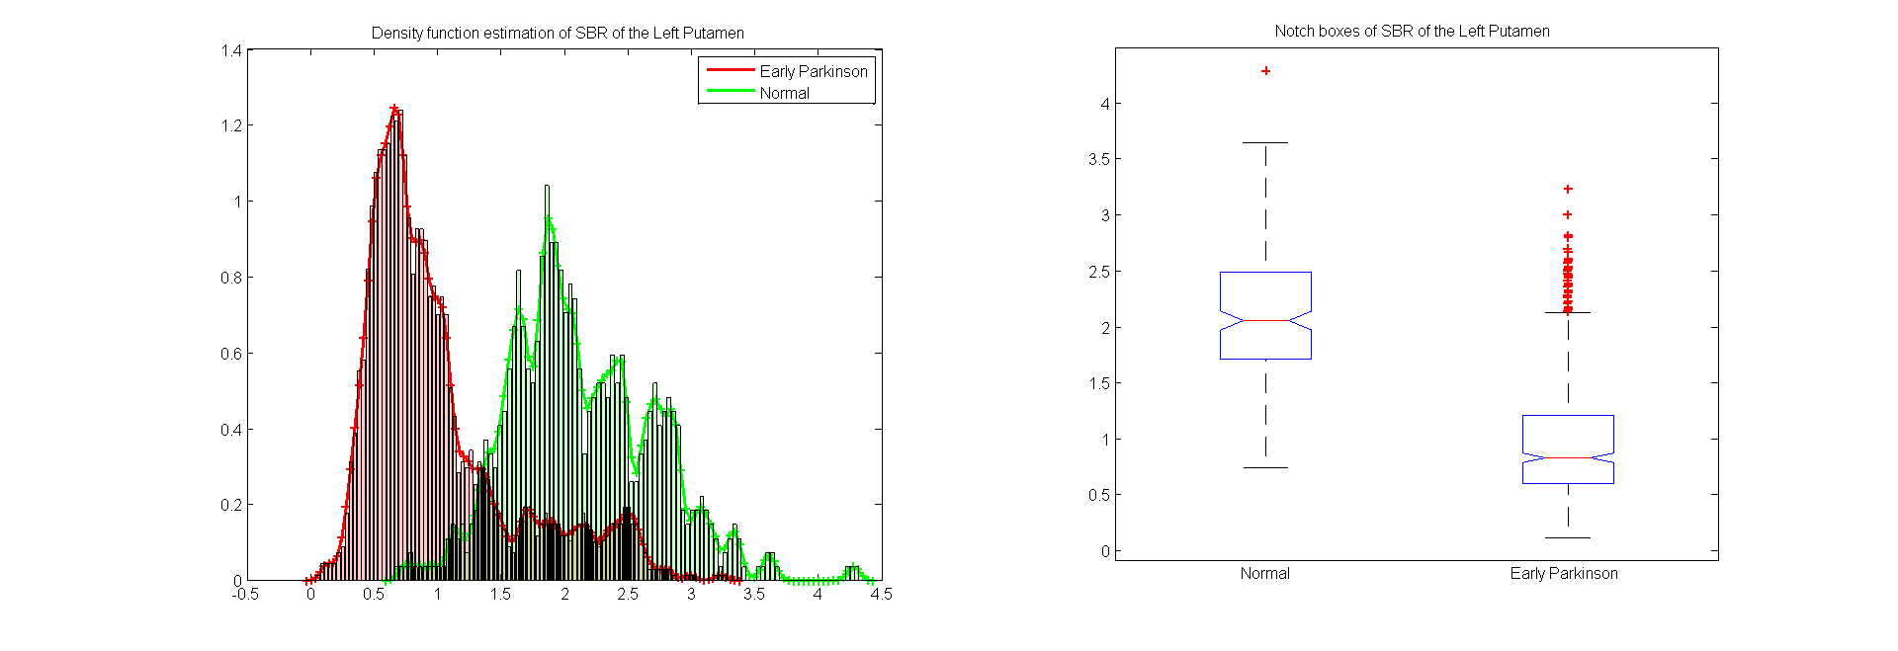
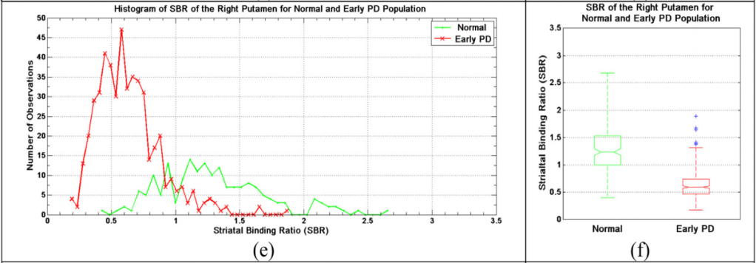
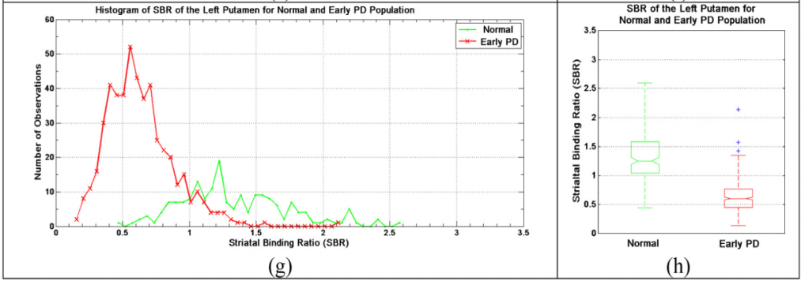
Feature analysis
SBR of Putamen
D = 1.7557 ; O = 20.7880% D = 1.8807 ; O = 21.4674%

Slide 7
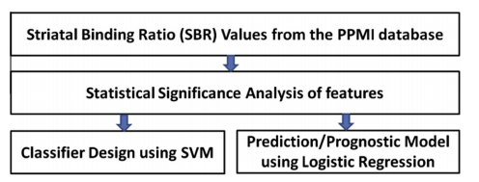
Classifiers
Authors suggest 2 classifiers (linear classifier & model prediction)
2 added (parametrical & non-parametrical) with Bayesian decision rule
Parametrical approach (Gaussian)
Non - Parametrical approach (Parzen window)
Bayesian decision rule

Slide 8
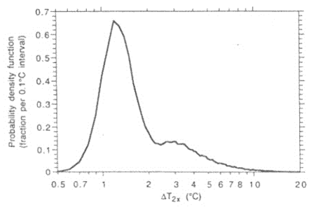
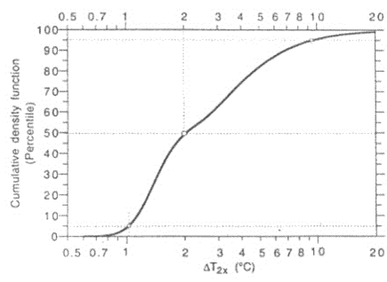
Classifier - Logistic Regression
To predict the occurrence’s probability of binary event (PD or no) knowing the random variable (SBR features)
Work with the repartition function
Density Repartition
Notes:
On veut prédire la probabilité d’un évènement binaire (parkinson ou non) en connaissant les variables aléatoire (caractéristiques SBR du patient).

Slide 9
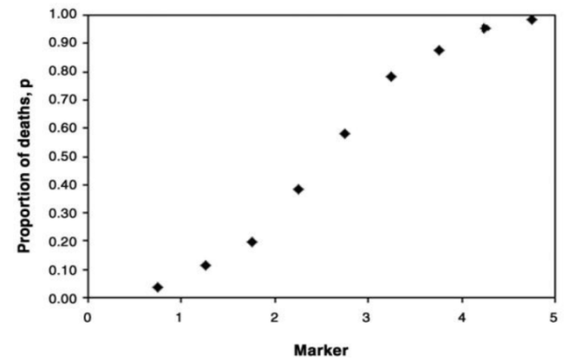
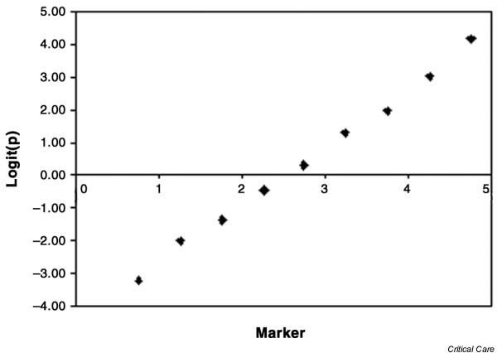
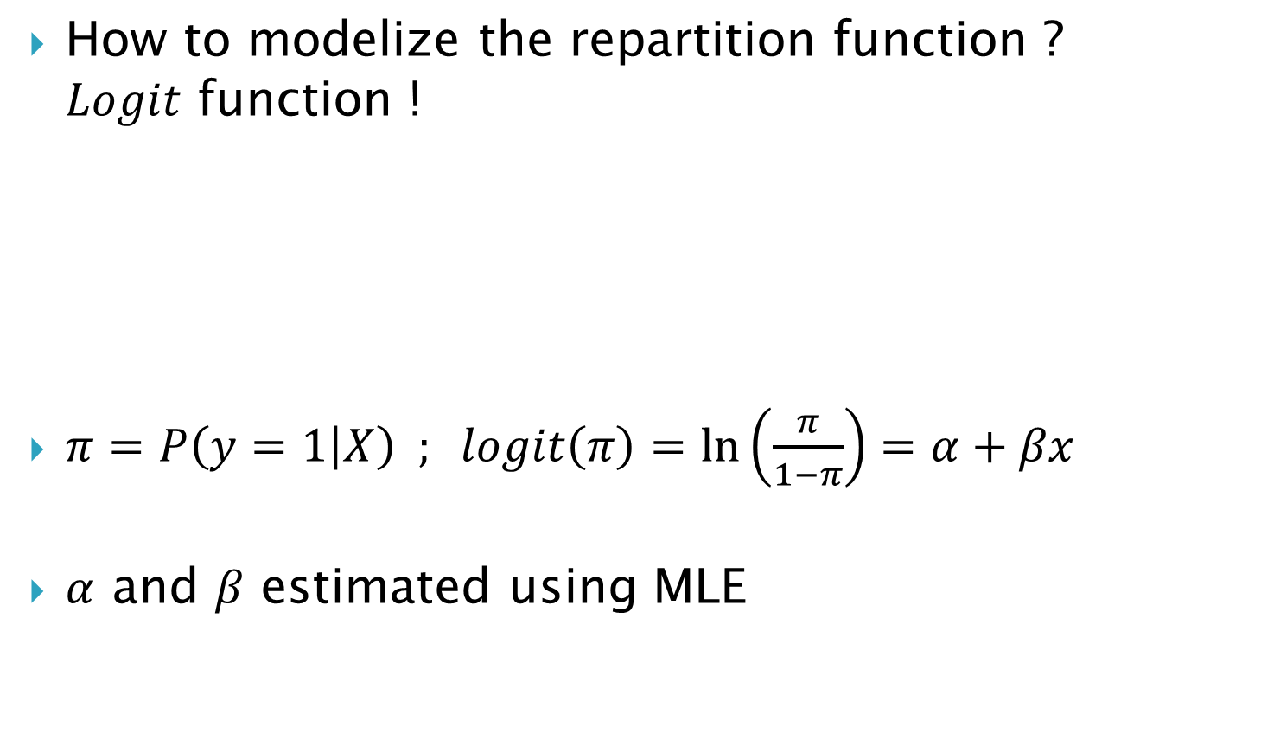
Classifier - M Logistic Regression
How to modelize the repartition function ? $Logit$ function !
$π=P\left(y=1 | X\right) ; logit\left(π\right)=\ln\left(\frac{π}{1−π}\right)=α+βx$
$α$ and $β$ estimated using MLE
Notes:
On veut prédire la probabilité d’un évènement binaire (parkinson ou non) en connaissant les variables aléatoire (caractéristiques SBR du patient).

Slide 10
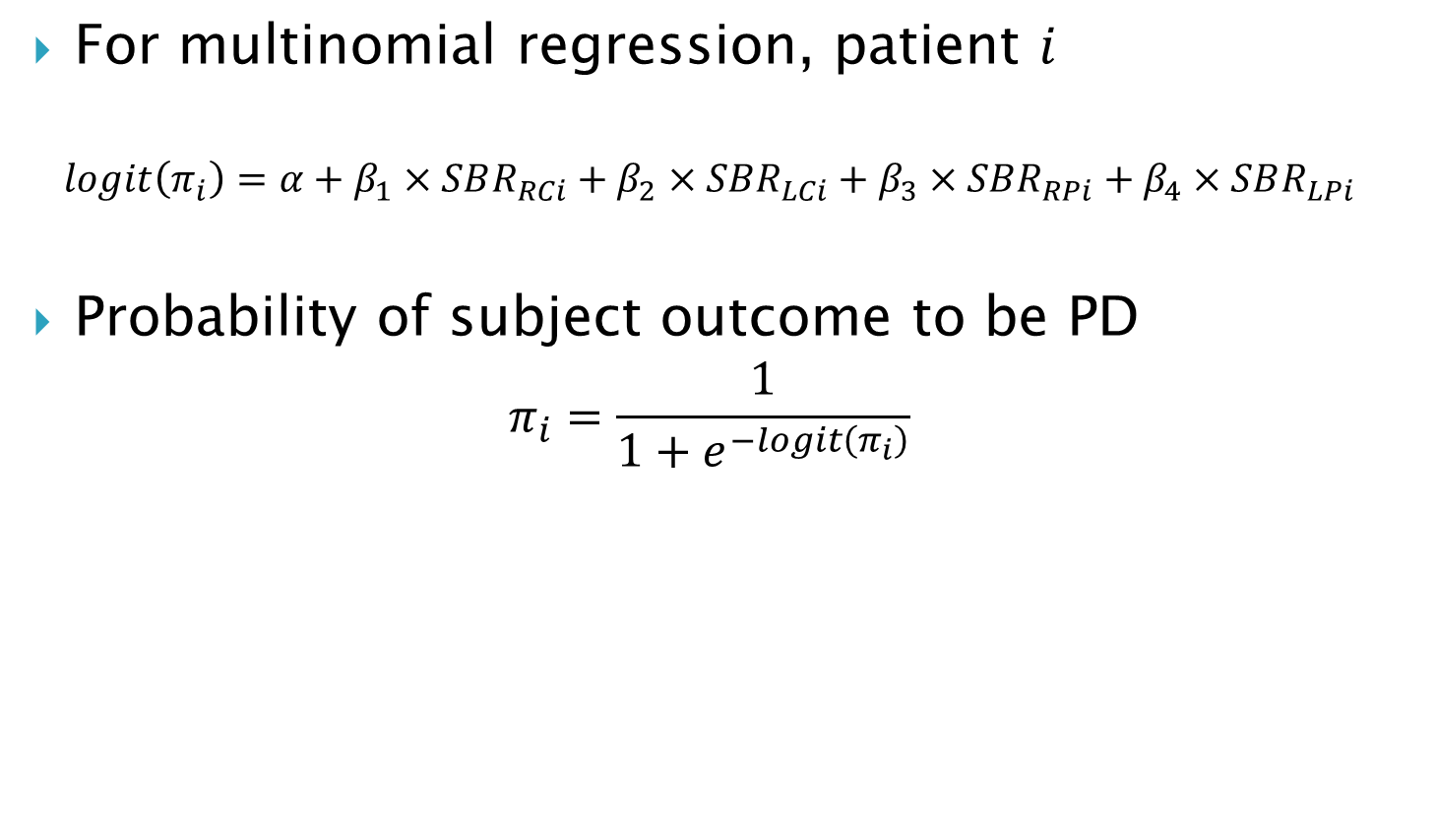
Classifier - Logistic Regression
For multinomial regression, patient $i$
$$logit\left(π_{i}\right)=α+β_{1}×SBR_{RCi}+β_{2}×SBR_{LCi}+β_{3}×SBR_{RPi}+β_{4}×SBR_{LPi}$$
Probability of subject outcome to be PD
$$π_{i}=\frac{1}{1+e^{−logit\left(π_{i}\right)}}$$
Notes:
La variance des points est lié au taux de recouvrement des 2 classes

Slide 11
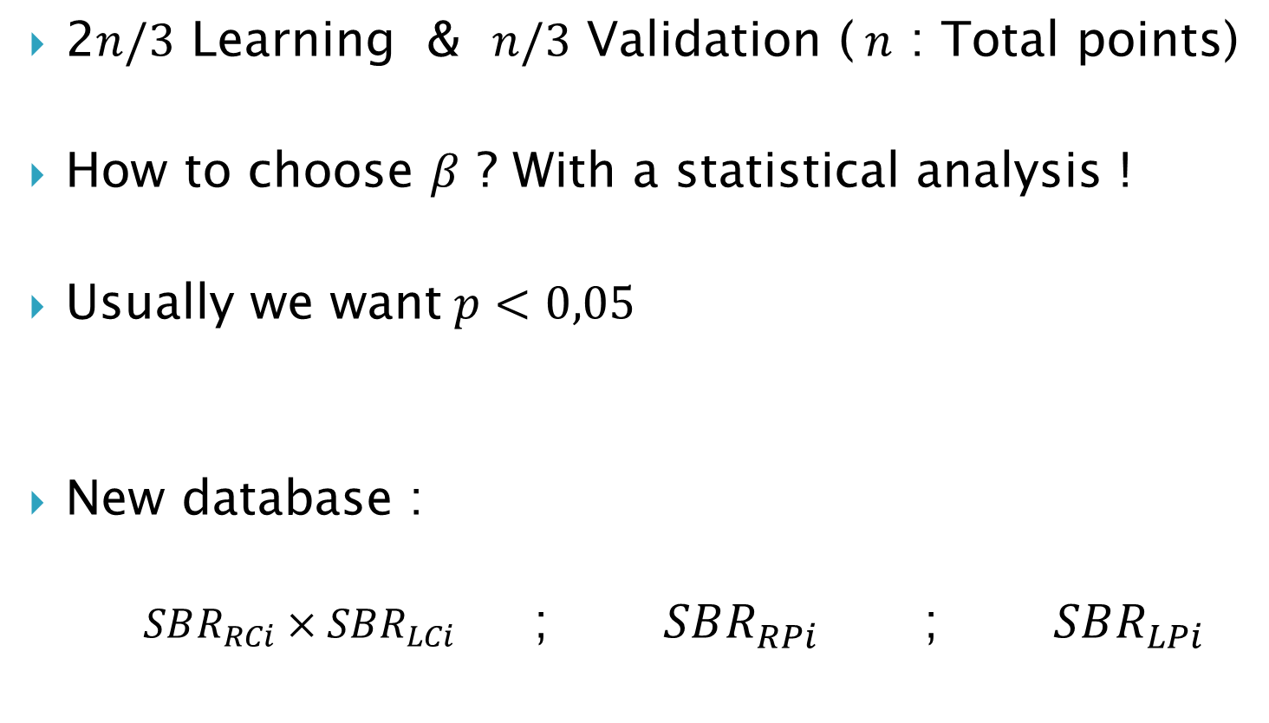

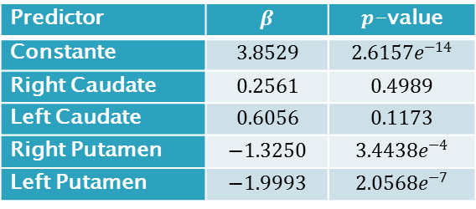
Classifier - Design MLR
2$n/3$ Learning & $n/3$ Validation ($n$ : Total points)
How to choose $β$ ? With a statistical analysis !
Usually we want$p<0,05$
New database :
$SBR_{RCi}×SBR_{LCi}$ ; $SBR_{RPi}$ ; $SBR_{LPi}$
Predictor | $$β$$ | $p$-value
Constante | $$3.8529$$ | $$2.6157e^{−14}$$
Right Caudate | $$0.2561$$ | $$0.4989$$
Left Caudate | $$0.6056$$ | $$0.1173$$
Right Putamen | $$−1.3250$$ | $$3.4438e^{−4}$$
Left Putamen | $$−1.9993$$ | $$2.0568e^{−7}$$
(*) For $P\left(y=0 | X\right)$
Notes:
La variance des points est lié au taux de recouvrement des 2 classes

Slide 12
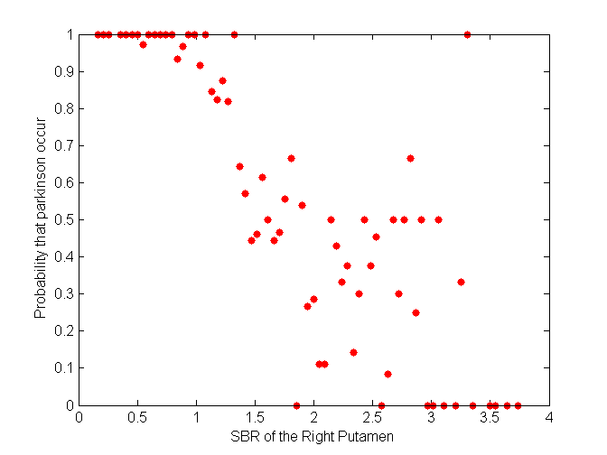
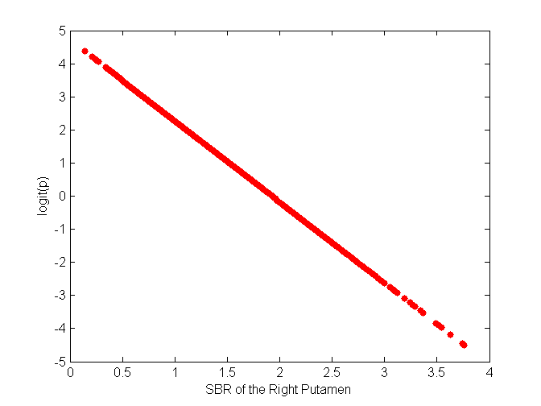
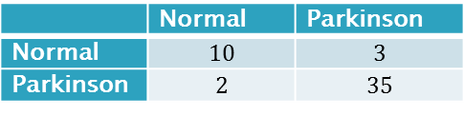


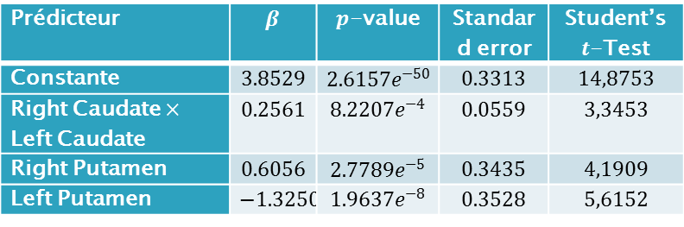
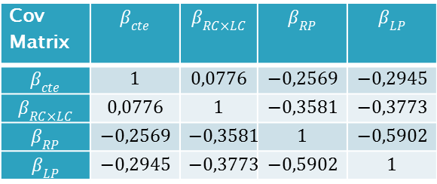

Classifier - Validation MLR
New predictors
$\text{Cross} \text{validation} \text{with} 50 \text{boxes}\text{ (}length=14\text{)}$
Prédicteur | $$β$$ | $p$-value | Standard error | Student’s $t$-Test
Constante | $$3.8529$$ | $$2.6157e^{−50}$$ | $$0.3313$$ | $$14,8753$$
Right Caudate $×$ Left Caudate | $$0.2561$$ | $$8.2207e^{−4}$$ | $$0.0559$$ | $$3,3453$$
Right Putamen | $$0.6056$$ | $$2.7789e^{−5}$$ | $$0.3435$$ | $$4,1909$$
Left Putamen | $$−1.3250$$ | $$1.9637e^{−8}$$ | $$0.3528$$ | $$5,6152$$
Cov Matrix | $$β_{cte}$$ | $$β_{RC×LC}$$ | $$β_{RP}$$ | $$β_{LP}$$
$$β_{cte}$$ | $$1$$ | $$0,0776$$ | $$−0,2569$$ | $$−0,2945$$
$$β_{RC×LC}$$ | $$0,0776$$ | $$1$$ | $$−0,3581$$ | $$−0,3773$$
$$β_{RP}$$ | $$−0,2569$$ | $$−0,3581$$ | $$1$$ | $$−0,5902$$
$$β_{LP}$$ | $$−0,2945$$ | $$−0,3773$$ | $$−0,5902$$ | $$1$$
(*) For $P\left(y=0 | X\right)$
 | Normal | Parkinson
Normal | $$10$$ | $$3$$
Parkinson | $$2$$ | $$35$$
Error rate : $11,11\%$
Notes:
La variance des points est lié au taux de recouvrement des 2 classes

Slide 13
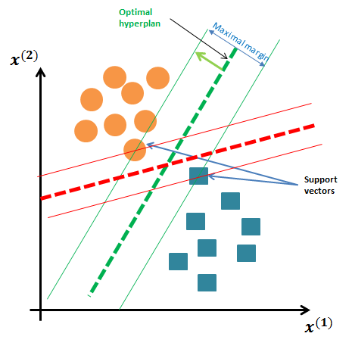
Classifier - SVM
How to choose the best hyper plan ?
SVM ➔ The one with the maximal margin !
Power of SVM
Flexibility using Kernels (non-linear boundary)
No assumption on the densities
Unique solution

Slide 14
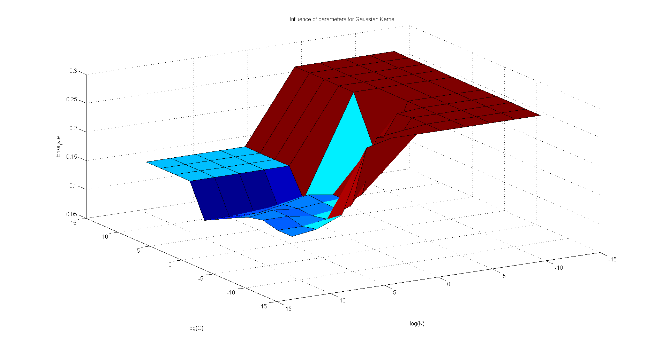
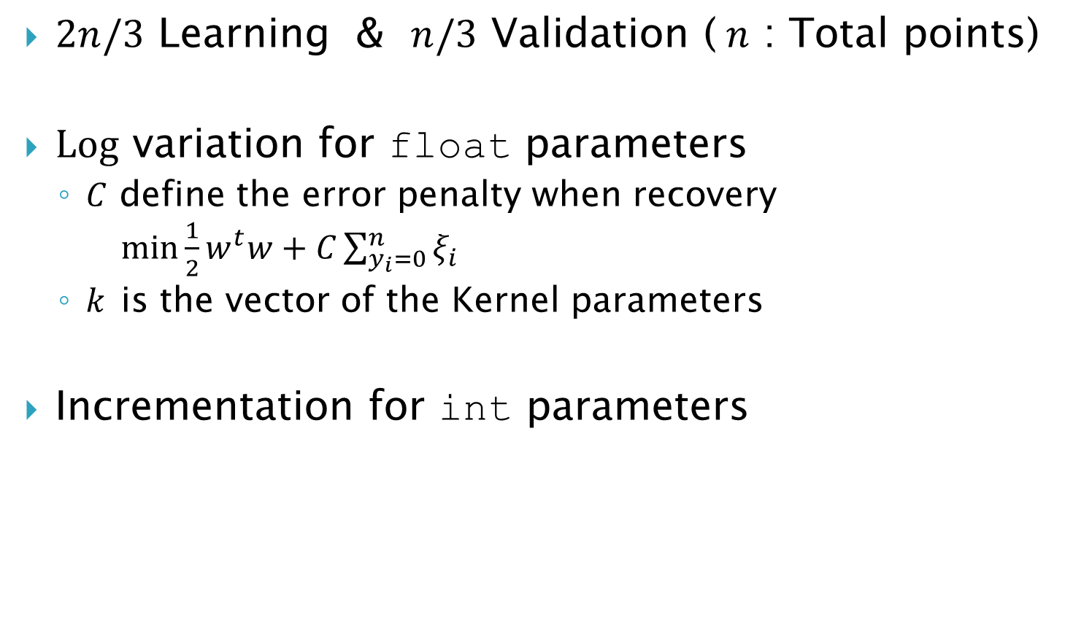
Classifier - Design SVM
$2n/3$ Learning & $n/3$ Validation ($n$ : Total points)
$Log$ variation for float parameters
$C$ define the error penalty when recovery $\min{\frac{1}{2}w^{t}w+C}\sum_{y_{i}=0}^{n}{ξ_{i}}$
$k$ is the vector of the Kernel parameters
Incrementation for int parameters

Slide 15
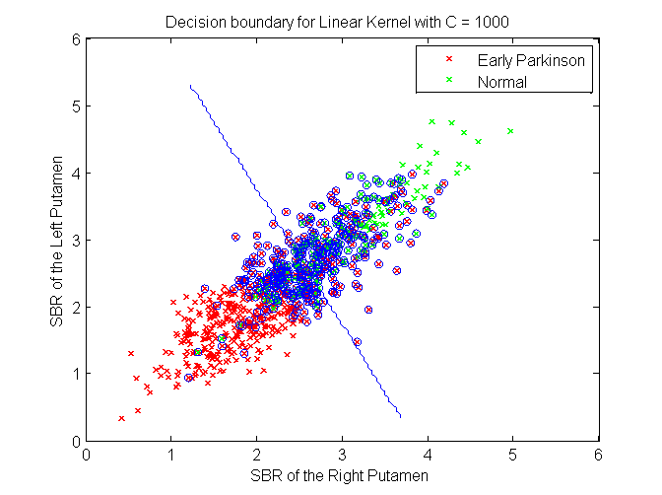


Classifier - Validation SVM
Cross validation with $50$ boxes ($length=14$)
Linear $K\left(x_{i},x\right)=x^{t}.x_{i}$
Label \ prediction | Normal | Parkinson
Normal | 10 | 2
Parkinson | 4 | 33
Error rate : $12,24\%$

Slide 16
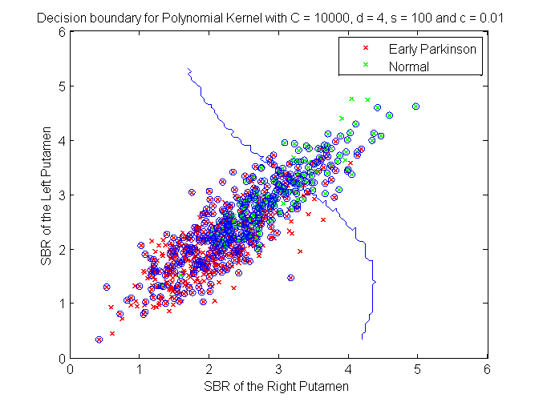
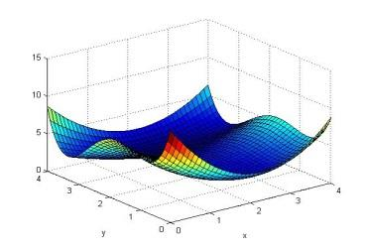


Classifier - Validation SVM
Polynomial $K\left(x_{i},x\right)={\left({s×x}^{t}.x_{i}+c \right)}^{d}$
Label \ prediction | Normal | Parkinson
Normal | 10 | 3
Parkinson | 1 | 36
Error rate : $8,0\%$

Slide 17
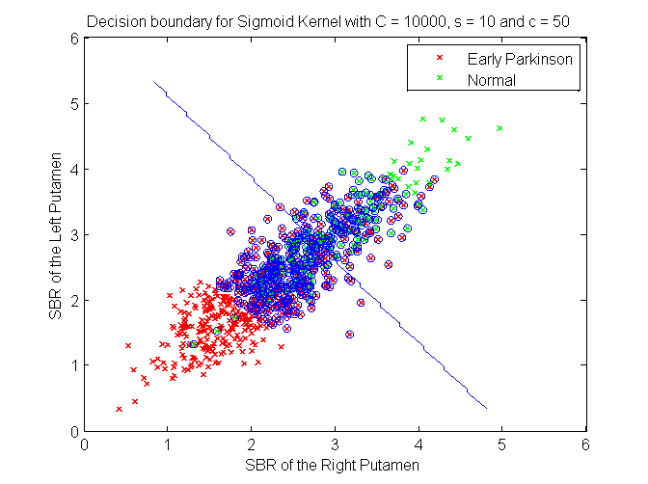
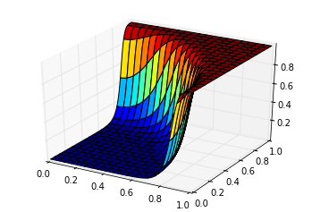


Classifier - Validation SVM
Sigmoid $K\left(x_{i},x\right)=tanh({s×x}^{t}.x_{i}+c)$
Label \ prediction | Normal | Parkinson
Normal | 10 | 3
Parkinson | 2 | 35
Error rate : $10,0\%$

Slide 18
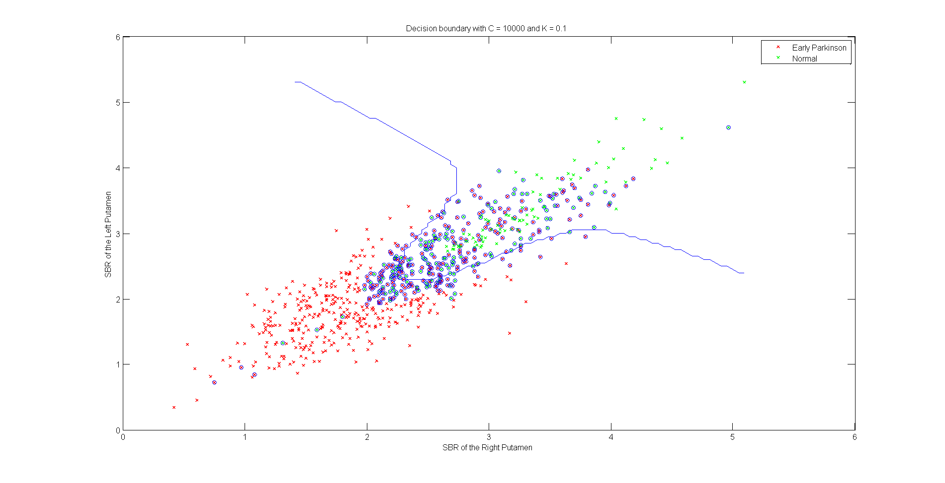
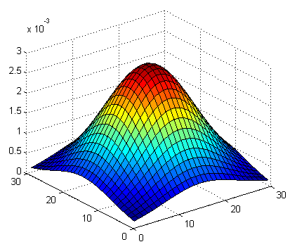


Classifier - Validation SVM
The best ! Gaussian $K\left(x_{i},x\right)=exp(−g{\left\|x−x_{i}\right\|}^{2})$
Label \ prediction | Normal | Parkinson
Normal | 11 | 2
Parkinson | 1 | 36
Error rate : $6,0\%$

Slide 19
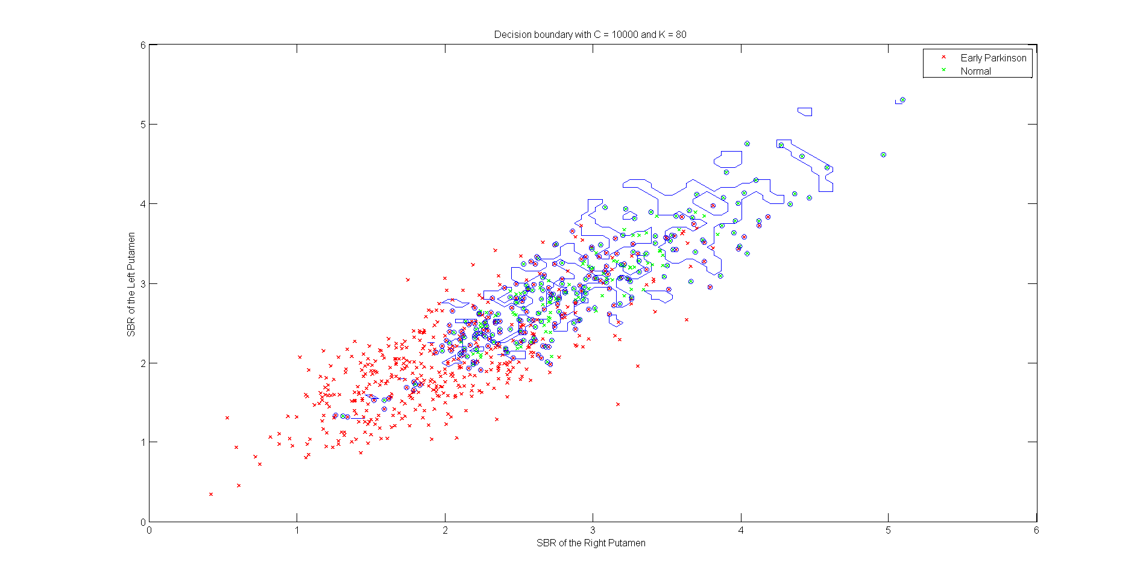
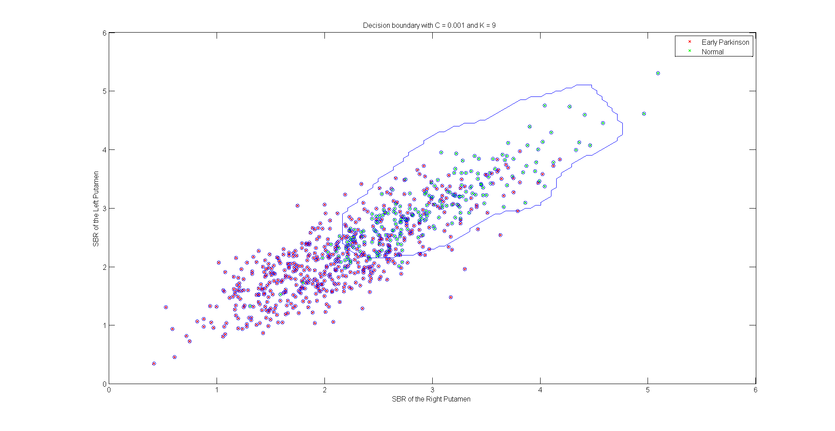
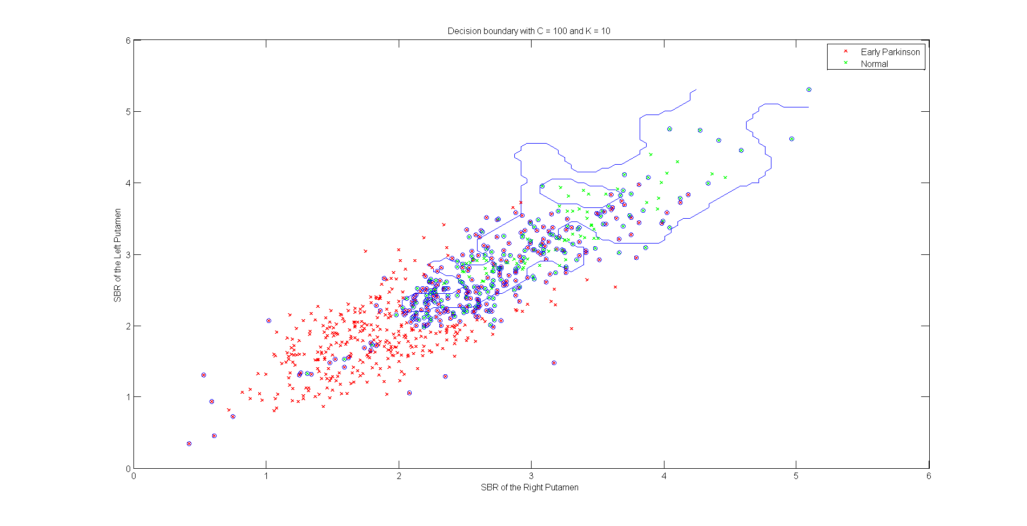

Classifier - Validation SVM
$C↗$ and $g↗$
Overfitting !

Slide 20
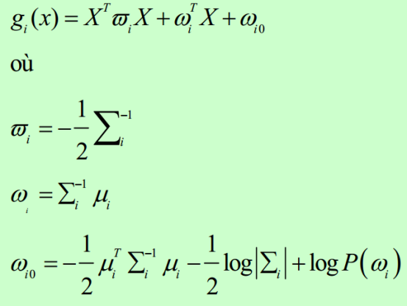
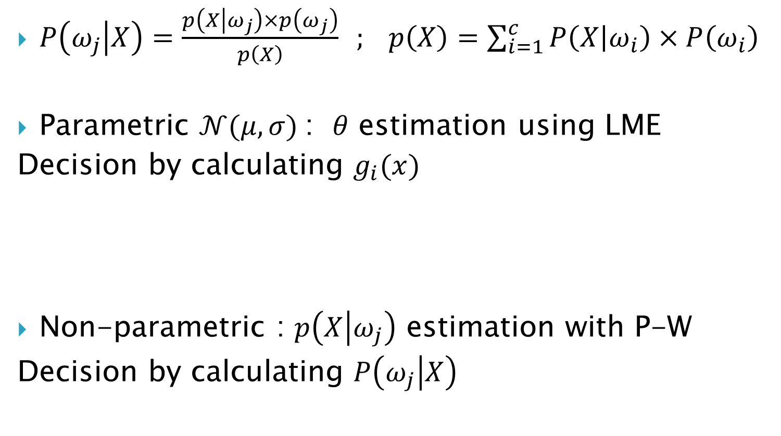
Classifier - Bayes
$P\left(ω_{j} | X\right)=\frac{p\left(X | ω_{j}\right)×p\left(ω_{j}\right)}{p\left(X\right)} ; p\left(X\right)=\sum_{i=1}^{c}{P\left(X | ω_{i}\right)×P\left(ω_{i}\right)}$
Parametric $𝒩(μ,σ)$: $θ$ estimation using LME
Decision by calculating $g_{i}(x)$
Non-parametric : $p\left(X | ω_{j}\right)$ estimation with P-W
Decision by calculating $P\left(ω_{j} | X\right)$

Slide 21
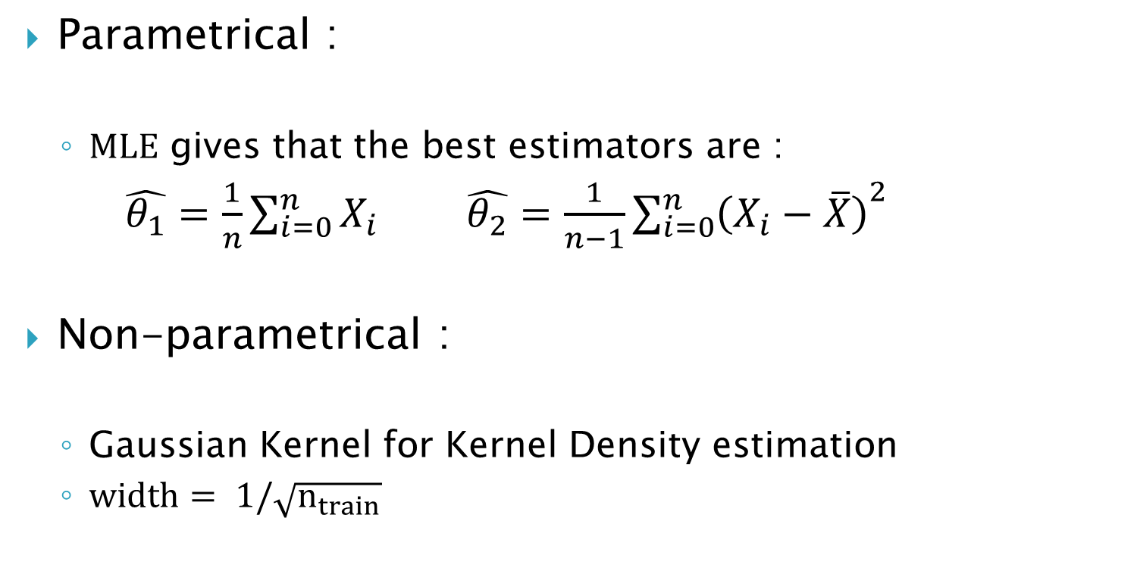
Classifier - Design Bayes
Parametrical :
$MLE$ gives that the best estimators are :
$\hat{θ_{1}}=\frac{1}{n}\sum_{i=0}^{n}{X_{i}}$ $\hat{θ_{2}}=\frac{1}{n−1}{\sum_{i=0}^{n}{\left(X_{i}−\overline{X}\right)}}^{2}$
Non-parametrical :
Gaussian Kernel for Kernel Density estimation
$width= 1/\sqrt{n_{train}}$

Slide 22
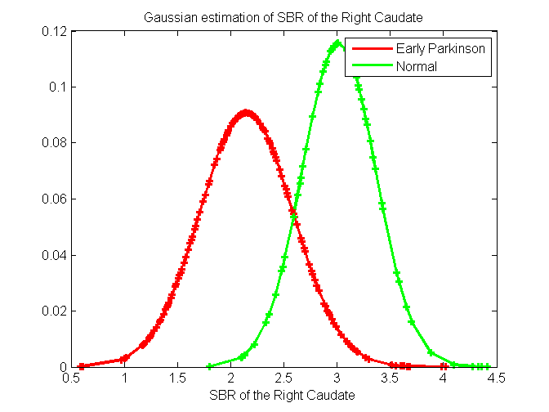
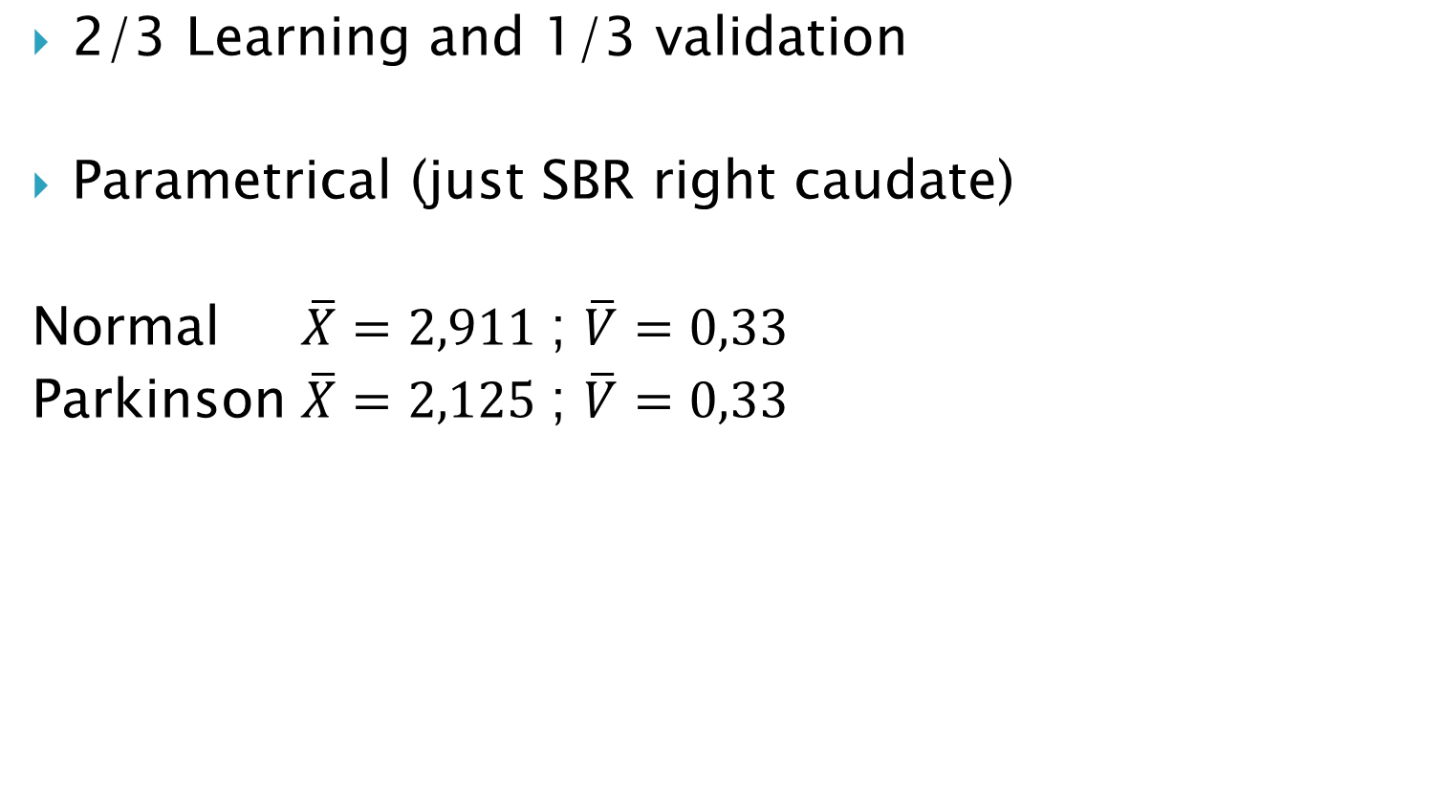

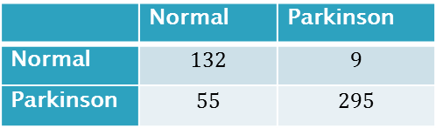
Classifier - Validation Bayes
$\text{2}\text{/3 }\text{Learning} \text{and} \text{1}\text{/3 }\text{validation}$
Parametrical (just SBR right caudate)
Normal $\overline{X}=2,911$; $\overline{V}=0,33$
Parkinson $\overline{X}=2,125$; $\overline{V}=0,33$
 | Normal | Parkinson
Normal | $$132$$ | $$9$$
Parkinson | $$55$$ | $$295$$
Error rate : $13,03\%$

Slide 23
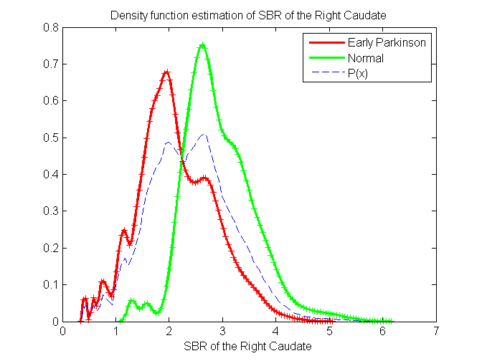


Classifier - Validation Bayes
Non-Parametrical (just SBR right caudate)
Using gaussian kernel (poor results with box)
 | Normal | Parkinson
Normal | $$105$$ | $$25$$
Parkinson | $$31$$ | $$330$$
Error rate : $11,41\%$

Slide 24





Classifiers comparison
 | SVM | MLR | Bayes param | Bayes non param
Error rate | $6.0\%$ $(++)$ | $$11.11\% (+)$$ | $$13.03\% (−)$$ | $$11.41\% (+)$$
Time | $$(−−)$$ | $$(=)$$ | $$(++)$$ | $$(+)$$
Complexity | $$(−−)$$ | $$(−)$$ | $$(++)$$ | $$(+)$$
Memory consumption | $23 MB$ (in MATLAB) $(=)$ | $31 MB$ $(−)$ | $9 MB$ $(++)$ | $50 MB$ $(−−)$
Article : $3,86\% 9,2\%$
Confusion matrix
Label \ prediction | Normal | Parkinson
Normal | 11 | 2
Parkinson | 1 | 36
MLR
 | Normal | Parkinson
Normal | $$10$$ | $$3$$
Parkinson | $$2$$ | $$35$$
SVM
 | Normal | Parkinson
Normal | $$132$$ | $$9$$
Parkinson | $$55$$ | $$295$$
 | Normal | Parkinson
Normal | $$105$$ | $$25$$
Parkinson | $$31$$ | $$330$$
BP
BNP

Slide 25

Classifiers comparison
Error is the most important criterion ➔ SVM
We can play on the boundary to accept:
More normal as parkinson : Specificity $↗$
Or more parkinson as normal: Sensitivity $↗$
Errors in the article :
They train on all the data (results are obviously better !)
Some patients have been analyzed several times. They include all the results in the data as multiple points. I included just the early parkinson (harder to detect)

Slide 26

Questions / Suggestions ?

