Slide 1
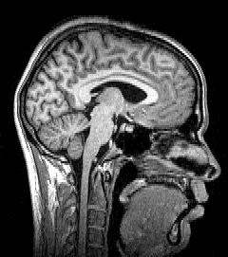
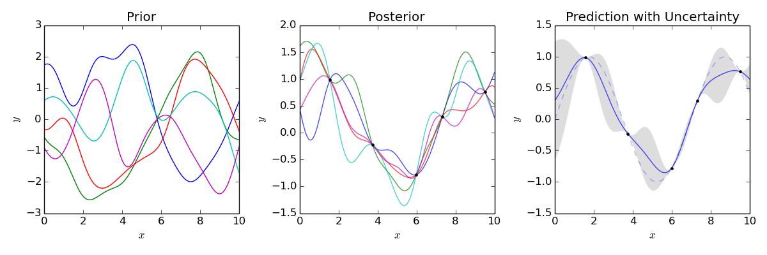
Gaussian Process Interpolation for Uncertainty Estimation in Image Registration
ECSE 626 - Project presentation
<number>
Notes:
Diagnostic précoce de la maladie de Parkinson
Par classification automatique et modèle de prédiction
<number>

Slide 2
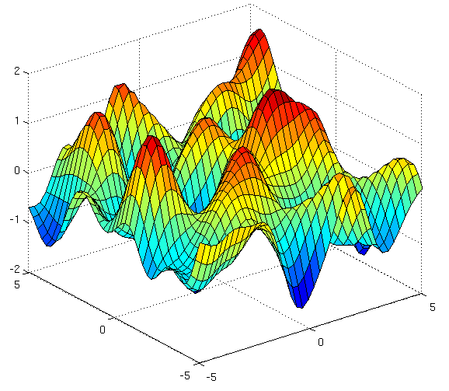
Guideline
Image Registration
Gaussian Process Interpolation
Method
Preliminary Results
<number>

Slide 3
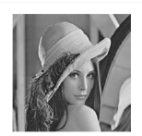
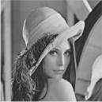



Image registration
Registration
What align the fixed and moving image ?
We take that maximizes similarity of and
<number>

Slide 4
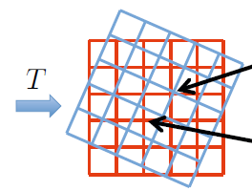
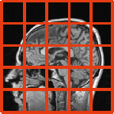
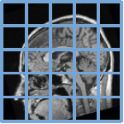
Image registration
Major problem
Each image is divided into a grid
To compute comparison of pixel value at the same position
Impossible to compare grid points of and and !
[1]
<number>

Slide 5
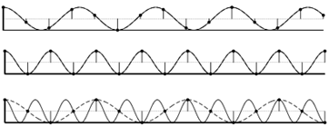
Image Registration
Interpolation :
Construction of continuous version of discrete signal
Convolution with a kernel through all the observations
Interpolator with Nyquist frequency [2]
fe > fs/2
https://commons.wikimedia.org/wiki/File:Nyquist_Aliasing.svg
<number>

Slide 6
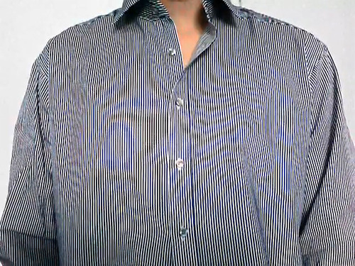
Image registration
Example of aliased image (too low image resolution for the details)
https://commons.wikimedia.org/wiki/File:Nyquist_Aliasi http://forum.hardware.fr/hfr/VideoSon/Traitement-Video/unik-artefacts-videos-sujet_142007_1.htm ng.svg
<number>

Slide 7
Image registration
Quadratic interpolation
-2
-1
0
1
2
<number>

Slide 8
Image registration
Resampling of
-2
-1
0
1
2
<number>

Slide 9
Image registration
Interpolated values
-2
-1
0
1
2
<number>

Slide 10
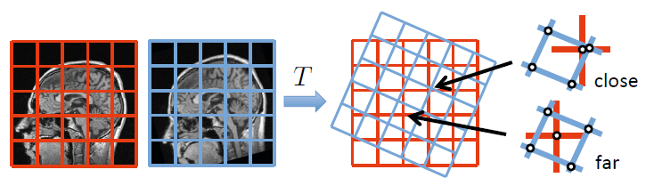
Image registration
Drawback of all the approaches
Interpolation error varies among pixels
How to model the interpolation uncertainty ?
<number>

Slide 11
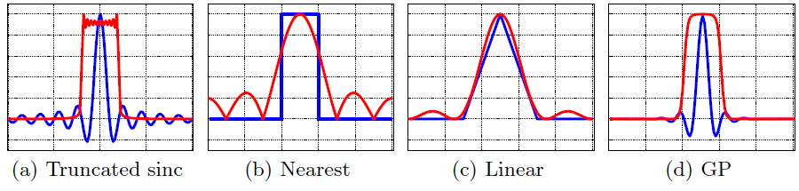
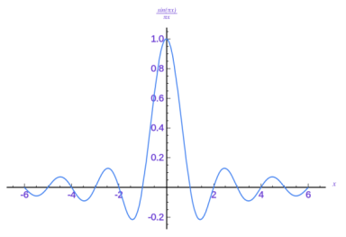
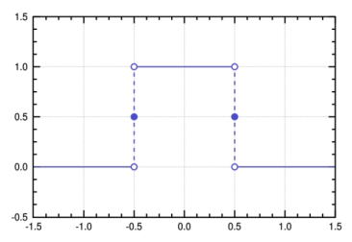
Gaussian Process Interpolation
Gaussian process
: Stochastic process defined by mean function and covariance function [3]
Also called « Kriging » (used in geostatistic) [4]
Why Gaussian Process interpolator
Because it takes into account uncertainty and is closed to the optimal interpolator !
<number>

Slide 12
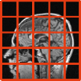
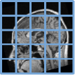
Method : Bayesian Regression
Fixed grid of sampled image :
Grid of sampled image : =>
Assumptions
prior over resampled image
Gaussian noise on measurements
Posterior of resampled values
<number>

Slide 13
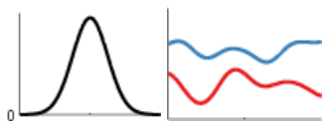
Method : Bayesian Regression
Choice of covariance function
The most important choice of !
Gaussian kernel :
Because it captures the neighbours relation
Parametrized by the length
http://people.seas.harvard.edu/~dduvenaud/cookbook/
<number>

Slide 14
Method : Similarity measure
Generative model instead of MAP
After marginalization over
=
Previous posterior Likelihood
<number>

Slide 15
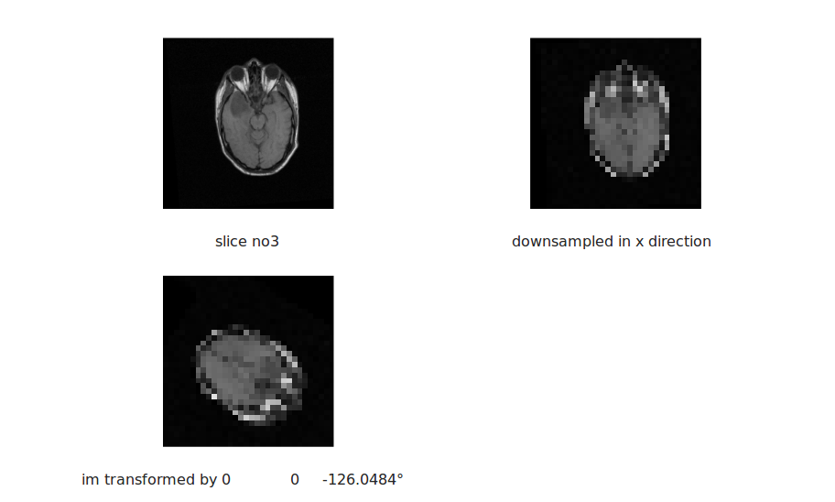
Preliminary results
Data
Downsampling in one direction by 5
Creation of a random T
<number>

Slide 16
Preliminary results
Grid creation
Arbitrary grid of [50x50] : X and sigma Im
Transformation of sigma Im : X star
<number>

Slide 17
Preliminary results
Interpolation results
l = 6.25 and noise = 0.1
<number>

Slide 18
Preliminary results
Influence of lengthscale l
<number>

Slide 19
Preliminary results
Influence of rotation on variance
<number>

Slide 20
Preliminary results
Influence of lengthscale l
<number>

Slide 21
Preliminary results
New similarity measure
<number>

Slide 22
Future work
Still work to do…
Parameter l estimation with occam razor
Comparison of interpolation results (NN, cubic, spline)
Comparison of cross correlation (with NN, cubic, spline) and new similarity with GP interpolation
<number>

Slide 23
Conclusion
Advantages
Compact and easy adjustable
Accurate with measure of uncertainty
is a growing field
Drawbacks
Complexity
High memory requirement
Covariance sensible to noise
Instability because of high dimensionnality
<number>

Slide 24
References
[1] Wachinger, Christian, et al. "Gaussian process interpolation for uncertainty estimation in image registration." Medical Image Computing and Computer-Assisted Intervention–MICCAI 2014. Springer International Publishing, 2014. 267-274.
[2] Lehmann, Thomas M., Claudia Gönner, and Klaus Spitzer. "Survey: Interpolation methods in medical image processing." Medical Imaging, IEEE Transactions on 18.11 (1999): 1049-1075.
[3] Rasmussen, Carl Edward. "Gaussian processes for machine learning." (2006).
[4] Van Beers, Wim, and Jack PC Kleijnen. "Kriging interpolation in simulation: a survey." Simulation Conference, 2004. Proceedings of the 2004 Winter. Vol. 1. IEEE, 2004.
<number>

Slide 25


Discussion
<number>

Slide 26
Annexe : Matrix computation on Matlab
<number>

