Slide 1
Function Chain CP Model Proposal
01.12.2017
Additional comments by Franco

Slide 2
Components
Let’s think a more general environment where the types of VNFs is larger but can still be classified in the three sets we originally identified:
We have two type of VNFs like the WANA and two types of VNF like the shaper
inactive domain
active domain
w
WANA VNF
s
SHAPER VNF
Blue VNF
Green VNF
v
VPN VNF
n
NAT VNF
Yellow VNF
d
DPI VNF
b
r
End VNF
BODER VNF

Slide 3
Domain Characteristics
Each domain has only ONE gateway node
A pair of domains have at most two domain links (directed)
start
1
6
2
8
10
7
In networking terms this means that each domain has just one borger gateway and the inter-domain connectivity is a full mesh topology.
This is not fully general but is a resonable assumptions for the time being.
3
target

Slide 4
Yellow (DPI)
Flow Property: at most ONE inflow, NO outflow
Function: traffic logging (analyze traffic by looking at packets), may be disabled after some time from traffic flow start-up
Predicate: message received must be clear (no WANA, or after 2 WANA)

Slide 5
Blue (WANA, VPN)
Flow Property: at most ONE inflow, at least ONE outflow
Function: VPN, encryption, decryption, etc …
When more WANAs exist, pick at most ONE WANA at random
WANA and SHAPER can have arbitrary order

Slide 6
SHAPER
Flow Property: at most ONE inflow, at least ONE outflow
Function: shape frequency, address adjustment (NAT)
When shaper service is required, each domain can utilize at most ONE shaper at random

Slide 7
Example
start
46
2
31
12
6
32
5
4
36
33
11
26
3
target

Slide 8
Assumptions
User demands a desired function chain
The Service Function Chain (SFC) is an ordered list of NFV that the traffic flow will traverse
User knows Source and Destination and the start & target domain
The user demand provides the NFV lists, the system:
MUST keep the requested order,
MAY choose the domain where to pick a requested VNF,
MAY insert NFVs not requested by the user for specific network needs (for the time being we do not consider this)

Slide 9
Aims of Proposed Constraints
To capture the ideas:
WANA manipulates msg before delivering to other domains, msg must be manipulated again before reading by the target -> each resulting domain has 1 WANA
Shaper shapes the traffic -> each resulting domain has at most 1 shaper
Users are interested in the total number of DPIs in the solution
To bring (interprete) VNF functions to VNF mapping in domains
Given the condition that users do not know which domains should be included

Slide 10
Proposed Constraints
We propose constraints on “Resulting domains”, namely:
acc_request: SERVICEs -> RANGE, i.e., total number of VNF of service_x belongs to the RANGE.
dis_request: SERVICEs -> RANGE, i.e., in each ‘Resulting Domain’, the number of VNF of service_x belongs to the RANGE.
e.g. given services=[dpi,wana,shaper], acc_request[dpi] = [5,10] means that the total number of DPI in the result should be in [5,10]

Slide 11
Constraints Refinements
request_bound: SERVICEs -> [0,1] limits the validity of acc_request and dis_request. i.e.
request_bound[service_x] = 1, acc_request & dis_request of service_x are only valid for start & target domains, and there is no presence of service_x in other domains.
request_bound[service_x] = 0, acc_request & dis_request of service_x are valid for all resulting domains.

Slide 12
SOLUTION
Two steps for the solutions:
generate Domain Connection Graph (DC graph) - optimization problem
VNF connection - SAT problem

Slide 13
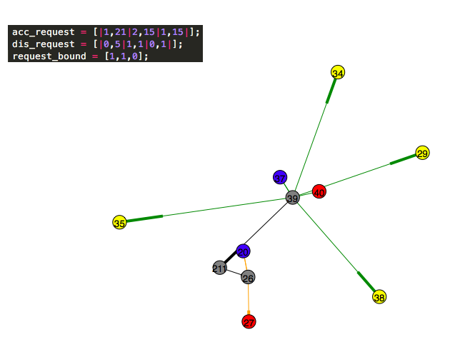
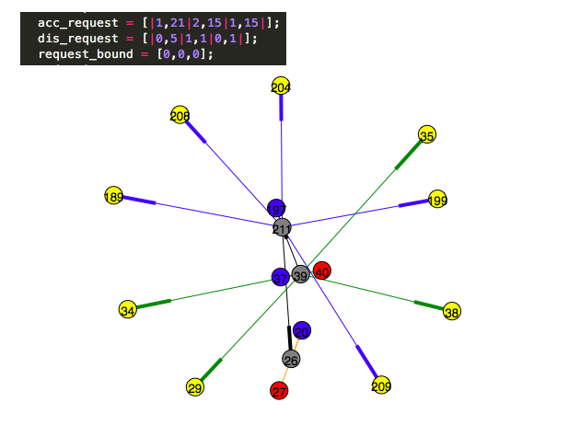
Examples

Slide 14
Our proposal for a test scenario of the proposed solution
Take N=10 domains
What are domains?
The different domains may be different data centers deploying NFVs for the same service provider or different network domains of different providers
In every domain allocate a certain number of VNF of the various kinds
In real life the NFVs are virtual machines running specific softwares
A virtual machine has a finite processing power and can serve a finite number of traffic flows (services)
Therefore any domain may sustain a finite number of service instances for a given VNF. Let’s say we represent this as a finite number of VNFs and, when a VNF is allocated to a service it can’t be used by other services (fully booked).
In every domain allocate an infinite number of sources and destinations There may always be a new source in a domain and there may always be a new destination of service request in a domain

Slide 15
Test the SFC allocation
Lets’ take 5 different service instances
Source – DPI – DPI – destination
This is a simple traffic flow that we want to take a look at
One DPI in source domain and 1 DPI in destination domain
request_bound[DPI] = 1
acc_request[DPI] = [2, 2]
dist_request[DPI] = [0, 1]
Source – DPI – WANA – destination
This is the case we have already discussed. The DPI is 1 in the source domain, the WANA is in source and destination domain
request_bound[DPI] = 1
request_bound[WANA] = 1
Novel issue If there is just 1 DPI in the chain and the bound is 1 has it to be mandatorly in the source domain, in the destination domain or in either the former or the latter by chance? My proposal is if this bound is 1 and the VNF is 1 then it has to be in the source domain

Slide 16
Source – NAT – WANA – destination
request_bound[NAT] = 1
acc_request[NAT] = [1, 1]
dist_request[NAT] = [0, 1]
Request_bound[WANA] = 1
acc_request[WANA] = [2, 2]
dist_request[WANA] = [0, 1]
Source – VPN – WANA – destination
request_bound[VPN] = 1
acc_request[NAT] = [1, 1]
dist_request[NAT] = [0, 1]
Request_bound[WANA] = 0
acc_request[WANA] = [2, 2]
dist_request[WANA] = [0, 1]
Source – DPI – NAT – SHAPER – destination
request_bound[DPI] = 0
acc_request[DPI] = [1, 2]
dist_request[DPI] = [0, 1]
request_bound[NAT] = 1
acc_request[NAT] = [1, 1]
dist_request[NAT] = [0, 1]
request_bound[SHAPER] = 0
acc_request[NAT] = [1, 1]
dist_request[NAT] = [0, 1]

Slide 17
My proposal is to execute a loop as follows:
Pick at random: source, destination, service instance
Execute algorithm to find SFC
Take off all NFVs used for the current service instance
Go back to point 1
Note that source and/or destination may be selected more than once, while the VNFs can be selected only once. This is logically consistent because the same source may have more than one call acgive in principle.
During this procedure we measure:
whether a solution can be found or not
the time needed to get an answer from the algorithm (either positive, there is a solution to the service request, or negative, the service instance can not be satisfied because of lack of VNFs)
How many tries? Honestly I do not know, it all depends on the overall time requested by the process. Ideal would be that we can execute a high number of requests, to get more reliable results regarding the time to find a solution.
It is also important to understand whether the time to find the SFC is correlated with the type of request or not.

Slide 18
Future Works

Slide 19
Domain inter-assistance model
VNFs serve not only other VNFs of the same domain, they assist also other domains.
e.g. target domain does not have any WANA, then, the packet travels trough a WANA in other domain (close to target domain)
e.g. shaper shapes the traffic also for other domains
Type of Function Chain:
restrict: each VNF works only for its own domain.
best effort: inter-assistance model

Slide 20
WANA cases
which is acceptable?
shall we propose a parameter
in input, e.g. 0,1,2
0 - no WANA
1 - restrict WANA
(must in Start Target domain)
2 - WANA best effort
s
16
2
s
16
e
2
s
16
e
e
2

