Slide 1
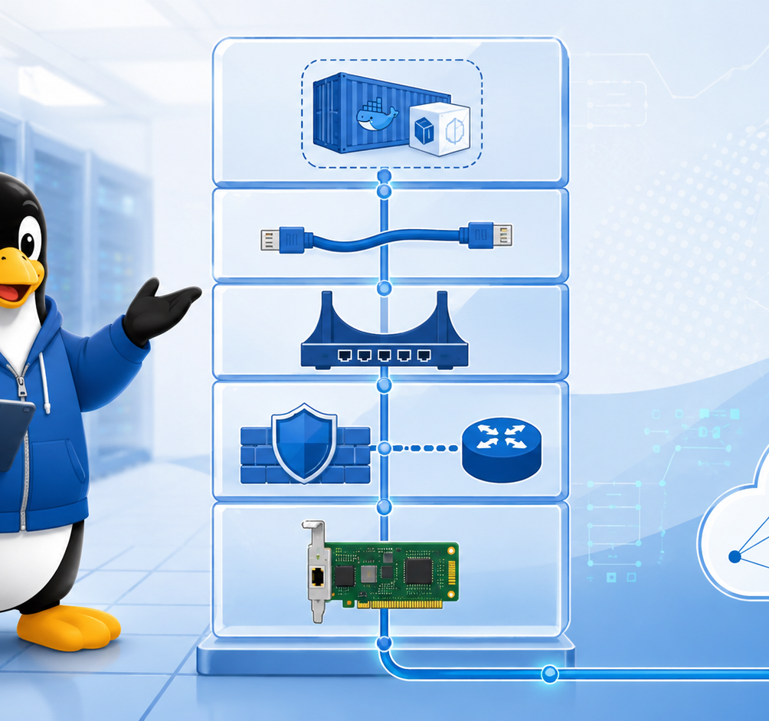
Combined deck · 50 slides
Introduction to Linux Networking for Containers
Single host foundations · bridges · namespaces · Docker bridge · NAT/port publishing
One practical lab: from single Linux host to Docker published port

Slide 2
Course storyline
A single practical lab grows into a container networking mental model
Step 0
Single host
Step 1
Linux bridge
Step 2
namespace + veth
Step 3
Docker bridge
Step 4
NAT + publish
Step 5
end-to-end
One continuous demo: Linux host → br0 → namespaces → Docker bridge → published nginx port

Slide 3
Lab/demo topology
Everything runs on a single Linux VM or bare-metal host
Linux host
Ubuntu/Debian/Rocky
br0 / Docker bridge
software switching
namespaces / containers
virtual hosts
iptables/NAT
packet translation
Prerequisites
$ sudo apt install docker.io iproute2 iputils-ping tcpdump conntrack nginx curl
$ sudo usermod -aG docker $USER
# log out and back in after adding docker group

Slide 4
Step 0
Single Host Configuration

Slide 5
Practical TCP/IP stack
Every later container packet still follows this model
Application
HTTP, SSH, DNS
Transport
TCP / UDP ports
Internet
IPv4 + routing
Link
Ethernet + ARP
Physical
NIC / cable / Wi-Fi
Troubleshooting rule: prove each layer before moving down

Slide 6
Layer-to-command mapping
Use the right tool for the layer you are testing
Layer
What you check
Linux commands
Application
Service, URL, DNS name
curl, dig, getent, logs
Transport
TCP/UDP ports and sessions
ss, nc, tcpdump
Internet
IP address and route
ip addr, ip route, ping
Link
MAC, ARP/neighbor, state
ip link, ip neigh, ethtool
Physical
Carrier, driver, medium
ethtool, dmesg, cable

Slide 7

IPv4 ranges: public vs private
Private addresses need routing/NAT to reach the Internet in most labs
Range
Prefix
Typical use
10.0.0.0 – 10.255.255.255
10.0.0.0/8
Enterprise/internal networks
172.16.0.0 – 172.31.255.255
172.16.0.0/12
Internal/container networks
192.168.0.0 – 192.168.255.255
192.168.0.0/16
Home/small office/LAN labs
Public IPv4
Internet-routable space
External services
Modern routing uses CIDR/prefix length, not old classful thinking

Slide 8
Read host addressing
Start by observing before changing configuration
Terminal
$ ip -br link
lo UNKNOWN 00:00:00:00:00:00
ens160 UP 00:50:56:aa:bb:cc
$ ip -br addr
ens160 UP 192.168.10.25/24 fe80::250:56ff:feaa:bbcc/64
Key: address + prefix + interface state

Slide 9
Routing: what path will the kernel choose?
ip route get is the fastest routing sanity check
Terminal
$ ip route
default via 192.168.10.1 dev ens160
192.168.10.0/24 dev ens160 proto kernel scope link src 192.168.10.25
$ ip route get 8.8.8.8
8.8.8.8 via 192.168.10.1 dev ens160 src 192.168.10.25
Linux uses longest prefix match, just like routers

Slide 10
DNS and sockets are separate problems
Do not confuse routing, DNS and application binding
Terminal
$ getent hosts example.com
93.184.216.34 example.com
$ ss -ltnp
LISTEN 0.0.0.0:22 sshd
LISTEN 127.0.0.1:8080 python
If ping 8.8.8.8 works but names fail: suspect DNS

Slide 11
Step 0 demo checkpoint
Single-host baseline before virtual networking
Demo commands
$ ip -br link
$ ip -br addr
$ ip route get 8.8.8.8
Expected outcome
You can identify interface, IP, route, DNS, listeners and packets
$ ip neigh
$ getent hosts example.com
$ ss -ltnp
$ tcpdump -ni any icmp

Slide 12
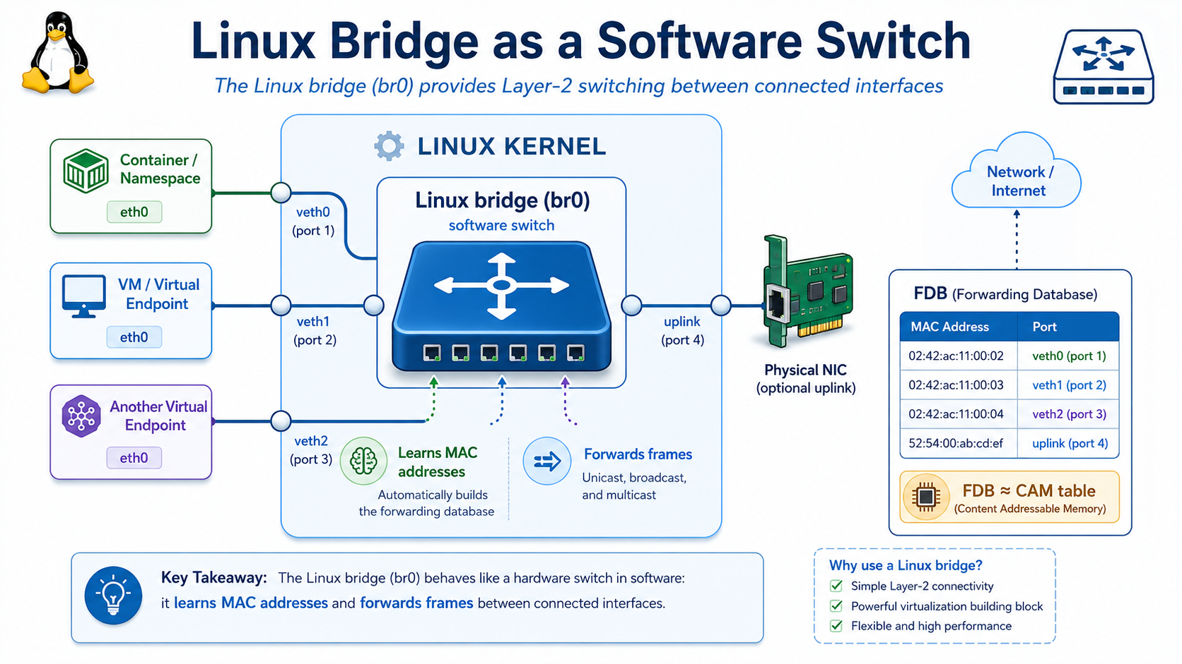
Step 1
Linux bridge as a software switch

Slide 13
Linux bridge mental model
A Linux bridge acts like a software Layer 2 switch
Linux bridge
br0
Namespace / VM / Container
veth / tap
bridge port
Physical NIC
optional uplink
Cisco analogy: bridge FDB ≈ CAM table

Slide 14
Create br0
First lab step: create a Linux bridge
Terminal
$ sudo ip link add br0 type bridge
$ sudo ip link set br0 up
$ ip -br link show br0
br0 UP 8e:5a:0d:40:11:01
br0 is now a software switch with no ports attached yet

Slide 15
Inspect bridge ports and FDB
Linux bridge forwarding is MAC-based
Terminal
$ bridge link
# shows interfaces enslaved to a bridge
$ bridge fdb show br br0
52:54:00:aa:10:11 dev veth1 master br0
52:54:00:aa:10:12 dev veth2 master br0
FDB answers: which MAC lives behind which bridge port?

Slide 16
Cisco CAM vs Linux FDB
Same switching logic, different command surface
Cisco switch
Linux bridge
Purpose
show mac address-table
bridge fdb show
learned MAC addresses
interface Gi1/0/1
dev veth1
port where MAC is learned
VLAN-aware switch
bridge vlan
VLAN filtering/port membership
CAM table troubleshooting
FDB troubleshooting
find where frames go

Slide 17
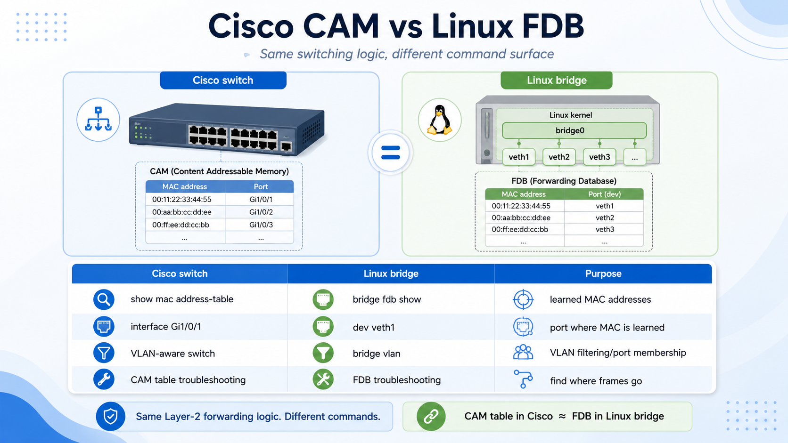

Slide 18
Step 1 demo checkpoint
You have created and inspected a virtual switch
Demo commands
$ ip link add br0 type bridge
$ ip link set br0 up
Expected outcome
You can explain br0 as a software switch and FDB as a CAM-like table
$ ip link show type bridge
$ bridge link
$ bridge fdb show br br0

Slide 19
Step 2
Network namespace + veth + bridge

Slide 20
Network namespace mental model
A namespace is an isolated network stack
Default host namespace
ens160, routes, sockets
ns1
eth0, routes, sockets
ns2
eth0, routes, sockets
Cisco-friendly analogy: a namespace is like a lightweight isolated host/VRF context

Slide 21
veth pair mental model
A veth pair is a virtual Ethernet cable
ns1
eth0
veth pair
virtual cable
host side
veth-ns1
Anything entering one side exits the other side

Slide 22
Namespace + veth + bridge topology
This is the manual version of a basic container network
ns1
192.168.50.11
br-demo
software switch
ns2
192.168.50.12
veth1-br
veth2-br

Slide 23
Build the namespace lab
Create namespaces, bridge and veth pairs
Terminal
$ sudo ip netns add ns1
$ sudo ip netns add ns2
$ sudo ip link add br-demo type bridge
$ sudo ip link set br-demo up
$ sudo ip link add veth1-br type veth peer name eth0 netns ns1
$ sudo ip link add veth2-br type veth peer name eth0 netns ns2

Slide 24
Attach and address
Host-side veth interfaces become bridge ports
Terminal
$ sudo ip link set veth1-br master br-demo
$ sudo ip link set veth2-br master br-demo
$ sudo ip link set veth1-br up
$ sudo ip link set veth2-br up
$ sudo ip -n ns1 addr add 192.168.50.11/24 dev eth0
$ sudo ip -n ns2 addr add 192.168.50.12/24 dev eth0
$ sudo ip -n ns1 link set eth0 up
$ sudo ip -n ns2 link set eth0 up

Slide 25
Test and inspect
Ping across the bridge and inspect the FDB
Terminal
$ sudo ip netns exec ns1 ping -c 2 192.168.50.12
64 bytes from 192.168.50.12: icmp_seq=1 ttl=64 time=0.09 ms
$ bridge fdb show br br-demo
52:54:00:aa:10:11 dev veth1-br master br-demo
52:54:00:aa:10:12 dev veth2-br master br-demo
$ sudo tcpdump -ni br-demo icmp

Slide 26
Step 2 checkpoint
The packet path is now visible
ns1
veth1
bridge
FDB
veth2
ns2
reply
Manual container-like network: isolated stacks + virtual cables + software switch

Slide 27
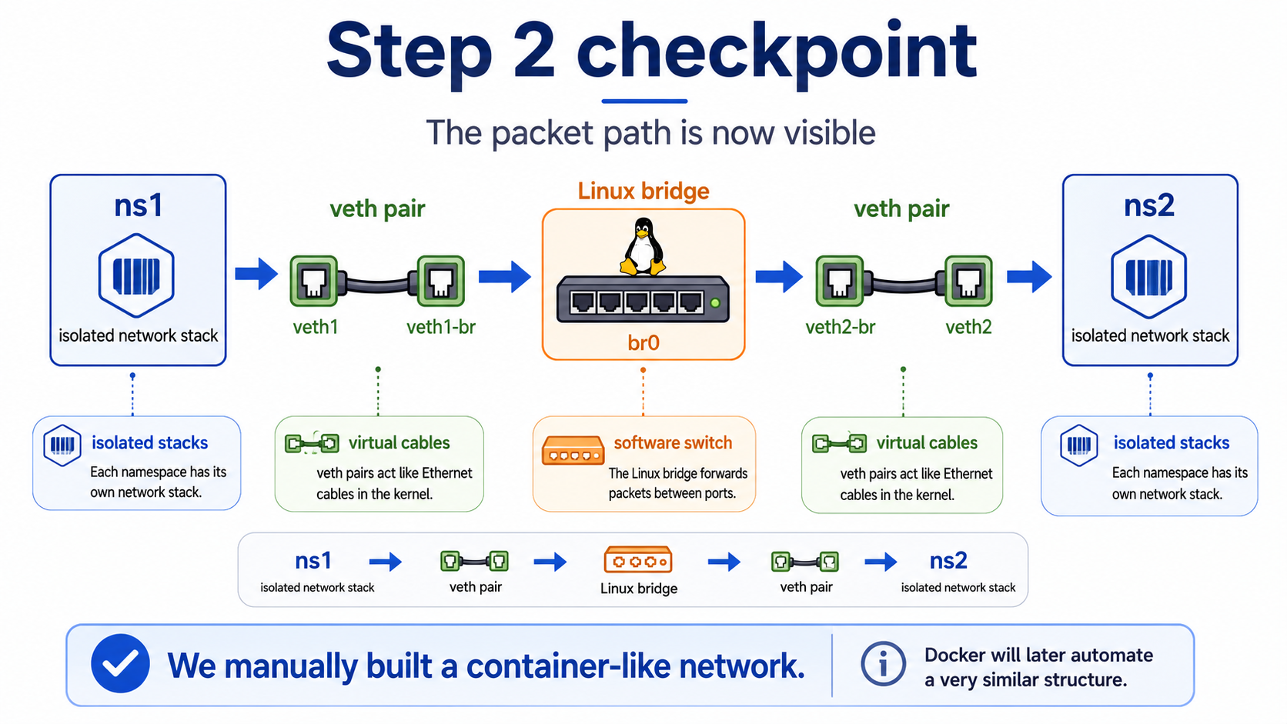

Slide 28
Step 3
Docker bridge networking

Slide 29
Docker maps to the primitives
Docker automates the topology you built manually
Manual lab
Docker equivalent
ip netns add ns1
container network namespace
ip link add ... type veth
Docker creates veth pair
ip link set veth master br0
Docker attaches host veth to bridge
ip addr add ...
Docker IPAM assigns container IP
bridge fdb show
bridge learns container MACs

Slide 30
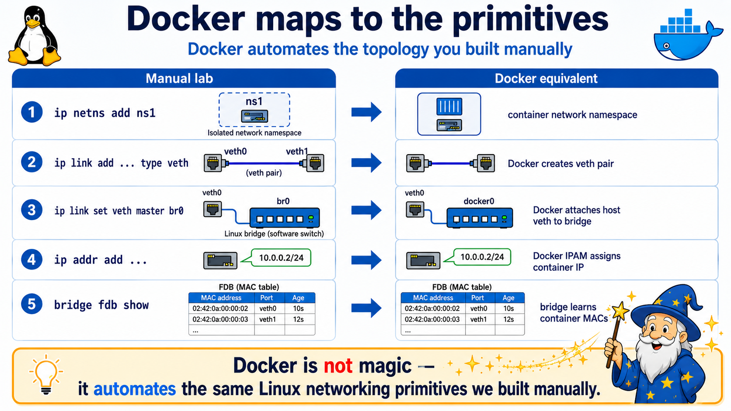

Slide 31
Inspect Docker default bridge
Start by looking at Docker network state
Terminal
$ docker network ls
NETWORK ID NAME DRIVER SCOPE
6b7c5e7f9a01 bridge bridge local
b58d781f1234 host host local
0f2d9ef77821 none null local
$ docker network inspect bridge

Slide 32
Default bridge topology
Containers on the same default bridge can communicate by IP
docker0
172.17.0.1/16
c1
172.17.0.2
veth
veth
c2
172.17.0.3

Slide 33
Run two containers on default bridge
Default bridge works by IP; name resolution is limited
Terminal
$ docker run -dit --name c1 alpine sh
$ docker run -dit --name c2 alpine sh
$ docker inspect -f "{{range.NetworkSettings.Networks}}{{.IPAddress}}{{end}}" c2
172.17.0.3
$ docker exec c1 ping -c 2 172.17.0.3 # works
$ docker exec c1 ping -c 1 c2 # usually fails on default bridge

Slide 34
Create a user-defined bridge
Preferred pattern for multi-container apps
Terminal
$ docker network create app-net
$ docker run -dit --name web --network app-net nginx:alpine
$ docker run -dit --name client --network app-net alpine sh
$ docker network inspect app-net
User-defined bridge gives per-app isolation and built-in container-name DNS

Slide 35
DNS resolution between containers
Container names become practical service-discovery names
Terminal
$ docker exec client cat /etc/resolv.conf
nameserver 127.0.0.11
$ docker exec client getent hosts web
172.18.0.2 web
$ docker exec client wget -qO- http://web | head
<!DOCTYPE html>

Slide 36
Step 3 checkpoint
Docker bridge is now understandable
client
veth
app-net
bridge + DNS
veth
web
HTTP reply
The same namespace + veth + bridge model is now automated by Docker

Slide 37
Step 4
Docker NAT / port publishing

Slide 38
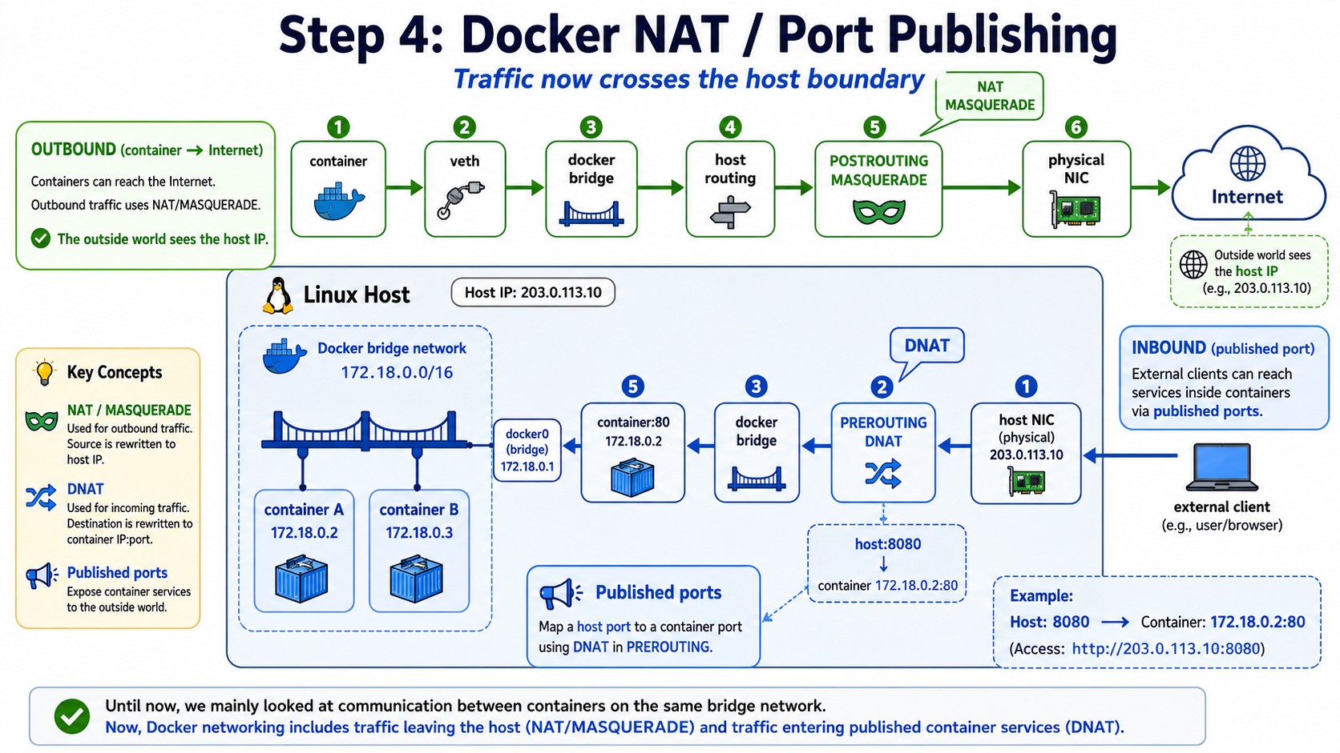

Slide 39
Why Docker needs NAT
Containers use private addressing; external networks usually do not route back
container
172.18.0.3
Docker bridge
172.18.0.1
host NAT
src = host IP
Internet
8.8.8.8
Outbound: POSTROUTING MASQUERADE changes source from container IP to host IP

Slide 40
Outbound NAT path
Container reaching the Internet
container
veth
bridge
FORWARD
POSTROUTING
MASQUERADE
NIC
The outside world usually sees the host IP, not the container IP

Slide 41
Inspect NAT and conntrack
NAT is both rules and state
Terminal
$ sudo iptables-save | sed -n "/\*nat/,/COMMIT/p"
-A POSTROUTING -s 172.18.0.0/16 ! -o br-xxxx -j MASQUERADE
$ sudo conntrack -L | grep 172.18.0.3
tcp 6 src=172.18.0.3 dst=93.184.216.34 sport=51234 dport=443 ...
conntrack remembers translations so return traffic reaches the correct container

Slide 42
Publish a container port
External client reaches host port; Docker DNAT forwards to container
Terminal
$ docker run -d --name web --network app-net -p 8080:80 nginx:alpine
$ docker ps --format "table {{.Names}}\t{{.Ports}}"
NAMES PORTS
web 0.0.0.0:8080->80/tcp
$ curl -I http://127.0.0.1:8080
HTTP/1.1 200 OK

Slide 43
Inbound published-port path
DNAT changes destination from host:8080 to container:80
client
host NIC
PREROUTING
DNAT
FORWARD
bridge
container
Important: published container traffic typically uses FORWARD, not only INPUT

Slide 44
Inspect DNAT rules
Docker-managed chains contain the translation
Terminal
$ sudo iptables-save | grep -E "8080|DNAT|DOCKER"
-A PREROUTING -m addrtype --dst-type LOCAL -j DOCKER
-A DOCKER ! -i br-xxxx -p tcp --dport 8080 \
-j DNAT --to-destination 172.18.0.2:80
Destination changes from host:8080 to container:80 before forwarding

Slide 45
INPUT vs FORWARD
The most common firewall confusion
Traffic
Destination after routing/NAT
Important chain/path
SSH to host
Linux host itself
INPUT
host:8080 → container:80
container behind bridge
PREROUTING DNAT + FORWARD
container → Internet
external destination
FORWARD + POSTROUTING NAT
host process → Internet
external destination
OUTPUT + POSTROUTING
Correct rule in the wrong chain is still wrong

Slide 46
Packet capture proves NAT
Capture before and after the translation point
Terminal
# before outbound NAT: on bridge
$ sudo tcpdump -ni br-xxxx host 8.8.8.8
IP 172.18.0.3 > 8.8.8.8: ICMP echo request
# after outbound NAT: on physical NIC
$ sudo tcpdump -ni ens160 host 8.8.8.8
IP 10.0.0.20 > 8.8.8.8: ICMP echo request

Slide 47
Step 4 checkpoint
You can now explain Docker egress and published ports
Outbound
container → Internet
SNAT/MASQ
POSTROUTING
Inbound
host:8080 → container:80
DNAT
PREROUTING + FORWARD
Docker NAT = DNAT + MASQUERADE + FORWARD + conntrack

Slide 48
Step 5
End-to-end mental model and practical lab

Slide 49
The main mental model
This is the diagram you should be able to draw from memory
Container namespace
veth pair
Every troubleshooting question becomes:
Where is the packet now, and where should it go next?
Each layer is both a forwarding point and an inspection point.
Linux bridge
host routing +
iptables/NAT
physical NIC
network

Slide 50
End-to-end troubleshooting decision tree
Classify the failure before changing the configuration
1
App works locally?
2
Container IP/route?
3
Bridge/FDB?
4
DNS/name?
5
NAT/FORWARD?
No at step 1: application issue
No at step 2: namespace/container network issue
No at step 3: bridge/veth issue
No at step 4: Docker DNS/network attachment issue
No at step 5: firewall/NAT/routing issue

Slide 51
Practical lab: build and verify
One compact demo that touches all course concepts
Lab script · Part 1
# 1) host baseline
ip -br addr && ip route get 8.8.8.8
# 2) create app network and containers
docker network create app-net
docker run -d --name web --network app-net -p 8080:80 nginx:alpine
docker run -dit --name client --network app-net alpine sh
# 3) verify service discovery and HTTP
docker exec client getent hosts web
docker exec client wget -qO- http://web | head

Slide 52
Practical lab: inspect packet path
Show Docker from Linux host perspective
Lab script · Part 2
# Docker view
docker network inspect app-net
docker ps
# Linux bridge view
ip link show type bridge
bridge link
bridge fdb show
# NAT/firewall view
iptables-save | grep -E "8080|DNAT|MASQUERADE|DOCKER"
conntrack -L | grep 172.18
# packet evidence
tcpdump -ni any tcp port 8080

Slide 53
Cleanup and reset
Keep labs reproducible
Cleanup commands
$ docker rm -f web client c1 c2
$ docker network rm app-net
$ sudo ip netns del ns1 2>/dev/null || true
$ sudo ip netns del ns2 2>/dev/null || true
$ sudo ip link del br-demo 2>/dev/null || true
$ sudo ip link del br0 2>/dev/null || true
$ docker network ls
$ ip -br link
Clean state = easier troubleshooting and repeatable demos

Slide 54
Final summary
The whole course in one sentence
Container namespace
Containers are not magic.
They are Linux networking primitives automated by Docker.
veth pair
Linux bridge
Single host TCP/IP gives you the baseline.
Bridge gives you software switching.
Namespace gives you isolation.
veth gives you the cable.
Docker gives you automation.
iptables/NAT gives you outside connectivity.
host routing +
iptables/NAT
physical NIC
network
Follow the packet — the model tells you where to look.

