Slide 1
Social Network Design and Algorithm
Dapeng Liu N12261428
Yuanting Song N10731496
May 10th, 2018

Slide 2
Topic of Problem
More and more people prefer using online social network systems to manage their own social networks.
Friend Recommendation’s purpose is to recommend new people to be your friends that you may know or you may have familiar background with.

Slide 3
Basic solution for this problem
1. Instance
People: Each person is a unit in the system, we will use a node to represent a single person.
Feature: Features including hobbies, age, gender, study background and so on, and we can also call ‘features’ ‘tags’. Each person could have several features. We also use a node to represent a feature.
Connection: We have two kinds of connections here. One means two people are already friends, if there is a connection(link) between them. The other one means one person owns a certain feature, if there is a connection(link) between a person and a feature.

Slide 4
Basic solution for this problem
2. Correlation
Correlation is a scalar to indicate degree of two people’s similarity, and also the value of correlation is the tendency to recommend these two people to establish connection with each other.

Slide 5
Basic solution for this problem
3. Constrains
Max number of friends: A person could establish connection with others but the number has a upper bound.
Correlation value of a person: A person’s total correlation value is the sum of the similarity with all others.
Keep the original topology: The original connections before the calculation should be kept, new topology should be based on the original topology.
Undirect connection: If two people connect to each with, then for these two people they all know they are friends.

Slide 6
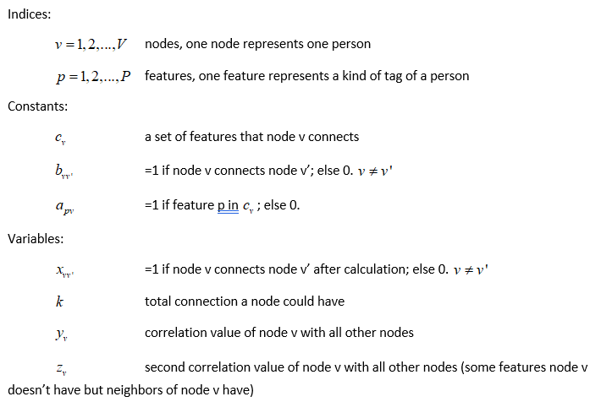
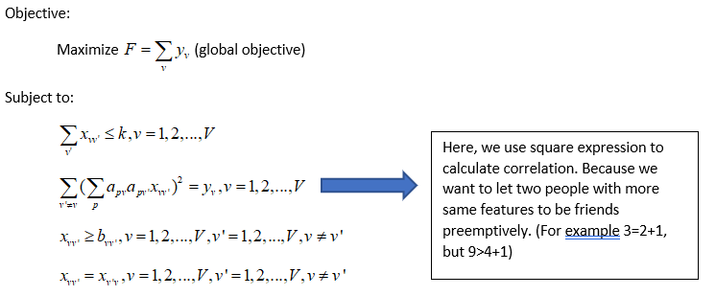
Basic situation model

Slide 7
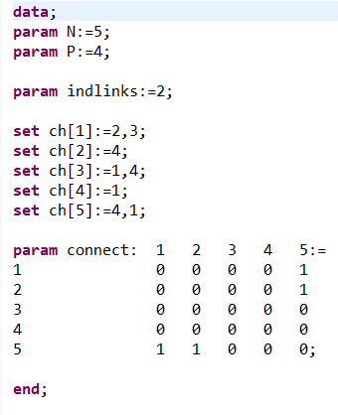
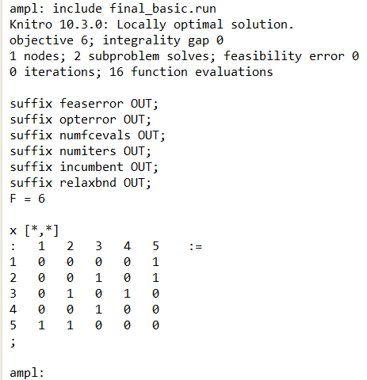
Basic situation example(Using full version AMPL and solver ‘Knitro’)
1. Input data: 2. Output result:

Slide 8
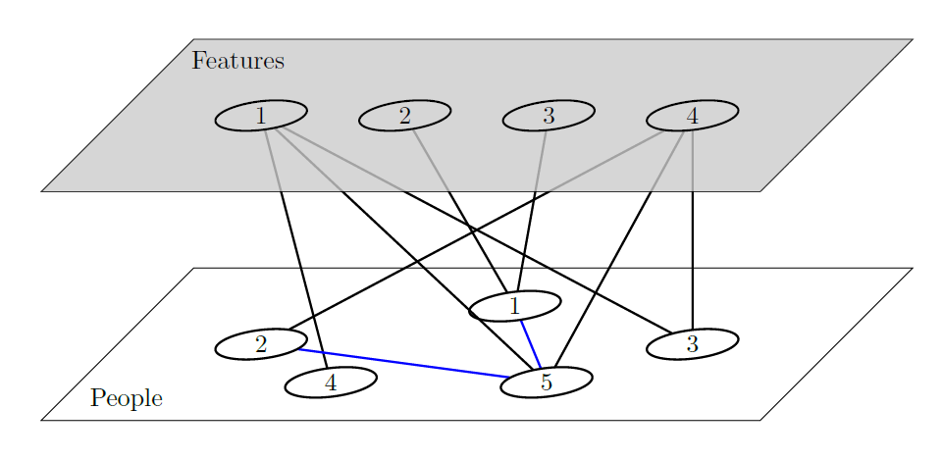
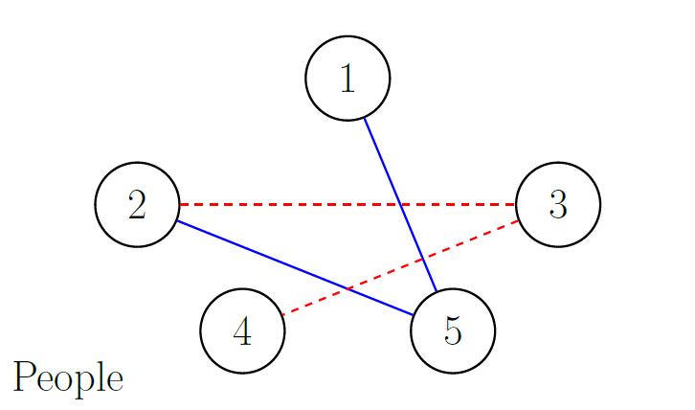
Basic situation example
Input:
Output:
Recommendation Sheet
1: None 4: 3
2: 3 5: None
3: 2,4

Slide 9
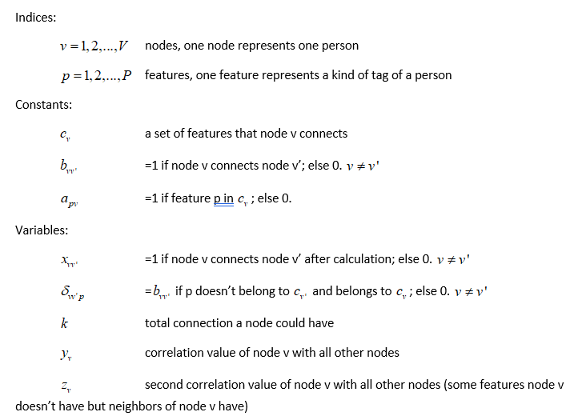
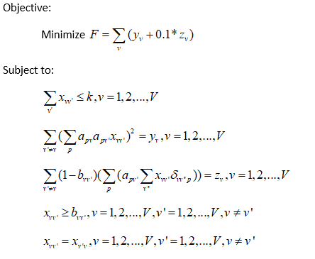
Friend impact model
Consider another condition which is more complex: A and B are friends, A likes soccer while B likes basketball. Then we have C and D, both of them are not A’s friends and also they are not interested in soccer, but C likes baseball and D likes basketball. Now if I want to recommend new friend C or D to A, who should be choose? We call it friend impact:

Slide 10
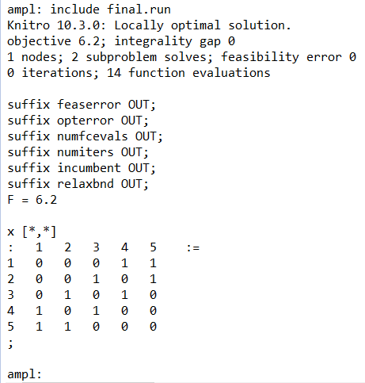
Friend impact example
1. Input data: 2. Output result:

Slide 11
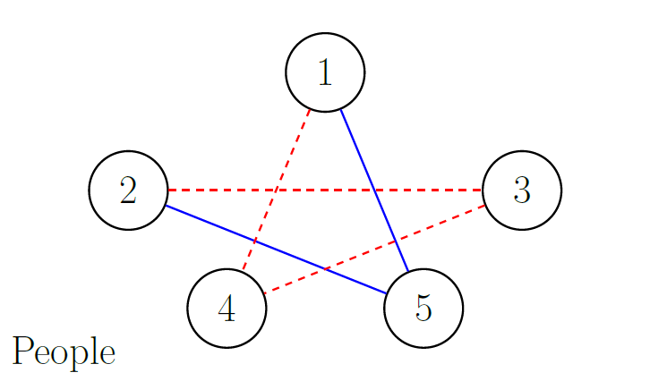
Friend impact example
Input:
Output:
Recommendation Sheet
1: 4 4: 1,3
2: 3 5: None
3: 2,4

Slide 12
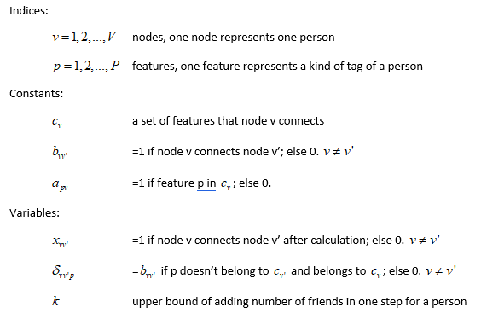
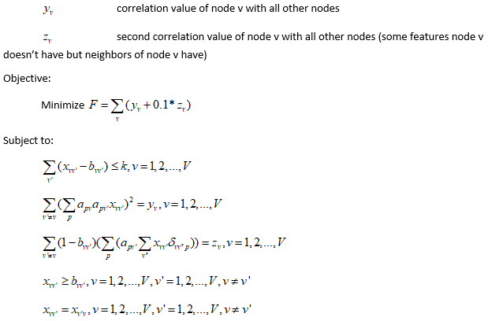
Adding constrain model
Now based on Friend impact model, we should consider why each person could only have limited number of friends. What if not?
Actually, in real world, we can see no matter how many friends a person already had, the system should also recommend some new friends to him/her, you will never see an empty friend recommendation page in your linkedin or facebook.

Slide 13
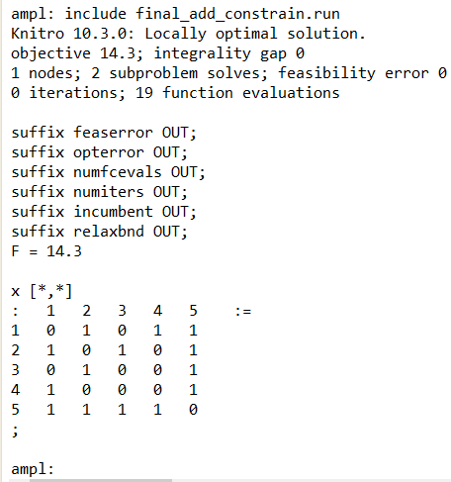
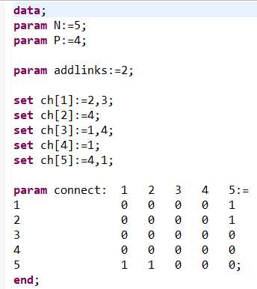
Adding constrain model
1. Input data: 2. Output result:

Slide 14
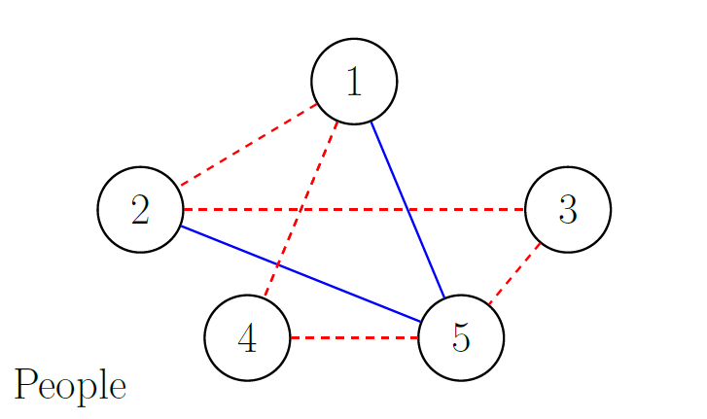
Adding constrain model
Input:
Output:
Recommendation Sheet
1: 2,4 4: 1,5
2: 1,3 5: 3,4
3: 2,5

Slide 15
Conclusion & more ideas
Now our system is really close to the real friend recommendation system, our models finish the basic functions of the system.
But now the models’ complexity is not very large, and also the models could append more complex functions and specific algorithms to let the models get more accurate results.
1. A person’s friends’ friends could also have influence to him/her, we could introduce a series of regression coefficients to distribute different weight to these influence.
2. If two people are not friends but they have shared friends, then these two people should have more chance to be friends.
3. …….

Slide 16
Thank you~

