Slide 1
Predicting NFL Success
With Fantasy Points

Slide 2
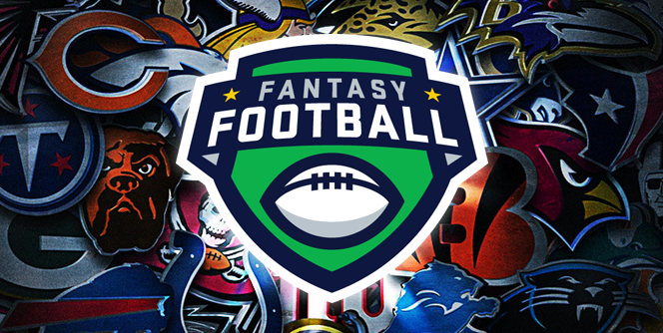
How Fantasy Football Works
Fantasy football is a game in which you are the general manager of a virtual football teams.

Slide 3
Draft Your Team
Each season, fantasy football leagues hold a draft where each team drafts NFL players. These players are kept unless they are traded or dropped. No player can be owned by more than one team.

Slide 4
Team Rosters
- Each team is allowed a certain number of players on its roster, as well as a specified number at each position that can or must be used in each game (the "starters"). Owners for each team then determine each week which players will start and which will be "benched". Just like in real football, bench players can become starters for various reasons: due to other players' injury, poor performance, or if another player's team has a bye that week.
- Each week, owners choose their starters before their players' real-world games start. Whether to sit or start a player is usually based on strategic considerations including the player's past and expected performance, defensive match-ups, etc.

Slide 5
Scoring
- League managers earn team points based on their starting players' performances in weekly NFL games. Players accumulate points based on their stats. For example, a touchdown might be worth 6 points while each yard passed, rushed, or carried may be worth a certain number of points, and so on. Players earn points for passing, rushing, and receiving yards, along with touchdowns.

Slide 6
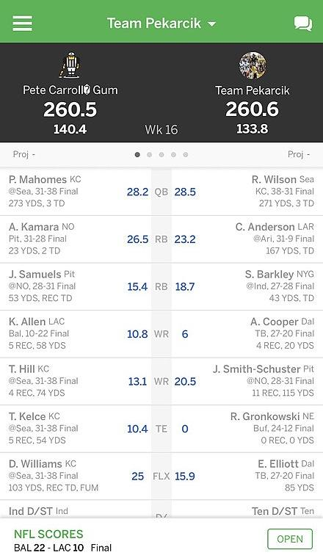
Weekly Matchups
- Fantasy teams match up against a different fantasy team from the league each week. The team that receives the most points of the two receives a win for that week. A team's total is the sum of all players' points who were placed in the starting lineup by the team owner for the day they were playing (as opposed to being on the bench, in which any points gained would not count). Teams with the best win-loss record advance to the playoffs.

Slide 7
Dynasty Leagues
Dynasty leagues are drafted in the same way to a traditional season-long league, however they continue indefinitely. There will be a follow up draft each year for rookies (incoming college players).

Slide 8
The Big Picture
Today we will focus on dynasty leagues and how to build a dynasty!
Because you keep your roster year after year, it is imperative to draft incoming rookies that have a high probability of success to replace aging players on your roster.
Using college player stats, physical measurements, and workout metrics, I built a model to predict average fantasy points per game over the players first 3 years in the NFL.

Slide 9
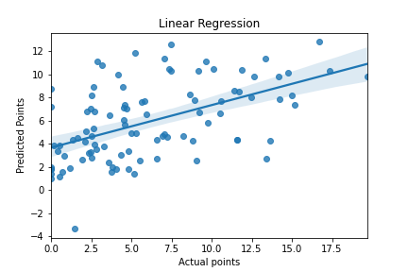
Linear Regression
RMSE: 6.96
The first model built was by far the worst according to RMSE.

Slide 10
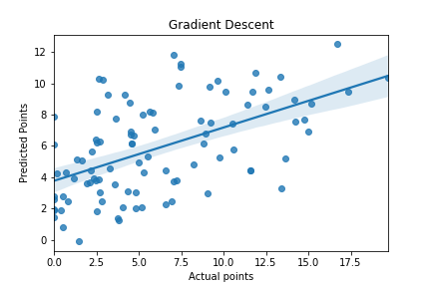
Gradient Descent
RMSE: 4.71
Improved RMSE by 2.25

Slide 11
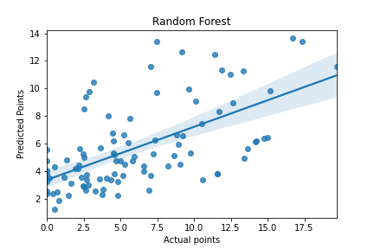
Random Forest
RMSE: 4.00
Improved RMSE by .71

Slide 12
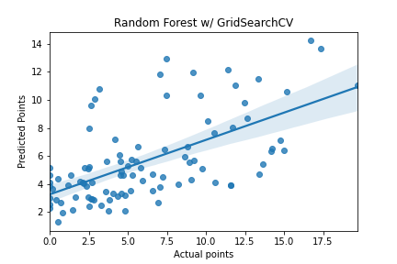
Random Forest w/ GridSearchCV
RMSE: 3.93
Improved RMSE by .07
Because Random Forest was the best default model to this point, I decided to perform a Grid Search to find the ideal hyperparameters.

Slide 13
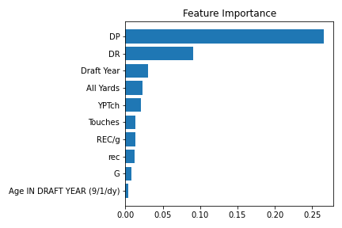
Feature Importance
Using my tuned Random Forest model, I inspected the importance of each attribute for making predictions.
As you can see, draft capital played a huge role in predicting player success. This makes sense as the best players are drafted early.

Slide 14
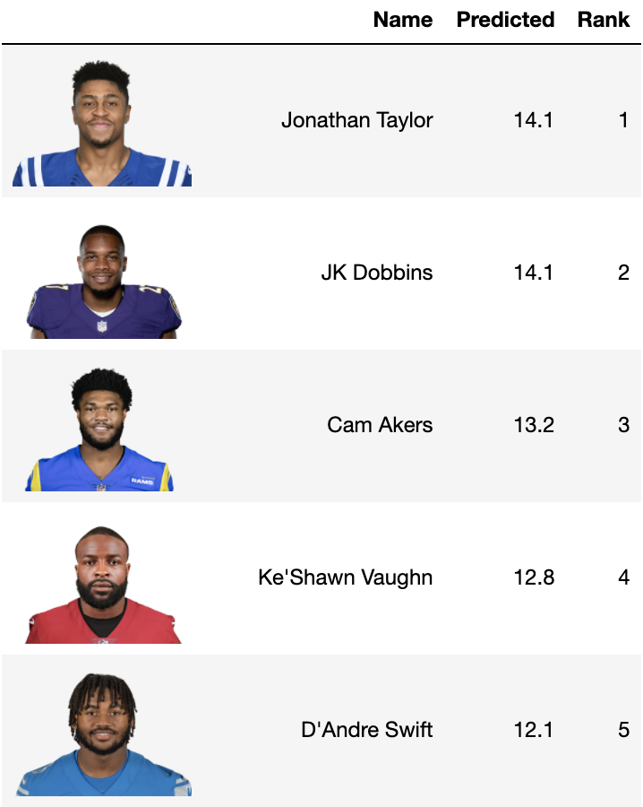
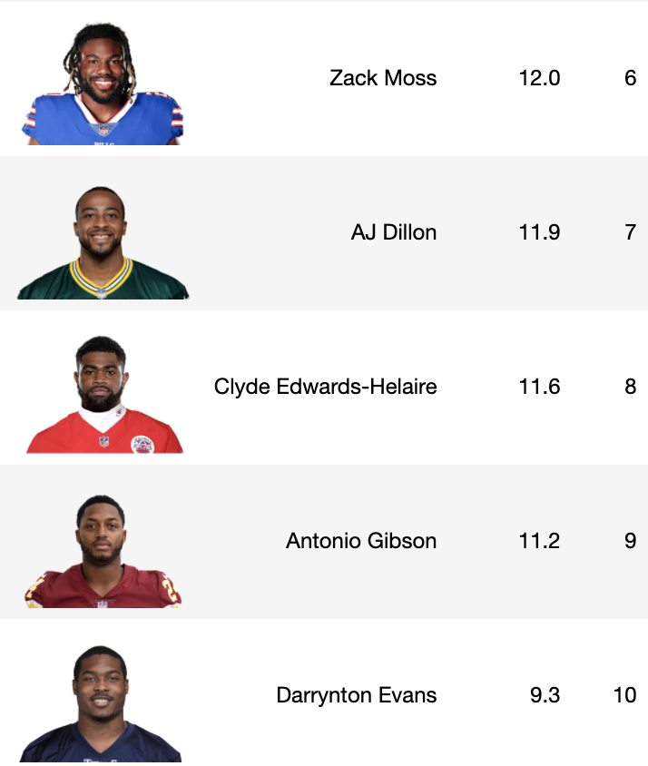
2020 Rookies

Slide 15
Next Steps
Perform feature extraction for highly correlated features
Reduce the number of samples to only players with high to mid draft capital
Create player tiers using k-means
Create a draft recommender based on players available

