Slide 1
Personal Overview
Phạm Kim Duy Long
Fresher K03
07/2020

Slide 2
Agenda
About me
My achieves through the fresher course
My goal in the future

Slide 3
About me
Pham Kim Duy Long
DoB: 08/04/2000
PoB: Ho Chi Minh city
Hobbies : Book, Music, Wanderlust…
“Nothing is absolute, nothing is forever and nothing from nothing”

Slide 4
Strength - Weakness
Strength
Weakness
Sociable person
Logic mindset
Quick learner
Thrive on pressure
Live by “code”
Lack of patience
Pretty intransigent
Get distracted sometime
Lack of composure

Slide 5





Experiences

Slide 6
Obstacles through course
Inexpert of working
Insufficient of knowledge
Disorientation about future
Unfamiliar technologies

Slide 7


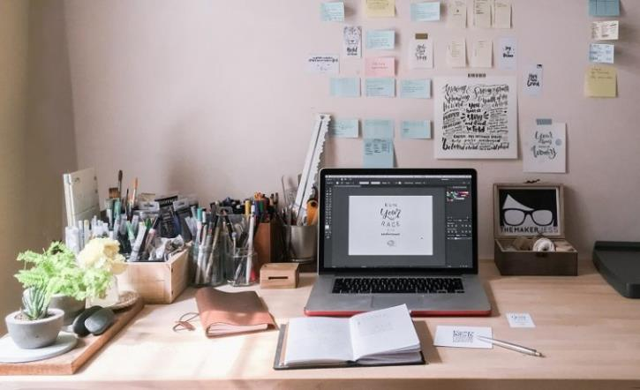
Great things I love about company

Slide 8
Result of the course
Improved

Slide 9





Result of the course
Learned

Slide 10

Result of the course
Orientation
Self-Management
Presenting skills
Real working-process experience

Slide 11

About future goals

Slide 12


