Slide 1
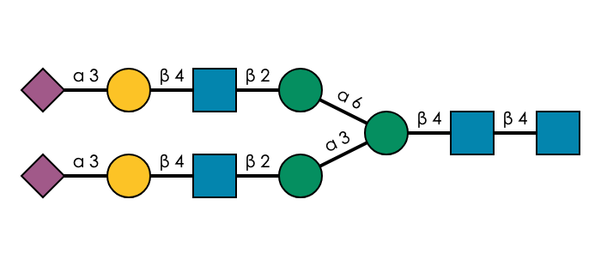
ßeta-linked
*
Man1-6
Man1-3
root
*

Slide 2
Alpha-linked
*
Man1-6
Man1-3
root
*

Slide 3
*
Man1-6
Man1-3
root
When Neu5Ac(a2-3) on each branch:
Neu5Ac on the Man(a1-6) branch is the most flexible

Slide 4
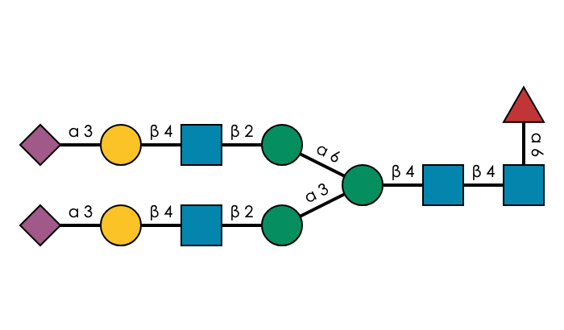
ßeta-linked
*
Man1-6
Man1-3
root
*

Slide 5
Alpha-linked
*
Man1-6
Man1-3
root
*

Slide 6
*
Man1-6
Man1-3
root
When Neu5Ac(a2-3) on each branch and core fucose is added:
Neu5Ac on the Man(a1-6) branch is still the most flexible
but
the root is more stable

Slide 7

ßeta-linked
*
Man1-6
Man1-3
root
*

Slide 8
Alpha-linked
*
Man1-6
Man1-3
root
*

Slide 9
*
Man1-6
Man1-3
root
When Neu5Ac(a2-6) on each branch:
Neu5Ac on the Man(a1-6) branch is the most flexible
→ No matter if both Neu5Ac are a2-6 or a2-3, it is always the one on the Man(a1-6) branch which is the most flexible

Slide 10

ßeta-linked
*
Man1-6
Man1-3
root
*

Slide 11
Alpha-linked
*
Man1-6
Man1-3
root
*

Slide 12
*
Man1-6
Man1-3
root
When Neu5Ac(a2-6) on each branch and core fucose is added:
Neu5Ac on the Man(a1-6) branch is still the most flexible
→ No matter if both Neu5Ac are a2-6 or a2-3 and if a glycan is core fucosylated or not, it is always the Neu5Ac on the Man(a1-6) branch which is the most flexible

Slide 13

ßeta-linked
*
Man1-6
Man1-3
root
*

Slide 14
Alpha-linked
*
Man1-6
Man1-3
root
*

Slide 15
*
Man1-6
Man1-3
root
When Neu5Ac(a2-3) is on the Man(a1-6) arm and Neu5Ac(a2-6) is on the Man(a1-3) arm:
Neu5Ac(a2-3), which is on the Man(a1-6) branch, is the most flexible

Slide 16

ßeta-linked
Man1-6
Man1-3
root
*
*

Slide 17
Alpha-linked
Man1-6
Man1-3
root
*
*

Slide 18
Man1-6
Man1-3
*
root
When Neu5Ac(a2-3) is on the Man(a1-3) arm and Neu5Ac(a2-6) is on the Man(a1-6) arm :
Neu5Ac(a2-3), which is on the Man(a1-3) branch, is the most flexible

Slide 19
*
Man1-6
Man1-3
root
*
Man1-6
Man1-6
Man1-3
Man1-3
root
root
*
*
Man1-6
Man1-3
root
The general rule seems to be that Neu5Ac on the Man(a1-6) branch is always the most flexible, unless it is a Neu5Ac(a2-6) and, on the Man(a1-3) branch, there is a Neu5Ac(a2-3).
Then, Neu5Ac(a2-3) is more flexible.
Question: what about Neu5Gc?

Slide 20
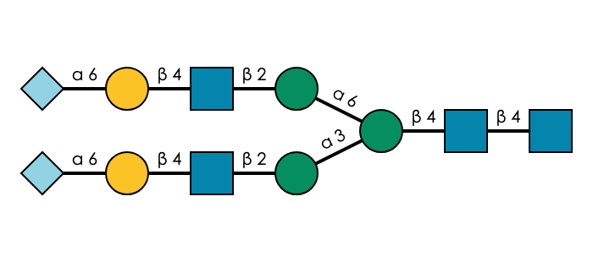
ßeta-linked
*
Man1-6
Man1-3
*
root
*
*

Slide 21
Alpha-linked
*
Man1-6
Man1-3
*
root
*
*

Slide 22
*
Man1-6
Man1-3
*
root
When Neu5Gc(a2-6) on each branch:
Both Neu5Gc are the most flexible, with a slightly higher flexibility for the one on the Man(a1-3) branch

Slide 23
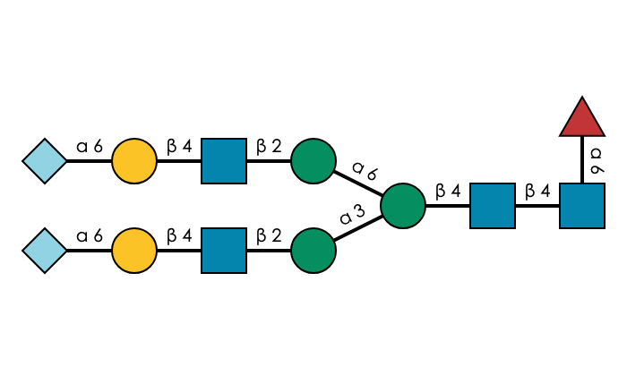
ßeta-linked
*
Man1-6
Man1-3
*
root
*
*

Slide 24
Alpha-linked
*
Man1-6
Man1-3
*
root
*
*

Slide 25
*
Man1-6
Man1-3
*
root
When Neu5Gc(a2-6) on each branch and core fucose is added:
Both Neu5Gc are still the most flexible, with a slightly higher flexibility for the one on the Man(a1-3) branch.
The root seems more stable

Slide 26
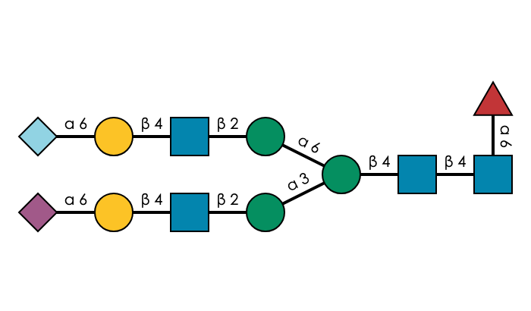
ßeta-linked
*
Man1-6
Man1-3
root
*

Slide 27
Alpha-linked
*
Man1-6
Man1-3
root
*

Slide 28
*
Man1-6
Man1-3
root
When Neu5Gc(a2-6) is on the Man(a1-6) branch and Neu5Ac(a2-6) is on the Man(a1-3) branch, with core fucose:
Neu5Gc is the most flexible
→ When a mixture of Neu5Gc and Neu5Ac is present, flexibility seems to follow the general rule: the monosaccharide on the Man(a1-6) arm is the most flexible.

Slide 29
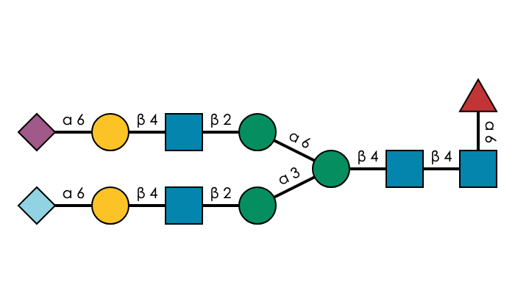
ßeta-linked
*
Man1-6
Man1-3
*
root
*
*

Slide 30
Alpha-linked
*
Man1-6
Man1-3
*
root
*
*

Slide 31
*
Man1-6
Man1-3
*
root
When Neu5Ac(a2-6) is on the Man(a1-6) branch and Neu5Gc(a2-6) is on the Man(a1-3) branch, with core fucose:
Both Neu5Ac and Neu5Gc are the most flexible, with a slightly higher flexibility for Neu5Ac on the Man(a1-6) branch.
→ When a mixture of Neu5Gc and Neu5Ac is present, flexibility seems to follow the general rule: monosaccharide on the Man(a1-6) branch is the most flexible. But, when Neu5Gc(a2-6) is present on the Man(a1-3) branch, it is also highly flexible

Slide 32
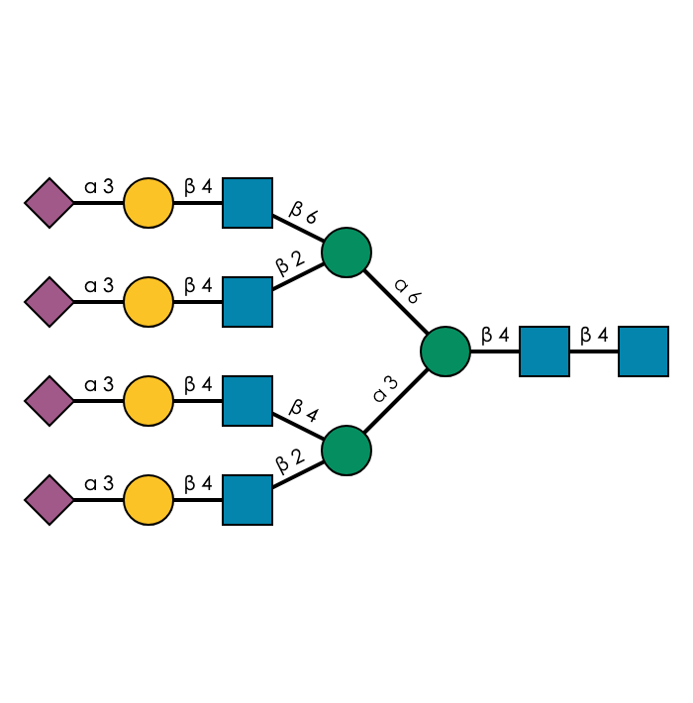
ßeta-linked
Man1-6/Glc1-6
*
Man1-6/Glc1-2
*
Man1-3/Glc1-4
*
Man1-3/Glc1-2
root
*
*
*

Slide 33
Alpha-linked
Man1-6/Glc1-6
*
Man1-6/Glc1-2
*
Man1-3/Glc1-4
*
Man1-3/Glc1-2
root
*
*
*

