Slide 2
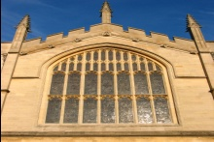

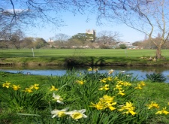
Hessian-Affine detector+
rootSIFT descriptor
Approximate K-Mean(AKM)
…
Set of features
…
Create Inverted File
Inverted file
Dictionary

Slide 3
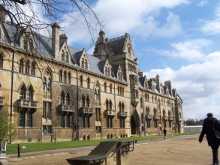

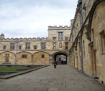
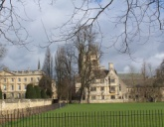

Hessian-Affine detector+
rootSIFT descriptor
features
Compute Word-IDs
Dictionary
Indexed Words
Compute ranked list
…
Inverted file
…
Ranked list

