Slide 1
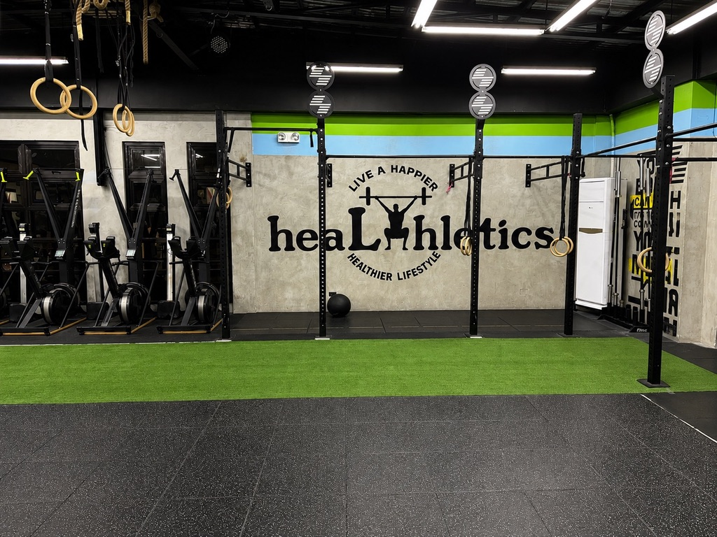
HEALTHLETICS:
AI-POWERED
MEMBER RETENTION
BUSINESS CAPSTONE PRESENTATION
Lynette T. Suller
PGD AI & Machine Learning
Using member data to identify churn risk and
support proactive retention.
PREDICT EARLIER • ENGAGE BETTER • RETAIN STRONGER
HEALTHLETICS • BUSINESS CAPSTONE | 01

Slide 2
01 • THE BUSINESS OPPORTUNITY
Why Member Retention Matters
• Member churn reduces recurring membership value and makes growth more dependent on replacing lost members.
• Healthletics needs an earlier signal that a member may be disengaging.
• The project asks a practical business question: who may need a timely retention support?
• Machine learning can turn member activity patterns into an actionable risk signal.
DATASET CHURNED
26.53%
Public proof-of-concept dataset
RETAINED
73.48%
Public proof-of-concept dataset
BUSINESS GOAL
EARLIER ACTION
Support member retention
HEALTHLETICS • BUSINESS CAPSTONE | 02

Slide 3
02 • WHAT THE ANALYSIS FOUND
The Strongest Business Signals
1-MONTH CONTRACT
42.3% churn
Highest contract-period churn
6-MONTH CONTRACT
12.5% churn
Much lower than 1-month
12-MONTH CONTRACT
2.4% churn
Lowest contract-period churn
NO GROUP VISITS
33.0% churn
Higher than group-visit members
GROUP VISITS
17.3% churn
Lower churn rate
LIFETIME ↔ CHURN
-0.438
Longer lifetime linked with lower churn
• Business implication: contract commitment and engagement behaviour are useful signals for retention planning.
• These relationships are observational; they should guide testing and outreach, not be treated as causal proof.
HEALTHLETICS • BUSINESS CAPSTONE | 03

Slide 4
03 • FROM INSIGHT TO ACTION
What Member Behaviour Suggests
CHURNED
1.04 AVG. FREQUENCY
Current-month attendance
RETAINED
2.03 VG. FREQUENCY
Current-month attendance
KEY SIGNAL
frequency_change
Recent activity trend
• Lower recent activity is associated with higher churn risk.
• frequency_change was the strongest predictive signal in the model.
• Business interpretation: a decline in participation can act as an early warning signal.
• Recommended response: use risk information to trigger supportive engagement—not punitive action.
HEALTHLETICS • BUSINESS CAPSTONE | 04

Slide 5
04 • PROPOSED BUSINESS SOLUTION
A Proactive Retention Workflow
1 IDENTIFY Flag members with elevated churn risk.
2 UNDERSTAND Review recent activity and member context.
3 ENGAGE Offer a relevant, positive retention touchpoint.
4 LEARN Track outcomes and refine the approach.
HEALTHLETICS • BUSINESS CAPSTONE | 05

Slide 6
05 • FROM MODEL TO ACTION
USING THE MODEL TO PRIORITIZE RETENTION SUPPORT
SELECTED MODEL
RANDOM FOREST
Strongest tested candidate
ROC-AUC
0.9879
Held-out test set
RECALL
0.9057
Churners identified
BUSINESS INTERPRETATION
The model can help Healthletics prioritize members who may benefit from earlier retention.
HEALTHLETICS • BUSINESS CAPSTONE | 06

Slide 7
06 • BUSINESS VALUE
WHAT SUCCESS COULD LOOK LIKE
POTENTIAL VALUE
RETAIN MEMBERS
Protect recurring membership value
OPERATIONAL VALUE
PRIORITIZE OUTREACH
Focus staff attention
STRATEGIC VALUE
LEARN BEHAVIOUR
Build evidence-based retention
• The project does not contain Healthletics financial data, so a dollar ROI is not claimed here.
• A production ROI calculation should combine member lifetime value, retention uplift, intervention cost and staff effort.
• A controlled pilot can establish the actual retention uplift before scaling.
HEALTHLETICS • BUSINESS CAPSTONE | 07

Slide 8
07 • RISK MANAGEMENT
Key Risks & How to Manage Them
DATA GENERALIZABILITY
Public dataset may not represent Healthletics members.
Mitigation: Validate on real, appropriately collected Healthletics data.
FAIRNESS
Performance can vary across demographic groups.
Mitigation: Monitor group-level performance and prediction rates.
OVER-RELIANCE
Predictions can be mistaken for certainty.
Mitigation: Use human oversight and supportive interventions.
PRIVACY
Future Healthletics member data sensitive.
Mitigation: Apply access controls, minimization and secure handling.
HEALTHLETICS • BUSINESS CAPSTONE | 08

Slide 9
08 • IMPLEMENTATION STRATEGY
Recommended Pilot Strategy
PHASE 1
VALIDATE
Validate on appropriately collected Healthletics data.
PHASE 2
PILOT
Run a small retention workflow with staff oversight.
PHASE 3
MEASURE
Track retention outcomes, costs and fairness.
PHASE 4
SCALE
Deploy only if evidence supports value and responsible use.
HEALTHLETICS • BUSINESS CAPSTONE | 09

Slide 10
09 • EXECUTIVE TAKEAWAY
Recommendation & Next Steps
DECISION
PILOT
Validate before scaling
• Proceed with a controlled validation/pilot rather than immediate production deployment.
• Use recent member activity decline as an early retention signal to investigate.
• Keep humans in the loop: the model should support staff decisions, not replace them.
• Measure actual retention uplift, intervention cost and member value to establish a defensible ROI.
• Scale only after performance, fairness, privacy and business value are demonstrated.
SUCCESS MEASURE
RETENTION UPLIFT
Compare outcomes
GUARDRAIL
RESPONSIBLE AI
Fair + human-led
HEALTHLETICS • BUSINESS CAPSTONE | 10

