Slide 1
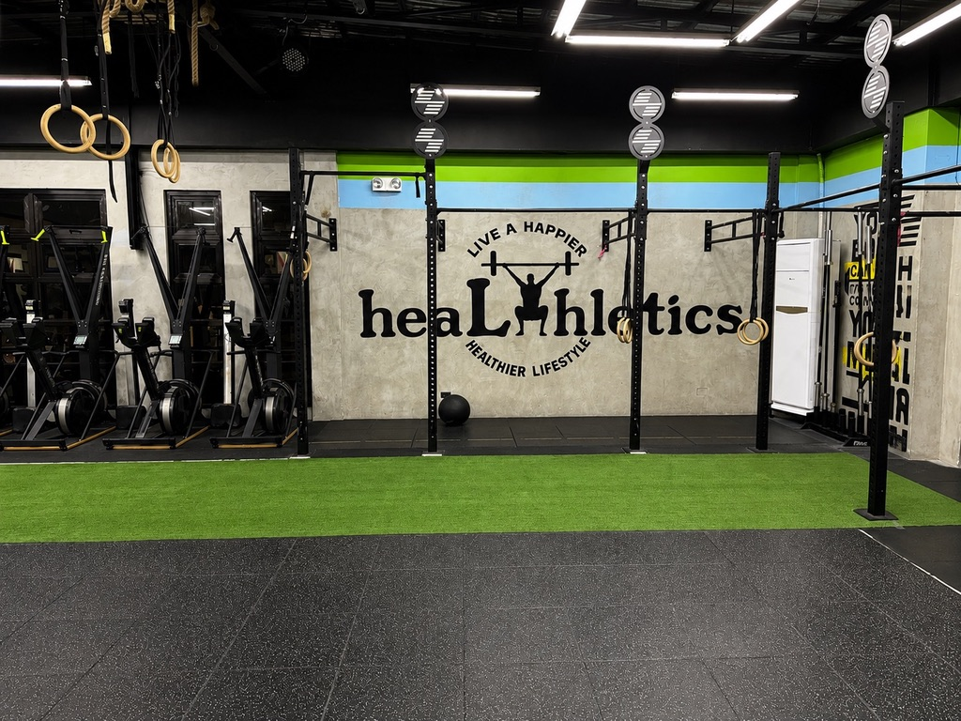
HEALTHLETICS:
AI-POWERED
MEMBER RETENTION
& CHURN PREDICTION SYSTEM
TECHNICAL CAPSTONE PRESENTATION,
Lynette T. Suller | PGD AI & Machine Learning
FITNESS/GYM MANAGEMENT •
BINARY CLASSIFICATION•
MACHINE LEARNING
HEALTHLETICS • TECHNICAL CAPSTONE | 01

Slide 2
01 • PROBLEM UNDERSTANDING & FRAMING
Business Problem & Project Objectives
ML TASK
CLASSIFICATION
Binary target
• Healthletics needs to identify members who may be at risk of churn or non-renewal.
• The objective is to support timely, positive retention actions—not simply predict churn.
• Task: binary classification using membership, activity, engagement and demographic data.
• Target: Churn (1 = churned, 0 = retained).
• Primary evaluation metric: ROC-AUC; business KPI: member retention rate.
PRIMARY METRIC
ROC-AUC
Model discrimination
BUSINESS KPI
RETENTION RATE
out Member come
HEALTHLETICS • TECHNICAL CAPSTONE | 02

Slide 3
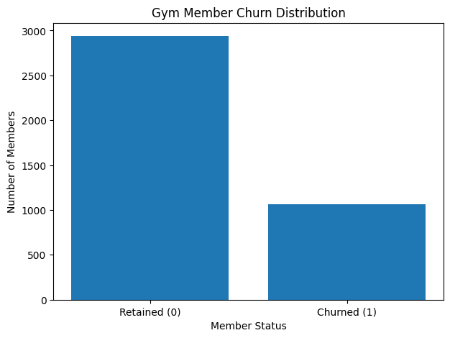
02 • DATA COLLECTION & UNDERSTANDING
Dataset Overview & Data Quality
ROWS
4,000
COLUMNS
14
MISSING VALUES
0
DUPLICATES
0
• Public gym-customer churn dataset used as a proof of concept.
• 73.48% retained and 26.53% churned.
• Predictors cover contract, activity, engagement and demographic variables.
• Future validation should use appropriately collected and anonymized Healthletics data.
Source: Kaggle — Gym Customers Features and Churn (Adrian Vinueza)
HEALTHLETICS • TECHNICAL CAPSTONE | 03

Slide 4
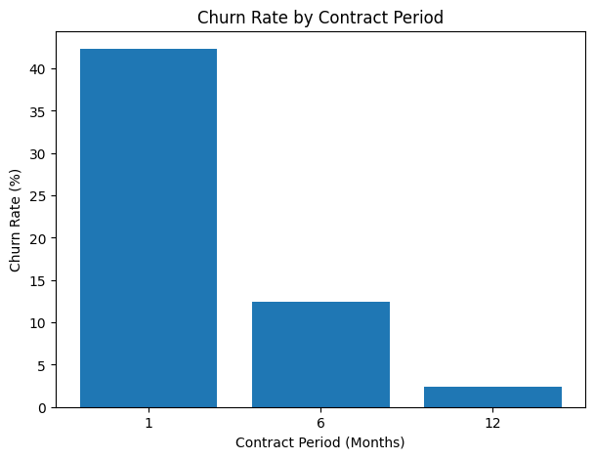
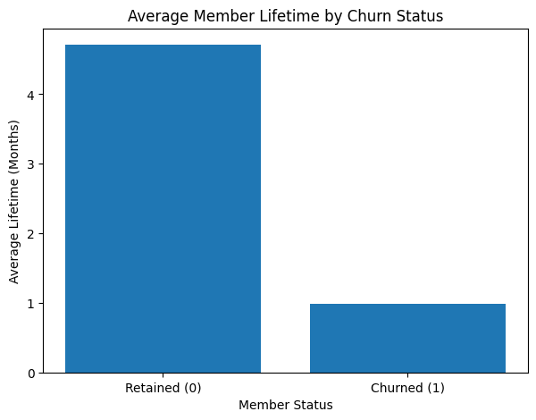
03 • EXPLORATORY DATA ANALYSIS
EDA: Contract Length & Member Lifetime
1-MONTH CONTRACT
42.32% churn
6-MONTH CONTRACT
12.48% churn
12-MONTH CONTRACT
2.40% churn
LIFETIME
4.71 vs 0.99 mo
HEALTHLETICS • TECHNICAL CAPSTONE | 04

Slide 5
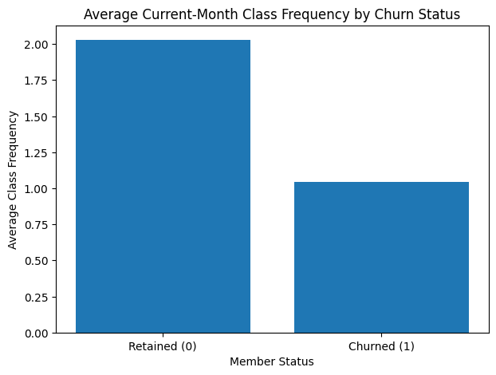
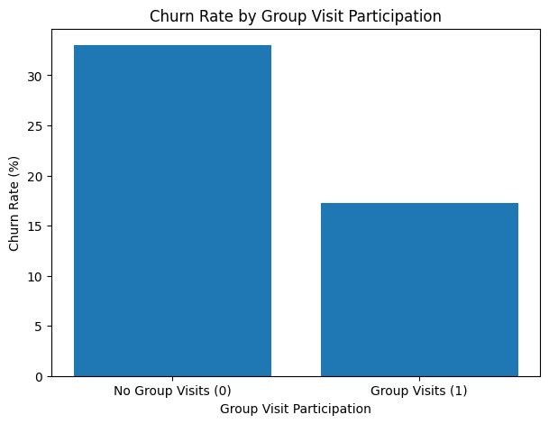
03 • EXPLORATORY DATA ANALYSIS
EDA: Engagement & Churn Signals
RETAINED FREQUENCY
2.03
CHURNED FREQUENCY
1.04
NO GROUP VISITS
33.01% churn
GROUP VISITS
17.28% churn
HEALTHLETICS • TECHNICAL CAPSTONE | 05

Slide 6
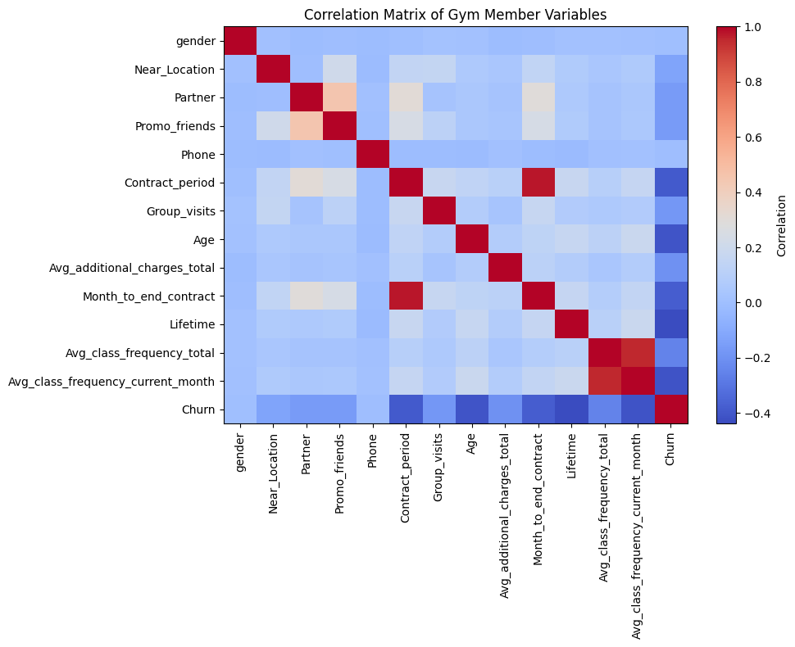
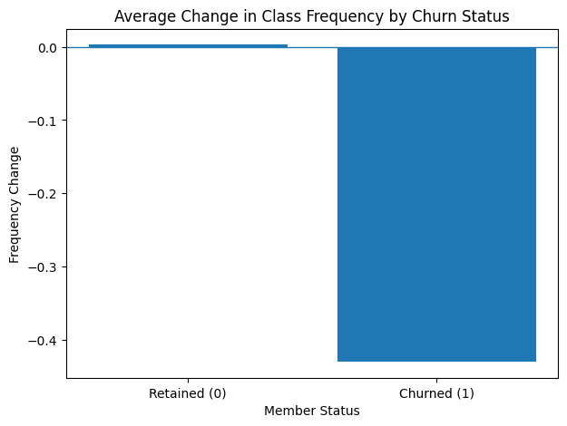
03–04 • EDA & FEATURE ENGINEERING
Correlation & Engineered Activity Trend
DEFINITION
Current − historical
FREQUENCY_CHANGE
−0.43 for churned
INTERPRETATION
Negative = decline
KEY INSIGHT
Activity matters
HEALTHLETICS • TECHNICAL CAPSTONE | 06

Slide 7
05 • FEATURE SELECTION & DIMENSIONALITY REDUCTION
Feature Selection & PCA
TOP MI FEATURE
frequency_change
MI = 0.3423
SECOND SIGNAL
Lifetime
MI = 0.2087
PCA
11 components
96.32% variance retained
• Mutual information identified frequency_change as the strongest feature after engineering.
• Standardization was applied before PCA.
• Eleven components retained at least 95% variance (96.32%).
• Mutual information indicates feature relevance, not causation.
HEALTHLETICS • TECHNICAL CAPSTONE | 07

Slide 8
06–07 • MODEL DEVELOPMENT & EVALUATION
Model Development & Performance Comparison
80/20 stratified train-test split • Accuracy • Precision •Recall • F1 • ROC-AUC
Model | Accuracy | Precision | Recall | F1 | ROC-AUC
Logistic Regression | 0.9262 | 0.8844 | 0.8302 | 0.8564 | 0.9775
Decision Tree | 0.9462 | 0.9519 | 0.8396 | 0.8922 | 0.9701
Random Forest | 0.9650 | 0.9600 | 0.9057 | 0.9320 | 0.9879
SELECTED MODEL
RANDOM FOREST
Highest ROC-AUC, recall and F1
ROC-AUC
0.9879
Test-set performance
5-FOLD CV
0.988 ± 0.0035
Stable across folds
HEALTHLETICS • TECHNICAL CAPSTONE | 08

Slide 9
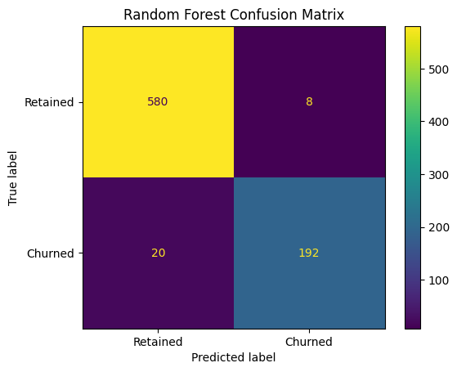
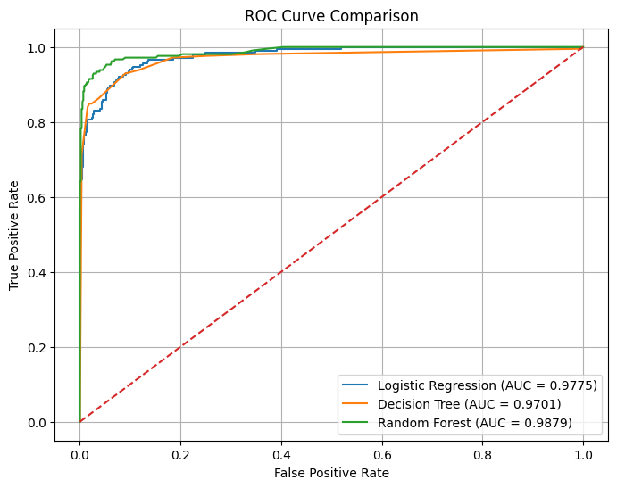
07 • MODEL EVALUATION
Random Forest: Confusion Matrix & ROC Curve
• 580 retained members correctly classified; 8 false positives.
• 192 churned members correctly identified; 20 false negatives.
• Recall = 0.9057, meaning most churned members in the test set were identified.
• ROC-AUC = 0.9879, the highest among the three tested models.
HEALTHLETICS • TECHNICAL CAPSTONE | 09

Slide 10
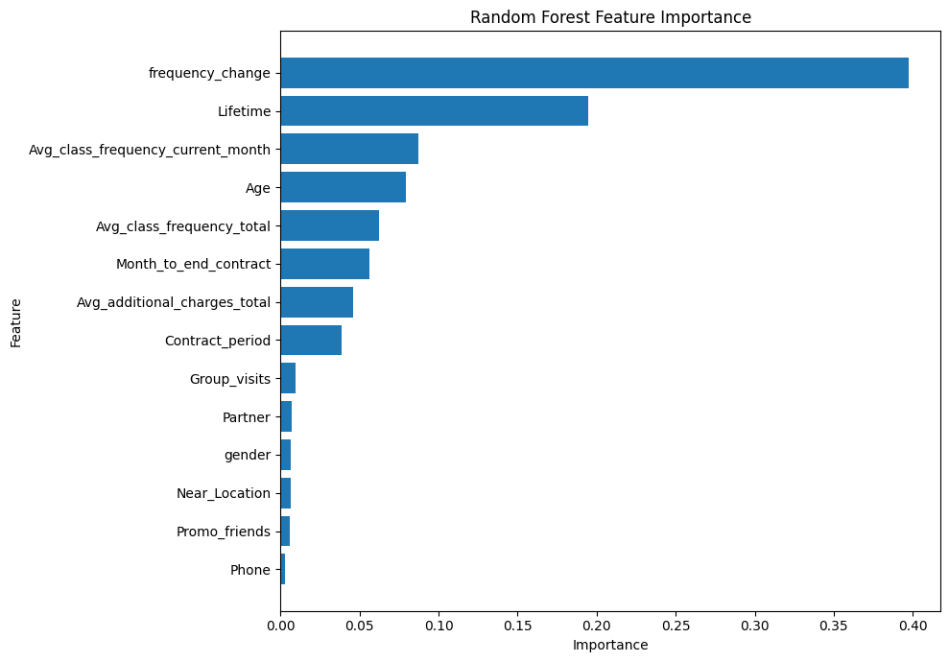
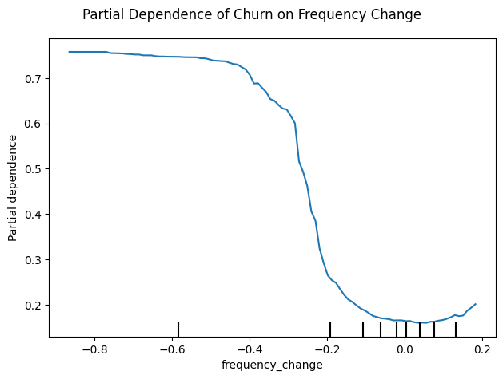
08 • EXPLAINABILITY
Explainability: What Signals Churn Risk?
PDP FINDING
Higher churn risk when activity decline is strong
FEATURE IMPORTANCE
frequency_change #1
PERMUTATION IMPORTANCE
0.1138
LIFETIME PERMUTATION
0.0385
HEALTHLETICS • TECHNICAL CAPSTONE | 10

Slide 11
09 • CRITICAL THINKING, ETHICAL AI & BIAS AUDIT
Bias, Fairness & Responsible AI
• Observed churn rates were very similar in the dataset.
• Model performance was not identical across age groups, so group-level monitoring is required.
• The 35–41 test group contained only 36 members; its 0.0000 recall is therefore unstable and should not be over-interpreted.
• Predicted churn rates also differed by age group, so prediction-rate differences should be investigated rather than treated as proof of unfairness.
• Use the model as decision support—not the sole basis for decisions about individual members.
Age group | Members | Recall | Pred. churn
18–24 | 59 | 1.0000 | 67.80%
25–29 | 377 | 0.9385 | 33.69%
30–34 | 328 | 0.7143 | 10.06%
35–41 | 36 | 0.0000 | 0.00%
RESPONSIBLE USE
HUMAN OVERSIGHT
Monitor group performance • Review thresholds • Human oversight
HEALTHLETICS • TECHNICAL CAPSTONE | 11

Slide 12
10 • CONCLUSION & FUTURE HEALTHLETICS APPLICATION
From Prediction to Member Retention
BEST MODEL
RANDOM FOREST
ROC-AUC 0.9879
RECALL
0.9057
Strong churn identification
KEY SIGNAL
frequency_change
Recent activity decline
• Random Forest provided the strongest overall test-set performance among the evaluated candidates.
• Recent changes in class frequency were the strongest predictive signal in the model.
• The project is a proof of concept based on a public gym dataset, not a production deployment.
• Before practical use, retrain and validate with appropriately collected and anonymized Healthletics data.
• Future vision: integrate churn-risk insights into a Healthletics member management and analytics system.
PREDICT EARLIER • ENGAGE BETTER • RETAIN STRONGER
HEALTHLETICS • TECHNICAL CAPSTONE | 12

