Slide 1
Running Docker on HPC
Adrian Madej, Martyna Sokołowska

Slide 2


Used technologies
Apptainer - containerization technology.
Source of Scripts (SoS) - a computational environment that supports the development and execution of scripts in multiple languages within a single session.

Slide 3
Apptainer - Singularity container
What does it provide?
Operates without requiring administrator (root) privileges
Isolation and portability – all data contained in a single .sif file
Security – supports container encryption and cryptographic signing to ensure image integrity.
Integration with HPC systems
Support for GPUs and accelerators
What Docker is to Kubernetes, Singularity is to HPC.

Slide 4
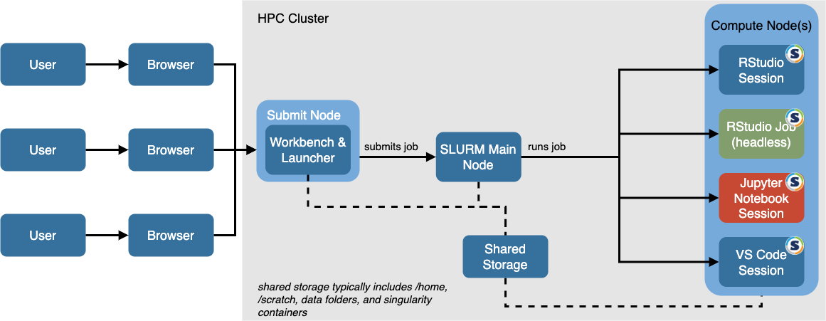
Integrating Apptainer into the SLURM Workflow

Slide 5
Apptainer - useful commands
cache - manage local cache
capability - manage Linux capabilities for users and groups
config - manage various Apptainer configuration (root user)
exec - run command within a container
instance - manage containers running as services
run - run user-defined default command within a container
shell - run shell within a container
test - run user-defined tests within a container
build - build Apptainer image
delete - delete image from library
pull - pull image from URI
push - upload image to the URI
sif - manipulate Singularity Image Format images

Slide 6
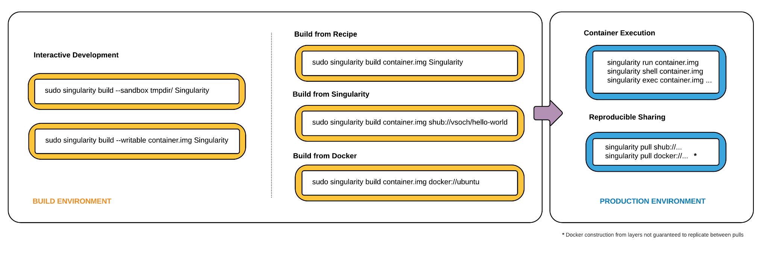
Apptainer – Singularity container

Slide 7
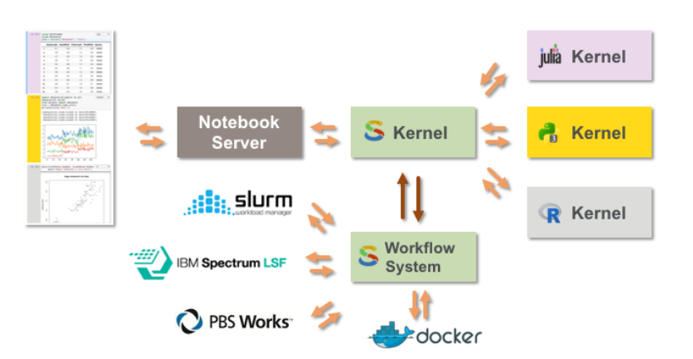
Source of Scripts

Slide 8
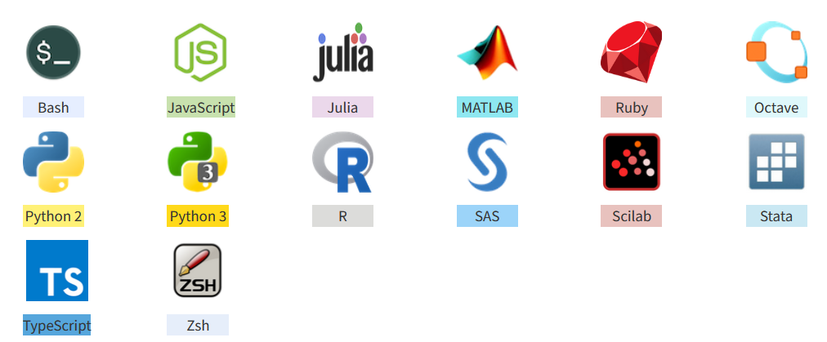
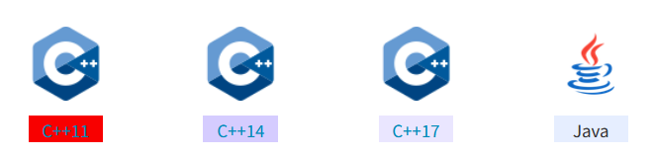
SoS - supported languages

Slide 9
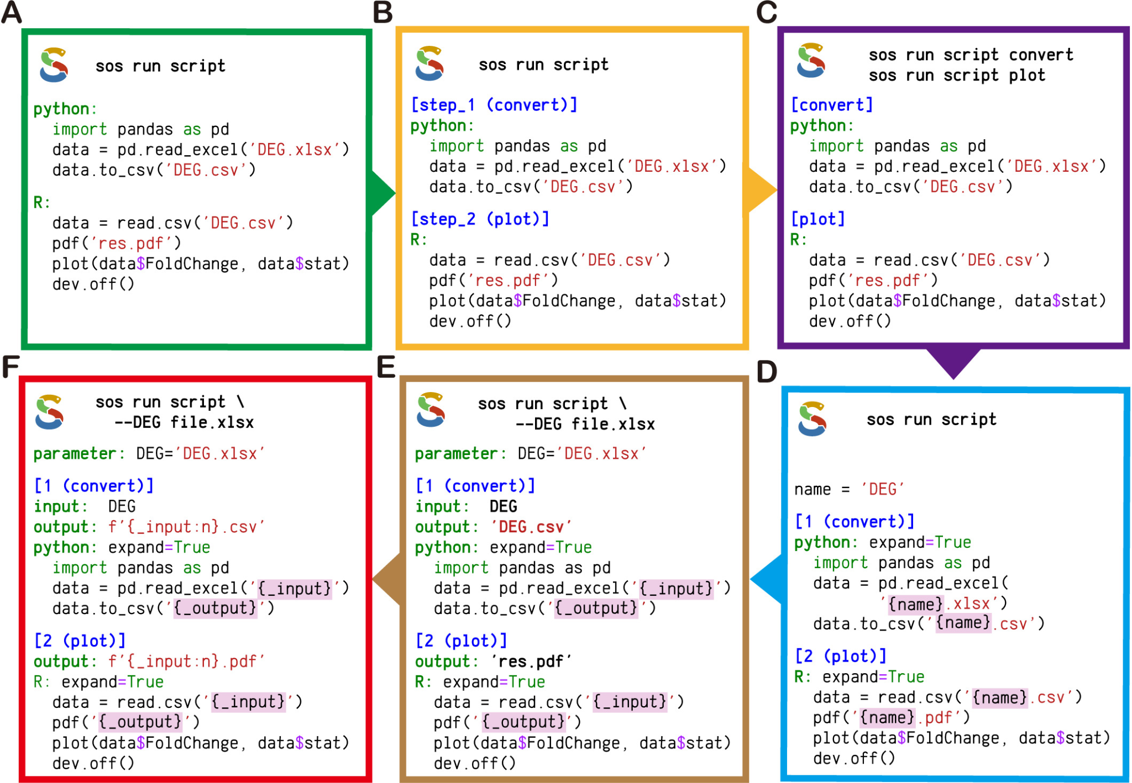
SoS - workflow system
Most workflow systems are complex and rigid. Sos is simple and flexible
Great for everyday data analysis, not just big projects

Slide 10
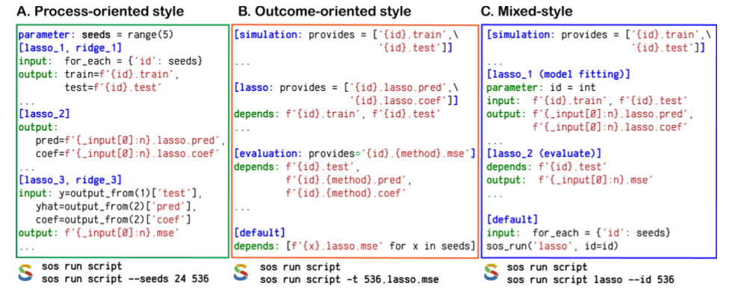
SoS - mixed style workflow
Supports step-by-step workflow
Supports makefile-style workflow
Supports mixed workflow

Slide 11
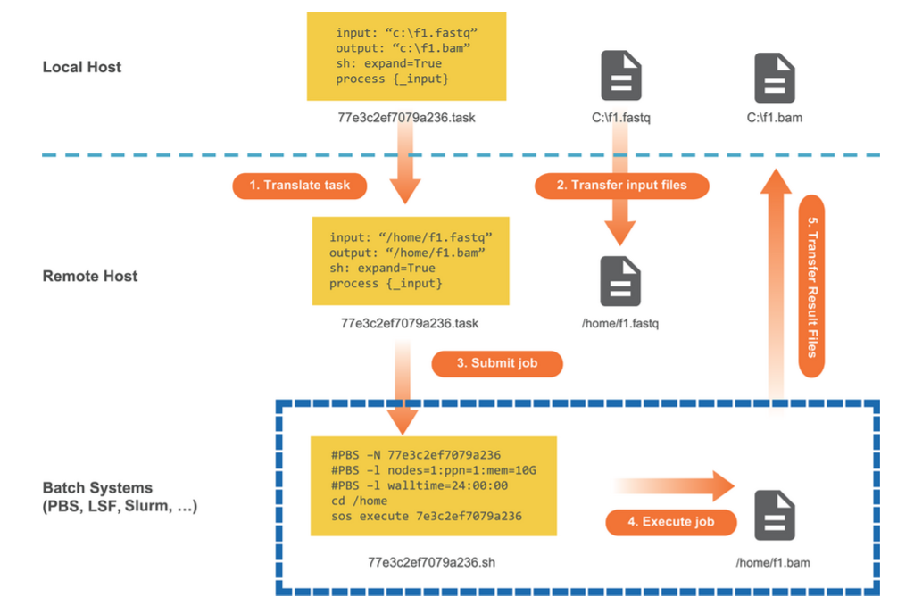
SoS - Remote Execution
Large workflows often require remote computational resources, which usually involve complex setup
SoS provides a remote execution model that allows sending tasks to remote servers and clusters directly from the local machine.
Enables reproducible and scalable data analysis without extra hassle

Slide 12
Thank you
Adrian Madej, Martyna Sokołowska

