Slide 1
Toward RFC9363bis
https://datatracker.ietf.org/doc/draft-toutain-schc-toward-rfc9363bis/
L. Toutain, M. Tiloca, A. Minaburo, S. Sirohi

Slide 2
Objective
Reflect in RFC 9363, WG discussion:
  Universal Options
  RFC8824 update
  ICMPv6
  Compound Ack
  And goodies
Not a RFC9363bis, initiate discussion in the WG

Slide 3
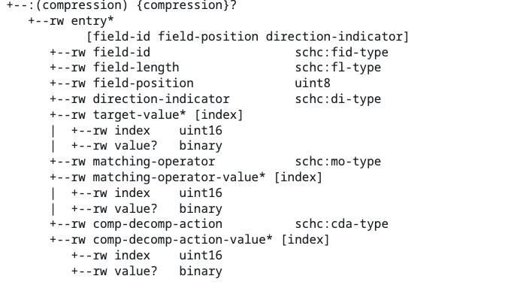
Universal Option
RFC 9363

Slide 4
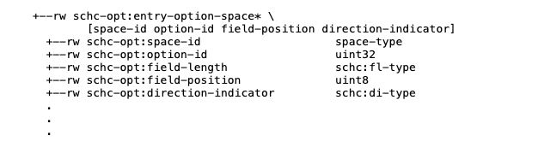
Universal Option
RFC 9363
draft-ietf-schc-universal-option

Slide 5

Universal Option
RFC 9363
draft-ietf-schc-universal-option
Loosing field order imposed by RFC 8724

Slide 6
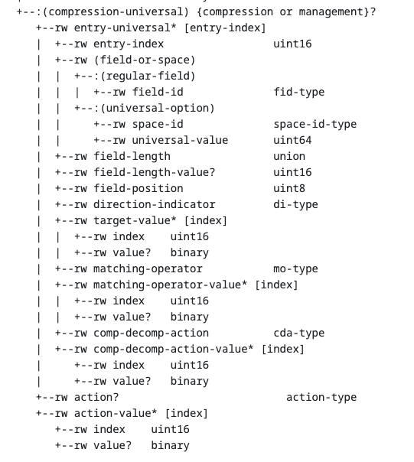
Universal Option
+
Deprecated

Slide 7
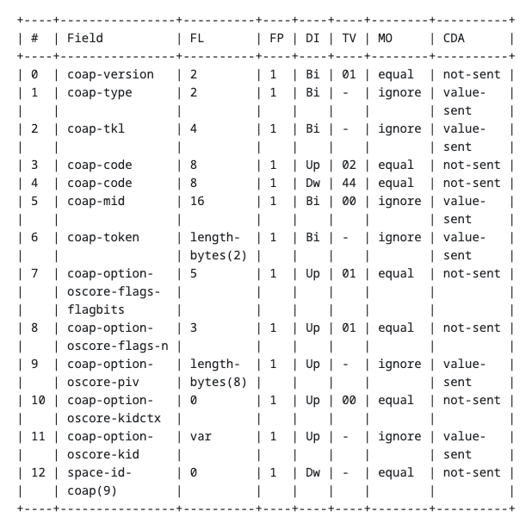
Universal Option
Shorter key:
important for management
+

Slide 8
Universal Option
Consequences
Deprecate coap options
but some options are subdivided
  OSCORE, KUDOS

Slide 9
Universal Option
Consequences
Deprecate coap options
but some options are subdivided
  OSCORE, KUDOS
Generalise fl-token-length:
  fl-length-bytes
  fl-length-bits

Slide 10
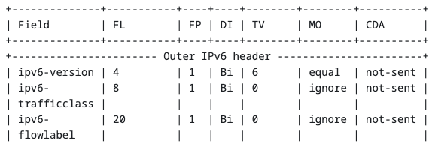
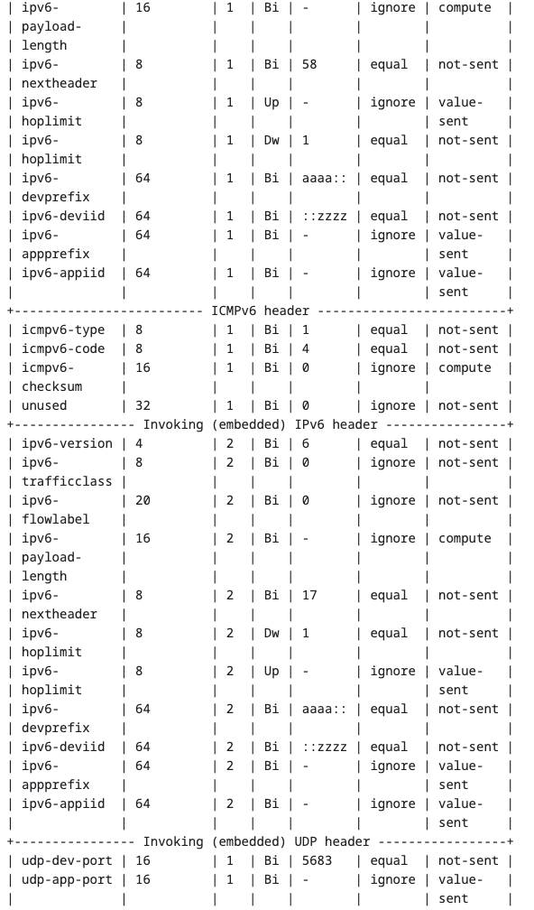
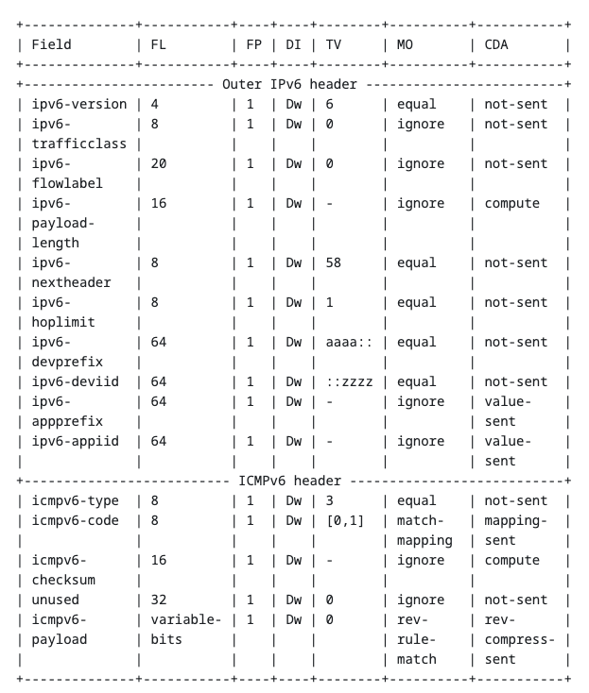

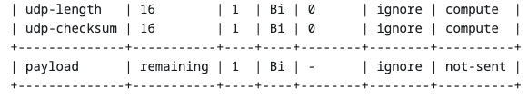
ICMPv6
What to do ?
Reverse
direction
Vs.

Slide 11
ICMPv6
Goodies
Reverse
direction
Vs.

Slide 12
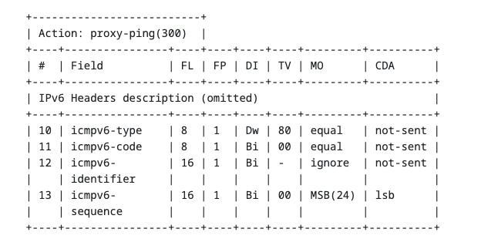
Actions
For ICMPv6
Removed for old OAM draft
  Bottom-up approach
Included in revision
  Top-down approach
  Proposed for payload compression

Slide 13

Management
New nature
Same behaviour as compression
Add guard period
More complex management (as RPC) will be covered by other documents
  Specialised management for an environment

Slide 14
SID allocation
Not yet covered
recommend:
  Manual allocation of SIDs
  Most usual identityref (equal, not-sent, …) be the first numbers to allow Sid translation (cf. draft-toutain-core-private-sid-translation)

Slide 15
Conclusion
Work in progress
Tested in H-SCHC implementation
When approved, rfc9363 easy to derive

