Slide 1
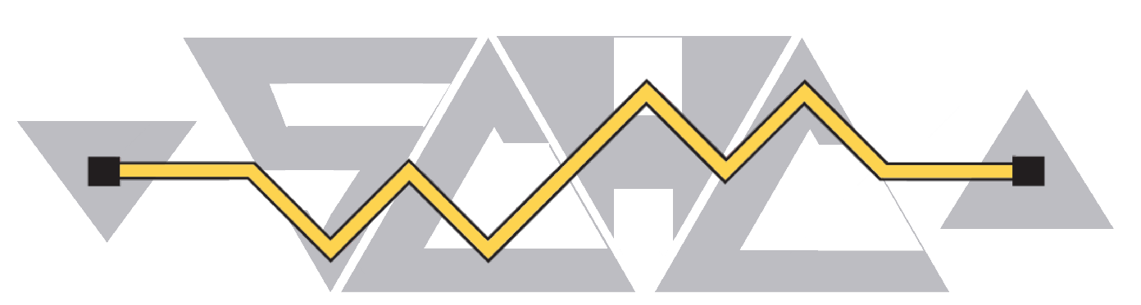
draft-ietf-schc-universal-option-02
Nov 17th, 2026
Authors: Q. Lampin, A. Minaburo, M. Tiloca, L. Toutain, S. Sirohi
Presenter: L. Toutain
IETF 127, San Francisco

Slide 2
Drafts organisation
toward-rfc9363bis
interim-2026-schc-13
Organisation

Slide 3
Drafts organisation
Universal-option
toward-rfc9363bis
ICMPv6
interim-2026-schc-13
Organisation

Slide 4
Drafts organisation
Universal-option
Coreconf-management
toward-rfc9363bis
RFC9363
bis
ICMPv6
interim-2026-schc-13
Organisation

Slide 5
draft-ietf-schc-universal-option-02
Nov 17th, 2026
Authors: Q. Lampin, A. Minaburo, M. Tiloca, L. Toutain, S. Sirohi
Presenter: L. Toutain
IETF 127, San Francisco

Slide 6
/-----------------------------------------------------------------\
| Rule N |
/-----------------------------------------------------------------\|
| Rule i ||
/-----------------------------------------------------------------\||
| (FID) Rule 1 |||
|+-------+--+--+--+------------+-----------------+---------------+|||
||Field 1|FL|FP|DI|Target Value|Matching Operator|Comp/Decomp Act||||
|+-------+--+--+--+------------+-----------------+---------------+|||
||Field 2|FL|FP|DI|Target Value|Matching Operator|Comp/Decomp Act||||
|+-------+--+--+--+------------+-----------------+---------------+|||
||... |..|..|..| ... | ... | ... ||||
|+-------+--+--+--+------------+-----------------+---------------+||/
||Field N|FL|FP|DI|Target Value|Matching Operator|Comp/Decomp Act|||
|+-------+--+--+--+------------+-----------------+---------------+|/
| |
\-----------------------------------------------------------------/
x--:(compression) {compression}?
| x--rw entry* [field-id field-position direction-indicator]
| +--rw field-id schc:fid-type
| +--rw field-length union
| +--rw field-position uint8
| +--rw direction-indicator schc:di-type
| +--rw target-value* [index]
| | +--rw index uint16
| | +--rw value? binary
| +--rw matching-operator schc:mo-type
| +--rw matching-operator-value* [index]
| | +--rw index uint16
| | +--rw value? binary
| +--rw comp-decomp-action schc:cda-type
| +--rw comp-decomp-action-value* [index]
| +--rw index uint16
| +--rw value? binary
Field ID : definied as an identity in the YANG DM
Evolution is difficult
Universal Option : Space ID and option number.
Compression entry’s key : 3 elements
Long sequence in CORECONF messages
Independant of the position in rule
Universal Option => add another element
Change the key structure

Slide 7
Deprecated
x--:(compression) {compression}?
| x--rw entry* [field-id field-position direction-indicator]
| +--rw field-id schc:fid-type
| +--rw field-length union
| +--rw field-position uint8
| +--rw direction-indicator schc:di-type
| +--rw target-value* [index]
| | +--rw index uint16
| | +--rw value? binary
| +--rw matching-operator schc:mo-type
| +--rw matching-operator-value* [index]
| | +--rw index uint16
| | +--rw value? binary
| +--rw comp-decomp-action schc:cda-type
| +--rw comp-decomp-action-value* [index]
| +--rw index uint16
| +--rw value? binary
x--:(compression) {compression}?
+--:(compression-universal) {compression or management}?
+--rw entry-universal* [entry-index]
| +--rw entry-index uint16
| +--rw (field-or-space)
| | +--:(regular-field)
| | | +--rw field-id schc:fid-type
| | +--:(universal-option)
| | +--rw space-id schc:space-id-type
| | +--rw universal-value uint64
| +--rw field-length union
| +--rw field-length-value? uint16
| +--rw field-position uint8
| +--rw direction-indicator schc:di-type
| +--rw target-value* [index]
| | +--rw index uint16
| | +--rw value? binary
| +--rw matching-operator schc:mo-type
| +--rw matching-operator-value* [index]
| | +--rw index uint16
| | +--rw value? binary
| +--rw comp-decomp-action schc:cda-type
| +--rw comp-decomp-action-value* [index]
| +--rw index uint16
| +--rw value? binary
+--rw action? action-type
+--rw action-value* [index]
+--rw index uint16
+--rw value? binary
Key is a single integer
FID is either :
Fid-*
Space-id, option
Old CoAP FID are deprecated
New Function Length :
fl-lenght-bytes (entry)
fl-length-bits (entry)
Add Data Model for syntactic CoAP compression :
Three fields (∆option, length, data)
Compression-universal

Slide 8
draft-ietf-schc-icmpv6-compression-03
Nov 17th, 2026
Authors: D. Barthel, L. Toutain, M. Dumay
Presenter: L. Toutain
IETF 127, San Francisco

