Slide 2
Swagger

Slide 3
Topics
Introduction to Swagger and OpenAPI
Top down/Bottom up techniques for API definition
Swagger specifications
Swagger editor for writing API
Explore API with Swagger UI
Swagger client/server code generation
Swagger HUB and other commercial tools

Slide 4
Introduction to Swagger and Open API

Slide 5

What is Swagger
A standard, language-agnostic interface to REST APIs
A new best practice in web software development
A set of rules interpretable by humans and machines
An high level interface providing quick overview about services functionalities
A set of rules that can be used to automatically generate server side code
A set of rules that can be used to automatically generate client side code
A set of tools for API sofware design

Slide 6
Why REST?
Client and server loosely coupled
Services easy to understand by humans
Exploit already existing HTTP protocol methods (GET, POST, PUT, DELETE)
Scalability because HTTP protocol is stateless
No XML parsing (Do you remember SOAP?)

Slide 7
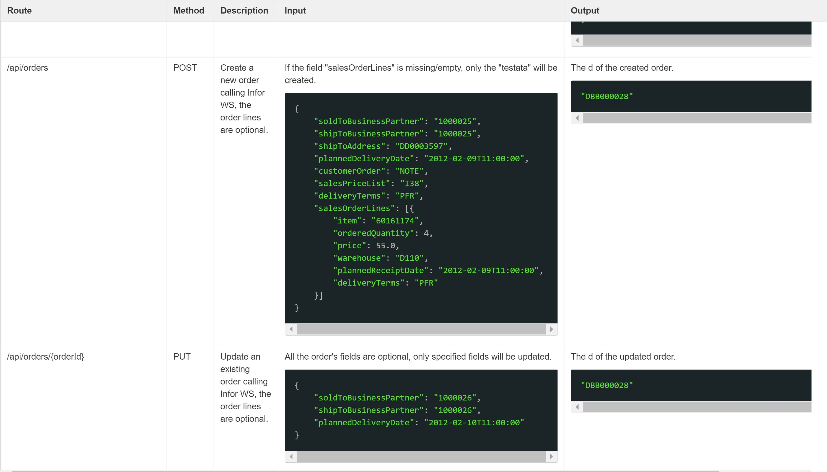
Why Standard?
Don't reinvent the wheel
Promote API maintaince
Promote API discovery
Robust API design
Learn once, use everywhere
Easy API mocking
Code generation tool
….

Slide 8

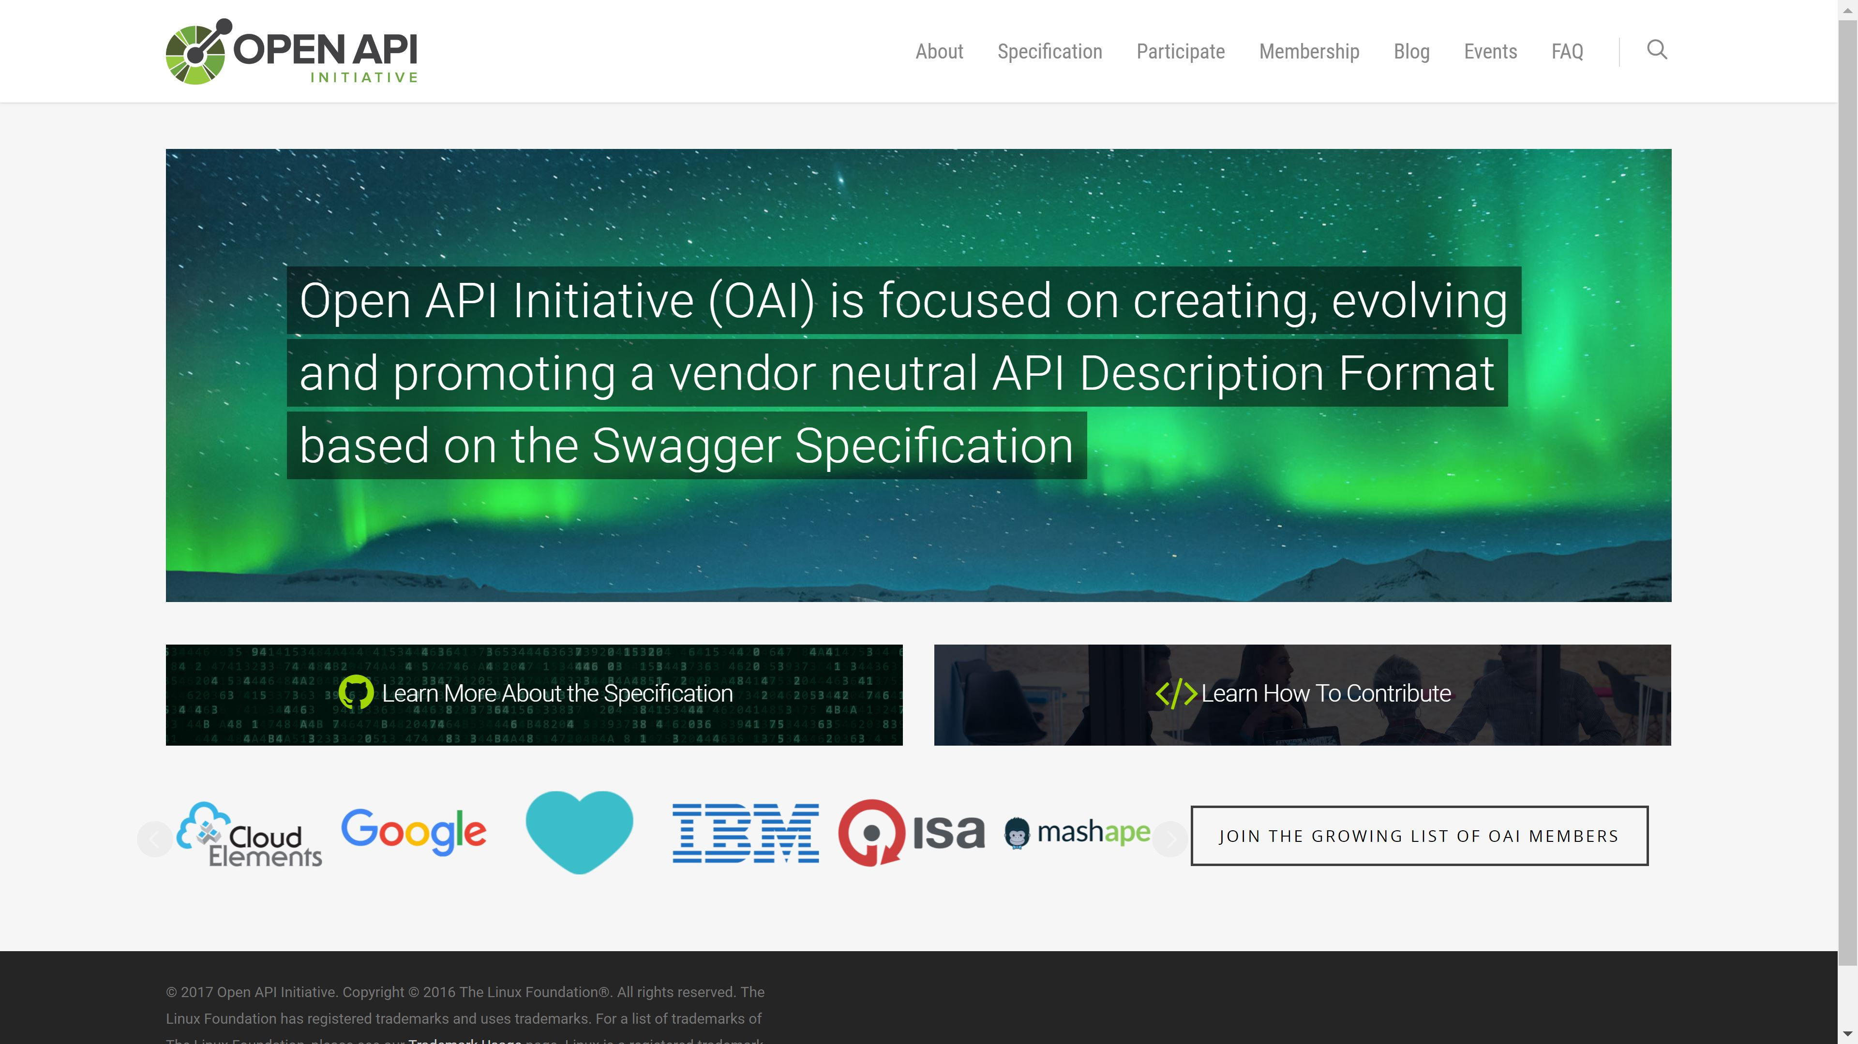
What is OpenAPI?

Slide 9
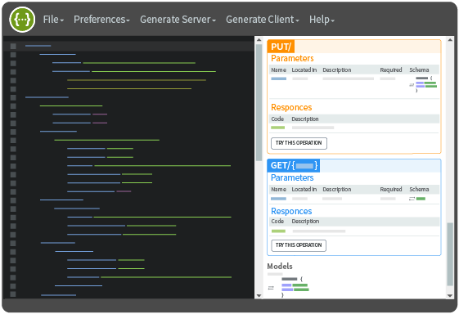
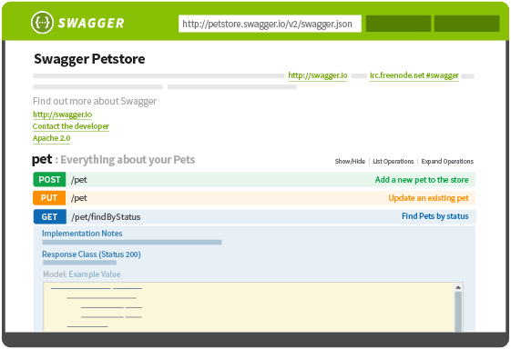
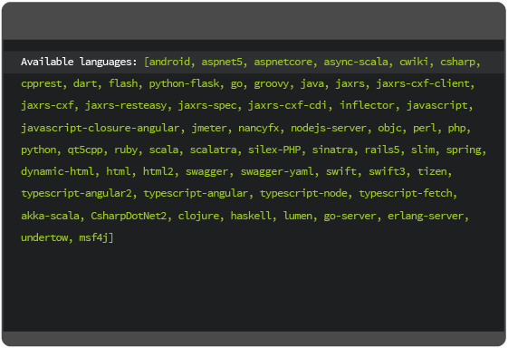
Swagger tools
Swagger is a set of speficications but also a set of tools
Swagger Editor
Swagger UI
Swagger Codegen

Slide 10
Bottom Up vs Top Down techinques

Slide 11
Top down vs Bottom Up
TOP DOWN: use the Swagger Editor to create your Swagger definition and then use the integrated Swagger Codegen tools to generate server implementation
BOTTOM UP: use custom metadata (annotation for example, if available for the currently used technology) directly into code to automatically generate swagger definitions

Slide 12
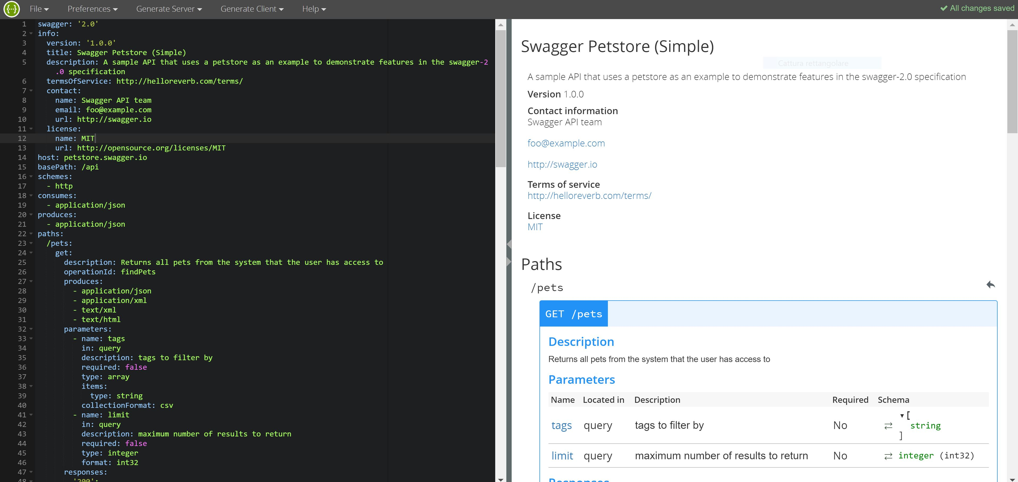
Top Down

Slide 13
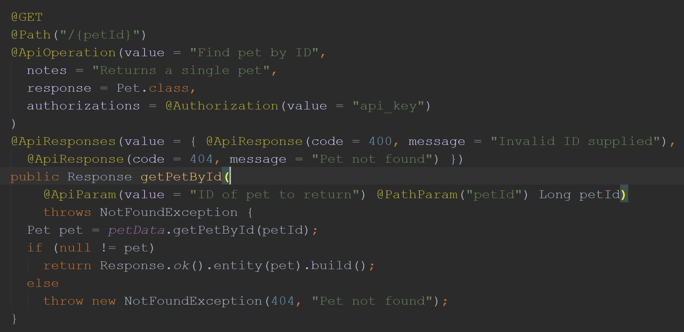
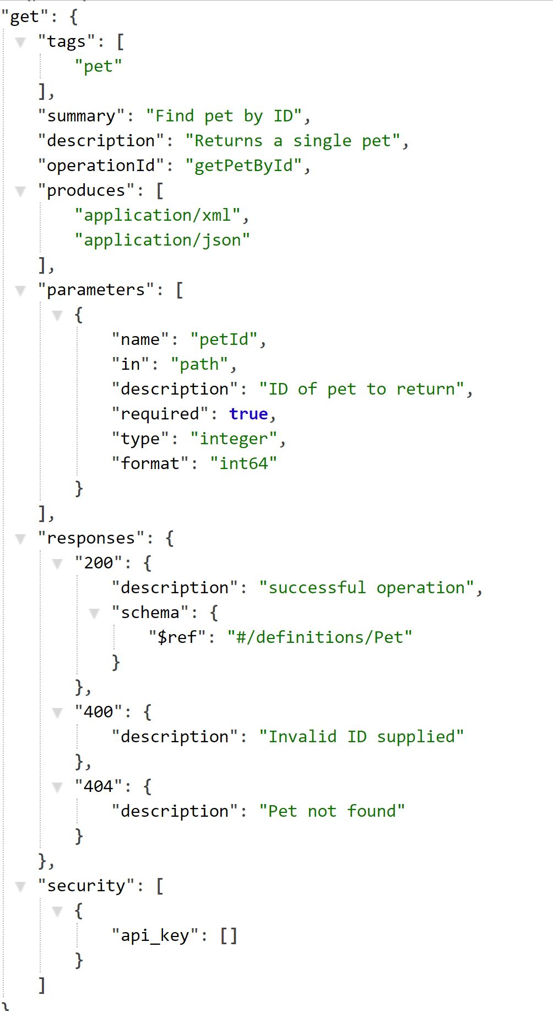
Bottom up
Code your controller and build to automatically generate swagger file (json/yaml)

Slide 14
Swagger specification

Slide 15
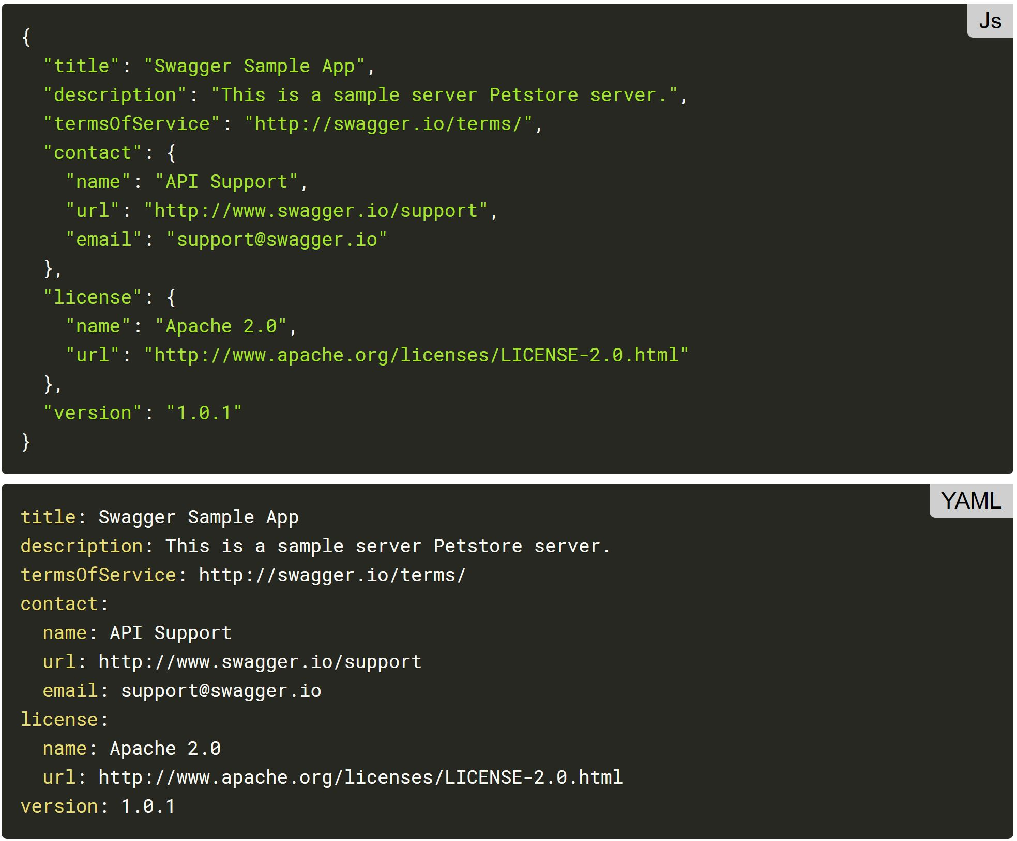
Swagger specification
The Swagger representation of the API is made of a single file. However, parts of the definitions can be split into separate files, at the discretion of the user. This is applicable for $ref fields in the specification as follows from the JSON Schema definitions.
By convention, the Swagger specification file is named swagger.json
YAML, being a superset of JSON, can be used as well to represent a Swagger specification file.

Slide 16
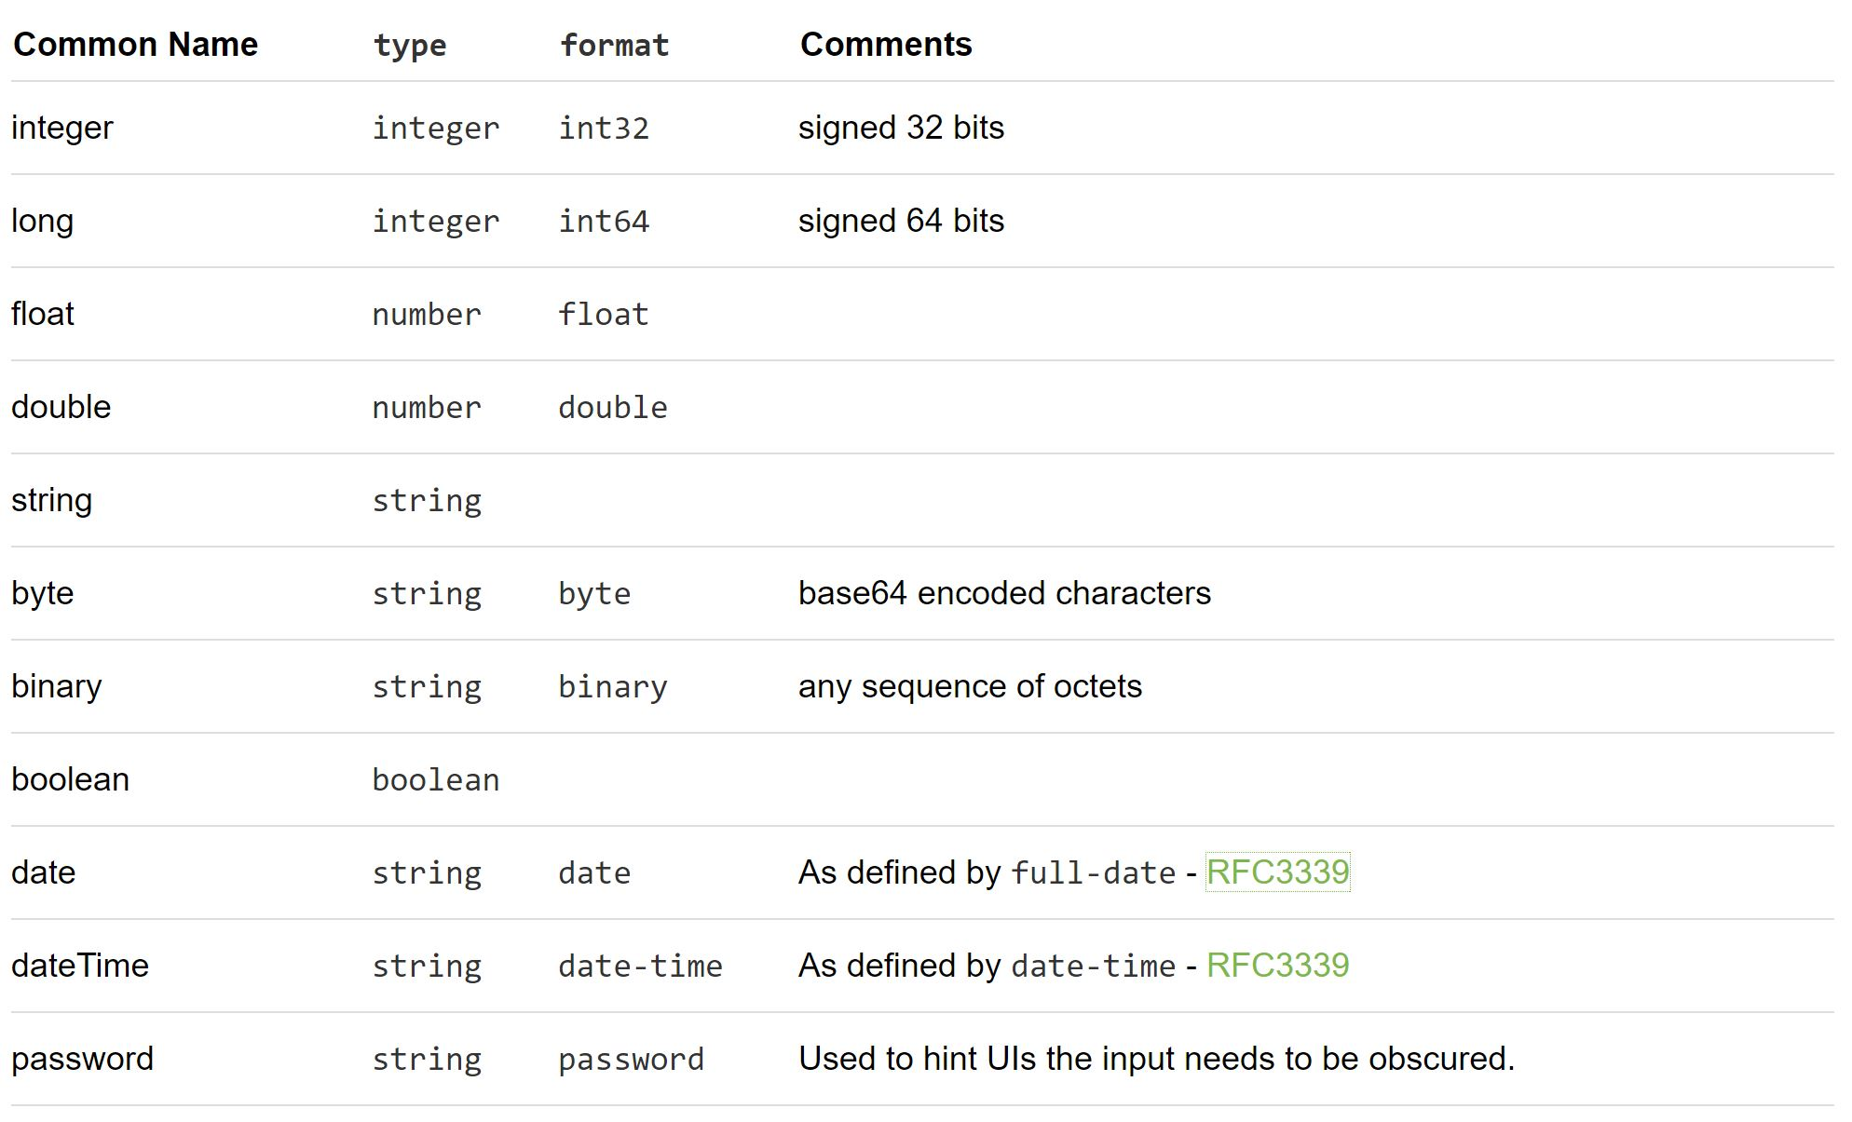
Data Types
Primitive data types in the Swagger Specification are based on the types supported by the JSON-Schema Draft 4.
An additional primitive data type "file" is used by the Parameter Object and the Response Object to set the parameter type or the response as being a file.

Slide 17
Data Types
Primitive data types in the Swagger Specification are based on the types supported by the JSON-Schema Draft 4.
An additional primitive data type "file" is used by the Parameter Object and the Response Object to set the parameter type or the response as being a file.

Slide 18
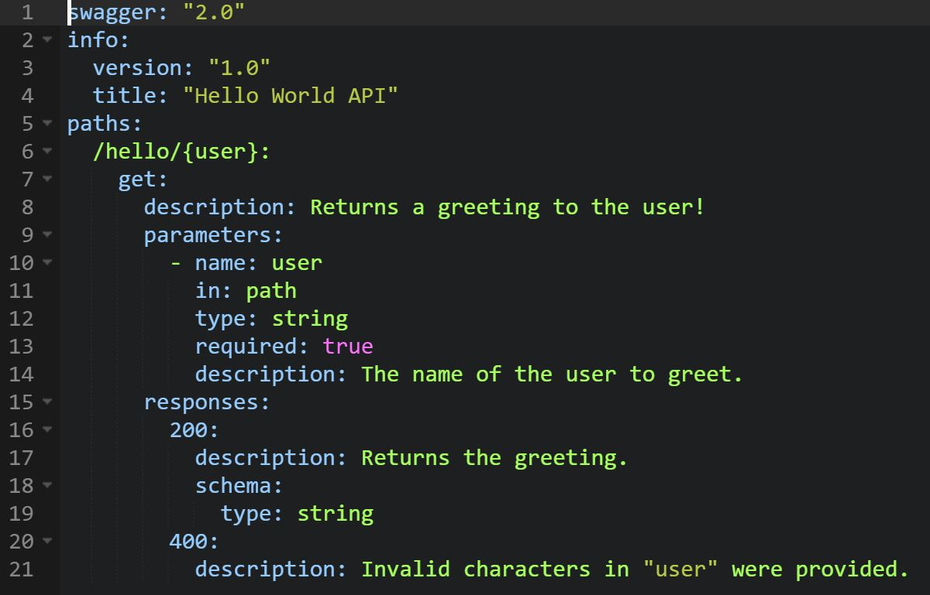
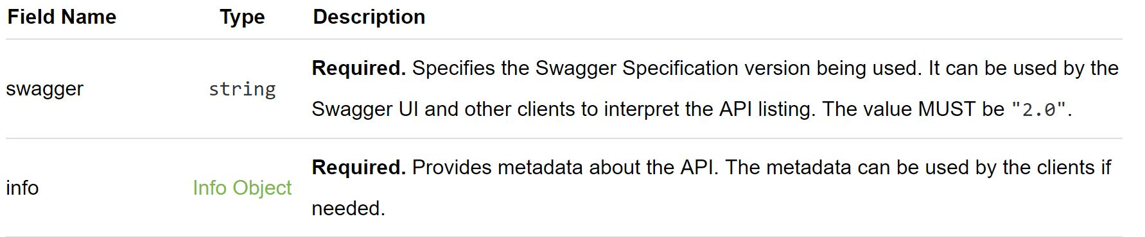
Swagger Object

Slide 19
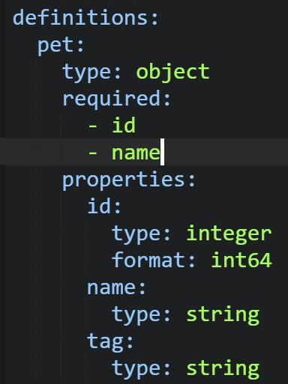
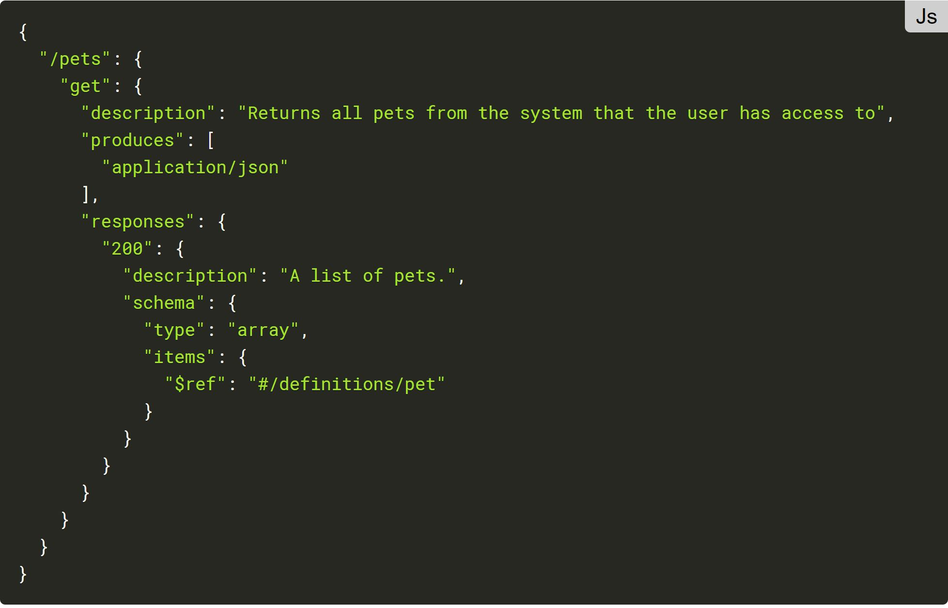
Path Element
Reference Object: A simple object to allow referencing other definitions in the specification. It can be used to reference parameters and responses that are defined at the top level for reuse.

Slide 20
Swagger editor
Reference Object: A simple object to allow referencing other definitions in the specification. It can be used to reference parameters and responses that are defined at the top level for reuse.

Slide 21
Swagger editor

Slide 22
Swagger editor
http://editor.swagger.io (available offline too)
Support code assistant
Quick schema validation
Samples available

Slide 23
Swagger editor

Slide 24
Swagger UI

Slide 25
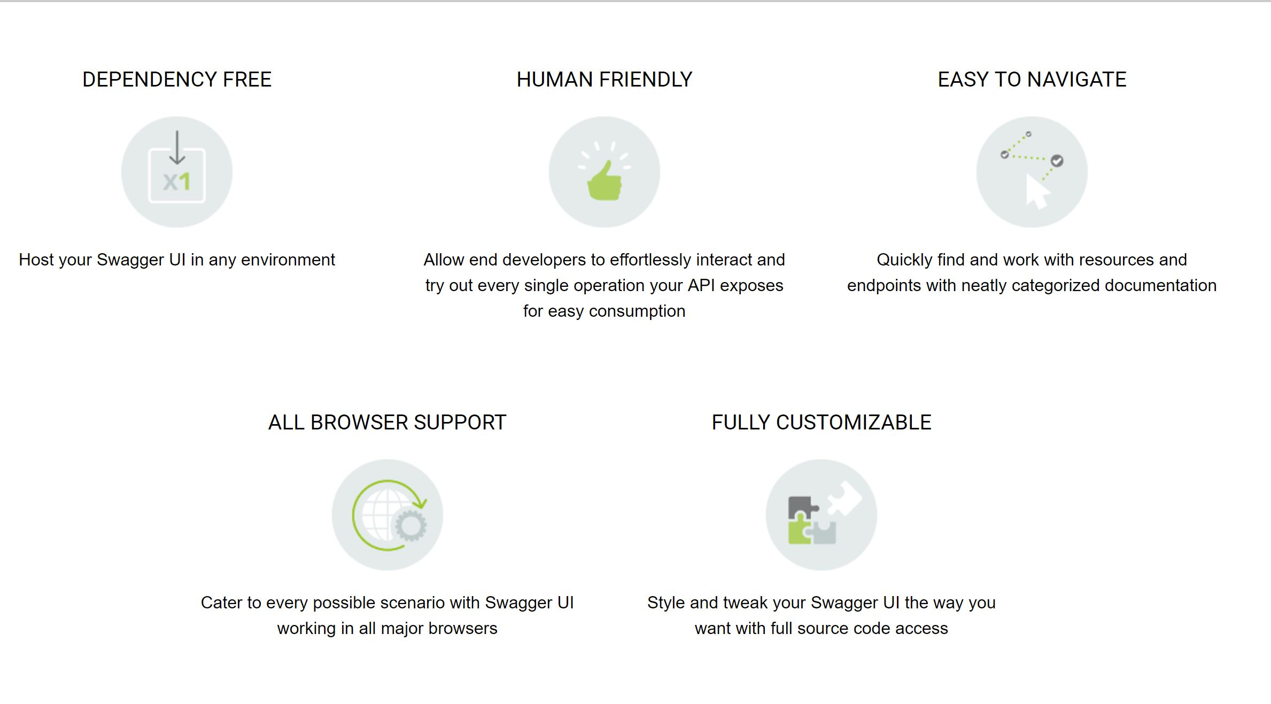
Swagger UI

Slide 26
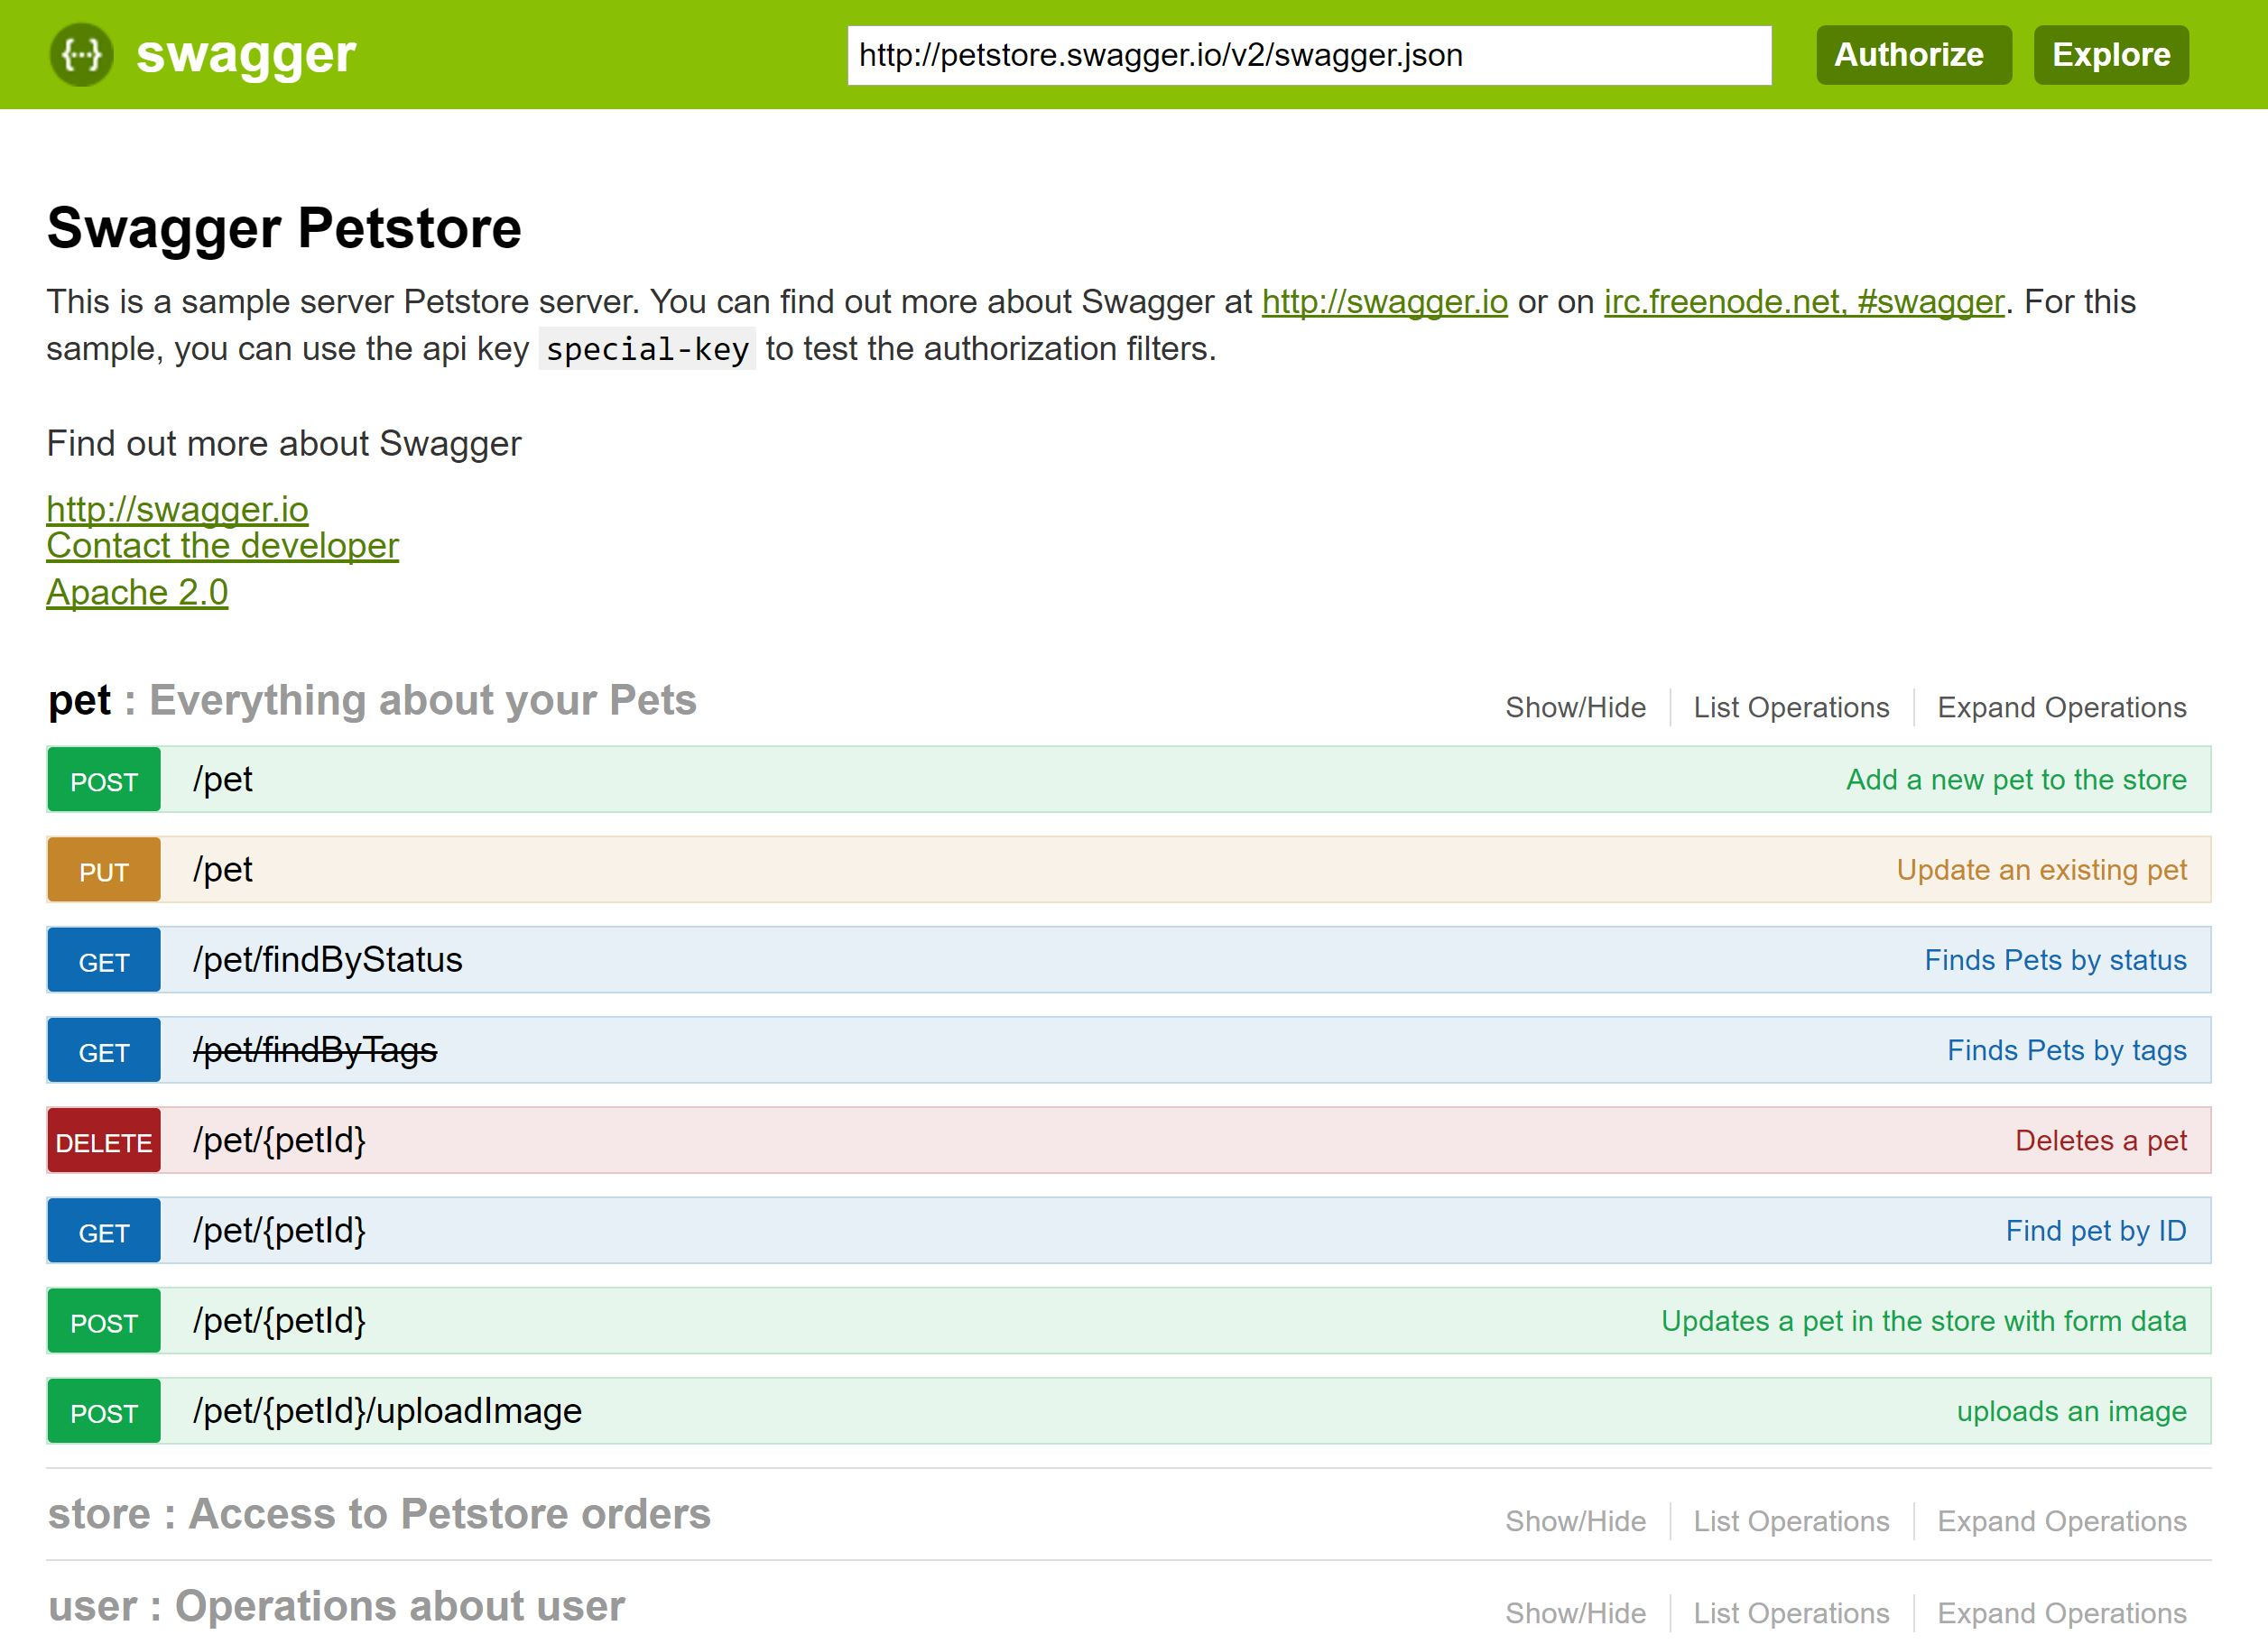
Swagger UI
Copy and paste the swagger file and click explore button

Slide 27
Swagger UI
Downloadable application from http://swagger.io/swagger-ui/
Documentation for installation and customization http://swagger.io/docs/#swagger-ui-documentation-29
The static Swagger UI web app can be placed under any web project or hosted on a common machine

Slide 28
Swagger Codegen

Slide 29
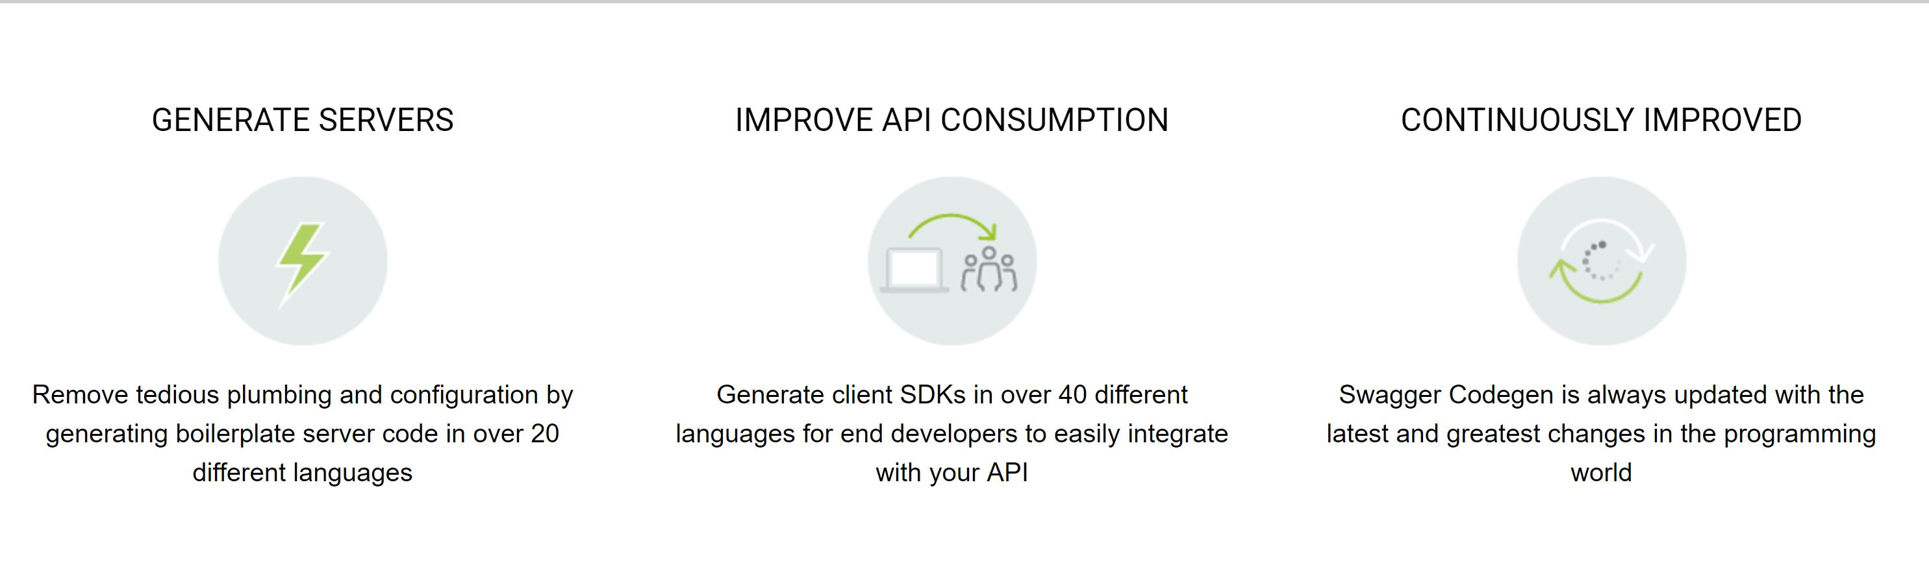
Swagger Codegen
The Swagger Codegen is an open source code-generator to build server stubs and client SDKs directly from a Swagger defined RESTful API.
Integrated in Swagger Editor but can also be used as a command line tool (See

Slide 30
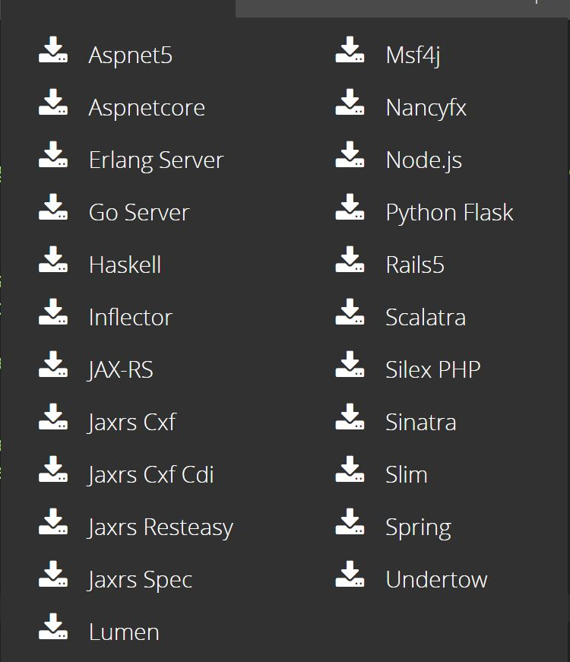
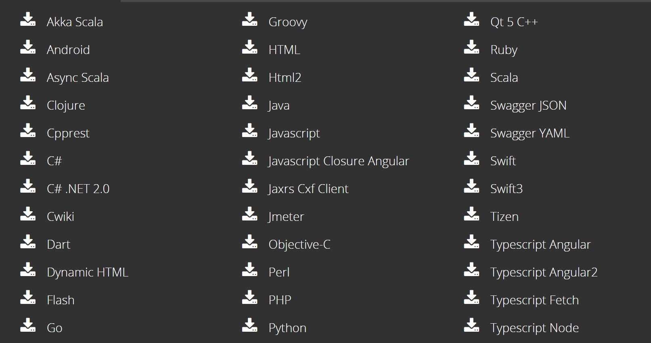
Swagger Codegen
Generate Server
Generate Clients

Slide 31
Swagger Hub

Slide 32
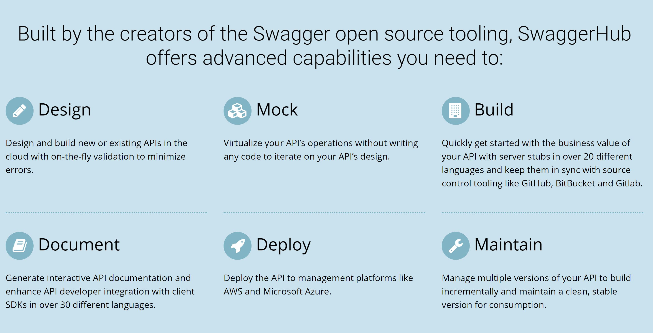
Swagger Hub

Slide 33
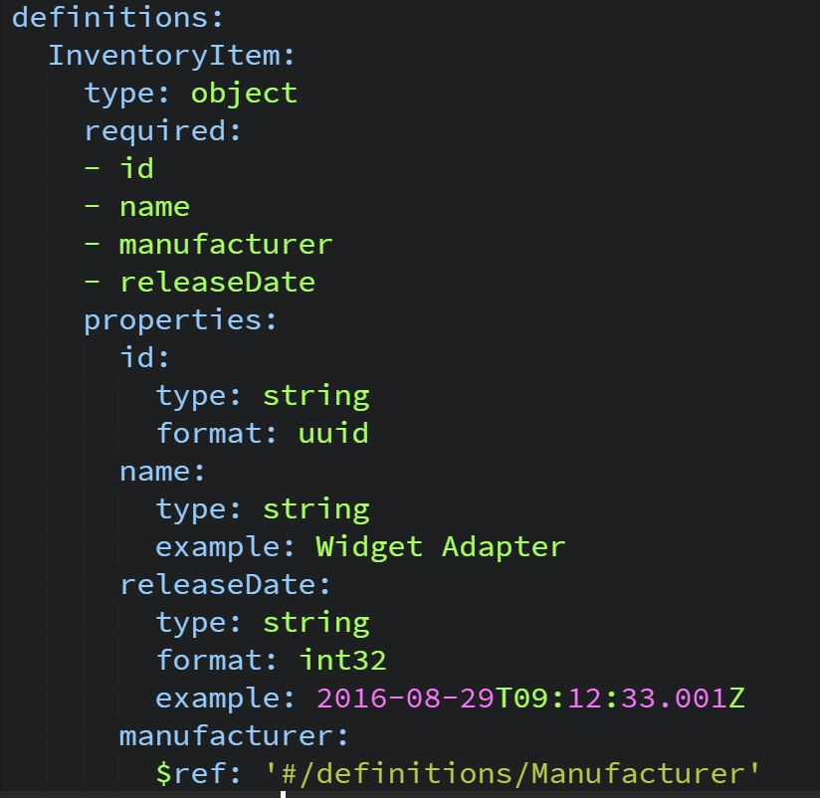
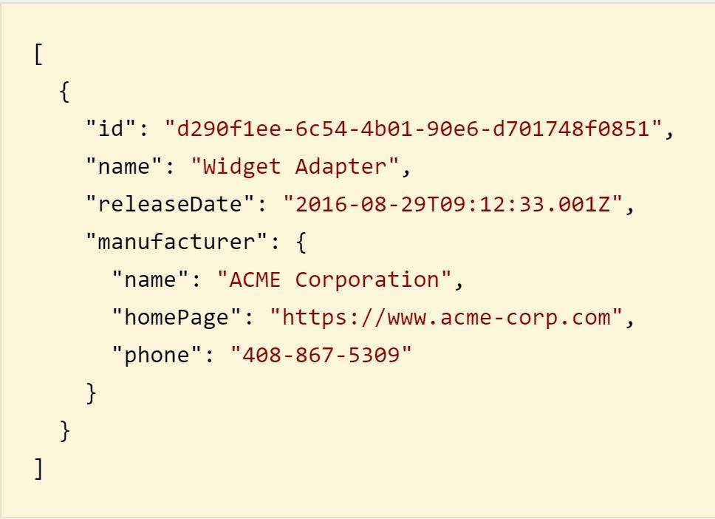
Swagger Hub
Automocking is a powerful feature to speed up development process
The json response is automatically provided filling fields with random string according to the field type or a string taken from example attribute

Slide 34
Now use Swagger!

