Slide 1

Constellation Brands
2014 Iowa Liquor Sales Analysis
Pham, Longley
Year Up United – Data Academy
Capstone 1
Notes:
Name
Aspiring Data Analyst at Year Up United – Chicago location

Slide 2

Scenario
You have been brought on as a data consultant by Constellation Brands to analyze sales performance using the Iowa Liquor Sales database.
The company wants to better understand how it performed during that year across different markets to inform future strategy.
Notes:
Brought in as a consultant to analyze and make sales recommendation to improve revenue and market outreach
2014 Iowa Liquor Sales Data
Products within the spirit market, strengths, weaknesses, and how to grow beyond what is offered.
You have been brought on as a data consultant by Constellation Brands to analyze sales performance using the Iowa Liquor Sales database, with a specific focus on transactions from 2014. The company wants to better understand how one of its product categories or brands performed during that year across different markets to inform future strategy.
Your role is to conduct a SWOT-style analysis by writing SQL queries that explore transaction data, product performance, store activity, and regional trends. You will focus on a specific category or vendor within the dataset to identify strengths, weaknesses, opportunities, and threats based on 2014 sales data.
As part of your analysis, you will generate insights from the data and export selected results to create visualizations that support your findings. These insights will be used to present actionable recommendations to Constellation Brands’ leadership team.
(OpenAI 2026)

Slide 3
Agenda
Overview
County Analysis
Black Velvet
Tequila Industry
Competitors
Key Takeaways

Slide 4
Annual Snapshot
2014 Fiscal Year
Jan 1, 2014 – Dec 31, 2014
155,408 Constellation-related transactions
Spirits market dominant
100% coverage across 99 counties
Total Revenue: $23.49M
Notes:
Constellation known for premium brands marketed towards consumers
Establish long-term relationship through trust and loyalty
Data drawn from 2014 fiscal year
Spirits and Liqueur
Notes:
Year 2014

Slide 5
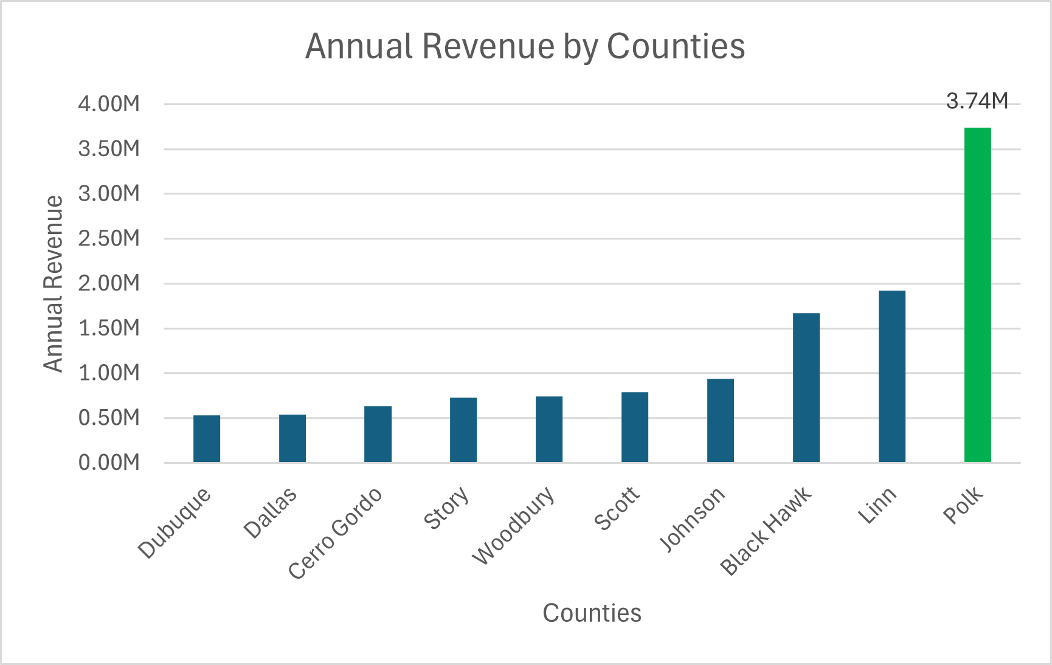
Geographical Analysis
Annual Revenue
Top 3 earners
Polk, Linn, Black Hawk
Over $1M in revenue
Polk: $3.73M
Top 3 Stragglers
Keokuk, Hancock, Mills
Keokuk: $22K
Figure 1: Annual Revenue by Counties
Notes:
Context:
Fiscal Year 2014
Iowa Counties > 10000
Highest earners
Lowest earners
As the county population increases, the more revenue they generate

Slide 6
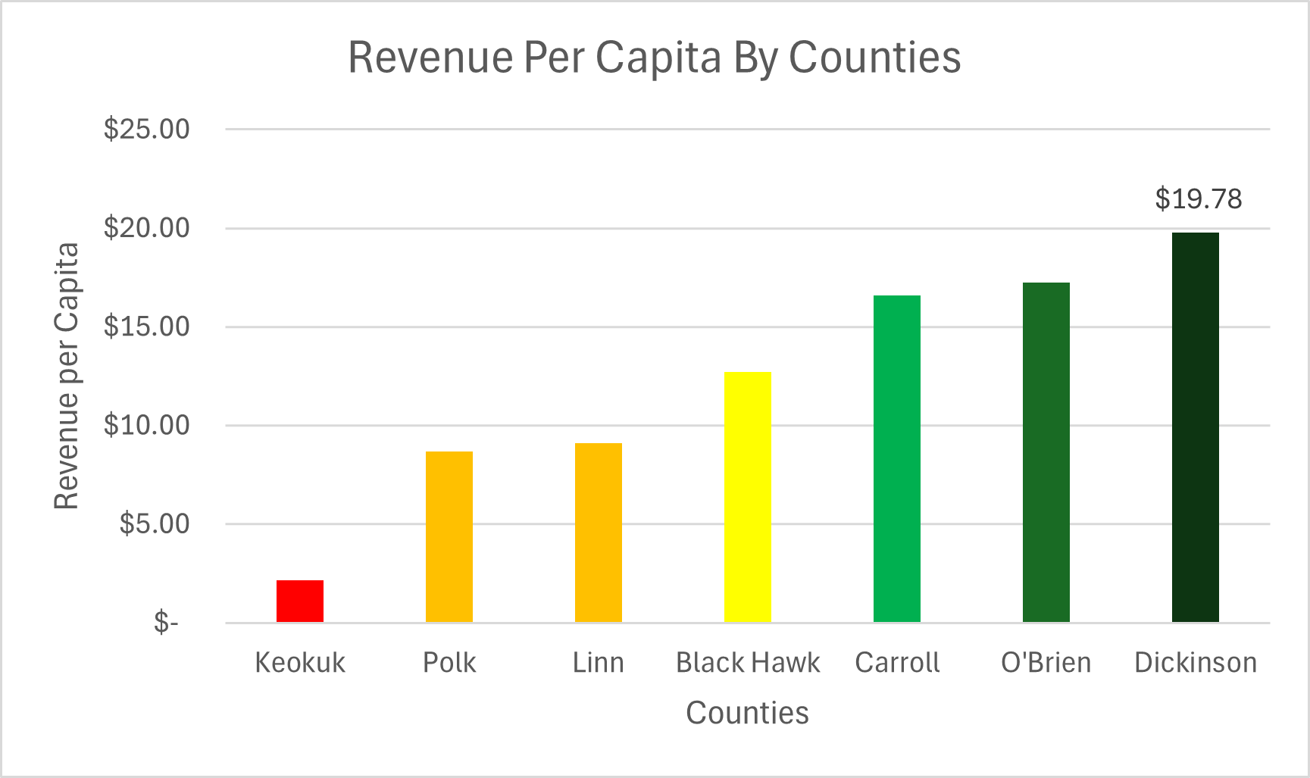
Geographical Analysis (Cont.)
Revenue per Capita
Top 3 earners
Dickinson, O’Brien, and Carroll
Dickinson: $19.78 per capita
Polk, Linn, Black Hawk dropped down
26th, 23rd, and 9th respectively
Figure 2: Revenue Per Capita By Iowa Counties
Notes:
Notes:
Revenue
Average revenue generated per county: $235K
Highest: Polk; lowest: Keokuk
Polk, Linn, and Black Hawk were our highest revenue generators
Over $1M in sales
Keokuk, Hancock, Mills were our lowest revenue generator
Dickinson, O’Brien, and Carroll had the biggest spending per person
Dickinson – about $20 per person
Dickinson’s population is only short of 17000 people. Over $320K in value

Slide 7
Total Revenue vs. Revenue per Capita
Efficiency
Scaling
Polk, Linn, and Black Hawk
Balanced lifestyles
Larger market, larger wallets
Average, if not sub-average spending
Dickinson, O’Brien, and Carroll
Tourist, retail, breathtaking scenery
Big spenders
Volatile, low proportionate population
Larger market * Big Spenders = Big Money
Notes:
Larger market, average, sub-par spending
Vs
Smaller market, very high spending
Geographical differences
Overall, our efficiency relies on how to maximize a large market and high spending in one concentrated area.

Slide 8
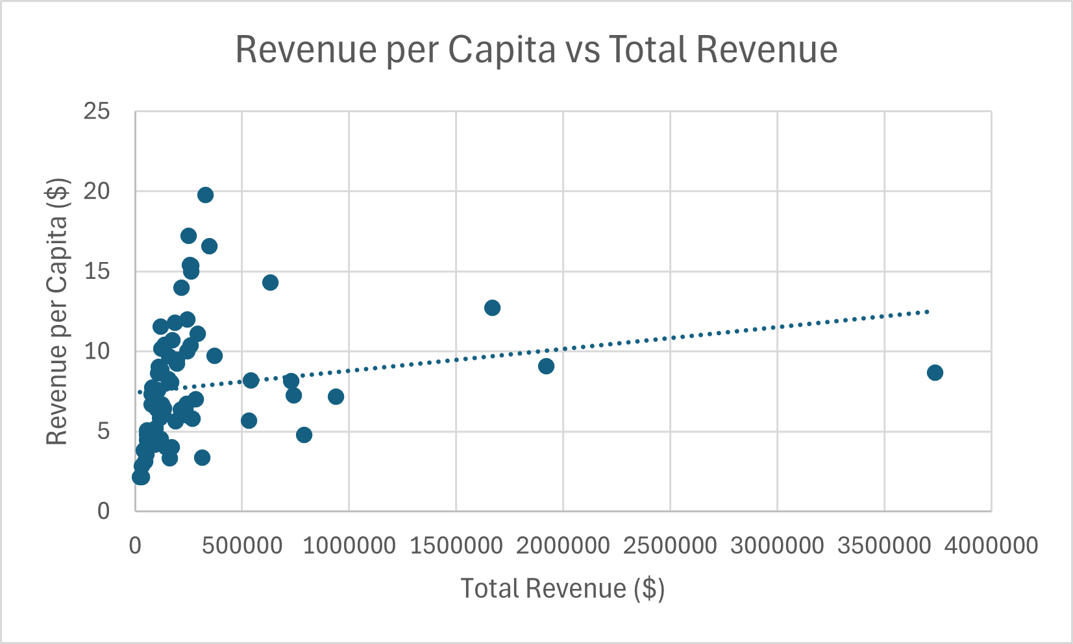
So What?
Figure 3: Revenue per Capita vs Total Revenue: Weak positive correlation
Notes:
Weak positive to no correlation based off our trend line.
Can’t say for sure that, however, we can look into how to push the bar a little higher and generate more value

Slide 9
Product Performance
Best
Worst
Product: Black Velvet
Series: Black Velvet
Category: Whiskies
Canadian Whiskies
Product: Canadian Mac Naughton Whiskey
Series: Canadian Mac Naughton Whiskey
Category: Tequila
Notes:
The best and the worst

Slide 10
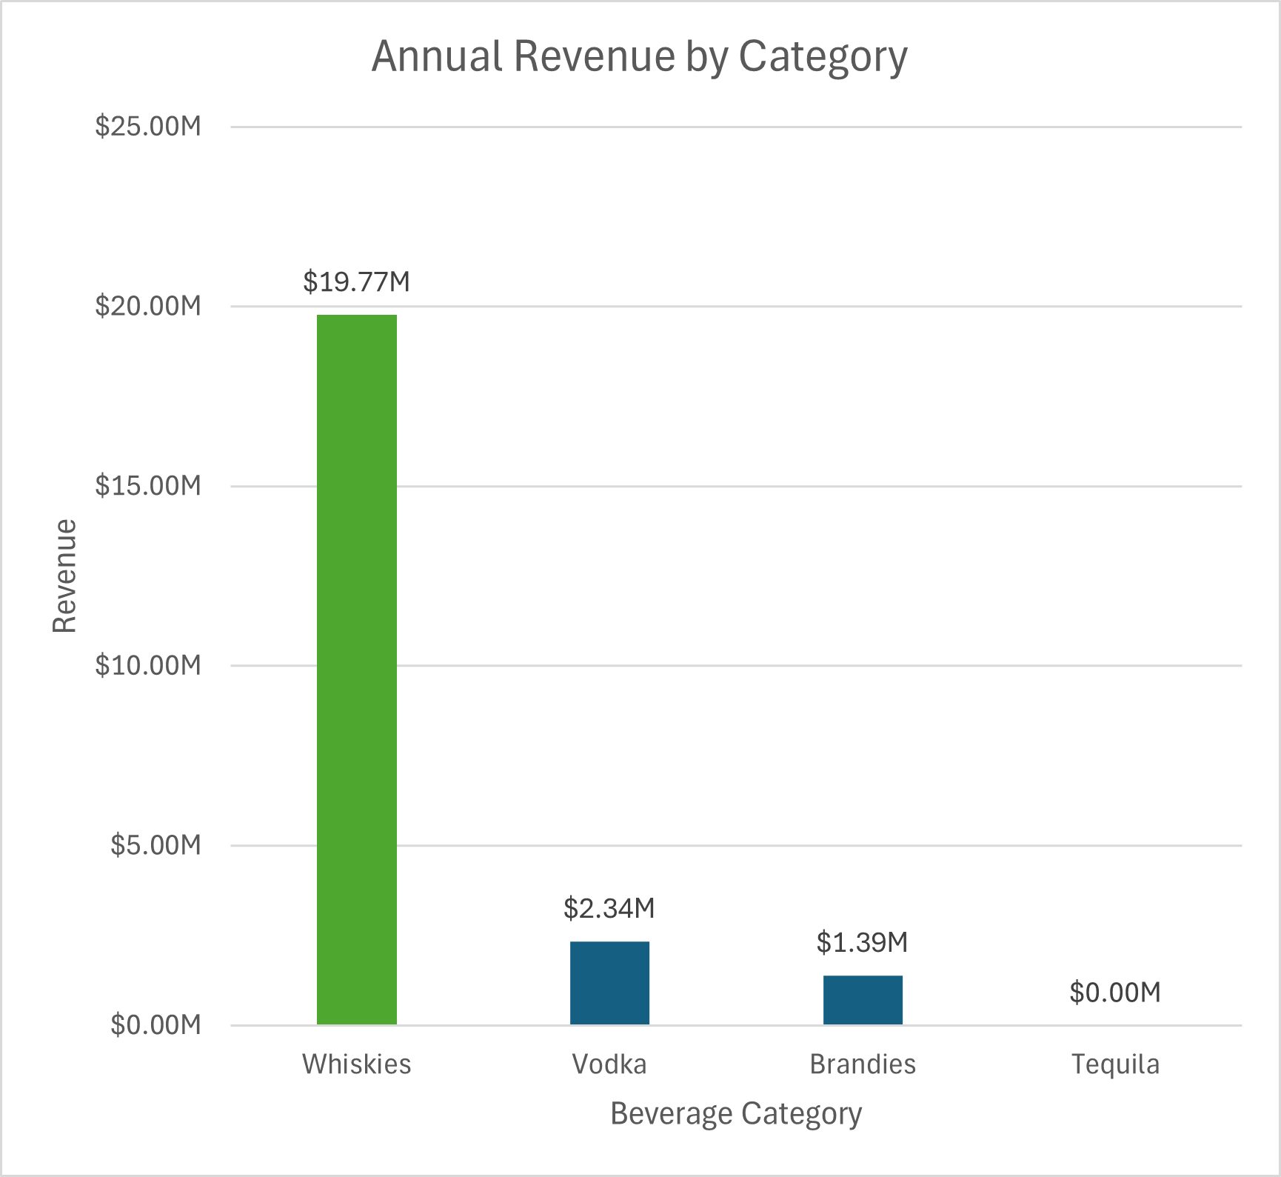
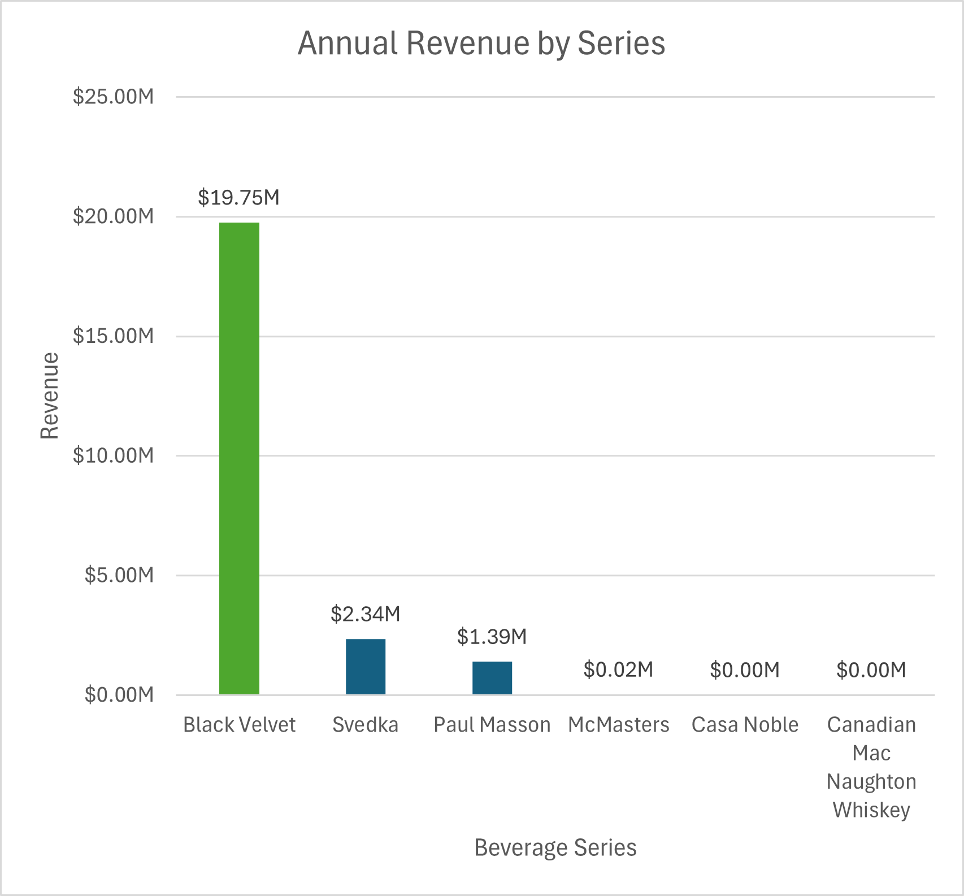
Product Performance (Cont.)
Figure 4: Annual Revenue by Category
Figure 5: Annual Revenue by Series
Notes:
Constellation products did best in Whiskies and Black Velvet (give numbers)

Slide 11
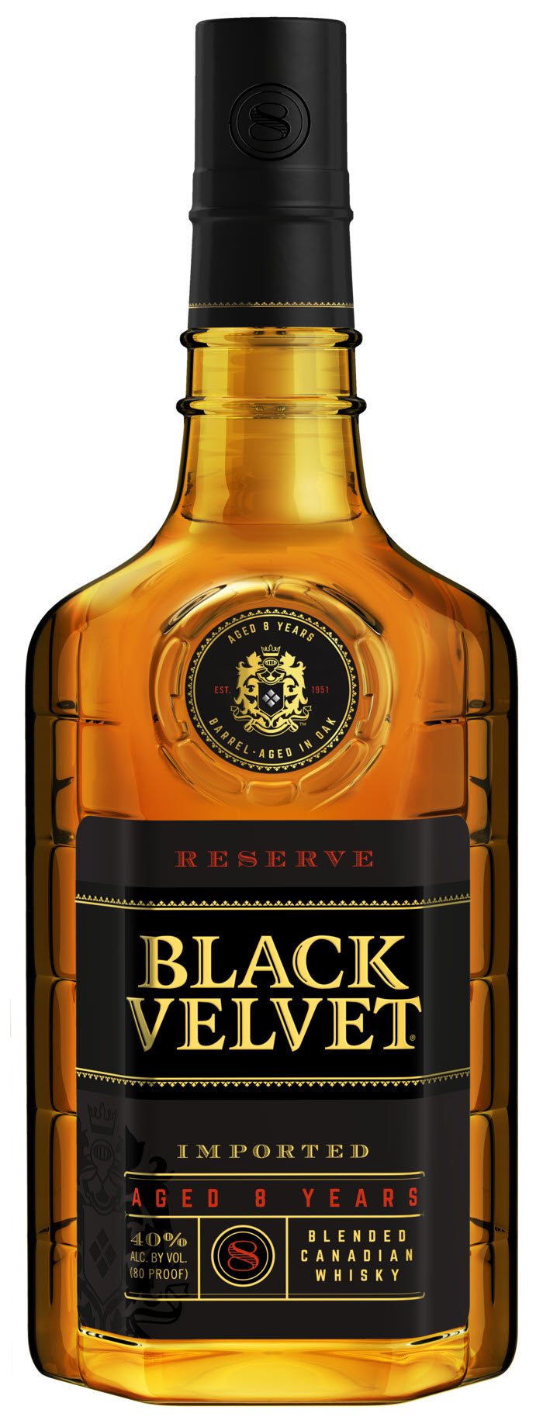
Black Velvet: The King of the Bottom Shelf
$19.7M out of $19.77M in Whiskey sales
Controls 16% of overall market
#1 among all whiskey brands
Why?
Smooth and easy to drink
Cheap and widely available
Designed for casual drinkers
Sells on brand recognition and loyalty
Notes:
Black Velvet
Makes up 99.7% of whiskey sales.
#1 leading product among all other competitors
“Something you can crack open without worry about cost and being around friends and family.”
We can set the pace, we can widen the gap, but we will own the finish line
(within the whiskey industry

Slide 12
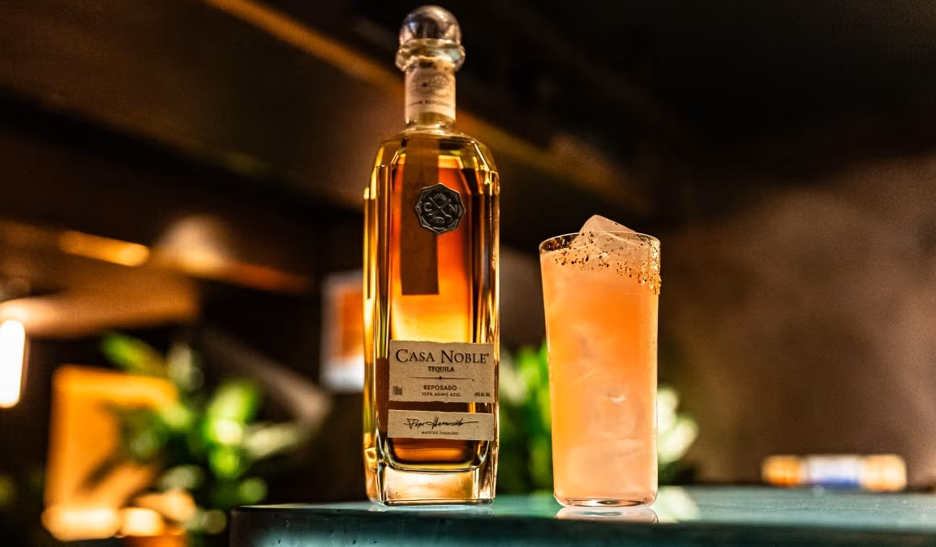
Tequila Market
Only one transaction, lowest performing market
$900 in sales
No brand recognition nor loyalty
Need to tie a “premium” reputation
Expensive, or potential
Notes:
Weakness
Lowest transaction
No focus around tequila market
Maybe expensive, or a potential market
Regardless, still risky but worth a look into because
THINGS CAN CHANGE

Slide 13
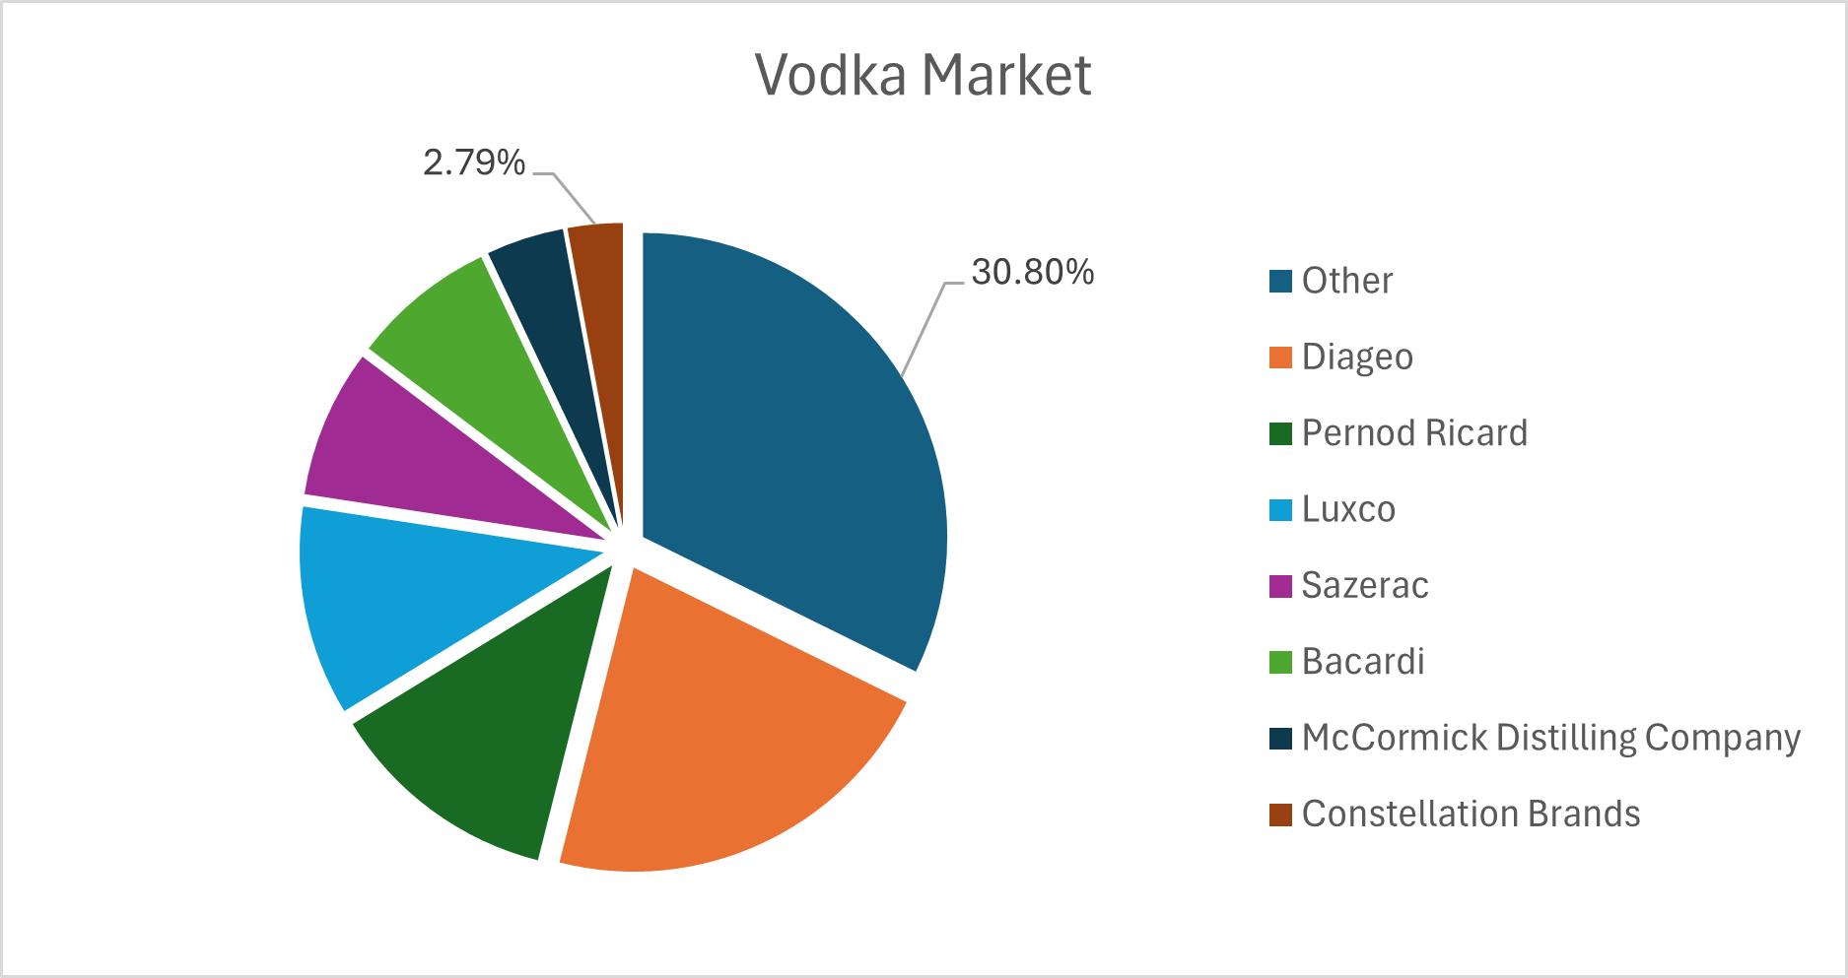
Other Market Mentions
Notes:
2nd strongest market: Vodka
Within top 10
Less than 3% of the market
$2.3M in a market over $75M

Slide 14
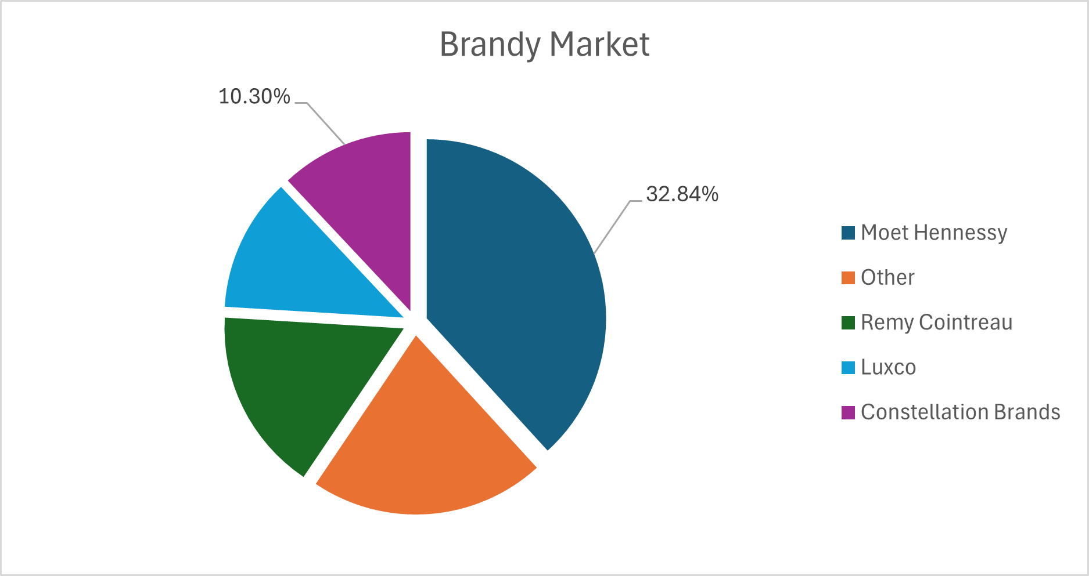
Other Market Mentions
Notes:
Brandy, Top 5 in market
10%, $1.39M out of $13M
Doing better in terms of market share, but still least driving in revenue.
We can see our influence, yet it does not have a big impact as Whiskey does.

Slide 15
Key Takeaways
We have influence in 100% of Iowa
Scale spender efficiency to larger markets through marketing recreational activities/promotions
Potential global revenue growth over 100%
More budget towards researching and marketing Black Velvet
Reconsider Tequila pilot marketing or drop completely
As with customer loyalty, make our brands worth reaching for
Notes:
Explore the Beer market and Wine market to see improvement
Acquisition of Modelo to enter the beer market in 2013
Focus on depth rather than breadth; we already captured Iowa.
Maximize spending with spenders to achieve higher spending
Potential global revenue growth over 100%
More budget towards researching and marketing Black Velvet and its variants; whisky industry
Replicate its success among Svedka
Make our products a staple in everyone’s home
Enough so that young adults can enjoy it too once they’re legal
May be expensive
Reconsider Tequila pilot marketing or drop completely
As with customer loyalty, make our brands worth reaching for

Slide 16
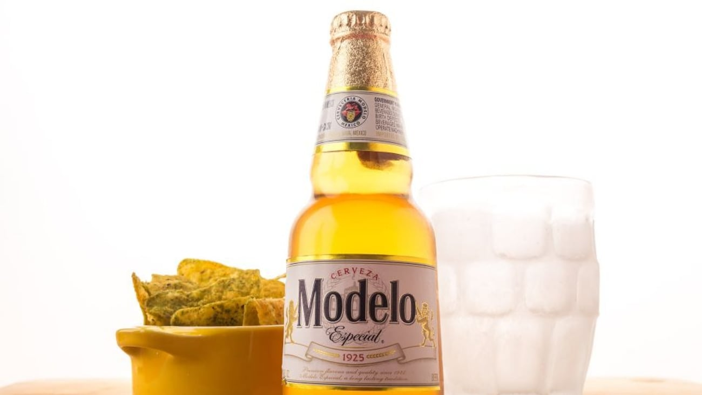
The Risky Play
We acquired Modelo back in 2013
Remember Black Velvet
Smooth and easy to drink
Cheap and widely available
Designed for casual drinkers
Sells on brand recognition and loyalty
Sell Black Velvet and scale in the beer market
Less expensive, more inclusive of “everyone”
Market it as premium
Grab an advantage in a limitless potential market
Notes:
The risky proposition
We sell off Black Velvet to enter the beer market through Modelo.
Research that in 2013, Constellation acquired U.S rights to Modelo.
Spirits vs Beer
Thank yous

Slide 17
Sources
State of Iowa, Alcoholic Beverages Division. (2014). 2014 Iowa liquor sales [Data set]. Iowa Open Data. https://data.iowa.gov/Sales-Distribution/2014-Iowa-Liquor-Sales/3m8f-uw4f/about_data
OpenAI. (2024). ChatGPT (Aug 2024 version) [Large language model]. https://chat.openai.com/
Notes:
Sources -> Questions?

