Slide 1
Agile Communication
Project

Slide 2
Agile Communication
Project
Sprints 1-3

Slide 3
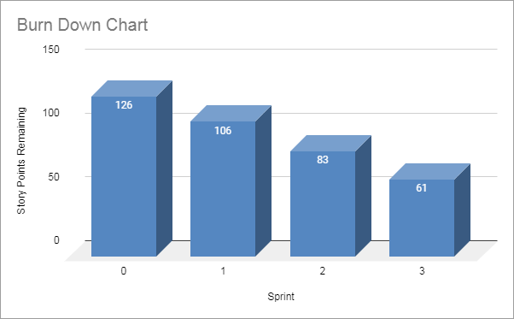
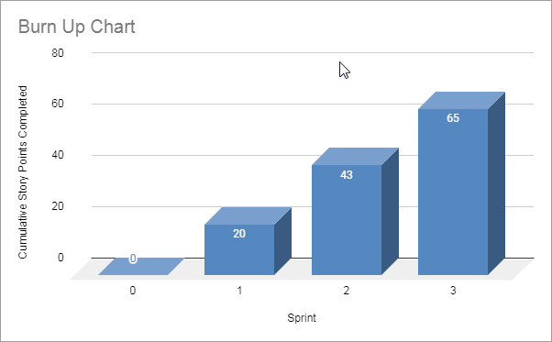
Sprints 1-3 Questions
What is your Velocity for the past 3 sprints?
21
How do you know your Velocity is correct?
The velocity is correct when the team is able to deliver results in a sustainable and constant way.
What would the BURN DOWN chart look like for Sprints 1-3?
Done
What would the BURN UP charts look like for Sprints 1-3?
Done
How many points do you think the Team should commit to for Sprint 4 and justify your answer?
I think 21 point should be a good number given the calculated velocity for the previous sprints
Place Burn Down Chart for Sprint 3 Here
Place Burn Up Chart for Sprint 3 Here

Slide 4
Agile Communication
Project
Sprint 4

Slide 5
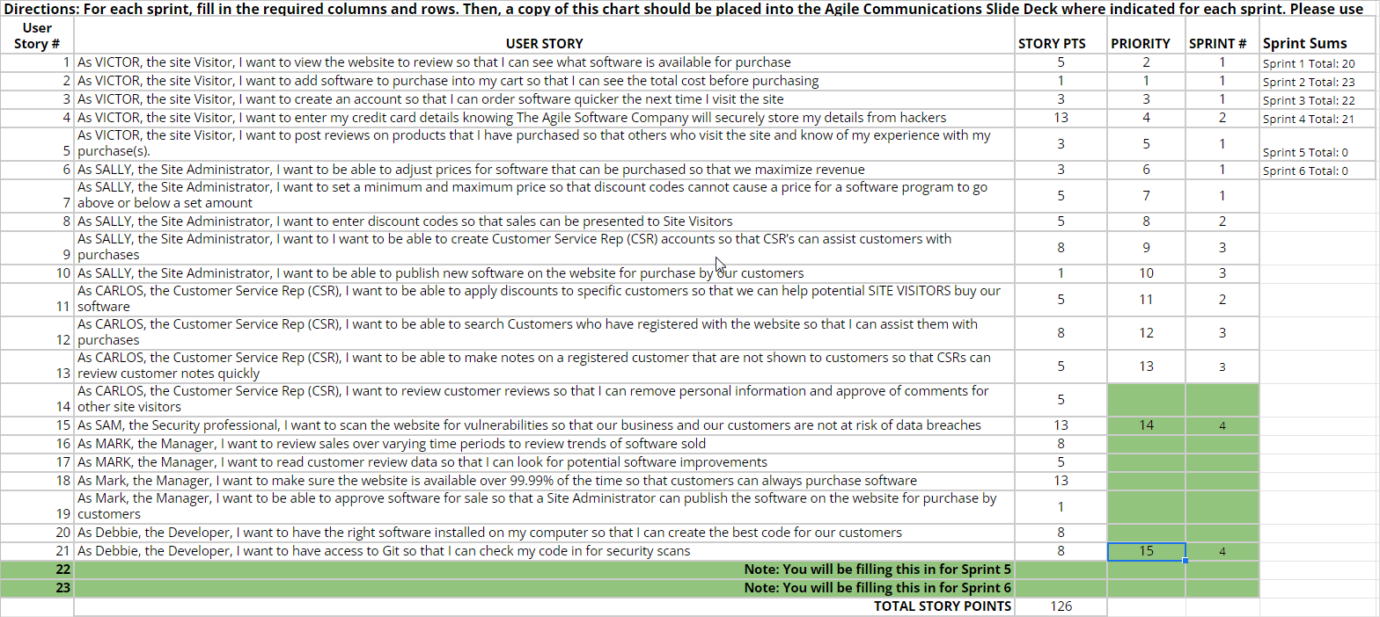

Slide 6
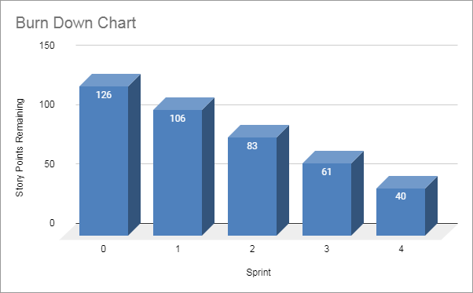
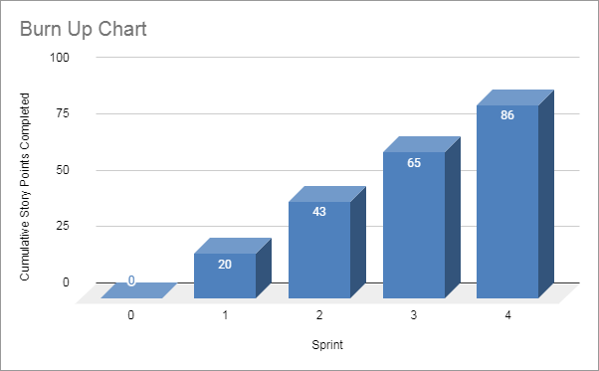
Sprint 4 Questions
What would the BURN DOWN chart look like for Sprints 1-4?
Done
What would the BURN UP charts look like for Sprints 1-4?
Done
What Risks did you identify in Sprint 4 and how do they affect the project? (Note: These would be your narrative findings)
Sprint 4 is crucial to solve the important security risks raised by the customer.
What Theme or Name did you give to Sprint 4?
Shields up!
Place Burn Down Chart for Sprint 4 Here
Place Burn Up Chart for Sprint 4 Here

Slide 7
SPRINT 4 DEMO of Working Product
The A-Team
Sprint 4 Name
“Shields up!“
Place Sprint 4 Burn UP Chart Here
User Stories in Sprint 4
1. Story # 15 with 13 points
2. Story # 21 with 8 points
3. Story # x with xx points
Total Sprint 4 Points: 21
Place Sprint 4 Burn Down Chart Here
Sprint 4 was for the A-Team the crucial moment to get the website’s “Shields up!”. We managed to scan the website for vulnerabilities in order to not expose our customers to the risk of data breaches and we also made sure to have access to Git in order to check our code for security scans. We learnt that even if code quality is high the help of a security professional can reveal interesting perspectives and improve software.
Not taking care of this topics would have exposed our website to data breaches.

Slide 8
Agile Communication
Project
Sprint 5

Slide 9
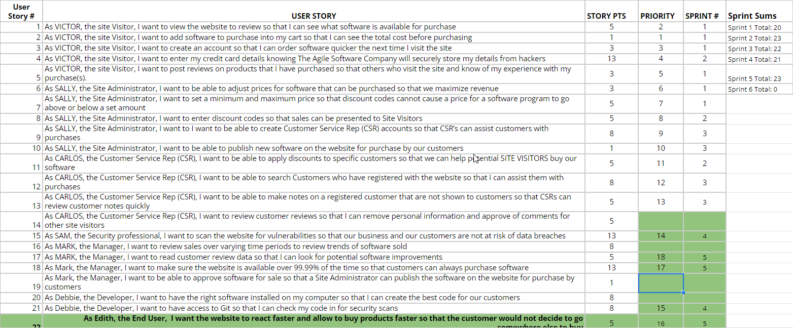

Slide 10
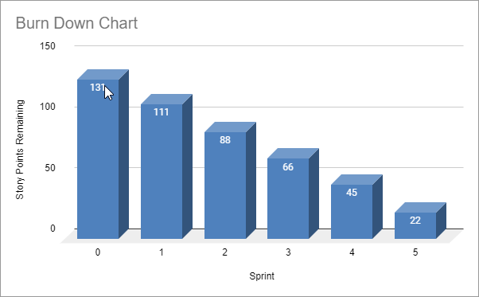
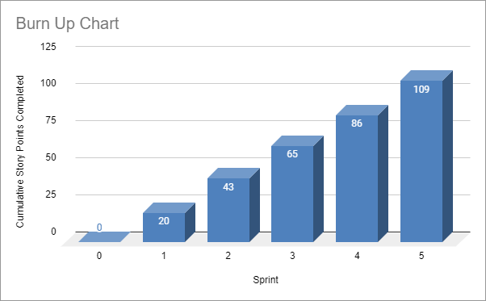
Sprint 5 Questions
What would the BURN DOWN chart look like for Sprints 1-5? Done
What would the BURN UP charts look like for Sprints 1-5? Done
What Risks did you identify in Sprint 5 and how do they affect the project? (Note: These would be your narrative findings)
In Sprint 5 the risk is related to the possibility of making the end user not happy. For this reason I have put the highest priority on that story.
How confident are you in delivering all of the user stories by the end of Sprint 6? Justify your answer.
I am fairly confident that stories will be delivered in time because our velocity seems to confirm it. In case of surprises we will make sure to deliver the most value possible to our customers in any case.
Place Burn Down Chart for Sprint 5 Here
Place Burn Up Chart for Sprint 5 Here

Slide 11
SPRINT 5 DEMO of Working Product
The A-Team
Sprint 5 Name
“Harder, better faster, stronger“
Place Sprint 5 Burn UP Chart Here
User Stories in Sprint 5
1. Story # 22 with 5 points
2. Story # 18 with 13 points
3. Story # 17 with 5 points
Total Sprint 5 Points: 23
Place Sprint 5 Burn Down Chart Here
In Sprint 5 we took feedback from our End Users and used it to make our website “Harder, better, faster, stronger”. We took care of making the website more responsive and of allowing customers not only to buy products faster but also to do it with confidence 99.99% of the time. We also wanted to make sure that End Users’ feedbacks are readable that we can look for even more software improvements. The main risk of this sprint was to disappoint End Users’ not bringing the value they specifically requested. This is the reason why we gave highest priority to the website’s responsiveness.

Slide 12
Agile Communication
Project
Sprint 6

Slide 13
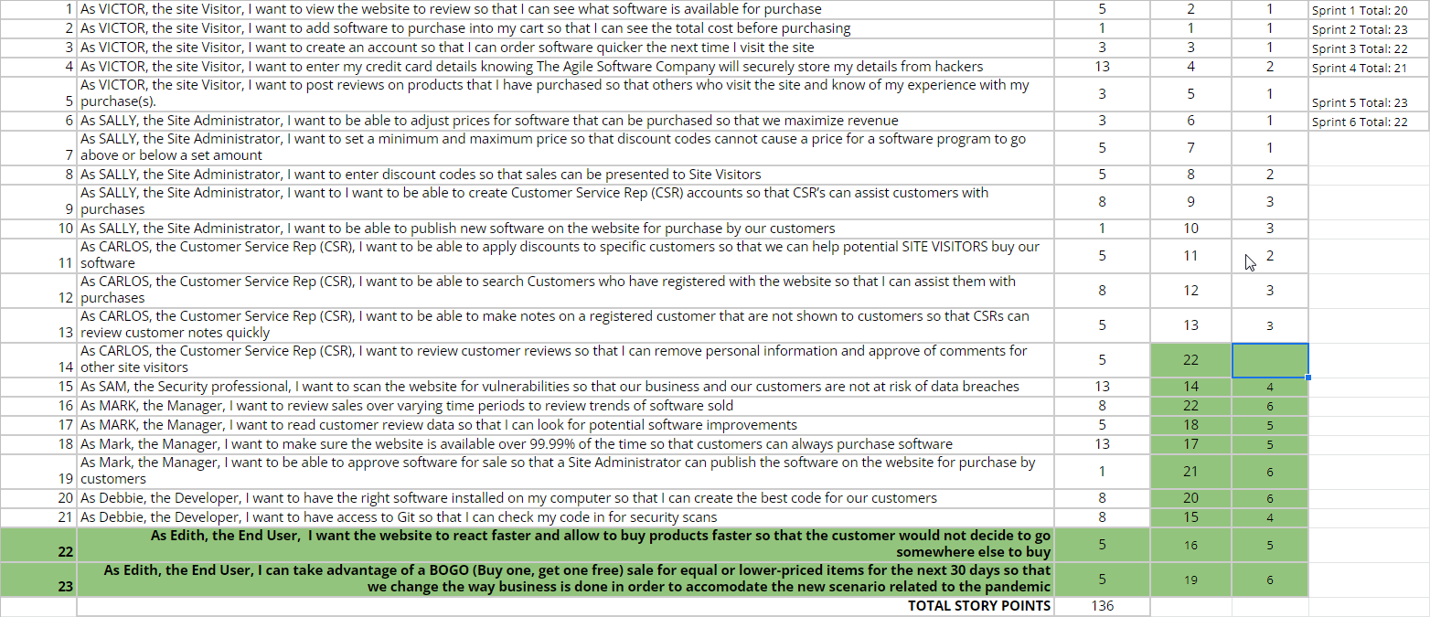

Slide 14
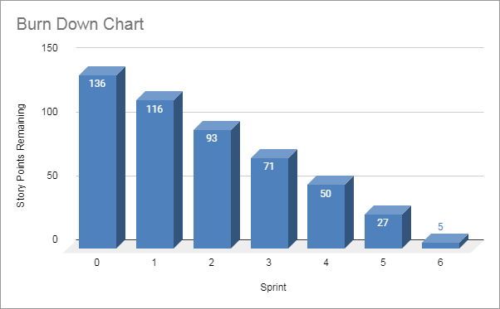

What would the BURN DOWN chart look like for Sprints 1-6? Done
What would the BURN UP charts look like for Sprints 1-6? Done
Was the Team able to complete all the work in the backlog or did you have to adjust what could be delivered? How would you tell this to Management and justify your answer.
The team was not able to complete all the work because of the ongoing pandemic. We had to adapt and change our plan to bring the most value for our customers. For this reason we gave highest priority to the BOGO story which will help us in changing our business and adapt fastly to this new situation and decided to postpone story 14. This solution allowed us to keep our velocity and guarantee high quality and sustainability.
Place Burn Down Chart for Sprint 6 Here
Place Burn Up Chart for Sprint 6 Here

Slide 15
SPRINT 6 DEMO of Working Product
The A-Team
Sprint 6 Name
“Survival of the fittest“
Place Sprint 6 Burn UP Chart Here
User Stories in Sprint 6
1. Story # 23 with 5 points
2. Story # 20 with 8 points
3. Story # 21 with 1 points
4. Story # 22 with 8 points
Total Sprint 6 Points: 22
Place Sprint 6 Burn Down Chart Here
Sprint 6 has been a difficult sprint because of the ongoing pandemic. This new and unprecedented scenario forced us to give strong priority in the story that allowed us to change our business and forced us to choose a story about CSR to postpone. We are happy with the result because bringing value to customers is the first directive of our work. We learnt that even the most perfect plan will have to change in front of global circumstances out of our control.

Slide 16
BVIR for Management Questions
Which charts would you want to include in the BVIR that Management would need and why?
Move the Orange boxes to the correct column below
The Burn Up Charts is a great one for Management, it shows value being delivered. Also Burn Down chart, given the good and constant velocity achieved by the team, can be a good chart to show do demonstrate constant and sustainable progress in the project. Committed vs Delivered Chart helps to ensure that the team is not adding additional features and driving up the cost or that they are delivering less than they should per sprint. I would not include Story Point Cost per Team because it will take us into a rabbit hole where we don’t want to go into.
Included
Not included
Burn Up Charts
Burn Down Charts
Committed vs. Delivered Chart
Story Point Cost per Team

Slide 17
Creating the BVIR for Management
Questions to answer before you start the BVIR
What would tell Management if they want to know the details about actual stories?
[Select from the choices below]
"While I understand that you want to get into individual stories and know all the details, we would prefer that Management spends your valuable time guiding and influencing the Roadmap and direction of the project and leave the story delivery to the Teams you have empowered."
Absolutely, let's get into the details!
No, that is none of your business
Which of the above did you choose (1,2,3) and why?
I’d choose 1 because it clearly explains and underlines the roles for Management and for the Team in a true Agile working environment.

Slide 18
Creating the BVIR for Management
Questions to answer before you start the BVIR
Is it project considered a failure because backlog items still remain? Explain.
I don’t think the project is considered a failure. The project kept delivering the highest possible value to customers even in the most difficult and unpredictable situation possible, like the pandemic. Bringing value to our customers is our main target and focus as agilists and our quick adaptation and react to the pandemic while following our client goal and request is an important confirmation of our good work. For those reasons I consider our project successful. I will make treasure of every wrong step taken for the future, in order to be able to predict, a bit more, also the unpredictable.

Slide 19
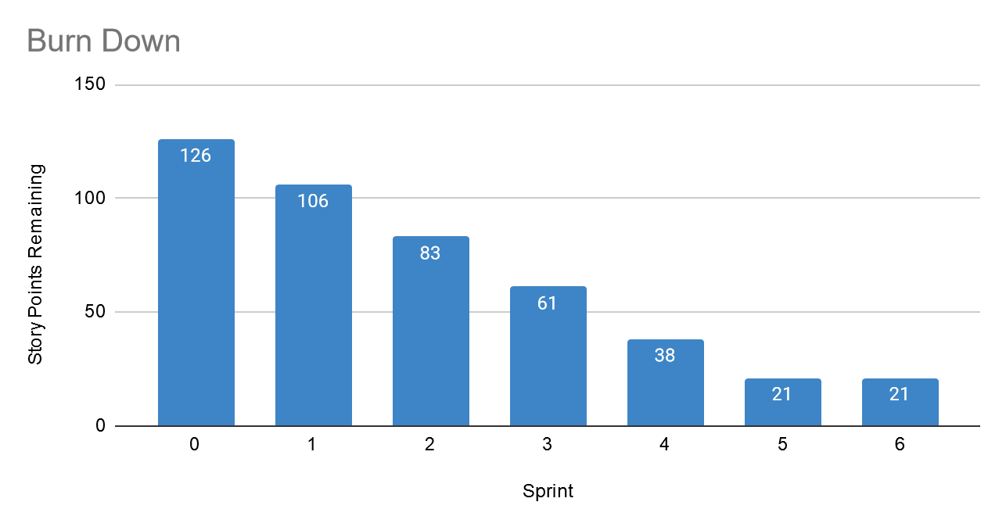
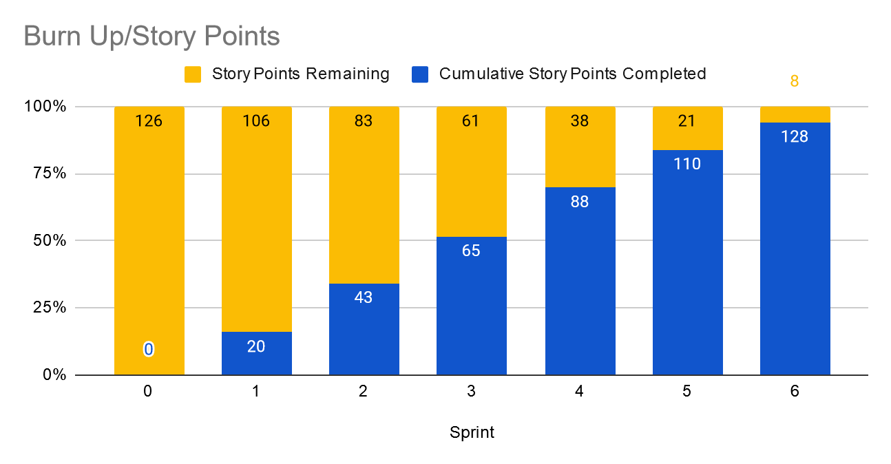
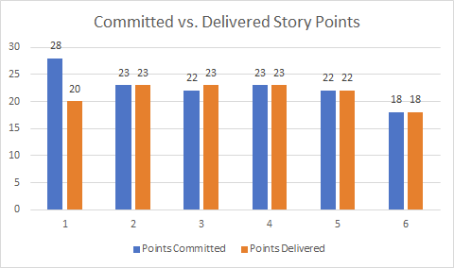
Creating the BVIR for Management
Instructions:
Start by creating your own BVIR. From the charts and sections below, please drag and drop items you would like to display to convey the story behind the MVP project
[Cut and paste items from this section and add them to the next slide. Remember to fill in information in the boxes where it is needed]
Roadmap
MVP VISION
Team Name
Chart Comparing Sprint Velocity of Teams 1 vs Team 2
Chart showing cost per story point

Slide 20
BVIR for Management
[Use this slide to create your BVIR. We have not provided a template for this, you get to decide what it looks like using the information from the previous slide]
Team Name
MVP VISION
Roadmap

Slide 21
BVIR for Management
[Now that you have created your BVIR for management, you need to create a video or written narrative explaining the MVP delivery status.
Use this slide to write your narrative or plan what you want to say in your video. ]
Include (at the minimum) the following:
Team Name
Vision
Sprint Burn Down Charts for Sprints 1-6
Sprint Burn Up Charts for Sprints 1-6
Project status (complete / incomplete)
Answers:
The A-Team
Allow our customers to buy our software in the fastest and most satisfying way via our new website

Slide 22


3.
4.
5. The project status is complete even if we are missing one story. Our mission was to deliver a MVP and I think that with the current status of the software we were able to deliver a solid projection of what the final work can be. We look forward to finalize it and to complete also the story we had to postpone in order to deliver value to the customers in the difficult time of the pandemic.

Slide 23
Questions from Management (Using Videos would be great!)
Instructions:
Watch the videos in the classroom.
Record your videos or provide your answers below. Remember to justify your answer.
[Video # 1 Answer]
The key of success is bringing value to the customer and this is more important that achieving the status of perfect product. What we have built brings a lot of value and took care of solving with high priority all the requests coming from the customer. I am confident in saying that what we will continue building on this foundation will be a success.

Slide 24
Questions from Management (Using Videos would be great!)
Instructions:
Watch the videos in the classroom.
Record your videos or provide your answers below. Remember to justify your answer.
[Video # 2 Answer]
As agilist we had to make a new plan that allowed us to bring the most value to our customers. The pandemic is indeed creating a new and complicated scenario but also an important opportunity. Ignoring our customer’s request would have not only disappointed them but also not allowed our software to be the driver of an important business change during the pandemic.

Slide 25
Questions from Management (Using Videos would be great!)
Instructions:
Watch the videos in the classroom.
Record your videos or provide your answers below. Remember to justify your answer.
[Video # 3 Answer]
While I understand that you want to get into individual stories and know all the details, we would prefer that Management spends your valuable time guiding and influencing the Roadmap and direction of the project and leave the story delivery to the Teams you have empowered.
We had to stick to our velocity because trying to squeeze more would have affected the team at some point and the quality of what we produce. This would have resulted in a dangerous boomerang for the whole company.

Slide 26
Questions from Management (Using Videos would be great!)
Instructions:
Watch the videos in the classroom.
Record your videos or provide your answers below. Remember to justify your answer.
[Video # 4 Answer]
I would recommend a last sprint, even a short one of one week could be sufficient to complete the only 5 point story remaining.
This would give us the opportunity to finish our work quickly and begin immediately with the new high priority project.

