Slide 1


Agile Transformation
Team Onboarding

Slide 2

Davide Nastri
davide@nastri.com
www.nastri.com
Notes:
Good day everyone and welcome to the team onboarding for WorldVisitz’s Agile Transformation. My name is Davide Nastri and I will be your Agile Coach in this exciting and rewarding journey.

Slide 3

Heraclitus
“Nothing endures but change.”
Notes:
Why do we need Agile? Here’s a few, powerful words of magnificent wisdom that still completely valid and applicable today.
If change is indeed the constant to human life then the only possible strategy that can allow us to dominate and control this magmatic chaos is… Accepting it. Accepting it and understanding how to quickly fail, get feedback, adapt, rearrange, rethink, learn from our errors, solve the issue we are facing and move to the next challenge. The question is… How to achieve all of this constantly and efficiently? Agile methodology is the answer we are looking for. Today we will discuss together about Agile and about how to implement an Agile framework in your Team.

Slide 4
Agile Team Onboarding Topics
Agile benefits
Information radiators
Ceremony schedule
Team composition
Appendix

Slide 5

01
Agile
Benefits
Notes:
Let’s start discussing the Agile Benefits for WorldVisitz and, specifically, for your Team. In the following slides I will focus on some of the important elements I have extracted from WorldVisitz case study and show you how the basic principles of Agile tackle those issues at their very origin.

Slide 6
Problem
Solution
Customer feedback is received late, in market testing and after product launch
In Agile our highest priority is to satisfy the customer through early and continuous delivery of valuable software
Notes:
The first one is (read Problem) How can Agile help in solving this issue? Feedback. Feedback in every stage, at every step. Feedback that allows to fail early, rearrange and get iteratively closer and closer to perfection. Which is the main feedback? The customer’s. How can Agile get that feedback often and quickly? (read Solution principle) This means that the whole Agile methodology is arranged and becomes practical using a series of ceremonies that have as main aim the possibility to receive not only fromo Team Members but also from customers, valuable feedback in order to improve the final quality of the software product. Customer satisfaction, with this kind of participation and continuous feedback loop, is achieved with higher certainty and less effort.

Slide 7
Problem
Solution
Work is primary planned by a single person that also assigns it to individuals based on preference
In Agile the best architectures, requirements, and designs emerge from self-organizing teams
Notes:
Here’s another element from WorldVisitz’s case study. (read Problem) Several studies* on the Market confirm that when provided with freedom, motivated teams generate the most value for the customer.
Agile fully acknowledges this fact and is a true propellent to push the teams efficiently to reach the Self-organizing status, in fact (read Solution) *
If anyone wants to read more in detail I will share the link to Deloitte’s study at the end of the presentation or in the material handed to the Team: https://www2.deloitte.com/us/en/blog/human-capital-blog/2021/predictions-teams.html

Slide 8
Problem
Solution
Preferring one-on-one interviews and calls and isolating the onshore and offshore teams. Business people are detached from developers.
In Agile business people and developers must work together daily throughout the project
Notes:
This is the last problem I would like to discuss because for me its importance is crucial and I believe it will be among the most powerful drivers for WorldVisitz Agile transformation. Agile will transform a group of individuals that are working on separate tasks used to achieve a common goal in a single entity, a True Agile Team.
The Agile ceremonies are structured exactly to keep everyone on the same page, to foster cooperation and to allow everyone to actively contribute to the achievement of customer satisfaction. An Agile Team is able to use its collective brainpower in synergy with the perks of each individual constituting it. Not only the final result will be better and appreciated by the customer but the team will be closer, stronger, happier. This can happen because (Read agile principle)

Slide 9
02
Information Radiators
Notes:
How can WorldVisitz achieve the Agile Benefits we discussed? What are the tools that can make this improvement possible? Let’s introduce a key concept that will act as a lighthouse for our Agile transformation journey, the information radiators.

Slide 10
What is an Information Radiator?
An information radiator is a big visual chart placed in a prominent location
It conveys key information and shows the health of a team
It is used to visualize the flow of work, shows where bottlenecks (or blockers) occur, and enables anyone to see what the team is working on at any time
Notes:
What is an Information Radiator? We typically think of radiators as items that emit some form of heat, light, or sound.
When it comes to Agile information radiators, the idea is much the same, but information is being emitted. The goal of an information radiator is to highlight data in an easily digestible format.
An information radiator is not a static item — it shows a team’s progress as it moves through an Agile project, so it will change regularly to incorporate updates.
An information radiator can include ”handwritten, drawn, printed, or electronic displays.”
Burndown charts and velocity charts are two of the most commonly used reporting tools, let’s look at their main characteristics…

Slide 11
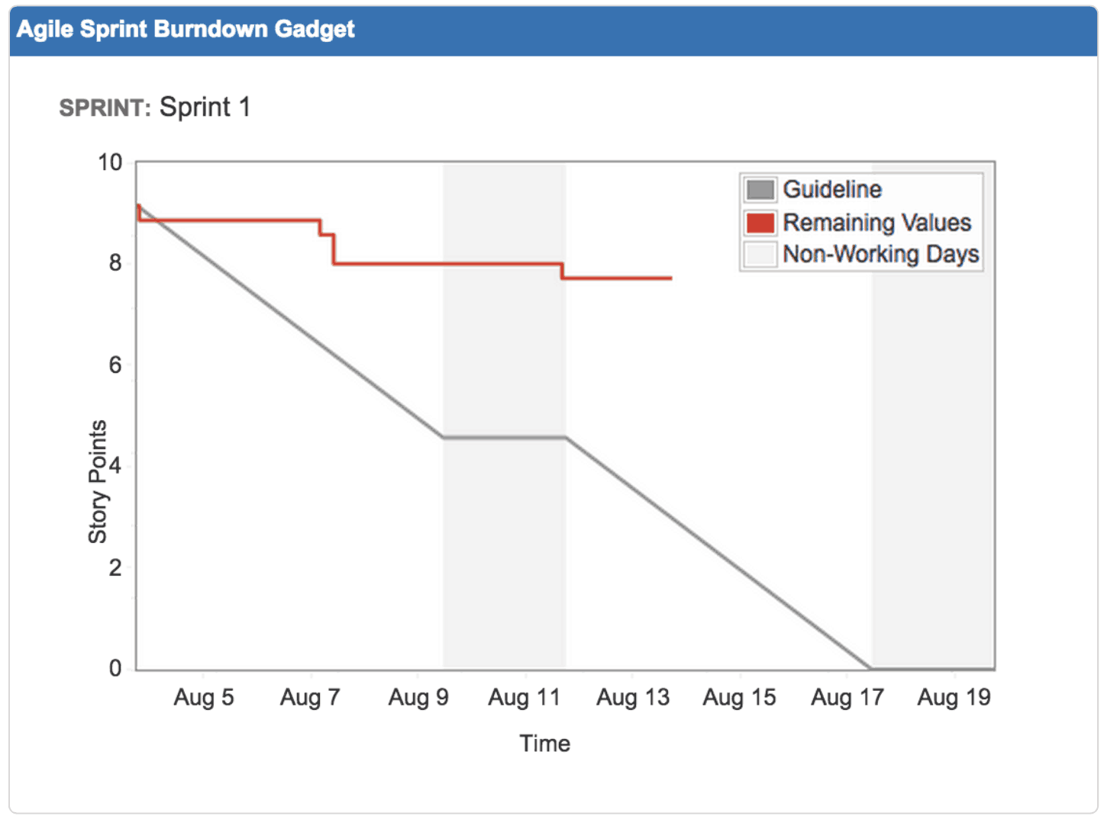
Burndown Chart
Notes:
A project burndown chart is a graph that shows how many project tasks are left to finish during a selected time period. Teams use it to keep track of progress and to visualize forecasting. The x-axis of the chart shows the amount of time (in days, weeks, or months) and the y-axis shows the story points.
It’s called “burndown” because it’s expected that your tasks will decrease as the project goes on, creating a literal downward line on the chart as your team “burns” through project activities.
This is, of course, under ideal circumstances with limited disruptions or backlog, which is why this graph line is called the ideal line.
Project managers also add a second graph line called “actual effort” to visualize the amount of work or hours that were actually put in during that time period.
This Information Radiator offers many advantages…
Burndown charts help teams visualize their progress in real-time.
It’s motivating and keeps everyone on the same page at any given moment.
They provide a big picture view of projects before they begin. Project managers can use them to create more accurate timelines and effectively manage resources.
Burndown charts facilitate client communication by setting simple and clear expectations.
They’re easy to read and can help customers to visualize your plan.
They help you reevaluate progress as obstacles or new tasks come up.
Simply adjust your tasks and timeline settings to see whether or not you’re still on track.
Burndown charts help teams quickly react to scope creep.
Once bottlenecks are identified, it’s easy to make new burndown charts that map out your client’s remaining options for better decision-making.

Slide 12
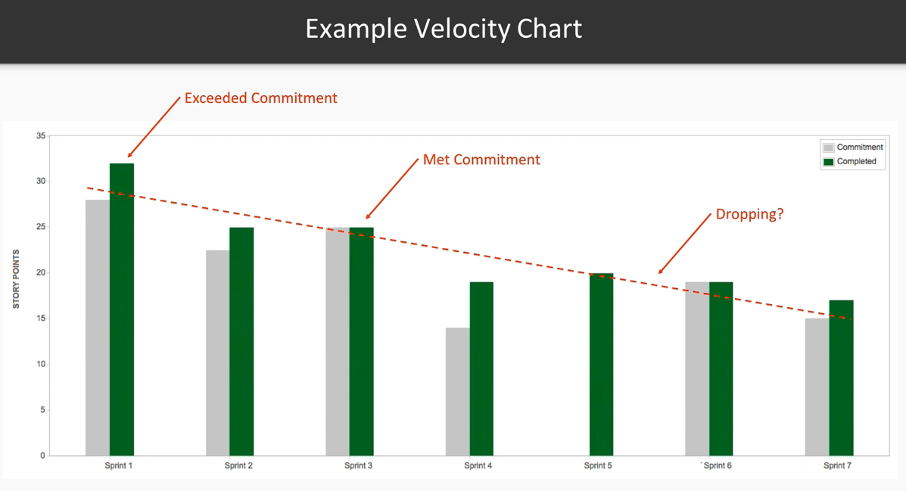
Velocity Chart
Notes:
A velocity chart in Agile highlights the overall journey of your project within the given confines of the Agile project management method.
The velocity graph shows how much work you have left to do and how much time you have left to do it.
Overall, this Agile milestone chart gives project managers a sense of what their teams can accomplish in future sprints between now and the end of the project.
Which are the benefits of using a Velocity Chart? Let’s underline a few of them…
Measuring Agile velocity makes it easier for project managers to forecast accurately, determine what additional resources are needed for any given objective, and to create a visual guide that keeps everyone on the same page at all times.
Measuring Agile velocity also makes it easier to navigate remote Agile teamwork when various members are in different parts of the world or with varying schedules and availability.

Slide 13

03
Team Composition

Slide 14
Roles in Scrum Framework
Product Owner
Scrum Master
Team members
The PO represents the business and helps translate customer requirements into work packages for the development team.
The SM oversees the development process and facilitates improvements to it.
Scrum is all about Team members working autonomously to contribute to the outcome
Notes:
Like in any project, defining roles and responsibilities between members of the project team and the business is important, so everyone is clear on who’s doing what.
In the Scrum framework, there are 3 key roles, let’s understand which are those roles and what are their key functionalities. (Read slide for PO) In our case the PO will be John Smith. His extensive research in the market and his knowledge of the product will allow him to efficiently translate customer requirements into work packages for the Team members. This cooperation will be greatly simplified allowing them to work together in the same office. The synergy will be great and communication faster and more fluid.
(Read slide for SM, adding that the SM also make sure team members have everything they need to get the job done) For Worldvisitz the SM will be Jane Doe she is a good communicator and she has been already in touch with team members constantly. It will be natural for her to see impediments in Team members work and cooperate in solving their issues.
(Read slide for Team Members) The remaining part of the employees will be team members. Your contribution is the pulsating heart of this project, good luck and have fun!

Slide 15
04
Ceremony Schedule
Notes:
The Agile Methodology I suggest for WorldVisitz is Scrum therefore I would like to share with you a Scrum Ceremony Schedule that you can use in your Agile transformation. Scrum ceremonies are very specific meetings with clearly defined goals, participants, and time constraints. Without those scrum ceremonies, scrum simply doesn't work. If you take out any of the scrum ceremonies or radically modify them, you are no longer practicing scrum.

Slide 16
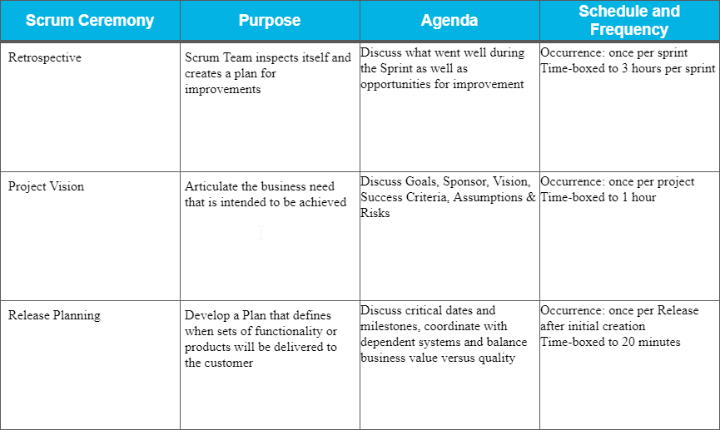
Ceremony Schedule
Notes:
Read the slide

Slide 17
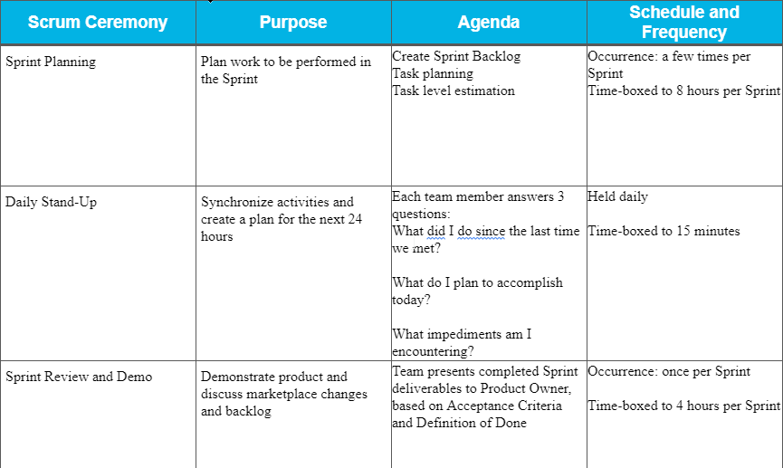
Ceremony Schedule
Notes:
Read the slide

Slide 18
05
Appendix
Notes:
CONFIDENTIAL This section identifies skill gaps or weaknesses for individual team members as well as antipatterns across the team and also outlines a training plan using Whole Team Coaching or one-on-one coaching to mitigate the gaps and antipatterns using either the Dreyfus or Shu Ha Ri model.

Slide 19
CONFIDENTIAL
Notes:
CONFIDENTIAL This section identifies skill gaps or weaknesses for individual team members as well as antipatterns across the team and also outlines a training plan using Whole Team Coaching or one-on-one coaching to mitigate the gaps and antipatterns using either the Dreyfus or Shu Ha Ri model.
Jane Doe - Project Manager
Jane has good communication skills but she is used to plan the work herself and assign it to individuals based on her preference. This doesn’t allow SCRUM Planning and the effective independence of the Team. This is one of the main reason because I have decided to assign Jane as Scrum Master role so that she can still use her capabilities close to the team but she will also able to learn the new way of working without being directly impacted by the change. I think this will simplify her transition to Agile and allow the team to have a good communicator in the role of Scrum Master.
John Smith - Product Manager
John likes to conduct extensive market research and product planning upfront; this are great perk for a Product Owner. But there is also an important anti pattern for him, he is detached from the developers by process, department, and facility boundaries. This issue needs to be solved as soon as possible and my suggestion is to keep all the onshore people in close vicinity if possible and involve also the offshore developers in all ceremonies arranging a specific room for the ceremonies with good audio / video conference in order to feel as close as possible. Clearly this is also possible in a full virtual scenario but if we have the possibility to stay also physically close the camaraderie, team building, cooperation and synergy will be catalyzed.
Jim Brady (USA)
Nathan Connor (USA)
Venkat Ragu (India)
Ali Khan (India)
Developers (2 Onshore, 2 Offshore)
The offshore developers are contractors who have more senior technical expertise; they are individually assigned the more complex project deliverables by the Project Manager. The less complex deliverables were individually assigned to the onshore developers by the Project Manager but we already took care of this anti pattern changing the Project Manager role. Every member of the Team should be able to pick any task in accordance with other team members. This will allow growth, responsibility and cooperation. Once this is achieve the problem of lacking consistent coding standard and knowledge transfer will be solved almost automatically. My strong suggestion to improve the speed of this process is having the habit of doing pair programming, also from remote using a shared screed. Spending days together solving problems is rewarding and the common spirit pushes all participants (“teacher” and “student” - which are roles that change several times, even in the same conversation because everyone has different T shaped expertise) to constantly improve. Knowledge transfer will also happen on the job and everyone will way more easily be on the same page, same can be said for enforcement of more consistent coding standards. Kathy Qualls - Tester Kathy’s work steps into the process lifecycle once the code has been developed thoroughly, in other words too late. Testing is a core part of a Scrum Team work and should be as automatic as possible. The suggestion here is to allow people like Kathy / other developers to start studying and applying CI/CD principles so that the code is anytime tested and deployable. Also her feedback should go to the whole team and not only to the Project Manager like she was used to do in the past.
Jerry Holden - Business Analyst Jerry already has all the skills related to product definition and business analysis, he just needs some 1:1 Agile coaching to understand that new requirements are very welcome and the idea of building a project iteratively allows more freedom and more possibilities to encounter the customer’s desires. His need to follow a precise project plan is indeed important but, as stated in the Agile Manifesto: Responding to change over following a plan
James Cowx -UX Designer “James builds out UX based on specifications and requirements in the Project Plan created by the Project Manager and Business Analyst. Customer feedback is received late, in market testing and after product launch.” The work that James was doing will naturally change after the change of the Project Manager and Business Analyst roles. As discussed for the tester the key here is fail fast. Customer feedback must be received quickly and continuously. This is the only way to reach customer satisfaction in a quicker and more secure way.
Holly Vogt - Subject Matter Expert Holly’s knowledge plays an important role in terms of expert opinion and guidance. Keeping this important feedbacks far from the Team is simply not possible. Once everyone will be in the Scrum Ceremonies the communication will be more fluid and a daily feedback will become natural. Everyone will greatly benefit of this change. Probably Holly prefers one-on-one interviews but we will need to know more about why. I would suggest some 1:1 coaching to understand the cause and solve this issue together.

