Slide 1
Agile Communication
Project

Slide 2
Agile Communication
Project
Sprints 1-3

Slide 3
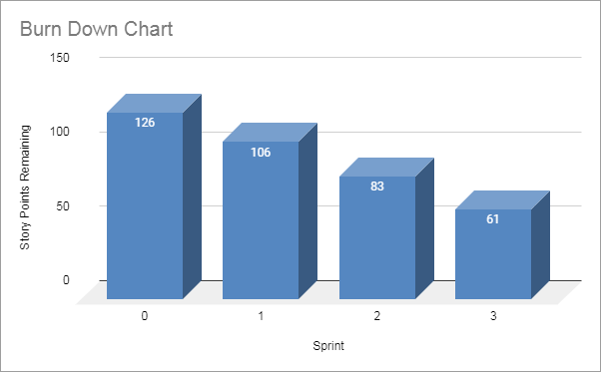
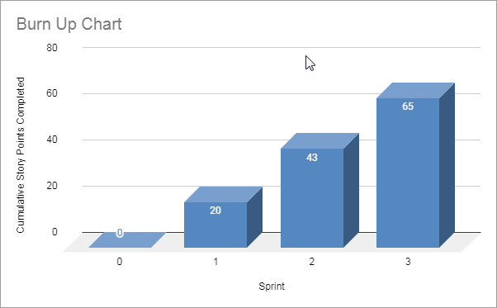
Sprints 1-3 Questions
What is your Velocity for the past 3 sprints?
21
How do you know your Velocity is correct?
The velocity is correct when the team is able to deliver results in a sustainable and constant way.
What would the BURN DOWN chart look like for Sprints 1-3?
Done
What would the BURN UP charts look like for Sprints 1-3?
Done
How many points do you think the Team should commit to for Sprint 4 and justify your answer?
I think 21 point should be a good number given the calculated velocity for the previous sprints
Place Burn Down Chart for Sprint 3 Here
Place Burn Up Chart for Sprint 3 Here

Slide 4
Agile Communication
Project
Sprint 4

Slide 5
Place User Stories Table for Sprint 4 Here

Slide 6
Sprint 4 Questions
What would the BURN DOWN chart look like for Sprints 1-4?
[Place your chart to the left]
What would the BURN UP charts look like for Sprints 1-4?
[Place your chart to the left]
What Risks did you identify in Sprint 4 and how do they affect the project? (Note: These would be your narrative findings)
[Your Answer]
What Theme or Name did you give to Sprint 4?
[Your Answer]
Place Burn Down Chart for Sprint 4 Here
Place Burn Up Chart for Sprint 4 Here

Slide 7
SPRINT 4 DEMO of Working Product
Team Name
Sprint 4 Name
“ “
Place Sprint 4 Burn UP Chart Here
User Stories in Sprint 4
1. Story # x with xx points
2. Story # x with xx points
3. Story # x with xx points
Total Sprint 4 Points: xxx
Place Sprint 4 Burn Down Chart Here
Narrative
Results
Learnings
Risks

Slide 8
Agile Communication
Project
Sprint 5

Slide 9
Place User Stories Table for Sprint 5 Here

Slide 10
Sprint 5 Questions
What would the BURN DOWN chart look like for Sprints 1-5?
[Place your chart to the left]
What would the BURN UP charts look like for Sprints 1-5?
[Place your chart to the left]
What Risks did you identify in Sprint 5 and how do they affect the project? (Note: These would be your narrative findings)
[Your Answer]
How confident are you in delivering all of the user stories by the end of Sprint 6? Justify your answer.
[Your Answer]
Place Burn Down Chart for Sprint 5 Here
Place Burn Up Chart for Sprint 5 Here

Slide 11
SPRINT 5 DEMO of Working Product
Team Name
Sprint 5 Name
“ “
Place Sprint 5 Burn UP Chart Here
User Stories in Sprint 5
1. Story # x with xx points
2. Story # x with xx points
3. Story # x with xx points
Total Sprint 5 Points: xxx
Place Sprint 5 Burn Down Chart Here
Narrative
Results
Learnings
Risks

Slide 12
Agile Communication
Project
Sprint 6

Slide 13
Place User Stories Table for Sprint 6 Here

Slide 14
What would the BURN DOWN chart look like for Sprints 1-6?
[Place your chart to the left]
What would the BURN UP charts look like for Sprints 1-6?
[Place your chart to the left]
Was the Team able to complete all the work in the backlog or did you have to adjust what could be delivered? How would you tell this to Management and justify your answer.
[Your Answer]
Place Burn Down Chart for Sprint 6 Here
Place Burn Up Chart for Sprint 6 Here

Slide 15
SPRINT 6 DEMO of Working Product
Team Name
Sprint 6 Name
“ “
Place Sprint 6 Burn UP Chart Here
User Stories in Sprint 6
1. Story # x with xx points
2. Story # x with xx points
3. Story # x with xx points
Total Sprint 6 Points: xxx
Place Sprint 6 Burn Down Chart Here
Narrative
Results
Learnings
Risks

Slide 16
BVIR for Management Questions
Which charts would you want to include in the BVIR that Management would need and why?
Move the Orange boxes to the correct column below
[Provide Justification goes here]
Included
Not included
Burn Down Charts
Burn Up Charts
Committed vs. Delivered Chart
Story Point Cost per Team

Slide 17
Creating the BVIR for Management
Questions to answer before you start the BVIR
What would tell Management if they want to know the details about actual stories?
[Select from the choices below]
"While I understand that you want to get into individual stories and know all the details, we would prefer that Management spends your valuable time guiding and influencing the Roadmap and direction of the project and leave the story delivery to the Teams you have empowered."
Absolutely, let's get into the details!
No, that is none of your business
Which of the above did you choose (1,2,3) and why?
[Your Answer]

Slide 18
Creating the BVIR for Management
Questions to answer before you start the BVIR
Is it project considered a failure because backlog items still remain? Explain.
[Your Answer]

Slide 19
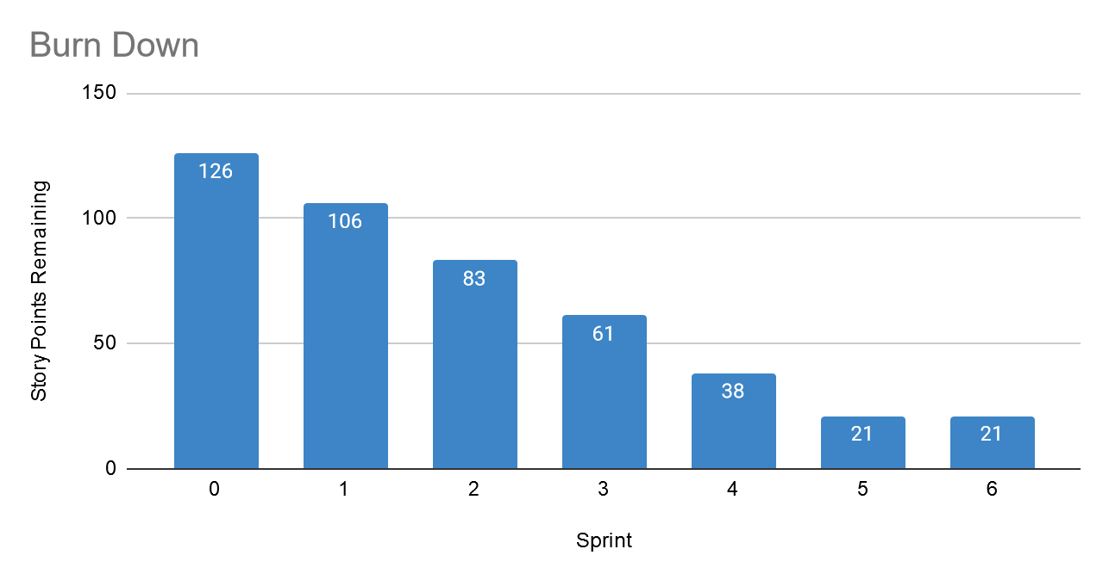
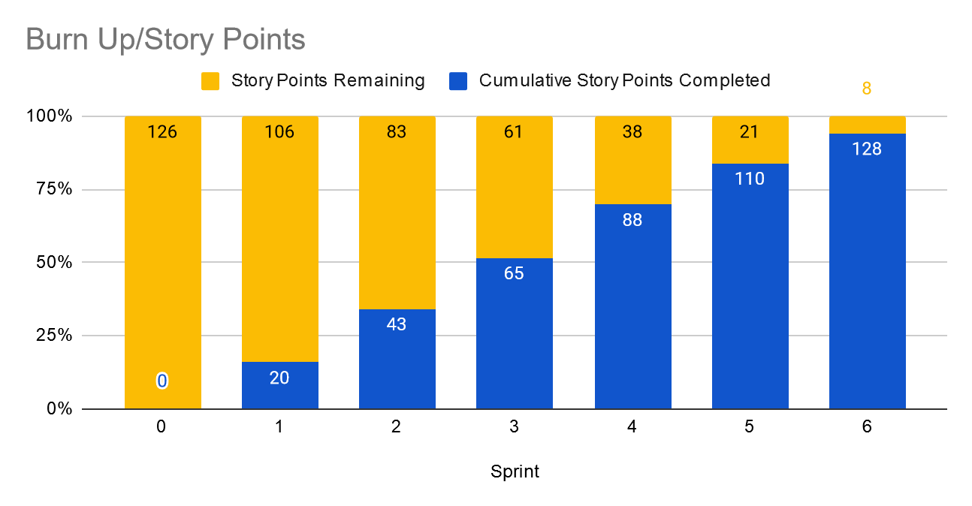
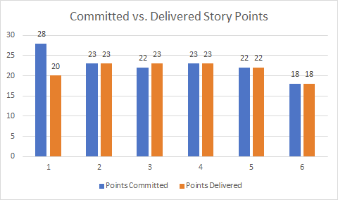
Creating the BVIR for Management
Instructions:
Start by creating your own BVIR. From the charts and sections below, please drag and drop items you would like to display to convey the story behind the MVP project
[Cut and paste items from this section and add them to the next slide. Remember to fill in information in the boxes where it is needed]
Roadmap
MVP VISION
Team Name
Chart Comparing Sprint Velocity of Teams 1 vs Team 2
Chart showing cost per story point

Slide 20
BVIR for Management
[Use this slide to create your BVIR. We have not provided a template for this, you get to decide what it looks like using the information from the previous slide]

Slide 21
BVIR for Management
[Now that you have created your BVIR for management, you need to create a video or written narrative explaining the MVP delivery status.
Use this slide to write your narrative or plan what you want to say in your video. ]
Include (at the minimum) the following:
Team Name
Vision
Sprint Burn Down Charts for Sprints 1-6
Sprint Burn Up Charts for Sprints 1-6
Project status (complete / incomplete)

Slide 22
Questions from Management (Using Videos would be great!)
Instructions:
Watch the videos in the classroom.
Record your videos or provide your answers below. Remember to justify your answer.
[Video # 1 Answer]
[Video # 2 Answer]
[Video # 3 Answer]
[Video # 4 Answer]

