Slide 1
CPS Framework Ontology Encoding
M. Balduccini and C. Vishik
November 23, 2017

Slide 2
Background Concepts
May be needed for understanding
Ontologies and ontology-based reasoning
Boolean satisfiability and Answer Set Programming (ASP)
Non-monotonic logic
Action languages
Constraint satisfaction
Soft constraints

Slide 3
Concern/Aspect Tree
CPS-independent
Encoded in the ontology file
Concern, Aspect: classes
Specific concerns/aspects: individuals
Sub-concerns specified by relation includesConcern

Slide 4
Properties
CPS-dependent
Encoded in the ontology file
Property: class; various subclasses
Specific properties: individuals
hasType: PropertyType_Assertion or Property_Type_Capability
rdfs:comment: description of the property
atomicStatement: internal label for the property
Called “atomic statement”
Used to state dependencies/constraints/trade-offs
Implemented with conditions and impact rules

Slide 5
Properties: Conditions
Conditions are used to help connect properties to concerns.
CPS-dependent and encoded in ontology.
Specific conditions: individuals
conditionPolarity, positive or negative
conditionProperty, Property attached to condition
Impact Rules used to connect condition to concern.

Slide 6
Properties: Impact Rules
An impact rule uses a condition, and addresses a concern, effectively connecting a property to a concern.
Specific Impact Rules: individuals
addressesAtFunc
addressesConcern, concern being impacted
addressesPolarity, positive or negative
hasCondition, condition which impact rule is dependent on
rdfs:comment: description of the property

Slide 7
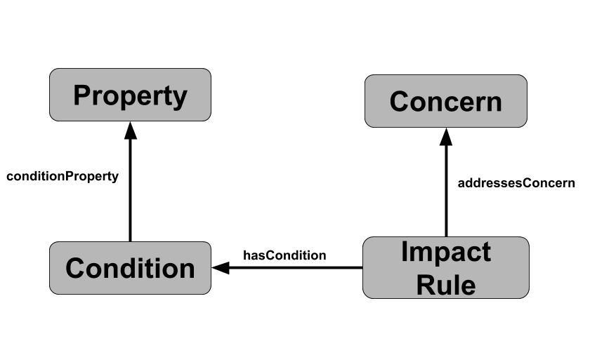
Why Impact Rules and Conditions?
Direct relation between concerns and properties breaks down as logic gets complicated.
Issues with combinations of Properties required for satisfaction of concern (ie two properties’ satisfaction)

Slide 8
Dependencies/Constraints/ Trade-offs
Encoded in action theory files
Configurable features
Observations (about initial state)
Assumptions (about initial state)
Fluents and their type
Actions, events
Truth value over time
Effects of actions
Dependencies between properties
Output interface (pretty-printing)

Slide 9
Dependencies: Configurable Features
Features of the CPS that can be configured at run-time
Specified as an atomic statement
config_feature(<atomic statement>).
Example
config_feature("using_basic_input1").
Meaning: the CPS includes a configurable feature “using_basic_input1”

Slide 10
Dependencies: Observations
Truth value of atomic statements in the initial state
obs(<atomic statement>,<true|false>).
Example
obs("encrypted_mem_input1",true).

Slide 11
Dependencies: Assumptions
Assumptions about the truth value of atomic statements in the initial state
assumed(<atomic statement>,<true|false>).
The statement is assumed true/false unless explicit evidence is available
Example
assumed("encrypted_mem_input1",true).
Link to property is in the ontology:

Slide 12
Dependencies: Fluents and Their Type
Fluents: properties whose truth value may change over time
All atomic statements are fluents
Types
Inertial: truth value normally persists over time
Defined positive: rules specify when true. Defaults to false
Defined negative: rules specify when false. Defaults to true
All fluents are inertial by default
Defined fluents:
defined(<pos|neg>,<fluent>).
Example
defined(neg,"consist_reading_freq_input1").

Slide 13
Dependencies: Actions, Events
Exogenous actions: occur beyond the control of agent/operator
Example: cyberattack
Occurrence:
occurs(<exog-action>,<step>).
(Agent) Actions: within the control of agent/operator
Example: applying a patch, replacing a component
action(patch(sam)).
Occurrence:
do(<action>,<step>).
Event: a high-level occurrence
Example: recording through out of court
event(<event>,<step>)

Slide 14
Dependencies: Truth Value Over Time
Current focus: discrete time steps
Specify that a fluent is true at step S
holds(<fluent>,<step>).
False at step S
-holds(<fluent>,<step>).

Slide 15
Dependencies: Effects of Actions
Logic programming rules
holds(<fluent>,<step>) :- <conditions>.
Can also use: -holds(<fluent>,<step>)
Example: the cyberattack causes the SAM to become affected
holds(affected(sam),S+1) :-
step(S), step(S+1),
occurs(cyberattack,S).

Slide 16
Dependencies: Dependencies Between Properties
Logic programming rules
impacted(neg,<atomic statement>,<step>) :- <conditions>.
Can also use: -holds(<fluent>,<step>)
Example:
impacted(neg,"consist_reading_freq_input1",S) :-
step(S),
holds("using_basic_input1",S),
holds("encrypted_mem_input1",S),
-holds("slow_mode_input1",S).

Slide 17
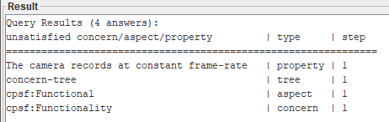
Dependencies: Output Interface
Table headings
output_headings("unsatisfied concern/aspect/property","type","step").
Table rows
output(C,aspect,S) :-
last_step(S), -holds(sat_concern(C),S), aspect(C).

Slide 18
Defining a CPS
Steps:
Define CPS properties in the ontology file(s)
Define all other elements in ASP files
No changes needed to the SPARQL file

Slide 19
Defining a CPS: Properties
With Protégé:
Start from cpsframework-v2-genCPS.owl
Encodes the concern/aspect tree
Add properties, impact rules, conditions
Set as needed:
hasType (In Property)
conditionProperty (In Condition)
addressesConcern(In Impact Rule)
etc
Save as a new file
Without Protégé:
Create an empty OWL file
Define properties, impact rules, conditions
In the reasoner use both cpsframework-v2-genCPS.owl and the new file

