Slide 1
DROUGHT-AREA RECONSTRUCTION
An example of continental-scale reconstruction of climate from tree rings
http://www.ltrr.arizona.edu/~dmeko/jordan/drought_area.ppt

Slide 2
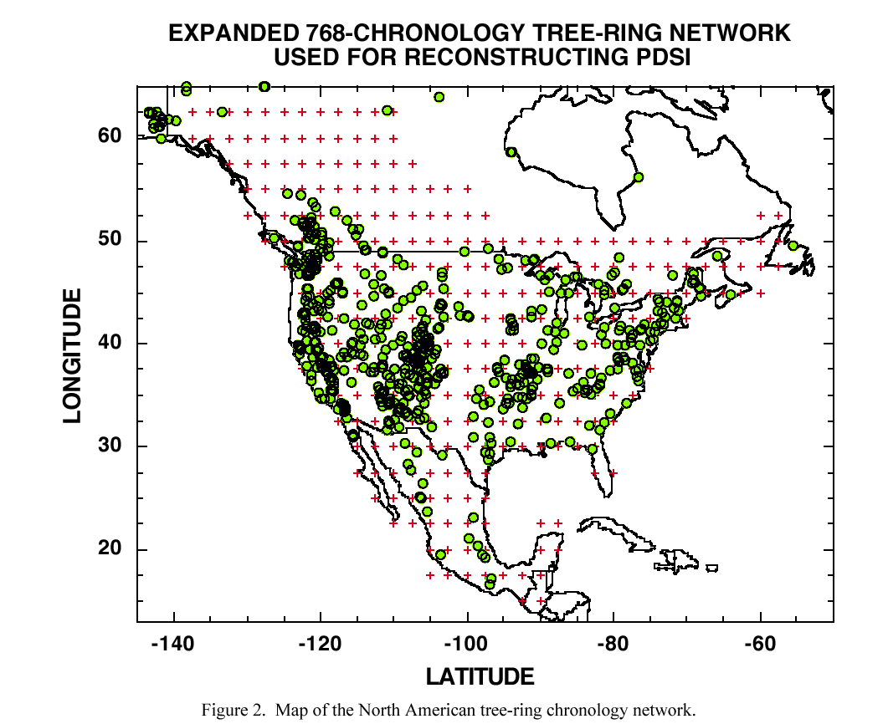
Personal communication, Ed Cook, 6-03-03

Slide 3
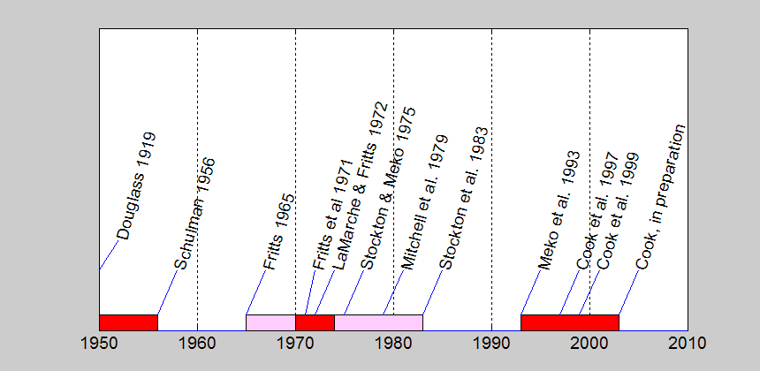
Timeline
Reconstruction of PDSI over western US; linkage of DAI to possible solar/lunar forcing
Expansion of tree-ring network and mapping of growth anomalies over western US
Early studies of possible solar cycles in tree rings at sites and site-groups
Development of screened continental tree-ring network
Reconstruction of gridpoint PDSI
Revisiting solar/lunar question
Adoption of PC-based spatial reconstruction tools by dendroclimatologists

Slide 4
Drought variable:
Palmer Drought Severity Index http://www.ltrr.arizona.edu/~dmeko/outbox/

Slide 5
PDSI INCLUDES
TEMPERATURE INFLUENCE
THORNTHWAITE WATER BALANCE MODEL
Function of T via PE
in Thornthwaite equation,
and available soil moisture
Built-in month to month autocorrelation of 0.89
P
ET
RO
S
Probability scheme for ending and beginning new droughts or wet periods
Z index, monthly
moisture anomaly

Slide 6
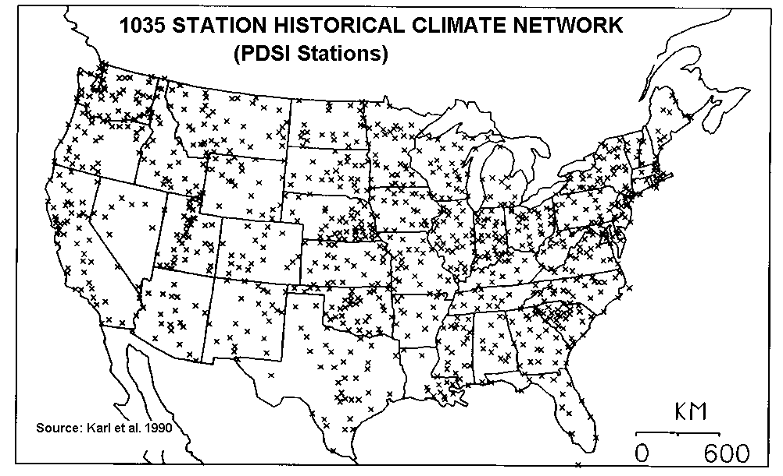
SPATIALLY COMPARABLE
PDSI <-3.0
Is “severe”
drought anywhere

Slide 7
Reconstruction Method

Slide 8
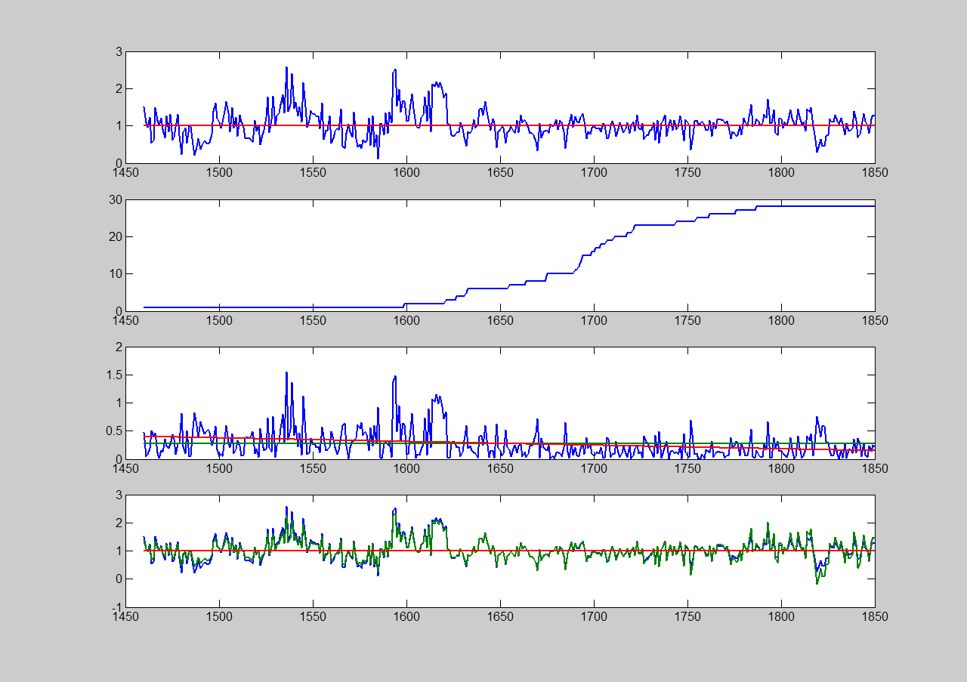
VARIANCE STABILIZATION
Green Mountain, AZ, PIPO
ORIGINAL INDEX
SAMPLE SIZE
ABSOLUTE DEVIATION FROM MEAN
ORIGNAL AND ADJUSTED INDEX

Slide 9
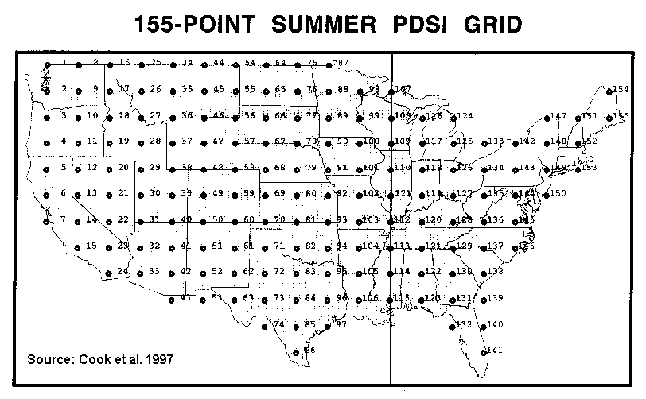
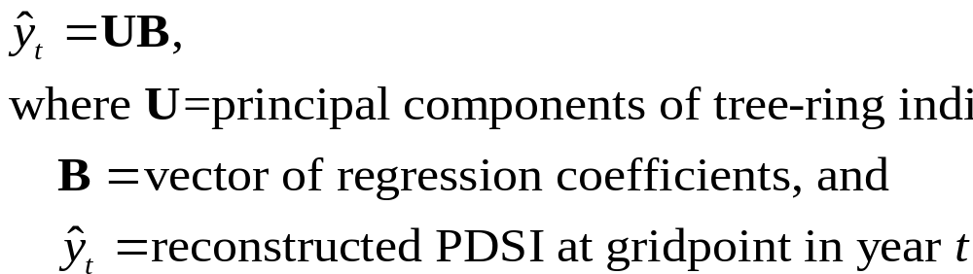
POINT-BY-POINT REGRESSION (PPR)
Attributes
Unconstrained by spatial patterns of unknown temporal stability
Reconstruction length can vary by gridpoint
Separate regressions for each grid point
Notes:
PPR is sequential, automated fitting of separate PCR models to each gridpoint
Premise: only tree ring sites proximal to the gridpoint are likely to be true “predictors” of pdsi at the gridpoint. Other methods rely on teleconnections and spatial patterns that may be instable in time.
DETAILS
Convert instrumental pdsi to z scores based on calib period mean and std deviation
Convert tree-ring chronologies to z scores
Convert the z-score chronologies to PC scores: U=XF, where F is the orthonormal mtx of eigenvectors on correl mtx of X
Develop eqn over 1928-78 calibration period
Estimate the regression coeffs B
Project pre-calib-period tree ring chrons onto the eigenvectors F
The resulting “augmented” scores U are those in the eqn above used to generate the reconstruction
The y_hats in the equation are standardized pdsi estimates
Convert the the y_hats to pdsi units by adding back in the mean and standard dev
AUTOCORRELATION SUBTLETY
The y and X are not really the original data, but data converted by AR modeling
Fit separate AR(p) models to the pdsi and tree-ring data for a gridpoint
Use the residuals in the regression modeling
Re-redden the reconstructed y by the model used to whiten the pdsi before regression

Slide 10
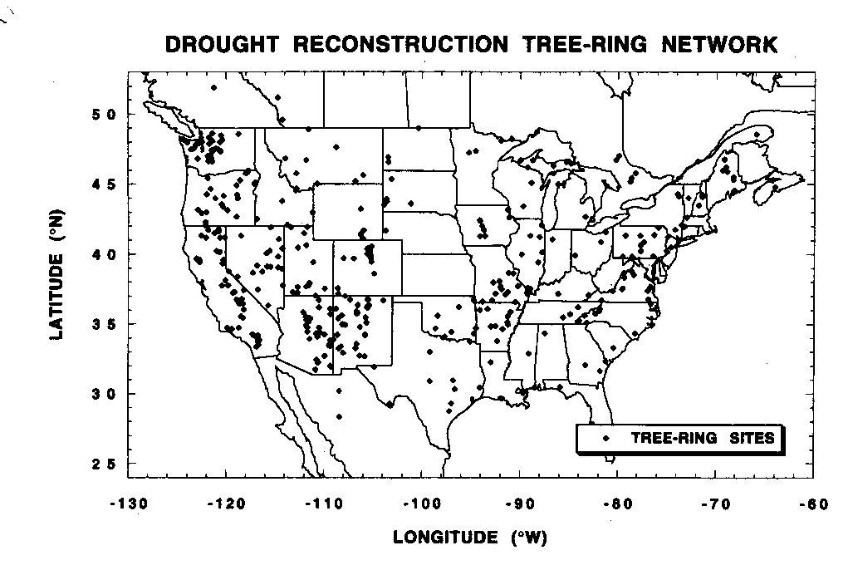
FOUR STAGES OF DATA REDUCTION
Stage 1: PROXIMITY
Stage 3: PCA ON CHRONOLOGIES
On correlation matrix for 1928-78
Accept PCs with eigenvalue > 1
Stage 4: REGRESSION ON PC SCORES
Regress gridpoint PDSI on the PC scores of chronologies
Only those predictors significantly reducing error variance after adjustment for loss of degrees of freedom are kept as final predictors
Begin with 150 km search radius
Expand in 50 km increments
Stop when at least 5 chronologies
Stage 2: CORRELATION
Correlate indices at times t and t+1 with pdsi at time t
Accept chronologies significantly correlated with PDSI at gridpoint

Slide 11
Drought-Area Index
(DAI)

Slide 12
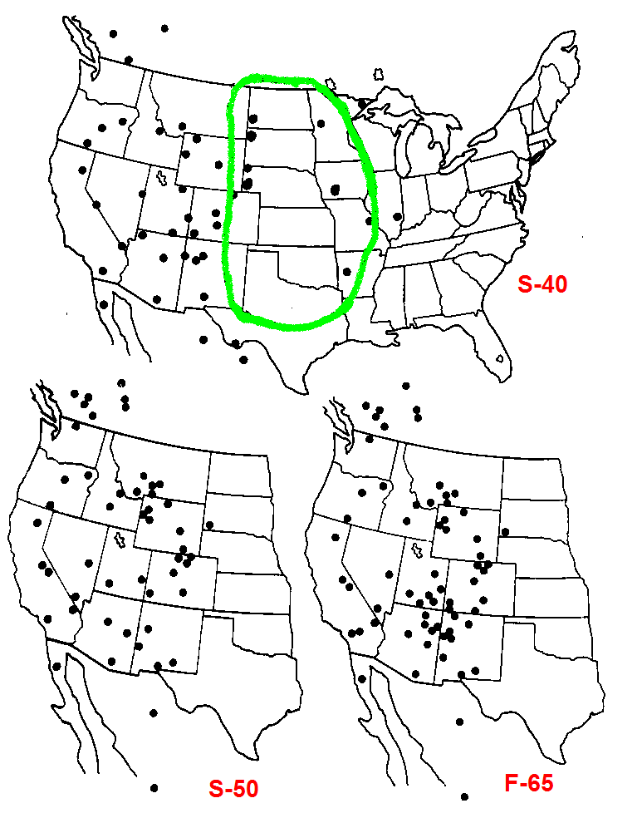
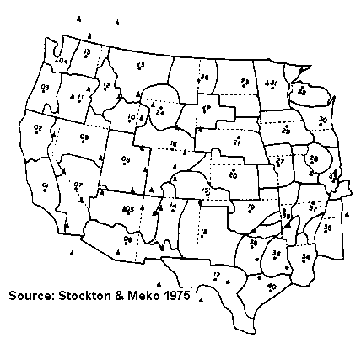
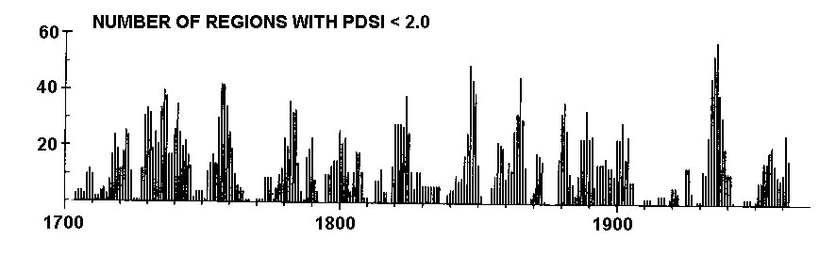
DAI Reconstructions, 1975-79
Tree-Ring Grids
PDSI Regions
Canonical
regression
PDSI by
region
Count
Source: Mitchell et al. 1979
Source: Stockton & Meko 1975

Slide 13
Identifying possible link of drought-area to solar activity

Slide 14
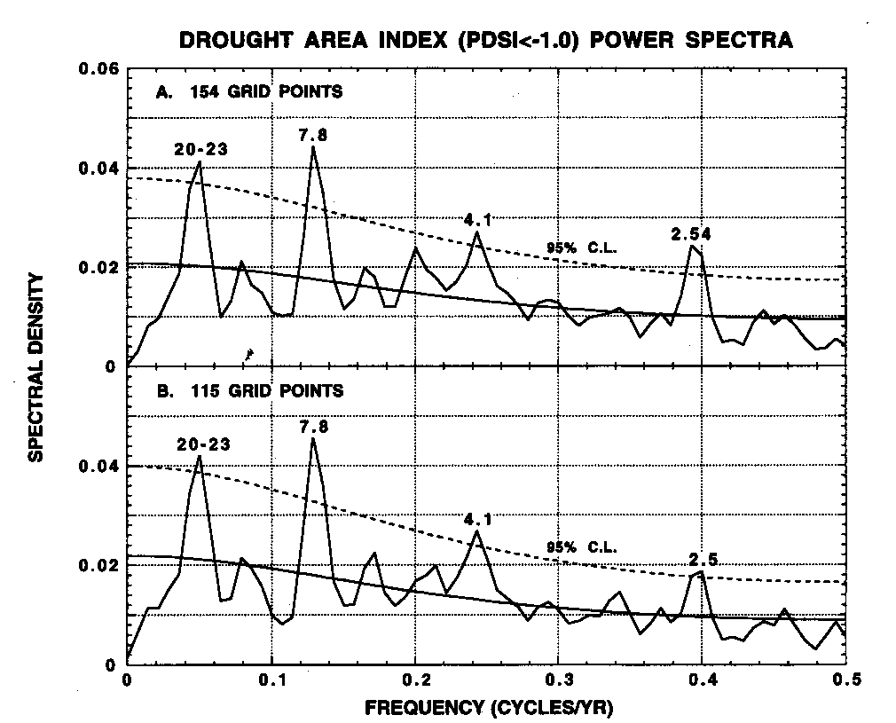
SPECTRA OF DAI
ENTIRE GRID
WEST
Source: Cook et al. 1997

Slide 15
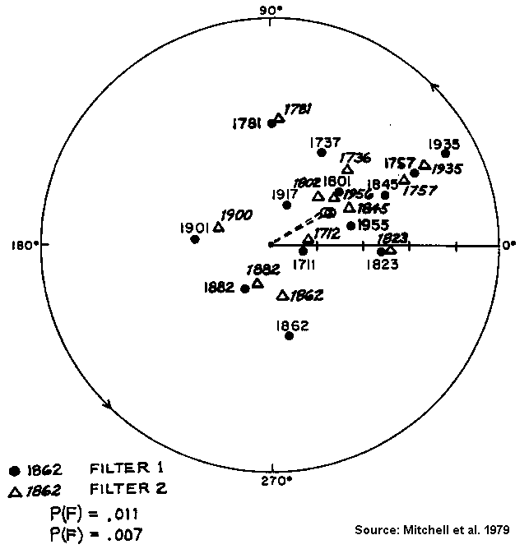
PHASE LINK TO SUNSPOT CYCLE
Harmonic Dial
Filter sunspot series and reconstructed DAI with 22-yr bandpass filter
Set 0˚at minimum in sunspot cycle
Plot DAI peaks on dial
  Angle is lag from sunspot minimum
  Radius is α size of DAI peak
Example: peak in 1935 is largest on record, and occurred about 30 degrees, or 2 years after the sunspot minimum
Similar finding by cross- spectal and superposed epoch analyses

Slide 16
HOW ACCURATE ?
Calibration statistics
Validation: check accuracy of reconstruction with observations withheld from calibration
Periods:
  Calibration: 1928-1978
  Validation: 1874-1927

Slide 17
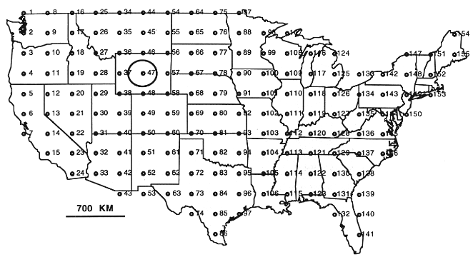
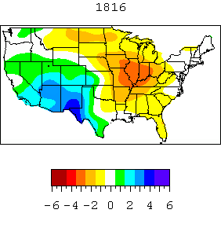
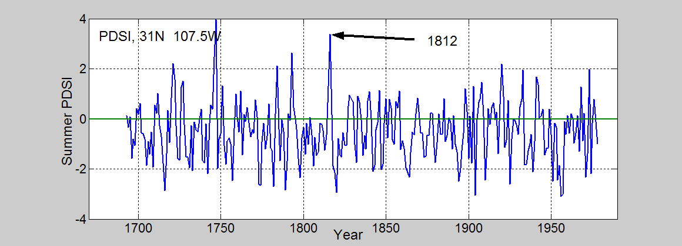
RECONSTRUCTIONS
1816

Slide 18
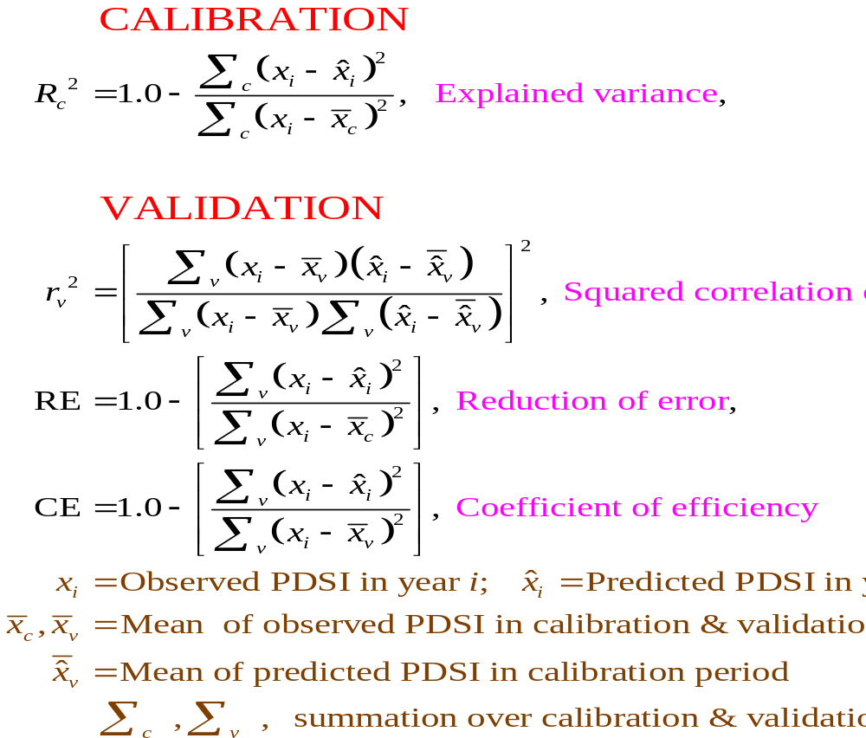
MEASURES OF POINT ACCURACY

Slide 19
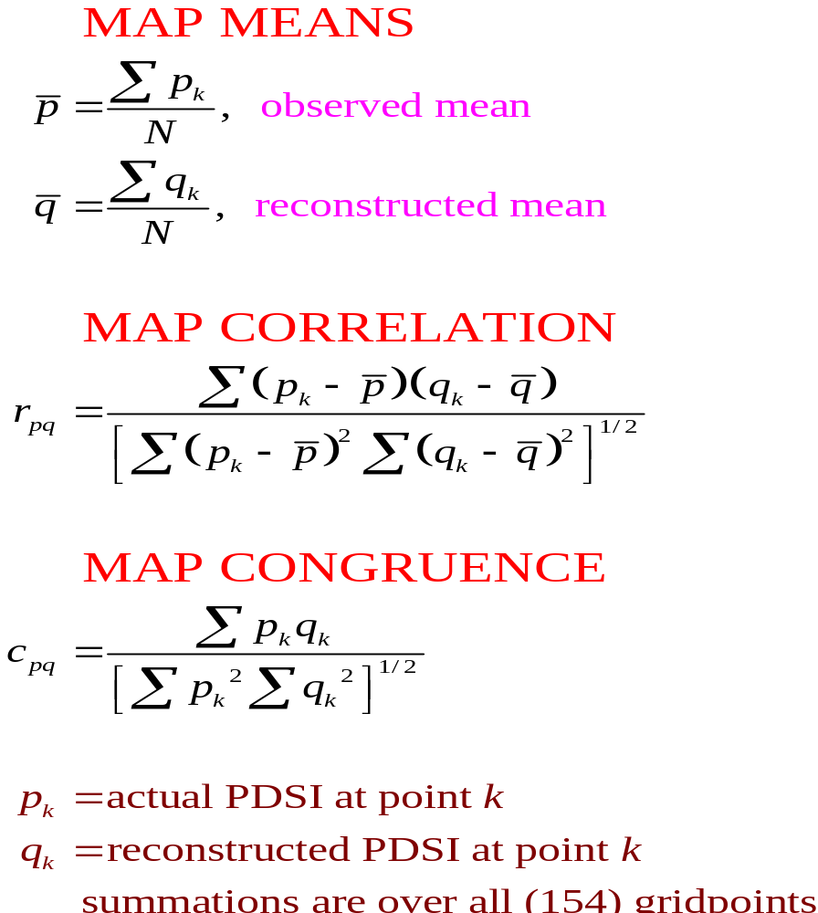
MEASURES OF MAP ACCURACY
Notes:
Prelimary step for map correlations and congruence: gridpoint reconstuctions standardized by the calibration period (1928-78) means and standard deviations. This was done to “avoid any regional bias in the map correlations due to spatial variations in the PDSI standard deviation.” Ed does not mention whether same standardization done on the observed PDSI, but I assume so.

Slide 20
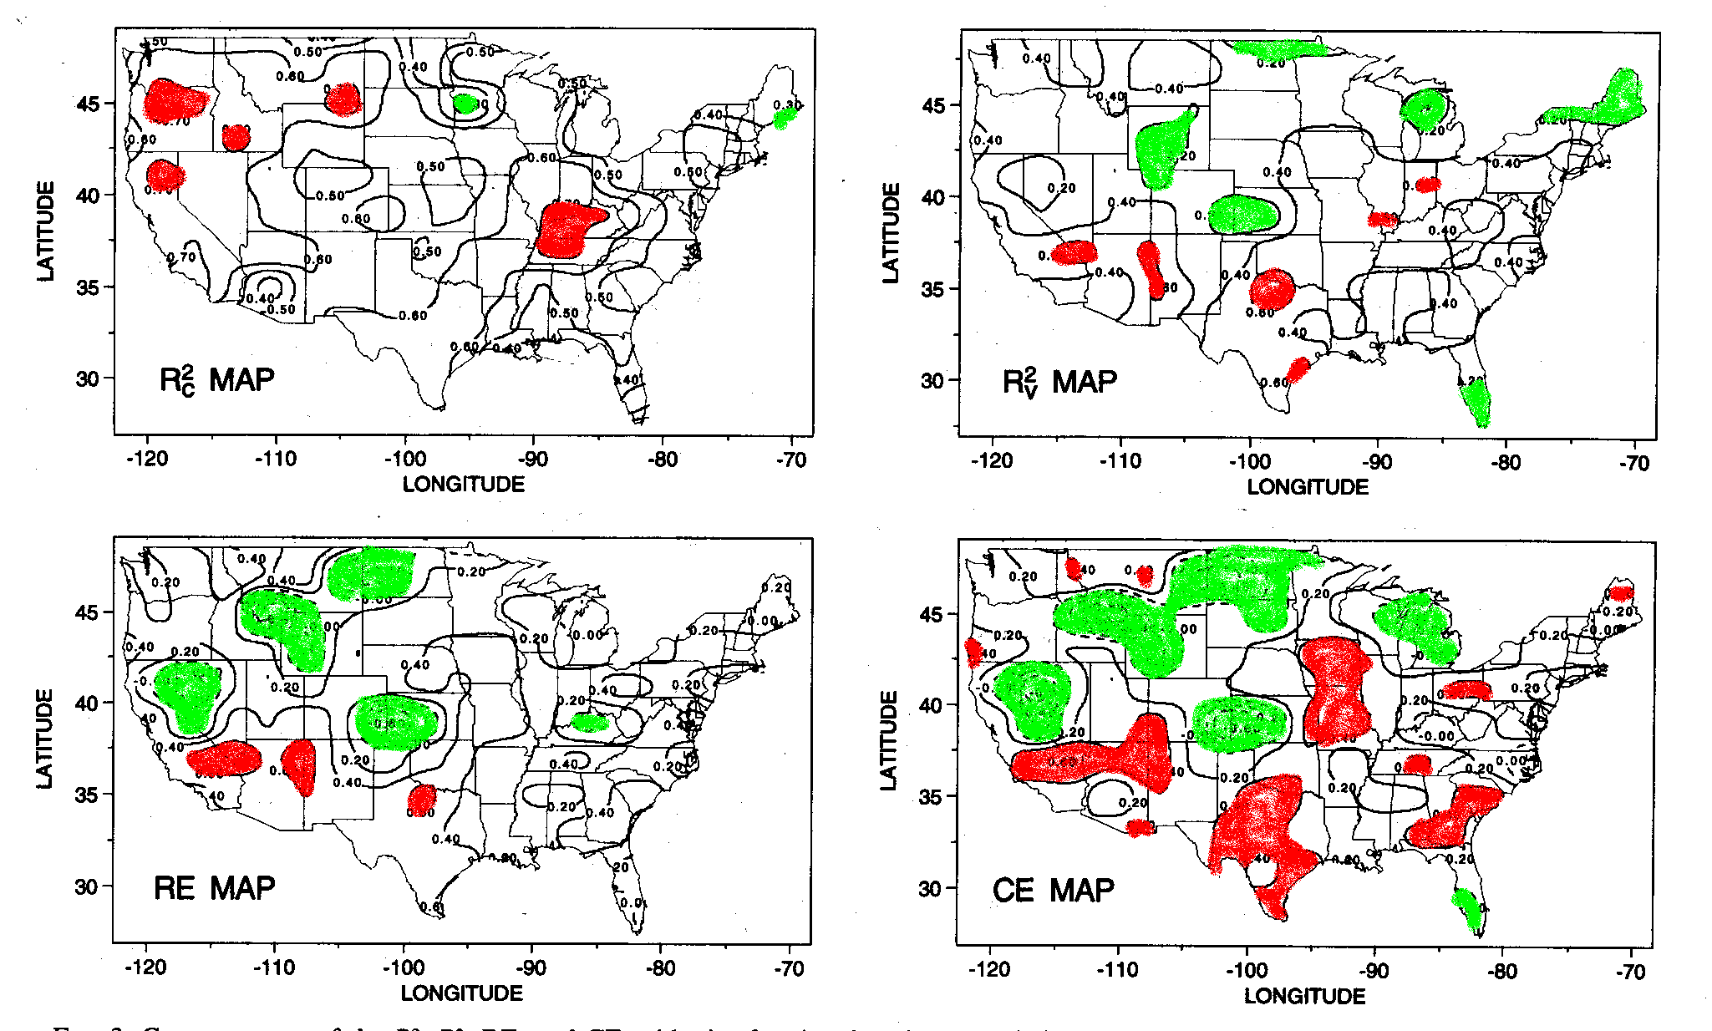
ACCURACY POINT BY POINT
>0.70
<0.20
<0.30
>0.60
<0
<0
>0.60
>0.40

Slide 21
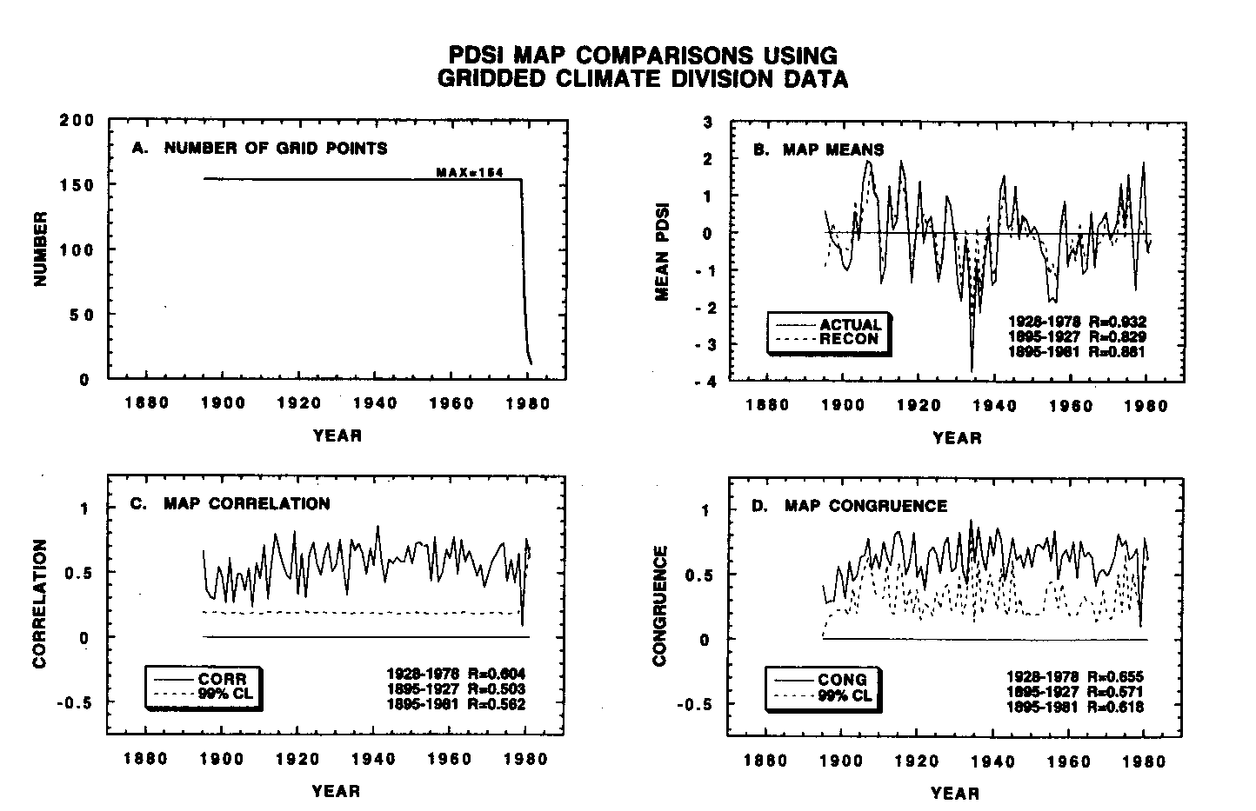
ACCURACY OF PATTERN
Source: Cook et al. 1999

Slide 22
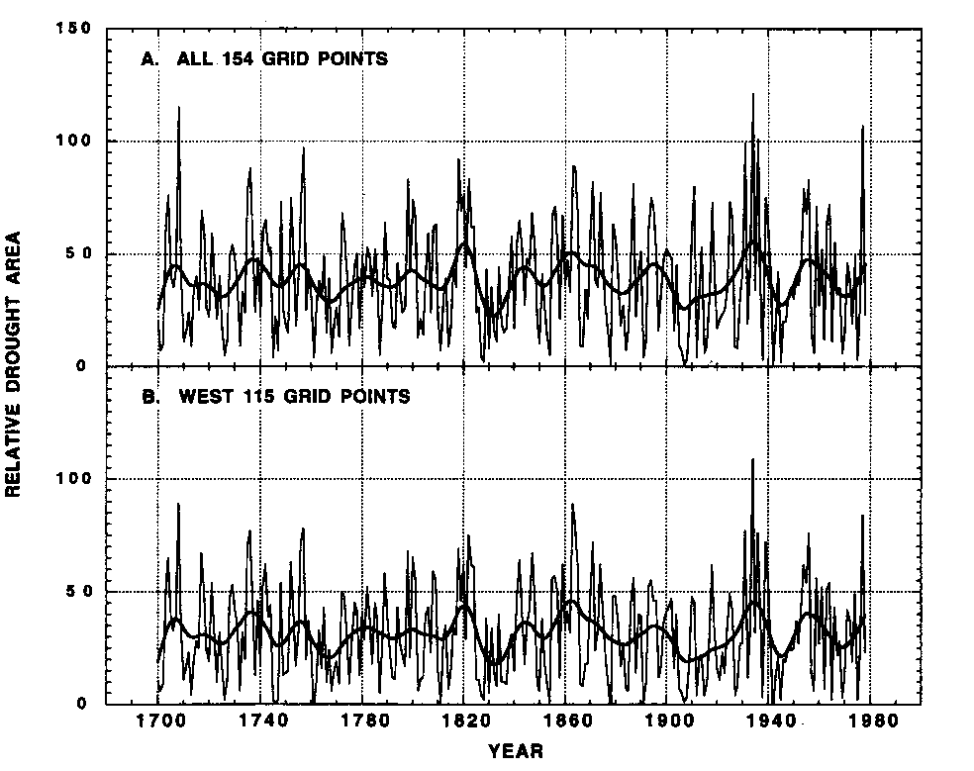
RECONSTRUCTED DAI
1930’s drought
Source: Cook et al. 1997

Slide 23
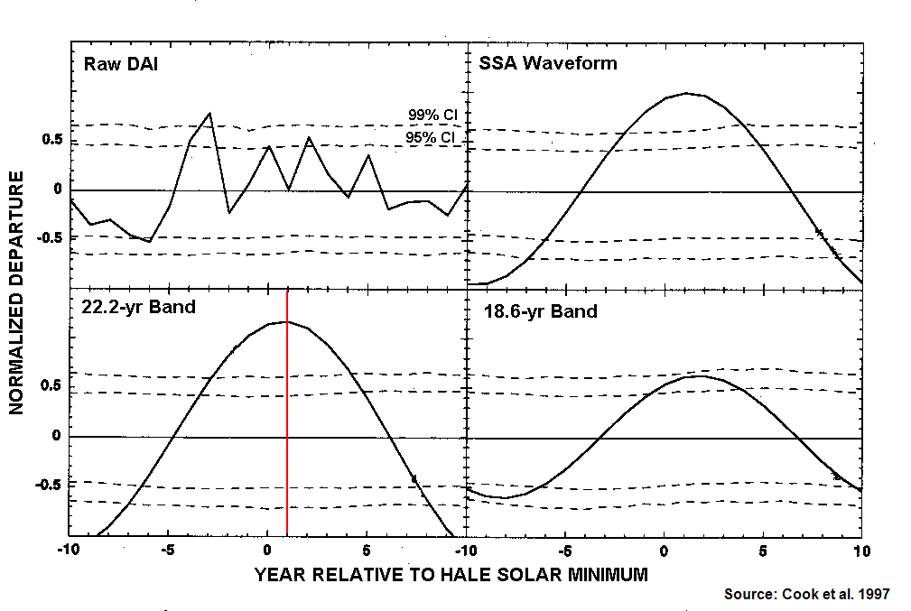
LINK TO HALE SOLAR MINUMA
SUPERPOSED EPOCH ANALYSIS OF DAI VS HALE SOLAR CYCLE
Drought area peaks 1 yr after solar minimum
Notes:
Begin with the reconstructed DAI (raw DAI); also generate band-pass versions centered at 22.2 yr and 18.6 yr
Assign key dates as minima in Hale sunspot series
Randomly shuffle the key dates (5000 times), each time computing the mean DAI at lags -10, -9, …+10 years from the key dates
Build empirical confidence intervals from the 5000 simulations
Plot the mean DAI for reconstructed series at the same lags from the observed (not scrambled) key dates
Check conditional means of DAI against confidence intervals
RAW DAI
Weak relationship, with major peak at t-3, second at t+2. The t+2 is same as Mitchell et al. (1979)
BAND PASS
22.2 yr band shows max DAI 1 yr after Hale minimum; Mitchell et al. (1979) found 2 yr, using similar band pass method
18.6 yr shows weaker, as expected, because filter
SSA
SSA is based on EOF of the autocovariance matrix. For an oscillation, the EOFs come in pairs with nearly equal eigenvalues and the EOFs are in quadrature with one another. So the total variance associated with the oscillation is the sum of the variances accounted for by the pair of EOFs. The loading of the EOFs act a s bandpass filter weights when applied to the series properly (Vautard et al. 1992).
We used 50 lags in the acv matrix. This from a window closing exercise that showed that 50 lags gives a smooth bidecadal waveform without overly smoothing the amplitude modulation apparent in the series.
SSA results for the SEA very similar to the bandpass filter results
REPEATED ANALYSIS FOR LUNAR NODAL MAX AS KEY YEARS
Results also show significant lindage. Drought area peaks in year of lunar maximum.
CONCLUSIONS
Original 1979 DAI is a robust expression of the spatial variability of drought over western US
Bidecadal rhyythm is a long-term featuyre of drought recurrence since 1700
SSA, bandpass filtering and SEA all support some phase-locking of the Hale and Lunar Nodal cycles
The solar and lunar forcing appear to act additively in modulating the DAI, especially if the pre-1800 phase discontinuity in the lunar term is considered
RECENT KEY YEARS (SOLAR/LUNAR); whole record has 13 solar, 15 lunar key years
1913.2/1817.5
1933.4/1936.1
1954.1/1954.7
1976.8/1973.3
Expect: (1996/1992.9; 2018/2011.5)

Slide 24
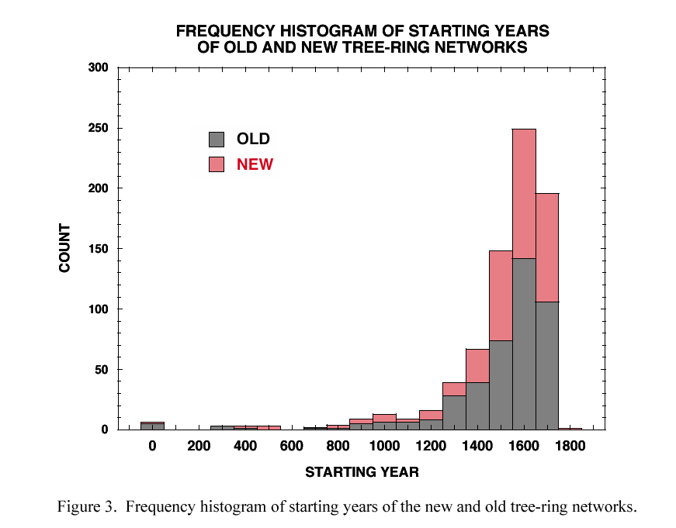
Personal communication, Ed Cook, 6-03-03

Slide 25
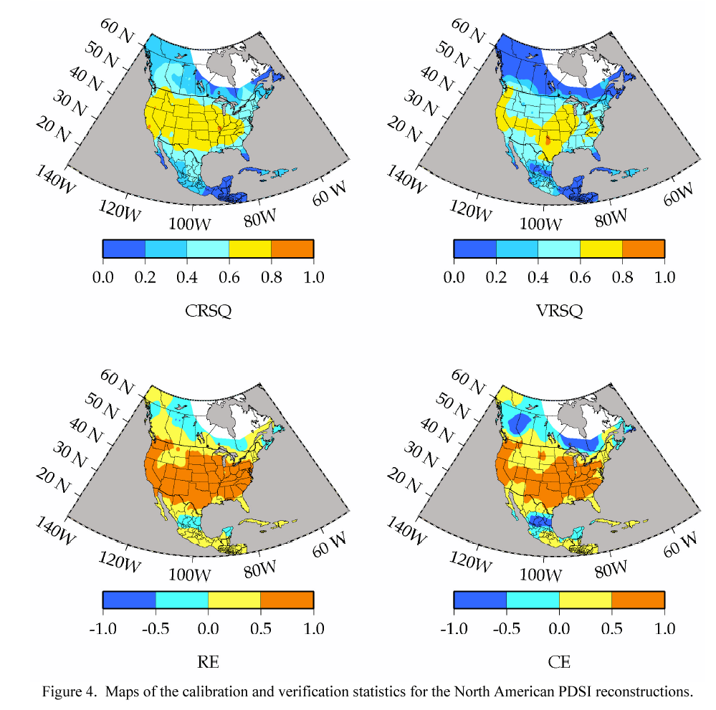
Personal communication, Ed Cook, 6-03-03

Slide 26
REFERENCE LIST
Cook, E.R., Meko, D.M., Stahle, D.W., and Cleaveland, M.K., 1999, Drought reconstructions for the continental United States: J. of Climate, v. 12, p. 1145-1162.
-----, Meko, D.M., and Stockton, C.W., 1997, A new assessment of possible solar and lunar forcing of the bi-decadal drought rhythm in the western United States: Journal of Climate, v. 10, p. 1343-1356.
Douglass, A.E., 1919, Climatic cycles and tree-growth: a study of the annual rings of trees in relation to climate and solar activity: Publication 289: Carnegie Institution of Washington, 127.
Fritts, H.C., 1965, Tree-ring evidence for climatic changes in western North America: Monthly Weather Review, v. 93, p. 421-443.
-----, Blasing, T.J., Hayden, B.P., and Kutzbach, J.E., 1971, Multivariate techniques for specifying tree growth and climatic relationships and for reconstructing anomalies in paleoclimate: J. of Applied Meteorology 10 (5), 845-864, v. 10, no. 5, p. 845-864.
LaMarche, V.C., Jr., and Fritts, H.C., 1972, Tree-rings and sunspot numbers: Tree-Ring Bulletin, v. 32, p. 19-33.
Meko, D.M., Cook, E.R., Stahle, D.W., Stockton, C.W., and Hughes, M.K., 1993, Spatial patterns of tree-growth anomalies in the United States and southeastern Canada: J. of Climate, v. 6, p. 1773-1786.
Mitchell, J.M., Jr., Stockton, C.W., and Meko, D.M., 1979, Evidence of a 22-year rhythym of drought in the western United States related to the Hale Solar Cycle since the 17th Century, B.M. McCormac and T.A. Seliga, eds., Solar-Terrestrial Influences on Weather and Climate, p. 125-143, D. Reidel Publishing Company, Dordrecht, Holland.
Schulman, E., 1956, Dendroclimatic changes in semi-arid America: Tucson, University of Arizona Press, 142 p.
Stockton, C.W., and Meko, D.M., 1975, A long-term history of drought occurrence in western United States as inferred from tree rings: Weatherwise, v. 28, no. 6, p. 245-249.
-----, Mitchell, M.J., and Meko, D.M., 1983, A reappraisal of the 22-year drought cycle, in McCormac, B.M., ed., Weather and climate responses to solar variations: Boulder, CO, Colorado Associated University Press, p. 507-515.

