Slide 1
Tree-ring record of variations in north-south moisture contrast across California
Single-site reconstructions of cool-season (Nov-Apr) precipitation from PRISM data and blue oak chronologies
Reduction of site reconstructions into regional series for North, South, Central regions
Tree-ring signal for north-south contrast in moisture anomalies
Derivation and analysis of time series “event” series:
  Dry overall
  Wet overall
  Gradient wetter to drier from N to S
  Gradient drier to wetter from N to S
Have not gone beyond this yet

Slide 2
Derivation of reconstructions
Background (1)
Water-year total reconstructions of precipitation were reconstructed “at” each tree-ring site through regression of PRISM precipitation on residual chronologies
As quality control, PRISM data were compared with site-interpolated GHCN precipitation
Spreadsheets with PRISM data, GHCN data, reconstuctions, description of procedure, and some summary analyis were archived at:
http://uark.edu/blueoak/data/
The initial version of water-year reconstructions (22 sites) was transferred to Arkansa in March 2006
As more oak chronologies were completed, the water-year reconstructions were expanded to 36 sites, and these were transferred in August 2006; these are the reconstructions in the spreadsheet under the link “4.6.3 PRISM Reconstructions” at http://uark.edu/blueoak/data/

Slide 3
Derivation of reconstructions
Background (2)
In discussions with collaborators, it was suggested that the water year might not be an optimal seasonal grouping of precipitation for blue-oak response. Work after August 2006 has focused on the cool season (Nov-Apr) as a reconstruction window, and on generation and analysis of time series reflecting anomalies and spatial gradients in anomalies in Nov-Apr precipitation.
Reconstructions of Nov-Apr PRISM precipitation (“.xls”) were made for the 36 tree-ring sites, and were followed with spatial analysis of a set of 32 sites with a specified minimum time coverage by reconstructions.
The method for these reconstructions was modified slightly from the method for the water-year reconstructions described above. The main difference is the used of a two-stage regression procedure:
  regression of precipitation on current and lagged residual index
  re-calibration of the reconstruction with a quadratic regression model if necessary to adjust for pronounced curvature in the scatter of the observed precipitation on the initial reconstructed precipitationlagged effects were allowed

Slide 4
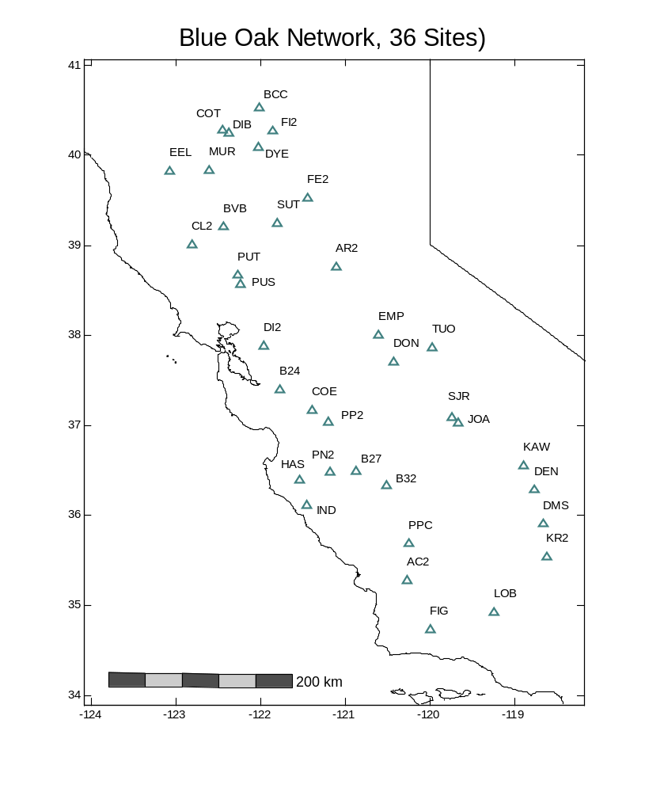
Site Network
Nov-Apr Precipitation Reconstructions
Nov-Apr PRISM precipitation, P, 1896-2005 tallied for each site
P reconstructed separately for each site using the site’s residual index and two-phase regression procedure described later
Reconstructions and PRISM “observed” precipitation available at ??
Notes:
Only 32 sites because the single-site recons for four sites did not cover 1699-2001
Because lags were included in the pool of potential predictors in single-site regressions, the single-site reconstructions may have slightly reduced (up to 2 years forward or backwards) coverage from the residual site chronologies that were the predictors for the models

Slide 5
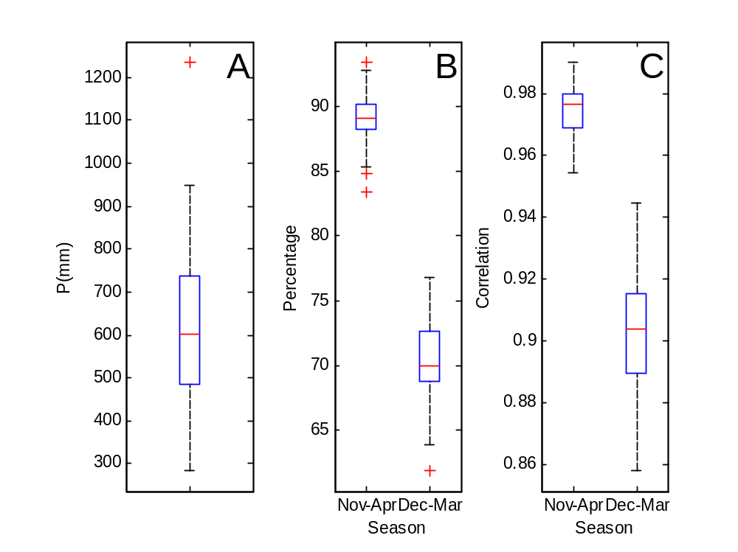
Nov-Apr “Cool Season”
Mean annual PRISM precipitation at the 36 sites has a median of about 600 mm, and ranges from less than 300 mm to more than 1200 mm*
Typically about 90% of the annual precipitation falls from Nov to Apr; only about 70% falls between Dec and Mar
Nov-Apr total precipitation is highly correlated with water-year-total precipitation
Nov-Apr was a compromise: meteorologically meaningful, yet includes large portion of the annual moisture supply to trees
* Statistics for water years 1896-2005
Notes:
Only 32 sites because the single-site recons for four sites did not cover 1699-2001
Because lags were included in the pool of potential predictors in single-site regressions, the single-site reconstructions may have slightly reduced (up to 2 years forward or backwards) coverage from the residual site chronologies that were the predictors for the models

Slide 6

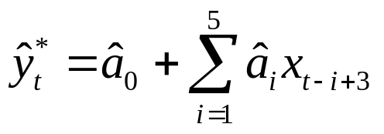
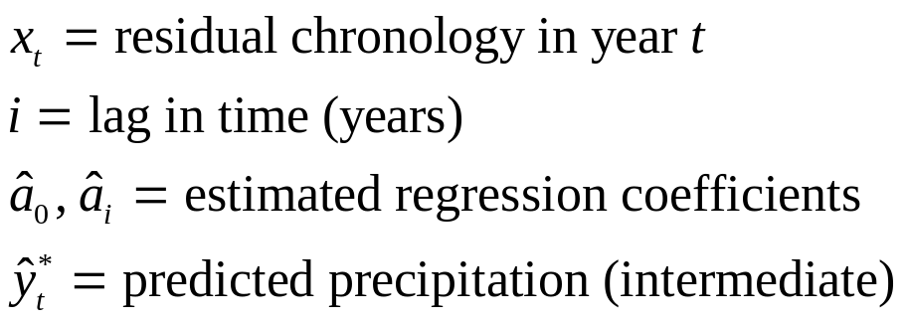
Reconstruction Procedure
Step 1: distributed-lagged regression
Model allows for input from rings in years t-2 to t+2 for reconstruction in year t
Forward stepwise regression with p_{enter}=0.25; the final model may or may not include lags
Model stability at this stage was checked with split-sample validation
Scatterplots (example, next slide) showed a linear relationship does not apply to all sites

Slide 7
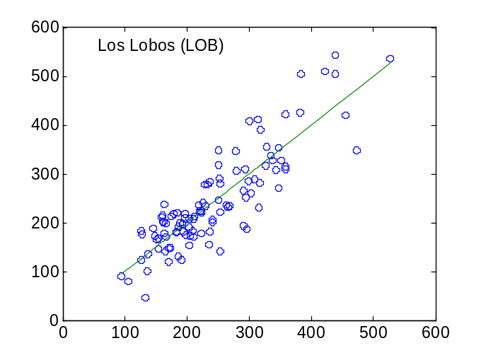


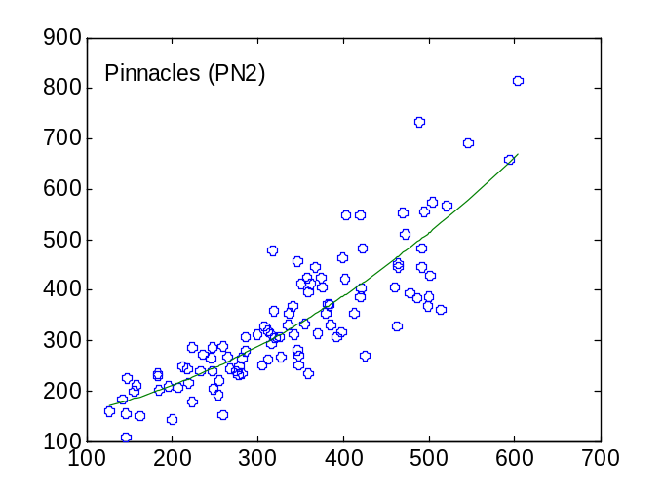
Reconstruction Procedure
Nonlinearity of precipitation-tree ring relationship some sites
R²=0.76
At left are plots of observed precipitation on precipitation predicted by the distributed-lag linear regression model
Top: linear model suitable for Los Lobos
Bottom: curvature suggest quadratic relation of observed on predicted—linear model flawed
Curvature was evident in scatterplots for of site reconstructions for several sites
A re-calibration step (next slide) was used to adjust the site reconstruction
R²=0.73
Notes:
Nov-Apr; LOB; adjR2 = 0.76; SL fit, R2 = 0.76
Nov-Apr; PN2; adjR2 = 0.71; Quadratic fit R2 = 0.73
lob.fig and PN2.fig

Slide 8
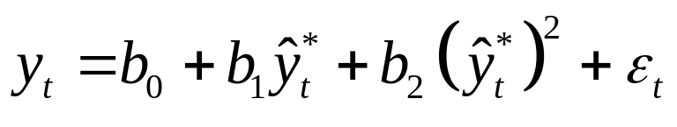
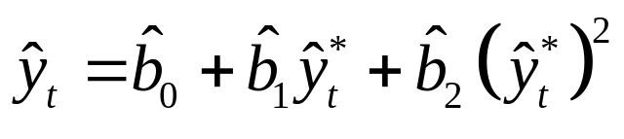
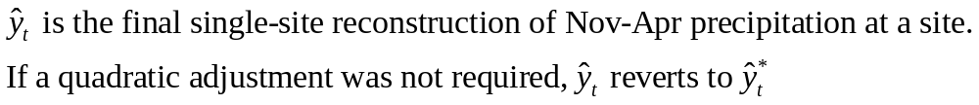
Reconstruction Procedure
Step 2: quadratic re-calibration
Observed P regressed on step-1 reconstruction in quadratic model
Fitted model used to adjust step-1 reconstruction for full length of tree-ring record
Quadratic adjustment made only if regression coefficient on the quadratic term is positive and significant at the 0.10 alpha-level

Slide 9
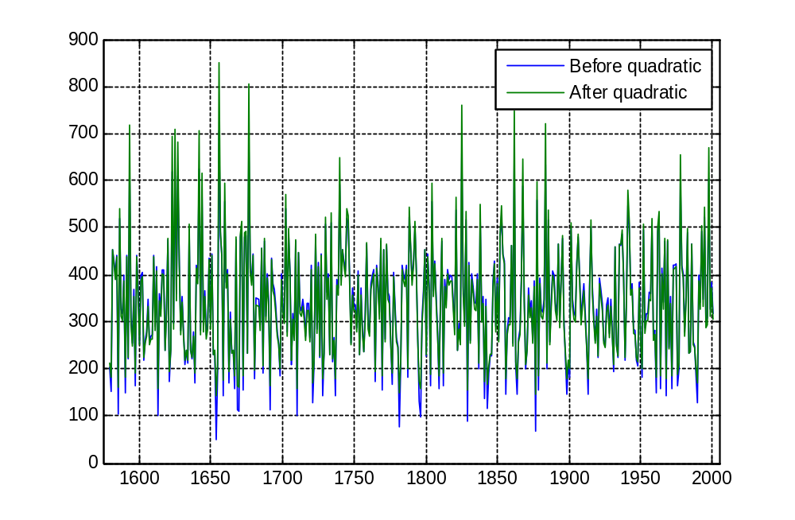
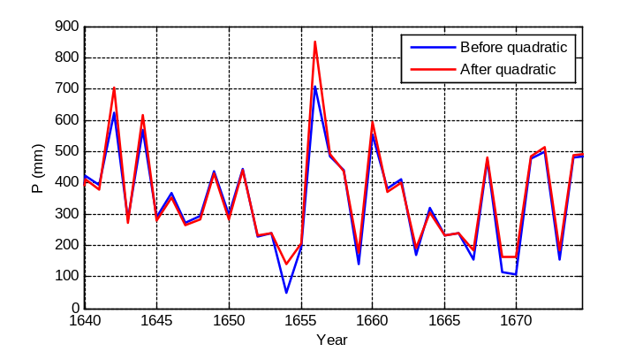
Nov-Apr Precipitation Reconstructions
Practical importance of quadratic adjustment
Pinnacles (PN2) Reconstructed P
Reconstructions with and without quadratic adjustment generally highly correlated (e.g., r=0.982 For PN2). Correlation not lower than r=0.98 for any site.
P (mm)
Large differences in some years, notably the very dry years

Slide 10
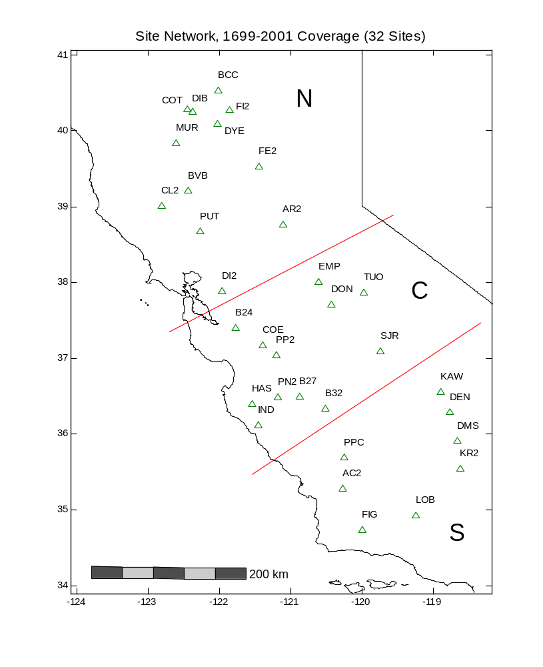
Regional Reconstructions
Site network and regional grouping
Minimum criterion was coverage of 1699-2001 period by the single-site reconstruction
  32 sites cover 1699-2001
  19 sites cover 1559-2001
Strategy for choosing regions
  Target of N/S contrast, with a separation zone
  SW-NE orientation of boundaries, consistent with “typical” storm tracks
  Multiple sites with high reconstruction R² in each region
Notes:
Only 32 sites because the single-site recons for four sites did not cover 1699-2001
Because lags were included in the pool of potential predictors in single-site regressions, the single-site reconstructions may have slightly reduced (up to 2 years forward or backwards) coverage from the residual site chronologies that were the predictors for the models

Slide 11
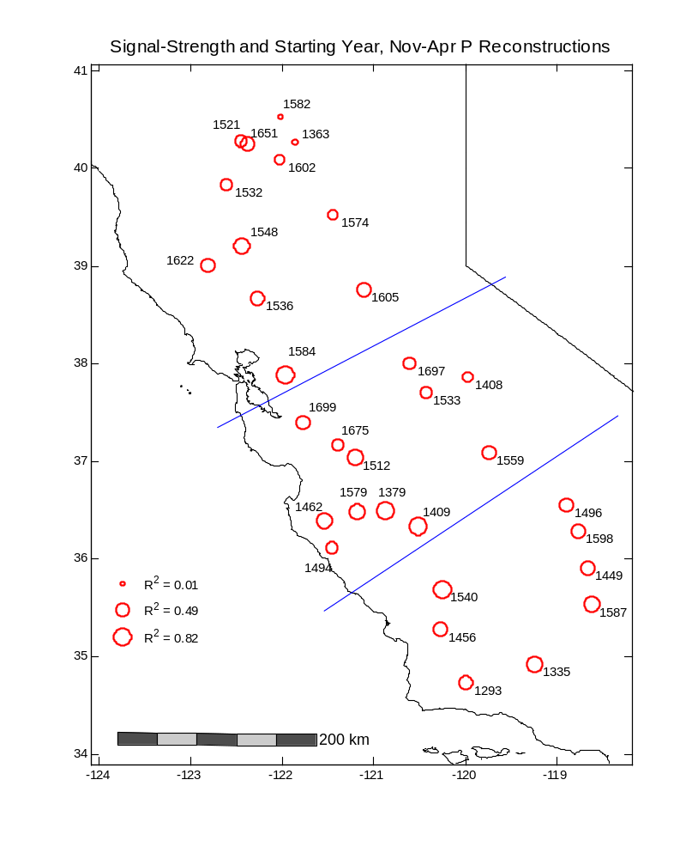
Regional Reconstructions
Signal strength and time coverage by single-site recons
Each region includes multiple sites with strong signal for cool-season precipitation
Signal strength is still high back to the 1500s. The selected 1559 start year for the earliest regional grouping could possibly be pushed back earlier into the 1500s, but the lack of very long chronologies with strong signal in the North region is limiting

Slide 12
Regional Reconstructions
Computation
Define 1901-2001 as “reference period”
Convert site reconstructions of Nov-Apr P to standardized anomalies from reference-period mean
Average standardized anomalies over sites in region; weight sites proportional to their signal strength (defined as the correlation of observed with reconstructed precipitation)
Repeat step 3 for two analysis periods: 1699-2001 and 1559-2001; longer period is based on sparser site network
The reconstructions are stored in spreadsheet
“Recons (stdzd anoms)” of file Nov_Apr.regional.precipitation.reconstructions.xls
Notes:
Only 32 sites because the single-site recons for four sites did not cover 1699-2001
Because lags were included in the pool of potential predictors in single-site regressions, the single-site reconstructions may have slightly reduced (up to 2 years forward or backwards) coverage from the residual site chronologies that were the predictors for the models

Slide 13
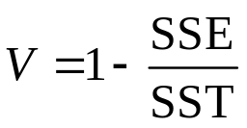
Regional Reconstructions
Comparison with observed --method
Compute observed regional P as arithmetic mean of PRISM percent-of-normal (1901-2001) averaged over all tree-ring sites in region
Scatterplot the observed P, 1901-2001, on the reconstructed regional precipitation, which is a mean standardized anomaly
Fit a cubic smoothing spline to the scatterplot to graphically summarize relationship, adapting to curvature as needed
Summarize strength of relationship by a variance-explained statistic
where SSE is the sum of squares of departures of observed P from the fitted line, and SST is the sum of squares of departures of observed P from its mean
-- results on next slide
Notes:
Only 32 sites because the single-site recons for four sites did not cover 1699-2001
Because lags were included in the pool of potential predictors in single-site regressions, the single-site reconstructions may have slightly reduced (up to 2 years forward or backwards) coverage from the residual site chronologies that were the predictors for the models

Slide 14
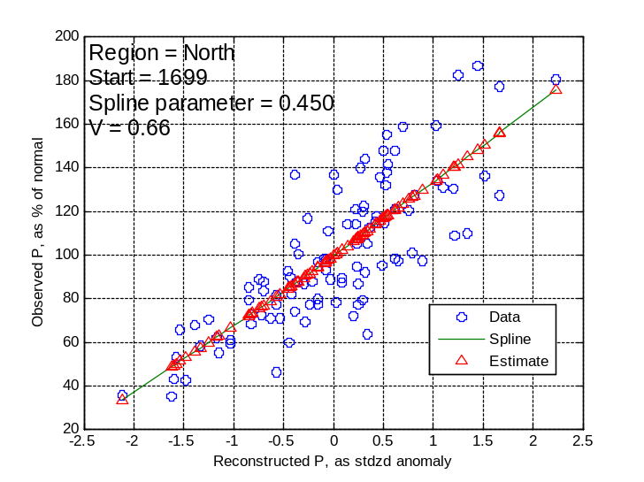
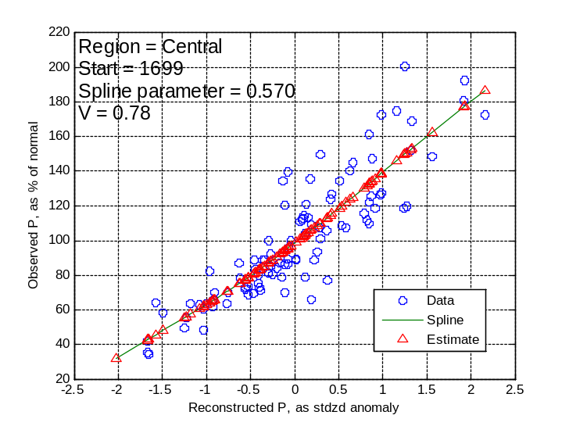
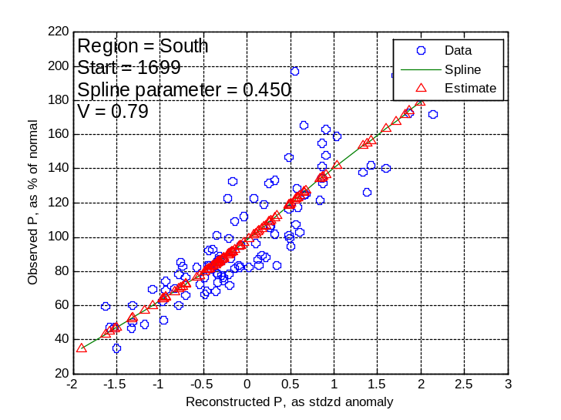
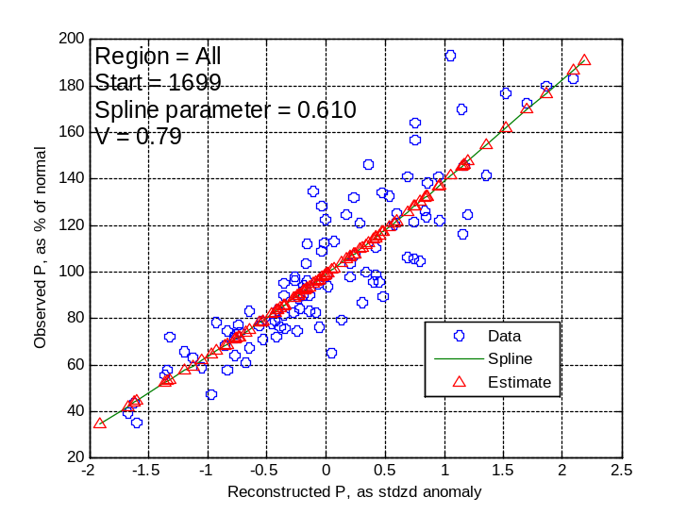
Regional Reconstructions
Comparison with observed-- results
Notes:
Only 32 sites because the single-site recons for four sites did not cover 1699-2001
Because lags were included in the pool of potential predictors in single-site regressions, the single-site reconstructions may have slightly reduced (up to 2 years forward or backwards) coverage from the residual site chronologies that were the predictors for the models

Slide 15
Regional Reconstructions
Comparison with observed-- summary
The reconstructions accurately depict the variations in regional-average precipitation over the 1901-2001 reference period
A given reconstructed value of regional precipitation can be interpolated as a regional-average percentage of normal from the scatterplots in the preceding slide.
The variance-explained statistics indicate accuracy of regional precpitation reconstruction corresponding to R-squared values of 0.66 to 0.79. Signal is weaker in the North than in the South
A spline has been used to allow for curvilinear relationships between observed percent-of-normal regional P and reconstructed mean-standardized-anomaly P. For practical purposes, a straight-line fit would have sufficed.
Results are shown for the 1699 model only in the previous slide. Similar accuracy was achieved for the reconstructions starting in 1559. For that model the V statistic is 0.63, 0.81, 0.78 and 0.79 for the North, Cental, South, and Overall regions, respectively. The only degradation is in the North
Notes:
Only 32 sites because the single-site recons for four sites did not cover 1699-2001
Because lags were included in the pool of potential predictors in single-site regressions, the single-site reconstructions may have slightly reduced (up to 2 years forward or backwards) coverage from the residual site chronologies that were the predictors for the models

Slide 16
Regional Reconstructions
Access
Regional reconstructions as mean standarized anomalies and as percent of normal (linearly interpolated from the spline-smoothed scatterplots) are included in spreadsheet
“Recons (stdzd anoms)” of file Nov_Apr.regional.precipitation.reconstructions.xls
The xls file also includes two alternative expressions of the long-term reconstructions:
  As quantiles, such that a reconstructed standardized anomaly is expressed as a quantile, or nonexceedance probability, based on the empirical cdf of reconstructed values for the 1901-2001 base period.
  As quantile-mapped observed percent-of-normal precipitaton. By this conversion, the lowest reconstructed value for 1901-2001 maps as the lowest observed percent-of-normal precipitation in the same period, the second lowest reconstructed value maps as the second-lowest observed, etc. This mapping forces the reconstruction for the reference period to have the same empirical cdf as the observed precipitation for the reference period. Values outside the range for the reference period are truncated, or mapped to the extremes of observed for the reference period
Notes:
Only 32 sites because the single-site recons for four sites did not cover 1699-2001
Because lags were included in the pool of potential predictors in single-site regressions, the single-site reconstructions may have slightly reduced (up to 2 years forward or backwards) coverage from the residual site chronologies that were the predictors for the models

Slide 17
Tree-Ring Signal for North-South Contrast
Approach
The single-site reconstructions of cool-season (Nov-Apr) precipitation (P) have been averaged regionally into North, Central and South regions
At the broadest spatial scale, the question is “can regional contrasts in P anomalies be inferred from the regionalized tree-ring reconstructions?” Because cool-season precipitation is highly spatially correlated in California, it is unclear that just because the blue oak chronologies are highly correlated with P that they can distinguish spatial gradients in P.
The DIFFERENCE in regional average precipitation anomalies (e.g., North minus South) is the variable of interest in this analysis.
The approach will begin with the broad regional-average reconstructions: North, Central South; later the analysis will be extended to the finer spatial scale of individual chronologies separated by short distances. At some point I expect eh signal for differences in anomalies to be buried in noise, as the observed precipitation between two nearby sites is so highly correlated that the difference in anomalies must be very small compared with the variance of those individual anomaliesmust be reflected in the tree-ring data
The next slides deal with testing the tree-ring signal for North-South, North-Central, and Central-South contrasts in moisture anomaly
Notes:
Only 32 sites because the single-site recons for four sites did not cover 1699-2001
Because lags were included in the pool of potential predictors in single-site regressions, the single-site reconstructions may have slightly reduced (up to 2 years forward or backwards) coverage from the residual site chronologies that were the predictors for the models

Slide 18
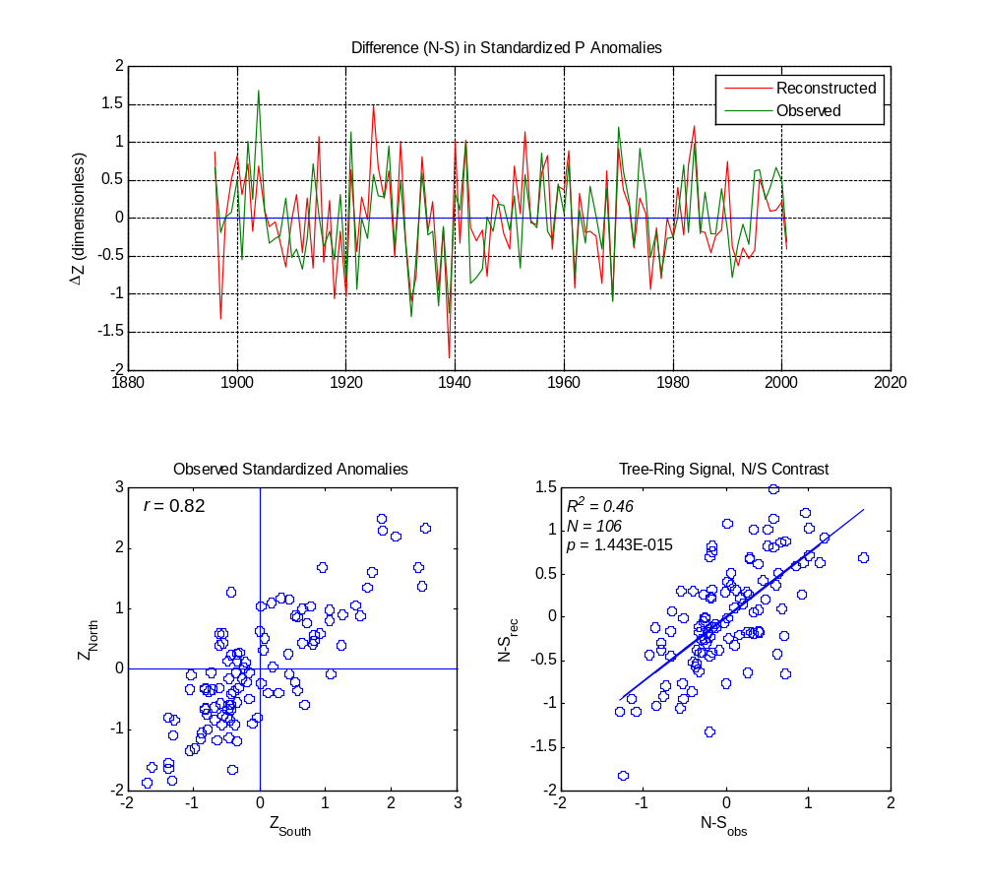
Tree-Ring Signal for North-South Contrast
North Region – South Region
Analysis period 1901-2001
Time series plots: reconstructions generally appear to track observed variation in moisture contrast
Scatter of observed standardized anomalies: overwhelming tendency if for both regions wet or both regions dry, but some years of contrast, as evidenced by observations in UL and LR quadrants
Scatter of reconstructed difference (N-S) on observed difference (N-S): The regionally averaged reconstructions have a statistically significant signal for N/S difference in moisture anomaly – at least on this broad scale of North Region vs South Region
This result indicates the blue oak signal can yield useful information on spatial contrasts in moisture anomaly and not just on the overall wetness or dryness of the region
1932: dry north, wet south
by both obs and recon P
Notes:
Only 32 sites because the single-site recons for four sites did not cover 1699-2001
Because lags were included in the pool of potential predictors in single-site regressions, the single-site reconstructions may have slightly reduced (up to 2 years forward or backwards) coverage from the residual site chronologies that were the predictors for the models

Slide 19
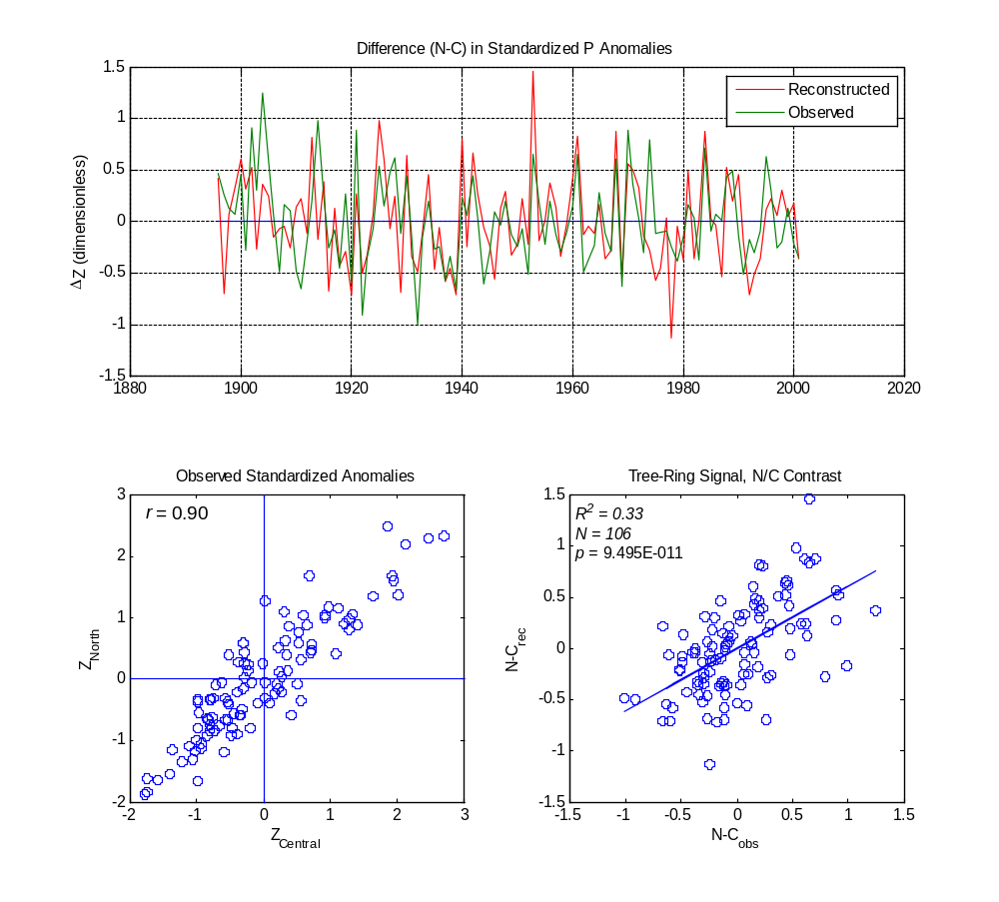
Tree-Ring Signal for North-South Contrast
North Region – Central Region
This summary as in the previous slide, , except that the contrast is between the North and Central Regions
Main differences from the N-S results:
  Observed standardized anomalies in Nov-Apr P are more highly correlated for this pair of regions (r=0.90 vs r=0.82)
  Tree-ring signal for contrast in anomalies is weaker, but still statistically significant
Notes:
Only 32 sites because the single-site recons for four sites did not cover 1699-2001
Because lags were included in the pool of potential predictors in single-site regressions, the single-site reconstructions may have slightly reduced (up to 2 years forward or backwards) coverage from the residual site chronologies that were the predictors for the models

Slide 20
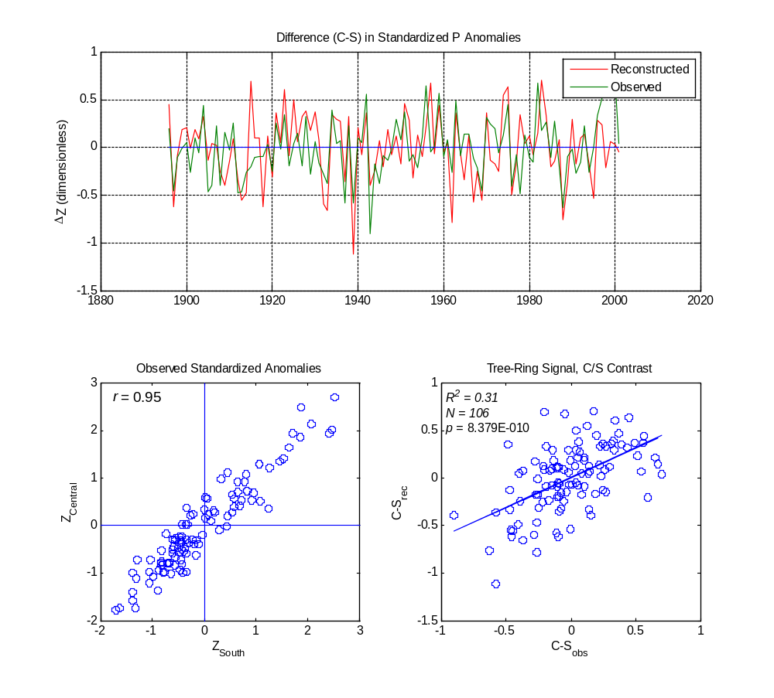
Tree-Ring Signal for North-South Contrast
Central Region – South Region
This is identical summary as in the previous slide, except that the contrast is between the Central and South Regions
Main differences from the N-C results:
  Observed standardized anomalies in Nov-Apr P are more highly correlated for this pair of regions (r=0.95 vs r=0.90)
  Tree-ring signal for contrast in anomalies is weaker, but still statistically significant
Notes:
Only 32 sites because the single-site recons for four sites did not cover 1699-2001
Because lags were included in the pool of potential predictors in single-site regressions, the single-site reconstructions may have slightly reduced (up to 2 years forward or backwards) coverage from the residual site chronologies that were the predictors for the models

Slide 21
Tree-Ring Signal for North-South Contrast
Summary
Observed cool-season (Nov-Apr) precipitation is highly correlated from north to south over the blue oak domain in California; the correlation appears to be higher between the central and southern parts than between the northern and central parts
The high inter-regional correlation in precipitation is a challenge if tree-ring data are to reflect spatial gradients in a anomalies that might be related to shifting storm tracks.
This analysis has shown that the blue oak signal for cool-season precipitation is strong enough to give information on time series variations in north-south differences in moisture anomaly on the large scale of the three regions defined here.
It appears justified therefore to examine the tree-ring record for long-term information on moisture contrasts – e.g., drier north and wetter south, as well as for the overall wetness or dryness of the entire blue oak domain.
Notes:
Only 32 sites because the single-site recons for four sites did not cover 1699-2001
Because lags were included in the pool of potential predictors in single-site regressions, the single-site reconstructions may have slightly reduced (up to 2 years forward or backwards) coverage from the residual site chronologies that were the predictors for the models

