Slide 1
Multi-Basin Drought and Arizona Water Supply
A Tree-Ring Perspective
Dave Meko
Katie Hirschboeck
Elzbieta Czyzowska,
Jennifer Lee
Kiyomi Morino
Laboratory of Tree-Ring Research, University of Arizona
Funding from The Salt River Project
A
22nd Pacific Climate Workshop, March 26-29, 2006
Asilomar State Beach & Conference Grounds , Pacific Grove , California
U

Slide 2
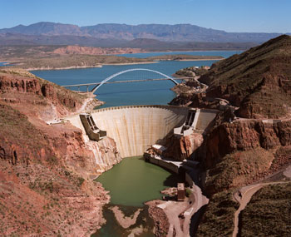
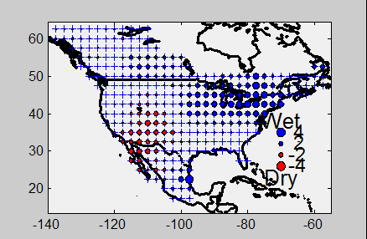
Roosevelt Dam
Reconstructed PDSI
Average for 1902-1904
Data from: http://www.ncdc.noaa.gov/paleo/pdsi.html
Capacity = 1.6 million acre-ft
Constructed 1905-1911
(http://www.usbr.gov/dataweb/dams/az10317.htm)

Slide 3
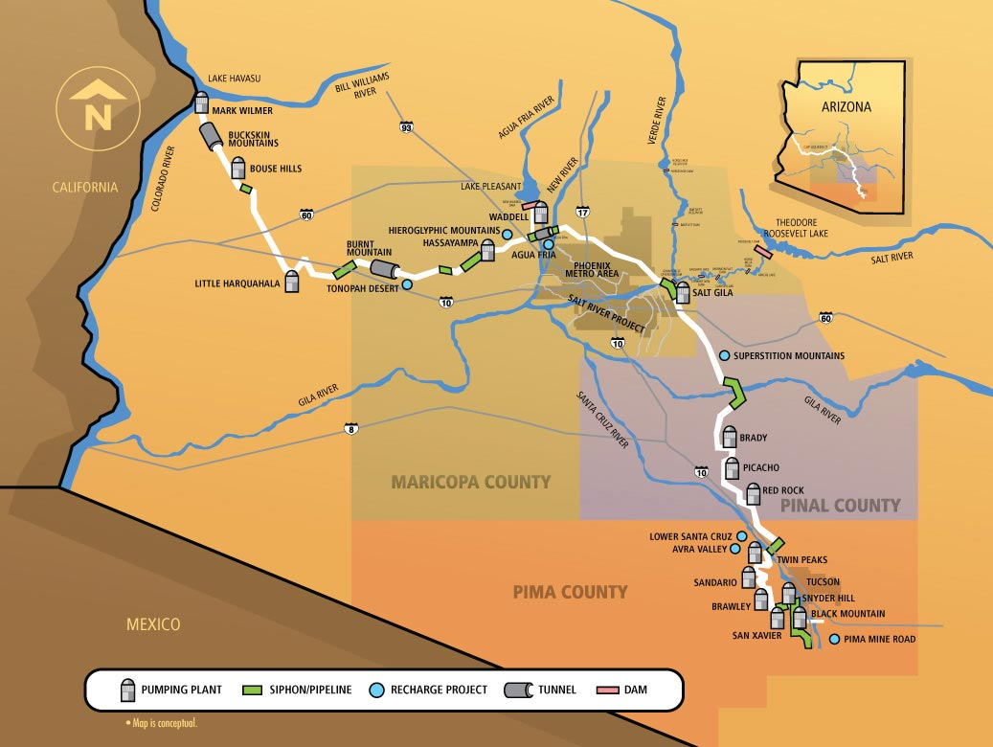
Colorado River as Buffer?
Central Arizona Project (CAP)
Important REMOTE supplemental source of water: Colorado River
Helped out in recent drought
Two widely separate source regions for water
What is risk of double-whammy?
SRP-sponsored tree-ring study
http://www.cap-az.com/
http://fp.arizona.edu/khirschboeck/srp.htm

Slide 4
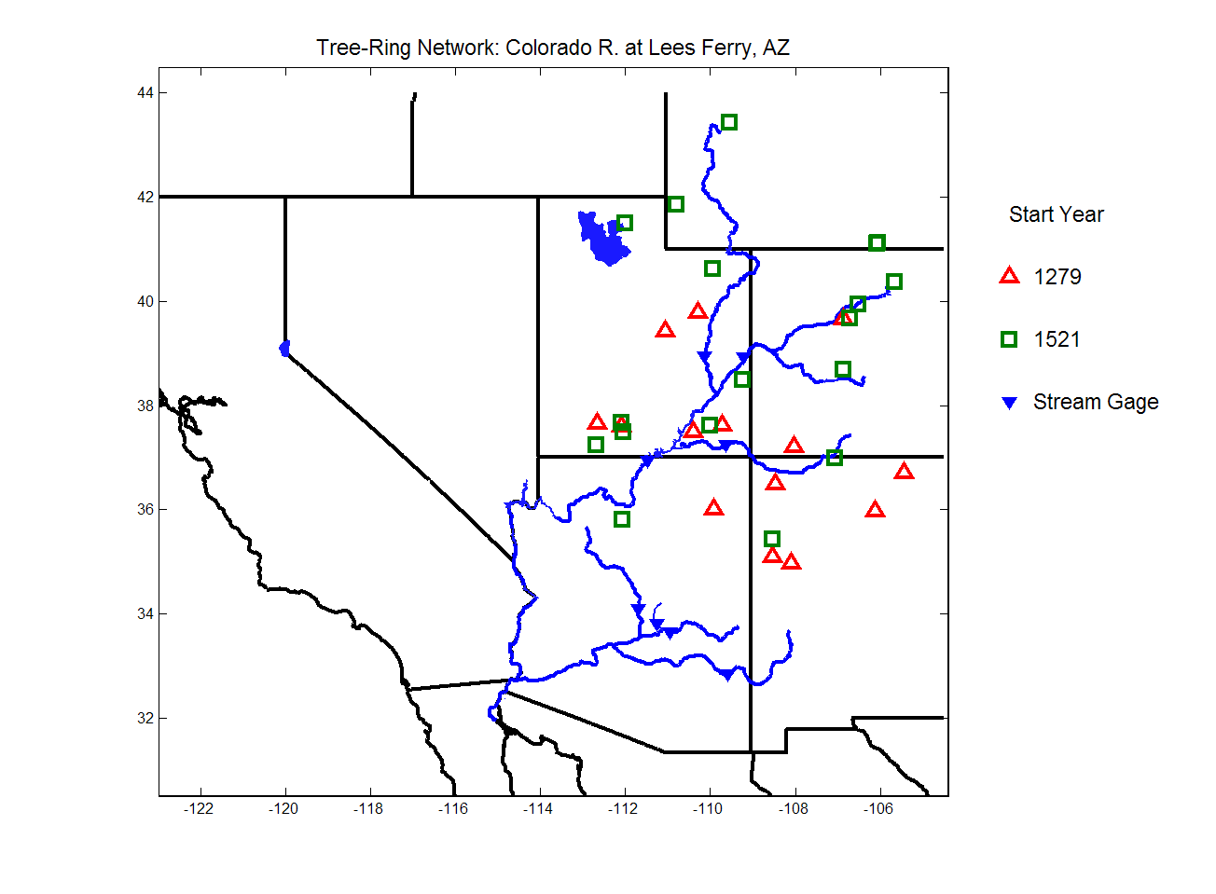
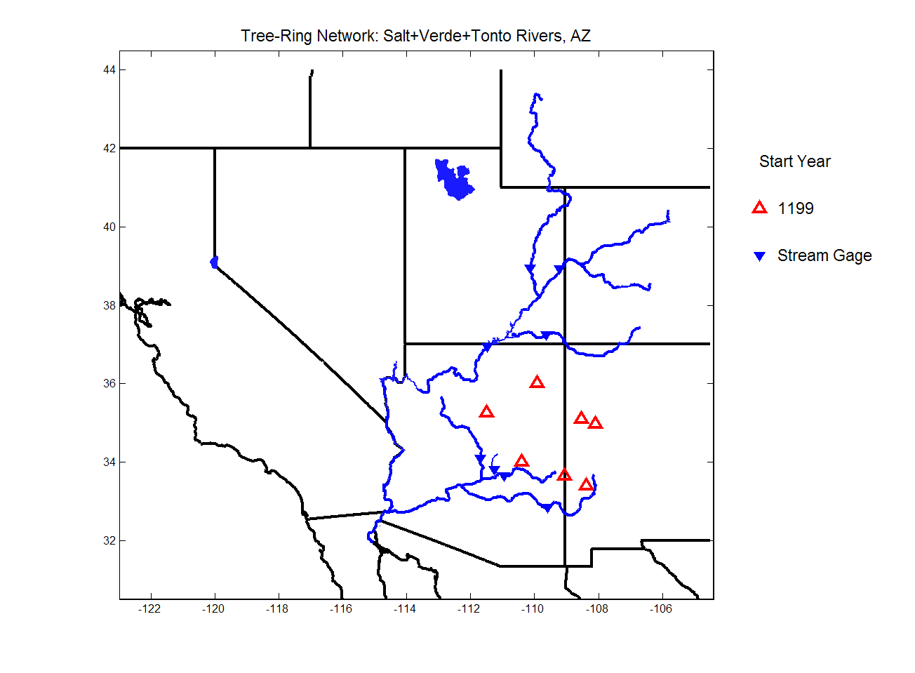
Tree Ring Networks
Upper Colorado Basin
Salt, Verde, & Tonto Basins
Sub-period networks
1279-1964
1521-1964
A.D. 1199-1988

Slide 5
Reconstruction Model
Watershed boundary as guide
Time coverage from target droughts
Select tree-ring sites
Converts each chronology into separate estimate of the streamflow series using distributed-lag regression
Single-site regression/reconstruction
Condenses common modes of variability in the single-site reconstructions
Run on the covariance matrix to retain importance of chronology differences in explained streamflow variance
PCA data reduction
Multi-site regression/reconstruction
Weights the modes of variation in single-site reconstructions into best estimate of streamflow

Slide 6
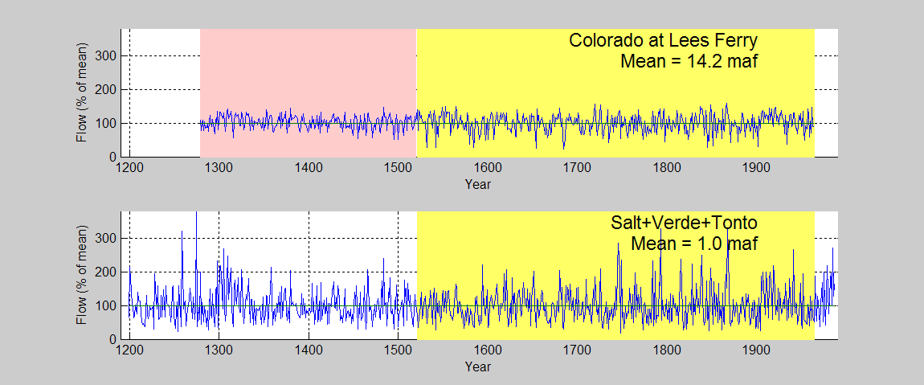
Reconstructed Flows
R²=0.77
RE=0.74
R²=0.70
RE=0.68
Speculative
Common Period = 1521-1964

Slide 7
Defining Joint Drought *
Colorado (north) / Salt-Verde-Tonto (south)
LH = Dry Colo, Wet Salt-Verde
HL = Wet Colo, Dry Salt-Verde
HH = Wet in both basins
LL = Dry in both basins
* Thresholds for L, H defined by 25th and 75th percentiles of annual flows

Slide 8
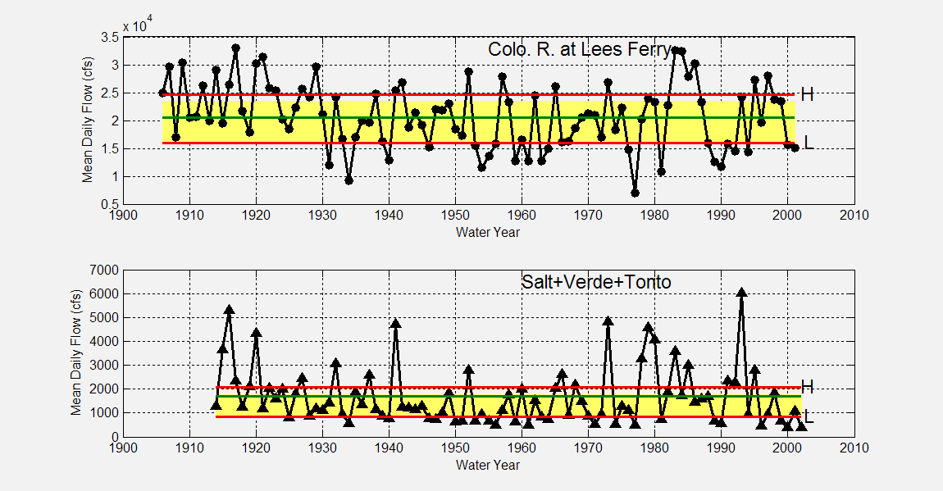
Observed Flows & Thresholds
Thresholds from
observed flows
Thresholds from
reconstructed flows
Notes:
2 reasons for discrepancy: (1) longterm mean (2) lower variance in reconstruction
25th & 75th percentile threshold comparison
of Observed (red lines) vs. Reconstructed (shaded) Series
(1914-2001) vs. (1521-1964)
Observed means: Lees = 20564 cfs; SVT= 1687 cfs
Plotted mean lines are for 1914-2001 mean of observed for both plots

Slide 9
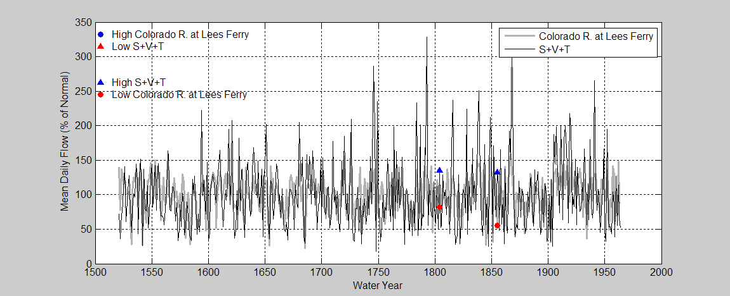
Reconstructed Flows: HL and LH Events
Probability (HL) = 0 / 444 = 0
Probability (LH) = 67 / 444 = 0.004

Slide 10
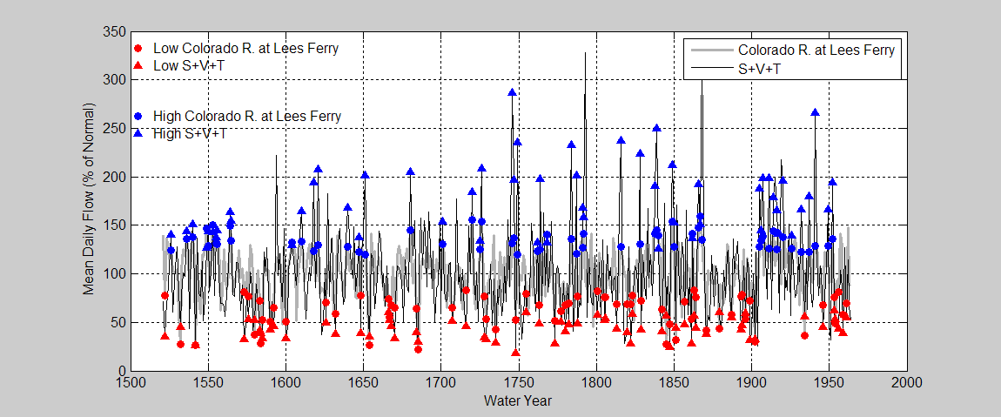
Reconstructed Flows: LL and HH Events
Probability (HH) = 57 / 444 = 0.128
Probability (LL) = 66 / 444 = 0.149

Slide 11
Clustering of LL and HH Events
Over the period 1521-1964 | LL # events / # possible (probability) | HH # events / # possible (probability)
Individual 1-yr events | 66 / 444 (0.149) | 57 / 444 (0.128)
2 consecutive yrs | 11 / 443 (0.025) | 14 / 443 (0.032)
3 consecutive years | 2 / 442 (0.005) | 3 / 442 (0.007)
2 yrs (within a moving 3-yr window) | 27 / 442 (0.061) | 26 / 442 (0.059)
3 yrs (within a moving 4-yr window) | 9 / 441 (0.020) | 9 / 441 (0.020)
4 yrs (within a moving 5-yr window) | 1 / 440 (0.002) | 0 / 440 (0.002)
Single occurrence of a synchronous extreme year (LL or HH) event ➔
CLUSTERING of synchronous extreme years within an
n-year moving window

Slide 12
Storage → Look at Low Frequencies
Colorado River (L. Mead and above)
  14 reservoirs with capacity > 18 kafª
  61.4 maf of storage (~ 4.1 years of storage)
Salt + Verde + Tonto Rivers
  4 reservoirs on Salt River, 2 on Verde River^{b}
  2.7 maf of storage (~ 2.7 years of storage)
ªHarding B. L., Sangoyomi T. B. and Payton E. A. (1995) Impacts of a severe sustained drought on Colorado River water resources. Water Resources Bulletin 316(5), 815-824 ^{b}http://www.usbr.gov/dataweb/html/saltriver.html#general

Slide 13
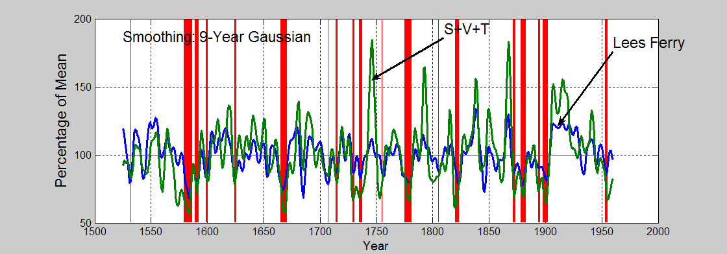
Joint Lows in Smoothed Reconstruction
Smoothed series simultaneously below 0.25 quantile
Notes:
F3 from spectra_cross , then hand-edited
0.25 quantile joint marked in red

Slide 14
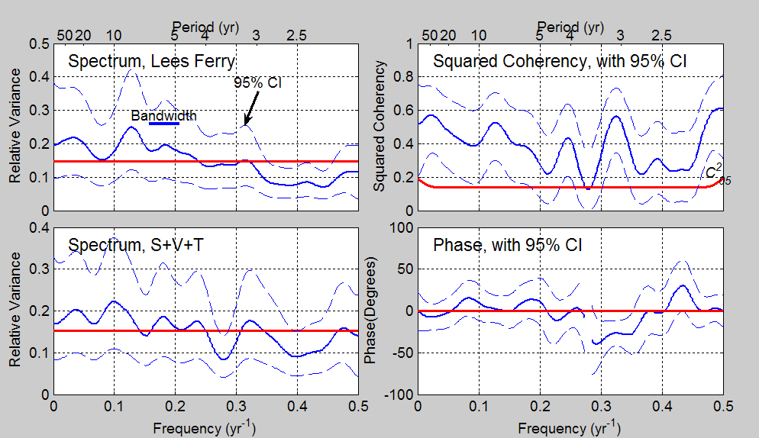
Cross Spectral Analysis, 1521-1964
Lees Ferry and Salt+Verde+Tonto
Notes:
F3 from spectra_cross , then hand-edited
0.25 quantile joint marked in red

Slide 15
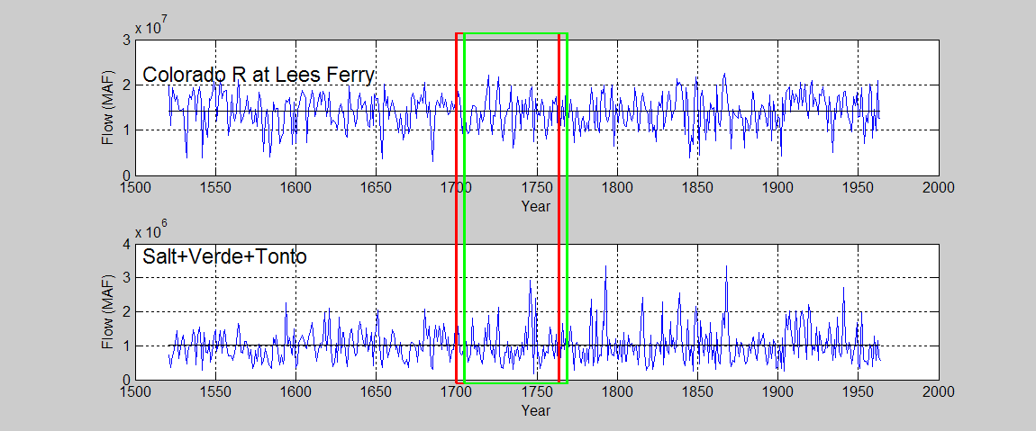
Correlation and Cross Spectrum in
Sliding Time Window
5 yr
65 yr

Slide 16
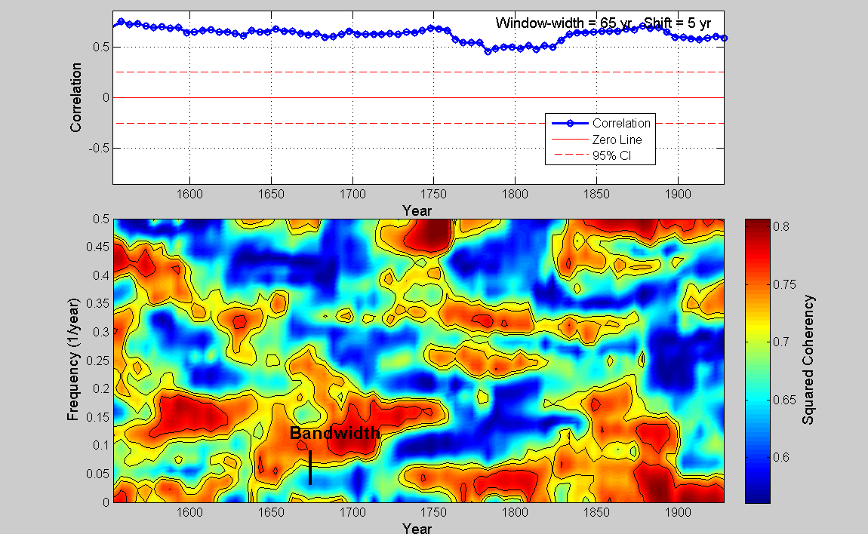
Windowed Correlation and Coherency

Slide 17
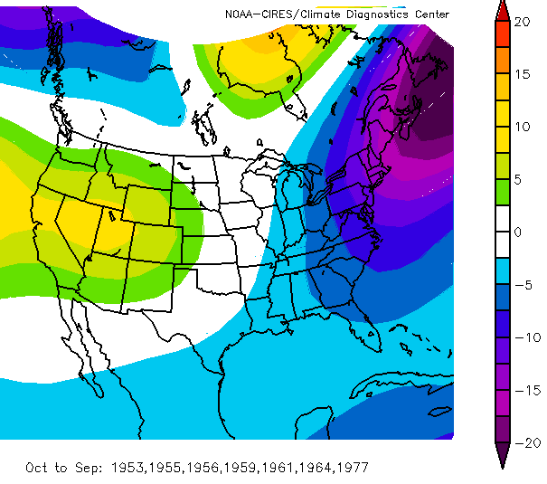
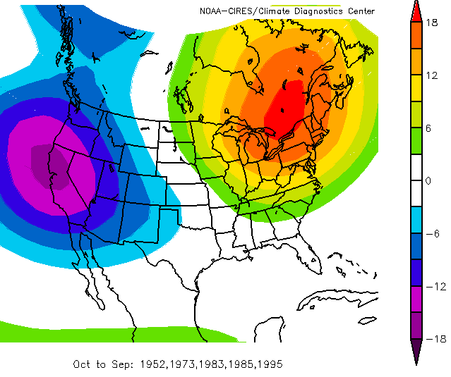
Climate
500 mb Height Anomalies
(LL and HH years from observed flows)
LL WATER YEARS
HH WATER YEARS
HIGH
PRESSURE
LOW PRESSURE
HIGH PRESSURE
higher-than-normal pressure over both basins
lower-than-normal pressure over both basins
500 mb Geopotential Height (m) Composite Anomaly, Oct-Sep water year

Slide 18
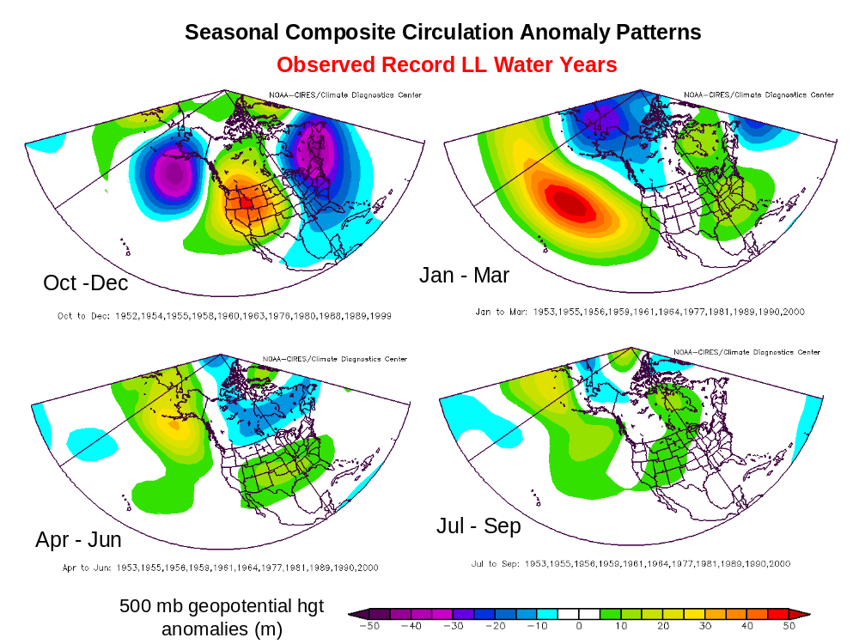
LL 500 mb Anomalies by Season

Slide 19
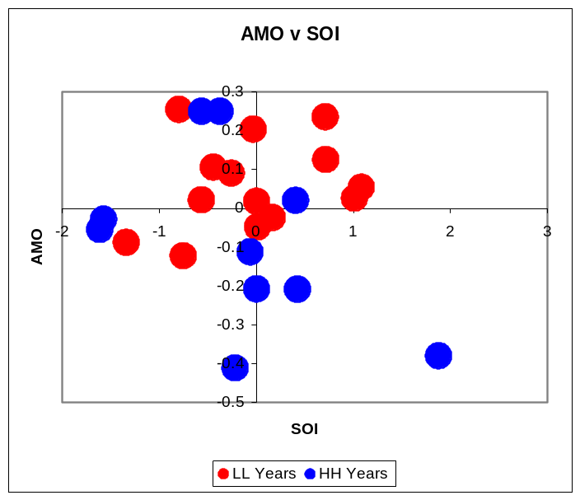
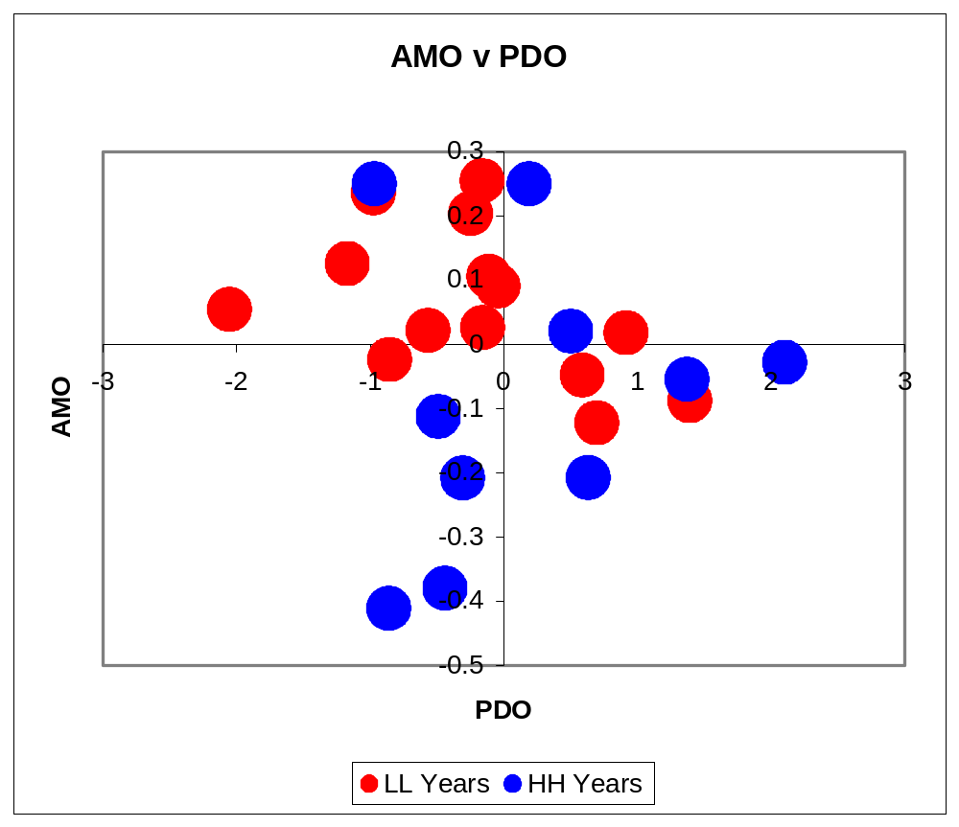
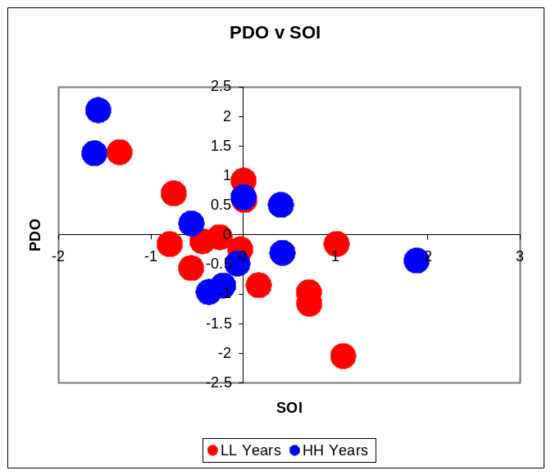
Link to Sea Surface Temperature Indices?
+ AMO
+ AMO
(warm North Atlantic)
- AMO
El Niño
La Niña
- AMO
(cool North Atlantic)
Relationships less clear w/ other indices
– PDO (cool phase)
+ PDO (warm phase)
+ PDO
PDO / AMO Hypothesis supported in many, but not all, LL events of last century
- PDO
El Niño
La Niña

Slide 20
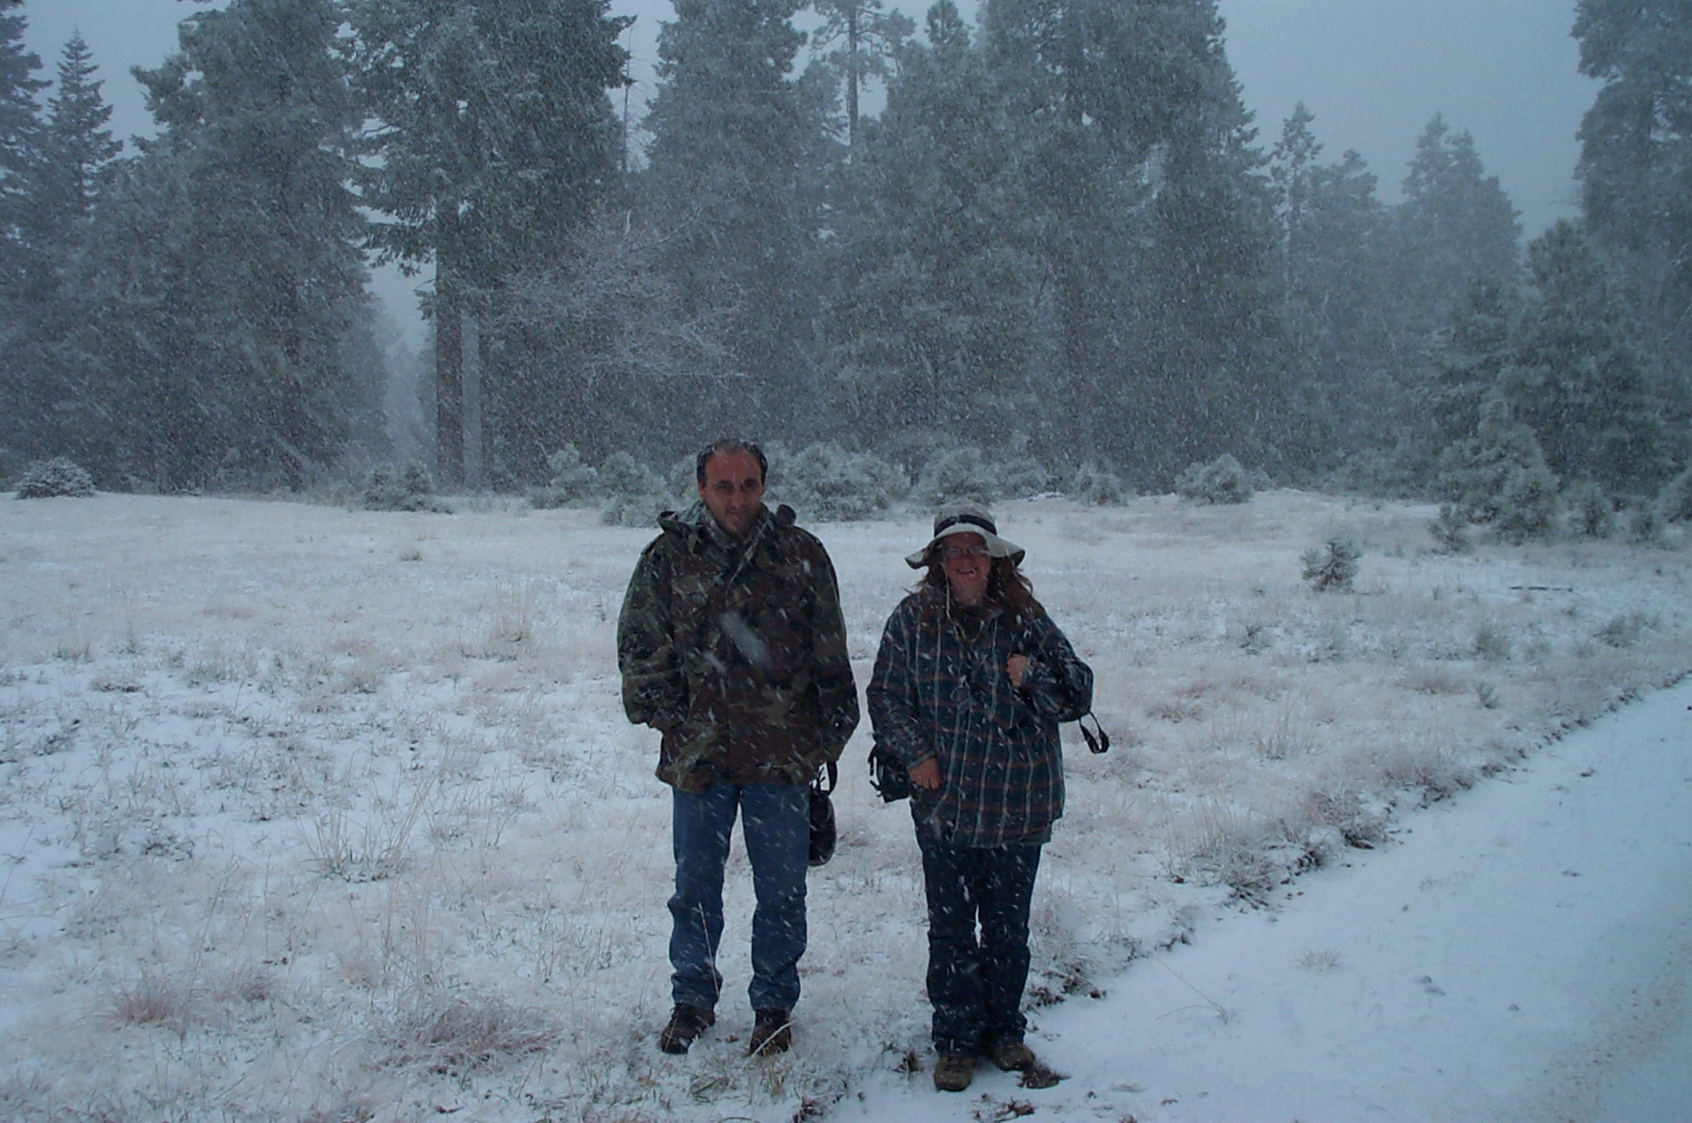
This Year?
Nov 11, 2005, Mogollon Rim N of Payson, AZ

Slide 21
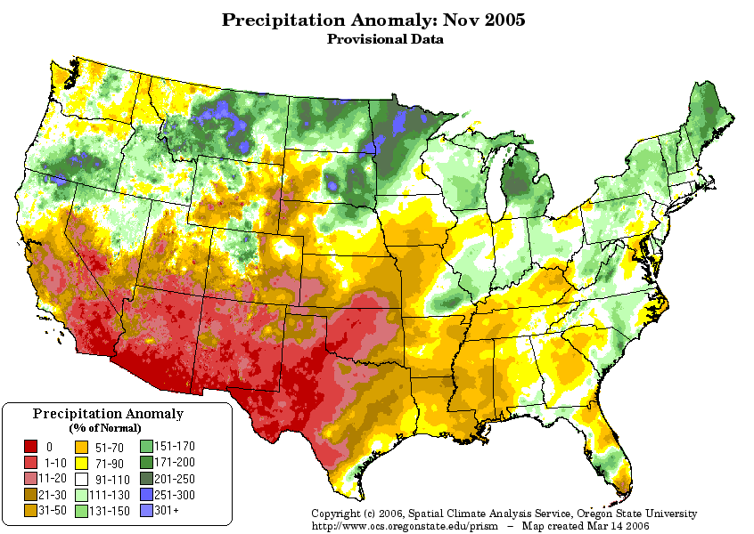
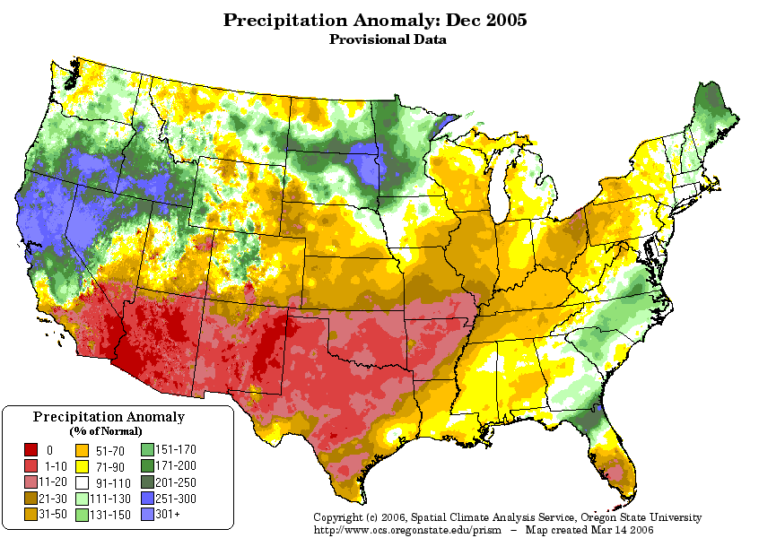
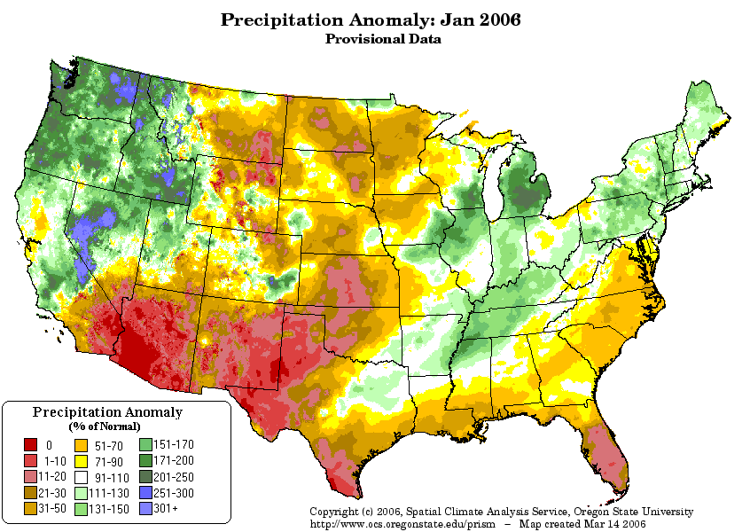
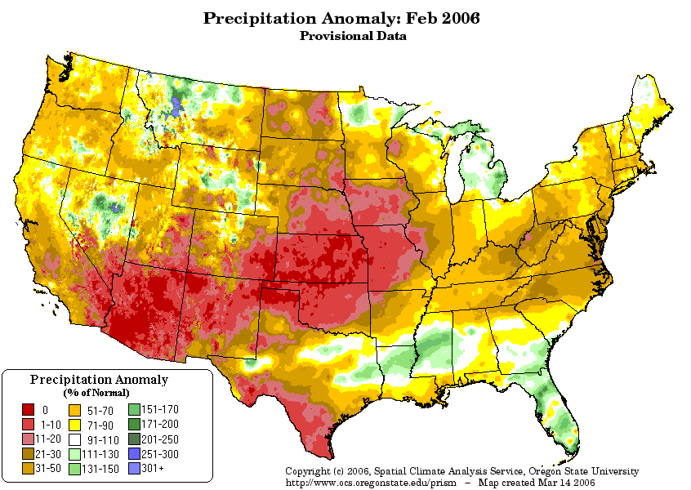
Precipitation Anomalies (% normal)
Nov 2005
Dec 2005
Jan 2006
Feb 2006
http://www.ocs.oregonstate.edu/prism/products/matrix.phtml?view=data

Slide 22
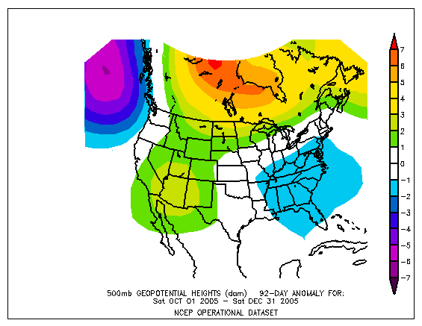
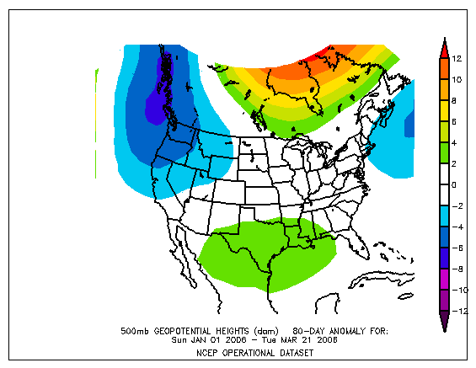
500mb Height Anomaly
Oct – Dec, 2005
Jan – Mar 21, 2006

Slide 23
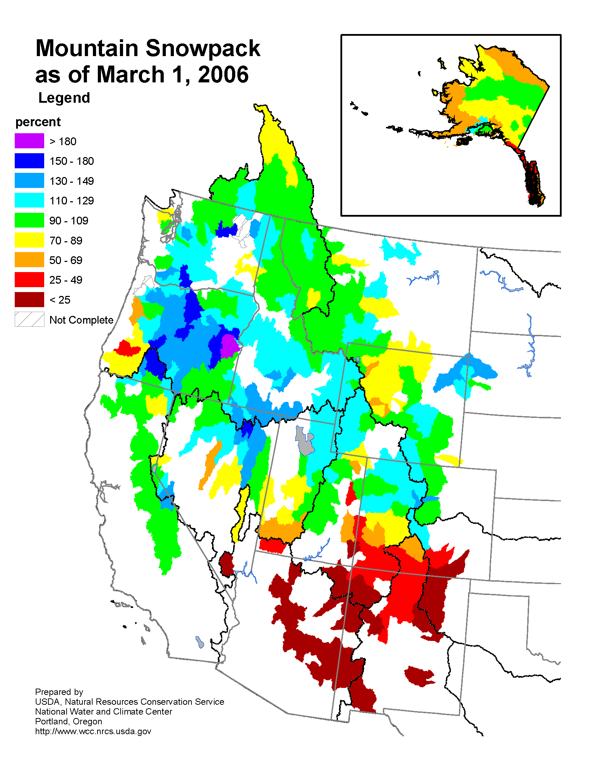
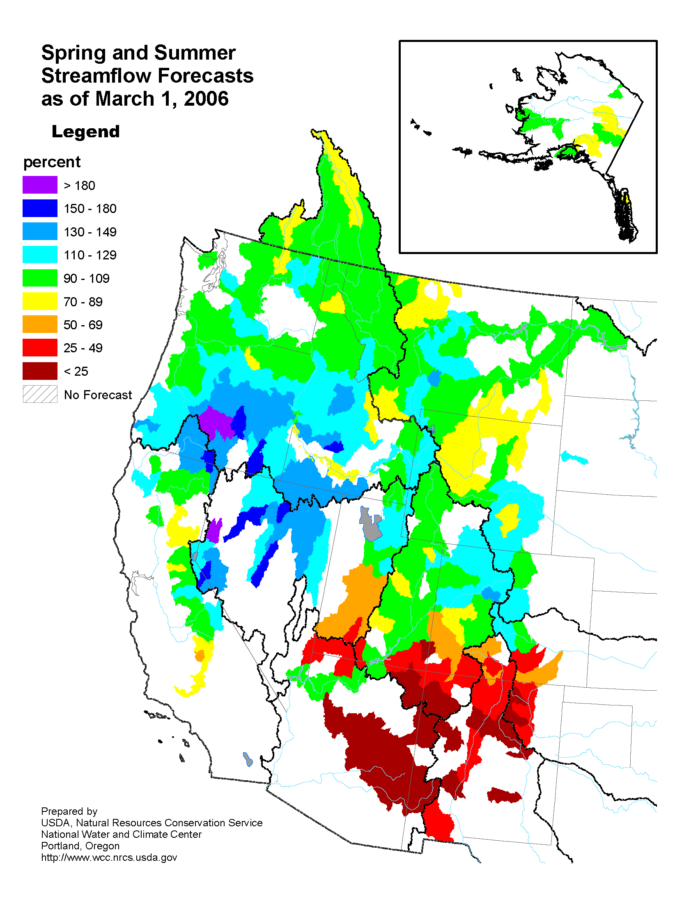
March 1, 2006, Assessment
Snowpack
Streamflow Forecast
http://www.wcc.nrcs.usda.gov/wsf/westwide.html

Slide 24
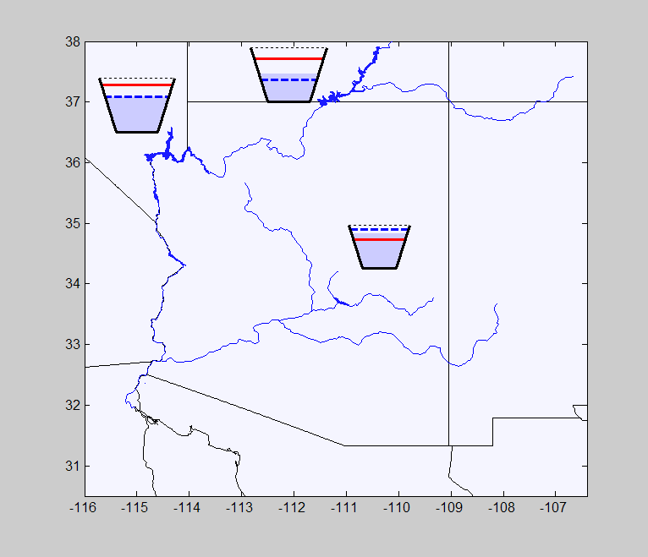
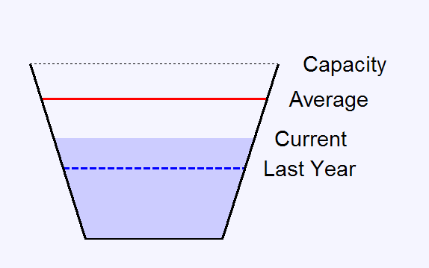
Reservoir Storage, End of Feb 2006
Reservoir | Average Storage (maf) | 2006 (% of Ave)
L. Mead | 22.1 | 70
L. Powell | 18.2 | 59
Salt-Verde (2 res) | 1.4 | 127
Data from: ftp://ftp.wcc.nrcs.usda.gov/data/water/basin_reports/arizona/wy2006/barsaz2.txt
Notes:
Capacity: Mead = 26.1 maf, Powell = 24.3 maf, SV = 2.3 maf
Plots from respmap.m on reservoirs.txt data

Slide 25
Conclusions
Water deficits due to Arizona droughts are unlikely to be offset by water excesses in the UCRB
Reservoir storage and the high volume water supply of the large UCRB may allow continued buffering during climate stress
Increasing demand and climatic change are additional factors that may exacerbate the effects of joint drought
Preliminary examination of El Niño, La Niña influences and ocean indices such as the Pacific Decadal Oscillation (PDO), and the Atlantic Multidecadal Oscillation (AMO)suggest linkage to some – but not all joint droughts

