Slide 1



Units Markup Language (UnitsML)
Open Forum 2003 on Metadata Registries
4:15 - 4:45 pm
Wednesday, January 22, 2003
Bob Dragoset
National Institute of Standards and Technology

Slide 2
Outline
Introduction
Background information on units and quantities
UnitsML
  Instance documents for SI units
  XML schema for measurement units markup
Repository containing measurement unit information
  XML schema for repository submissions
  Will offer to publish in NIST XML registry/repository
Issues
Future

Slide 3
Introduction
Units Markup Language (UnitsML) is a proposed method of representing scientific units of measure in XML.
Original motivation for this project came from initial effort by Frank Olken and John McCarthy of the Lawrence Berkeley National Laboratory (LBNL).
Collaborators:
  Barry Taylor (NIST,emeritus)
  Michael McLay (NIST)
  Frank Olken (LBNL)
  Peter Murray-Rust (CML - Chemical Markup Language)
Funded in part by NIST's Systems Integration for Manufacturing Applications (SIMA) program.
  http://www.nist.gov/sima

Slide 4
Introduction (cont.)
VISION
XML schema(s) available for incorporating UnitsML into XML documents for encoding scientific units of measure.
Extensive XML repository containing schemas and information on units, quantities, prefixes.
Design of schemas and repository to facilitate unit information processing:
  validating documents for self-consistent usage of units, quantities, and prefixes
  unit conversion and manipulation

Slide 5
Background Information on Units and Quantities

Slide 6
7 SI Base Units
& Quantities
SI defines
7 base units
Unit Name | Unit Symbol | Base Quantity | Quantity Symbol | Dimension Symbol
meter | m | length | l | L
kilogram | kg | mass | m | M
second | s | time | t | T
ampere | A | electric current | I | I
kelvin | K | thermodynamic temperature | T | Θ
mole | mol | amount of substance | n | N
candela | cd | luminous intensity | I_{v} | J
Examples: l = 7.24 m v = 6.32 m/s
m = 1.53 kg dim v = L T⁻¹

Slide 7
22 SI Special Derived Units
Derived quantity | Special name | Special Symbol | Expression in terms of
 |  |  | other SI units | SI base units
plane angle | radian | rad |  | m · m⁻¹ = 1
solid angle | steradian | sr |  | m² · m⁻² = 1
frequency | hertz | Hz |  | s⁻¹
force | newton | N |  | m · kg · s⁻²
pressure, stress | pascal | Pa | N/m² | m⁻¹ · kg · s⁻²
energy, work, quantity of heat | joule | J | N · m | m² · kg · s⁻²
power, radiant flux | watt | W | J/s | m² · kg · s⁻³
electric charge, quantity of electricity | coulomb | C |  | s · A
electric potential, potential difference, electromotive force | volt | V | W/A | m² · kg · s⁻³ · A⁻¹
capacitance | farad | F | C/V | m⁻² · kg⁻¹ · s⁴ · A²
electric resistance | ohm | Ω | V/A | m² · kg · s⁻³ · A⁻²
electric conductance | siemens | S | A/V | m⁻² · kg⁻¹ · s³ · A²

Slide 8
22 SI Special Derived Units (cont.)
Derived quantity | Special name | Special Symbol | Expression in terms of
 |  |  | other SI units | SI base units
magnetic flux | weber | Wb | V · s | m² · kg · s⁻² · A⁻¹
magnetic flux density | tesla | T | Wb/m² | kg · s⁻² · A⁻¹
inductance | henry | H | Wb/A | m² · kg · s⁻² · A⁻²
Celsius temperature | degree Celsius | °C |  | K
luminous flux | lumen | lm | cd · sr | cd · sr
illuminance | lux | lx | lm/m² | m⁻² · cd · sr
activity (of a radionuclide) | becquerel | Bq |  | s⁻¹
absorbed dose, specific energy (imparted), kerma | gray | Gy | J/kg | m² · s⁻²
dose equivalent, et al. | sievert | Sv | J/kg | m² · s⁻²
catalytic activity | katal | kat |  | s⁻¹ · mol
There are also many derived quantities with units without special names; e.g., the quantity area has units of m².

Slide 9
UnitsML
  Example instance documents for unit markup
  Complex instance document illustrating an XML schema for measurement units markup

Slide 10
Instance Documents
Simple Examples, i.e., contains base SI units:
1. <physicalQuantity name="tableLength">1.75 m</physicalQuantity>
2. <physicalQuantity name="tableLength">
<value>1.75</value>
<units>m</units>
</physicalQuantity>
3. <physicalQuantity name="tableMass" value="18.5" units="kilogram" />
Not so simple example, i.e., contains derived units:
4. <physicalQuantity name="specialAcceleration">
<value>100</value>
<units>mm·µs^-2</units>
</physicalQuantity>
Why not use MathML to markup these units?

Slide 11
Complex Instance Document
Usage within a document:
<physicalQuantity name="specialAcceleration"
value="100"
unitIDRef="millimeterPerMicrosecondSquared" />
Definition within a document:
<derivedUnit unitID="millimeterPerMicrosecondSquared"
quantityRef="acceleration">
<unitsML:units>
<unit name="meter" prefix="milli" power="1" system="SI" />
<unit name="second" prefix="micro" power="-2" system="SI" />
</unitsML:units>
</derivedUnit>
Alternatively, one could use unit & prefix symbols rather than unit & prefix names.

Slide 12
XML Repository
Detailed instance documents and graphics representing an XML schema for repository submissions and extractions.

Slide 13
Repository Hierarchy
http://unitsml.nist.gov/version
/units/SI/base
/units/SI/specialDerived
/units/SI/coherentDerived
/units/customary
/quantities
/prefixes/SI
/prefixes/binary
/symbols/units
/symbols/prefixes
/symbols/quantities
/symbols/dimensions
/tools
No expected submissions for prefixes.

Slide 14
Defined Namespaces
Units
  xmlns:SI ="http://units.nist.gov/2003/01/units/SI"
  xmlns:cu ="http://units.nist.gov/2003/01/units/customary"
  …
Prefixes
  xmlns:pre ="http://units.nist.gov/2003/01/prefixes"
Quantities
  xmlns:q ="http://units.nist.gov/2003/01/quantities"
Symbols
  xmlns:usym ="http://units.nist.gov/2003/01/symbols/units"
  xmlns:psym ="http://units.nist.gov/2003/01/symbols/prefixes"
  xmlns:qsym ="http://units.nist.gov/2003/01/symbols/quantities"
  xmlns:dsym ="http://units.nist.gov/2003/01/symbols/dimensions"
May use "href"s rather than namespaces,
(other than a single, default UnitsML namespace).
This is really a processing issue.

Slide 15
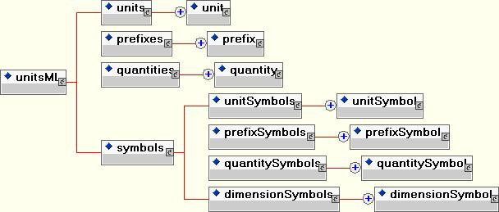
UnitsML Schema Diagram

Slide 16
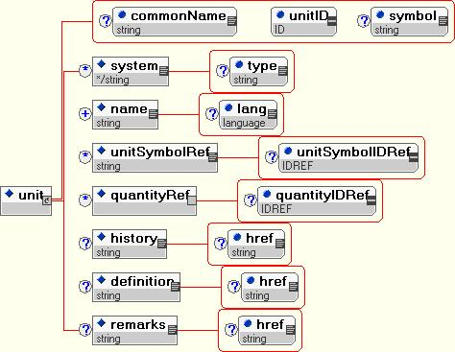
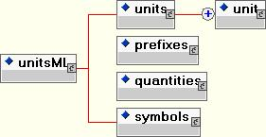
UnitsML Schema Diagrams
- unit -

Slide 17
Details of a Single SI Base Unit
- Meter -
<units xmlns="http://units.nist.gov/2003/01/units/SI"
xmlns:q="http://units.nist.gov/2003/01/quantities"
xmlns:usym="http://units.nist.gov/2003/01/symbols/units" >
<unit commonName="meter" unitID="unit0001" symbol="m">
<system type="base">SI</system>
<name xml:lang="en-US" >meter</name>
<name xml:lang="en-GB" >metre</name>
<name xml:lang="fr" >mètre</name>
<unitSymbolRef unitSymbolIDRef="usym:symbol0001">m</unitSymbolRef>
<quantityRef quantityIDRef="q:quantity0001" />
<history href="http://…">…</history>
<definition href="http://…">…</definition>
<remarks href="http://…">…</remarks>
</unit>
</units>
XML documents containing IDREFs can only be validated with an XML schema if the corresponding IDs are present.

Slide 18
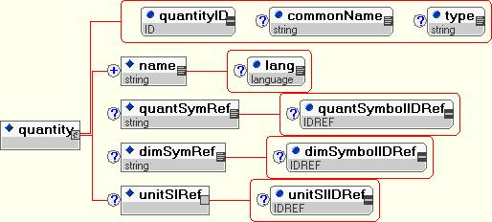
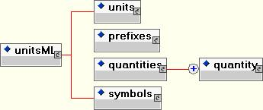
UnitsML Schema Diagrams
- quantity -
No "system" element!
How do we handle repository submissions for domain specific quantities, e.g., slew rate?

Slide 19
Quantities for 7 Base Units
XML Repository
<quantities xmlns="http://units.nist.gov/2002/01/quantities"
xmlns:qsym="http://units.nist.gov/2002/01/symbols/quantities"
xmlns:dsym="http://units.nist.gov/2002/01/symbols/dimensions" >
  <quantity quantityID="quantity0001" commonName="length" type="base">
<name xml:lang="en-US">length</name>
<quantSymRef quantSymbolIDRef="qsym:symbol0001">l</quantSymRef>
<dimSymRef dimSymbolIDRef="dsym:symbol0001">L</dimSymRef>
<unitSIRef unitSIIDRef="SI:unit0001" />
</quantity>
<quantity name="mass" symbol="m" dimensionSymbol="M" />
<quantity name="time" symbol="t" dimensionSymbol="T" />
<quantity name="electric current" symbol="I" dimensionSymbol="I" />
<quantity name="thermodynamic temperature" symbol="T" dimensionSymbol="Θ" />
<quantity name="amount of substance" symbol="n" dimensionSymbol="N" />
<quantity name="luminous intensity" symbol="I_{v}" dimensionSymbol="J" />
</quantities>
Mixed typefaces and subscripts not allowed in attributes.

Slide 20
Special Derived Units
XML Repository - Examples
<units system="SI" xmlns="http://units.nist.gov/2002/01/units/SI"
xmlns:usym="http://units.nist.gov/2002/01/symbols/units" >
<unit type="specialDerived" commonName="joule" symbol="J" unitID="unit0060" >
<unitRef unitIDRef="newton" power="1" />
<unitRef unitIDRef="meter" power="1" />
<symbolRef unitSymbolIDRef="usym:symbol0060" />
</unit>
<unit type="specialDerived" commonName="volt" symbol="V" unitID="unit0070" >
<unitRef unitIDRef="watt" power="1" />
<unitRef unitIDRef="ampere" power="-1" />
<symbolRef unitSymbolIDRef="usym:symbol0070" />
</unit>
<unit type="specialDerived" commonName="radian" symbol="rad" unitID="unit0080" >
<unitRef unitIDRef="meter" power="1" />
<unitRef unitIDRef="meter" power="-1" />
<symbolRef unitSymbolIDRef="usym:symbol0080" />
</unit>
</units>
N · m
m² · kg · s⁻²
W/A
m² · kg · s⁻³ · A⁻¹
m · m⁻¹ = 1

Slide 21
Quantities for Special Derived Units
XML Repository
<quantities
xmlns="http://units.nist.gov/2002/01/quantities" xmlns:qsym="http://units.nist.gov/2002/01/symbols/quantities"
xmlns:SI="http://units.nist.gov/2002/01/units/SI" >
<quantity quantityID="quantity0050" commonName="energy" type="derived">
<name xml:lang="en-US">energy</name>
<quantSymRef quantSymbolIDRef="qsym:symbol0100" />
<unitSIRef unitSIIDRef="SI:unit0060" />
</quantity>
<quantity name="work" unit="joule" />
<quantity name="quantityOfHeat" unit="joule" />
<quantity name="voltage" unit="volt" />
<quantity name="electricPotential" unit="volt" />
<quantity name="electricPotentialDifference" unit="volt" />
<quantity name="electromotiveForce" unit="volt" />
<quantity name="electricTension" unit="volt" />
<quantity name="planeAngle" unit="radian" />
</quantities>
V
V_{emf}

Slide 22
SI Coherent Derived Units
XML Repository?
<units xmlns="http://units.nist.gov/2002/01/units/SI" >
<unit commonName="squareMeter" unitID="unit1000" symbol="m^2">
<system type="derived">SI</system>
<name xml:lang="en-US">square meter</name>
<unitRef unitIDRef="unit0001" power="2"/>
</unit>
<unit commonName="meterPerSecond" unitID="unit1010" symbol="m/s^-1">
<system type="derived">SI</system>
<name xml:lang="en-US">meter per second</name>
<unitRef unitIDRef="unit0001" />
<unitRef unitIDRef="unit0003" power="-1"/>
</unit>
</units>
To what extent will the repository be populated with coherent derived units and their associated symbols?

Slide 23
Quantities for
SI Coherent Derived Units
<quantities system="SI" xmlns="http://units.nist.gov/2002/01/quantities"
xmlns:SI="http://units.nist.gov/2002/01/units/SI" >
<quantity commonName="area" commonUnit="squareMeter" symbol="A"
quantityID="quantity1000" >
<unitSIRef unitSIIDRef="SI:unit1000" />
</quantity>
<quantity commonName="speed" commonUnit="meterPerSecond" />
<quantity commonName="velocity" commonUnit="meterPerSecond" />
</quantities>
Adding symbols for derived quantities may be too ambitious!
Quantity symbols are not unique.
Example: Velocity is a vector quantity. In the English language, the magnitude of velocity is usually called speed. The symbols for velocity include υ and c. Also, the notation u, υ, w are recommended for the components of a velocity.
Example: The symbols for plane angle include , , , ☺, , ….

Slide 24
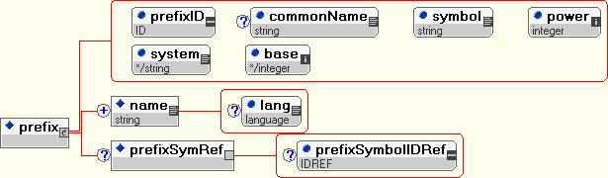
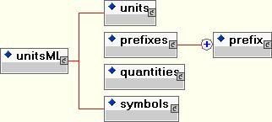
UnitsML Schema Diagrams
- prefix -

Slide 25
SI Prefixes
XML Repository
<prefixes xmlns="http://units.nist.gov/2002/01/prefixes"
xmlns:psym="http://units.nist.gov/2002/01/symbols/prefixes">
…
<prefix prefixID="prefix0004" commonName="mega" symbol="M"
power="6" system="SI" base="10">
<name xml:lang="en-US" >mega</name>
<prefixSymbolRef prefixSymbolIDRef="psym:symbol0004" />
</prefix>
<prefix name="kilo" symbol="k" power="3" />
<prefix name="hecto" symbol="h" power="2" />
<prefix name="deka" symbol="da" power="1" />
<prefix name="deci" symbol="d" power="-1" />
<prefix name="centi" symbol="c" power="-2" />
<prefix name="milli" symbol="m" power="-3" />
<prefix name="micro" symbol="µ" power="-6" />
…
</prefixes>
deka (U.S.)
deca (U.K.)
Not 7-bit ASCII,
but Unicode

Slide 26
Binary Prefixes
XML Repository
For information storage and transfer
<prefixes xmlns="http://units.nist.gov/2002/01/prefixes"
xmlns:psym="http://units.nist.gov/2002/01/symbols/prefixes" >
<prefix prefixID="prefix0050" commonName="kibi" symbol="Ki"
power="10" system="binary" base="2" >
<name xml:lang="en-US" >kibi</name>
<symbolRef prefixSymbolIDRef="psym:symbol0050" />
</prefix>
<prefix name="mebi" symbol="Mi" power="20" />
<prefix name="gibi" symbol="Gi" power="30" />
<prefix name="tebi" symbol="Ti" power="40" />
<prefix name="pebi" symbol="Pi" power="50" />
<prefix name="exbi" symbol="Ei" power="60" />
</prefixes>

Slide 27
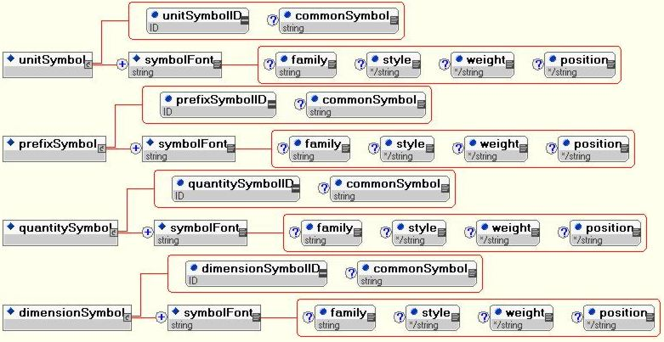
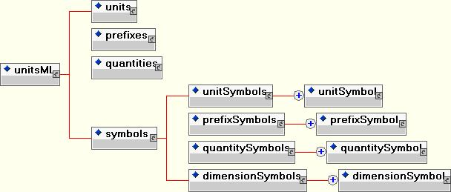
UnitsML Schema Diagrams
- symbols -

Slide 28
Unit & Prefix Symbols
XML Repository
<symbols>
<unitSymbols xmlns="http://units.nist.gov/2002/01/symbols/units" >
<unitSymbol unitSymbolID="symbol0001" commonSymbol="m">
<symbolFont family="serif" style="normal" weight="normal">m</symbolFont>
</unitSymbol>
</unitSymbols>
…
<prefixSymbols xmlns="http://units.nist.gov/2002/01/symbols/prefixes" >
<prefixSymbol prefixSymbolID="symbol0001" commonSymbol="m">
<symbolFont family="serif" style="normal" weight="normal">m</symbolFont>
</prefixSymbol>
</prefixSymbols>
</symbols>
m
m

Slide 29
Quantity & Dimension Symbols
XML Repository
An alternative markup scheme would be to use the presentation mode of MathML.
<symbols>
<quantitySymbols xmlns="http://units.nist.gov/2002/01/symbols/quantities">
<quantitySymbol quantitySymbolID="symbol0001" commonSymbol="l">
<symbolFont family="serif" style="italic" weight="normal">l</symbolFont>
</quantitySymbol>
<quantitySymbol quantitySymbolID="symbol0007" commonSymbol="I_v">
<symbolFont family="serif" style="italic" weight="normal">I</symbolFont>
<symbolFont family="serif" style="normal" weight="normal"
position="sub">v</symbolFont>
</quantitySymbol>
</quantitySymbols>
…
<dimensionSymbols xmlns="http://units.nist.gov/2002/01/symbols/dimensions" >
<dimensionSymbol dimensionSymbol ID="symbol0001" commonSymbol="L">
<symbolFont family="sans-serif" style="normal" weight="bold">L</symbolFont>
</dimensionSymbol>
<dimensionSymbol dimensionSymbol ID="symbol0005" commonSymbol="Θ">
<symbolFont family="sans-serif" style="normal" weight="bold">Θ</symbolFont>
</dimensionSymbol>
</dimensionSymbols>
</symbols>
l
I_{v}
L
Θ

Slide 30
UnitsML XML Schema

Slide 31
Issues
Unit, prefix, and quantity names are not standardized internationally (e.g., meter vs metre vs mètre).
  Solution: Inclusion of more than U.S. English spellings of names.
Symbols often require special fonts and characters
(e.g., unit °C, prefix µ, and quantity V_{emf} ).
  Notation for symbol representation: HTML/CSS and/or MathML.
Symbols are not available (or not standardized internationally) for all units or quantities.
  E.g., there is no defined symbol in SI for nautical mile.
Many quantities, units, and symbols are not unique and will be domain specific. Examples:
  “ t ” is the quantity symbol for time and Celsius temperature.
  “ " ” is a unit symbol for the second (plane angle) and inch.
  “second” is a unit name for time and plane angle.
  Note that symbols and names may be able to be distinguished by unit system or hierarchy (must manage namespaces).

Slide 32
Issues (Cont.)
If the user community is dependent upon our repository, how do we insure its constant availability?
  Solutions: Mirroring/caching and/or portable dictionaries.
Various (e.g., ISO, IEC) existing hierarchies for quantity names and symbols.
Inclusion of dimensions of quantities
(e.g., velocity, LT⁻¹; force, LMT⁻²).
  Dimensions of SI base quantities: L, M, T, I, Θ, N, and J.
Identify/develop appropriate tools for use with UnitsML.
  Units editor for generating markup.
  Software library for manipulating units.
  Software to validate user defined units against repository.
Education on use of units:
Quantities should not be mixed with units.
  flux = 100 neutrons/second
  neutron flux = 100/second

Slide 33
Processing Issues
SI Base unit “kilogram” is a combination of the prefix “kilo” and the unit “gram.”
If prefixes are applied at different “levels,” multiple prefixes (e.g., millikilometer) could occur. Possible solutions:
  Allow prefixes at only one level.
  Combine prefixes (e.g., millikilometer = meter).
  Convert leading prefixes to multiplier
  (e.g., millikilometer = 10⁻³ kilometer).
  Note: A prefix + unit can imply measurement range (e.g., kV/µs vs. GV/s).
Unit representation in symbolic manipulation in calculations.
  Units can be represented in the 7 SI base units, which is particularly useful when combining units in an equation. However, final representation of units may be more practical in special derived units. (e.g., m² · kg · s⁻² = N · m ).
  There are multiple representations for special derived units.
  (e.g., V = W / A = Ω · A ).

Slide 34
Future
Publish prototype schemas on website.
Solicit industry/organization/government input.
  e.g., ebXML, Agilent, ISO, IUPAC, ANSI, IEEE, ASTM, ASME, APS, ACS, DISA, EPA, DoE, NASA, DoD, NIH, NSF
Contact W3C and/or OASIS about activity.
Revise schemas to allow:
  SI derived units
  non-SI units, with conversion to SI units
Create units repository, including SI, IEC, and
"inch-pound" units.
Create portable dictionaries or mirror sites.
Draft paper.
Develop useful tools.
  unit conversion utility
  UnitsML editor, e.g., plug-in for Amaya
  XSLT & XSL-FO rules

Slide 35
For More Information
Bob Dragoset
National Institute of
Standards and Technology
dragoset@nist.gov
http://unitsml.nist.gov

