Slide 1
Bayesian Networks for Object and Intent Classification in Ground-Based Air Defense Systems
EN.605.745FA22 – Reasoning Under Uncertainty – Final Project
Leete Skinner

Slide 2
Agenda
Motivation
Discuss Problem Frame
Present Bayesian Network Architecture
Discuss CPD generation
Review Several Test Cases
Takeaways and Conclusion

Slide 3
Motivation
Wanted to do something in defense realm
Drones and c-SUAS systems interest me
Hypersonic missiles are a challenging new threat
Interested in what future of AI for military application will look like
Sensor fusion also interests me
Complementary, but different, data streams
Different strengths, different weaknesses
Intrigued by Bayesian Networks
Especially after working through message passing
Liked the bidirectionality of information exchange

Slide 4
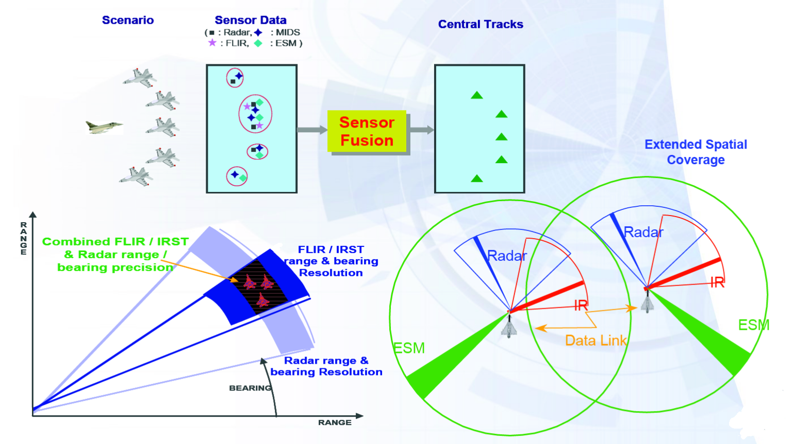
Problem Frame: Ground-Based Air Defense
Several Components
Detection →
Tracking →
Classification →
Intent →
Situational Awareness →
X-space Management
Our scope:
Classification + Intent
Implementation:
Python with pgmpy (https://pgmpy.org/)
Source: https://en.wikipedia.org/wiki/Sensor_fusion

Slide 5
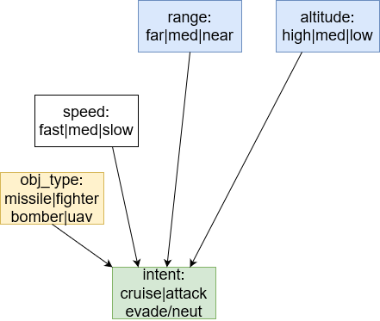
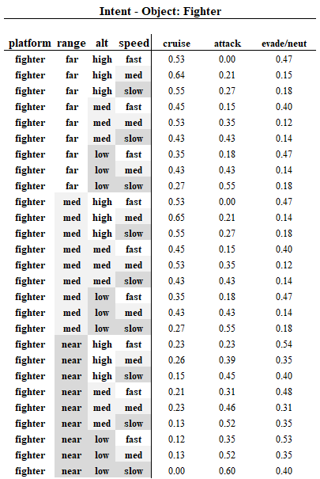
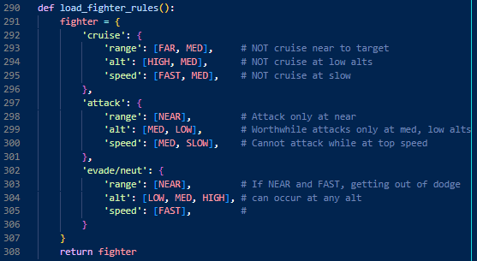
Intent Classification
Object Type
Intermediate problem frame
Speed:
Fusion of two sensor readings
Range:
Low fidelity observations
Altitude:
Low fidelity observations

Slide 6
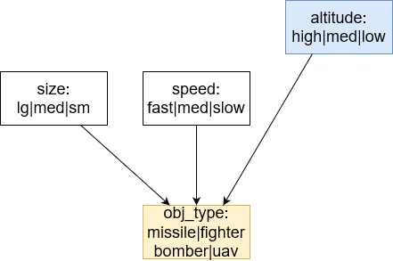
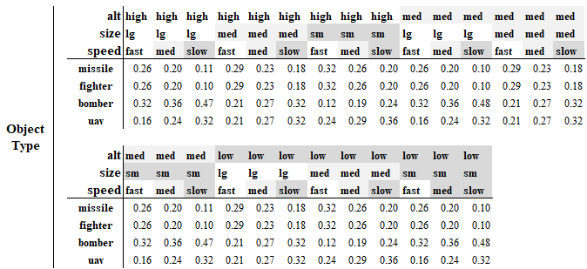
Object Classification
Size
Fusion of two sensors
Speed
Fusion of two sensors
Altitude
Low Fidelity observation

Slide 7
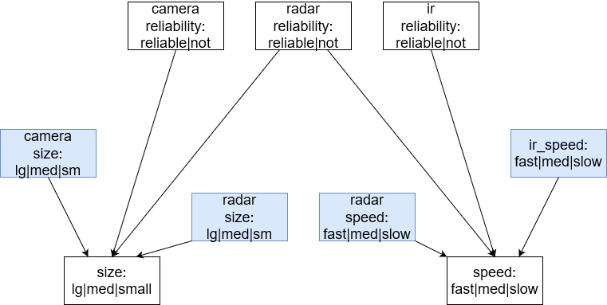
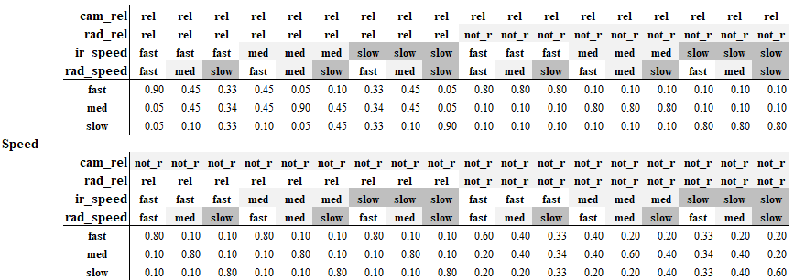
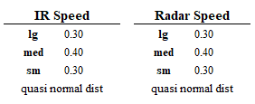
Size and Speed Resolution
Ingest readings from N sources
Also conditioned on reliability of source sensor
Primary CPD focus is resolving disagreements

Slide 8
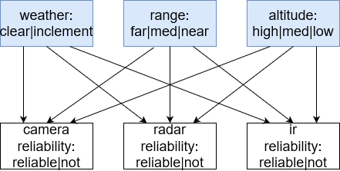
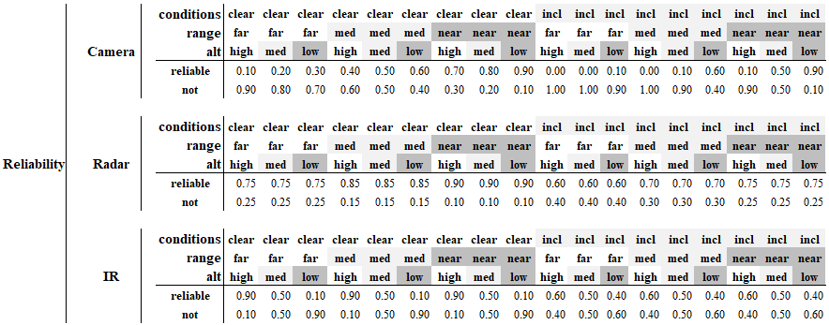
Sensor Reliability Conditioning
Camera
Most reliable at near range and low alts
Radar
Slightly negatively impacted by range
IR
Positively impacted by altitude

Slide 9
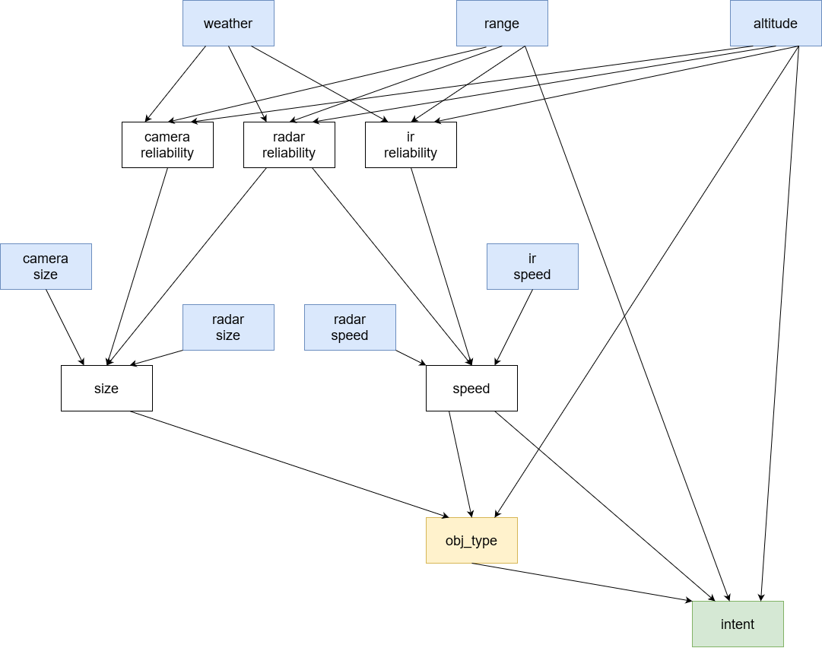
Overall Network

Slide 10
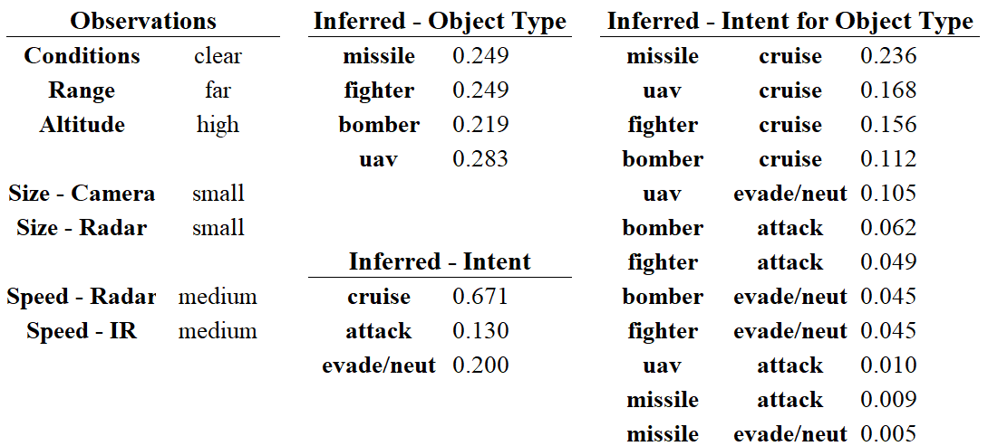
Test Case 1 – Missile in Cruise
Optimal sensor conditions
Far away and high altitude
Sensors agree
Despite UAV being highest mass object, a Missile in Cruise highest obj-int pair
Note, missile in attack, evade/neut lowest odds

Slide 11
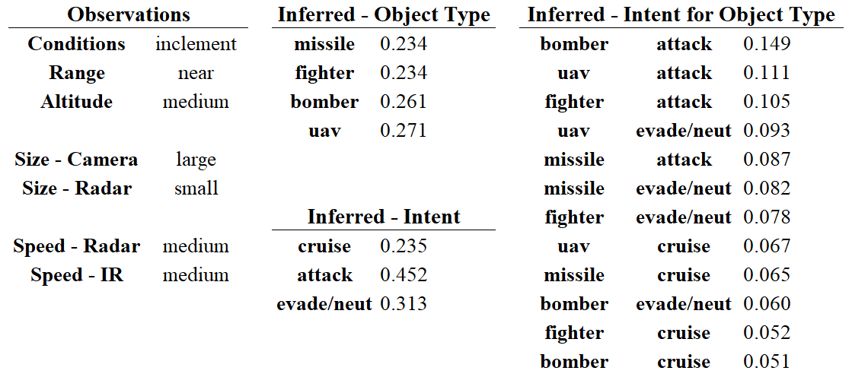
Test Case 3 – Bomber with Stealth under Inclement
Inclement conditions
Camera and Radar Size readings disagree
Whatever the object is, it looks dangerous
Bomber in attack ~15% of probability mass
Reasons through obstructions

Slide 12
Takeaways
Managing CPD tables can get unwieldy
Ideally, less states makes for smaller tables
But, discretizing continuous data feeds loses information
If have data, use that to learn larger ones
If no data, can define a rule base of possible states to generate CPDs
Don’t need to hand define every single value
BNs handle data existing, or not existing, very well
BNs provide great interface points to replace priors with observed values, should they become available at a later point

Slide 13
Thank you!

