Slide 1

COMPUTER ORGANIZATION AND ARCHITECTURE
Computer Arithmetic
DESIGNING FOR PERFORMANCE
11th Edition, Global Edition
William Stallings
CHAPTER 11

Slide 2





TABLE OF CONTENTS
1. ALU & Integers
2. Integer Arithmetic
3. FP Representation
4. FP Arithmetic
ALU block diagram, Integer representation systems (Sign-Magnitude, Twos Complement, Biased representation), and sign extension rules.
Logic gates negation, subtraction overflow checks, high-performance Booth's multiplication algorithm, and division mechanics.
Scientific notations, standard IEEE 754 layouts (binary32, binary64, binary128 formats), and handling edge states.
Complex calculations, rounding constraints, guard bits, strict interval computations, and handling extreme NaNs.
SLIDE 2

Slide 3
ARITHMETIC & LOGIC UNIT (ALU)
✦
The central core of the computer processing system that performs all mathematical calculations and logical evaluations.
✦
Every other computational element is designed to fetch, move, or store data operands for the ALU to execute.
✦
Constructed completely out of binary digital logic structures that evaluate basic Boolean algebra rules.
SLIDE 3

Slide 4

INTEGER REPRESENTATION
Decimal & Standard Notations
Hardware Level Constraints
Human arithmetic systems leverage specialized conceptual abstractions for arithmetic, including:
Digital memory cells and computational registers have physical constraints:
✦
Explicit signs for negative integers
✦
No special symbols allowed for minus signs
✦
Radix points to denote fractions
✦
Only absolute 1s and 0s are used
SLIDE 4

Slide 5

TWOS COMPLEMENT CHARACTERISTICS
Table 11.1: Standard Architectural Rules of Twos Complement
Characteristic | Definition / Standard Operational Rule
Representational Range | -2n-1 up to 2n-1 - 1
Representations of Zero | One unique representation (0000...0000)
Negation Rule | Invert each individual bit (Boolean complement), then add 1.
Bit Extension | Move the sign bit left and pad new bits with original sign state.
Addition Overflow Rule | Overflow occurs if and only if two inputs of matching signs produce an output with the opposite sign.
Subtraction Rule | Complement the subtrahend and perform standard addition: A - B = A + (-B).
SLIDE 5

Slide 6

ALTERNATIVE 4-BIT INTEGERS
Table 11.2: Comparative Systems for 4-Bit Layouts
Decimal | Sign-Magnitude | Twos Complement | Biased (Bias = 8)
+8 | – | – | 1111
+7 | 0111 | 0111 | 1110
+4 | 0100 | 0100 | 1011
+1 | 0001 | 0001 | 1000
+0 / -0 | 0000 / 1000 | 0000 | 0111
-1 | 1001 | 1111 | 0110
-4 | 1100 | 1100 | 0011
-8 | – | 1000 | 0000
SLIDE 6

Slide 7



RANGE EXTENSION & SIGN EXTENSION
Sign-Magnitude Limits
Twos Complement Rule
Accomplished by shifting the sign bit to the absolute leftmost position and padding the intermediary spaces with zeros.
Shift the sign bit to the leftmost slot and pad remaining intermediary bits with a copy of the sign bit.
Positive numbers: Pad left spaces with zeros
Negative numbers: Pad left spaces with ones
SLIDE 7

Slide 8

FIXED-POINT NEGATION
Twos Complement Logic:
✦
Compute the bitwise Boolean inversion of every single bit of the input word.
Example conversion of +18 to -18 and back:
✦
Add 1 to the resulting bit pattern, evaluating it as an unsigned value.
✦
This double-inversion loop naturally proves that the negation of a negated value resolves back to the original value.
SLIDE 8

Slide 9


NEGATION SPECIAL CASES
Case 1: Zero (0)
Case 2: Minimal Negative
Zero complements back to itself:
The asymmetric floor limits negation:
(Carry out/overflow is ignored; -0 = 0)
The MSB fails to invert! Standard overflow flag triggers to flag this arithmetic limitation.
SLIDE 9

Slide 10


ADDITION & SUBTRACTION
Standard Addition Rule
Hardware Subtraction
Perform direct binary addition bitwise. Monitor signs of inputs and outputs:
Rather than using distinct arithmetic structures, compute negative complement and add:
✦
If opposite signs are added, overflow is physically impossible.
A - B = A + TwosComplement(B)
✦
If identical signs are added and the result sign flips, overflow occurred.
SLIDE 10

Slide 11
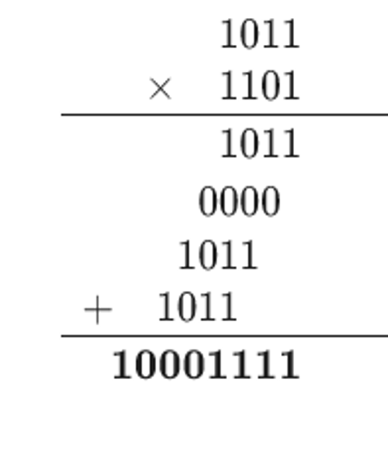
UNSIGNED MULTIPLICATION
✦
Evaluated by calculating intermediate partial products for each non-zero position in the multiplier factor.
✦
Each step yields either all zeros or a shifted copy of the multiplicand.
✦
Final product resolves by performing successive accumulation of all generated partial product steps.
SLIDE 11

Slide 12


BOOTH'S ALGORITHM
Decision Operations
Arithmetic Shifting
A powerful technique that accelerates signed multiplication. Operates on adjacent bits Q0 and Q-1:
During the subsequent shift step, a crucial shift must execute to preserve correctness:
✦
01: Add M to high half of product
Arithmetic right shift is strictly required instead of logical right shift to correctly preserve the negative sign bit.
✦
10: Subtract M from high half of product
✦
00 / 11: No arithmetic operation needed
SLIDE 12

Slide 13
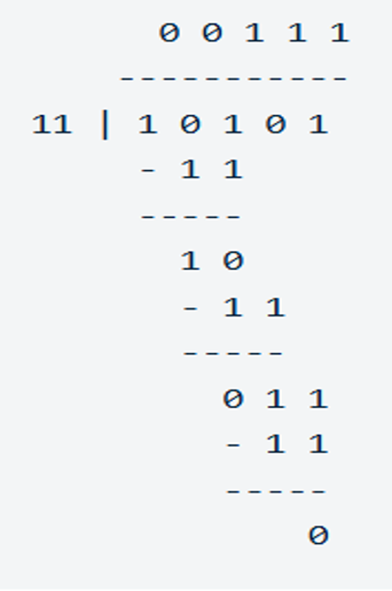
UNSIGNED DIVISION
✦
Closely mirrors standard long-hand division logic practiced in manual base-10 algebra.
✦
Progresses by evaluating intermediate subtractions to confirm whether the divisor word matches inside the current partial remainder.
✦
Resolves by appending a '1' bit into the quotient if subtraction completes, or a '0' if remainder check fails.
SLIDE 13

Slide 14


FLOATING-POINT PRINCIPLES
Dynamic Scientific Strategy
Fixed-Point Limitations
By defining a dynamic, sliding binary radix point, floating-point representations enable a significantly expanded numeric scale.
Fixed-point registers face structural scaling constraints:
✦
Cannot express huge scientific values
A given floating-point value is standardly parameterized as:
✦
Cannot preserve extremely minute fractions
Significand × Base $∧$ Exponent
SLIDE 14

Slide 15



IEEE STANDARD 754 FORMATS
Arithmetic Format
Basic Format
Interchange Format
Fully defined operations which standard-compliant processors must evaluate directly on hardware pathways.
Covers 5 core configurations (3 binary and 2 decimal) specifying layout bit allocations required for standard mathematical tools.
Specifies bit-exact layouts for consistent file transfers, protecting data integrity when migrating files between architectures.
SLIDE 15

Slide 16

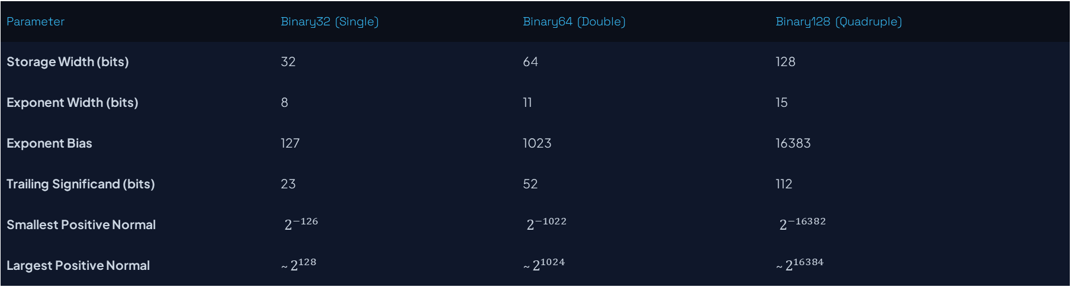
IEEE 754 FORMAT PARAMETERS
Table 11.3: IEEE Standard Bit Allocation Schemes
Parameter | Binary32 (Single) | Binary64 (Double) | Binary128 (Quadruple)
Storage Width (bits) | 32 | 64 | 128
Exponent Width (bits) | 8 | 11 | 15
Exponent Bias | 127 | 1023 | 16383
Trailing Significand (bits) | 23 | 52 | 112
Smallest Positive Normal | $2^{−126}$ | $2^{−1022}$ | $2^{−16382}$
Largest Positive Normal | ~ $2^{128}$ | ~ $2^{1024}$ | ~ $2^{16384}$
SLIDE 16

Slide 17

EXTENDED & EXTENDABLE PRECISION
Extended Formats
Extendable Formats
Adds extra bits directly to exponent fields and significand words to prevent computation degradation:
Provides complete programmatic control over bit lengths to evaluate critical custom scientific steps:
✦
Protects intermediate operations from accumulative roundoff.
✦
Tailors numeric precision parameters programmatically.
✦
Avoids spurious overflows in intermediate calculations.
✦
Offers custom flexibility for high-end modeling fields.
SLIDE 17

Slide 18

IEEE 754 WORD INTERPRETATIONS
Table 11.5: Word Interpretations for Standard binary32
Sign | Biased Exponent | Fraction Field | Interpreted Value
0 / 1 | 0 | 0 | Positive / Negative Zero
0 / 1 | all 1s | 0 | Plus / Minus Infinity (∞)
0 or 1 | all 1s | ≠ 0 (MSB = 1) | Quiet NaN (qNaN)
0 or 1 | all 1s | ≠ 0 (MSB = 0) | Signaling NaN (sNaN)
0 | 0 < e < 255 | f | 2e-127(1.f) [Positive Normal]
1 | 0 < e < 255 | f | -2e-127(1.f) [Negative Normal]
0 / 1 | 0 | f ≠ 0 | ± 2-126(0.f) [Subnormal]
SLIDE 18

Slide 19


FP ARITHMETIC OPERATIONS
Mathematical Formulas
Calculation Trace
Floating-point operations align to the following structures (given XE ≤ YE):
Evaluating: X = 0.3 × 102, Y = 0.2 × 103
X + Y = (0.3 × 102-3 + 0.2) × 103
Addition: (XS × BXE - YE + YS) × BYE
= (0.03 + 0.2) × 103
Subtraction: (XS × BXE - YE - YS) × BYE
= 0.23 × 103 = 230
Multiplication: (XS × YS) × BXE + YE
Division: (XS ÷ YS) × BXE - YE
SLIDE 19

Slide 20


PRECISION & GUARD BITS
Guard Bits Strategy
IEEE Rounding Standard
Guard bits are extra temporary registers configured to the right of intermediate fractions during arithmetic steps.
✦
Round to Nearest: Rounds to matching even value in ties.
✦
Round toward +∞: Rounds upward to positive values.
They prevent massive precision drop-offs when evaluating subtractions of highly similar numbers.
✦
Round toward -∞: Rounds downward to negative values.
✦
Round toward 0: Truncates all remaining fractional elements.
SLIDE 20

Slide 21


INTERVAL ARITHMETIC
Interval Boundary Computations
Truncation Disadvantages
Produces upper and lower bounds containing the true, exact real result to help trace calculation limits:
Simplest rounding technique where extra bits are completely discarded (round toward zero):
✦
Width of output interval indicates propagation of error.
While simple, this method introduces persistent, biased rounding error toward zero.
✦
Extremely useful in scientific computing.
SLIDE 21

Slide 22

SPECIAL MATHEMATICAL STATES
Infinity Evaluations
Table 11.7: Quiet NaN Triggers
Treated as standard algebraic limit values in real calculations:
Quiet NaNs generate on undefined mathematical operations:
5 + (+∞) = +∞
Magnitude subtraction of infinities: (∞ - ∞)
5 ÷ (+∞) = +0
Invalid multiplications: 0 × ∞
(+∞) + (+∞) = +∞
Invalid divisions: 0 ÷ 0 or ∞ ÷ ∞
(-∞) - (+∞) = -∞
Negative square roots: √x where x < 0
SLIDE 22

Slide 23

CHAPTER 11 SUMMARY
✦
Logic Core & ALU: Arithmetic operations evaluate on binary digital structures.
✦
Signed Representation: Twos complement solves sign issues with one unique zero representation.
✦
Booth's Multiplication: Accelerates signed multiplication using arithmetic shifts.
✦
IEEE 754 Standard: Provides strict rules across single, double, and quad precision layouts.
SLIDE 23

Slide 24
CHAPTER 11 SUMMARY
Question 1: In twos complement representation, which of the following operations is used to perform the negation of an integer?
A. Invert only the value of the sign bit (the leftmost bit).
B. Take the Boolean complement (bit inversion) of each binary bit, then add 1 to the result.
C. Perform an arithmetic right shift to preserve the sign bit.
D. Perform sign extension by filling the left side with 0 bits.
Answer: B
SLIDE 23

Slide 25
CHAPTER 11 SUMMARY
Question 2: According to the IEEE 754 standard for floating-point representation, a number stored in a binary word consists of which three fields?
A. Sign bit, Base, and Significand.
B. Sign bit, Exponent, and Significand.
C. Exponent, Significand, and Guard bit.
D. Sign bit, Significand, and Implicit bit.
Answer: B
SLIDE 23

Slide 26


Questions & Answers
We have completed the review of Chapter 11 from the standard 11th Edition Global presentation of **"Computer Organization and Architecture"** (William Stallings).
Chapter 11 Review Hardware Arithmetic
SLIDE 24

