Slide 1
Gaussian Process for Surrogate Modelling: Application in Non-Linear Mechanics
Tianyi LI
Tutors：Joseph MORLIER
Simone CONIGLIO
Pierre-jean BARJHOUX

Slide 2
Table of Contents
1. Introduction
2. My subject
3. Methodology
4. Result
5. Conclusion
Notes:
I am going to give the presentation from 4 parts.

Slide 3
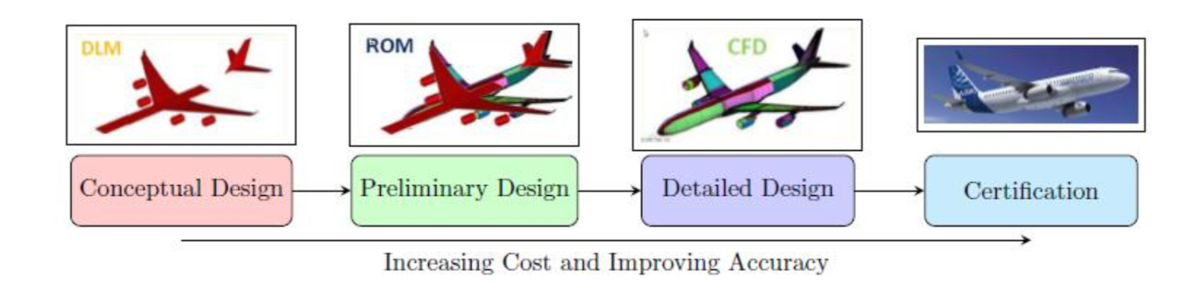
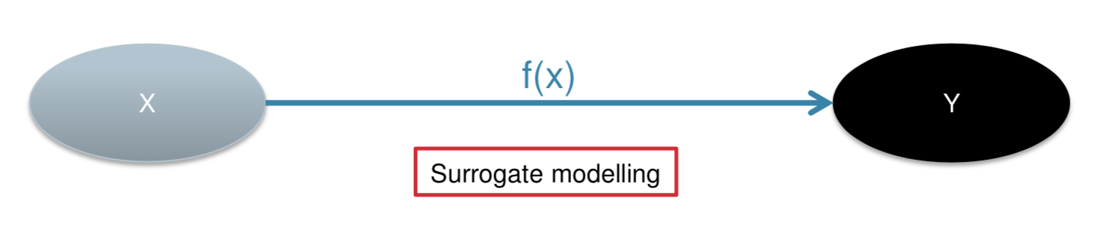
Introduction
Figure 1. Aircraft Design
Figure 2. Surrogate Model
A quicker, cheaper representation
Notes:
The whole project is to build a surrogate model. But what is a surrogate model and why we construct it?
The basic idea in the ‘surrogate model’ approach is to avoid the temptation to invest one’s computational budget in answering the question at hand and, instead, invest in developing fast mathematical approximations to the long running computer codes.
Engineering design is concerned with the making of decisions based on analysis, which engage in a great deal of analysis for months of analysis by dedicated teams to be undertaken to inform key product decisions. For example, in modern aerospace design offices the computational power needed to support advanced decision making can be prodigious and, even with the latest and most powerful computers, designers still wish for greater understanding than can be gained by straightforward use of the familiar analysis tools, such as those coming from the fields of computational fluid dynamics or computational structural mechanics.

Slide 4


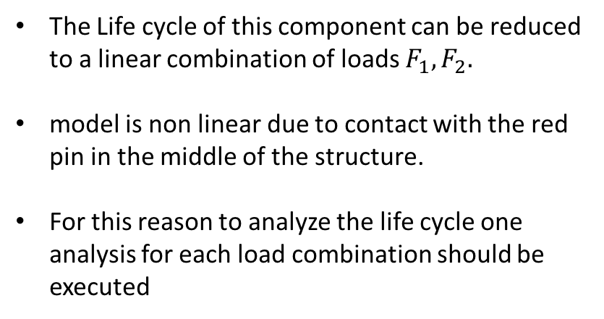



My Subject
The Life cycle of this component can be reduced to a linear combination of loads $F_{1},F_{2}.$
model is non linear due to contact with the red pin in the middle of the structure.
For this reason to analyze the life cycle one analysis for each load combination should be executed
R.P.
$$F_{1}$$
$$F_{2}$$
Figure 1. Component of Pylon
Since the FEA can be very expensive and the number of load combination can be of 5000 different load this approach can be prohibitive
$$F_{x}$$
$σ$max
$$F_{y}$$
Figure 2. Simulation Process
Notes:
A pylon serves to connect the frame of an aircraft to an object that is being carried, for example here it is used to connected the aircraft engine and wings.

Slide 5
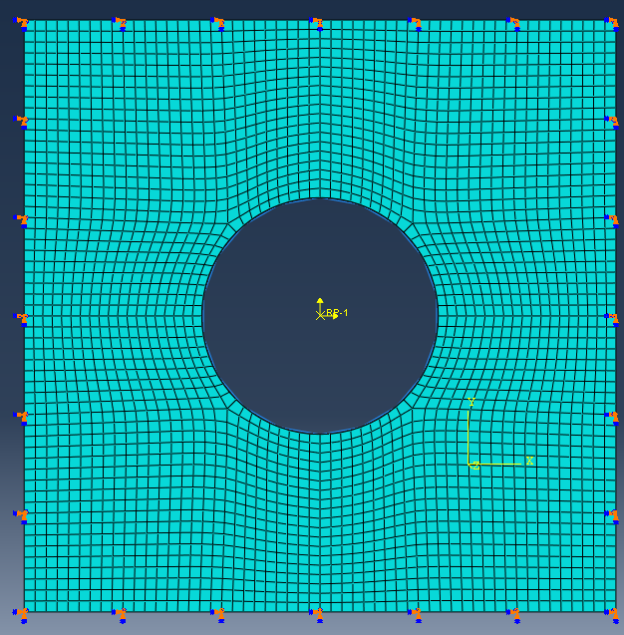
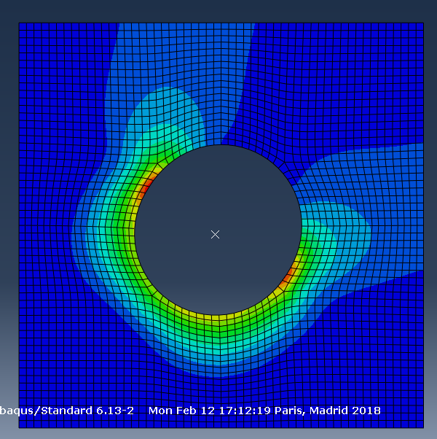







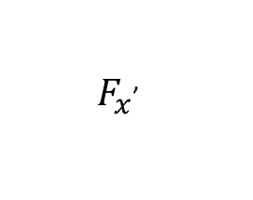
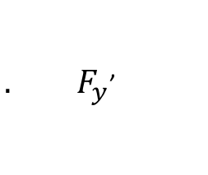

My Subject
Input
${ F}_{x}$’
$$F_{x}$$
${. F}_{y}$’
$$F_{y}$$
2. Prediction
1. Building
Surrogate Model
ABAQUES
Response
2. Prediction
$$X_{σ}$$
$σ$max
$$X_{σ}$$
$$Y_{σ}$$
$σ$’
$$Y_{σ}$$
Notes:
For this reason, the goal of this project is to build un surrogate model by the method of surrogate modelling in order to get the estimation of max principle stress sigma. By using the surrogate model, both the time and cost can be greatly reduced and we can get the estimated principle stress of each point and force combination.

Slide 6
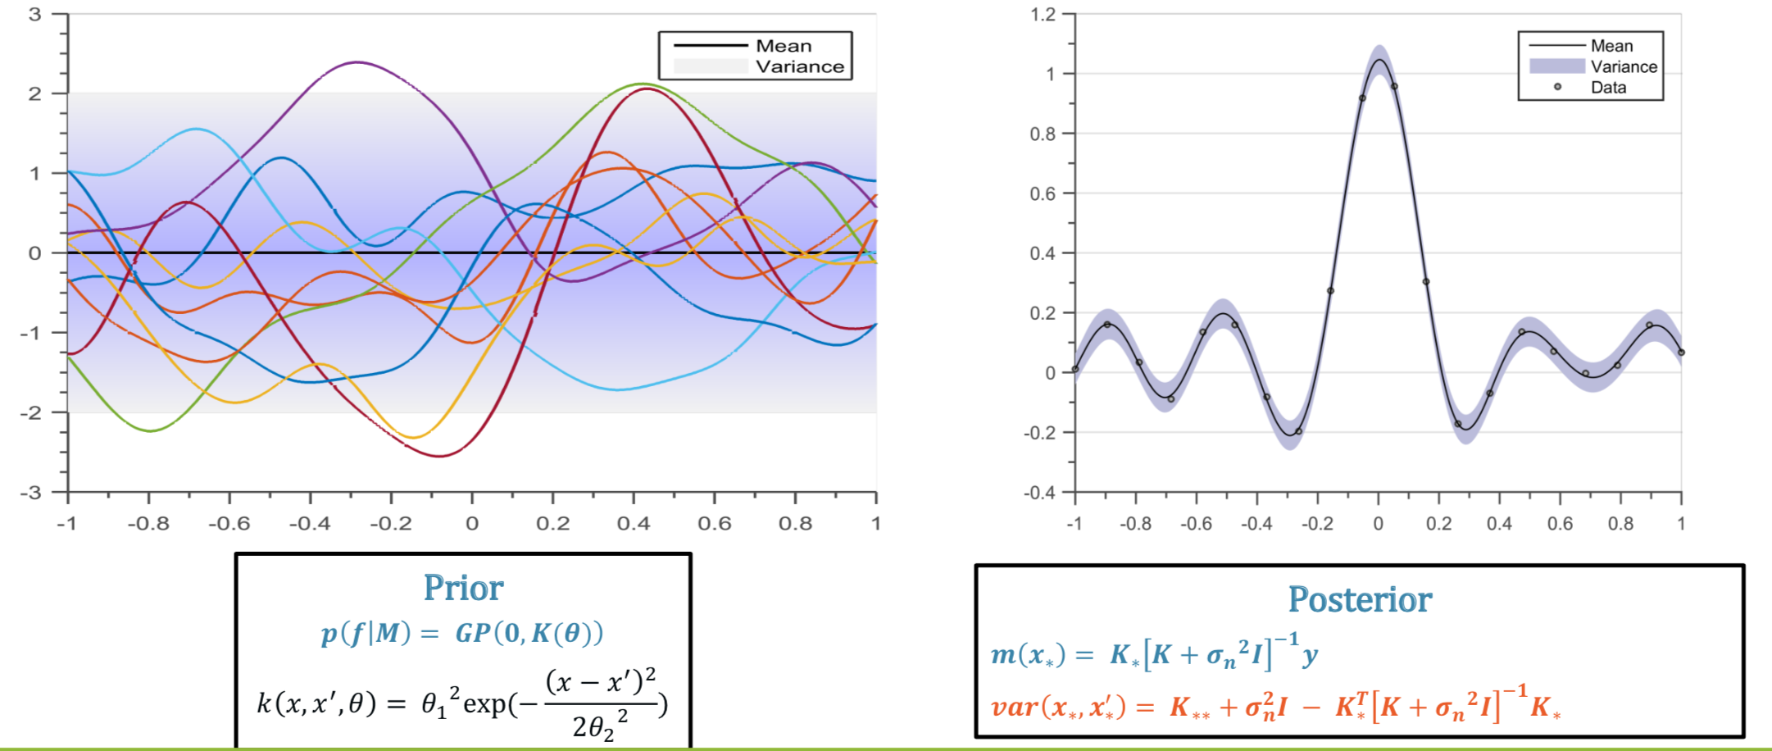
Methodology
Gaussian Process Regression
Figure 1. Gaussian process regression from Function-space View
A I. J. Forrester et. al.[1], Engineering Design via Surrogate Modelling: A Practical Guide
C. E. Rasmussen & C. K. I. Williams [2], Gaussian Processes for Machine Learning
Notes:
In this chapter we discuss the fundamentals and some of the technical minutiae of a number of specific surrogate model types capable of accomplishing this learning process.
We use a Gaussian process (GP) to describe a distribution over functions.
A Gaussian process is completely specified by its mean function and co- variance function.
posterior, i.e. the prior conditioned on the five noise free observations indicated

Slide 7
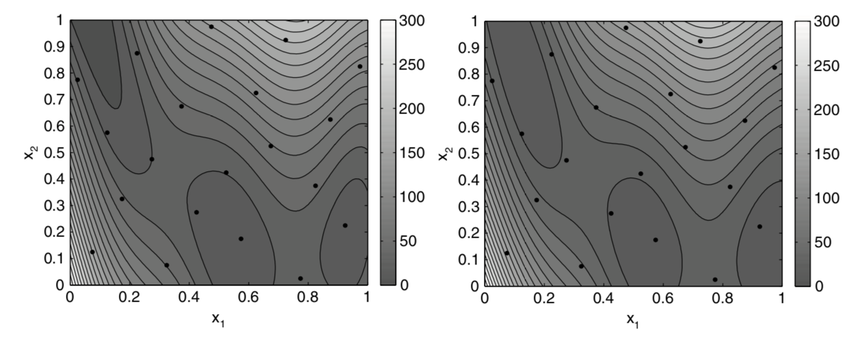
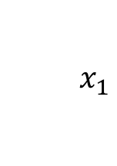
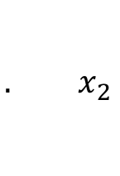

Methodology
Training the GPR Model to Fit the Branin Function
$${ x}_{1}$$
GPR
Model
Mean Function : []
$$f$$
$${. x}_{2}$$
Cov Function : Isotropic Squared Exponential
a) GPR prediction points b) true Branin function (right)
A I. J. Forrester et. al.[1], Engineering Design via Surrogate Modelling: A Practical Guide
Notes:
When an axial load is applied, the shear stress in the coil wire is calculated as:
Root-Mean-Square Error (RMSE) is employed to quantify the prediction error.

Slide 8
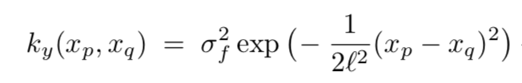
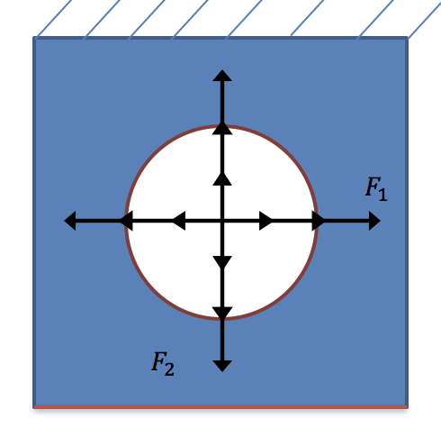
Result
Cov Function : Isotropic Squared Exponential
1. Max Stress Estimation
1.1 GPR Model Establishment and Cross Validation
hyperparameter
Leave-One-Out Cross-Validation
Cross-Validation Error : 1.5896
F1 = [-1000, -666, -333, 0, 333,666 ,1000]
F2 = [-1000, -666, -333, 0, 333,666 ,1000]
Hyperparameter : [7.17 3.50]
[F1 F2] has 49 possibilities !
Notes:
When an axial load is applied, the shear stress in the coil wire is calculated as:
Root-Mean-Square Error (RMSE) is employed to quantify the prediction error.

Slide 9
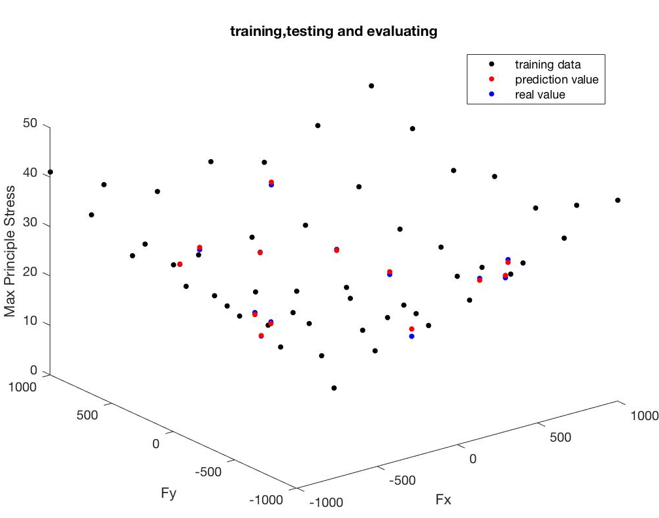
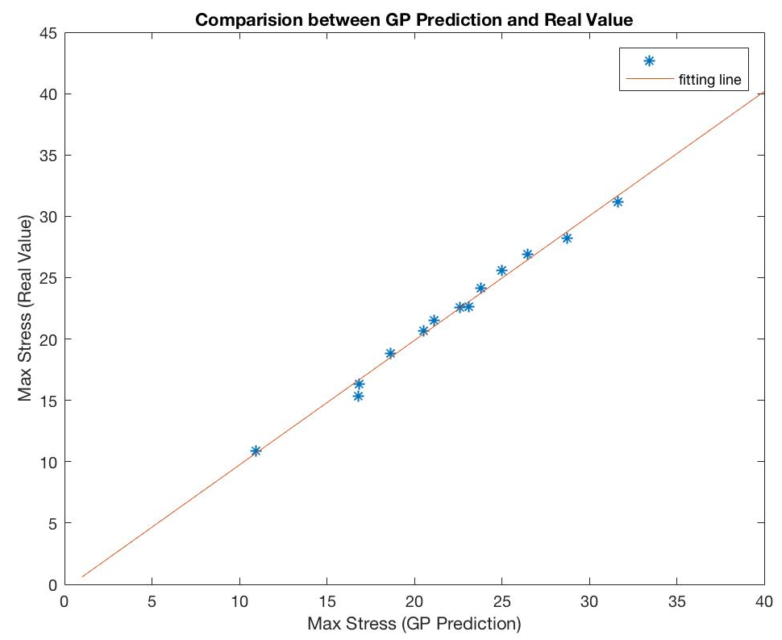
Result
1. Max Stress Estimation
Training Data: 49 (sampling plan 1)
Testing Data: 14 random generated
1.2 Max Stress Prediction in New Data
RMSE = 0.5431
y = 1.01 x - 0.41
Notes:
When an axial load is applied, the shear stress in the coil wire is calculated as:
Root-Mean-Square Error (RMSE) is employed to quantify the prediction error.

Slide 10
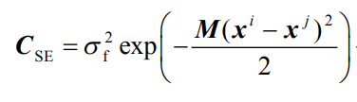
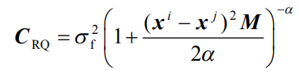

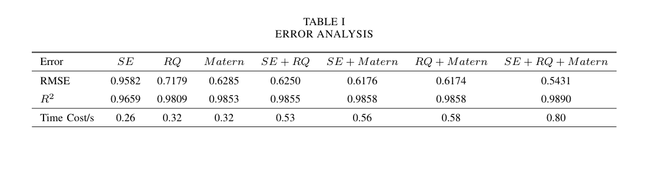
Result
1. Max Stress Estimation
Training Data: 49 (sampling plan 1)
Testing Data: 14 random generated
1.3 Comparison between Different Kernel functions
SE:
RQ:
Matern:
Notes:
When an axial load is applied, the shear stress in the coil wire is calculated as:
Root-Mean-Square Error (RMSE) is employed to quantify the prediction error.

Slide 11
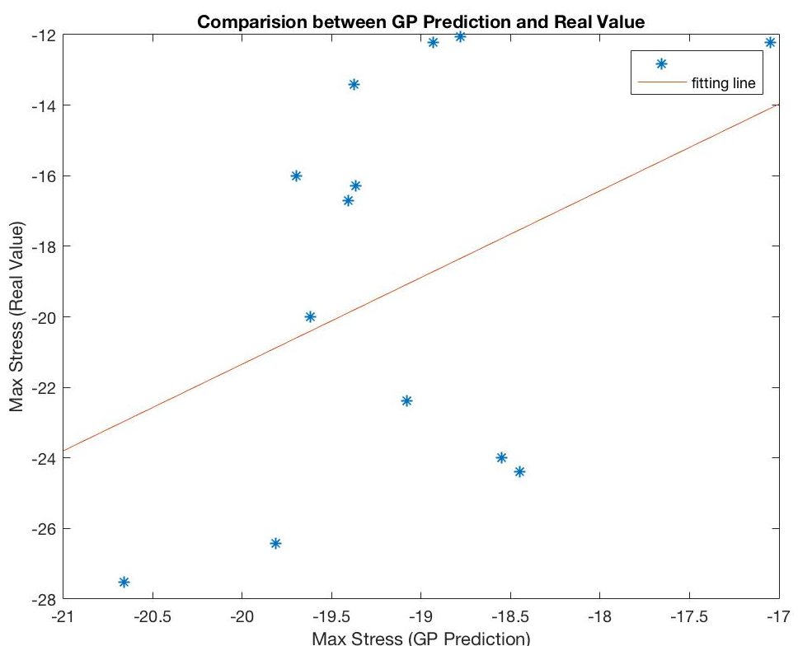
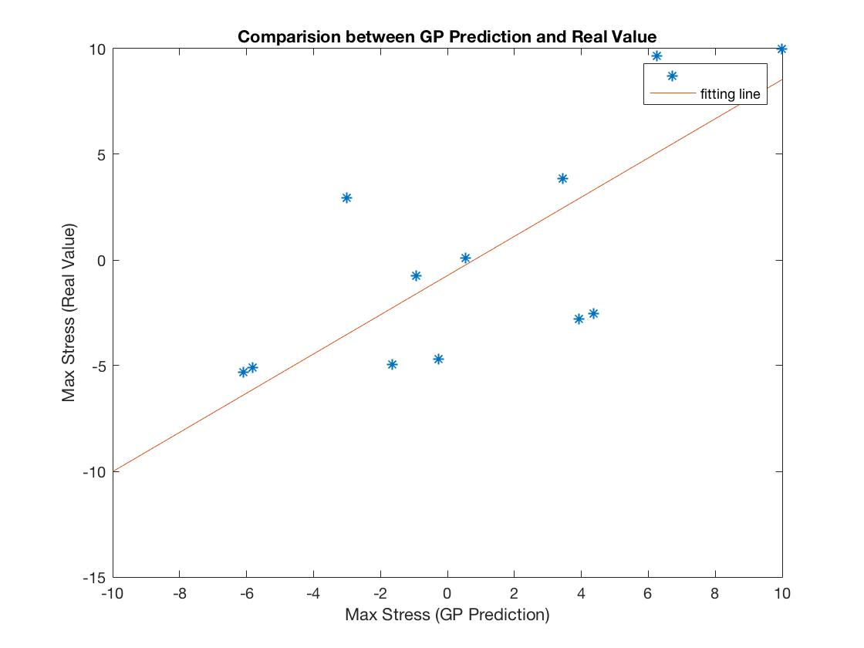
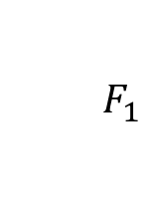
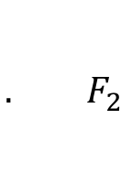

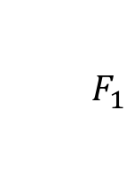

Result
2. Max Stress Location Estimation
Training Data: 49 (sampling plan 1)
2.1 Training X and Y Coordinate Separately
Testing Data: 14 random generated
$${ F}_{1}$$
GPR
Model
$${ F}_{1}$$
GPR
Model
$$X_{σmax}$$
$$Y_{σmax}$$
$${. F}_{2}$$
$${. F}_{2}$$
RMSE= 5.18
y = 2.5x + 27.8
RMSE= 3.65
y = 0.93x – 0.74
Notes:
When an axial load is applied, the shear stress in the coil wire is calculated as:
Root-Mean-Square Error (RMSE) is employed to quantify the prediction error.

Slide 12
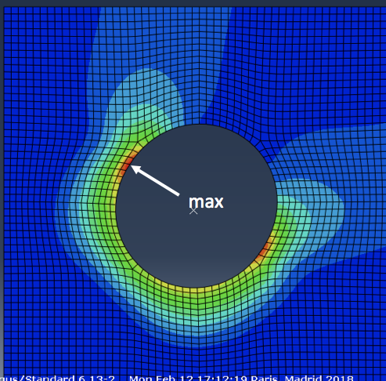
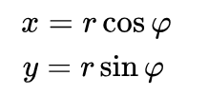
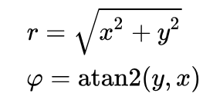
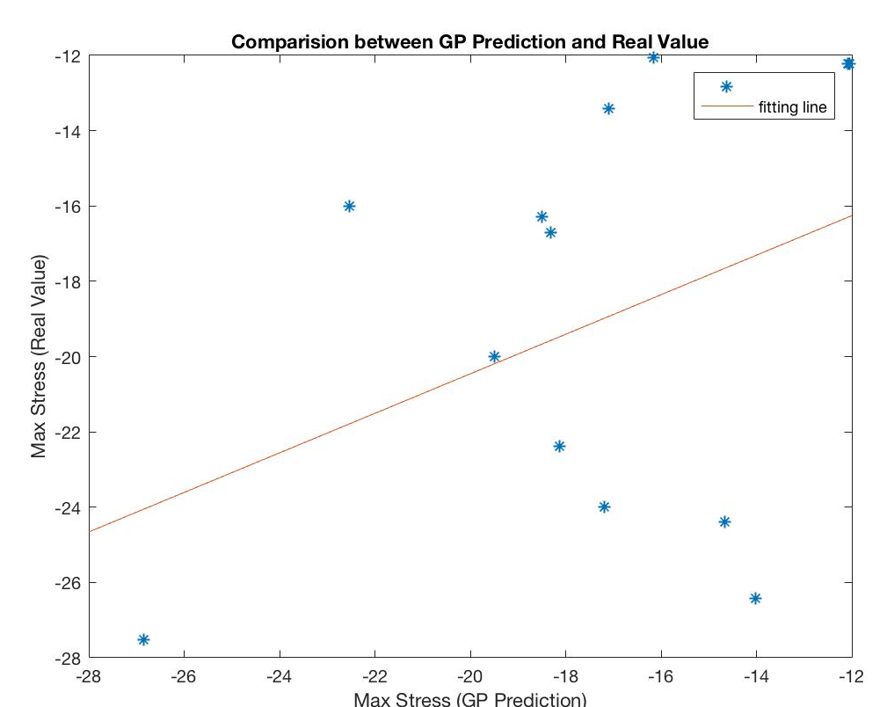
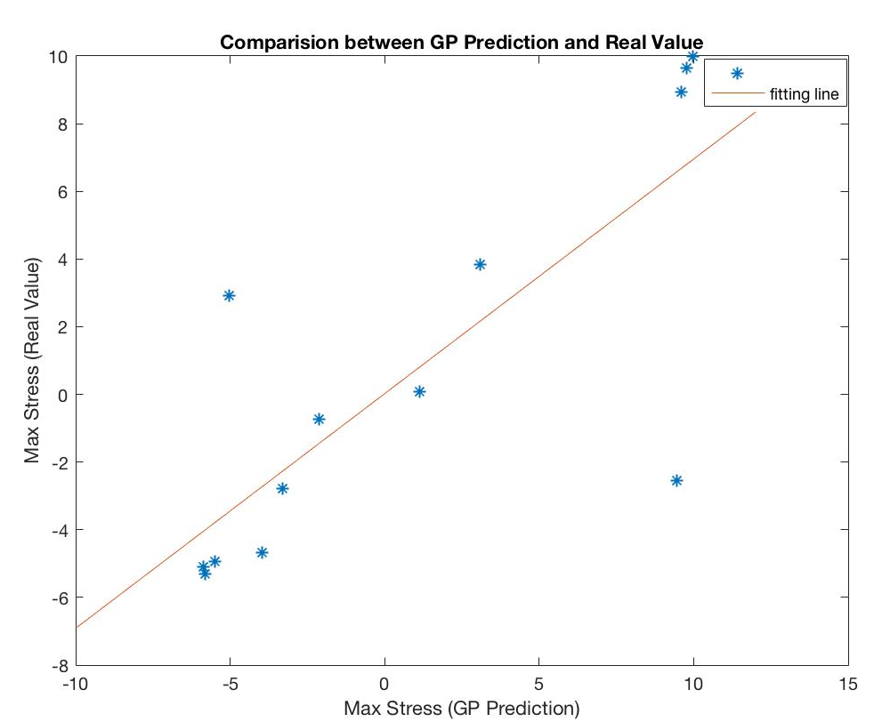
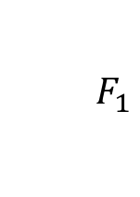

Result
2. Max Stress Location Estimation
2.2 Prediction in Polar Coordinate
$${ F}_{1}$$
GPR
Model
$${φ }_{σmax}$$
$${. F}_{2}$$
RMSE= 5.61
y = 0.52 x -9.9
RMSE= 3.90
y = 0.70x + 0.02
Notes:
When an axial load is applied, the shear stress in the coil wire is calculated as:
Root-Mean-Square Error (RMSE) is employed to quantify the prediction error.

Slide 13
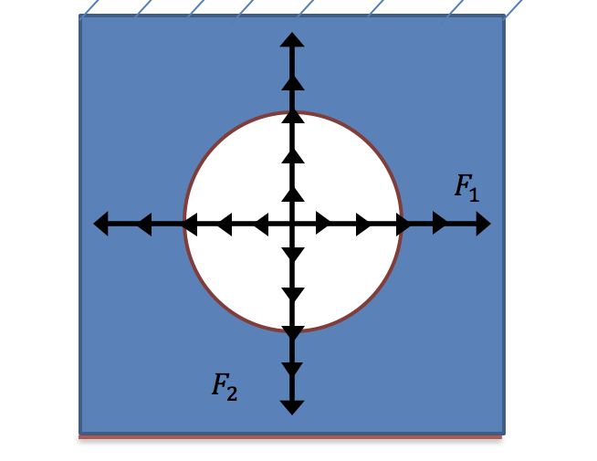
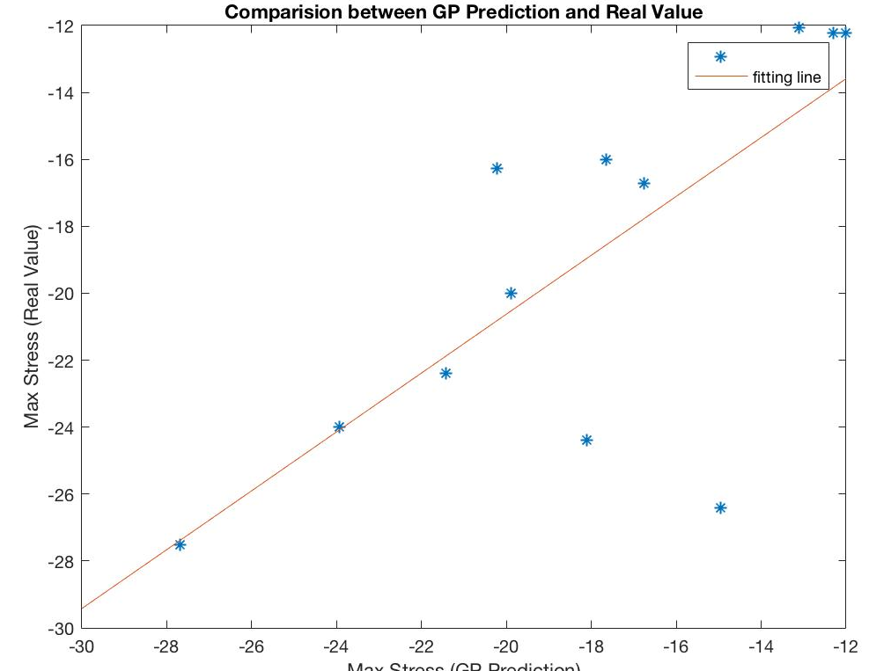
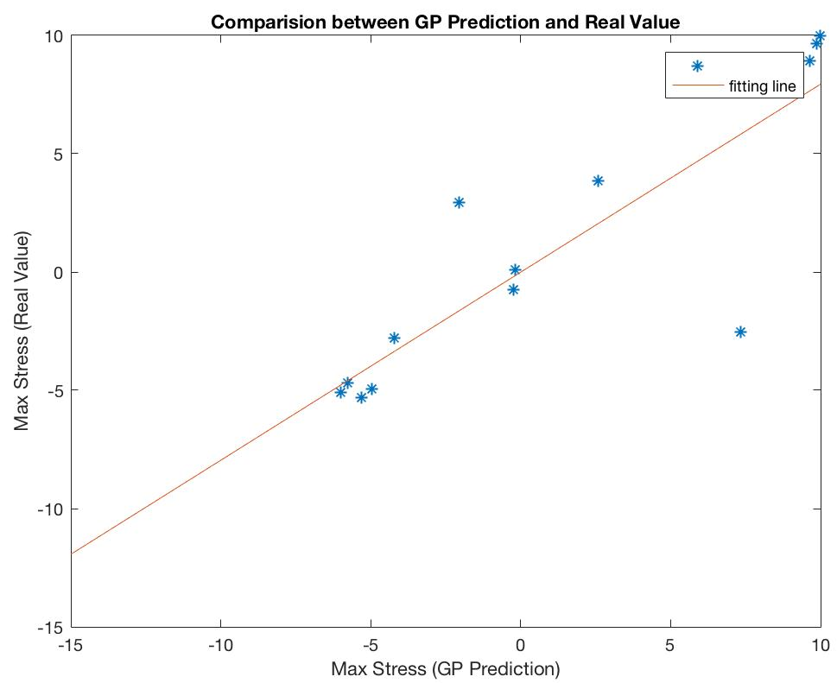
Result
2. Max Stress Location Estimation
2.3 Prediction in Polar Coordinate with 121 samples
F1 = [-1000, -800, -600, -400,-200,0, 200,400, 600 ,800,1000]
F2 = [-1000, -800, -600, -400,-200,0, 200,400, 600 ,800,1000]
[F1 F2] has 121 possibilities !
RMSE= 3.7
y = 0.88 x -3
RMSE= 3.0
y = 0.80x
Notes:
When an axial load is applied, the shear stress in the coil wire is calculated as:
Root-Mean-Square Error (RMSE) is employed to quantify the prediction error.
38.249

Slide 14
Conclusion
1. Gaussian Process Regression model could give accurate prediction for maximum principle stress and significantly reduce the time consumption.
2. Co-variance Function Selection will have impact on the prediction
accuracy. Proper co-variance Function should be selected for each GPR model.
3. For the multiple output learning problem, encoding the known relation between output will simplify the problem.
4. Sampling method and samples numbers have huge influence in GPR prediction results.
Notes:
decompose every fields (in the learning process) using svd (== POD)

Slide 15
Thank you!
[1] Alexander Forrester, Andy Keane ,et al. Engineering design via surrogate modelling: a practical guide. John Wiley & Sons, 2008.
[2] Carl Edward Rasmussen. Gaussian processes in machine learning. In Advanced lectures on machine learning, pages 63–71. Springer, 2004.
[3] Hongyi Xu, Ching-Hung Chuang, and Ren-Jye Yang. Towards optimization of multi-material structure: Metamodeling of mixed-variable problems. SAE International Journal of Materials and Manufacturing, 9(2016-01-0302):400–409, 2016.

