Slide 1
Visualising data & other horror stories
with Lucy

Slide 2
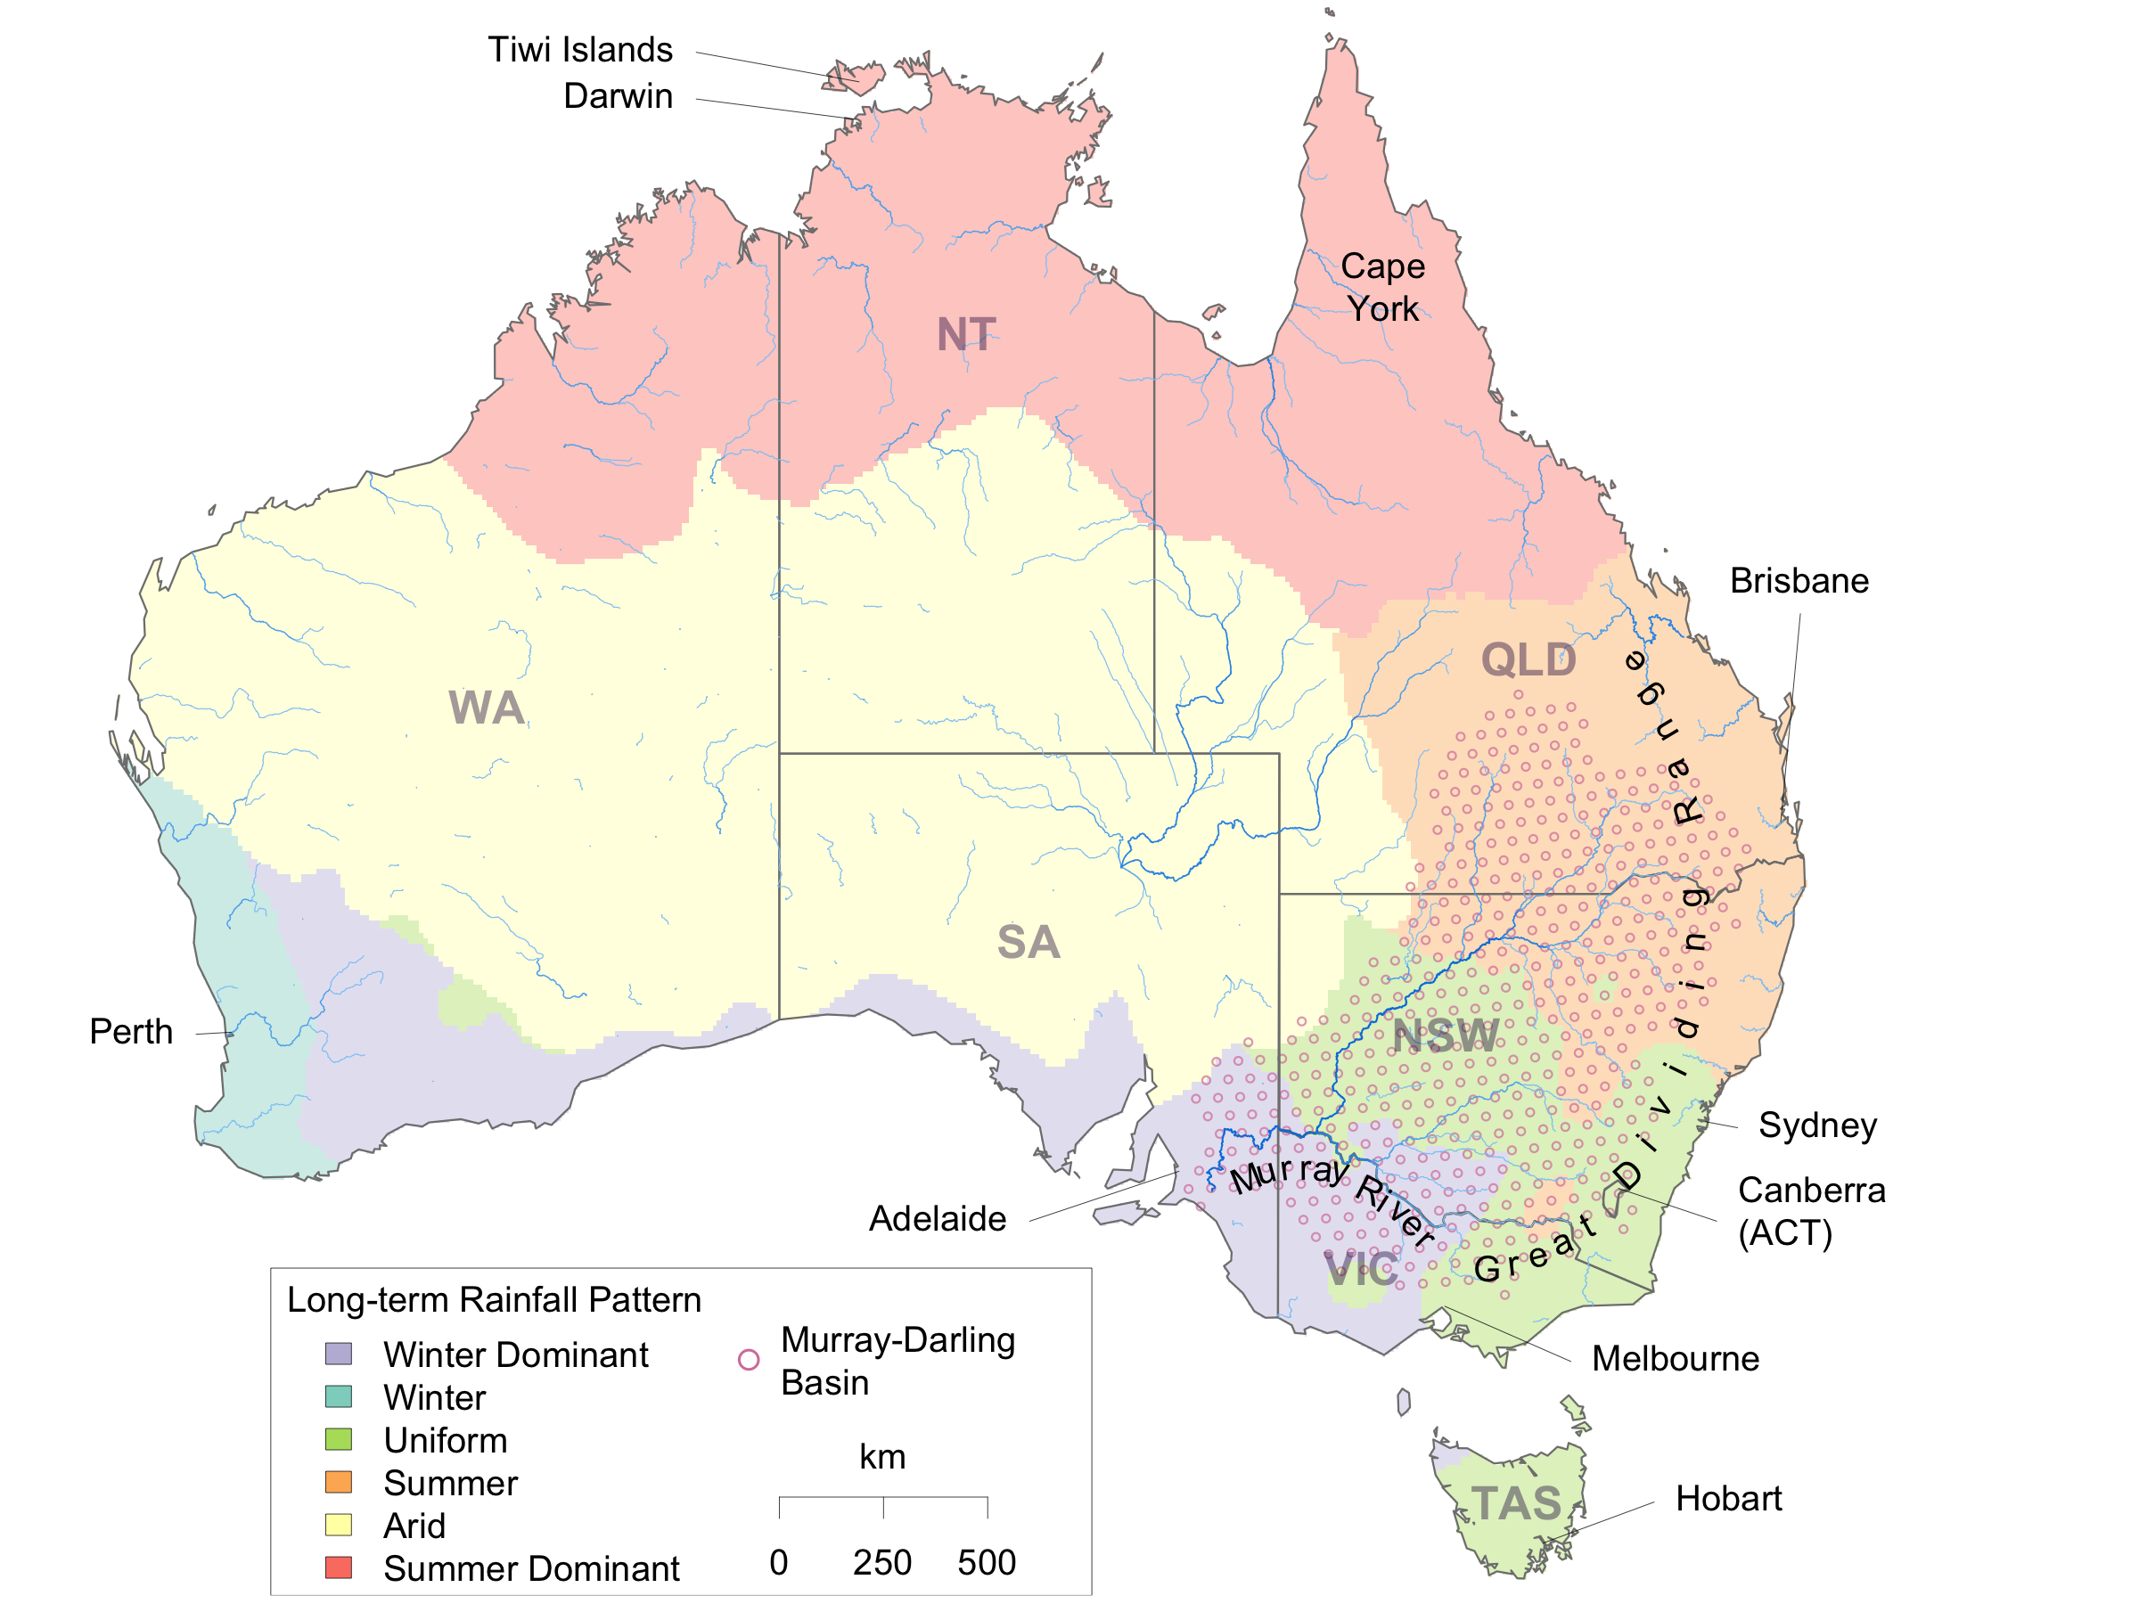
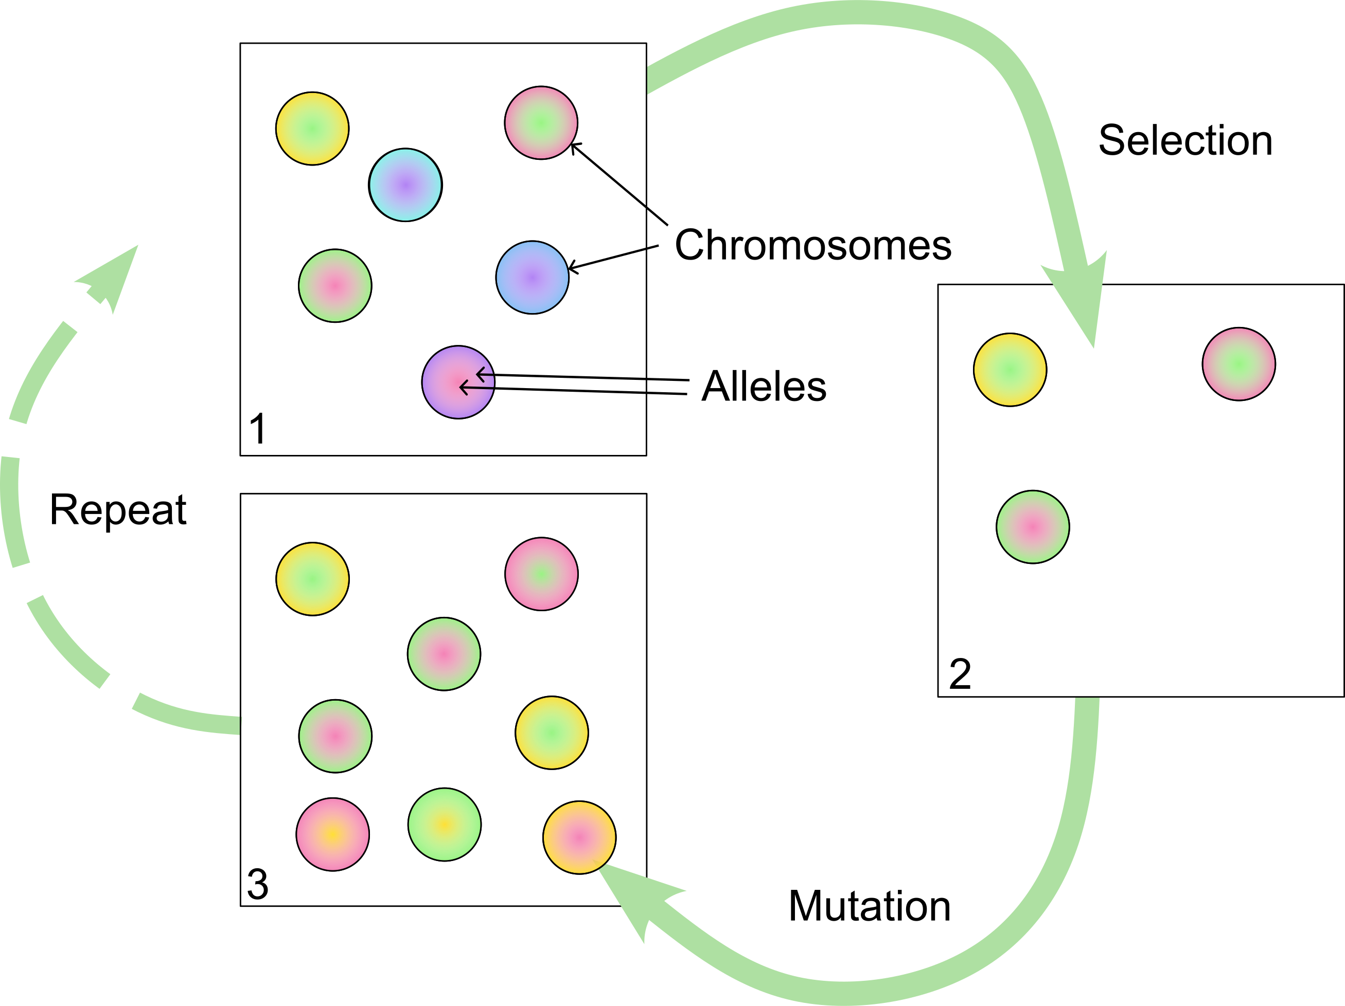
Preface
Visualisation is my favourite part of my job

Slide 3
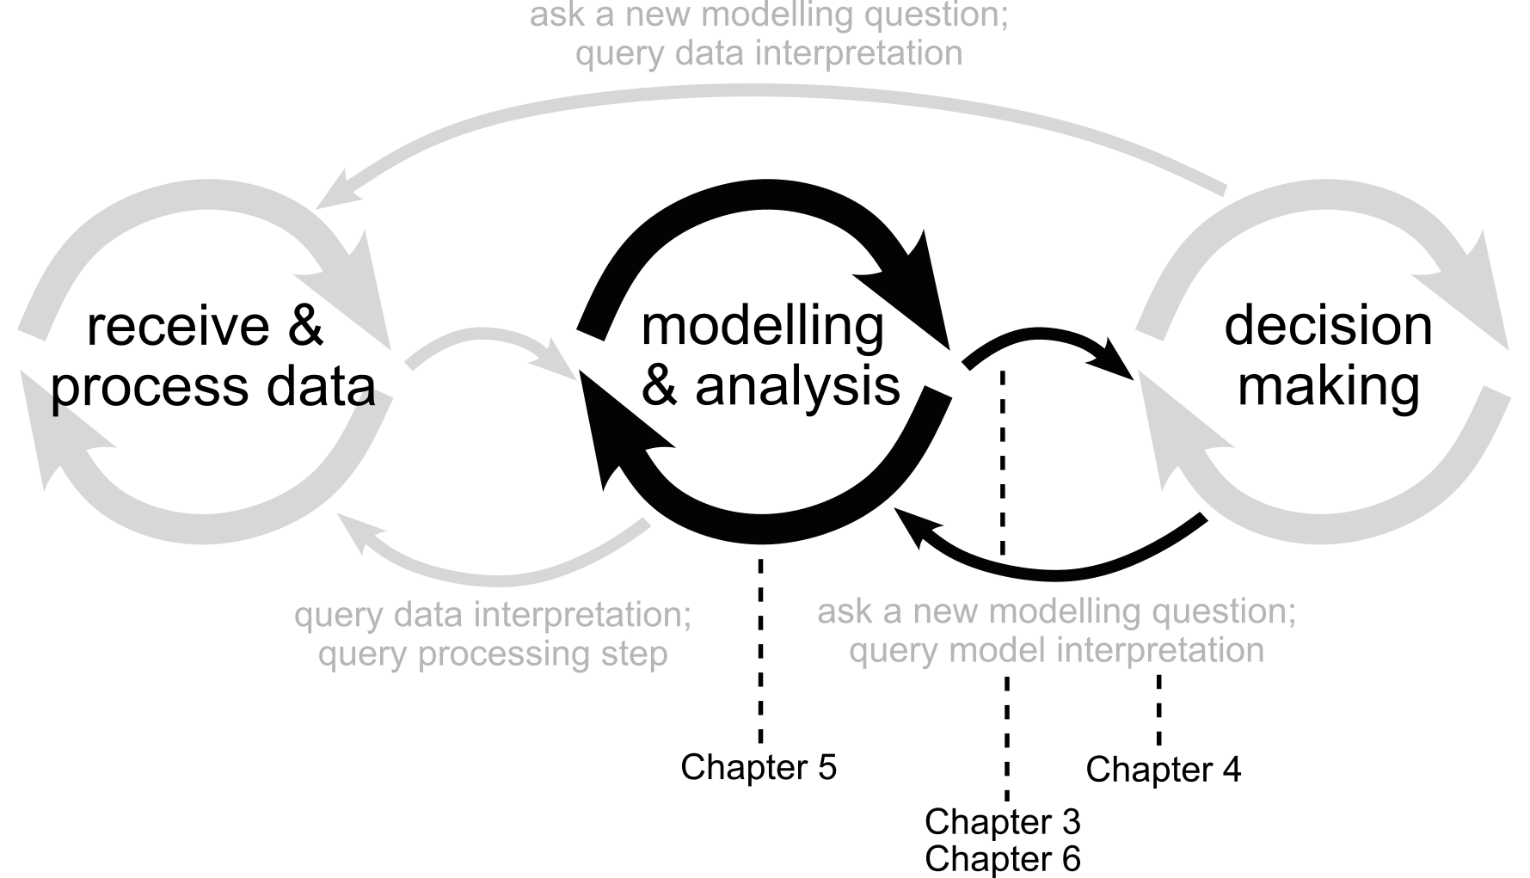
Preface
Here is my PhD thesis:

Slide 4
This afternoon, we will:
Talk through some tips/tricks/rules of thumb for visualisation
Workshop the visualisations we’re working on together
Pick a visualisation from your manuscript, and we will peer review

Slide 5
Resources
Weissgerber et al. (2015). Beyond bar and line graphs: time for a new data presentation paradigm. PLoS biology, doi: 10.1371/journal. Pbio.1002128
Weissgerber et al. (2019). Reveal, don’t conceal: transforming data visualization to improve transparency. Circulation, doi: 10.1161/CIRCULATIONAHA.118.037777
Midway (2020). Principles of effective data visualization. Patterns, doi: 10.1016/j.patter.2020.100141
Hehman & Xie (2021). Doing better data visualization. Advances in Methods and Practices in Psychological Science, doi: 10.1177/25152459211045334.

Slide 6
Some principles for visualising data …
Show the data
But don’t show too much
Uncertainty is important
And so is proportion
And colour
And finally, if in doubt … get another opinion!

Slide 7
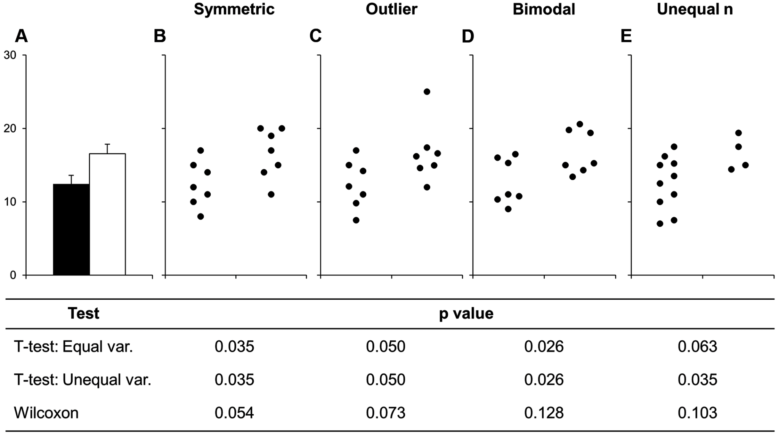
Weissgerber et al., 2015

Slide 8
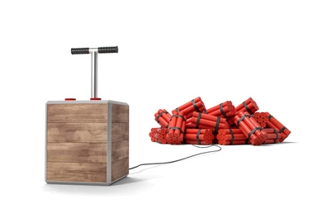
Weissgerber et al., 2015

Slide 9
Show the data
Weissgerber et al., 2015

Slide 10
Show the data
Weissgerber et al., 2015

Slide 11
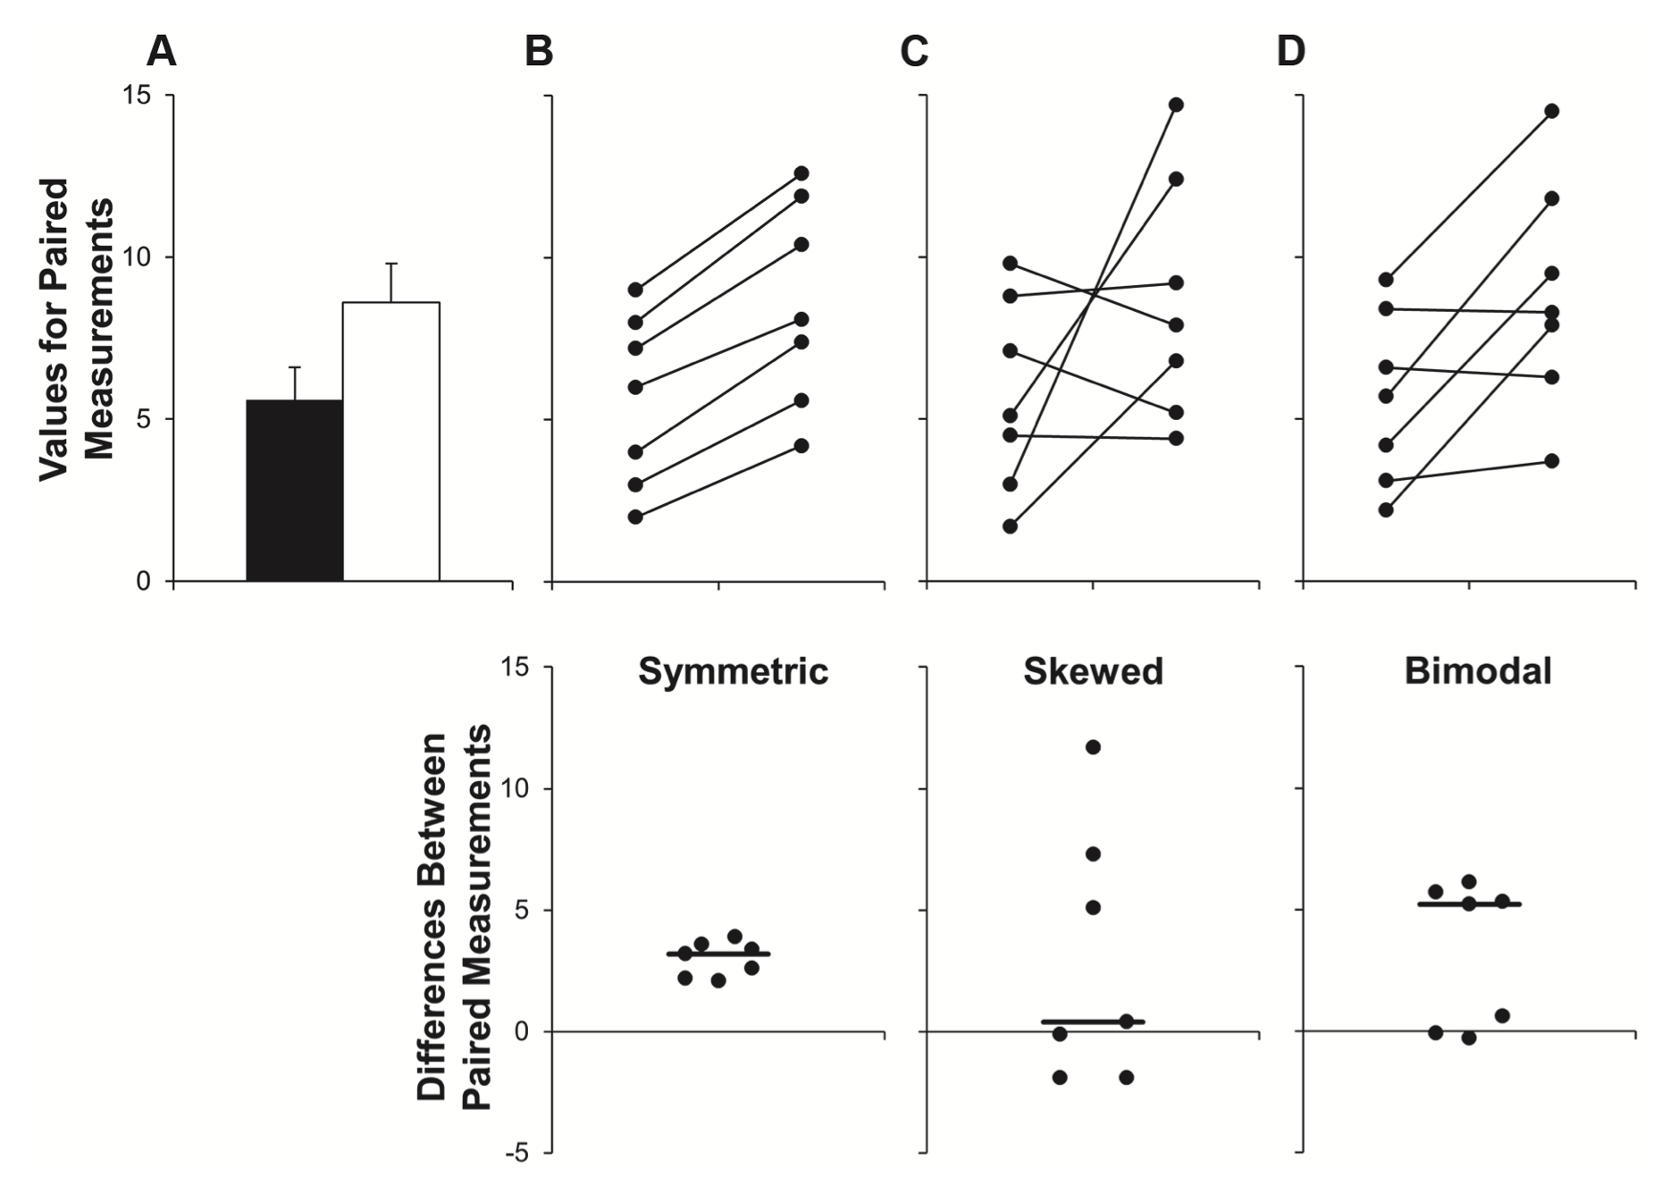
Show the data
Weissgerber et al., 2015

Slide 12
Show the data
Weissgerber et al., 2015

Slide 13
Show the data
Weissgerber et al., 2015

Slide 14
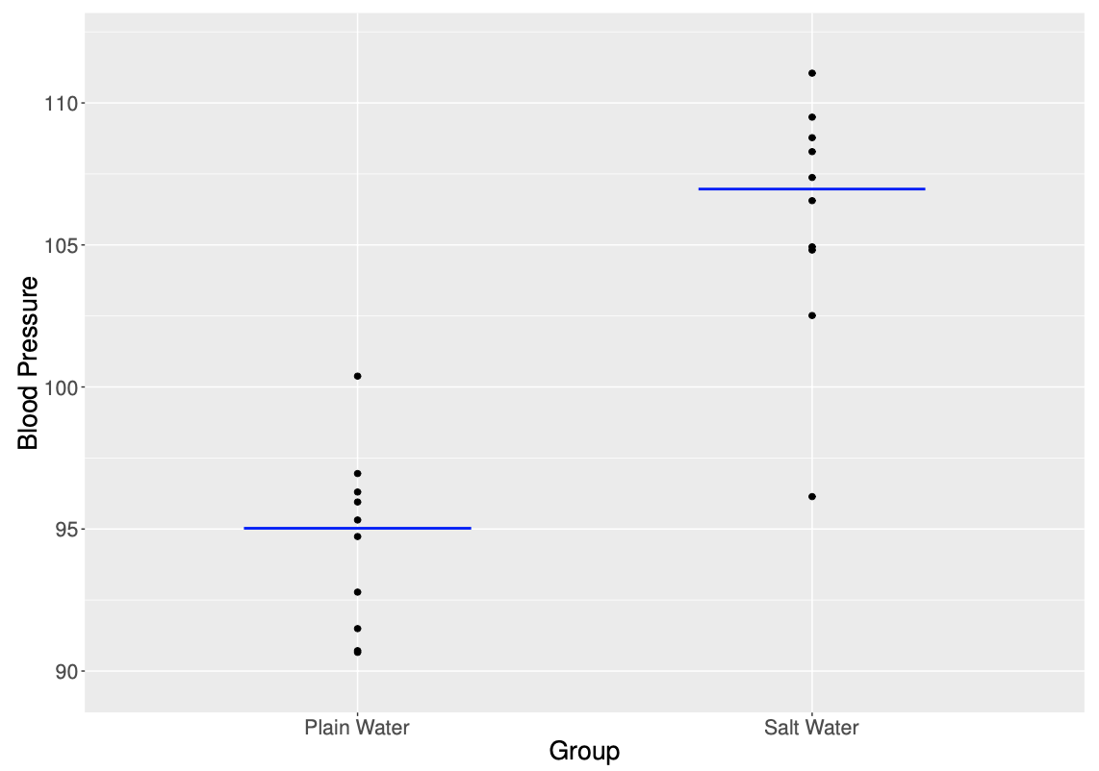

Slide 15
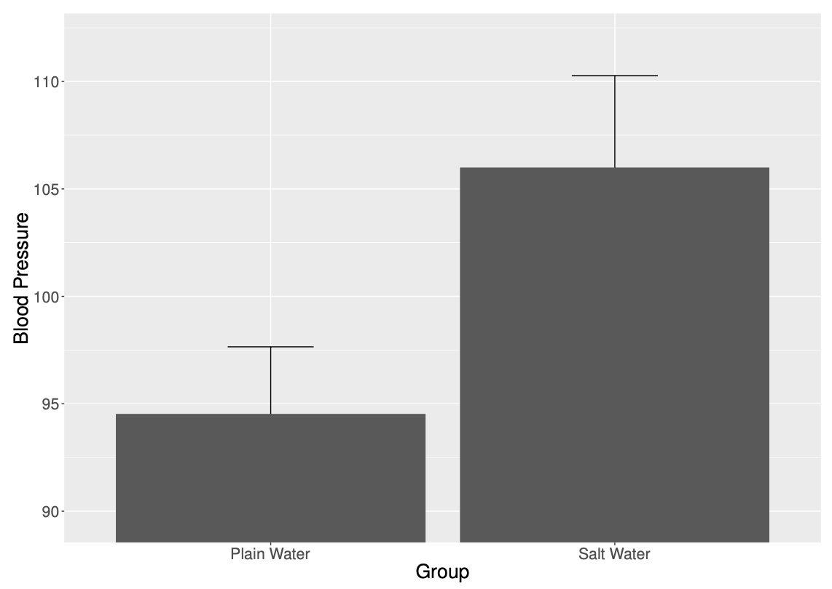

Slide 16
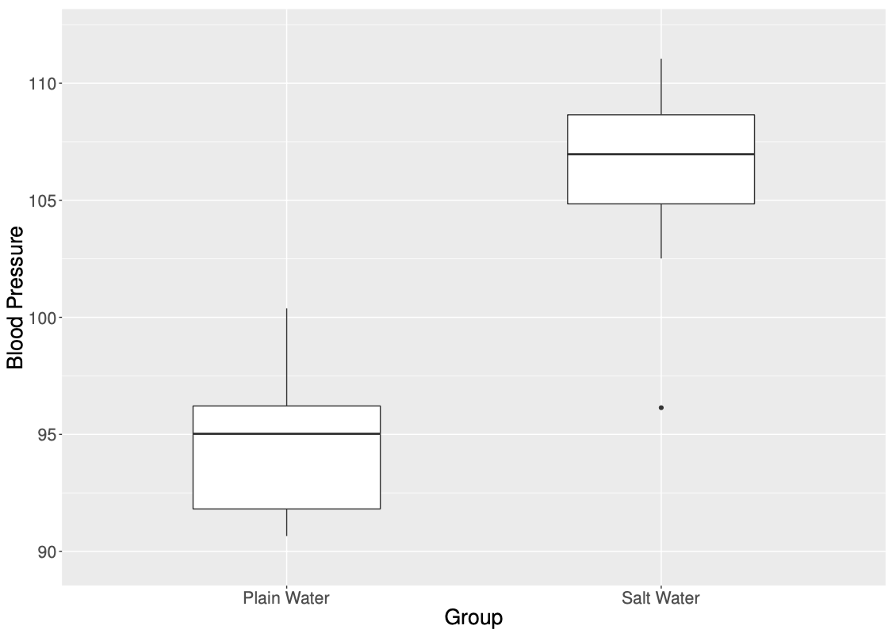

Slide 17


Slide 18
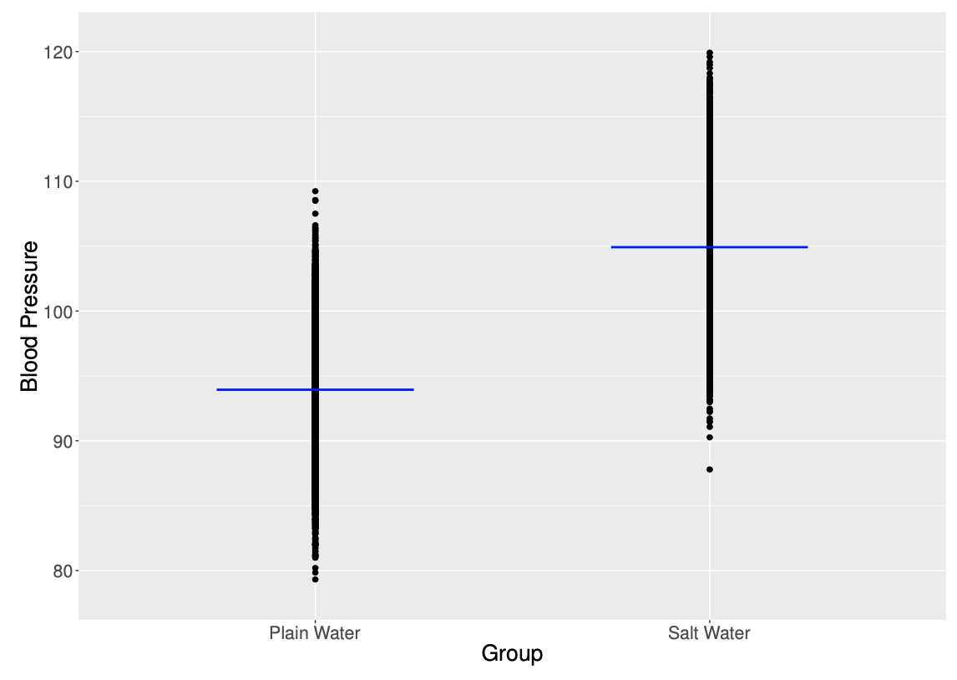

Slide 19
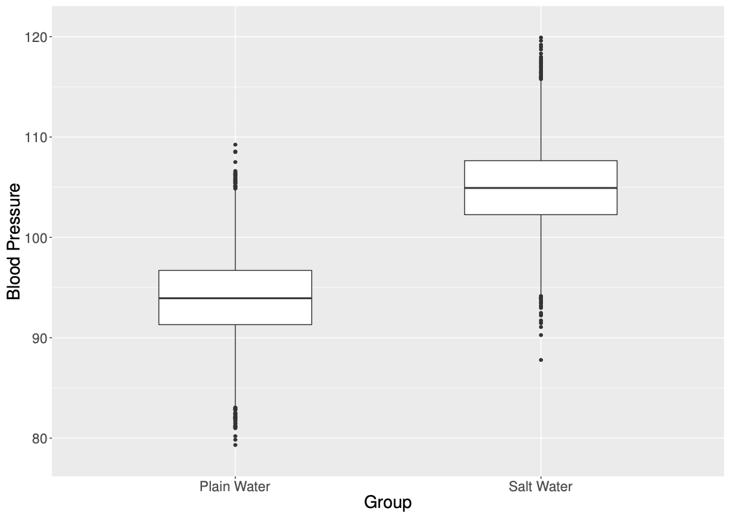

Slide 20
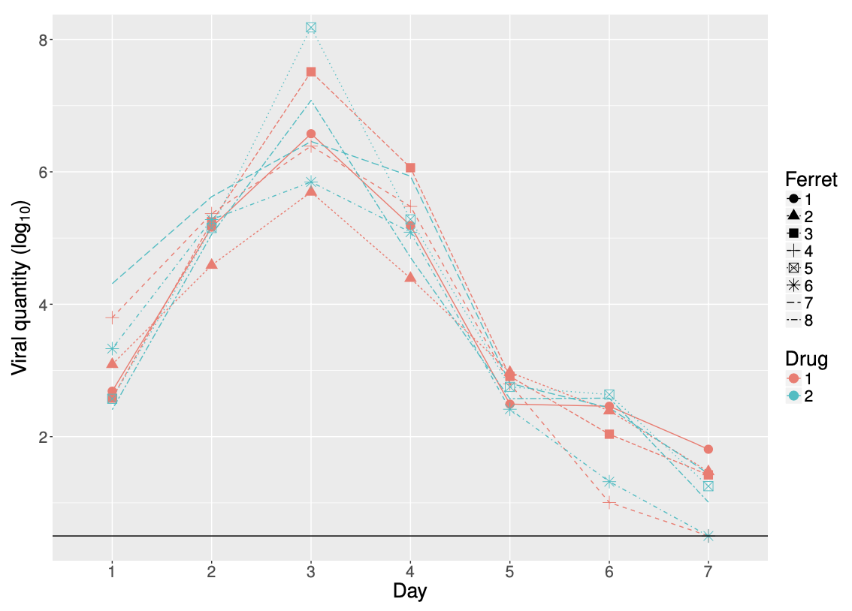
Less may be more

Slide 21
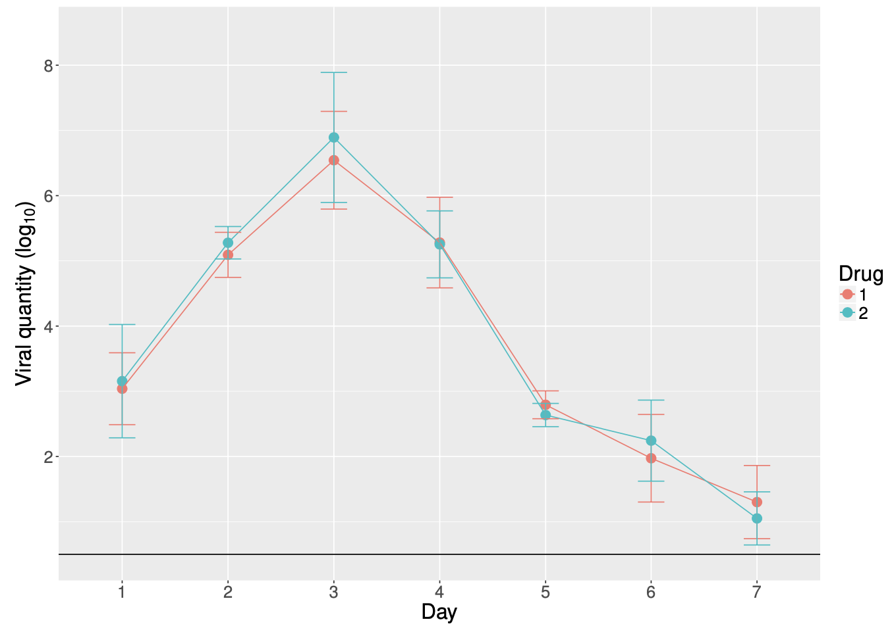
Less may be more

Slide 22
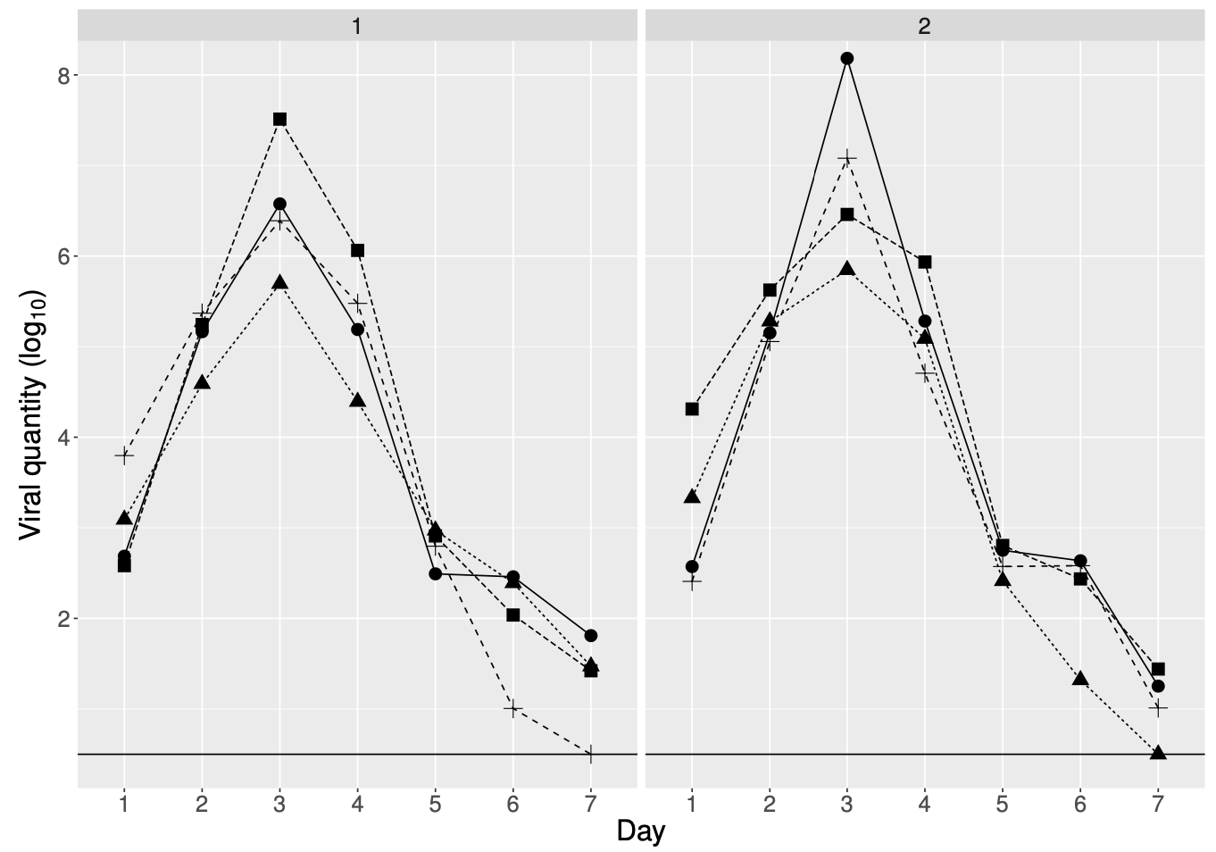
Less may be more

Slide 23
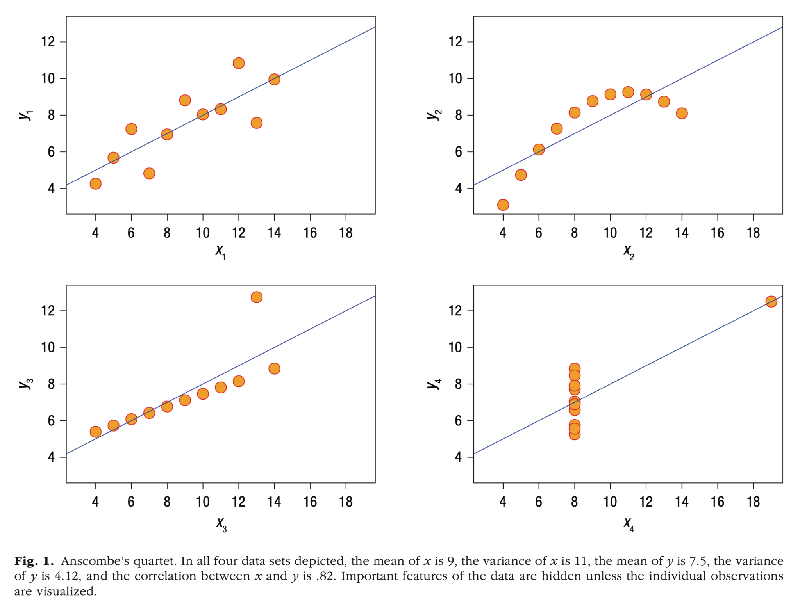
Summary statistics can be misleading
Hehman & Xie, 2021

Slide 24
Summarising your data (e.g. “detonator plots”) can remove information

Slide 25
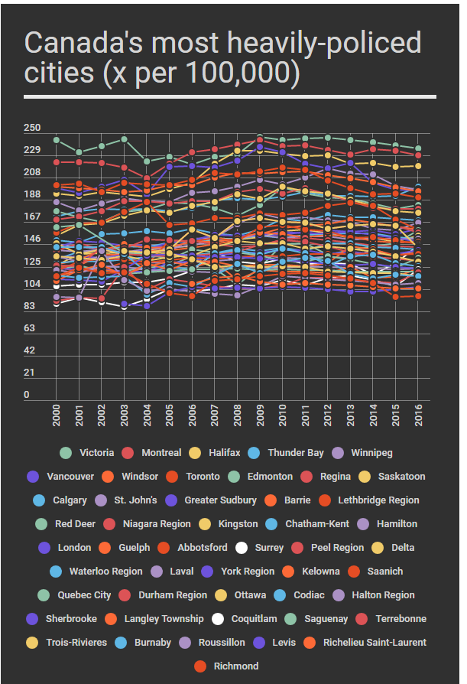
Keep it simple
(i found this on reddit)

Slide 26
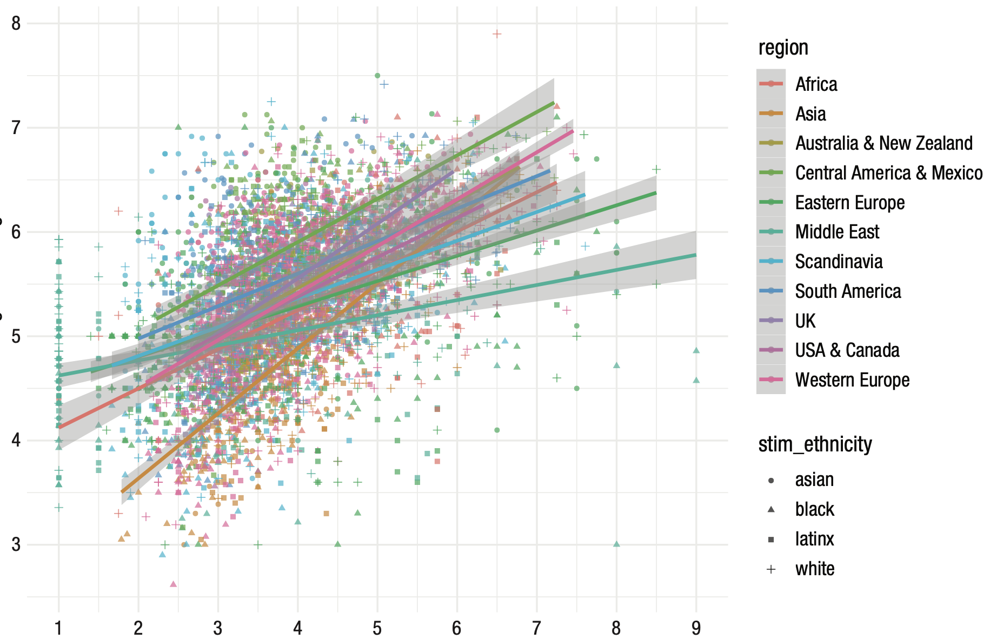
Keep it simple
Hehman & Xie, 2021

Slide 27
Colour is important!

Slide 28
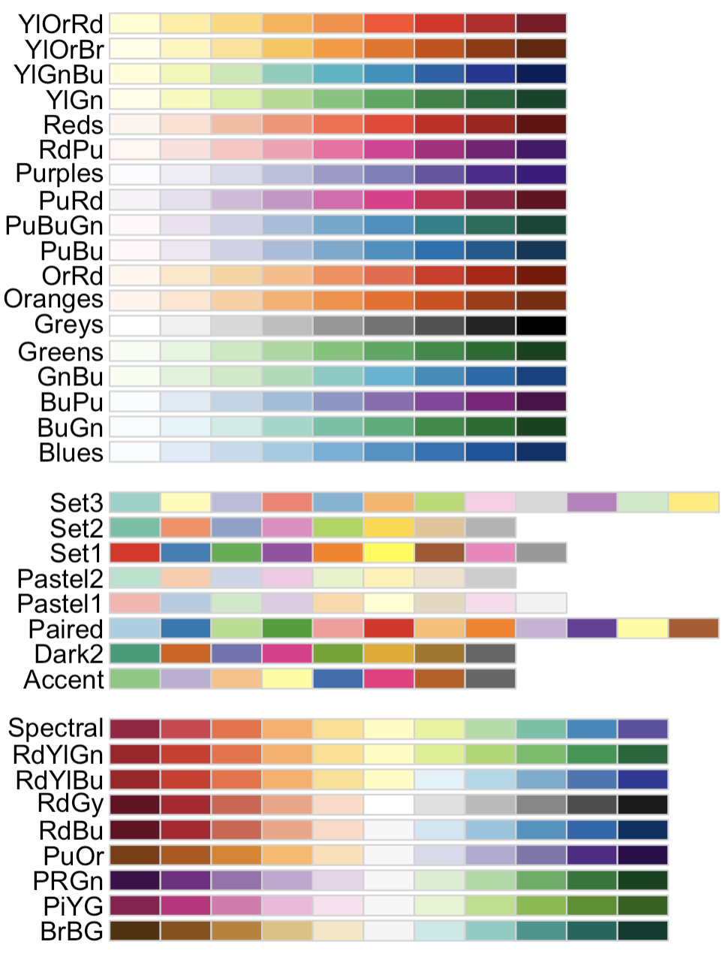
Colour is important!
Categorical / qualitative

Slide 29
Colour is important!
Categorical / qualitative
Continuous
Diverging

Slide 30
Colour is important!
Categorical / qualitative
Continuous
Diverging
Sequential
Single hue

Slide 31
Colour is important!
Categorical / qualitative
Continuous
Diverging
Sequential
Single hue
Multi-hue

Slide 32
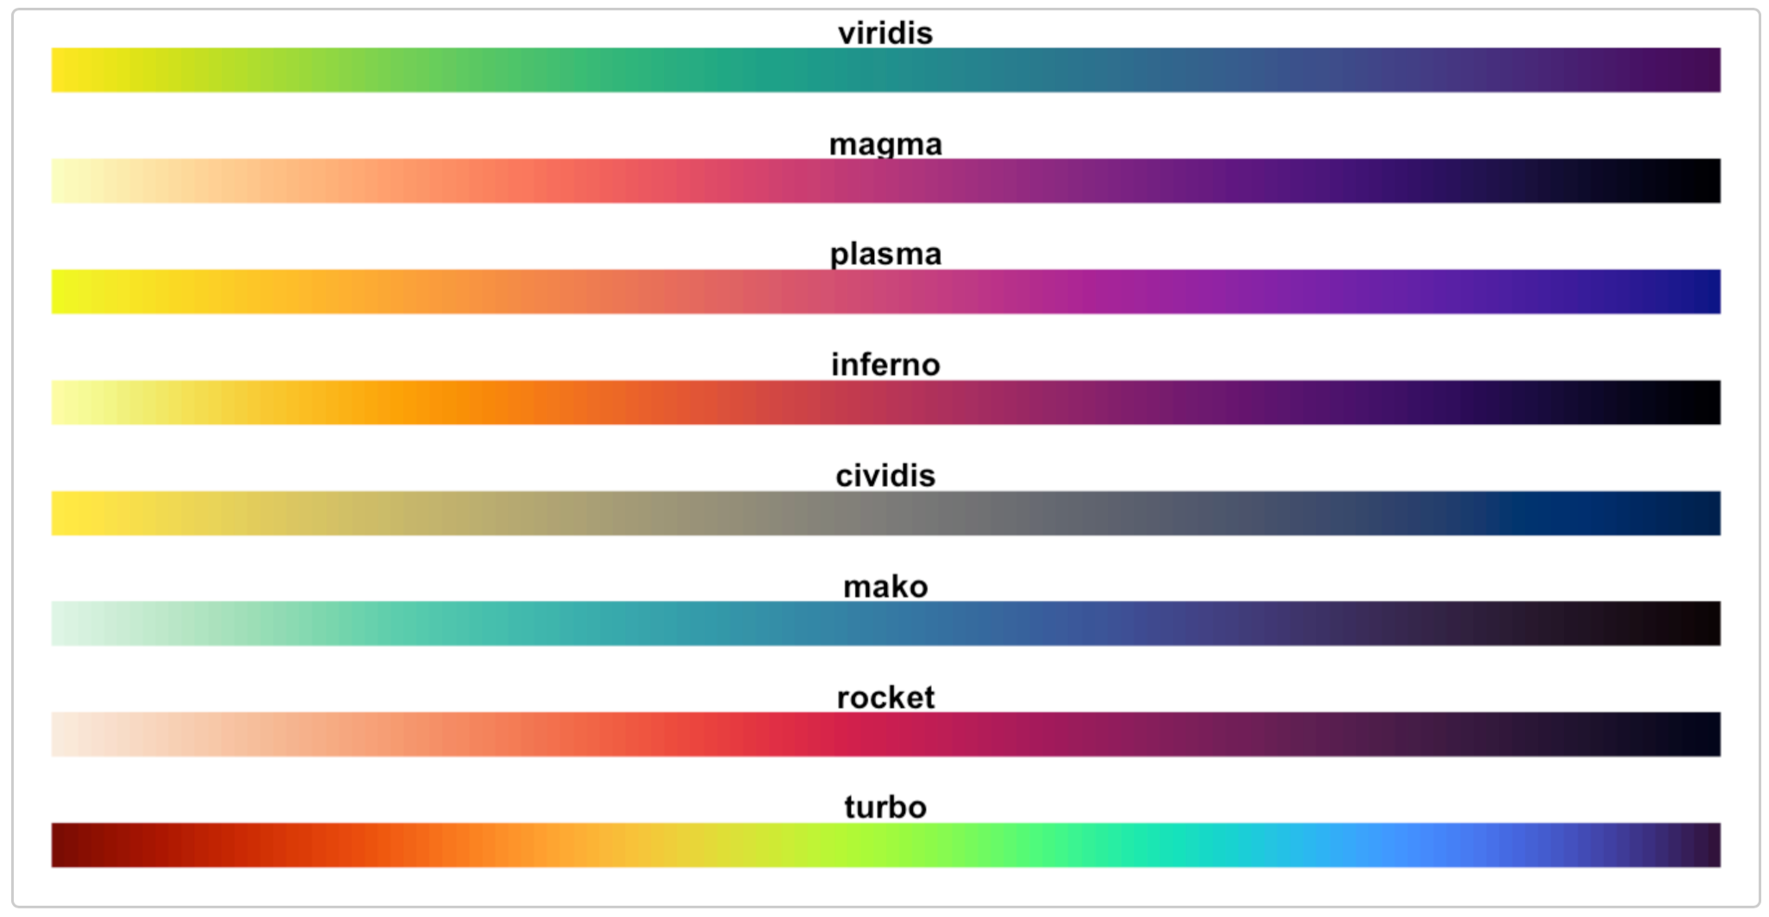
Colour is important!
Categorical / qualitative
Continuous
Diverging
Sequential
Single hue
Multi-hue
Color brewer:
https://colorbrewer2.org
Bonus: Viridis
https://cran.r-project.org/web/packages/viridis/vignettes/intro-to-viridis.html

Slide 33

Colour is important!
Categorical / qualitative
Continuous
Diverging
Sequential
Single hue
Multi-hue
Color brewer:
https://colorbrewer2.org
Bonus: Viridis
https://cran.r-project.org/web/packages/viridis/vignettes/intro-to-viridis.html

Slide 34
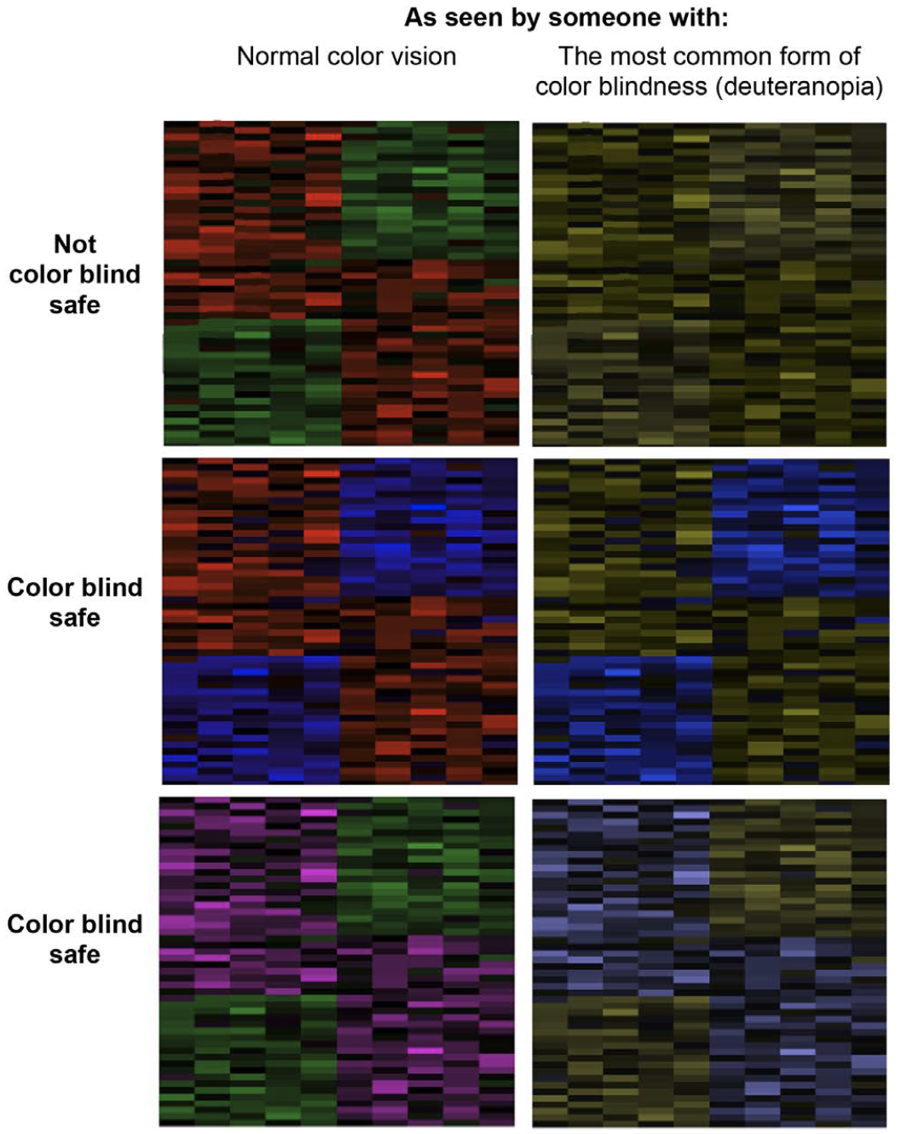
Colour is important!
Weissgerber et al., 2019 (using Color Oracle)
https://colororacle.org
Color brewer:
https://colorbrewer2.org

Slide 35
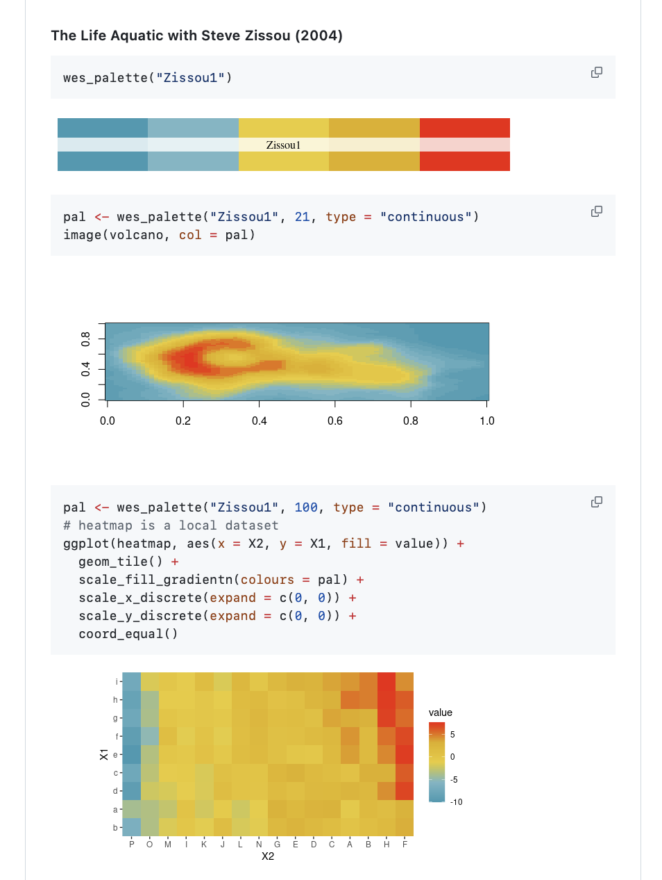

Colour is important!
There are lots of palettes out there, once you’ve had enough of Colour Brewer + Viridis:
https://github.com/karthik/wesanderson

Slide 36
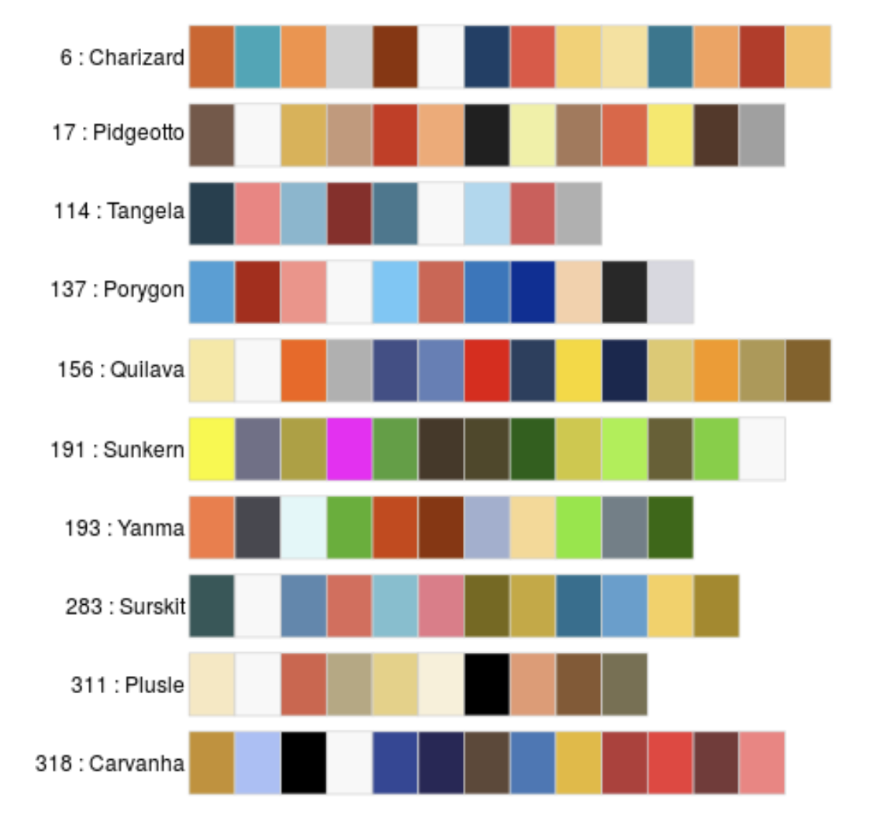
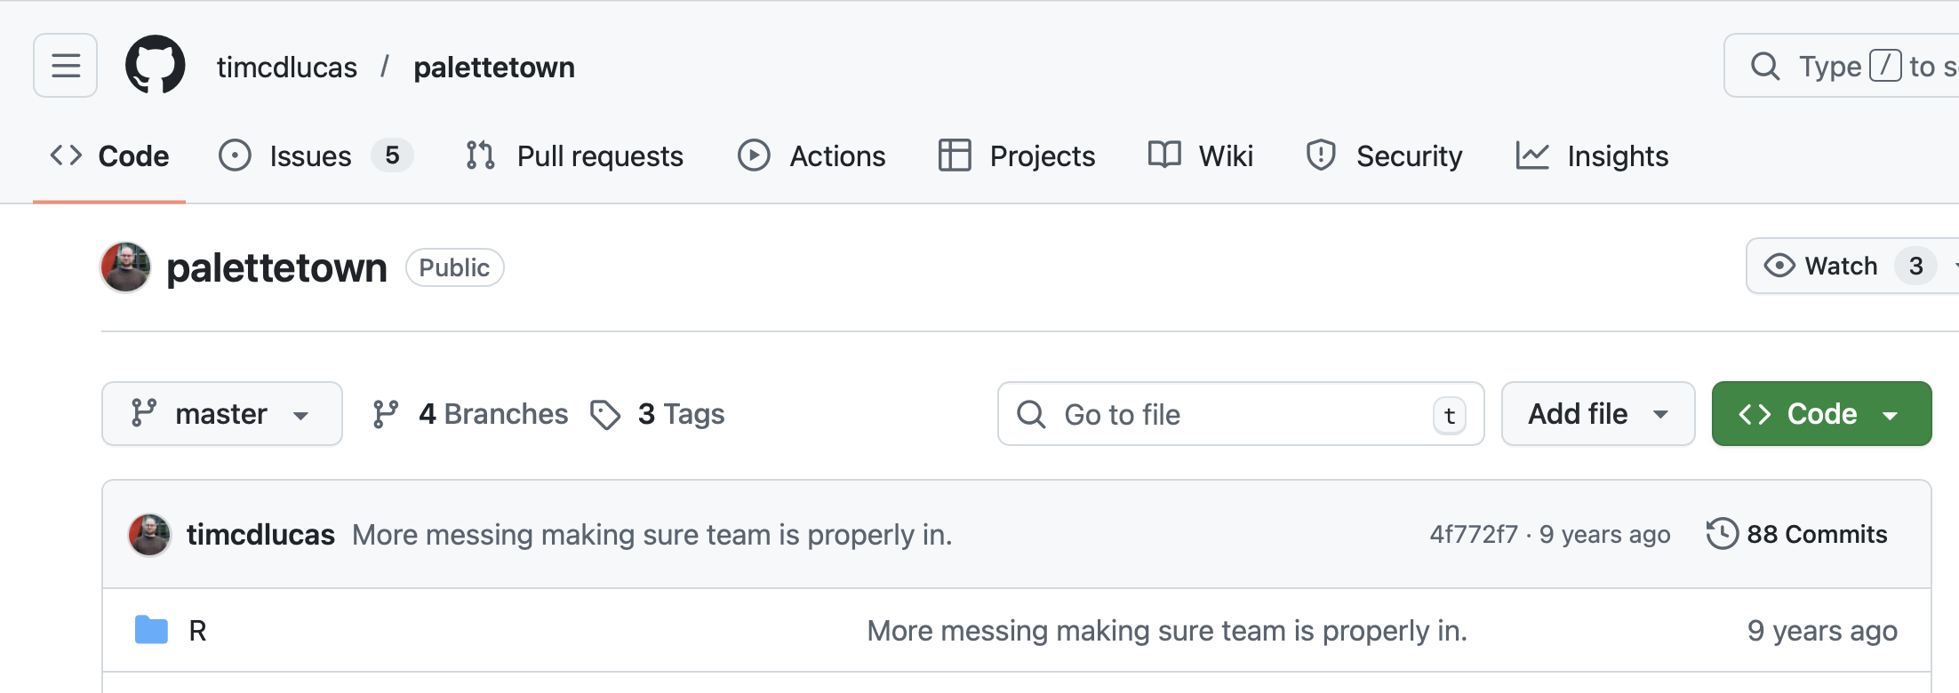

Colour is important!
There are lots of palettes out there, once you’ve had enough of Colour Brewer + Viridis:
If you can’t find the colour palette you’re looking for, make up your own!
https://github.com/timcdlucas/palettetown

Slide 37
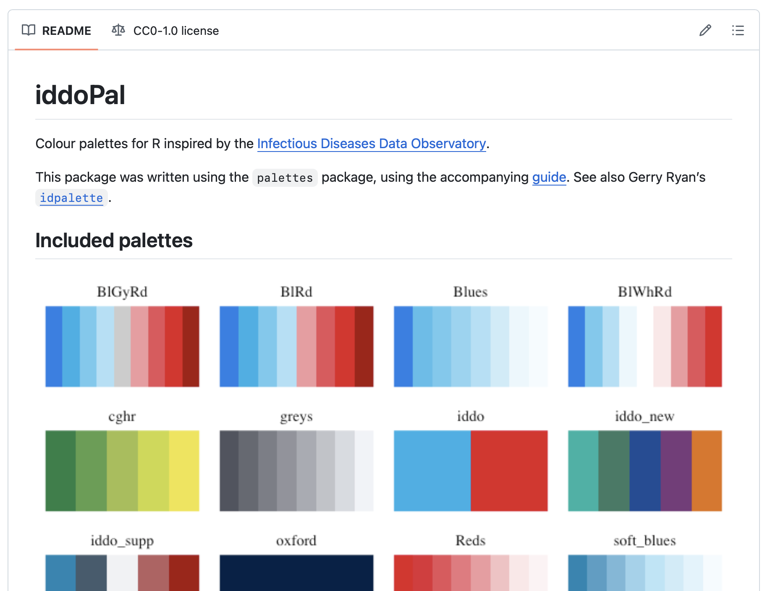

Colour is important!
If you can’t find the colour palette you’re looking for, make up your own!

Slide 38
Colour is important!
https://mccarthy-m-g.github.io/palettes/articles/creating-packages.html
If you can’t find the colour palette you’re looking for, make up your own!

Slide 39
A little diversion: I love maps
Background should be distinct
Beware blue
Consider detail carefully
Keep track of scale, projection + aggregation
And all of the other rules apply too

Slide 40
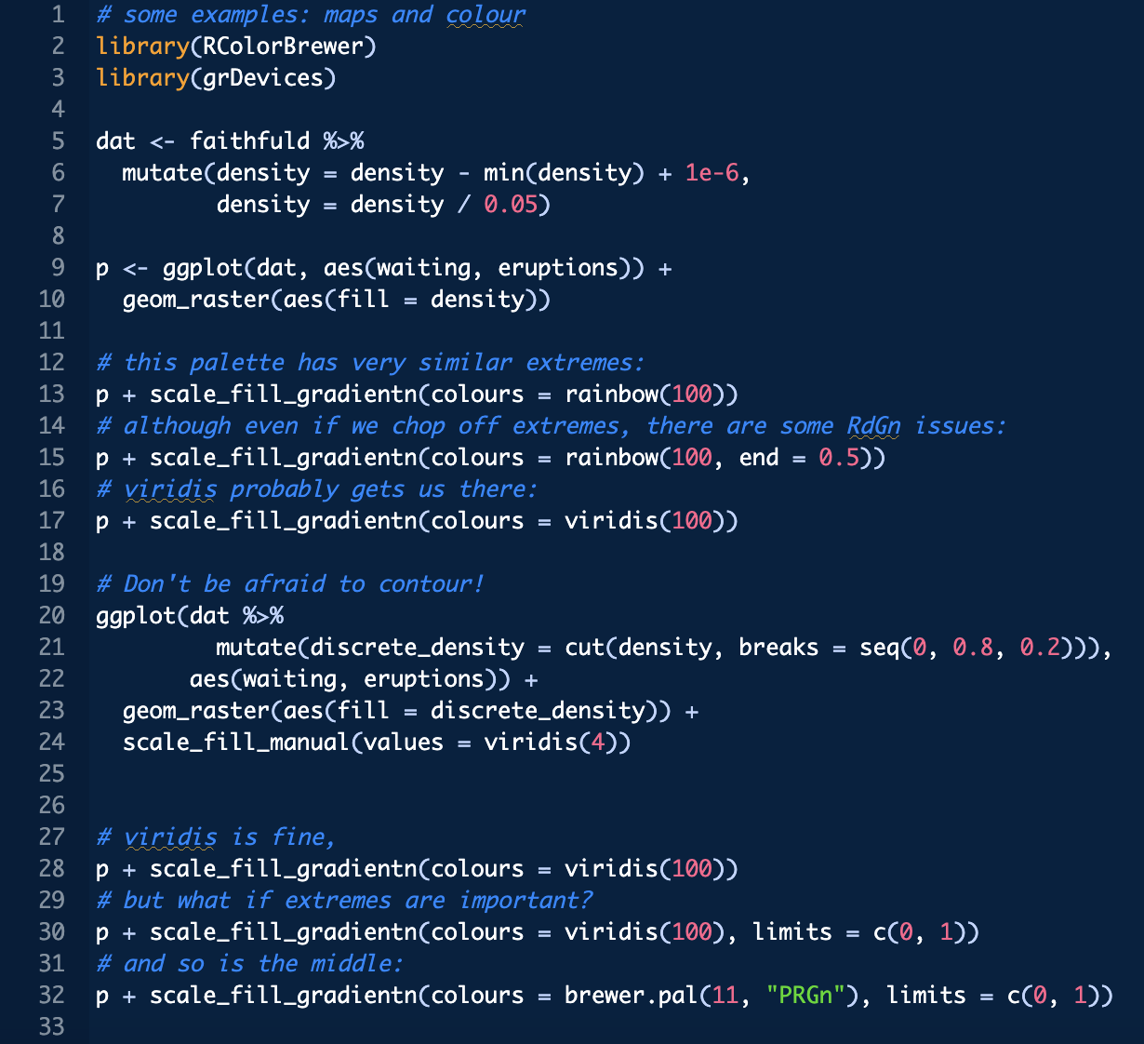

Slide 41
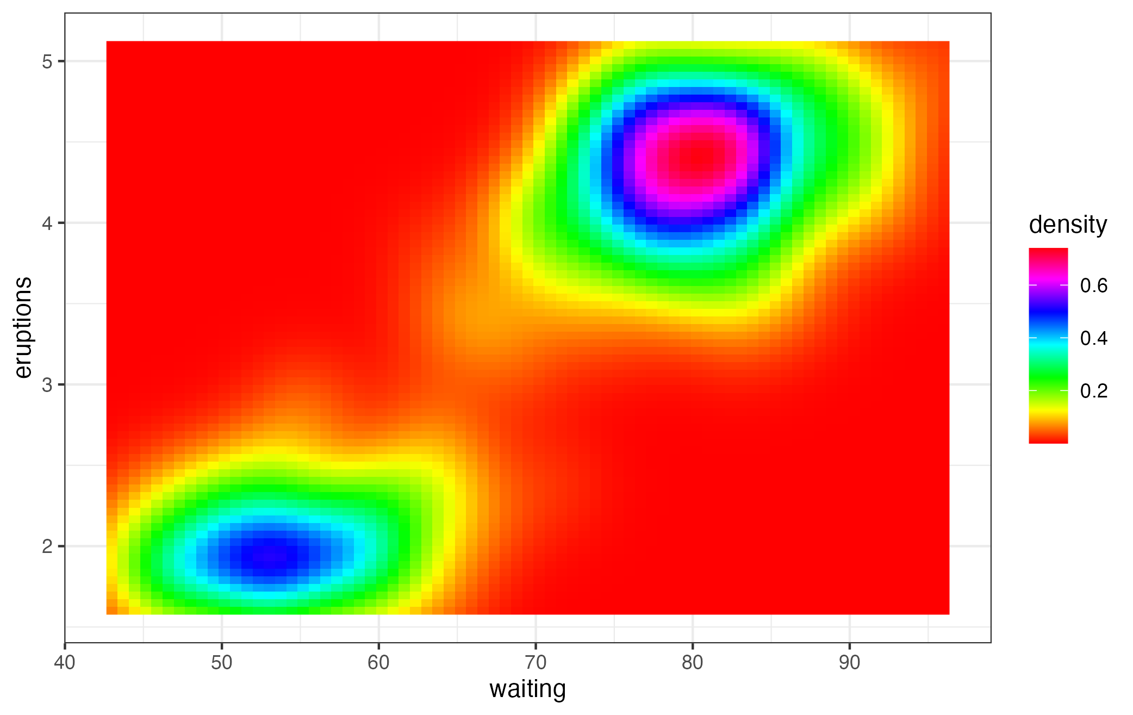

Slide 42
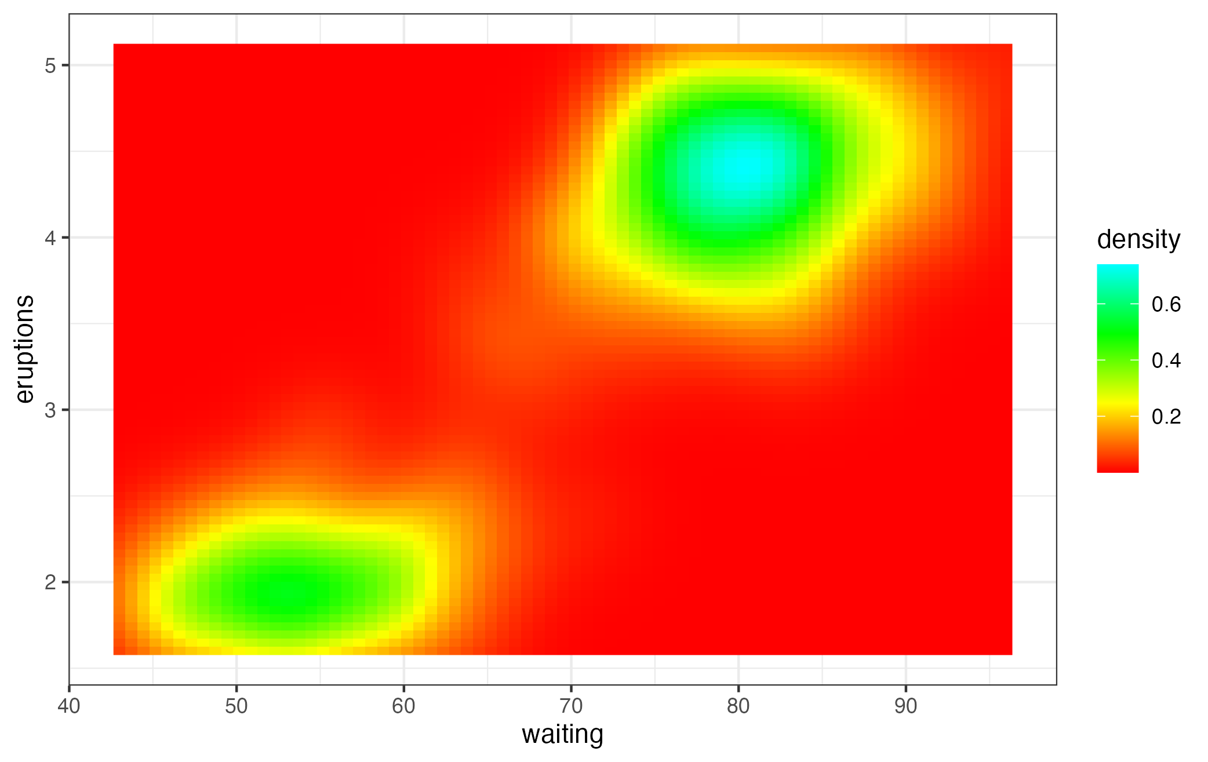

Slide 43
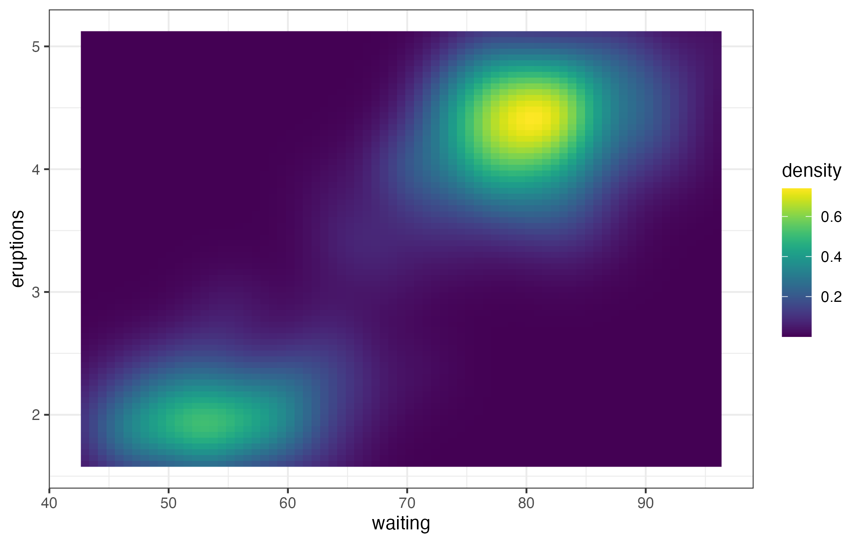

Slide 44
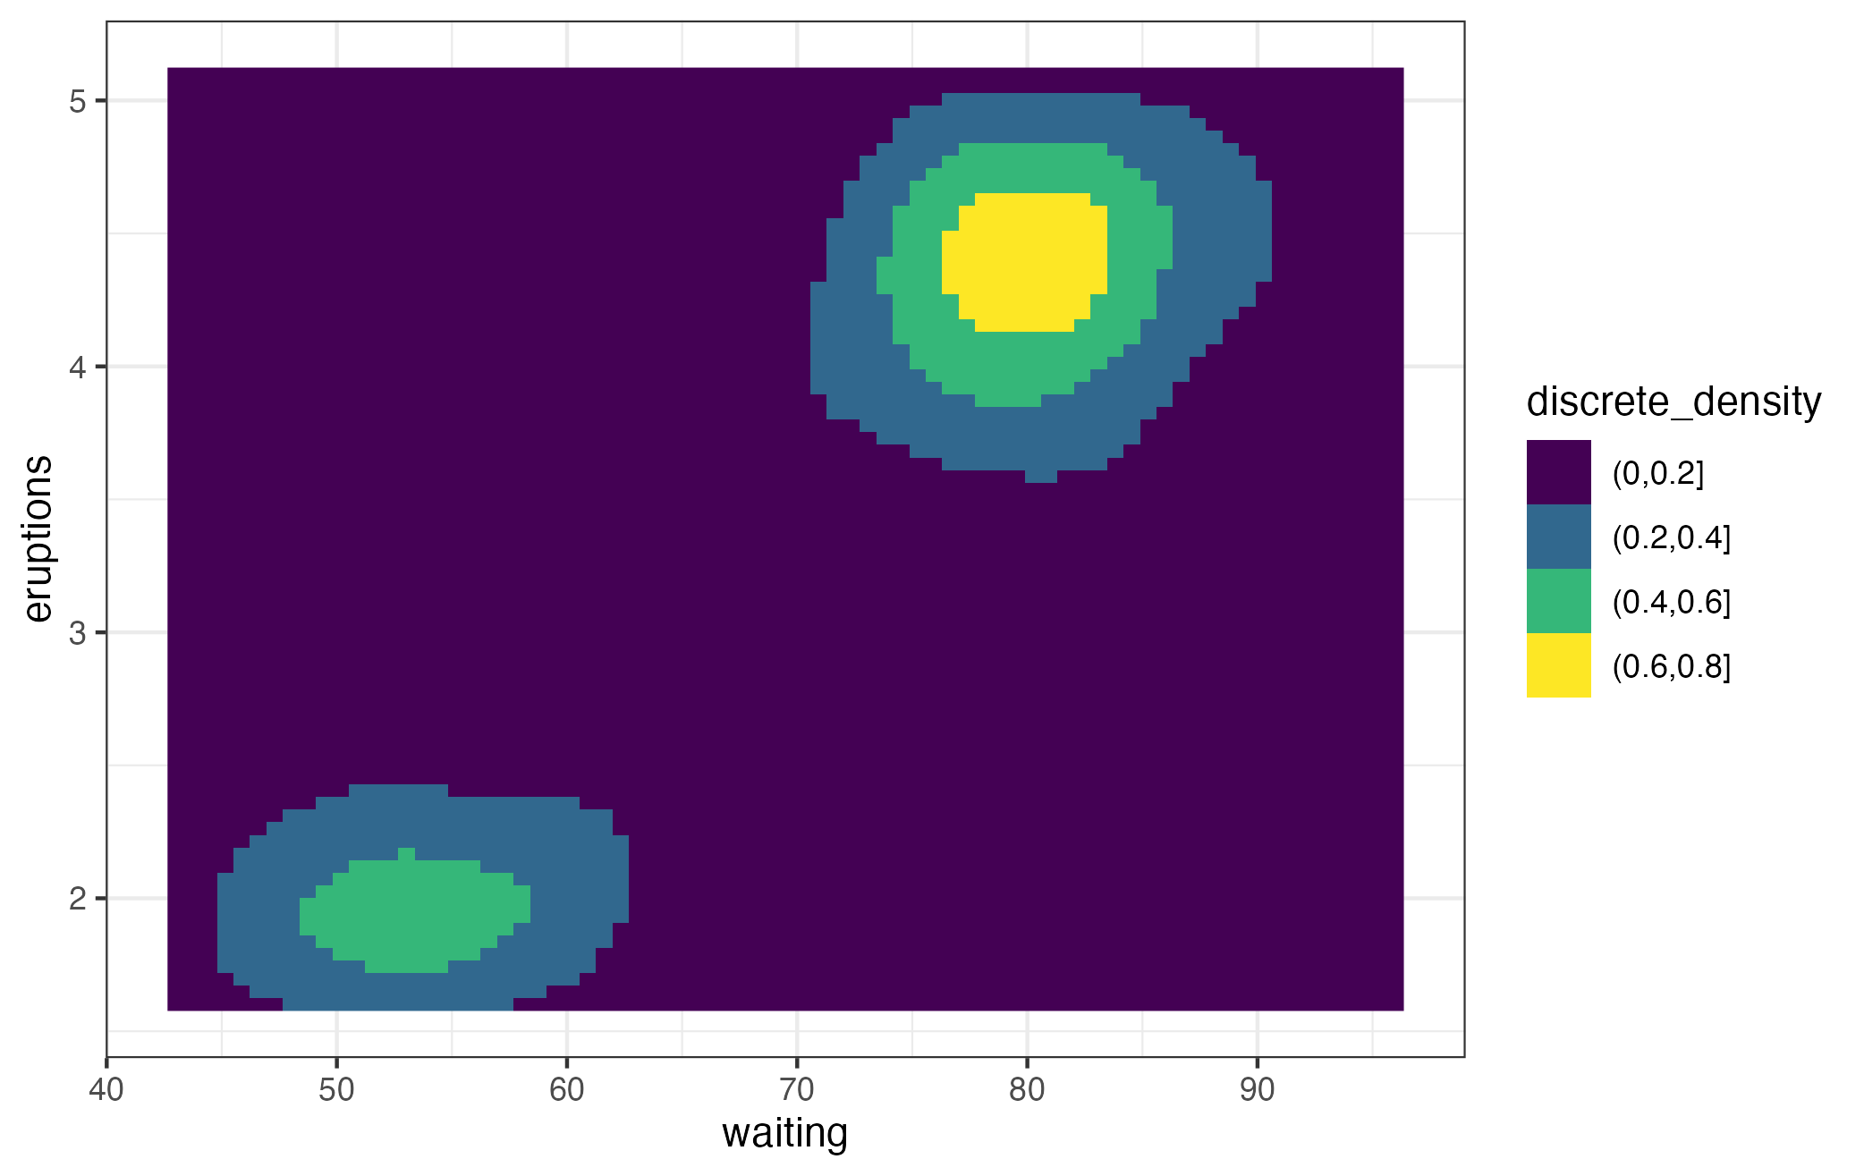

Slide 46
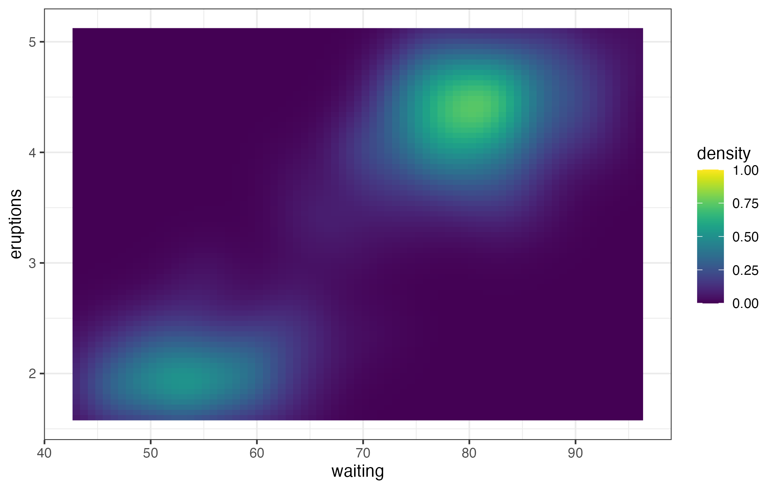

Slide 47
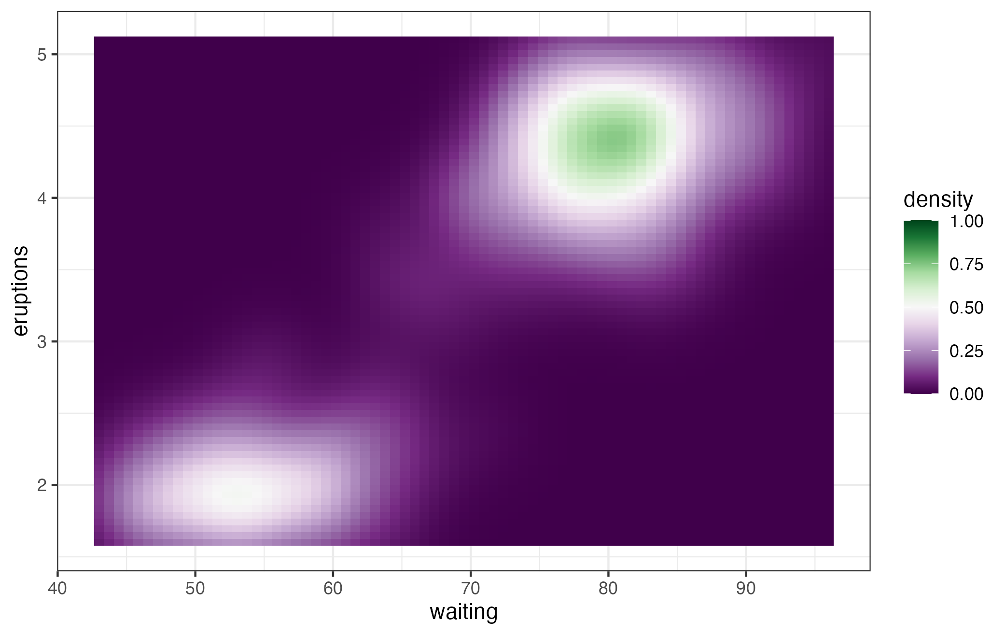

Slide 48
Finally, if in doubt …

Slide 49
Finally, if in doubt …
… get another opinion!

Slide 50
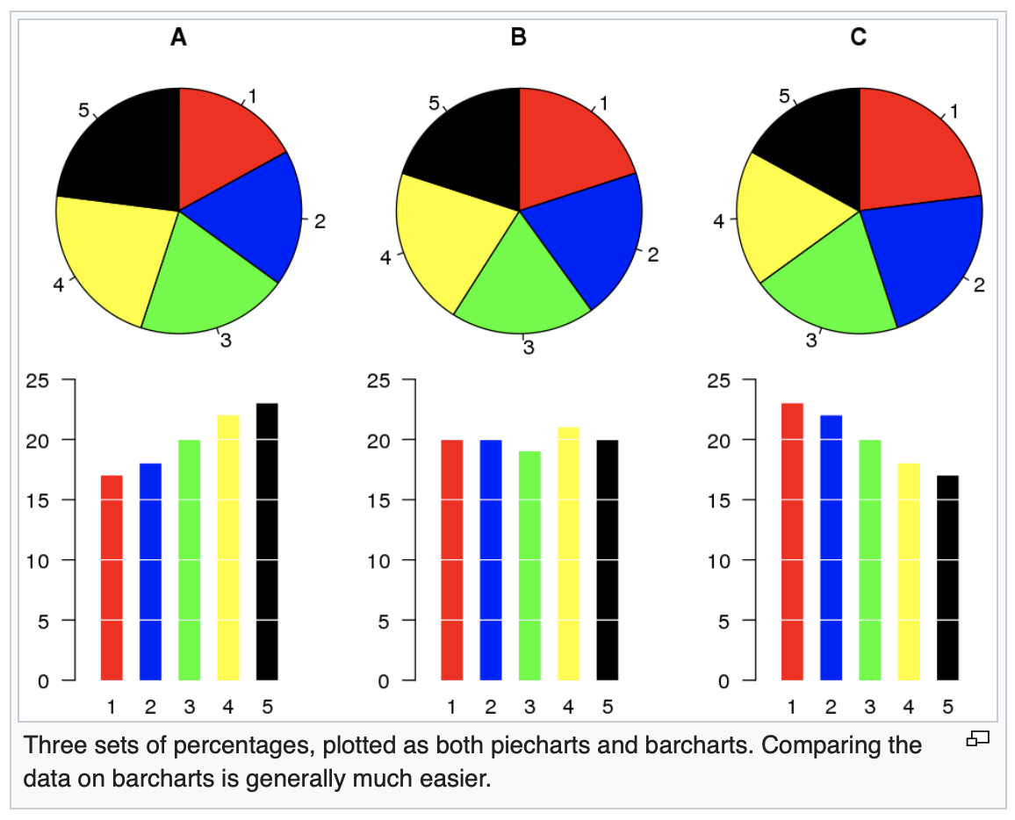
… and reconsider that pie chart!
Hill, Andrew. "Are pie charts evil? An assessment of the value of pie and donut charts compared to bar charts." Information Visualization 24, no. 1 (2025): 3-23.
Bertini, Enrico, Niklas Elmqvist, and Thomas Wischgoll. "Judgment error in pie chart variations." In Proceedings of the Eurographics/IEEE VGTC conference on visualization: Short papers, pp. 91-95. 2016.
Siirtola, Harri. "The cost of pie charts." In 2019 23rd International Conference Information Visualisation (IV), pp. 151-156. IEEE, 2019.

Slide 51
We now enter my hall of fame:
Figures that are really published in peer-reviewed journals
(We’ll start with some mild examples)

Slide 52
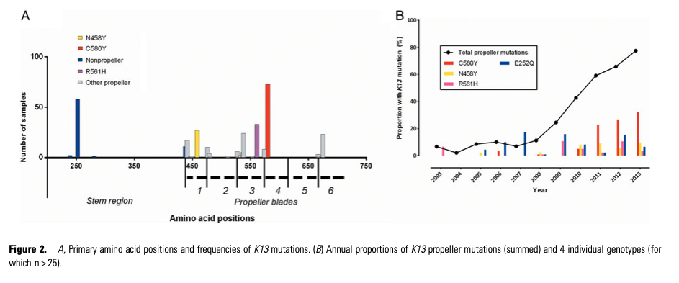
Notes:
https://doi.org/10.1093/cid/ciw388
The text is super small
The colours aren’t consistent
In A, the bars overlap

Slide 53
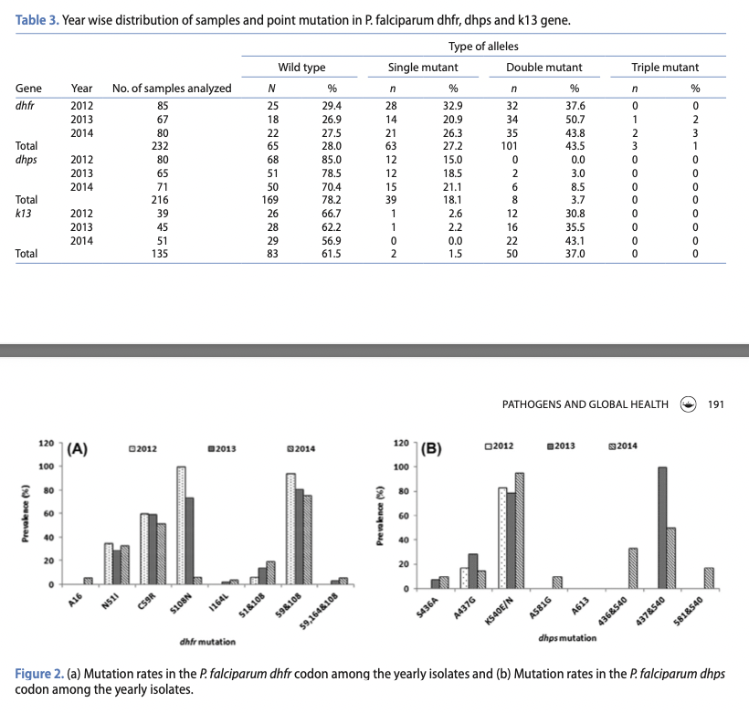
Notes:
https://doi.org/10.1080/20477724.2017.1331875
120% ?!
Details really hard to get at

Slide 54
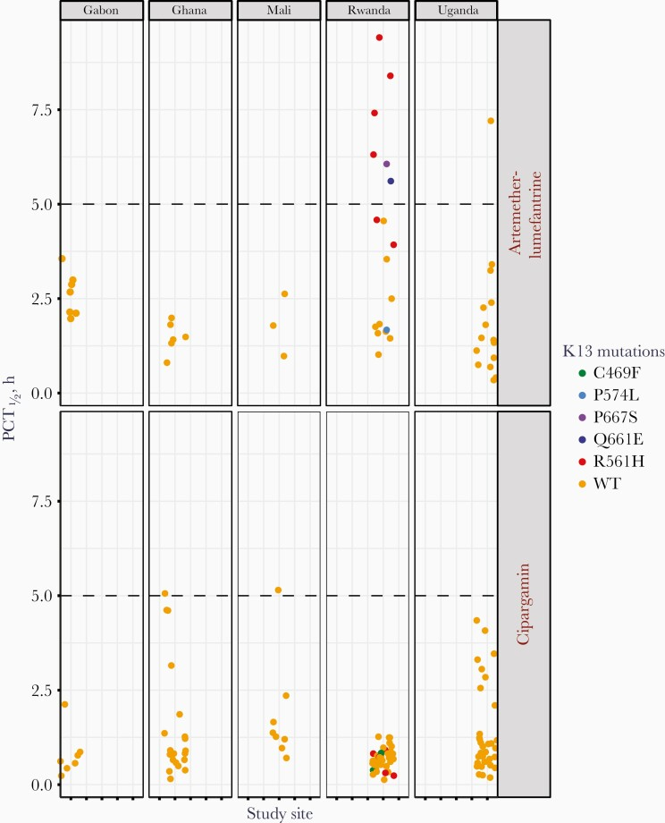
Let’s discuss
Notes:
https://doi.org/10.1093/infdis/jiab352
X-axis is meaningless – all Gabon sites are centred around “1”, Ghana sites are centred around “2”, etc.
Show two treatment groups on the same y-axis?
Point opacity: WTs obscure R561H in cipargamin group in Rwanda

Slide 55
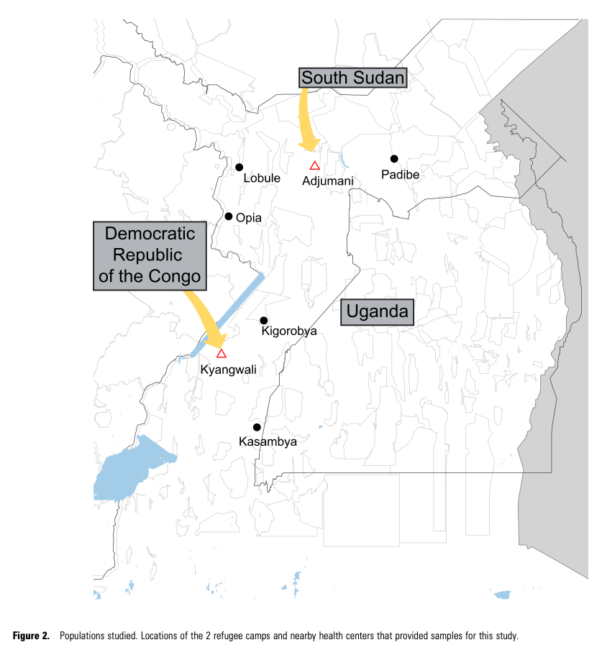
Let’s discuss
Notes:
https://doi.org/10.1093/infdis/jiae288
Nobody looked at this when it was proofed did they
Phil Rosenthal senior author
Why are we even bothering with journals at this point

Slide 56
Time for a quiz!
https://www.matplotlib-journey.com/bonus/design-principles

Slide 57
In summary ..
Show the data
But don’t show too much
Uncertainty is important
And so is proportion
And colour
And finally, if in doubt … get another opinion!

Slide 58
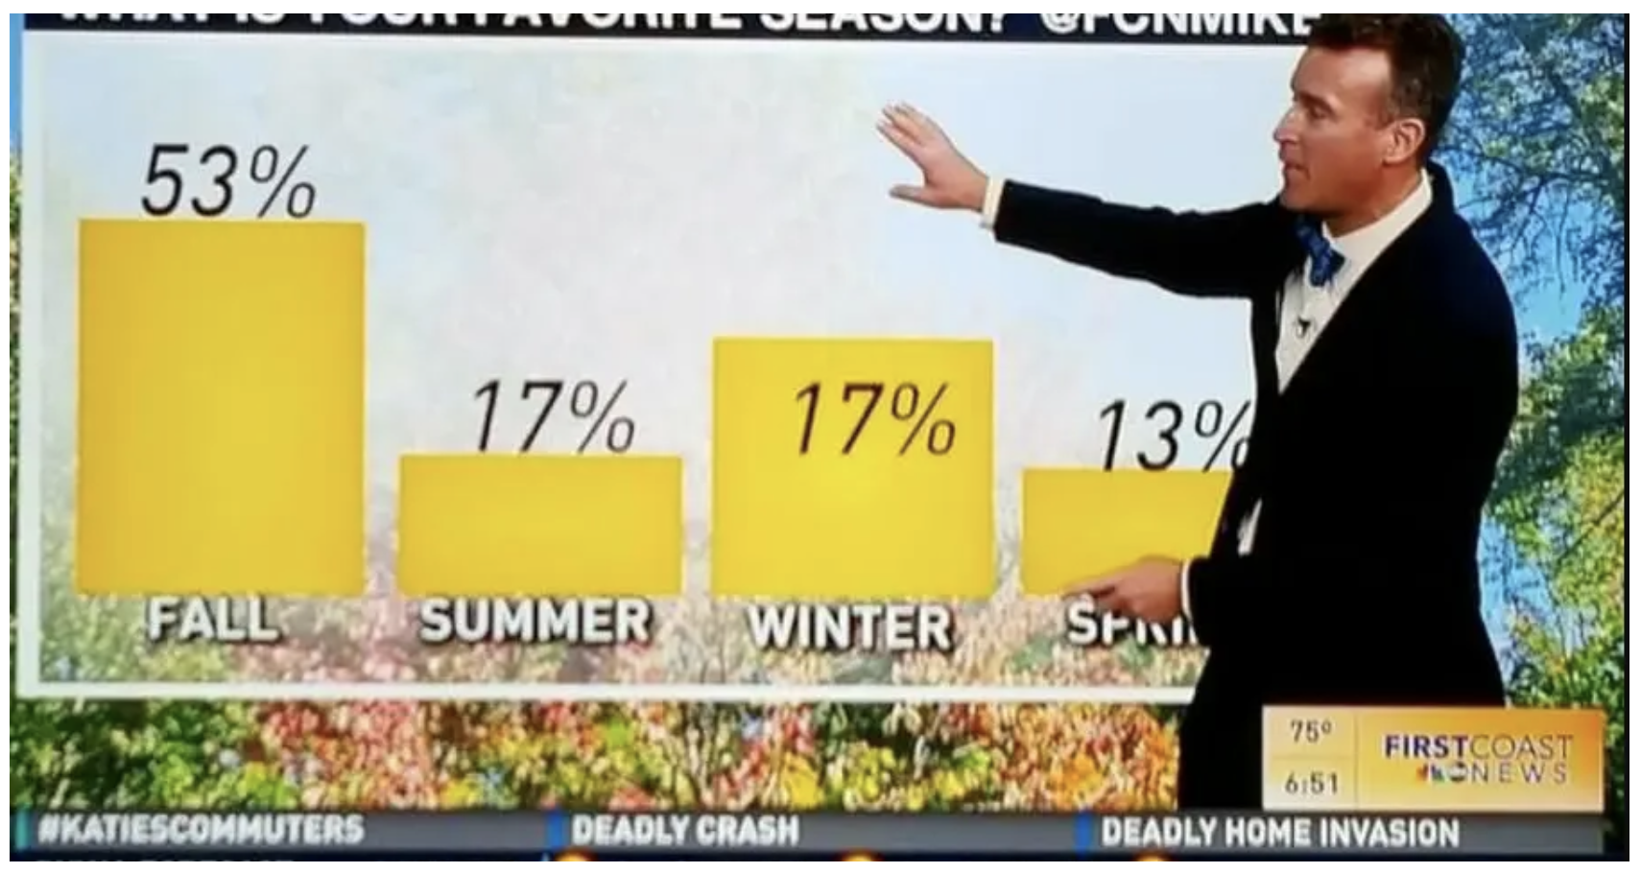
~ Let’s compare notes ~

