Slide 1
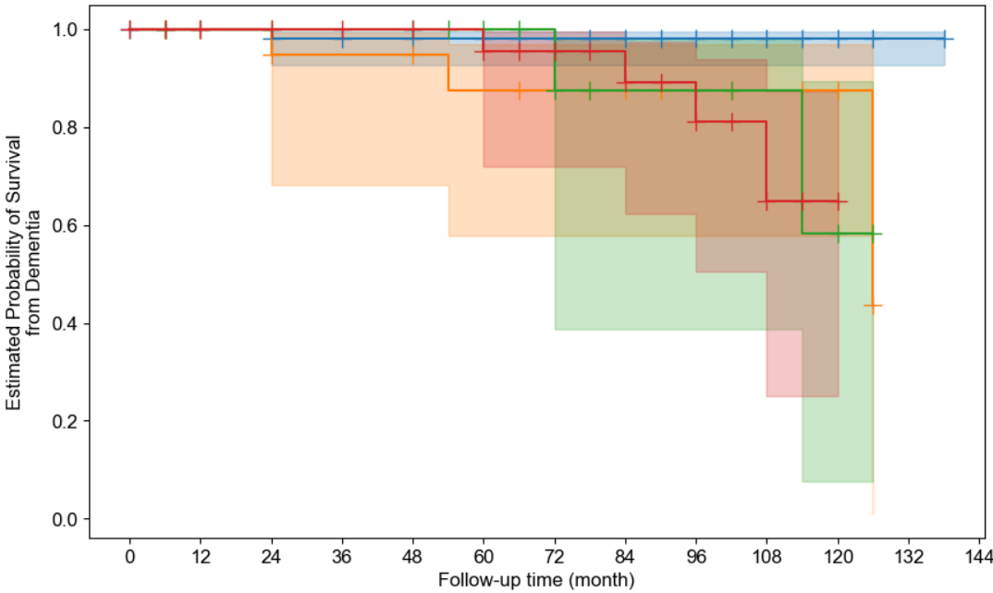
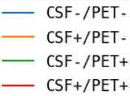
115 | 111 | 107 | 89 | 84 | 72 | 68 | 55 | 50 | 35 | 17 | 2 | 0
22 | 20 | 19 | 15 | 15 | 14 | 11 | 10 | 7 | 5 | 4 | 0 | 0
21 | 19 | 19 | 16 | 16 | 12 | 8 | 6 | 5 | 3 | 3 | 0 | 0
47 | 43 | 40 | 31 | 29 | 22 | 17 | 15 | 12 | 5 | 2 | 0 | 0

Slide 2
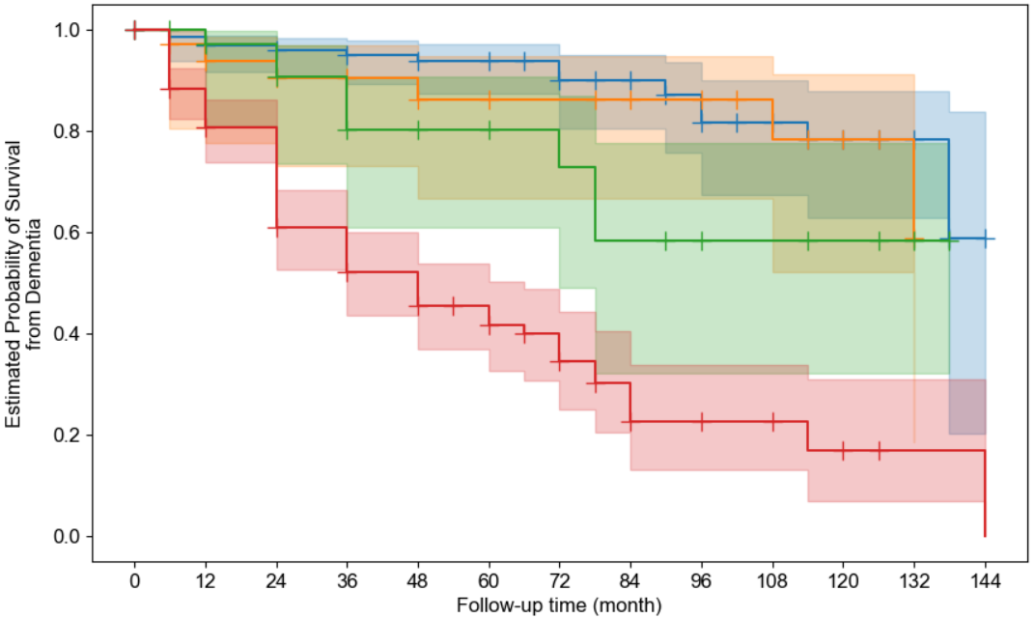
131 | 124 | 117 | 103 | 88 | 64 | 50 | 44 | 34 | 27 | 20 | 13 | 2
33 | 32 | 29 | 27 | 23 | 19 | 18 | 17 | 14 | 11 | 8 | 4 | 0
36 | 34 | 31 | 28 | 23 | 19 | 11 | 9 | 7 | 6 | 5 | 3 | 0
165 | 158 | 137 | 113 | 86 | 58 | 34 | 27 | 18 | 8 | 5 | 1 | 1

Slide 3
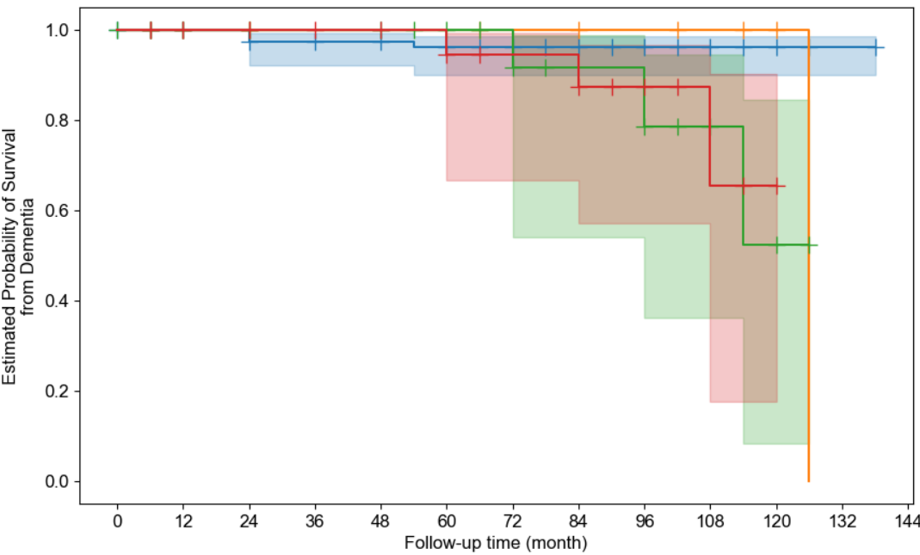
123 | 119 | 115 | 97 | 92 | 79 | 74 | 60 | 53 | 37 | 19 | 2 | 0
14 | 12 | 11 | 7 | 7 | 7 | 5 | 5 | 4 | 3 | 2 | 0 | 0
31 | 28 | 26 | 20 | 20 | 16 | 12 | 8 | 7 | 4 | 3 | 0 | 0
37 | 34 | 33 | 27 | 25 | 18 | 13 | 13 | 10 | 4 | 2 | 0 | 0

Slide 4
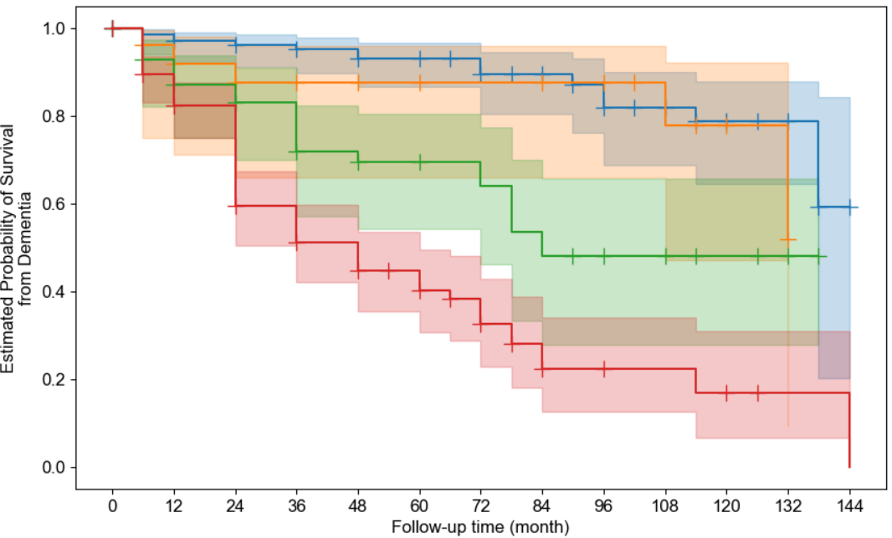
139 | 132 | 123 | 109 | 93 | 68 | 54 | 47 | 37 | 29 | 22 | 14 | 2
25 | 24 | 23 | 21 | 18 | 15 | 14 | 14 | 11 | 9 | 6 | 3 | 0
57 | 53 | 50 | 44 | 37 | 27 | 14 | 12 | 10 | 7 | 5 | 3 | 0
144 | 139 | 118 | 97 | 72 | 50 | 31 | 24 | 15 | 7 | 5 | 1 | 1

Slide 5
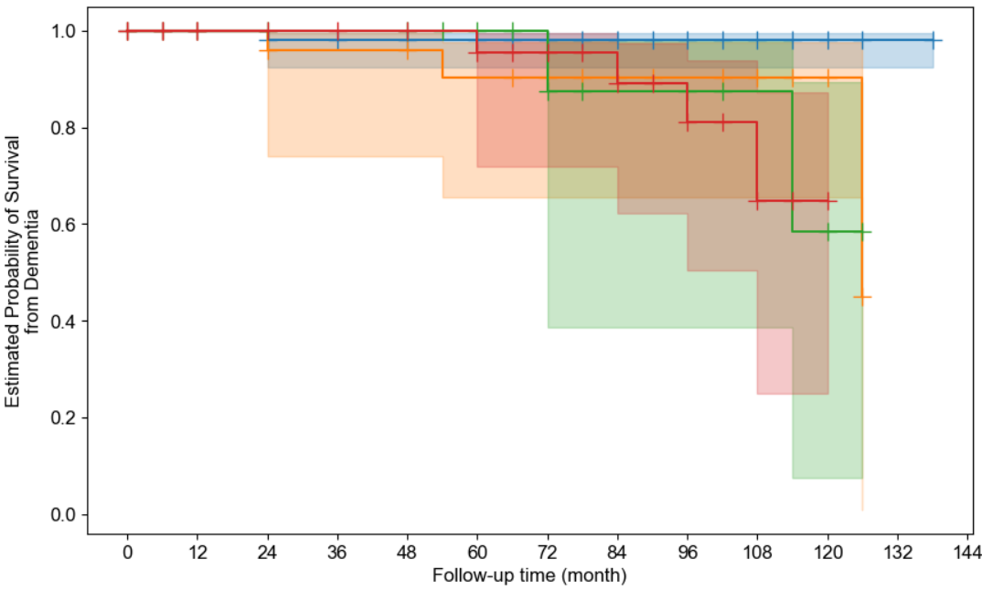
108 | 105 | 102 | 85 | 80 | 68 | 64 | 53 | 48 | 33 | 16 | 2 | 0
29 | 26 | 24 | 19 | 19 | 18 | 15 | 12 | 9 | 7 | 5 | 0 | 0
18 | 18 | 18 | 15 | 15 | 12 | 8 | 6 | 5 | 3 | 3 | 0 | 0
50 | 44 | 41 | 32 | 30 | 22 | 17 | 15 | 12 | 5 | 2 | 0 | 0

Slide 6
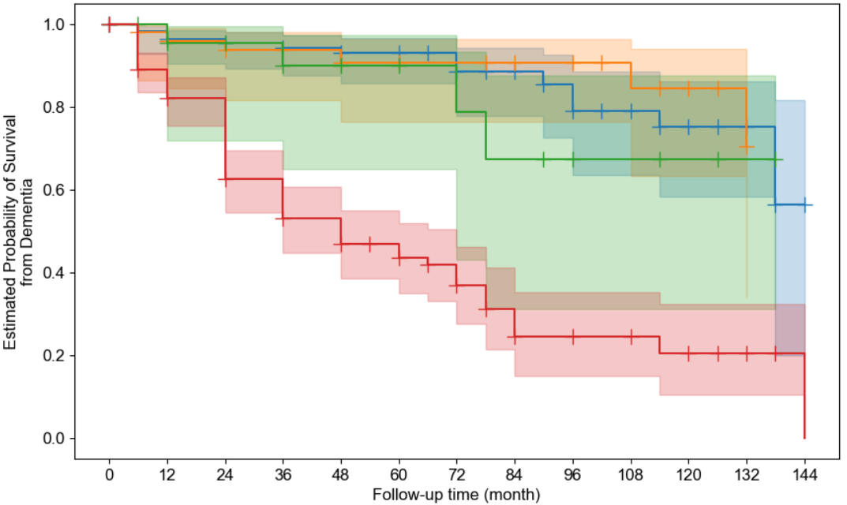
115 | 108 | 101 | 88 | 79 | 58 | 44 | 38 | 30 | 23 | 18 | 11 | 2
49 | 48 | 45 | 42 | 32 | 25 | 24 | 23 | 18 | 15 | 10 | 6 | 0
24 | 22 | 19 | 18 | 16 | 12 | 8 | 7 | 5 | 4 | 3 | 1 | 0
177 | 170 | 149 | 123 | 93 | 65 | 37 | 29 | 20 | 10 | 7 | 3 | 1

Slide 7
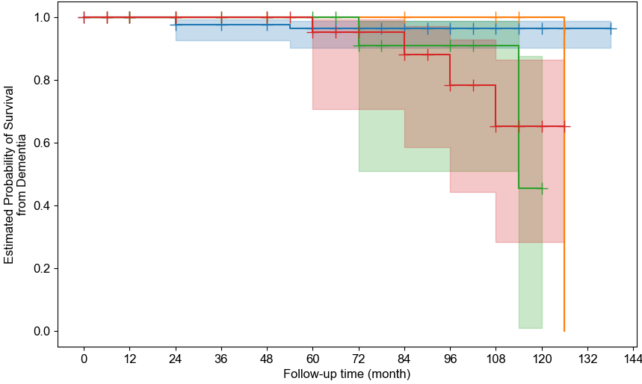
129 | 124 | 120 | 99 | 94 | 82 | 75 | 61 | 54 | 37 | 20 | 2 | 0
8 | 7 | 6 | 5 | 5 | 4 | 4 | 4 | 3 | 3 | 1 | 0 | 0
22 | 22 | 20 | 16 | 15 | 13 | 11 | 8 | 7 | 2 | 2 | 0 | 0
46 | 40 | 39 | 31 | 30 | 21 | 14 | 13 | 10 | 6 | 3 | 0 | 0

Slide 8
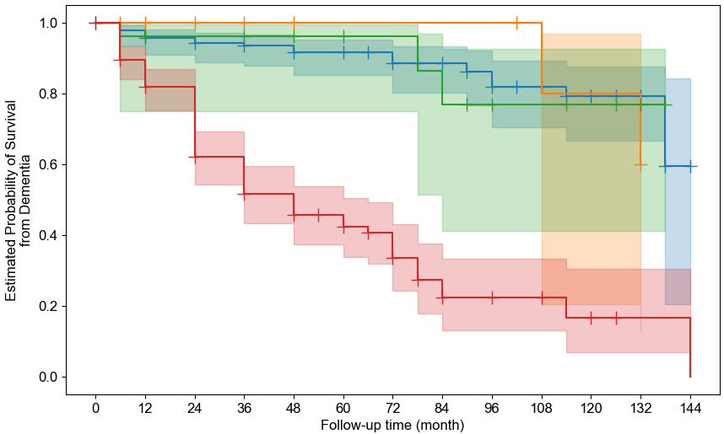
148 | 141 | 133 | 118 | 103 | 77 | 62 | 55 | 42 | 33 | 24 | 13 | 2
16 | 15 | 13 | 12 | 8 | 6 | 6 | 6 | 6 | 5 | 4 | 4 | 0
25 | 25 | 19 | 19 | 16 | 13 | 10 | 9 | 8 | 6 | 5 | 3 | 0
176 | 167 | 149 | 122 | 93 | 64 | 35 | 27 | 17 | 8 | 5 | 1 | 1

