Slide 1
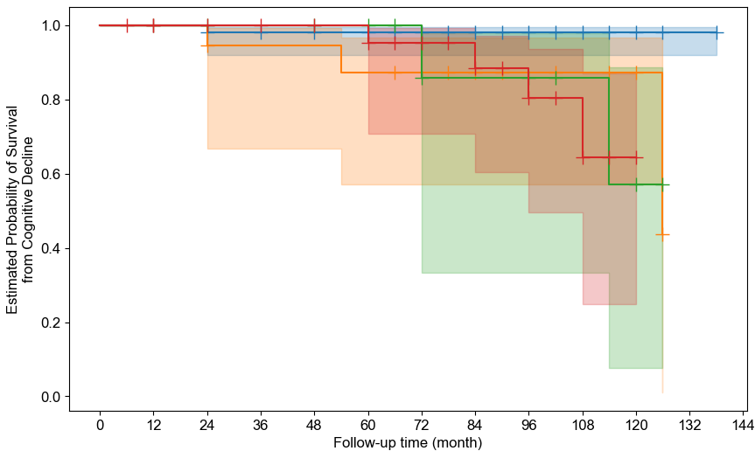

 | N | N (%) converted | HR | p
CSF-/PET- | 100 | 2 (2) | 0.54 [0.25, 1.16] | 0.114
CSF+/PET- | 19 | 3 (16) | 1.39 [0.47, 4.07] | 0.549
CSF-/PET+ | 16 | 2 (12) | 1.3 [0.39, 4.27] | 0.669
CSF+/PET+ | 41 | 4 (10)
CN at baseline
Conversion to AD
100 | 100 | 96 | 80 | 76 | 64 | 61 | 50 | 45 | 30 | 15 | 2 | 0
19 | 19 | 18 | 14 | 14 | 14 | 11 | 10 | 7 | 5 | 4 | 0 | 0
16 | 16 | 16 | 14 | 14 | 11 | 7 | 6 | 5 | 3 | 3 | 0 | 0
41 | 39 | 36 | 29 | 28 | 21 | 16 | 14 | 12 | 5 | 2 | 0 | 0

Slide 2
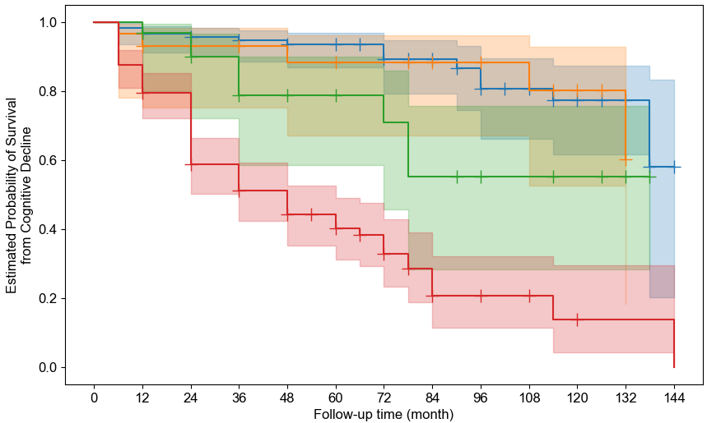
 | N | N (%) converted | HR | p
CSF-/PET- | 118 | 14 (12) | 0.24 [0.16, 0.36] | < 0.001
CSF+/PET- | 29 | 5 (17) | 0.29 [0.16, 0.54] | < 0.001
CSF-/PET+ | 32 | 9 (28) | 0.46 [0.26, 0.79] | 0.005
CSF+/PET+ | 151 | 89 (59)
MCI at baseline
Conversion to AD
118 | 118 | 112 | 98 | 84 | 61 | 47 | 41 | 33 | 26 | 19 | 12 | 2
29 | 29 | 26 | 24 | 21 | 18 | 17 | 16 | 13 | 11 | 8 | 4 | 0
32 | 32 | 29 | 26 | 21 | 18 | 10 | 8 | 6 | 5 | 4 | 2 | 0
151 | 150 | 130 | 107 | 80 | 54 | 32 | 25 | 16 | 7 | 4 | 1 | 1

Slide 3
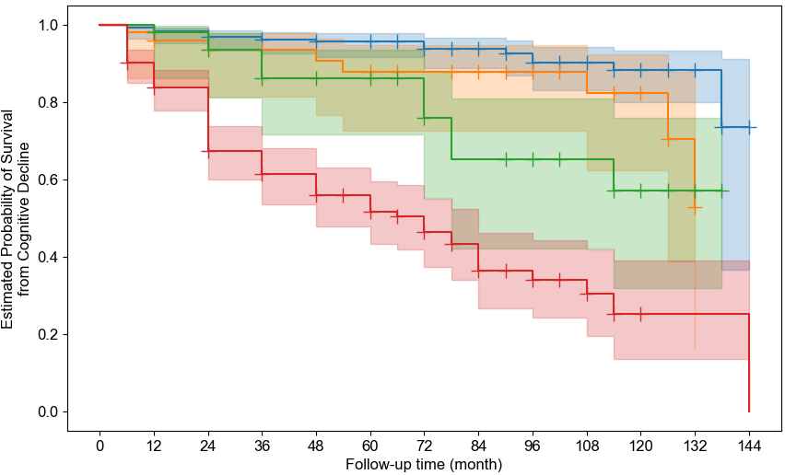
 | N | N (%) converted | HR | p
CSF-/PET- | 218 | 16 (7) | 0.25 [0.18, 0.35] | < 0.001
CSF+/PET- | 48 | 8 (17) | 0.4 [0.24, 0.67] | < 0.001
CSF-/PET+ | 48 | 11 (23) | 0.53 [0.33, 0.87] | 0.012
CSF+/PET+ | 192 | 93 (48)
CN or MCI at baseline
Conversion to AD
218 | 218 | 208 | 178 | 160 | 125 | 108 | 91 | 78 | 56 | 34 | 14 | 2
48 | 48 | 44 | 38 | 35 | 32 | 28 | 26 | 20 | 16 | 12 | 4 | 0
48 | 48 | 45 | 40 | 35 | 29 | 17 | 14 | 11 | 8 | 7 | 2 | 0
192 | 189 | 166 | 136 | 108 | 75 | 48 | 39 | 28 | 12 | 6 | 1 | 1

