Slide 1
PSYC121 Analysis
Week 4
Z-scores, probabilities and hypothesis tests

Slide 2
Learning outcomes
Understanding Z-scores, distributions and probabilities
Understand why hypothesis testing is important to psychology
Understand the stages in hypothesis testing
Appreciate the role of probabilities in testing hypotheses

Slide 3
Z-scores
z-scores can tell us where a value is positioned in a distribution
Is a score high or low? Likely or unlikely?
We can also use z-scores to help understand how common certain score values are.
E.g IQ scores have a mean of 100 and SD of 16. What range of scores encompass 95% of people in the middle?

Slide 4
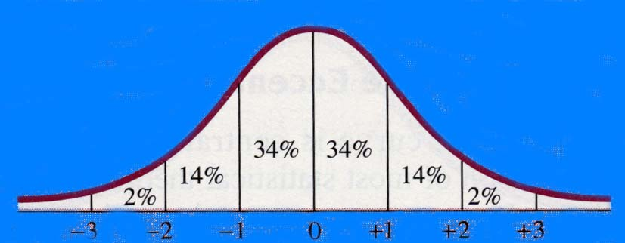
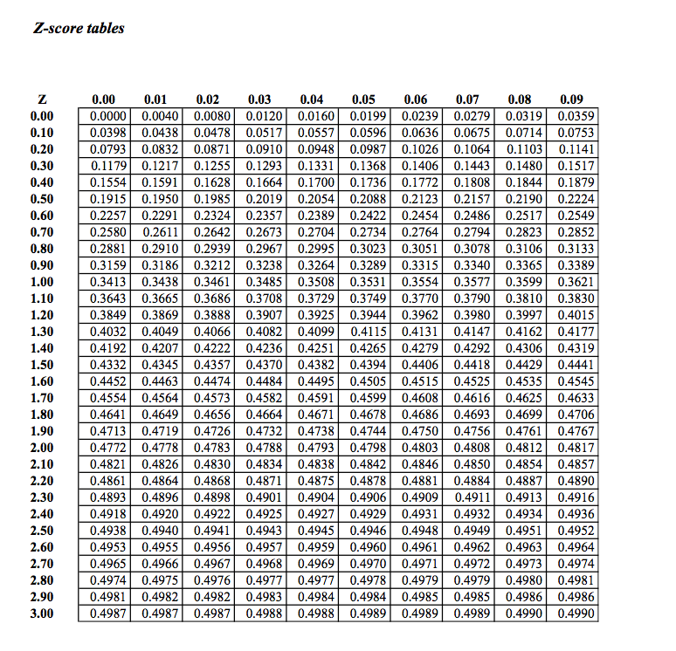

Slide 5
What does this question involve?
A sketch and rough estimate
What precise z-score(s) are needed
What z score corresponds to 47.5% (on each side)?
z=1.96 and z=-1.96
Does this match any sketch?
What are the corresponding raw scores?
X=z(SD) + M,
X=1.96(16) + 100, X= 131.36
And X=-1.96(16)+100, X=68.64

Slide 6
Z-scores and scaling
Z-scores could be used to adjust a set of values into a different scale
A test produces a mean mark of 30 correct answers, with a standard deviation of 8
Converting this to an IQ scale (where the mean=100, SD=16)

Slide 7
Probabilities
Large z-scores (whether plus or minus values) represent unusual outcomes
Most scores fall in the middle of a distribution
So far this term, we have looked at descriptive statistics
Z-scores are an example of this
Often in psychology, we need to work with inferential statistics
What is the difference between the two?
How many slides do I use in a lecture?
Will I move to the next slide within 60 seconds?

Slide 8
Inferential testing and probabilities
Hypothesis testing uses probabilities to help decide whether the outcome of a study (results for a sample) support a particular theory or practical innovation (which applies to a population)
Illustrates the distinction between descriptive statistics and inferential statistics.

Slide 9
Something to think about
“Next time someone tells you they don’t believe a small sample poll can possibly tell you anything, just say to them ‘OK, then. Next time you have to have a blood test, why don’t you ask them to take the whole lot?’”
British opinion pollster Nick Moon in Significance, March 2010

Slide 10
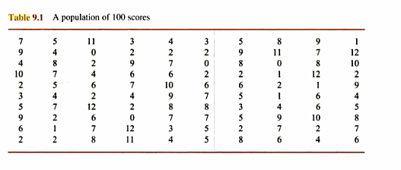
A population of 100 scores
Take a sample of 5 scores

Slide 11
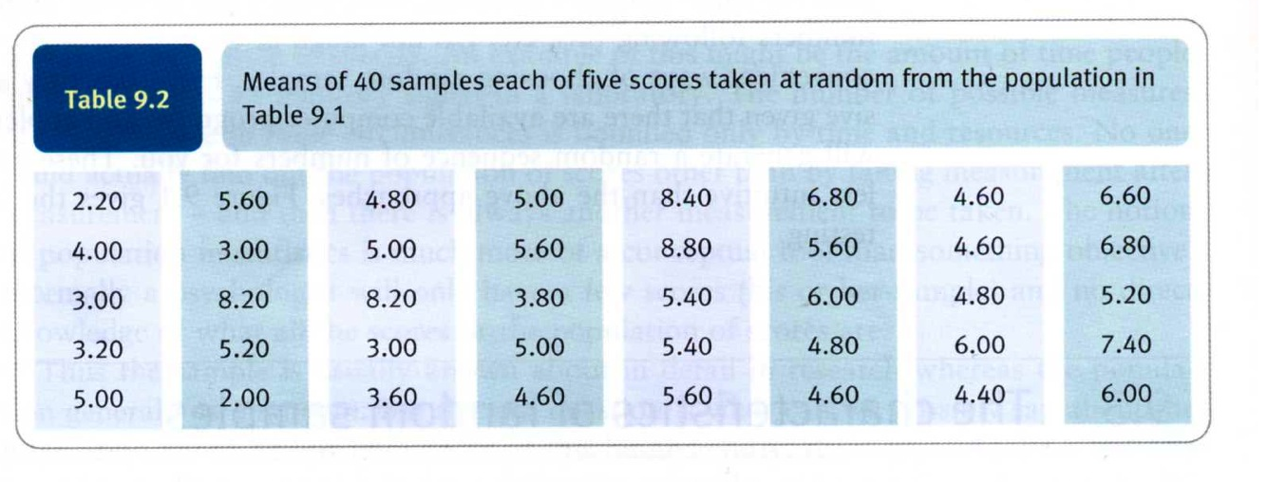
Sample of 5 scores

Slide 12
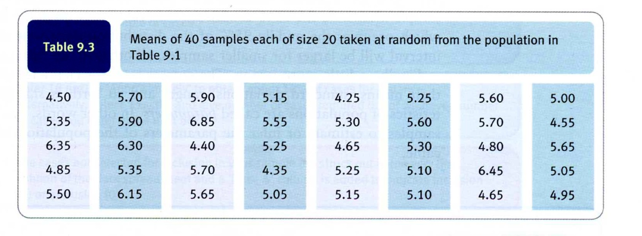
Samples of 20 numbers

Slide 13
Hypothesis testing
If I obtain 5 scores with a mean of 5.00, is it reasonable to suggest that it could come from the population we looked at?
If I had a sample of 5 scores with a mean of 11.8, is it likely to have come from the population?
If I had a sample of 5 scores with a mean of 12.2, is it likely to have come from the population?

Slide 14
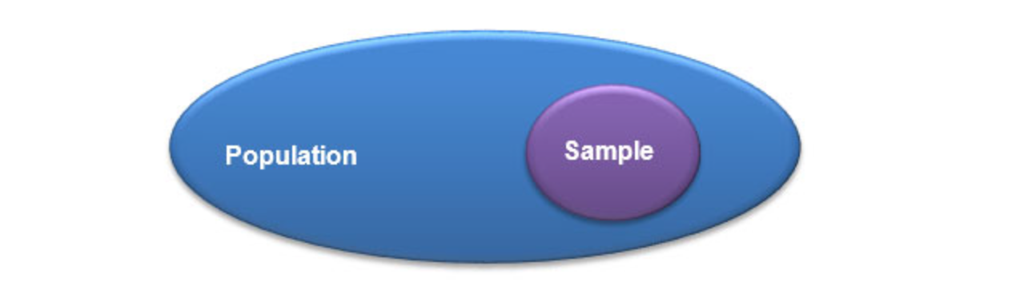
Sample and populations

Slide 15
Samples and overlapping populations

Slide 16
Sample and separate populations

Slide 17
Hypothesis testing (2)
In the previous examples, we have sample and population information
This helps predict whether the two might be related
In many psychological situations, we only have the sample information
But we still want to talk about populations
Fortunately we know about the properties of samples, sample sizes and their variation
So we can estimate whether samples are linked to certain populations

Slide 18
Hypothesis testing (3)
In many situations, we primarily want to determine what is true for a population. A sample is not so interesting per se.
But we only have sample statistics.
So
We identify two population distributions
We generate a (research) hypothesis that makes a statement about these populations
We also use a null hypothesis that provides an opposing statement.
We use sample data to compare these hypotheses

Slide 19
Hypothesis testing at work (1)
Does winning the lottery make you happy?
A cinema manager likes to keep a very close eye on how much popcorn goes into each bag sold, so he knows that the average bag has 80g of popcorn and that this varies a little bit, about 10g. That is, the known population mean is = 80 and the known population standard deviation = 10.
The owner wants to make sure that the newest employee is filling bags correctly, so over the course of a week he randomly assesses 25 bags filled by the employee to test for a difference (n = 25).

Slide 20
Hypothesis testing at work (1)
We know the average size of a popcorn serving (mean=80) and the standard deviation (SD=10)
Population 1: A standard serving from an experienced server
Population 2: New, nervous employee
Research hypothesis: The new employee is not up to the task. They don’t serve a standard amount (either too generous or not generous enough)
Null hypothesis: The new employee is not different from other (not new) employees

Slide 21
Why make things complicated by having a null hypothesis as well?
We can’t prove that something is true, but we can prove something to be false
The null hypothesis provides a common starting assumption (eg the difference between populations is 0)
We can then ask: are any effects found in the sample so big that we can reject the notion that the true population difference is 0?

Slide 22
Hypothesis testing at work (2)
New employee: average popcorn bag serving is ̅X = 75g with a trial of 25 servings.
This gives them a z-score of 75 – 80 / 10/sq rt (25) = -5/2 = -2.5
This is an extreme or unusual score. A z-score of -1.96 would be required to be in lower 2.5% of small servings
Here we can justify rejecting the null hypothesis
There is evidence that our new employee is underserving

Slide 23
Errors in hypothesis testing
Type 1 error: Rejecting the null hypothesis when it is in reality true
α - probability of a type I error
We sampled employee when there was a huge queue
Type II error: Not rejecting the null hypothesis when it is false
β - probability of a type II error
We didn’t observe enough trials to know what they were doing
Remember to consider whether a test is one-tailed or two tailed

Slide 24
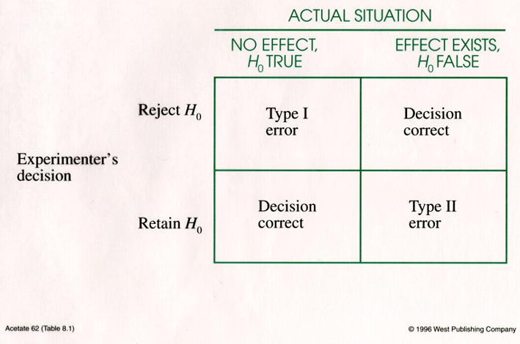
Errors in hypothesis testing

Slide 25
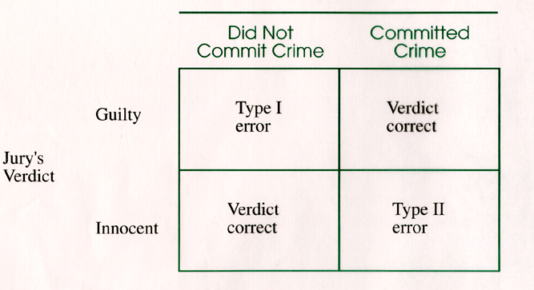
Errors in hypothesis testing:
The analogy of jury decisions

Slide 26
Summary
We need to be comfortable with notions of central tendency and variability to understand many psychological phenomena
The normal distribution is important for thinking about how to interpret descriptive data
Hypothesis testing examines whether the null hypothesis can adequately explain the observed pattern of data.

