Slide 1
Introducing Interactions into Multiple Regression Models
PSYC234 Week 13
Dr Emma Mills e.mills@lancaster.ac.uk

Slide 2
This week:
Continuing to work with both categorical and continuous predictors
Continuing to work with the analysis workflow
Building a series of models , adding one predictor at a time
Formally comparing two consecutive models to see if the variance explained is significantly different in the larger model
Modelling an interaction term
Interpreting an interaction term
I will model a process in the lecture, you will build your own script on a different dataset in the lab.
Notes:
RS

Slide 3
R-studio: introducing the dataset

Slide 4
Model comparison
Or….which of the smaller or larger model is the better fit for my data?

Slide 5
Model comparison
A cautious and conservative approach to multiple regression is to create several models, each one building upon the next
These are called “nested” models
  Every model uses exactly the same data
  The latest model has all of the previous models within it
    The latest model can differ by +1 predictor or more

Slide 6
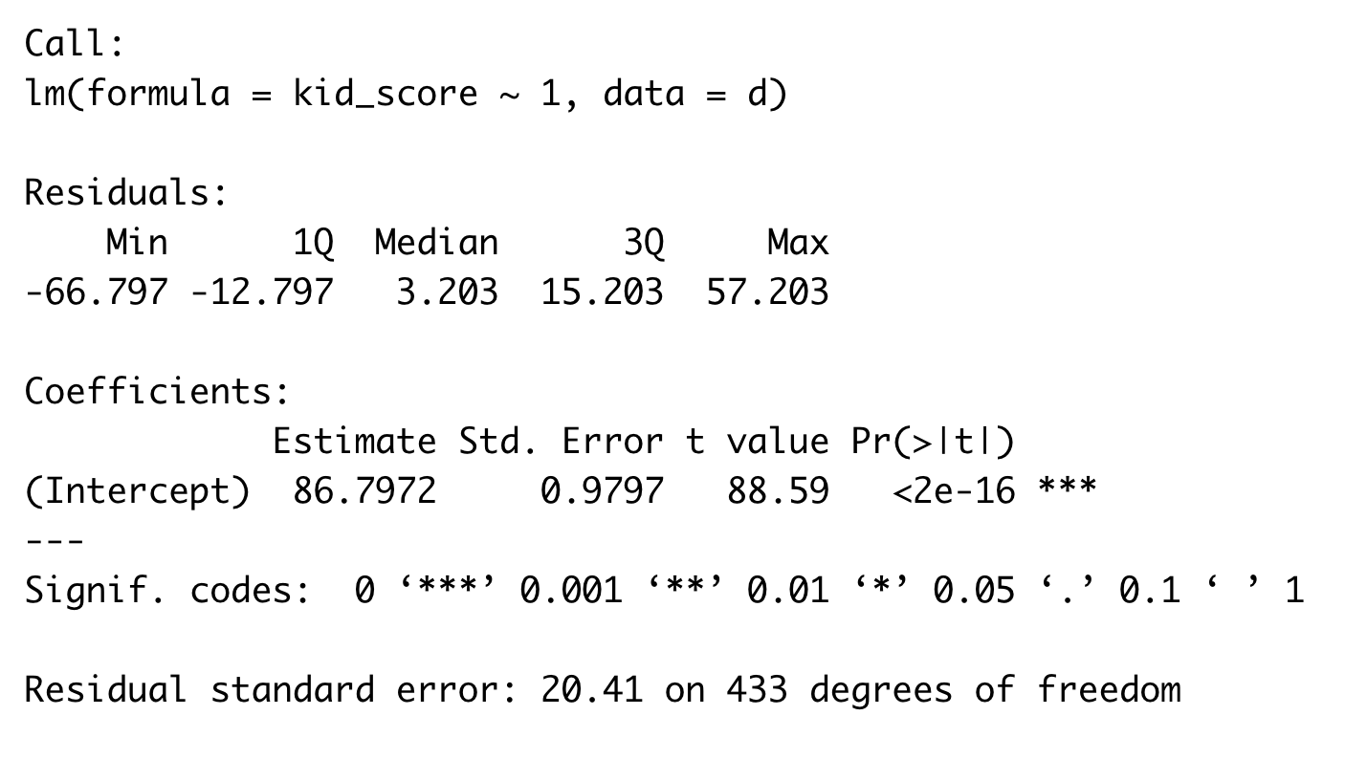
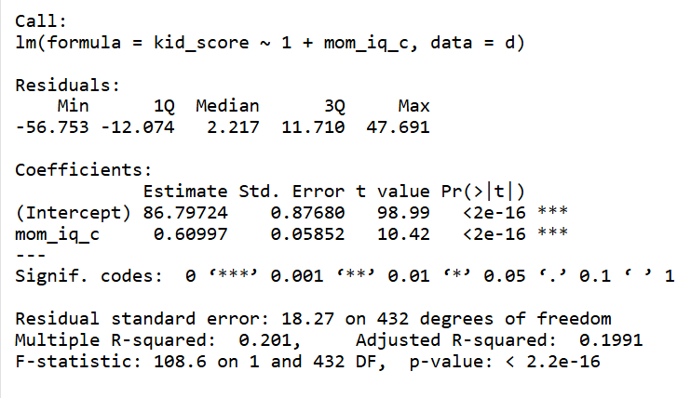
Model comparison
Empty or Intercept only model
Simple regression model

Slide 7
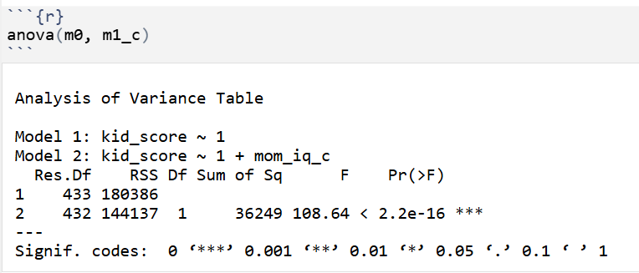
Which model do I choose..?

Slide 8
Which model do I choose..?

Slide 9
Building a series of models: hazard warning!
This is where p-hacking and cherry picking and HARKing can occur really easily
Strategies to defend against such questionable research practices: (remember from PSYC124 last year)
  State clearly whether you are in confirmatory or exploratory analysis mode
  Explain your process to yourself and your future reader before you start (at best in a pre-registration; at the very least before you begin)
  Report all models – use a script such as .Rmd file or an interactive notebook so that the process is recorded and can be reproduced
  Be honest and comprehensive in your reporting.

Slide 10
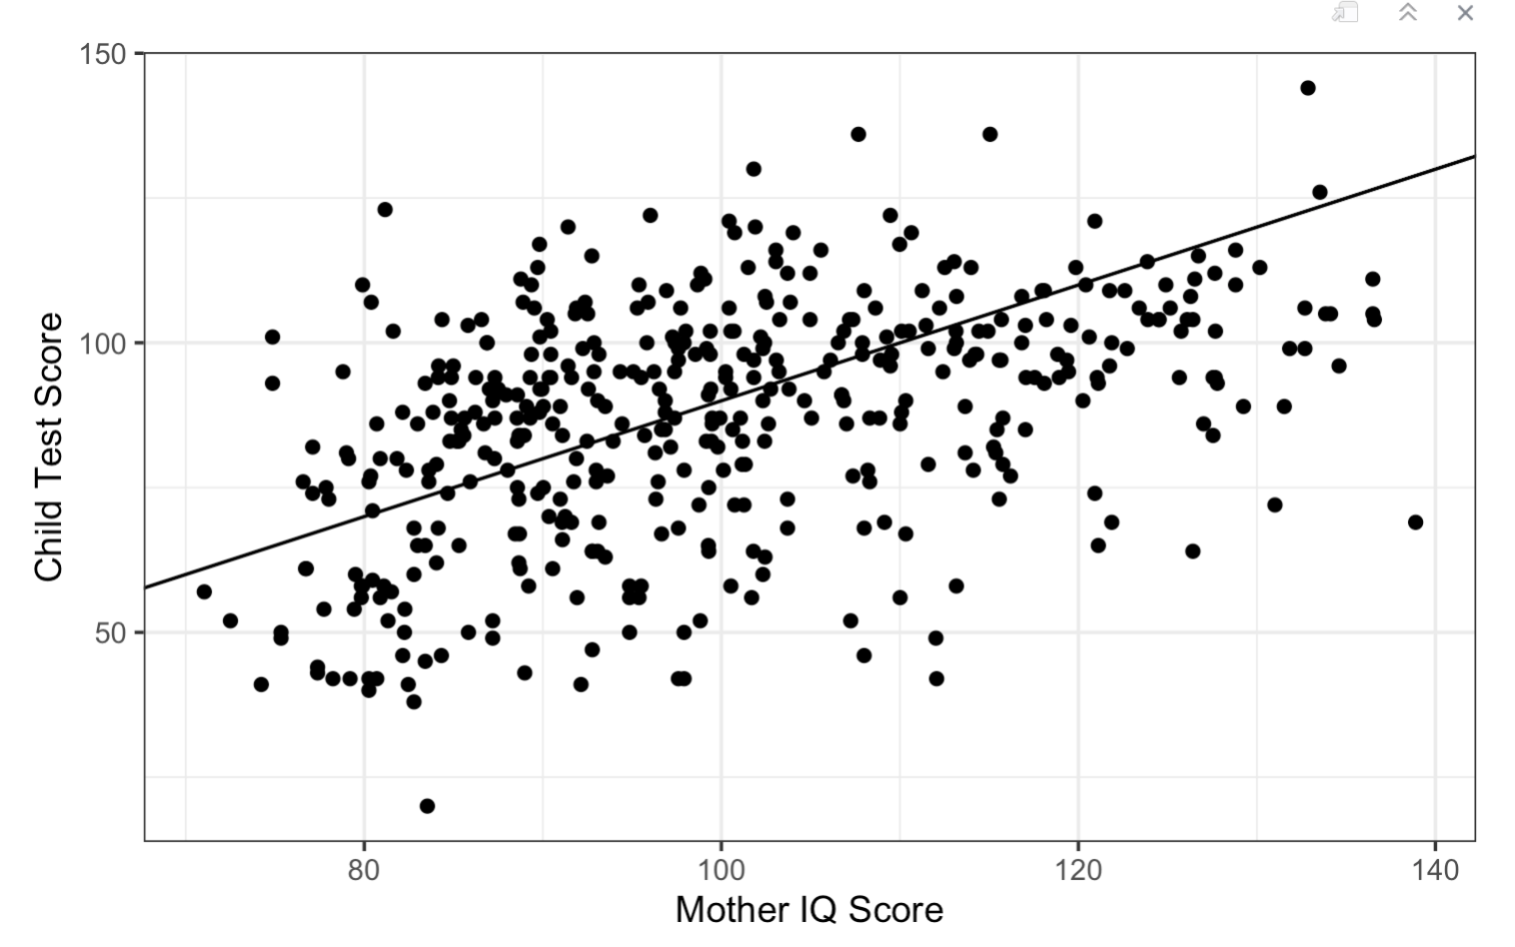
Simple Regression
slope black
Intercept black

Slide 11
Simple Regression
slope black
Intercept black

Slide 12
Simple Regression
slope black
Intercept black

Slide 13
Rstudio: Adding a further predictor

Slide 14
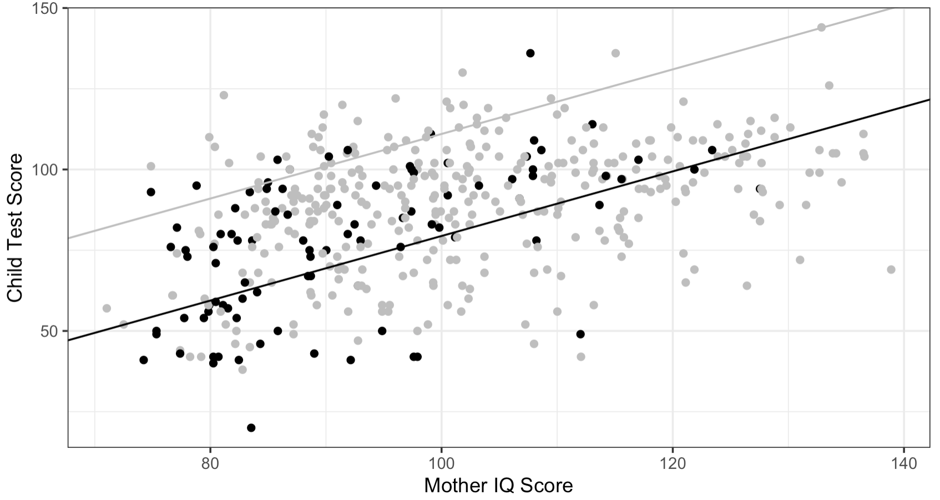
No interaction in the presence of two groups
slope grey
slope black
Intercept grey
Parallel lines indicate no difference in the slopes of two groups across the range of values in Mother’s IQ
Intercept black
Notes:
RS

Slide 15
Rstudio: Adding an interaction term

Slide 16
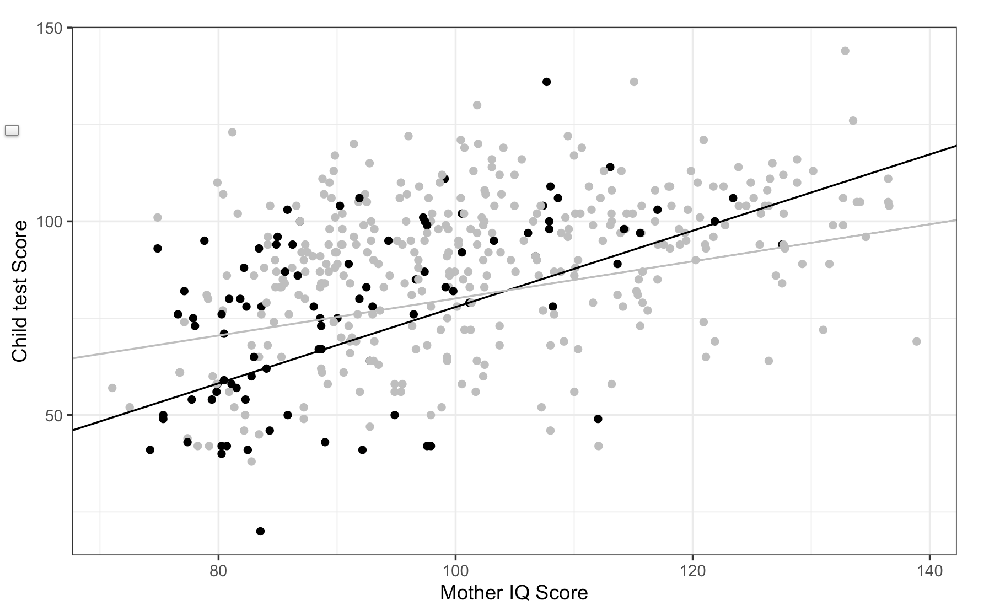
Different rates of change across levels of one predictor for the levels of another predictor
slope black
slope grey
Intercept
grey
Intercept
black

Slide 17
Different rates of change across levels of one predictor for the levels of another predictor
slope black
slope grey
Intercept
grey
Red arrows are the same length. See how they are too long for parts of the group difference slopes
Intercept
black

Slide 18
Interaction!!!
slope black
slope grey
Intercept
grey
Red arrows are the same length. See how they are too long for parts of the group difference slopes
Intercept
black

Slide 19
Interactions
When one variable moderates the effect of another variable on the outcome variable
Or
When a coefficient for one predictor changes its size when it moves between the levels or values of another predictor
Or
The change that one predictor predicts for the outcome variable depends on a specific level of another predictor
Moderation – a process for exploring the differing conditions under which two or more variables may work together.
Notes:
RS

Slide 20
The interaction plot once more:
slope black
slope grey
Intercept
grey
Intercept
black

Slide 21
R Studio: Proving the decrease in score difference for the grey group across IQ
If mum completed high school, initially the child has an advantage of about 2.48 points. BUT with every increase of 1 IQ point, this advantage descrease by 0.48 point….

Slide 22
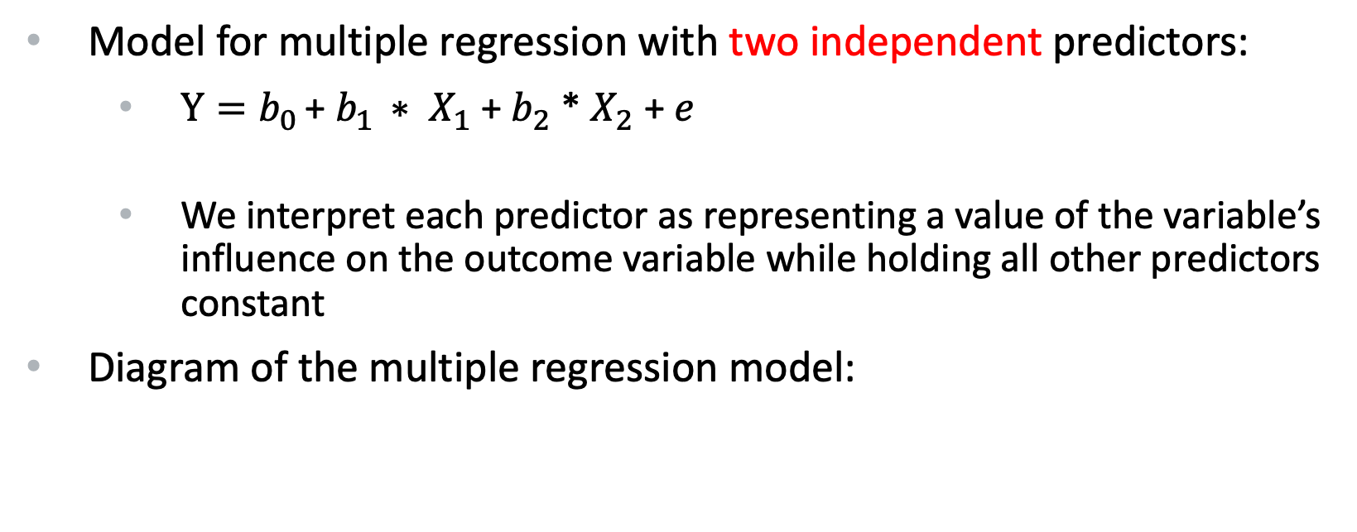
What are interaction terms?
Model for multiple regression with two independent predictors:
  $Y=b_{0 }$+ $b_{1 }∗ X_{1}$ + $b_{2}$ * $X_{2}$ + $e$
  We interpret each predictor as representing a value of the variable’s influence on the outcome variable while holding all other predictors constant
Diagram of the multiple regression model:
X₁
X₁ and X₂ do not talk to each other – only Y
Y
X₂

Slide 23
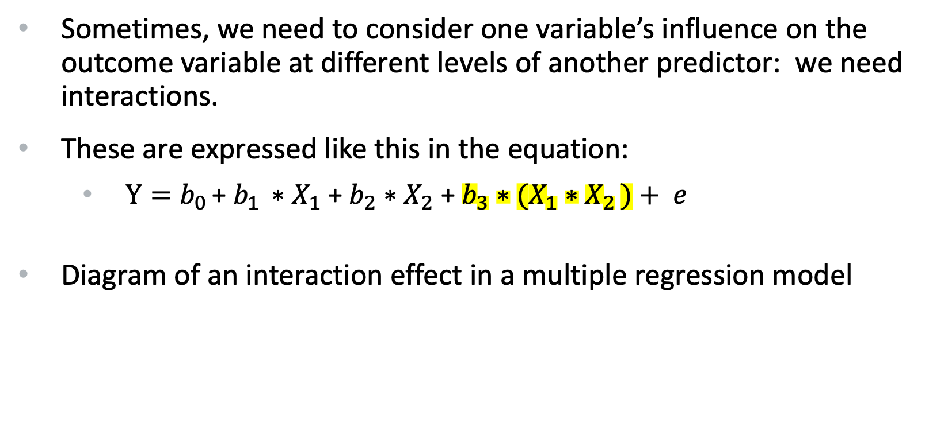
What are interaction terms?
Sometimes, we need to consider one variable’s influence on the outcome variable at different levels of another predictor: we need interactions.
These are expressed like this in the equation:
  $Y=b_{0 }$+ $b_{1 }∗X_{1}$ + $b_{2}∗X_{2}$ + $b_{3}∗(X_{1}{∗X}_{2 })+ e$
Diagram of an interaction effect in a multiple regression model
X₂
X₁ and X₂ do talk to each other – and they both talk to Y
X₁
Y

Slide 24
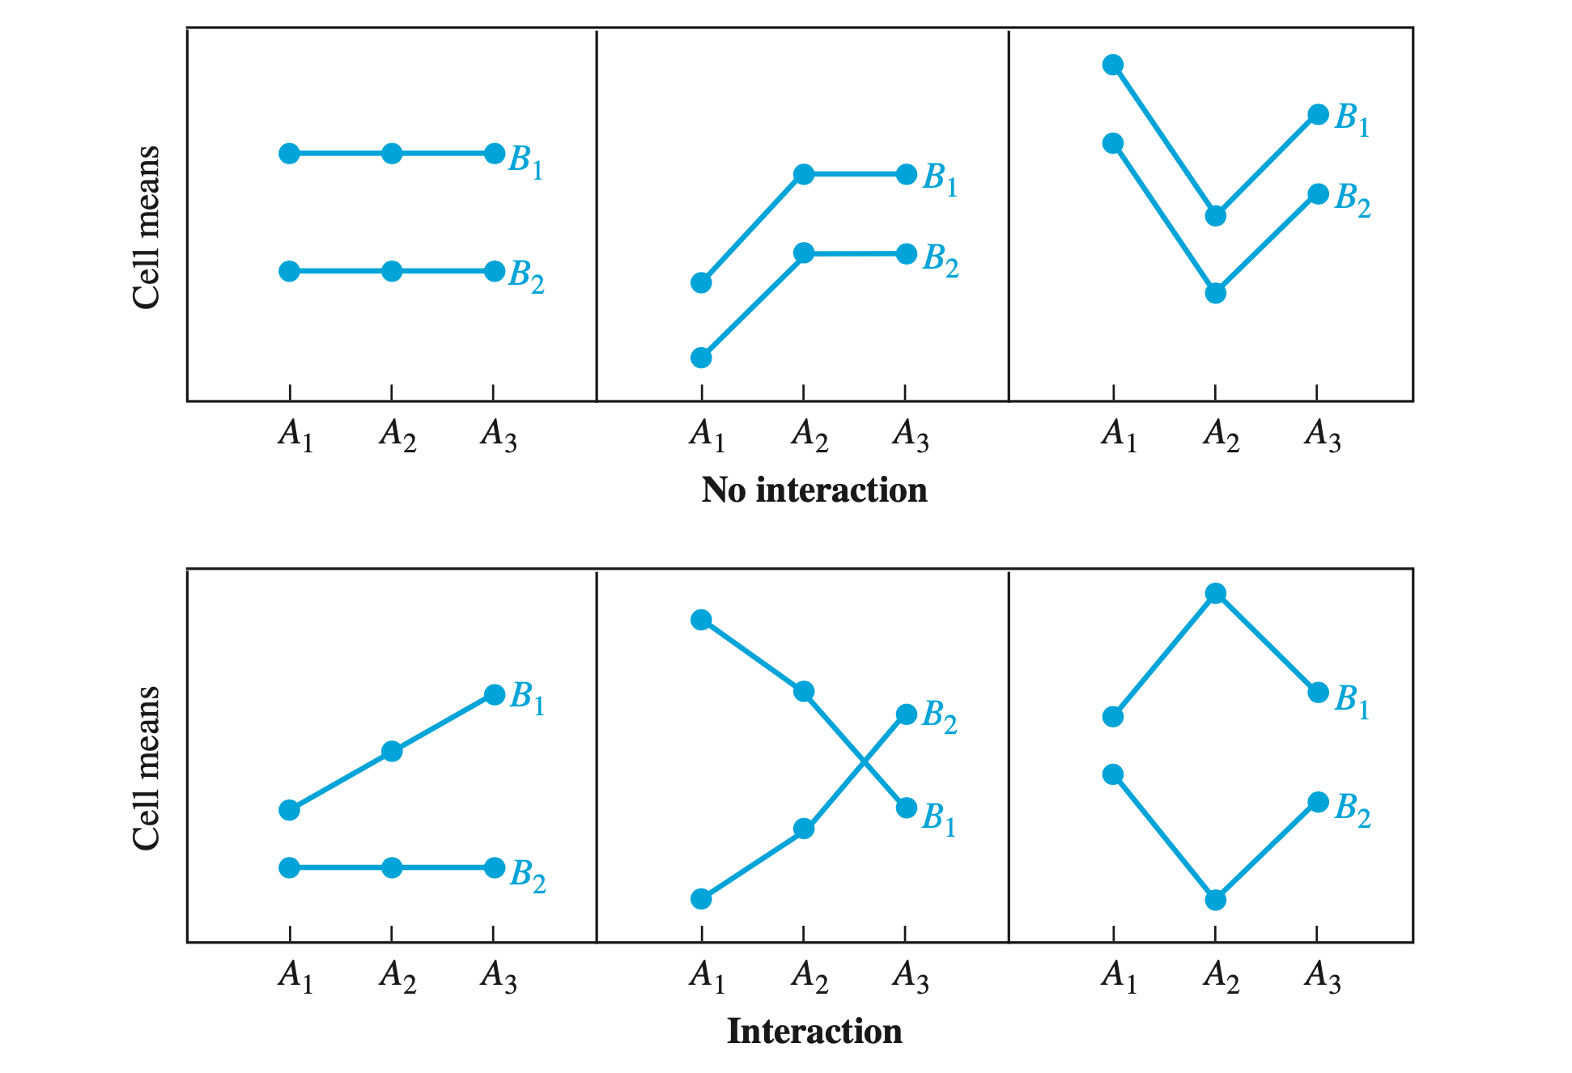

Slide 25
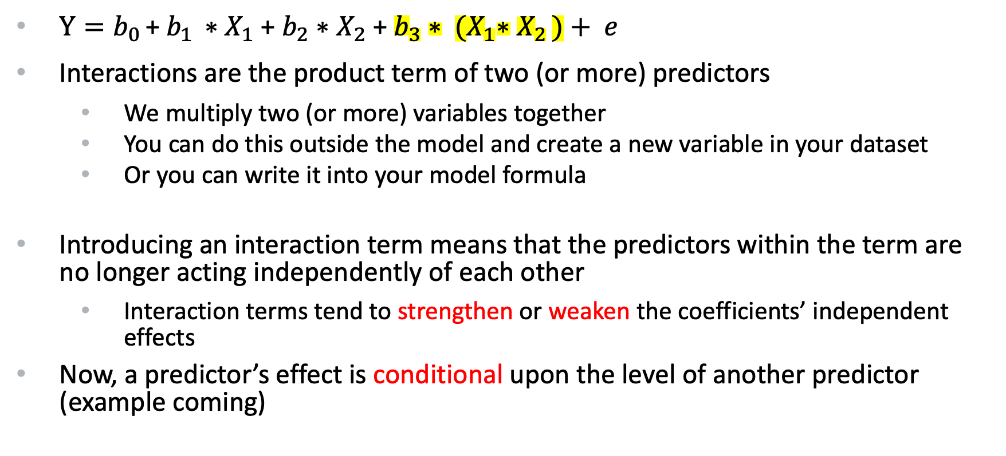
What are interaction terms?...con’t
$Y=b_{0 }$+ $b_{1 }∗X_{1}$ + $b_{2}∗X_{2}$ + $b_{3}∗ {(X}_{1}{∗X}_{2 })+ e$
Interactions are the product term of two (or more) predictors
  We multiply two (or more) variables together
  You can do this outside the model and create a new variable in your dataset
  Or you can write it into your model formula
Introducing an interaction term means that the predictors within the term are no longer acting independently of each other
  Interaction terms tend to strengthen or weaken the coefficients’ independent effects
Now, a predictor’s effect is conditional upon the level of another predictor (example coming)

Slide 26
When are interaction terms used?
Theory may predict them
  Research questions / hypotheses may predict them
Study design may implicitly suggest them (groups?)
Results may suggest them
  Regression coefficients that seem large when modelled independently may suggest the need for an interaction term
  Make sure you are aware of where you are in the analysis workflow
    Don’t just add them
    Save any unplanned additions of interaction terms for an exploratory analysis phase…

Slide 27
What is the statistical power of interactions?
Many effect sizes in psychology hover around Cohen’s d = 0.4
Based upon an effect size like this:
  The power of an interaction can be a small as 1/16th of the independent effects within a model (Gelman et al. 2020)
  This is for ANOVA and regression methods
  This is when all the assumptions of the model are met
Most models violate model assumptions in some way
  Although relatively tolerant of violations:
    Power of the effects are thus reduced further…
Something to consider…

Slide 28
Preparation of data for using interactions:
Centre or standardise your continuous variables
  Standardising puts both predictors on the same scale
  So interpreting the effect of one predictor on the other will be using the same scale of units
Consider how to use your categorical variables
  Dummy coding..?
  Sum coding..?
  Making new binary variables…?
  Coercing a binary variable to numeric class and mean centring
    (so many choices! So little time!)

Slide 29
Building a model with interactions:
Plan to build the model suggested by your research questions / hypotheses / theory
  If that includes the interaction term, build it as the first model
If not,
  Build an independent predictor model first
  Build a further model that includes independent and interaction terms
Question: does a study design that uses different groups of people, implicitly motivate an interaction term?

