Slide 1
4bits 上數計時器
學生: 呂侑宸

Slide 2
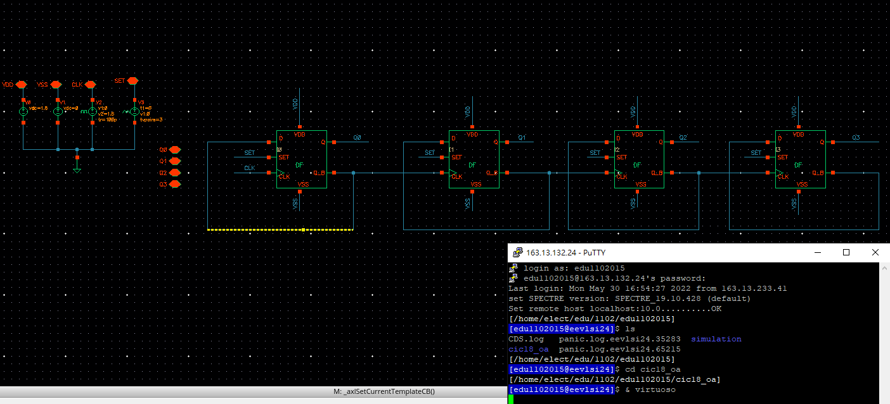
schematic

Slide 3
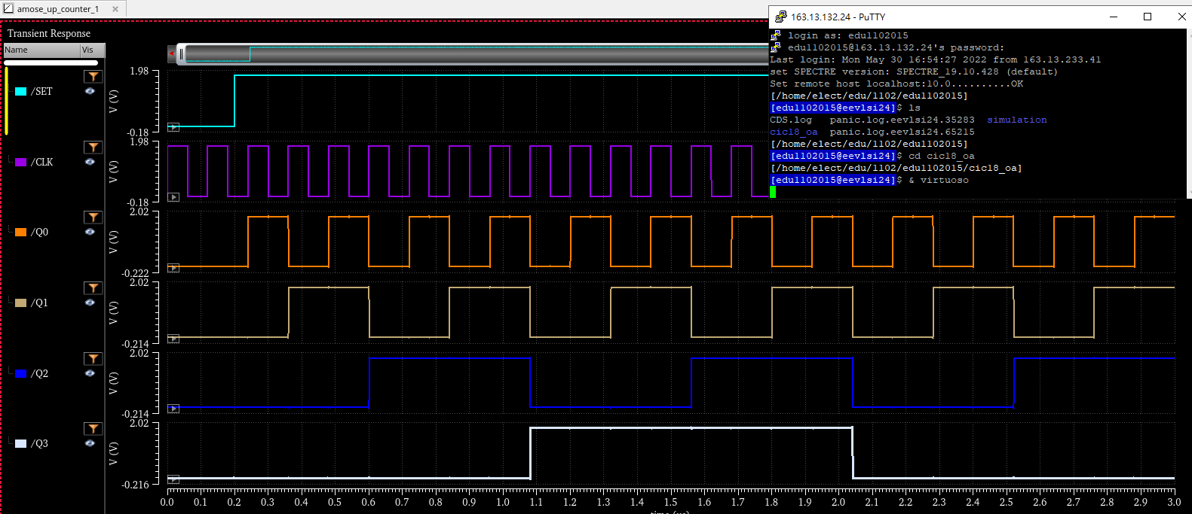
Pre-sim
0 1 0 1 0
0 0 1 1 0
0 0 0 0 1
0 0 0 0 0

Slide 4
Thanks for your attention !!

