Slide 1
五級環形震盪器(NAND+INV)
學生:呂侑宸

Slide 2
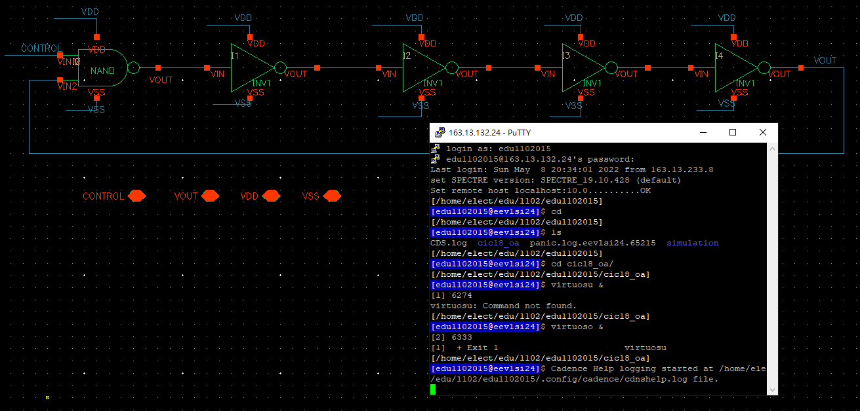
Schematic

Slide 3
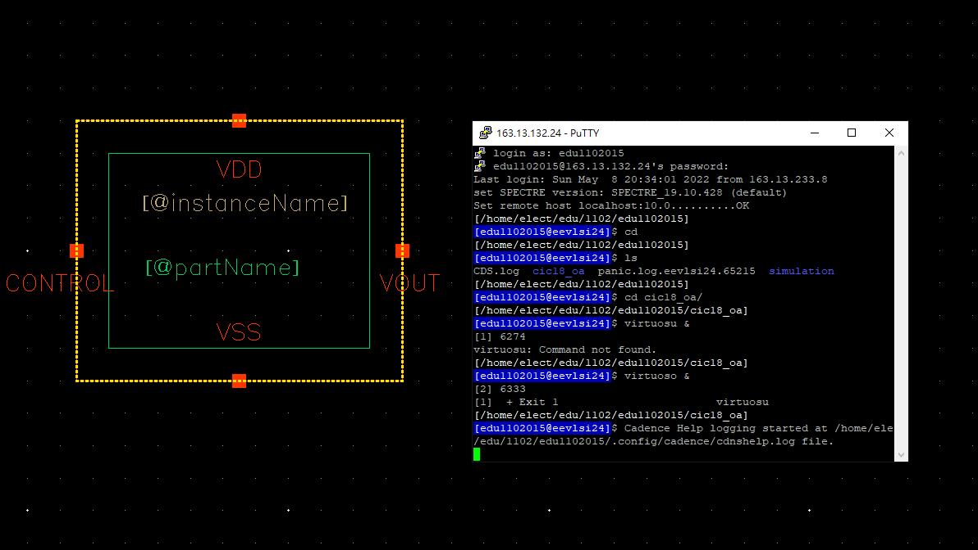
Symbol

Slide 4
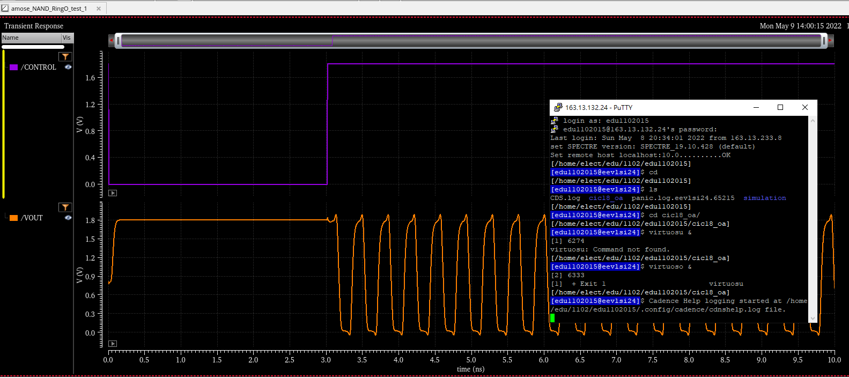
Pre-sim

Slide 5
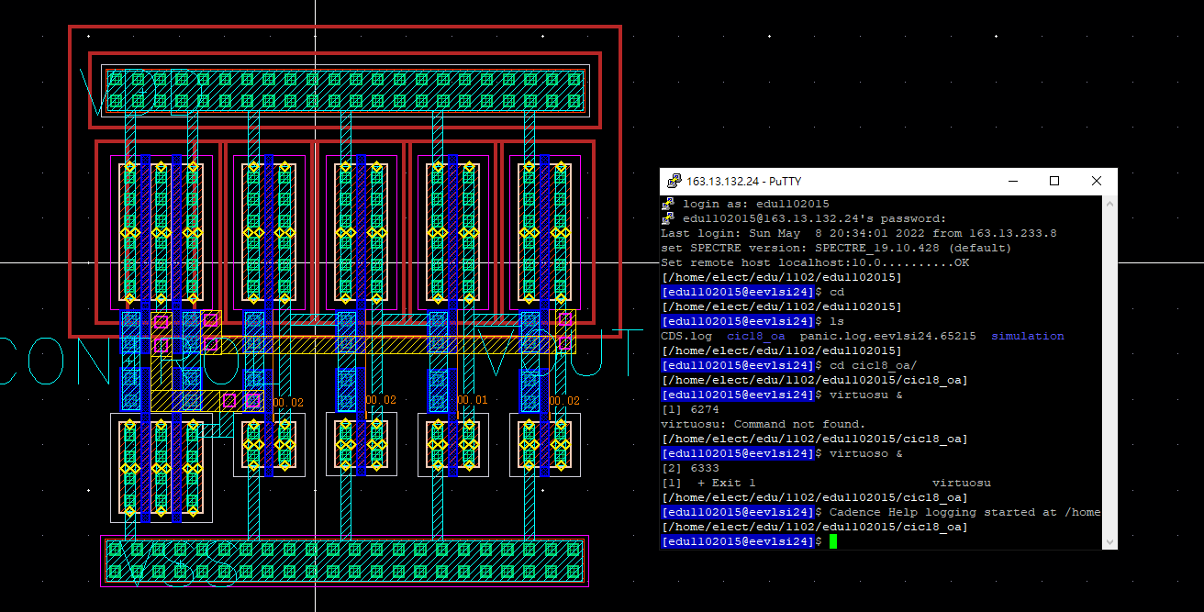
layout

Slide 6
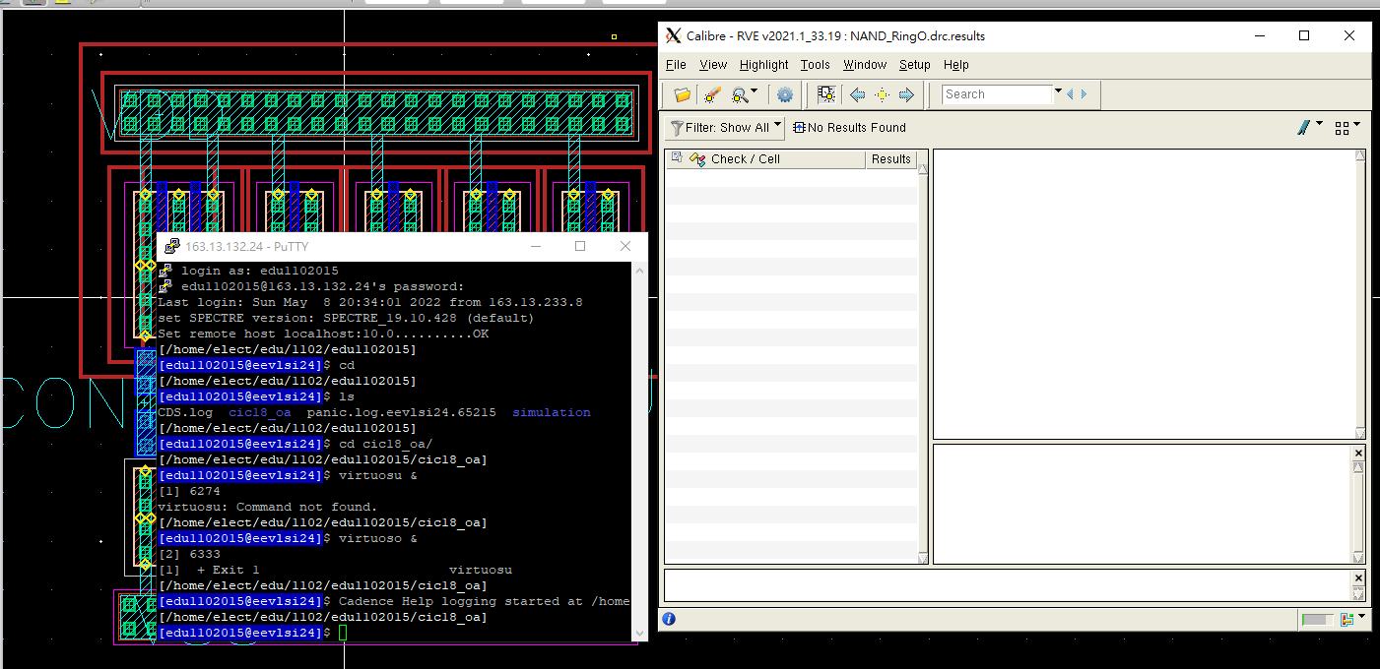
DRC

Slide 7
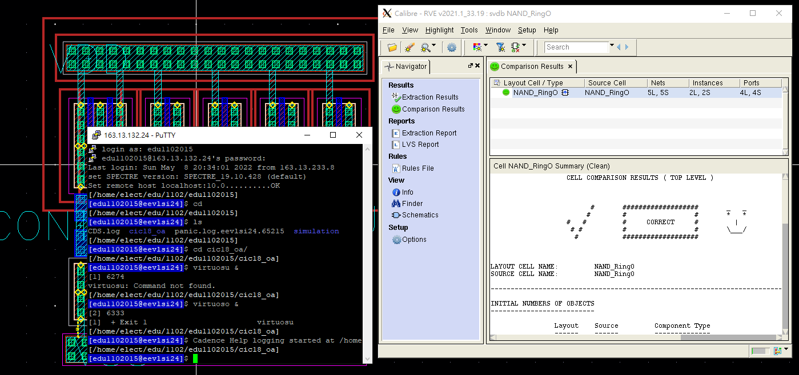
LVS

Slide 8
Thanks for your attention !!

